Slide 1
Bruegel
Improving economic policy

Slide 2
About Bruegel
What we do Research Fact-based, policy-oriented research
  Impact Policy shaping at every governance level and contribution to the public debate
Values Independence Demand-driven questions, independent answers
  Openness No a priori stance, partisanship, or euro-centric bias
  Collaboration Linking research, government, business, and civil society
  Pluralism No institutional position (recommendations made by individual fellows only)
  Transparency Statement of Research Integrity and annual disclosure of fellows’ external interests
Awards The 2012 “Global Go To Think Tanks Report” (a peer-ranked survey with 1950 participants, published annually by the Think Tanks and Civil Societies Program of the University of Pennsylvania) ranked Bruegel:
    #1 Think Tank in Western Europe
    #2 Think Tank in the World (non-US)
    #1 International Economic Policy Think Tank in the World
  Bruegel also received the European Think Tank of the Year and Global Think Tank of the Year
  awards from Prospect Magazine in 2012.
  Bruegel’s mission is to contribute to the quality of economic policy through open and fact-based research, analysis and debate

Slide 3
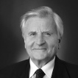
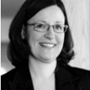
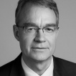
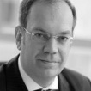
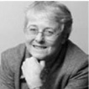
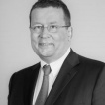
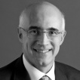
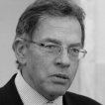
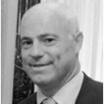
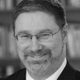
Bruegel’s Structure
Bruegel strives for a geographically diverse representation among its Scientific Council and Board members. The Board also represents a variety of occupations and backgrounds.
Board *
Per Callesen
José Manuel Campa
Anna Ekström
Wolfgang Kopf
Andreas Penk
Lars-Hendrik Röller
Dariusz Rosati
Jean-Claude Trichet, Chairman
Vincenzo La Via
Helen Wallace
Executive Management*
Guntram B. Wolff, Director
Matt Dann, Secretary General
Scientific Council*
Giuseppe Bertola
Sergei Guriev
Kai Konrad
Philippe Martin
Kevin O’Rourke
Lucrezia Reichlin, Chair
Paul Seabright
Members*
17 state members
28 corporate members
8 institutional members
Jean-Claude Trichet, Chairman
Anna Ekström
Per Callesen
Wolfgang Kopf
Helen Wallace
Andreas Penk
Vincenzo La Via
* As of December 24, 2013
Dariusz Rosati
José Manuel Campa
Lars-Hendrik Röller

Slide 4
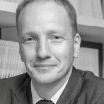
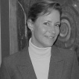
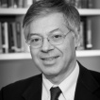
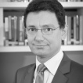
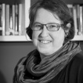
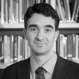
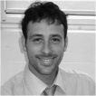
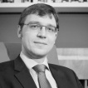
Bruegel’s People
Bruegel strives for a geographically diverse representation among its team. Permanent staff members come from over 20 countries in Europe and beyond. Visiting Fellows add to this diversity.
Director
Guntram B. Wolff
Resident scholars
André Sapir, Nicolas Véron, Reinhilde Veugelers, Karen Wilson (Senior Fellows)
Zsolt Darvas, Mario Mariniello, Georg Zachmann (Research Fellows)
Non-resident scholars
Philippe Aghion (Harvard), Alan Ahearne (Dublin), Carlo Altomonte (Milan), Jürgen von Hagen (Bonn), Mark Hallerberg (Berlin), Henrik Horn (Stockholm), Dalia Marin (Munich), Ashoka Mody (Princeton), Rainer Münz (St. Gallen), Jim O’Neill, Gianmarco Ottaviano (London), Bruno van Pottelsberghe (Brussels), Jörg Rocholl (Berlin),
Affiliate fellows
Tommaso Aquilante (Brussels), Jérémie Cohen-Setton (Berkeley), Francesco Papadia, David C. Saha (Berlin)
Fellows at large
Ignazio Angeloni (Frankfurt), Benedicta Marzinotto (Brussels), Shahin Vallée (Brussels), Jakob von Weizsäcker (Erfurt)
Visiting scholars
Michiel Bijlsma, Dimitris Drougkas, Michał Grajek, Mark Huberty, Suparna Karmakar, Éric Monnet, Francesco Papadia, Karen Wilson
Research assistants
Team of Masters-level and PhD candidate assistants
Guntram B. Wolff
Karen Wilson
André Sapir
Nicolas Véron
Reinhilde Veugelers
Zsolt Darvas
Mario Mariniello
Georg Zachmann

Slide 5
Bruegel’s Research
Bruegel’s annual research agenda is based on a “core-halo model”:
it builds on four research pillars to develop comprehensive, transversal and wide-reaching studies.
Research focuses for 2013-2014 are detailed below.
1. European Macroeconomics
  Macroeconomic policy and adjustments in the EMU: Addressing fiscal policies in the European Union
  Evolving governance of the EU: Looking at how EU treaties and policies affect the European economy
  Further enlargement of the euro area: Using the past experiences of euro countries to prepare for the euro’s expansion
  Priorities for the new European Commission: Making policy suggestions to the new European Commission in 2014
2. Global Economics
  Asia-Europe Programme: Facilitating economic discussion between Asia and Europe (see focus on page 6)
  Global governance: Analysing global trade and trade agreements
  Major regional players: analysing economic relations between the EU and its neighbourhood
4. Competition, innovation & sustainable growth
  Long-term economic growth and Europe’s competitiveness map: addressing competitiveness and long-term growth potential in Europe
  Innovation and entrepreneurship – keys to economic growth: Finding ways that innovation can be boosted and entrepreneurship encouraged
  Entry and competition as drivers of growth and competitiveness: Analysing how growth is affected by competition policy
  Policies and governance mechanisms as growth barriers: Studying how government policies can be improved to encourage growth
3. Financial Regulation
  European Banking Union: Contributing to the European banking union debate
  Global accounting and auditing reform: Analysing regulatory and accounting practices around the world
  Transformation of the European financial system: Looking at European economic trends that have resulted from the 2007 crisis

Slide 6
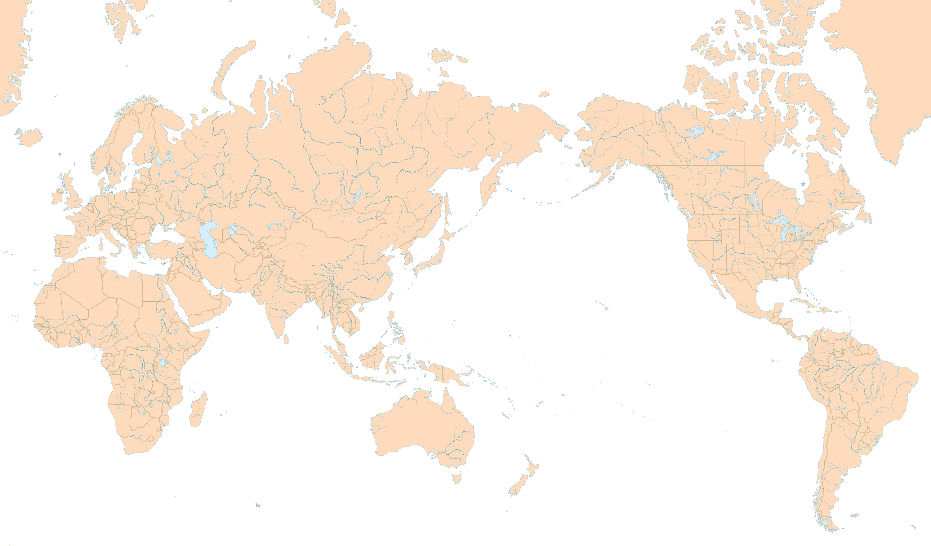
Bruegel’s Research – focus on the Asia-Europe Program
Since 2006, Bruegel has made Asia-Europe economic relations a strategic priority for its research, and it has become a key European hub for Asian economists.
1. Asia Europe Economic Forum
Annual forum launched by Bruegel in 2006
Organized alternatively in Asia and Europe
Partnership with five high-level organizations from Europe and Asia: Asian Development Bank Institute (ABDI), Bertelsmann Stiftung, Centre d'Etudes Prospectives et d'Information Internationale (CEPII), Chinese Academy of Social Sciences (CASS), Korea University
2. Fellowships
4. Partnerships
Agreements with leading organizations to host visiting fellows at Bruegel for 1 to 18 months
In 2013, Bruegel will host fellows from:
Institute of World Economics and Politics (IWEP)
Chinese Academy of Social Sciences (CASS)
Japanese National Institute for Research Advancement (NIRA)
Kobe University
India (non-affiliated economist)
Partnerships with high-level research organizations in Asia:
Japan: Kobe University, National Institute for Research Advancement (NIRA), Asian Development Bank Institute (ABDI), IDE-JETRO
Korea: Centre for East Asian Studies, Korea University, Korea Institute for Finance (KIF), Korea Institute for International Economic Policy (KIEP), Samsung Economic Research Institute, Korea Development Institute (KDI)
China: Academy of Macroeconomic Research (NDRC, P.R. China), Institute of World Economics and Politics (IWEP), Chinese Academy of Social Sciences (CASS)
India: Indian Council for Research on International Economic Relations (ICRIER)
Asia: Asia-Europe Foundation (ASEF)
3. Publications
These include blog posts, policy contributions, policy briefs, blueprints, and books
Bruegel is currently pursuing possibilities for translation of future publications
http://www.bruegel.org/pages/asia/

Slide 7
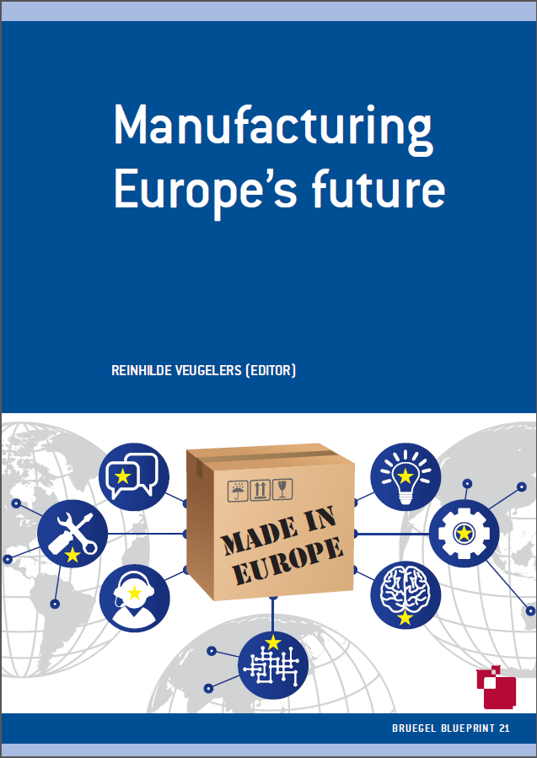
Bruegel’s Output - Publications
Bruegel publications offer both in-depth analysis and timely responses to economic developments
Bruegel publishes:
Blog posts on new economic developments (weekly)
Policy contributions (20+ per year)
Working papers (10+ per year) on topical policy issues
Policy briefs (6+ per year): short, easy to read, timely research-based insights
Blueprints (3-4 per year) for in-depth, policy-oriented analyses
Books (1-2 per year)
Newsletters for all and newsletters for members
Publication alerts
Reviews of economic blogs
In addition:
Individual scholars at Bruegel also have a high profile in target media through their published articles and columns.

Slide 8
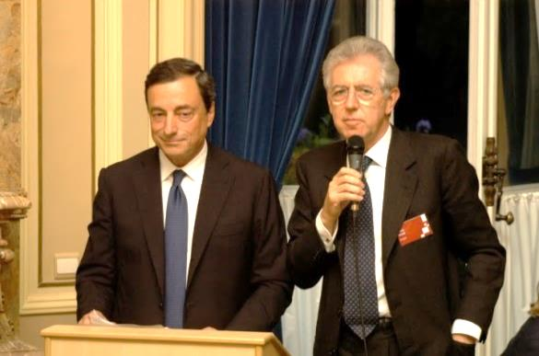
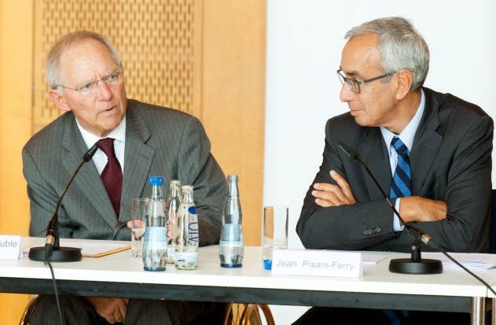
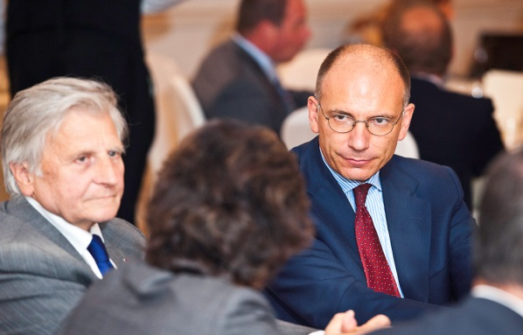
Bruegel’s Output - Direct contributions to the policy sphere
Bruegel uses events and direct interactions with policy-makers to fulfil its mission to improve economic policy.
Conferences and large-scale events organized annually in G20 cities
Contributions to rotating EU presidencies
Presentations to the informal ECOFIN meetings (Copenhagen and Nicosia in 2012, Dublin and Vilnius in 2013)
Parliamentary testimonies in the US, the EU, and EU member states (full list of parliamentary testimonies available here)
Participation of fellows in national government advisory groups (e.g. Conseil d’Analyse Economique, advisor group for the French prime minister)
Bilateral meetings with policymakers at the national and EU levels
Mario Draghi and Mario Montii (2011)
Wolfgang Schaüble and Jean Pisani-Ferry (2011)
Jean-Claude Trichet & Enrico Letta (2013)

Slide 9
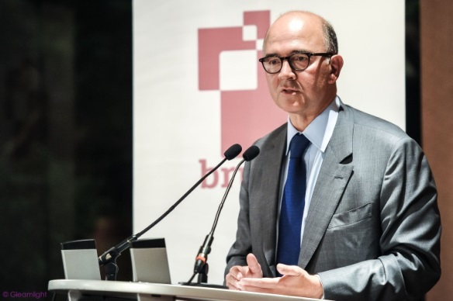
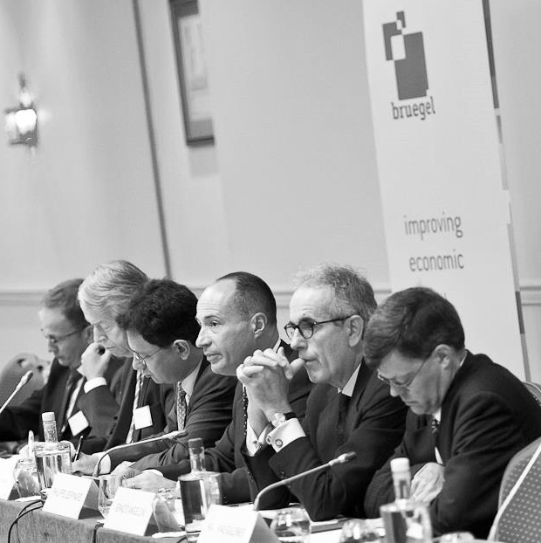
Bruegel’s Output - Events
Bruegel gathers key decision-makers at over 60 events a year
Bruegel’s Annual Meeting gathers Members and senior policy-makers and features keynote speeches and panel discussions with high-level guests– in 2013 the dinner speech was made by Enrico Letta and panellists included Charles Goodhart, Martin Hellwig, Gert-Jan Koopman, Ignazio Angeloni, Jörg Asmussen, Alvaro Nadal, Paul Sheard and Anne Ruth Herkes
Bruegel Economic Club dinners provide an informal forum for 20 to 25 high-level European policy-makers and senior representatives from the business world and academia
Pierre Moscovici (2012)
Conferences take place in many G20 cities several times a year in collaboration with European, US and Asian institutions – topics in 2013 included Japan and the UE in the global economy and the Single Resolution Mechanism
Workshops gather high-level policymakers, experts and members to work closely together on issues such as new European macro-prudential instruments, the TTIP, banking crises, financial stability and state aid – in 2013 participants included Joaquin Almunia, Peter Praet and Sony Kapoor
The Energy & Climate Exchange series explores topics such as post-election energy policy in Germany, emission trading beyond backloading and developments in European energy markets
Competition Policy Labs have in 2013 covered topics including regulatory challenges in European telecoms, minority shareholding in merger control and new competition rules for technology transfer agreements
Finance Focus Breakfasts are regular short discussions chaired by Bruegel fellow Nicolas Véron – recent topics have included bond market development and the transformation of China’s financial system, unleashing investment in innovative firms in Europe and the EU debate about audit reform
Guntram Wolff, Martin Hellwig, Nicolas Veron , Philippe Lespinard, Ignazio Angeloni, Matthias Güldner (2013)

Slide 10




Bruegel’s Output – Communicating effectively
Bruegel recognizes that effective communication is necessary to inform members and influence policy-makers, and thus employs a variety of media outlets to publicize its work.
Media presence and social media are
Website
154,423 visits from 189 countries in January 2013
The top ten nationalities visiting include Belgian, American, British, French, Italian, German, Spanish, Greek, Dutch and Polish
Social Media
Over 15,500 followers on Twitter
BruegelTV YouTube channel since 2011
Mobile Access
iPad app launched in 2012
User-friendly mobile version of the website
Media
Dynamic relations with the media community at the national, EU and global level
Syndicated columns in European and Asian media
3950
3166
1895
Total Press Mentions 2010-2012

Slide 11
Evaluation of Bruegel’s work
Bruegel is highly attentive to measuring its impact on policymakers and thought-leaders.
Since its inception, it has put in place several evaluation processes
to monitor impact and guide research investments.

Slide 12
Bruegel’s Finances
Bruegel believes it is important to disclose its financial records and prevent itself from becoming overly dependent on a single funding source in order to maintain the credibility and independence of its work.
Bruegel’s financial structure aims to
    Provide a balance between public and private funds
    Protect independence (no member provides more than 3-5% of the budget, depending on budget year)
    Reflect transparency (financial statements disclosed in the Annual Report, Scholars’ external interests disclosed on their bio page, Private funding disclosed on the Membership Page...)
  Bruegel receives occasional project funding, but over 85% of income is core funding provided through the Membership Program
  Bruegel is currently exploring new funding sources, including the possibility of building up an endowment.
  Income for 2012: €3,831,311.14
  Budget for 2012: €3,667,174.40

Slide 13
For more information
Pauline.labib@bruegel.org

