Slide 1
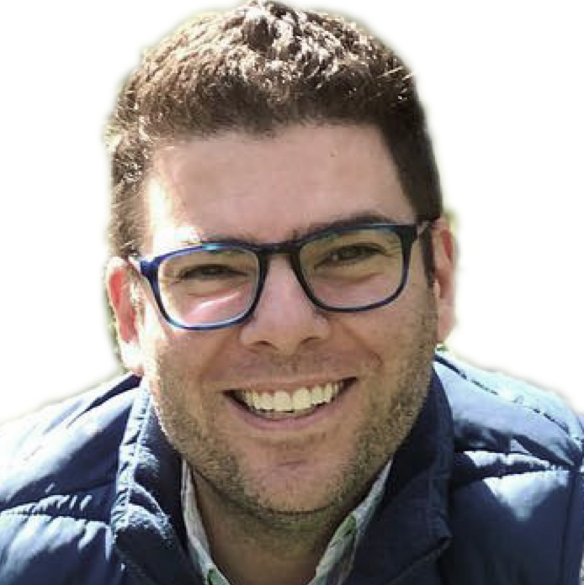

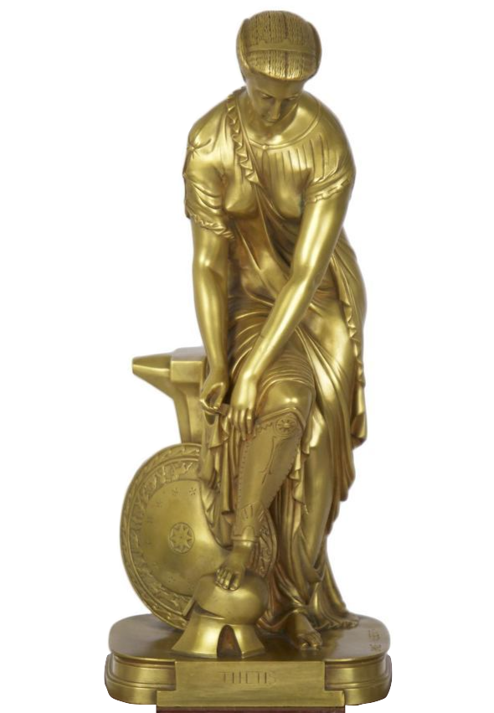
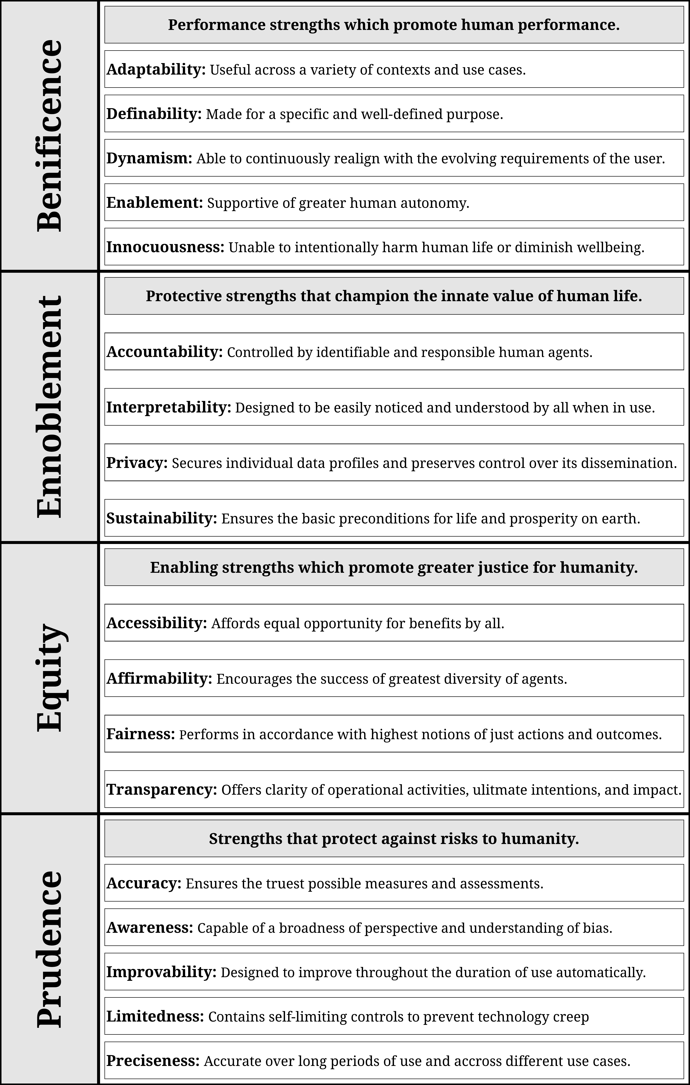
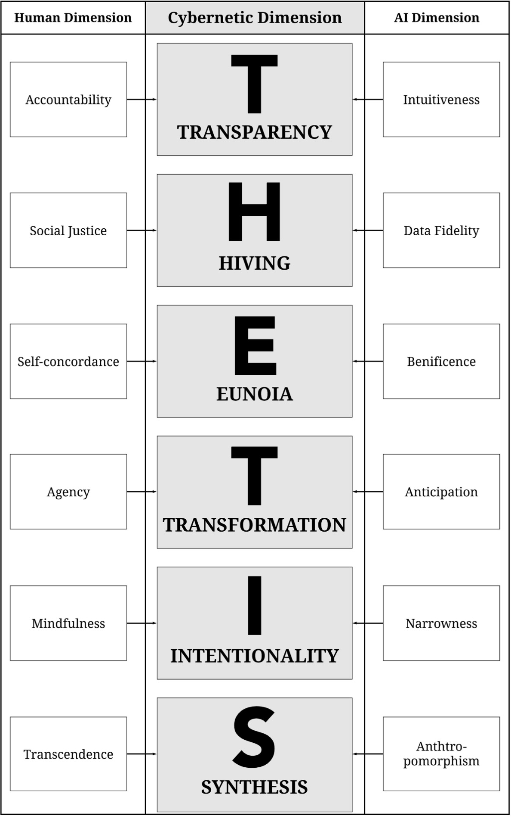
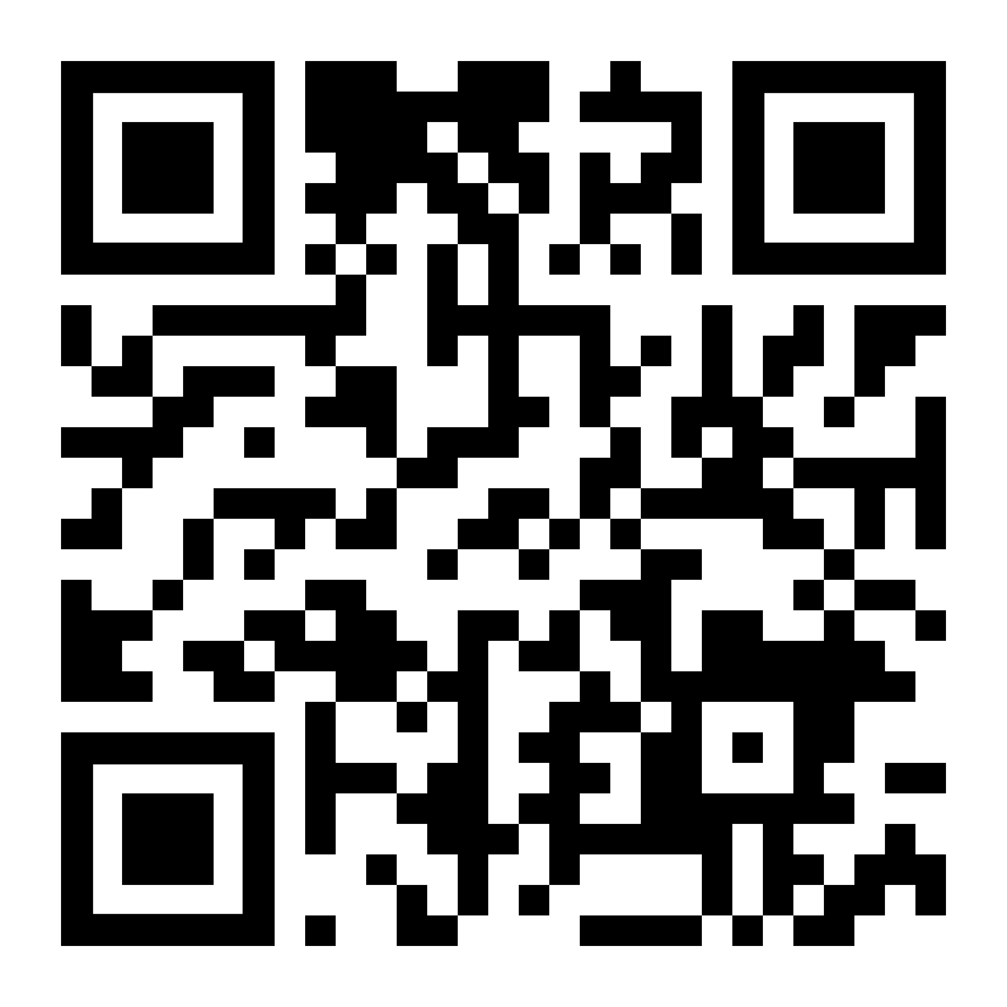
A MEASURE OF ALL MINDS:
A CLASSIFICATION OF THE ARTIFICIAL INTELLIGENCE STRENGTHS AND VIRTUES
& THE CREATION OF THE THETIS DIMENSIONS OF CYBERNETIC WELLBEING
SETH R. NORMAN
srnorman@sas.upenn.edu
By establishing the unique strengths and virtues of artificial intelligence, it becomes possible to identify and cultivate shared dimensions of cybernetic wellbeing as computer programmers seek to create a virtuous future shared by human- and machine-kind.
THETIS (Θέτις): I wish to honor Thetis as the mother of collaborative innovation and the divine source of cybernetic virtue through the naming of these tools. Though immortal, Thetis is a lesser Olympian deity, known primarily—if at all—for the overprotective mothering of her much more famous son, Achilles. Far less xxxxxxxx well remembered is her adoption of Hephaestus,, xxxxxxxxxxxxxxxxxxxx the god of blacksmiths, forges, and technology, xxxxxxxxxxxxxxxxxxxxx who was born with a deformity so unsightly that xxxxxxxxxxxxxxxxxxxx the other gods threw him off Mount Olympus xxxxxxxxxxxxxxxxxxxxxx into the Aegean Sea. It was there that xxxxxxxxxxxxxxxxxxxxxxxxxxxx Thetis, a sea goddess, found and xxxxxxxxxxxxxxxxxxxxxxxxxxxx rescued him, and then helped him xxxxxxxxxxxxxxxxxxxxxxxxxxxxxxx to establish a clandestine workshop. Xxxxxxxxxxxxxxxxxxxxxxxxxxxxx Deep underneath his old home of xxxxxxxxxxxxxxxxxxxxxxxxxxxx Mount Olympus, Hephaestus would xxxxxxxxxxxxxxxxxxxxxxxxxxx create the very first instances of natural xxxxxxxxxxxxxxxxxxxxxxxxxxx and artificial intelligence: Talos, the xxxxxxxxxxxxxxxxxxxxxxxxxxx first intelligent robotic agent in history, xxxxxxxxxxxxxxxxxxxxxxxxxxx was built to protect the island and people xxxxxxxxxxxxxxxxxxxxxxxxxx of Crete, while Pandora was xxxxxxxxxxxxxxxxxxxxxxxxxxxxxxxxxxxx the world’s first woman who xxxxxxxxxxxxxxxxxxxxxxxxxxxxxxxxxxx gifted hope to all mankind. This xxxxxxxxxxxxxxxxxxxxxxxxxxxxx paper is, of course, about natural xxxxxxxxxxxxxxxxxxxxxxxxxxxxxx and artificial intelligence, but xxxxxxxxxxxxxxxxxxxxxxxxxxxxxxxxxx more specifically, it is xxxxxxxxxxxxxxxxxxxxxxxxxxxxxxxxxxxxx about my great hope for xxxxxxxxxxxxxxxxxxxxxxxxxxxxxxxxxxxxxx the engineers and designers xxxxxxxxxxxxxxxxxxxxxxxxxxxxxxxxxxxxx who toil away in the xxxxxxxxxxxxxxxxxxxxxxxxxxxxxxxxxxxxx darkness under Sand Hill xxxxxxxxxxxxxxxxxxxxxxxxxxxxxxxxxxx Road working to build a xxxxxxxxxxxxxxxxxxxxxxxxxxxxxxxxxxxxx more virtuous tech- xxxxxxxxxxxxxxxxxxxxxxxxxxxxxxxxxxxx nological future for us all; xxxxxxxxxxxxxxxxxxxxxxxxxxxxxxxxxxxxxx work made possible xxxxxxxxxxxxxxxxxxxxxxxxxxxxxxxxxxxxxxxx from her virtuous example
(Slatkin, 1995).
PROBLEM: Silicon Valley has failed to realize the full potential of artificial intelligence:
In danger of losing the artificial intelligence race
No long-term vision for a harmonious future shared with AI
Insufficient innovation practices for AI development
PROPOSAL: Silicon Valley can reclaim its mandate to lead the development of AI by adopting a Positive Existential Posthuman approach to innovation:
Positive psychology teaches us how to classify the strengths of virtuous AI tools (Peterson & Seligman, 2004)
Existential Psychology offers a model for unifying human wellbeing with AI wellbeing through meaning (Wong, 2010)
Posthumanism helps us to view AI as our partner in this work, imbued with equal importance to humanity (Ferrando, 2019)
METHODS: Analyzed perspectives from governments and public universities, non-profit think tanks, and private technology companies:
Identified 18 discrete characteristics of artificial intelligence and organize into 4 virtuous categories
Proposed 6 promising opportunities for the elements of wellbeing unique to humans and artificial intelligences can unify under a single shared dimension of cybernetic wellbeing
Applied findings to the improvement of AI innovation practices
DISCUSSION: Silicon Valley can create better AI by applying the THETIS dimensions to their design practices:
It is possible for virtue philosophy to contribute to the creation and use of better artificial intelligence products
The sooner we prepare for the arrival of conscious artificial intelligence, the more likely it is that our relationship will be mutually beneficial
Virtuous design practices also have the potential to improve the wellbeing of Silicon Valley designers
Classification of the Artificial Intelligence Strengths and Virtues
THETIS Dimensions
of Cybernetic Wellbeing
SCAN HERE TO LEARN MORE

