Slide 1
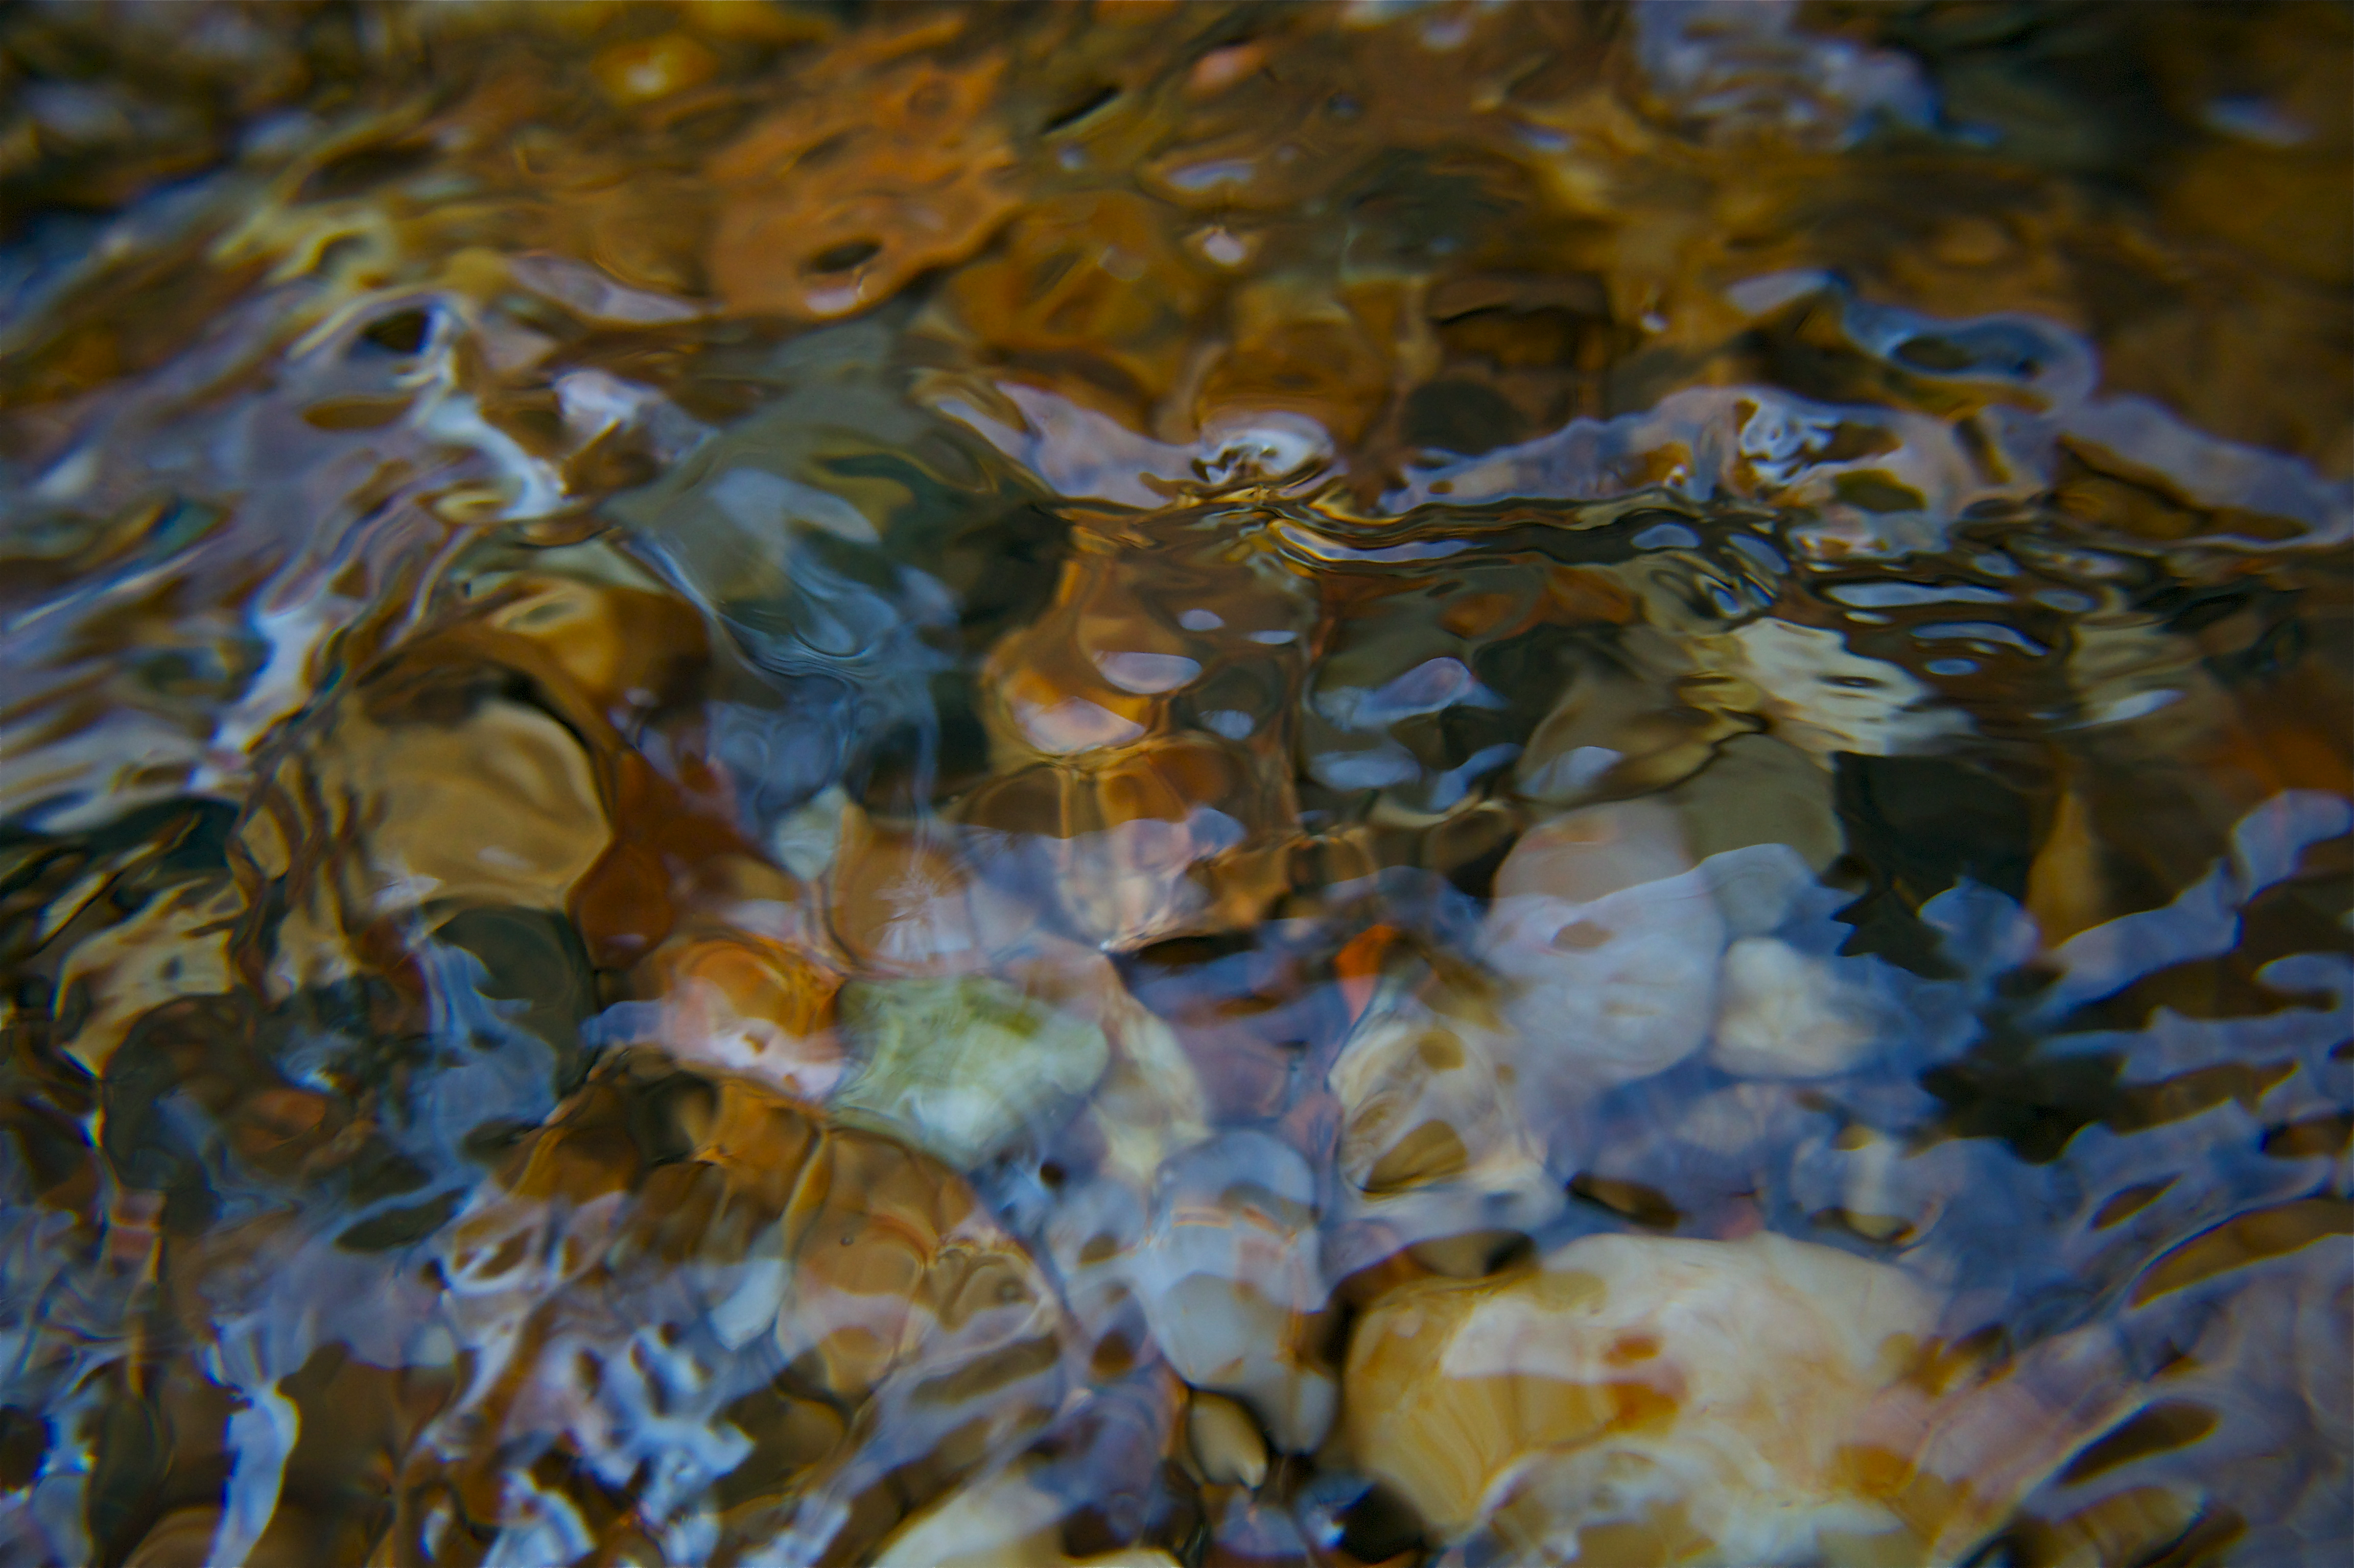
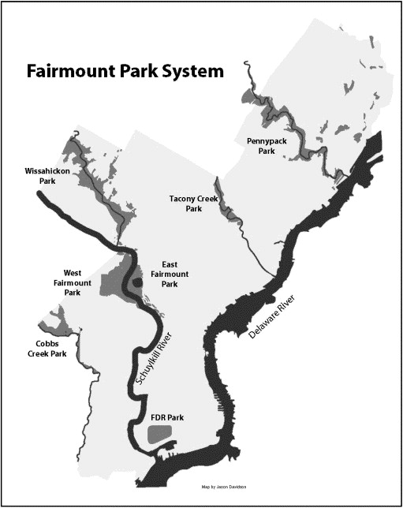
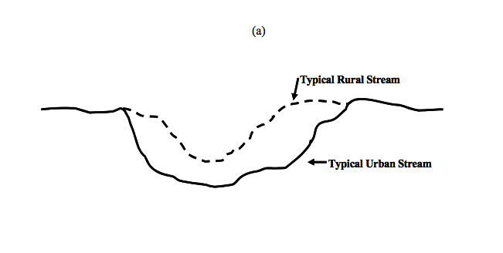

Urbanization in Fairmount Park: The deterioration of stream beds
Emma Schad
STSC 179
Dr. Ann Greene
Fairmount park is known for being the largest inner city park in the country. What is perhaps most notable about the park is the diversity in habitats that it houses, forest/riparian zones, meadow, wetland, and stream bed habitats all call Fairmount home. Fairmount has over 95km of stream, and the park itself is comprised of 6 stream valleys.
Since it’s creation in 1855, Fairmount park was land acquired and seized by the city to protect the water quality of the Schuylkill
-The park always had an emphasis on recreation and public use
-The mission of Fairmount to serve the public, may also be a root cause of the deterioration of the park itself. Heavy public use makes restoration an ongoing upkeep.
-Disconnect between personal life of a city resident and the health of the park system.
Water, water, everywhere
Although iconic for its extensive trails and forested areas, the water system of Fairmount is essential to the health of the Delaware Valley watershed, and the Schuylkill river drainage basin, as well as the physical integrity of the park’s landscape.
Another effect on stream quality: Pollution from fertilizers and urban runoff

