Slide 1
_{Carnegie Moscow Center}
_{Ideas Debate Impact}

Slide 2
About the Carnegie Moscow Center
A center within the Carnegie Endowment global organization which marked its Centennial in 2010
Yeltsin’s decree signed 1992, Moscow Center established 1994
Staffed by Russians; publications in Russian and other languages
Director Dmitri Trenin
Leading scholars in their respective fields
№1 Think Tank in Russia & Central/Eastern Europe from 2009 to 2012, (University of Pennsylvania rating)

Slide 3
Global Vision
Pioneering in Moscow’s first Global Think Tank
Conduct activities as a member of a global Carnegie organization
Joint projects with Carnegie offices in DC, Brussels, Beirut, Beijing, and Almaty
Locally-based, multi-lingual scholars
Global quality standards and uniform visual identity requirements
Innovative research methodologies
Advanced use of modern technologies: videoconferencing; live internet transmissions of events; interactive online discussions; polls and ratings; and social media networking
Carnegie offices in DC, Brussels, Beirut, Beijing, and Almaty
Another office to be opened soon in New Delhi

Slide 4
Our Mission
To impact debate and policy through promoting independent research and disseminating its results to a global audience of media, government, academics, and business
To provide a free and open forum for the discussion and debate of critical national and regional issues of Russia and Eurasia, as well as world affairs
To promote a security community in the Euro-Atlantic, help build a credible security arrangement in the Asia-Pacific, and further dialogue and understanding with the Muslim world
Our principles: independence, neutrality, and quality analysis

Slide 5
Our Programs
Russian Domestic Politics and Political Institutions (Lilia Shevtsova)
Foreign and Security Policy (Dmitri Trenin)
Nonproliferation (Alexei Arbatov)
Society and Regions (under the general supervision of the director)
Religion, Society and Security (Alexey Malashenko)
Program chairs – each a leading expert in their field

Slide 6
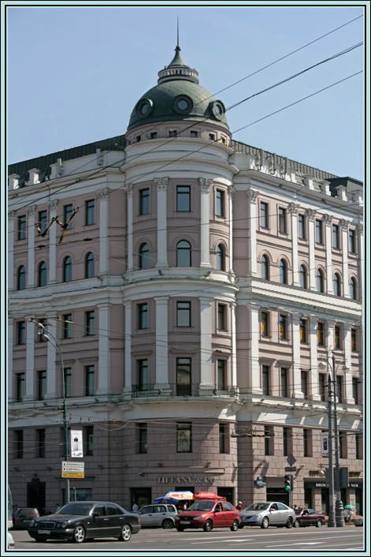
What we do
Research
Events
Consultations
Publications
Website
Articles and interviews
Activities in social networks
Outreach
Interns
Library
Focus on real world outcomes in all our activities

Slide 7
Measuring Impact
Measuring impact through real life outcomes
Our EASI initiative in 2009-2012, aimed at helping construct the intellectual basis for a security community in the Euro-Atlantic, the initative got the U.S., Russian, and European leaderships interested at the highest level, its result was arguably the best set of joint U.S.-European-Russian proposals on moving toward a security community; and the EASI iniative received public praise from the foreign ministers of Germany, Russia, the United States, and the secretary general of NATO.
We explored the Asia-Pacific dimension of Russia’s foreign and security policy formulating ideas for an increased cooperation with China and for a settlement of Russian-Japanese territorial dispute so as to forge partnerships with these countries while promoting the development of Russia’s eastern provinces.
We conducted analysis of the implications of the Arab Spring and the conflict in Syria on Russia’s foreign policy and its relations with other global and regional players, including Turkey, Iran, and Afghanistan.
We investigated the continued evolution of the Russian political regime and the ruling elite, emphasizing the interrelationship between domestic politics and foreign policy.
We developed Russia-2020, scenarios of the country’s likely evolution through the end of the decade.

Slide 8
Measuring Impact
Measuring impact through real life outcomes (continued)
We conducted, for almost ten years, a unique monitoring of Russia’s regions, covering key social, economic and political developments, with a focus on the comparative levels of democracy of Russia’s regions, the regional elites, the growing social society, and the electoral process.
We provided monthly briefings for the Ministerial Club of Moscow-based deputy chiefs of mission of foreign embassies.
We pioneered the study of the religious and ethnic aspect of the “Russian Awakening” in Russia and the expanding Islamic trends in the country.
We suggested ways for realistic U.S.-Russian collaboration on nuclear reduction and strengthening strategic stability; offered recommendations for establishing a framework for U.S.-Russian-Chinese dialogue on strategic stability issues; and provided ideas for U.S.-Russia dialogue on BMD and for the multilateralization of the nuclear arms reduction process.
We generated practical recommendations for strengthening nonproliferation regime, with a particular emphasis on the Middle East, and North-East and South Asia.

Slide 9
Media activities
Over 400 op-eds and interviews in Russian and English in FY 2012 – in leading Russian press and academic journals
Quoted over 2000 times a year in Russian and English press and academic journals
10-20 press at each of our events, up to 3-5 TV crews
Our experts – Dmitri Trenin, Alexei Arbatov, and Alexey Malashenko – regularly appear in prime time on national TV stations
Activities over social networks: Facebook, Twitter, Carnegie Moscow Center’s Eurasia Outlook, and other blogs
We are the newsmaker – our events & pubs considered newsworthy

Slide 10
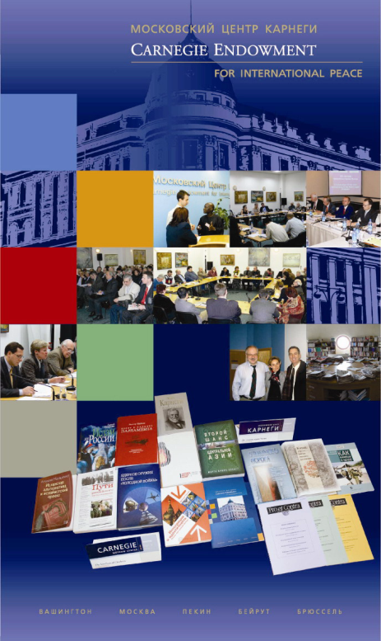
Publications
A record 37 “major genre” publications in FY’12: books, reports, Working Papers, and Briefings
In FY’12 we produced over a dozen books – all authored and/or edited by our scholars
In Russian, English, and occasionally in other languages
Books on most topical issues: Russia’s relations with the West, Russia’s development, Islam and Islamism, Euro-Atlantic security and nonproliferation, and Asia-Pacific cooperation
Full texts of all our books/reports since 1998 are freely available on our website, Carnegie.ru

Slide 11
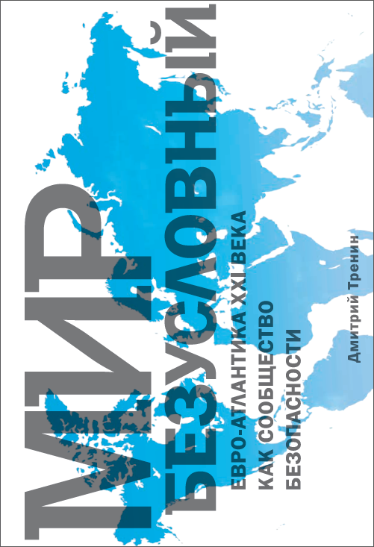
Recent Publications
Unconditional Peace: The 21st Century Euro-Atlantic as a Security Community, by Dmitri Trenin (in Russian)
Missile Defense: Confrontation and Cooperation, (Russian eds. Alexei Arbatov, Vladimir Dvorkin; English ed. Natalia Bubnova)
Central Asia and Russia’s Expectations, by Alexey Malashenko (in Russian and English)
Post-Imperium: a Eurasian Story, by Dmitri Trenin (in Russian and English)
Russia-2020, eds. Nikolay Petrov and Maria Lipman (in Russian and English)
World in Their Hands: Ideas From the Next Generation, by Carnegie Moscow Center’s interns and visiting scholars, ed. Natalia Bubnova (in English)
20 Years Without the Berlin Wall, ed. Natalia Bubnova (in Russian and English)
Resetting U.S.–Russian Nuclear Relations, eds. Alexei Arbatov, Vladimir Dvorkin, and Natalia Bubnova (in Russian and English; English ed. Natalia Bubnova)
Summer or winter, it is hot in Moscow!

Slide 12
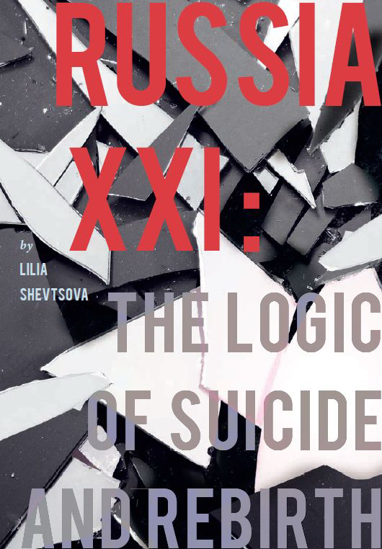
Reports
Russia’s Military Reform: Current Situation and Prospects, by Alexei Arbatov and Vladimir Dvorkin
Strengths and Weaknesses of Pakistan, by Vladimir Moskalenko and Petr Topychkanov
Crisis: Russia and the West in the Time of Troubles, by Lilia Shevtsova
Russian Awakening, by Dmitri Trenin, Maria Lipman, Alexey Malashenko, Nikolay Petrov, and Lilia Shevtsova
Russia XXI: The Logic of Suicide and Rebirth, by Lila Shevtsova
Russia’s Pacific Future: Solving the South Kuril Islands Dispute to Secure Russia's Pacific Future and Improve Japan’s Position vis-à-vis Asia, by Dmitri Trenin and Yuval Weber
A 21st Century Myth – Authoritarian Modernization in Russia and China, by Bobo Lo and Lilia Shevtsova

Slide 13
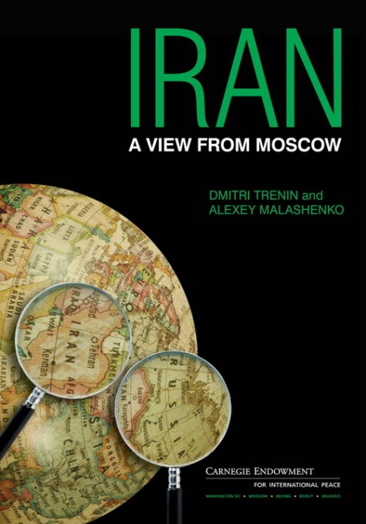
Book and report series
Book series Religion in Eurasia, eds. Alexey Malashenko and Sergei Filatov
Religion and Globalization
Religion and Conflict
Twenty Years of Religious Freedom in Russia
Russian Orthodox Church Under the New Patriarch
Report Series on Russia-China relations
(together with the Centre for European Reform in London)
Russia, China and the Geopolitics of Energy in Central Asia, by Alexandros Petersen
True Partners? How Russia and China See Each Other, by Dmitri Trenin
Russia, China and Global Governance, by Charles Grant
Report series View from Russia
Afghanistan: a View from the North, by Dmitri Trenin and Alexey Malashenko
Iran, a View from Moscow, by Dmitri Trenin and Alexey Malashenko
The Arctic: a View from Moscow, by Dmitri Trenin and Pavel K. Baev

Slide 14
Translations
We publish Russian translations of select Carnegie Endowment publications
Silver Bullet? Asking the Right Questions About Conventional Prompt Global Strike, by James Acton
Georgia’s Choices: Charting a Future for Georgia in Uncertain Times, report by Thomas de Waal
Indispensable Institutions: The Obama-Medvedev Commission and Five Decades of U.S.-Russian Dialogue, by Matthew Rojansky
Russia’s Neglected Energy Reserve, by John Millhone
Reading Khamenei, by Karim Sadjadpour
Central Asia’s Second Chance, by Martha Olcott
Carnegie Endowment publishes translations of our select books/reports in DC
Russia-2020, eds. Nikolay Petrov and Maria Lipman (in Russian and English)
Lonely Power. Why Russia Has Not Become the West and Why the West Is Difficult for Russia, by Lilia Shevtsova
Outer Space: Weapons, Diplomacy and Security, eds. Alexei Arbatov and Vladimir Dvorkin
Carnegie Endowment/Carnegie Global Offices publish our experts’ publications written in English
Post-Imperium: Russia and Its Neighbors, by Dmitri Trenin
Change or Decay. Russia’s Dilemma and the West’s Response, by Lilia Shevtsova & Andrew Wood
Our books have been published in the United States, China, Poland, Latvia, Saudi Arabia, Syria, Great Britain, Germany, Italy, Japan, Canada, among others.

Slide 15
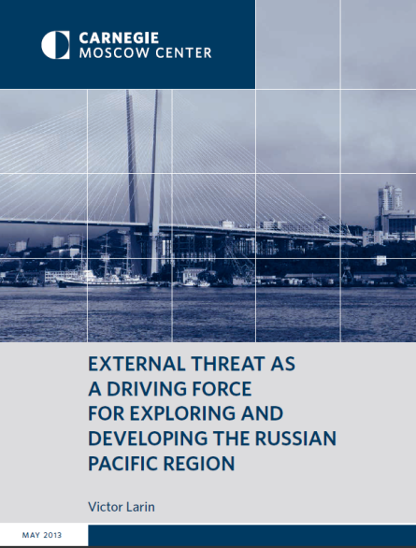
Carnegie Papers, Briefings, and
Moscow Center Newsletter
Carnegie Papers provide ready access to timely research on the domestic and foreign policies of Russia and neighboring countries
Briefings and Policy Outlooks offer analysis and practical policy recommendations for Russian foreign and domestic policies, economic policy, and security
Moscow Center Newsletter – a bilingual monthly electronic bulletin presenting news tied in with the Carnegie events and publications
Recent issues of the Carnegie Papers
The Mythical Alliance: Russia’s Syria Policy, by Dmitri Trenin
Russia and the Arab Spring, by Alexei Malashenko (in Russian & English)
Great Strategic Triangle, by Alexei Arbatov and Vladimir Dvorkin (in Russian)
Nuclear Weapons and Strategic Security in South Asia, by Peter Topychkanov (in English)
The “Green” Economy, by Boris Porfyriev (in Russian and English)
Most recent Briefings:
North Caucasus: Russia’s Internal Abroad? by Alexey Malashenko (in Russian & English)
Series of briefings on Central Asian countries: Turkmenistan, Kazakhstan, Uzbekistan, Kyrgyzstan, Tajikistan, by Alexey Malashenko (in Russian & English)

Slide 16
Pro et Contra
Leading political journal, published for 15 years, recognized as country’s best periodical with expert analysis
Over 4000 subscribers in 100 cities in Russia and abroad
Analysis of Russia’s domestic and foreign policy, economics and international relations, social trends, socio-political institutions, and the media
Conflicting view points
Seminars around most issues
Full texts, in Russian, on the website www.carnegie.ru, with summaries in English; redesigned electronic version
English translations of select issues including “The Power of Oil & the Power of Gas,” and “Two Crises: Consequences & Outlook”
Special issue on the Center’s 15th anniversary “Agenda for the New Presidency”
Subscriptions to the redesigned electronic version at Carnegie.ru

Slide 17
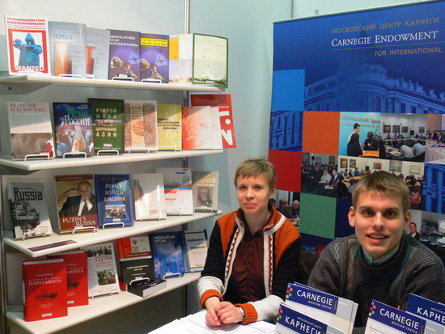
Promotion
Increased print-runs to 3000-4000
Better advertising: bookstores, catalogs, internet, book fairs, meetings with readers
Free distribution to major universities, libraries, research centers, and state institutions
Creation of targeted lists for distribution of each book distributed in Russia, Ukraine, Kazakhstan, U.S., China, and others
Non/fiction Book Exhibition – Russia’s leading annual event for intellectual literature is one of our main yearly venues for book promotion
Promotion through Facebook and Twitter
Our publications have been featured in the Non/Fiction,
Nezavisimaya Gazeta, and Ex Libris top lists on multiple occasions

Slide 18
Events at the Carnegie Moscow Center
U.S.-Russia Relations & European Missile Defense
Conference on Ballistic Missile Defense
Meeting with military attachés regarding Dmitri Medvedev’s statement on Russia’s countermeasures
What Comes After the New START: the Goals for Future Arms Control and Security Cooperation
Conditions and Prospects for Further Progress in Nuclear Disarmament and Nonproliferation
U.S.–Russia Security Relations
The Euro-Atlantic Security System
The role of nuclear weapons in European security and the NATO-Russian Strategic Dialogue
Transatlantic Security in the 21st Century: Do New Threats Require New Approaches?
Carnegie Russian–European Forum “The Upcoming Decade: What Kind of Partner Russia May Become?”
NATO–Russia: Partners for the Future – NATO Secretary General Anders Fogh Rasmussen’s speech
Videoconference of the Euro-Atlantic Security Initiative
Situation in the Middle East
Arab Spring and Regional Security in the
Middle East. A View from Israel
The Future of Afghanistan and Obama’s
Foreign Policy
Elections 2012
Russia on the Eve of Elections
Ministerial Club with DCMs of Embassies in Moscow
Roundtable on Elections in Russia
Videoconference together with the Institute of World Policy: Elections–2012: Impact on Russia and Post-Soviet Space
Corruption
Corruption in Russia. An event with Elena Panfilova
Russian Opposition About the Russian Authorities,
Upcoming Elections, the Current Situation, Foreign Policy, and Themselves

Slide 19
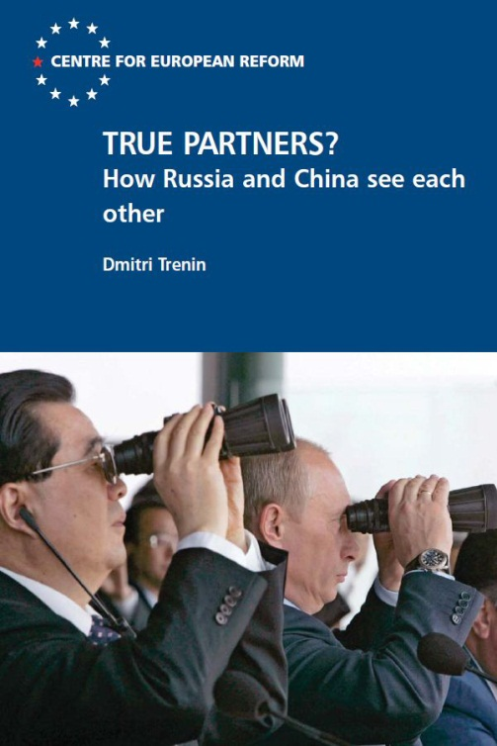
We partner with other organizations
Joint publications
Russia-China reports together with the London-based Centre for European Reform
Report on Russia-Georgia relations, published together with the Georgian Foundation for Strategic International Studies
3 reports produced jointly with the Lithuanian Center for Geopolitical Studies
Book “A Path to Europe,” coedited by Lilia Shevtsova, produced jointly with the Liberal Mission Foundation
Black Sea reports together with the Black Sea Peacebuilding Network, (a project of the Crisis Management Institute, Helsinki/Brussels)
Rosspen Publishing House
Ves Mir Publishing House

Slide 20






We partner with other organizations
Joint events and projects
Polish Institute of International Affairs
Liberal Mission Foundation
Moscow Institute of International Relations (MGIMO)
Stanford University–Russia Forum (SURF)
Gorbachev Fund
Weapons of Mass Destruction Commission
Nuclear Threat Initiative
Evans-Kawaguchi Commission
Chatham House
American National Security Archive
Internships
Interns come to the Center independently or through partner organizations:
Stanford University
School of Russian and Asian Studies (SRAS)
Middlebury College
Association of American Universities
New Economic School
Alfa Fellowship Program
Moscow State University

Slide 21
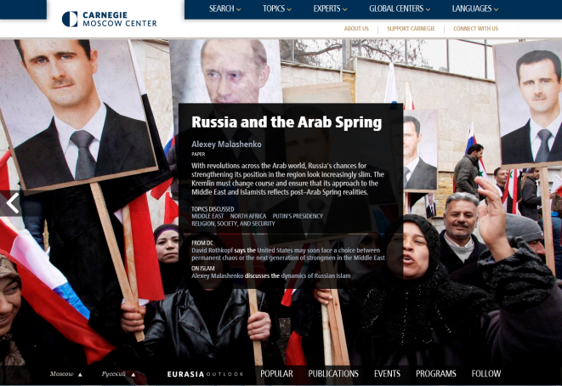
Carnegie Moscow Center’s website
A new platform fully integrated with the Carnegie’s sites in Washington, Brussels, and Beirut
Fresh and user friendly format
Seamless navigation throughout the world of analysis and insight that the Endowment provides
Work in Moscow integrated into the global context in which it rightfully belongs
Exclusive web-articles on daily events by Carnegie experts
Eurasia Outlook blog with daily insights on events
Updated daily in Russian and in English
Website redesign in 2013 provided opportunities to better present timely analysis.
The Carnegie Endowment in 2010 was named best among world’s Think Tanks
for use of the internet.

Slide 22
Looking to the future – new projects
Promoting Euro-Atlantic security space and Asia-Pacific Security environment
Launching the rating of the level of modernization of Russia’s regions
Videos of interviews on the Carnegie Moscow Center’s new publications with their authors – for the website and YouTube
Expanding use of social networking and engaging younger people
Focus on electronic publications to facilitate access to broader audiences and enhanced interactive communication

Slide 23
Be the change you wish to see in the world.
Mahatma Gandhi
At the Carnegie Moscow Center, we make an impact.

