Slide 1

Creative Commons: A License to Share
Sarah Wipperman
Scholarly Communication & Digital Repository Librarian
University of Pennsylvania
swipp@upenn.edu

Slide 2
Copyright
What has copyright?
Work in a fixed, tangible form
When does copyright happen?
Immediately
What does it protect?
Rights to reproduction, distribution, and reuse
Restricts reuse

Slide 3


What is copyright?
This slide has animations and should be viewed in presentation mode.

Slide 4
Author
This slide has animations and should be viewed in presentation mode.

Slide 5
Republish
Redistribute
Make a movie
Post online
Remix
Translate
This slide has animations and should be viewed in presentation mode.

Slide 6





Republish
Republish
Redistribute
Redistribute
Make a movie
Post online
Remix
Translate
Post online
Remix
This slide has animations and should be viewed in presentation mode.

Slide 7
What if you want to give away rights automatically?

Slide 8
Creative Commons
Republish
Redistribute
Redistribute
Redistribute
Redistribute
Redistribute
Redistribute
Redistribute
Make a movie
Post online
Remix
Translate
This slide has animations and should be viewed in presentation mode.

Slide 9
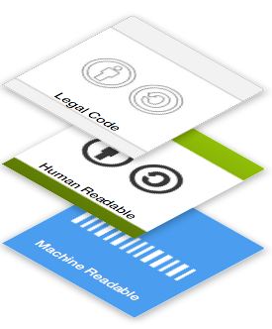
Creative Commons Licenses
Public
Widely recognized
“Some rights reserved” vs “all rights reserved”
Three “layers”

Slide 10
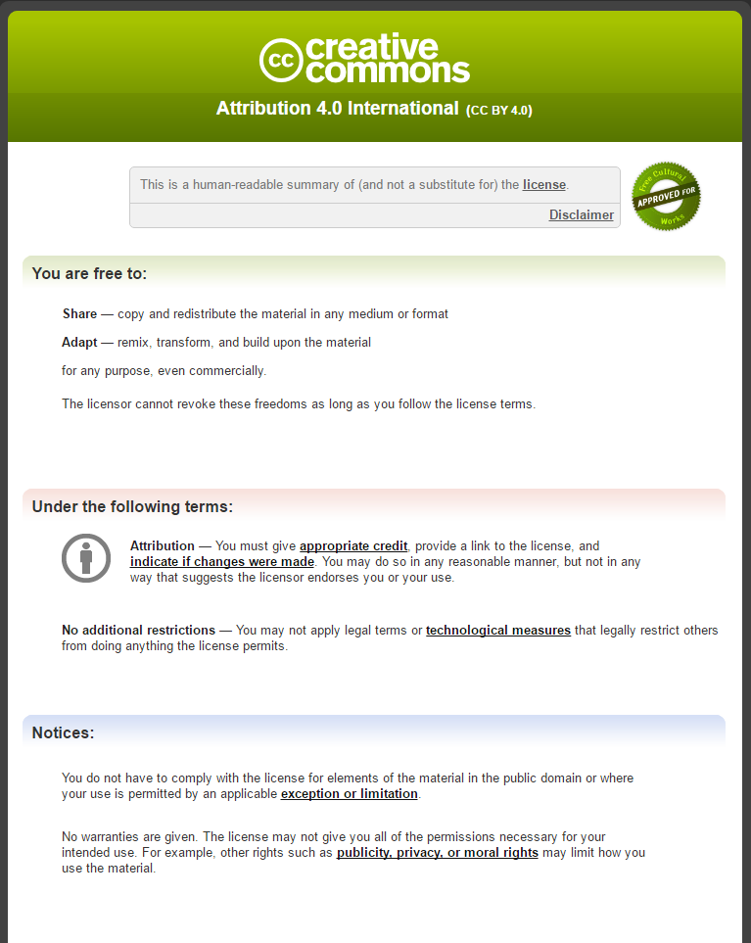

Types of Licenses: Attribution
CC BY
“Credit me”
Most Open
Part of all CC licenses
NOT the same as academic integrity

Slide 11
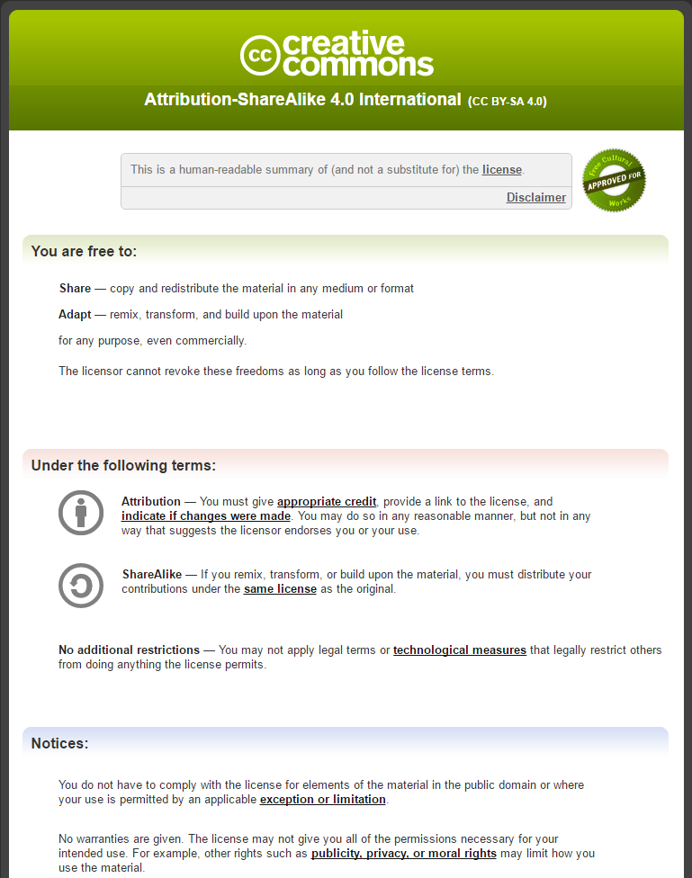

Types of Licenses: Share-Alike
CC BY-SA
“Do as I do”
Supports open licensing

Slide 12
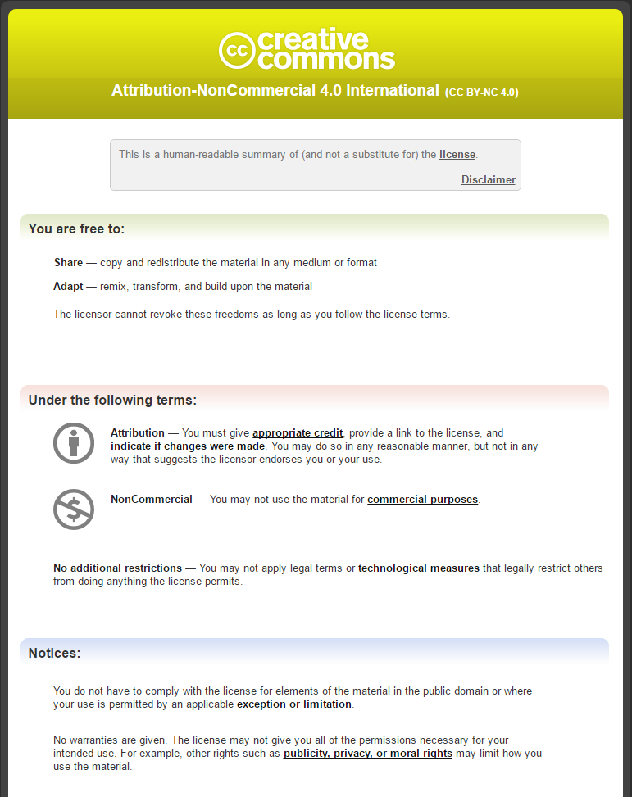

Types of Licenses: NonCommercial
CC BY-NC
“You can’t make money off my work”
Restricts who can use it

Slide 13
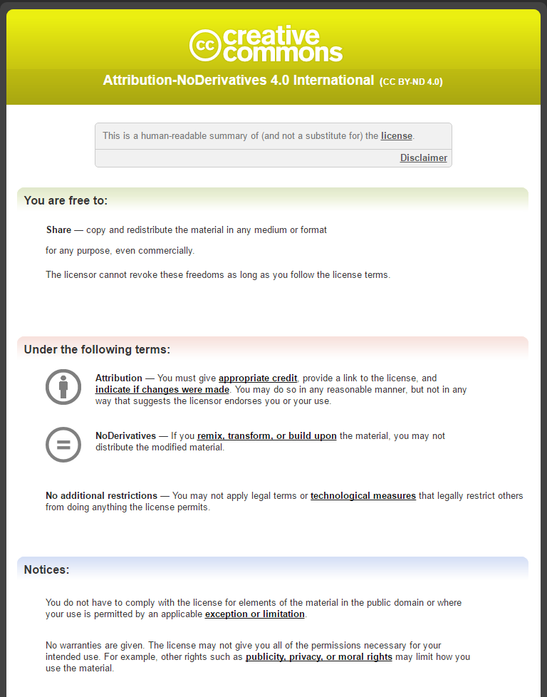

Types of Licenses: NoDerivatives
CC BY-ND
“You can’t distribute remixed works that include my materials”
Restricts reuse

Slide 14


Combining Licenses
“Mix-and-Match”
CC BY-NC-SA
CC BY-NC-ND
Most restrictive

Slide 15


No Rights Reserved
You choose to give up your rights to the work
Anyone can use the work in any way, even commercially

Slide 16
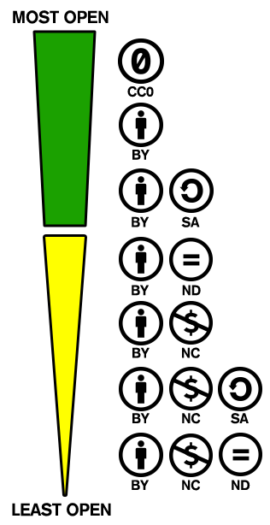
How Open Is It?
https://creativecommons.org/share-your-work/public-domain/freeworks/

Slide 17
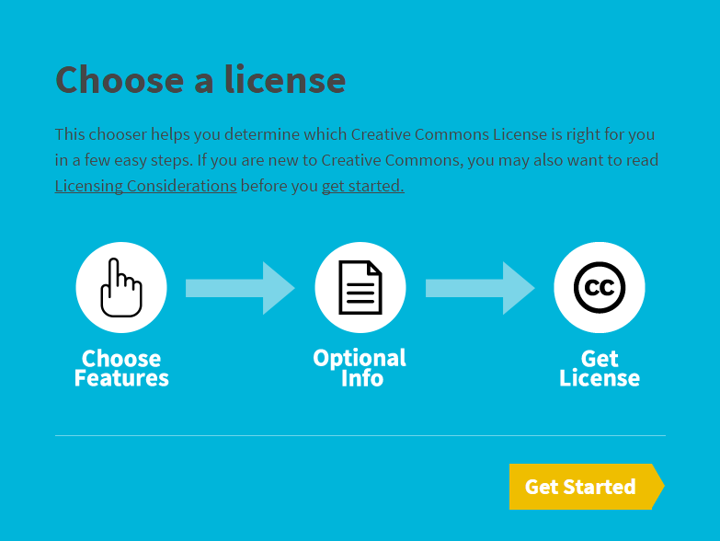
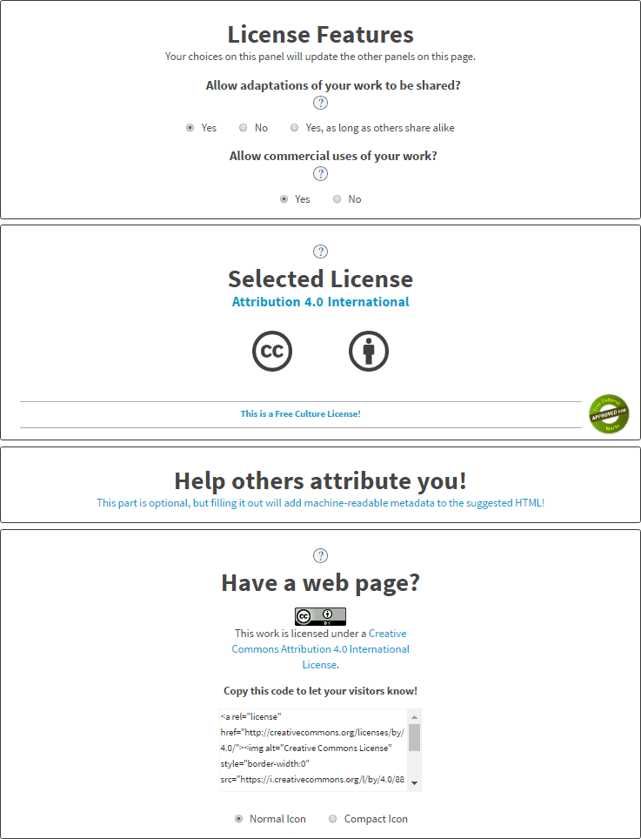
Licensing Your Content
https://creativecommons.org/share-your-work/
https://creativecommons.org/choose/

Slide 18
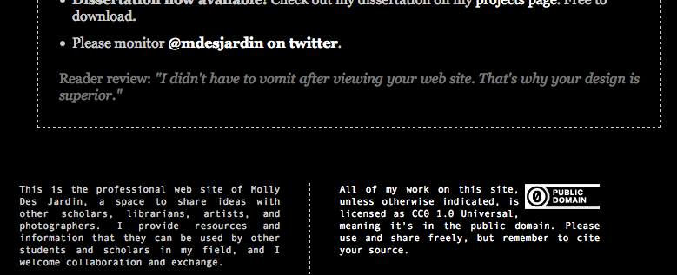
Where Can I Find CC Licensed Content?
Look for the CC symbol

Slide 19
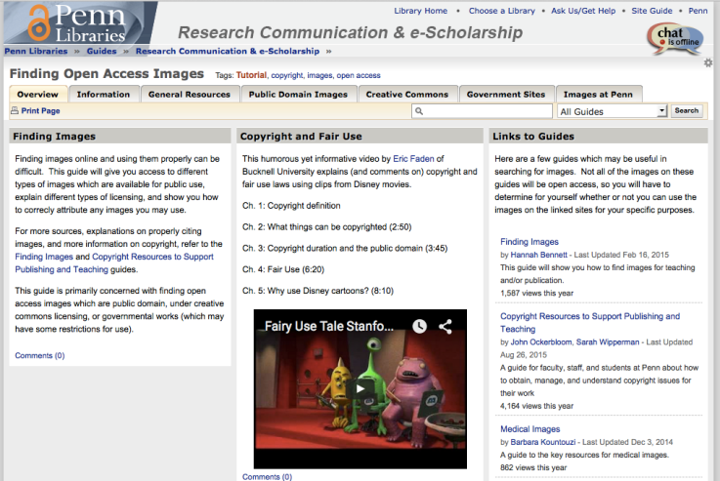
LibGuide: Finding Open Access Images
http://guides.library.upenn.edu/open_access_images

Slide 20
Questions?
swipp@upenn.edu

