Slide 1


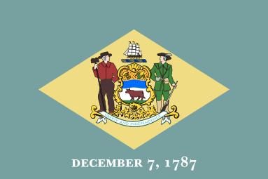
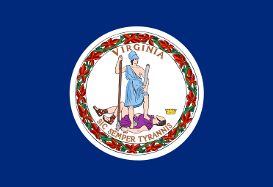
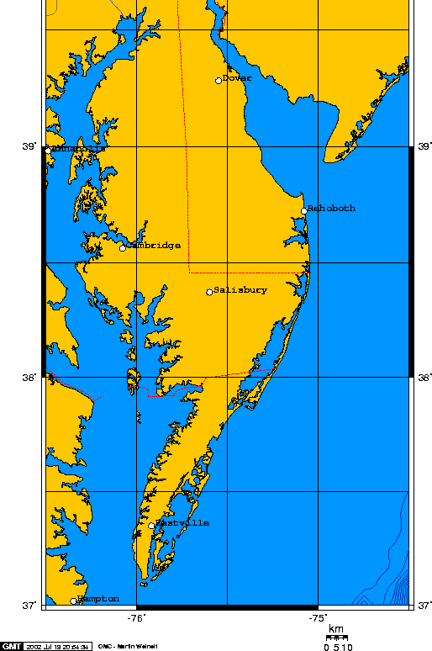
Policy Actions to Improve Economic and Environmental Outcomes of Poultry Litter Management in Delmarva
Justin Maroccia
Master of Environmental Studies 2022
Leah H. Palm-Forster, Ph.D., University of Delaware
Michael Kulik, M.S., University of Pennsylvania
Discussion
On the Delmarva Peninsula, shown in Figure 1, poultry production reigns supreme as the most dominant feature of this region’s agricultural sector. This industry generates massive economic output, but also large amounts of animal waste, called poultry litter.
Poultry litter is a valuable soil amendment, however, state policies in each Delmarva state which govern the transport, storage, and utilization of poultry litter are grossly uncoordinated. As such, This lack of policy coherence has left many willing Delmarva farmers with distinct nutrient needs without access to litter and created problems for poultry producers looking for a litter destination. There are also numerous environmental and economic impacts like excess nutrient runoff or unnecessary synthetic fertilizer purchasing.
In this study, main policy barriers are identified and analyzed, followed by the development of succinct policy recommendations, implementation methods, and obstacles to implementation.
Environmental and economic consequences of litter management status quo were evaluated alongside political realities. These foundational pieces informed the impetus for policy action, as well as the conceptual framework of Table 1.
This information assisted an identification process of the main policy barriers at play in Delmarva litter management. Additionally, conversations were conducted with numerous regional policy experts from organizations focused Chesapeake Bay health.
Recommendation development followed policy barrier identification.
Upon making recommendations, statutory and regulatory research informed implementation strategy development. These implementation methods were followed by a review of potential obstacles to their success.
The environmental and economic drivers for policy change in poultry litter management are strong, however, they are often difficult to relate to distinct policy barriers.
It is hard to identify a truly definitive forum to facilitate the type of inter-state/agency engagement needed to harmonize this landscape.
Political drivers for litter management policy change may shape the will to accept, initiate, or implement the proposed recommendations
  Ranging from bureaucratic inertia to non-Delmarva interests in keeping the status quo, obstacles to implementation are evident.
Poultry production is one of the main industries of the Delmarva agricultural sector. This industry generates massive amounts of poultry litter, a valuable nutrient resource, that could be more efficiently managed on the Delmarva Peninsula.
Uncoordinated policies among the Delmarva states regarding the transport, storage, and utilization of poultry litter have led to negative economic and environmental consequences for the Chesapeake Bay and Delmarva growers.
The identified policy recommendations, implementation strategies, and associated barriers to implementation from this study may be a valuable source of information for Delmarva state policymakers as they look for ways to keep improving the health of the agricultural sector and the Chesapeake Bay.
Figure 1: Wikimedia Commons. (2007). Delmarva. Wikimedia Creative Commons. https://commons.wikimedia.org/wiki/File:Delmarva.png
Introduction
Figure 1: Map of the Delmarva Peninsula.
Source: Wikimedia Commons
Conclusion
Table 1: Delmarva Poultry Litter Policy Conceptual Framework
Conceptual Elements | Delaware | Maryland | Virginia
Nutrient Management Regulatory Authority | Delaware Nutrient Management Commission | Maryland Department of Agriculture | Virginia Department of Conservation and Recreation
Storage Requirements | Strict | Moderately strict | Flexible
Transport Program Requirements | Flexible | Flexible | Inflexible
Delmarva Population out of Total State Population | Significant | Low | Low
Delmarva Political Representation | Significant | Low | Low
Chesapeake Bay Environmental Culture | Moderate importance | High importance | Low importance
Delmarva Ag Sector Economic Contribution | High | Moderate | Low
Methods
Works Cited

