Slide 1

The impact of ogap on elementary math teacher knowledge and student achievement
Jonathan Supovitz
Abigail Gray
Consortium for policy research in education
University of Pennsylvania
March 3, 2016
This presentation is based on work supported by the National Science Foundation under Grant No. DRK-12 1316527.

Slide 2
The OGAP study is an NSF-funded two-year RCT and implementation study of a mathematics formative assessment initiative in two Philadelphia-area school districts
Study Overview

Slide 3
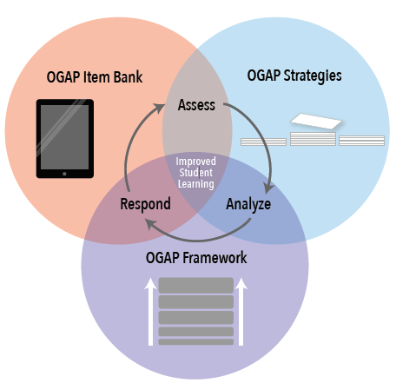
What is OGAP?
A formative assessment system
  Supplements existing curriculum
Ongoing professional development
  Multiplication and fractions
  4 days of PD on how students learn math and how to analyze student work to guide instruction
  Ongoing support through PLC meetings facilitated by trained teacher leaders

Slide 4
Formative Assessment Cycle
Assessment
Learner
Goal
Learning Progression
Teacher

Slide 5
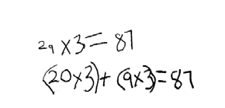
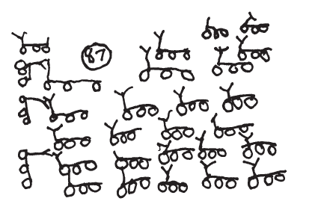
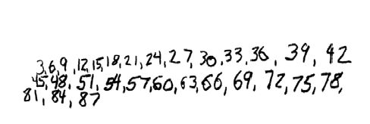
OGAP: Analysis of Student Work
One tricycle has three wheels. How many wheels do 29 tricycles have?
Multiplicative
Sam’s Response
Samir’s Response
Transitional
Additive
Ava’s Response
Non-
Multiplicative

Slide 6
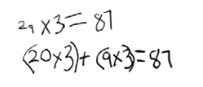

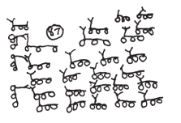
OGAP: Classification of Student Work
Samir’s Response
Multiplicative
Strategies
Ava’s Response
Transitional Strategies
Sam’s Response
Additive Strategies
Non-Multiplicative
Strategies

Slide 7
Implementation and Impact Study: Data
  Implementation Data
  Teacher Log
  Teacher Survey
  Qualitative data from fieldwork in schools
  State test data
Teacher Outcome Data
  CPRE’s Teacher Analysis of Student Knowledge (TASK)
  Mathematical Knowledge for Teaching (Ball & Hill)
  Set of Scales (trust, comfort with technology, formative assessment practice, etc.)
Student Outcome Data
  Project-developed assessment scores
  State Test Data

Slide 8
Outcome Measures for Today
Teacher Outcome
    Teacher Analysis of Student Thinking (TASK)
    Previously developed and piloted by CPRE
    Measures teachers ability to analyze student work, assess their developmental levels, and plan responsive instruction
    Seven-item open-ended assessment
Student Outcome
  OGAP Assessment
    Vertically scaled open-ended assessment developed & piloted by CPRE
    7 items, multiplicative reasoning
    Scored for both correctness and sophistication
    Pre-test: 3 items; Fall, 2014 (& Fall 2015 for incoming 3rd graders)
    Post-test: 7 items; Spring, 2015 & 2016
    ~14,000 Year 1 assessments scored by trained raters in Summer, 2015

Slide 9
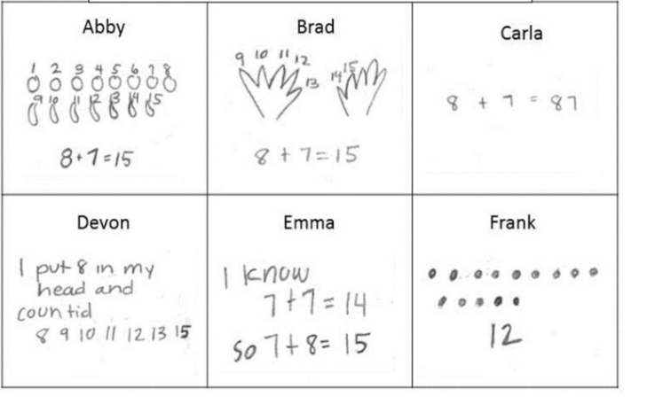
Teacher Analysis of Student Thinking (TASK)
There are 8 oranges and 7 bananas in the bowl. How many pieces of fruit are there all together in the bowl? Show your work.

Slide 10

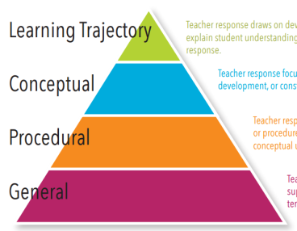
TASK Scoring
Assesses 3 Domains:
1. Analysis of Student Thinking
Teachers comment on what students’ solution strategies suggest about their understanding of numbers and operations
2. Learning Trajectory Orientation
Teachers rank student solutions based on sophistication of mathematical thinking and explain their rationales
3. Informed Instructional Decision-Making
Teachers suggest instructional next steps and explain their rationales
Rubric
Notes:
a student who has a correct, but less-sophisticated response to the problem, and a student who demonstrates conceptual weakness in the response.

Slide 11
OGAP Assessment Scoring
CORRECTNESS
0 | Incorrect answer
1 | Correct answer with no label or incorrect label
2 | Correct answer with label
SOPHISTICATION
0 | Non-multiplicative solution or no response
1 | Early additive
2 | Additive
3 | Early transitional
4 | Transitional (models)
5 | Multiplicative

Slide 12
2015 Sample: Teachers (N=603)
Treatment Control
Mean Baseline TASK Score (SD) | 2.21 (.38) | 2.18 (.37)
Mean TASK Post Score (SD) | 2.57 (.56) | 2.26 (.35)
Mean Years Teaching (SD) | 13.7 (8.3) | 13.4 (8.3)
ESL teacher | 10.6% | 10.0%
SPED teacher | 21.9% | 15.8%
3rd grade teacher | 34.2 | 36.9%
4th grade teacher | 34.8% | 35.2%
5th grade teacher | 32.8% | 29.3%

Slide 13
2015 Sample: Schools (n=60)
 | Treatment (n=30) | Control (n=30)
Total students in school Mean (SD) | 567 (221) | 594 (188)
School District of Philadelphia Schools | 18 | 19
Philadelphia Charter Schools | 7 | 6
Upper Darby Schools | 5 | 5

Slide 14
Teacher Impacts
Fixed-Effect Estimates for Model Predicting TASK Performance
 | Coefficient | SE
Intercept | 1.541*** | .225
Level 1
TASK Baseline | .423*** | .058
Treatment | .359*** | .043
Years of Experience | -.003 | .003
ELL Teacher | .018 | .074
SPED Teacher | -.008 | .056
Level 2
School Size (per 100 students) | -.001 | .000
Pct Free/Reduced Lunch | .222 | .155
Charter School | -.001 | .074
Upper Darby School | .148* | .064

Slide 15
OGAP Assessment: Pre- and Post
 | 3rd Grade (n=4,122) |  | 4th Grade (n=4,086) |  | 5th Grade (n=3,455)
 | Treatment | Control | Treatment | Control | Treatment | Control
Correctness (0-2)
Mean Baseline (SD) | .489 (.506) | .493 (.504) | .364 (.431) | .372 (.460) | .603 (.553) | .599 (.566)
Mean Post (SD) | .650 (.558) | .547 (.500) | .568 (.500) | .492 (.493) | .603 (.508) | .453 (.451)
Sophistication (1-5)
Mean Baseline (SD) | .610 (.676) | .626 (.719) | 1.10 (1.11) | 1.09 (1.11) | 1.89 (1.47) | 1.89 (1.49)
Mean Post (SD) | 1.36 (1.09) | 1.21 (1.05) | 1.95 (1.43) | 1.65 (1.37) | 2.38 (1.44) | 1.99 (1.41)

Slide 16
Posttest Score Distribution: 4th Grade
Correctness
Percent of Students
Score Range

Slide 17
Posttest Score Distribution: 4th Grade
Solution Sophistication
Percent of Students
Non-
Multiplicative
Early
Additive
Additive
Early
Transitional
Transitional
(Models)
Multiplicative

Slide 18
Student Impacts: Correctness
 | Grade 3 | Grade 4 | Grade 5
Intercept | .772*** (.173) | .561*** (.141) | .495*** (.099)
Level 1
Pre-Test | .389*** (.016) | .496**** (.016) | .433*** (.013)
Treatment | .088 (.060) | .113* (.049) | .143*** (.035)
Level 2
School Size (per 100 students) | -.010 (.015) | -.005 (.000) | .009 (.008)
Pct Free/Reduced Lunch | -.388* (.195) | -.415** (.159) | -.351** (.111)
Charter School | .003 (.077) | -.160 (.063) | -.133** (.044)
Upper Darby School | -.095 (.099) | -.130 (.081) | -.028 (.056)

Slide 19
Student Impacts: Sophistication
 | Grade 3 | Grade 4 | Grade 5
Intercept | 1.766*** (.346) | 2.028*** (.391) | 1.835*** (.273)
Level 1
Pre-Test | .542*** (.023) | .556*** (.019) | .524*** (.014)
Treatment | .066 (.121) | .350* (.176) | .376*** (.096)
Level 2
School Size (per 100 students) | -.003 (.003) | -.002 (.003) | -.001 (.002)
Pct Free/Reduced Lunch | -.885* (.390) | -1.306** (.439) | -.901** (.304)
Charter School | .102 (.156) | -.382* (.176) | -.392** (.122)
Upper Darby School | -.340 (.198) | .359 (.224) | -.068 (.153)

Slide 20
Summary
We see impacts on:
1) Teacher knowledge of formative assessment practices
2) Student outcomes on OGAP-aligned assessment
Next Steps
What are the relationships between teacher practice and student outcomes?
What are the impacts on student state test performance?
What are the influence of hypothesized moderators (amount of pd, teacher practice variables, school support and other school characteristics, MKT)
What predicts school-level variation?

Slide 21
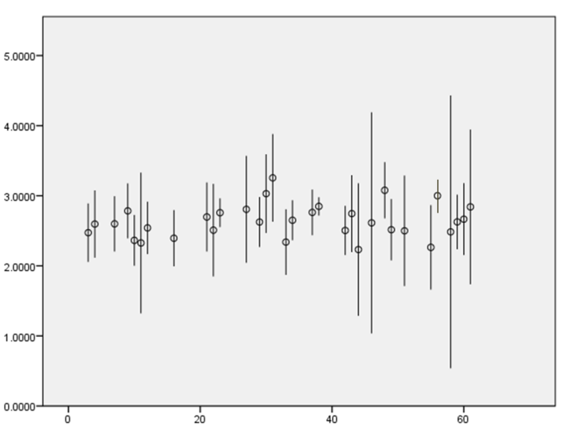
School-Level Variation on TASK
TASK SCORE
School

Slide 22
The impact of ogap on elementary math teacher knowledge and student achievement
Jonathan Supovitz
Abigail Gray
Consortium for policy research in education
University of Pennsylvania
This presentation is based on work supported by the National Science Foundation under Grant No. DRK-12 1316527.

