Slide 1
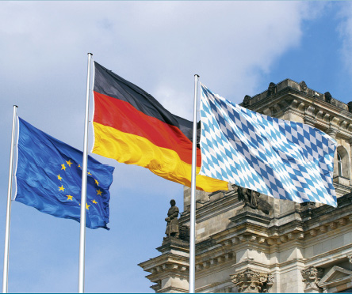

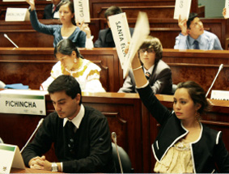


Hanns Seidel Foundation 2013
In the service of democracy, peace, and development

Slide 2
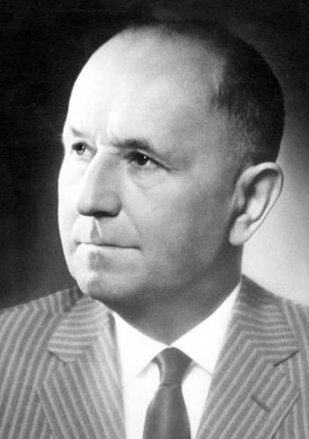
Named in honor of:
Dr. Hanns Seidel (1901-1961)
Minister-President of Bavaria (1957 – 1960)
CSU Chairman (1955 – 1961)
Establishment of the Hanns Seidel Foundation (1967)

Slide 3
The Foundation
Established 1967 as a political foundation, close to the Hanns-Seidel-Foundation
Oriented to the Christian ideal in our work
Providing political education in Germany and 60 other states worldwide
250,000 participants yearly in events around the world

Slide 4
Political Foundations in Germany
Hanns-Seidel-Foundation (CSU)
Friedrich-Ebert-Foundation (SPD)
Heinrich-Böll-Foundation (Bündnis 90/Die Grünen)
Konrad-Adenauer-Foundation (CDU)
Rosa-Luxemburg-Foundation (Die Linke)
Stiftung für die Freiheit (FDP)
The political foundations are financed in relation to their associated party’s
election results for the national parliament.

Slide 5
Hanns Seidel Foundation
The object of the association is:
to foster the democratic and civic education of the German people on the basis of Christianity
-Excerpt from the Statutes § 2

Slide 6
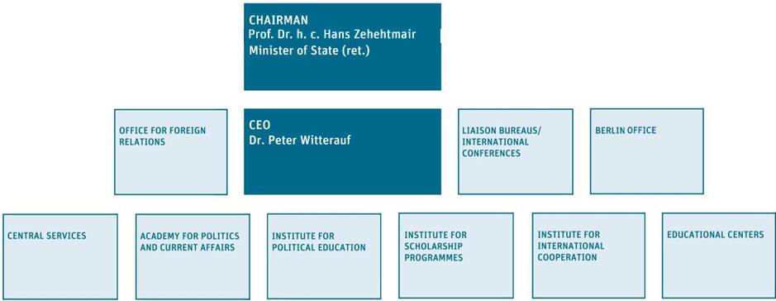
Organization

Slide 7
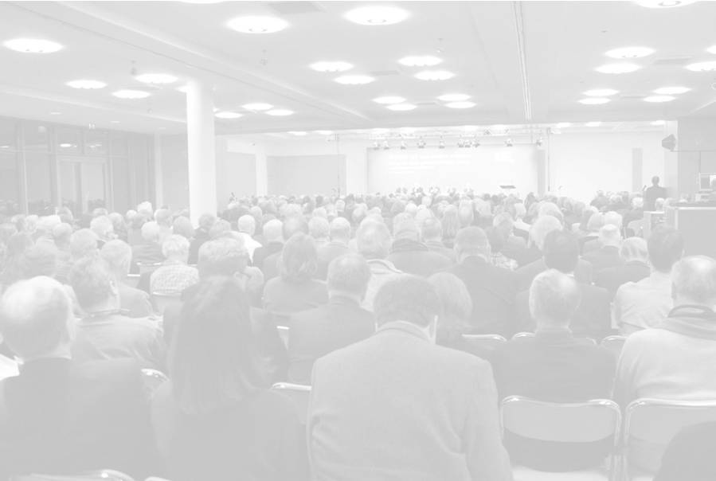
Academy for Politics and Current Affairs
Think tank for political advice
Expert meetings, symposia, and workshops on socio-political topics
104 events with ca. 7,800 participants every year
Trend analysis and identification
Development of political strategies and solutions

Slide 8

Institute for Political Education
Political Education
ca. 1,400 seminars
ca. 52,000 participants
Order the latest Seminar Program or visit: www.hss.de/veranstaltungen.html
for the current database.

Slide 9
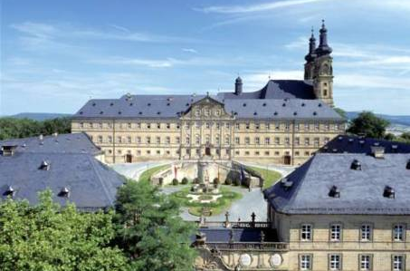
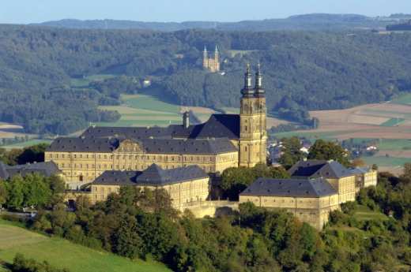
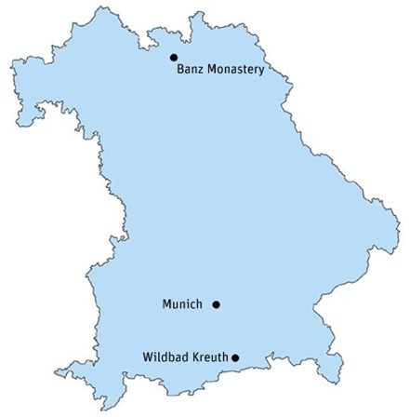
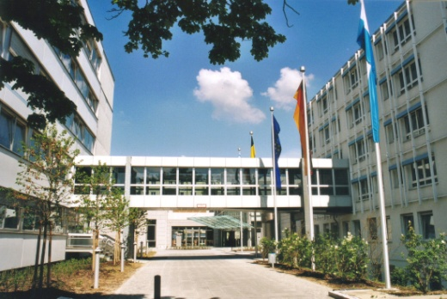
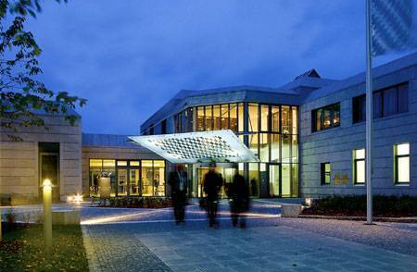
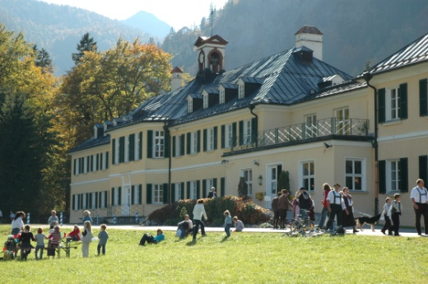
Political Education – Educational Centers
Educational Center
Banz Monastery
Additional
seminars in
Bavarian
regions
Conference Center Munich
Educational Center
Wildbad Kreuth

Slide 10
Political Education
Orientation in changing times
Articulation of normative principles and shared values
Instruction in political basics
Encouragement in citizen engagement
Focus 2013: The home country today

Slide 11
Political Education − Themes
Political management, rhetoric, public relations
Local history, values, and culture
Ethics and religion, integration
Women, young people, family, and seniors
European and foreign affairs, security policy
Energy and environmental questions, agricultural policy
Media, new technologies, consumer protection

Slide 12

Institute for Scholarship Programmes
Stipends currently for 1000 gifted and politically active students
Program | Scholarship recipients
University scholarships | 407
College scholarships (HAW) | 226
Doctoral scholarships | 189
Journalism scholarships | 76
BIL / MIG Program | 63
International study courses (IS) | 61
Study Abroad scholarships | 87

Slide 13
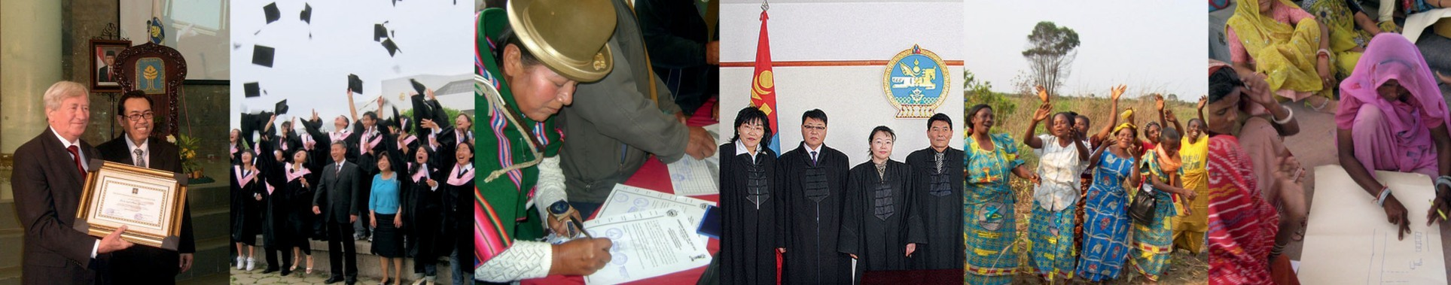
Institute for International Cooperation
103 development cooperation projects in around
70 states worldwide
4,600 seminars with ca. 190,000 participants per year

Slide 14
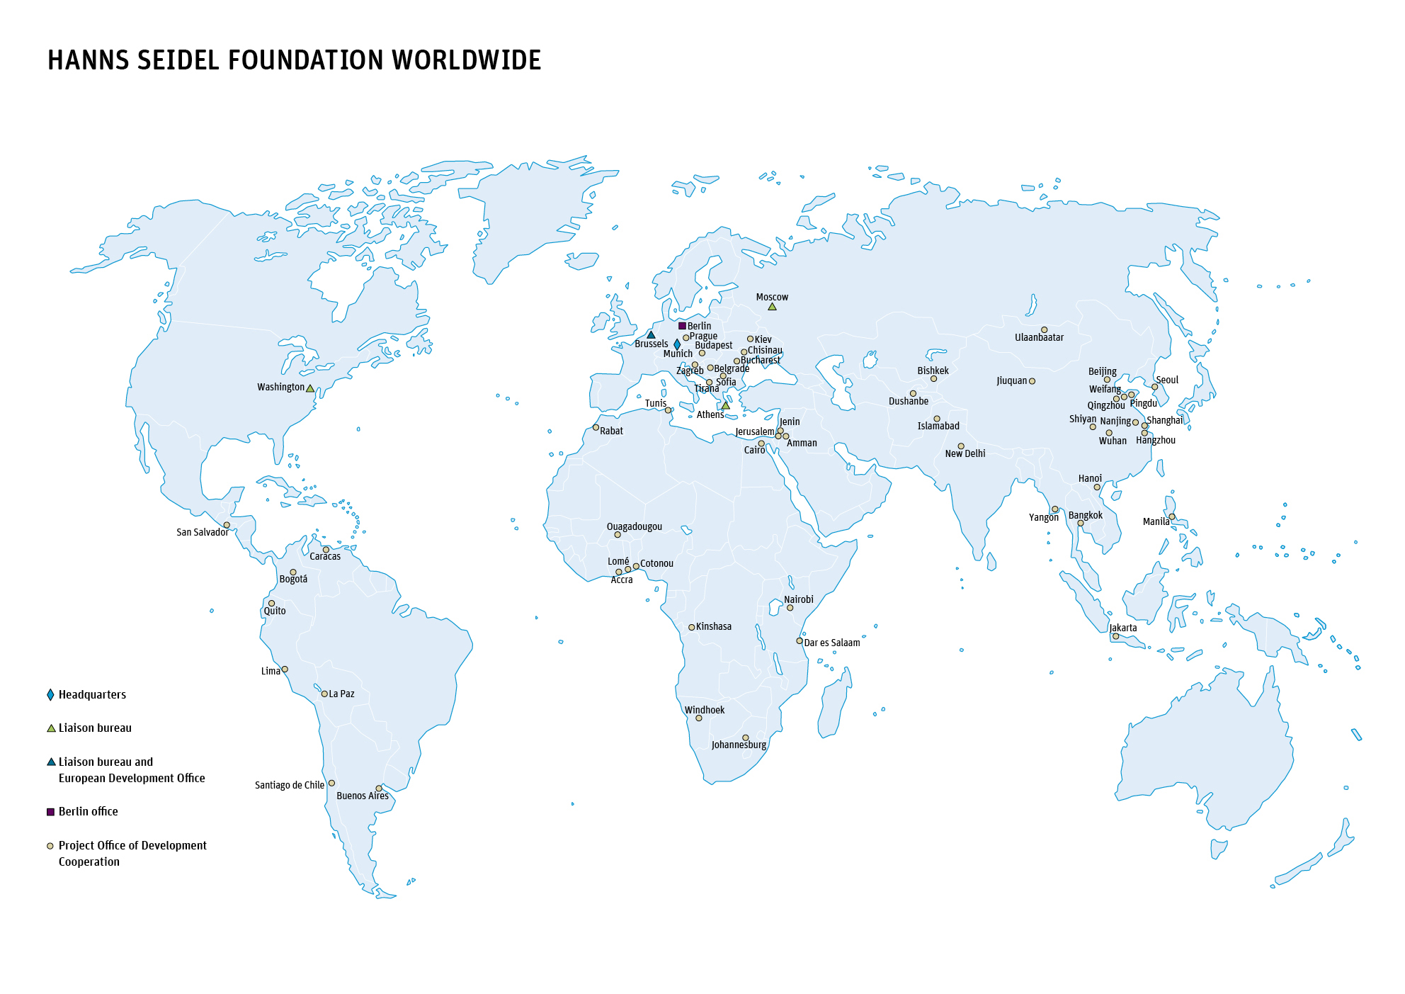
Institut für Internationale Zusammenarbeit

Slide 15
Institute for International Cooperation
Core areas:
Strengthening civil society and its organizations
Decentralisation and citizen participation
Supporting the rule of law
Advising decision makers in politics, economy, and administration
Promoting women
Job education and management training
Overcoming social and ethnic cleavages
Encouraging environmental awareness in the population

Slide 16
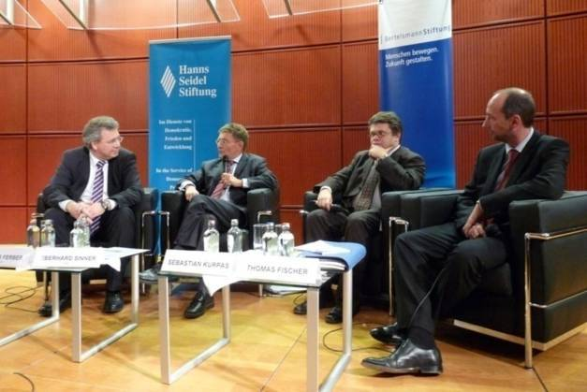
Liaison Bureaus/
International Conferences
Specialist meetings and conferences in Germany and abroad with high-ranking political contacts
Liaison bureaus located in Washington, Brussels, Athens and Moscow
80 events with more than 5,500 participants

Slide 17
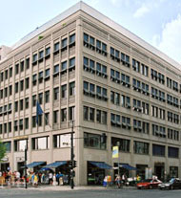
Berlin Office
Holds conferences in the federal capital as
a contribution to political discourse
Maintains contact to parliament, ministries,
and diplomacy
Receives groups of foreign visitors

Slide 18
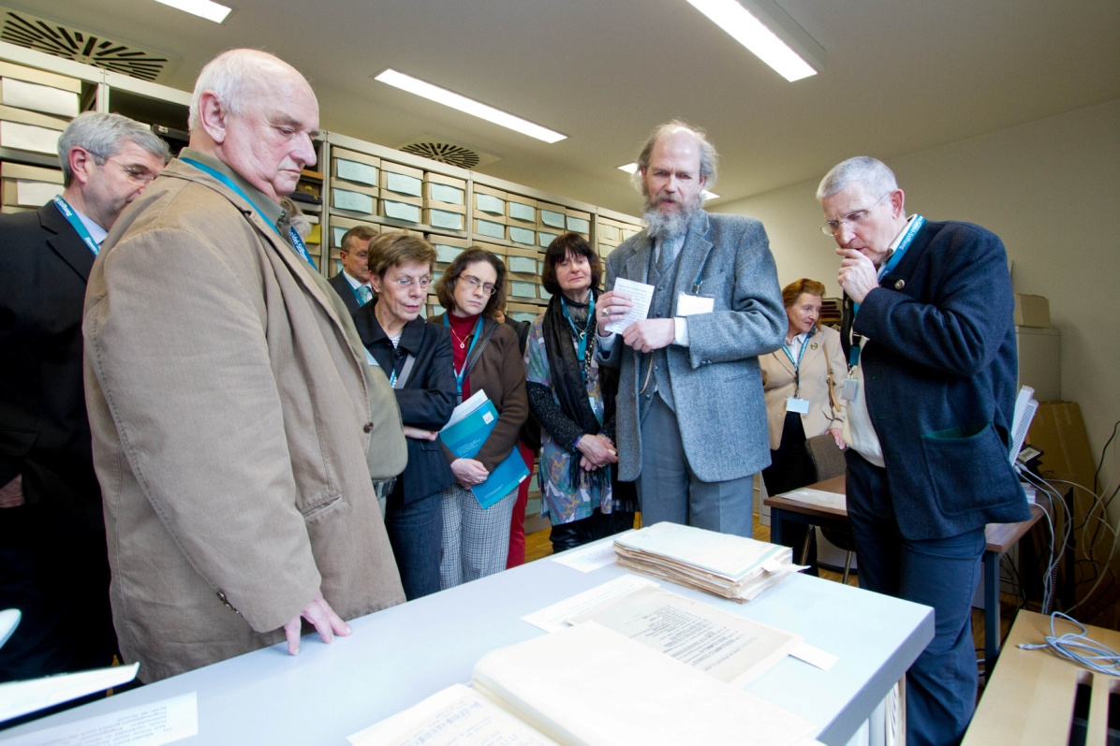
Archives for Christian-Social Politics
Central institution for the
complete archives
of the CSU and
their representatives
Comprises 4,000 metres
of shelves of files
as well as several
collections
Documentation centre
Public library for
political literature

Slide 19



Publications

Slide 20
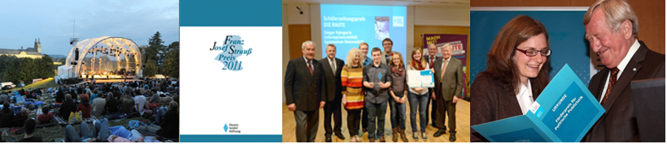
Prizes and Competitions
Franz Josef Strauß Award
School newspaper prize DIE RAUTE
Patronage Award for Young Song Poets
Patronage Award for Political Journalism
Patronage Award for Young Journalists
Patronage Award for Economic Ethics

Slide 21
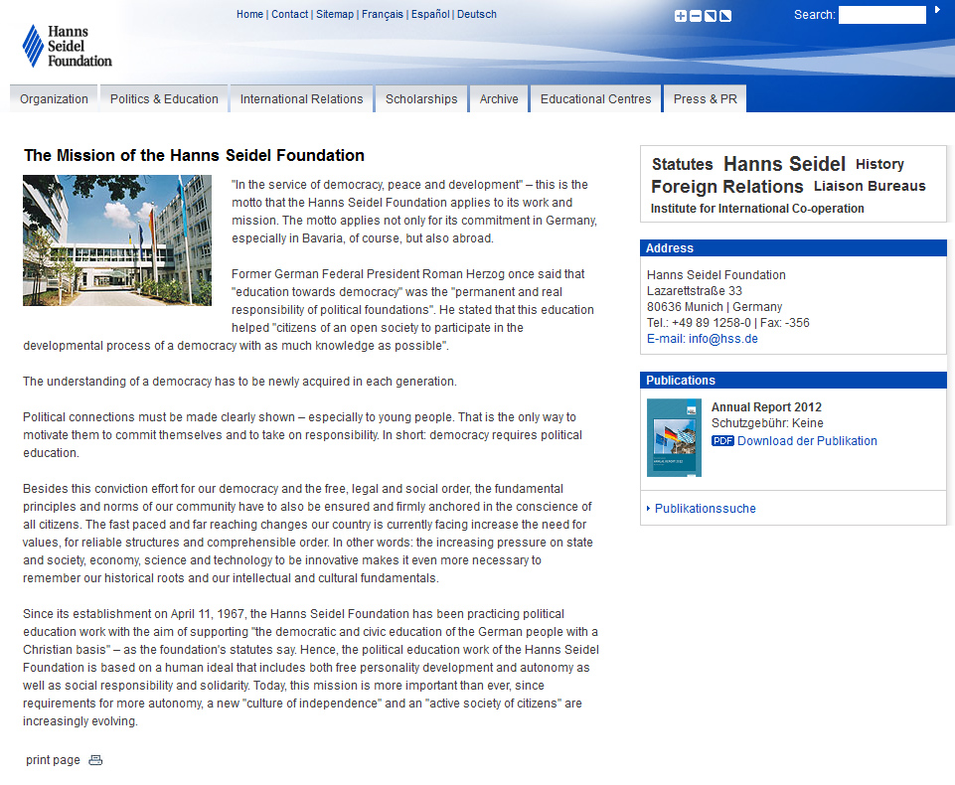
Website, www.hss.de

Slide 22
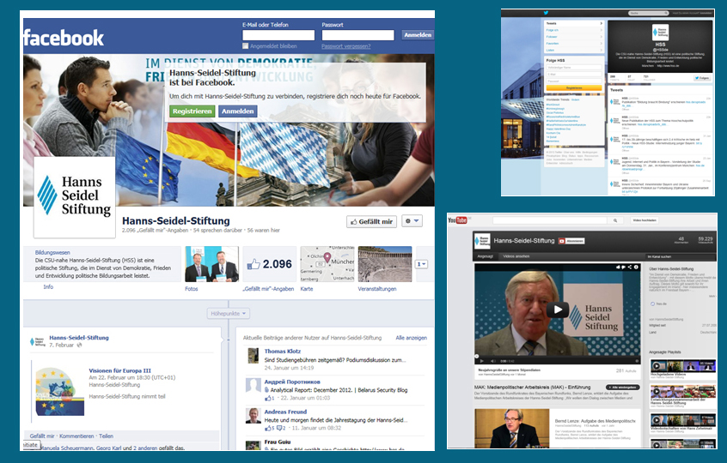
Social Media: Facebook, Twitter, YouTube

