Slide 1
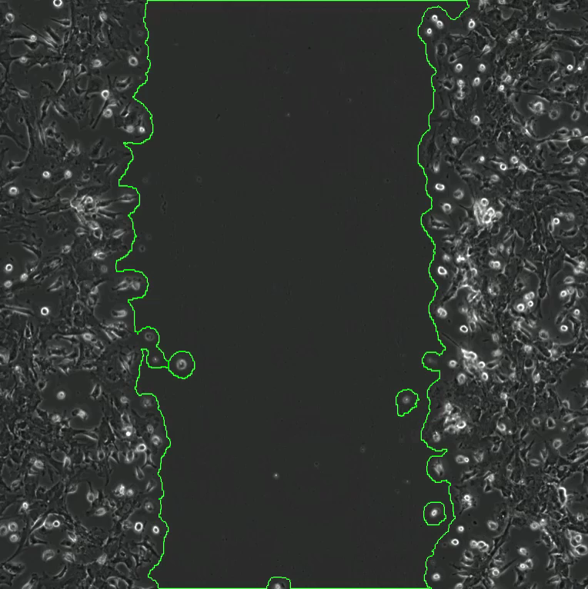
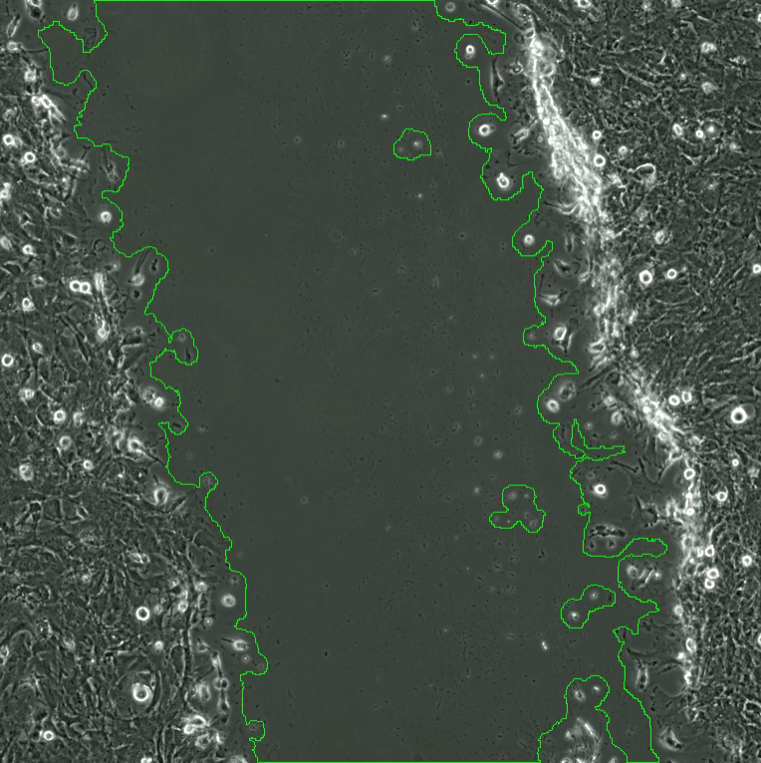

Supplemental Video 1: Live-cell imaging of scratch assays.
WT
Cn^{-/-}

