Slide 1



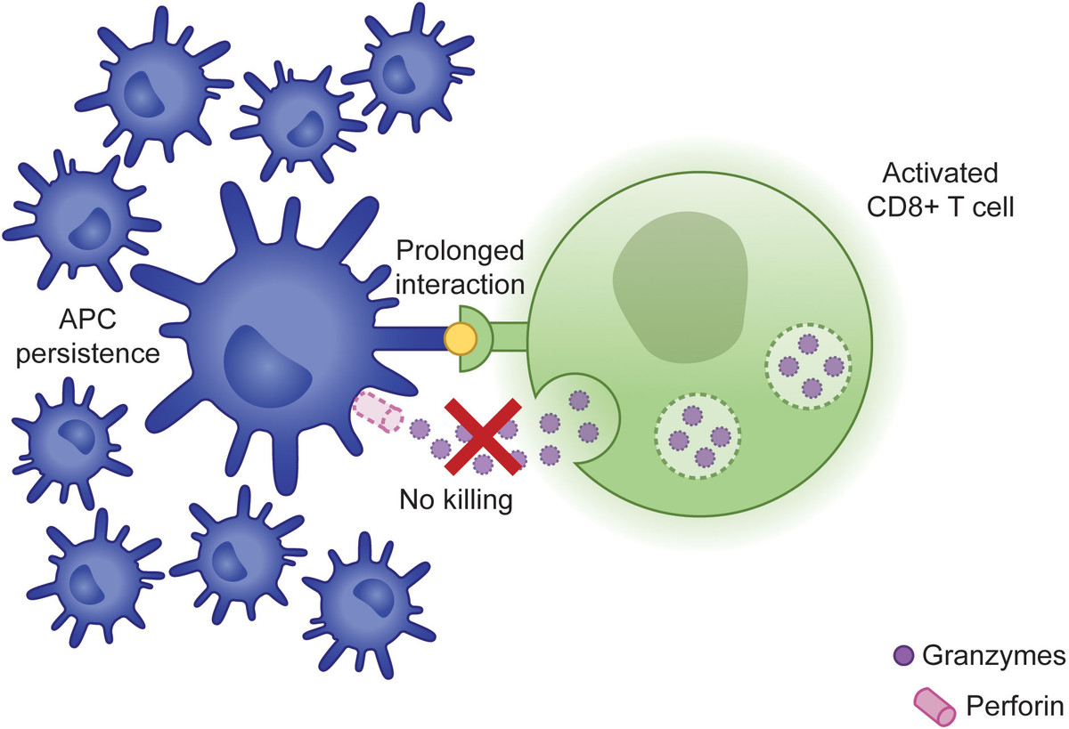
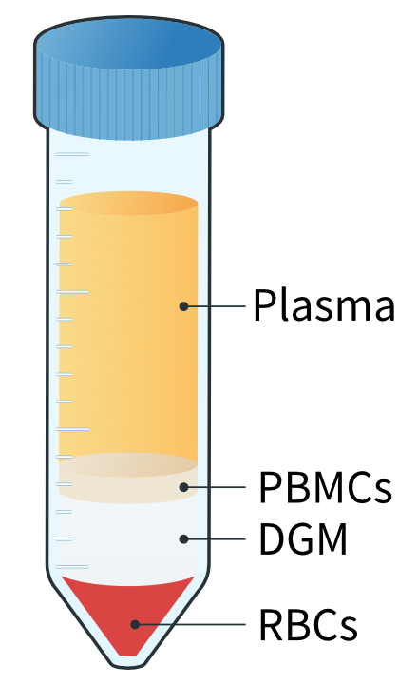
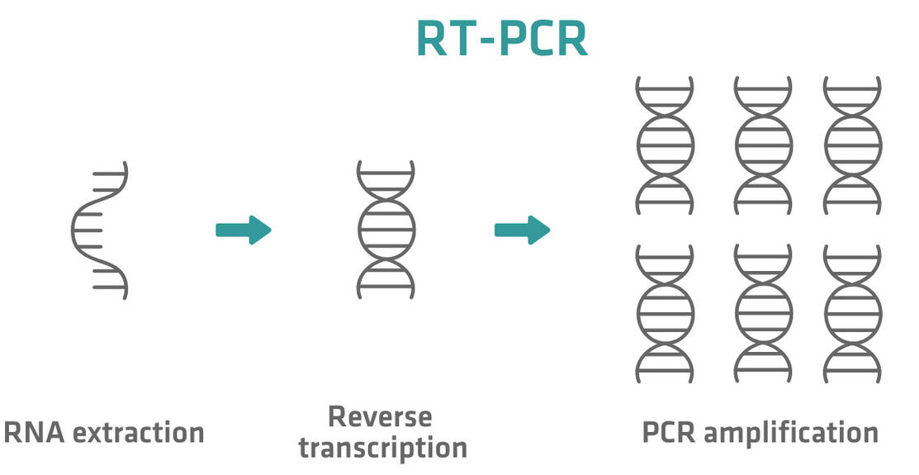
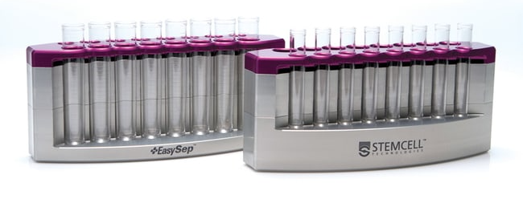
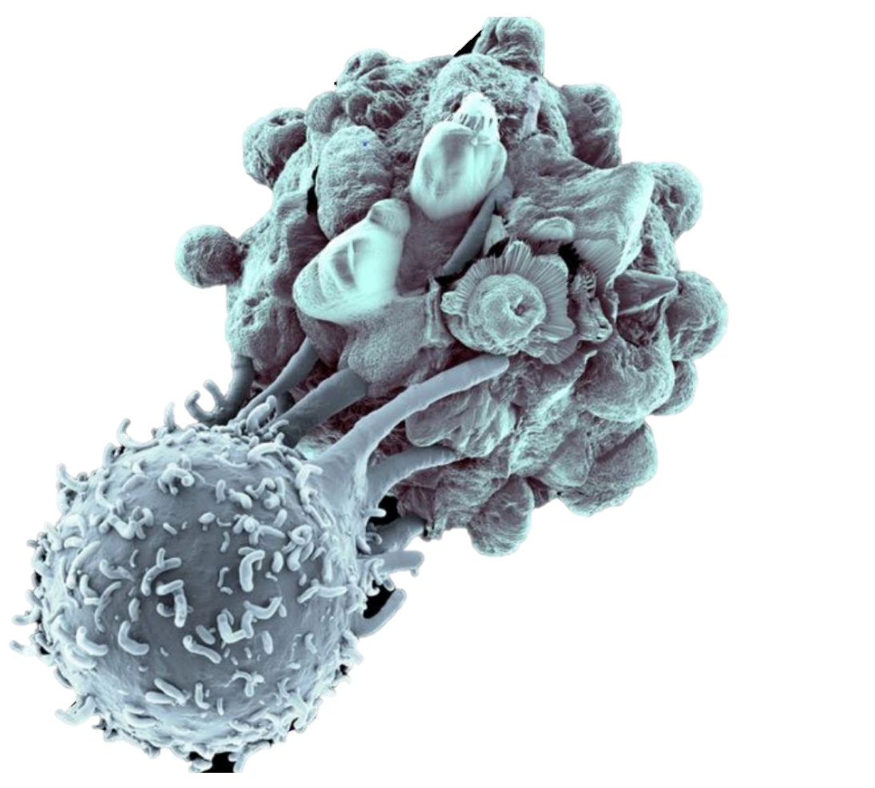
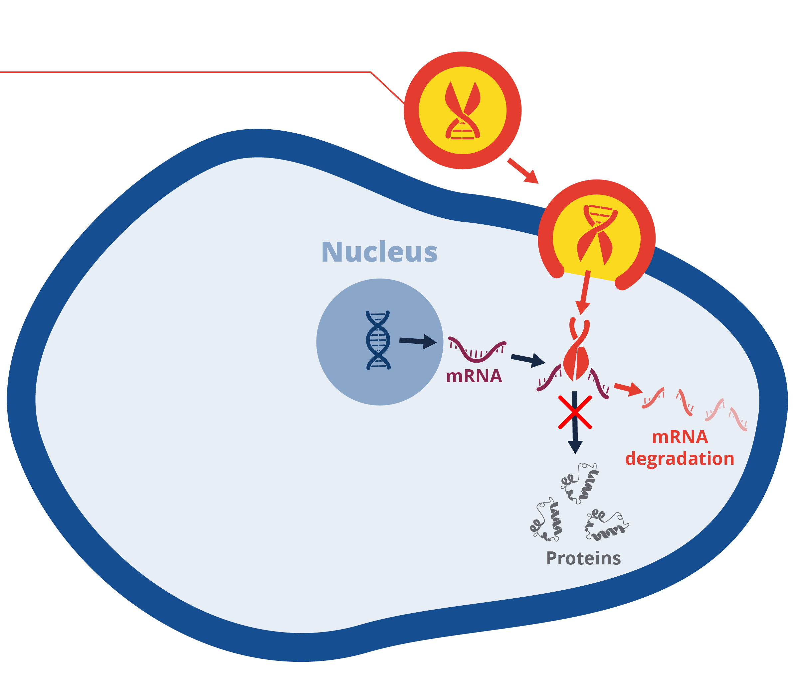
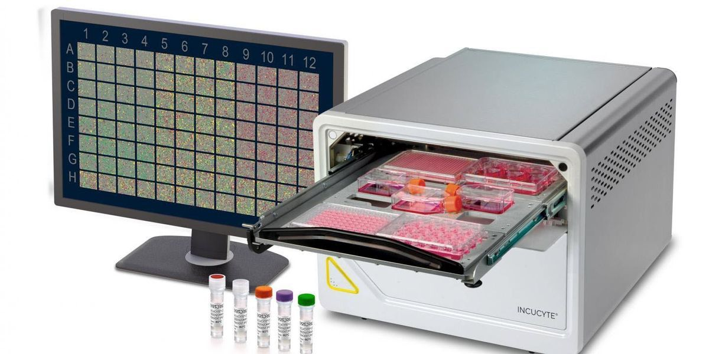
Assessing human Cytotoxic T-Lymphocyte Killing
using a CD3/CD19 Bispecific Antibody
Jonmejoy Dhar^{2,4} , Anastasia Frank-Kamenetskii¹, Leonardo Huang¹, Jeremy Morrissette³, Scott Canna^{1,3}
1.Division of Rheumatology, Department of Pediatrics, Children’s Hospital of Philadelphia, Philadelphia, PA
2. Department of Biology, University of Pennsylvania, Philadelphia, PA
3. Perelman School of Medicine, University of Pennsylvania, Philadelphia, PA
4. College of Arts and Sciences (Class of 2027)
Pediatric Rheumatology, Children’s Hospital of Philadelphia
Abstract
1. Incucyte Killing Assay showed results using unsorted PBMCs
4. CD8 T-cells lacking perforin were significantly less cytotoxic than functional CD8 T-cells
Familial Hemophagocytic Lymphohistiocytosis (HLH) is a biallelic genetic disorder that may cause disruptions in the assembly and transport of perforin-containing granules in CD8 T-Cells and NK Cells, and this lack of perforin-containing granules may result in reduced cytotoxicity and hyperinflammation. Current methods for detecting HLH in patients are poor due to the prolonged length of genetic testing and the high rate of false positives for NK Cell chromium-51 assays. Measuring cytotoxicity from CD8 T-Cells is ideal due to their prominent role in fighting infections as they occur, but the antigenic specificity of T-Cell receptors has made developing an assay difficult. Blinatumomab, a bispecific monoclonal antibody developed to combat B-Cell acute lymphoblastic leukemia (ALL), may offer a potential solution. Through its anti-CD3 and anti-CD19 portions, it can join any CD8 T-Cell with a B Cell. This triggers the CD8 T-Cell to release its granules and induce cell apoptosis while ignoring the T-Cell receptor’s antigenic specificity. Thus, we aimed to develop an assay for detecting HLH by co-culturing CD8-T-Cells obtained from their blood with B-Cells in the presence of Blinatumomab. We hypothesized that the memory T-cells from HLH patients with granule-mediated cytotoxicity mutations will have a prolonged immune synapse duration and increased production of cytokines when compared to functional memory T cells.
To develop this assay, CD8 T-cells were isolated from a blood sample and were transfected with siRNA. One portion of the cells was transfected with siRNA that silenced the expression of perforin to simulate the phenotype of an HLH patient and the other with siRNA, which did not silence the expression of any protein, to simulate the phenotype of a non-HLH patient. Through RNA extraction, cDNA amplification, and qPCR, the expression of perforin was measured for both groups. Then, these CD8 T-Cells were co-cultured with Nalm6 cells (a B Cell precursor to ALL) and Blinatumomab in a killing assay. From the results of the killing assay, we found a substantial difference in the cytotoxicity between the T-Cells with functional perforin and the T-cells that lacked perforin, which indicates promise in using Blina to detect HLH from a killing assay performed on CD8 T-Cells. For future research, the cytotoxicity of CD8 T-Cells obtained directly from the blood samples of HLH patients should also be measured in a killing assay with Nalm6 and Blinatumomab to determine if this potential assay can detect a difference in cytotoxicity for non-simulated HLH.
Figure 1: A killing assay performed on unsorted PBMCs which indicates that presence of Blinatumomab was necessary for T-Cells to kill Nalm6 Cells.
2. Negative Selection for CD8 T-Cells Resulted in 86% Purity
Before CD8 Isolation
After CD8 Isolation
CD3 - APC
CD3 - APC
Figure 4: GFP-positive Nalm6 cells were incubated in the following three conditions: Nalm6 alone, Nalm6 with “Scr” CD8 T-Cells, and Nalm6 with ”PrfKO” CD8 Cells (cell that lack Prf1 expression). Using the Incucyte SX5, GFP-positive cells were counted every 4 hours. The results of this assay indicate a significant difference between the T-cells whose perforin expression was silenced and T-Cells that had normal perforin levels
What is fHLH?
Mutation Effect
Conclusions
FHl1 Gene
FHl2 Gene
FHl3 Gene
Unknown
Perforin Deficiency
Granule Formation and Assembly
CD8 – PerCCY5.5
CD8 – PerCCY5.5
There was a significant difference in the initial cytotoxicity between CD8 T-Cells with functional and dysfunctional perforin when co-cultured with Nalm6 and Blinatumomab
This affirms the potential Blinatumomab may have in the development of a detection assay for familial HLH
Areas for future research to develop this potential assay may include conducting this assay again using CD8 T-Cells directly obtained from blood samples of HLH patients and comparing their cytotoxicity to the CD8 T-Cells obtained from the blood samples of a healthy donor
Figure 2: A flow cytometry graph to measure the percentage of CD8 T-cells after negative selection. The gating strategy employed selected for lymphocytes, live cells, and then cells that expressed both CD3 and CD8. From this, 86.2% of the cells after selection were found to be CD8 T-cells.
Methods
3. Simulating FHL2 CTLS with siRNA knockdown of perforin
1. PBMC isolation
4.
Acknowledgements
Project supported by Penn’s Center for Undergraduate Research & Fellowship (CURF) GfMUR grant, (PI-Canna) & the CHOP Research Institute. I would also especially like to thank Dr. Frank-Kamenetskii for her mentorship on this project.
2. CD8 magnetic negative selection
5. Co-culture and NALM6 quantitation using incucyte
References
T
NALM6
1. Van Der Kraak LA, Schneider C, Dang V, et al. Genetic and commensal induction of IL-18 drive
intestinal epithelial MHCII via IFNgamma. Mucosal Immunol. 2021;14(5):1100-1112.
2. Landy E, Varghese J, Dang V, Szymczak-Workman A, Kane LP, Canna SW. Complementary HLH
susceptibility factors converge on CD8 T-cell hyperactivation. Blood Adv. 2023;7(22):6949-6963.
3. Carol HA, Mayer AS, Zhang MS, et al. Hyperferritinemia Screening to Aid Identification and
Di]erentiation of Patients with Hyperinflammatory Disorders. J Clin Immunol. 2024;45(1):4.
4. Nakandakari-Higa S, Walker S, Canesso MCC, et al. Universal recording of immune cell interactions in vivo. Nature. 2024;627(8003):399-406.
5. Chiang S, Covill L, Bianca T, et al. Efficacy of T-cell assays for the diagnosis of primary defects in cytotoxic lymphocyte exocytosis. Blood. 2024;144(8): 873-887
6. Diorio C, Teachey DT, Canna SW. Cytokine Storm Syndromes in Pediatric Patients. J Allergy Clin
Immunol Pract. 2023;11(6):1636-1644.
Figure 1: Zara Puckrin. “How to isolate PBMCs from whole blood using density centrifugation” 19 October 2022 https://www.reprocell.com/blog/cls/protocol-isolating-pbmcs-whole-blood
Figure 2: StemCell Technologies. “EasyEights EasySep Magnet.” https://www.selectscience.net/product/easyeights-tm-easysep-tm-magnet
Figure 3: Polyplus. “Transfection solutions for highly reliable and effective gene silencing with siRNA and co” May 3, 2021. https://www.polyplus-sartorius.com/gene-silencing-sirna
Figure 4: Werner, Anina. “From RNA to Results: The essential guide to RT-PCR” https://www.integra-biosciences.com/global/en/blog/article/rna-results-essential-guide-rt-pcr
Figure 5: Sartorius. “Incucyte S3 Live-Cell Analysis Instrument” https://www.sartorius.com/en/products/live-cell-imaging-analysis/live-cell-analysis-instruments/s3-live-cell-analysis-instrument
3. siRNA transfection for Prf1 or Scrambled (Scr) – negative control
Figure 3: After siRNA transfection, the expression of Perforin was assessed via qPCR . The ”Scr” condition refers to scramble siRNA which does not affect any functional mRNA in the cell. The comparison was normalized against expression of housekeeping gene - 18s, a ribosomal protein expressed in all cell

