Slide 1





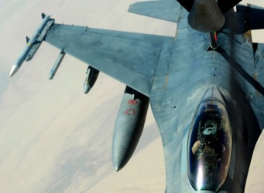


About
RAND

Slide 2



To help improve policy and decisionmaking through
research and analysis
—RAND’s mission

Slide 3
What is RAND?
An independent, nonprofit research institution
A unique collection of men and women focused on the critical issues of our time
A center for education and training in policy analysis
Not a university and not a management consultant—but with the capabilities of both

Slide 4
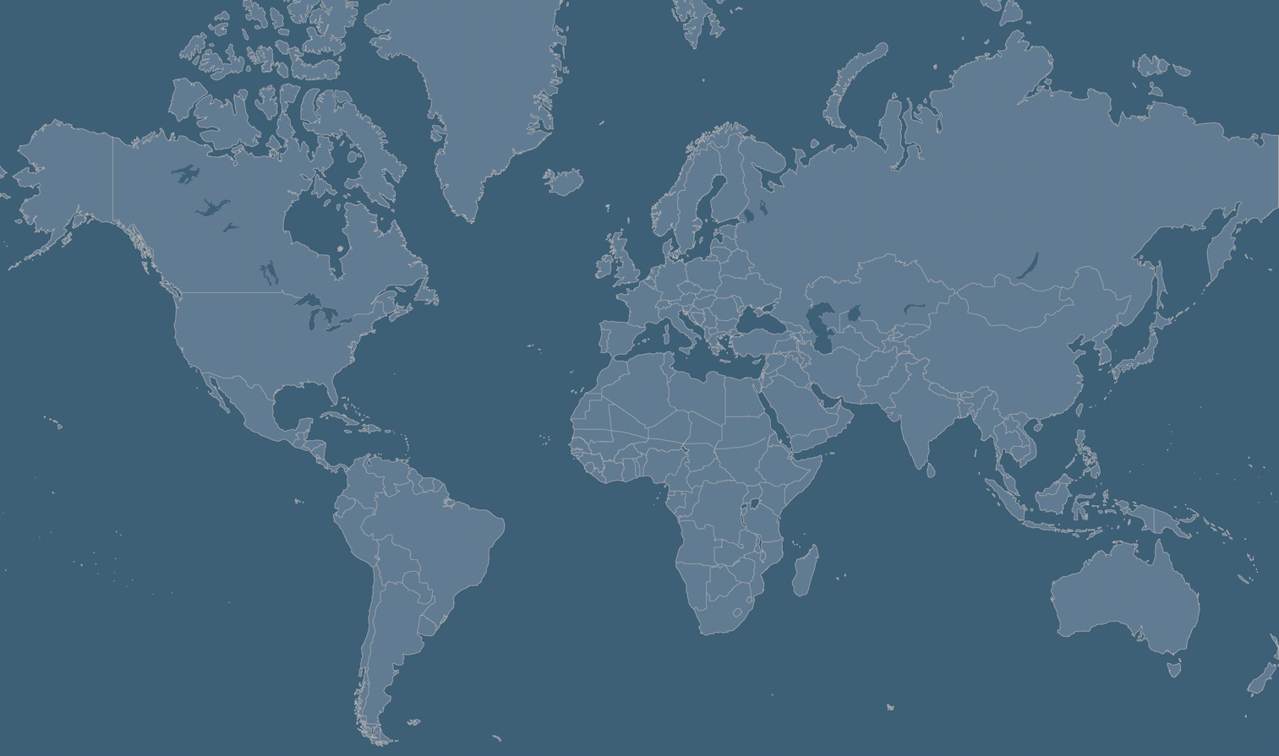
RAND’s presence is global
Cambridge
Brussels
Pittsburgh
Boston
Santa Monica
Washington DC
Jackson
New Orleans
Headquarters
Other offices

Slide 5
Clients and grantors value RAND as a trusted resource
CONSUMER FINANCIAL PROTECTION BUREAU DEPARTMENT OF COMMERCE FORD FOUNDATION DEPARTMENT OF THE AIR FORCE DEPARTMENT OF THE ARMY DEPARTMENT OF THE NAVY JOINT STAFF OFFICE OF THE SECRETARY OF DEFENSE DEFENSE ADVANCED RESEARCH PROJECTS AGENCY DEPARTMENT OF LABOR DEPARTMENT OF EDUCATION DEPARTMENT OF HEALTH AND HUMAN SERVICES CENTERS FOR MEDICARE AND MEDICAID SERVICES CENTERS FOR DISEASE CONTROL AND PREVENTION NATIONAL INSTITUTES OF HEALTH THE MACARTHUR FOUNDATION DEPARTMENT OF HOMELAND SECURITY U.S. COAST GUARD DEPARTMENT OF DEFENSE DEPARTMENT OF ENERGY DEPARTMENT OF JUSTICE DEPARTMENT OF VETERANS AFFAIRS MEDICARE PAYMENT ADVISORY COMMISSION NATIONAL AERONAUTICS AND SPACE ADMINISTRATION THE COMMONWEALTH FUND NATIONAL SCIENCE FOUNDATION UNITED STATES AGENCY FOR INTERNATIONAL DEVELOPMENT COMMONWEALTH OF AUSTRALIA EUROPEAN CENTRE FOR THE DEVELOPMENT OF VOCATIONAL TRAINING ELIZABETH DOLE FOUNDATION EUROPEAN COMMISSION DARTMOUTH COLLEGE EUROPEAN DEFENCE AGENCY IRAQ STATE OF QATAR KURDISTAN REGIONAL GOVERNMENT

Slide 6








RAND relies on philanthropic dollars to reach beyond the scope of client-sponsored work

Slide 7
Our research agenda is broad
Terrorism
and
Homeland
Security
Children
and
Families
Science
and
Technology
Education
and
the Arts
Providing practical
solutions to
complex problems
Public
Safety
Energy
and
Environment
Population
and
Aging
Health and
Health Care
National
Security
Infrastructure
and
Transportation
Law
and
Business
International
Affairs

Slide 8
RAND provides research services, systematic analysis, and innovative thinking
Terrorism
and
Homeland
Security
Children
and
Families
Primary
Data
Collection
Policy
Option Development
International Benchmarking
Implementation and Capacity Building
Modeling and Simulation
Communications
and Dissemination
Historical
Analysis
Cost
Analysis

Slide 9

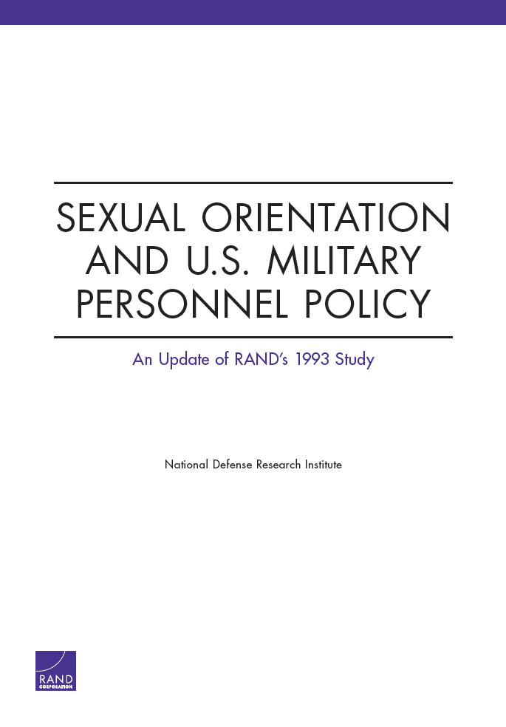


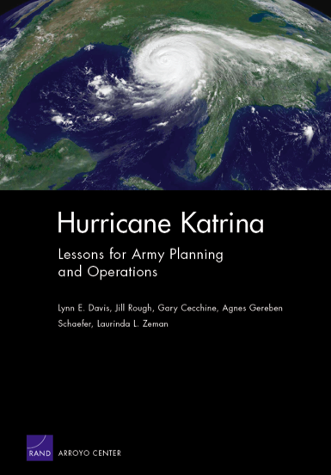
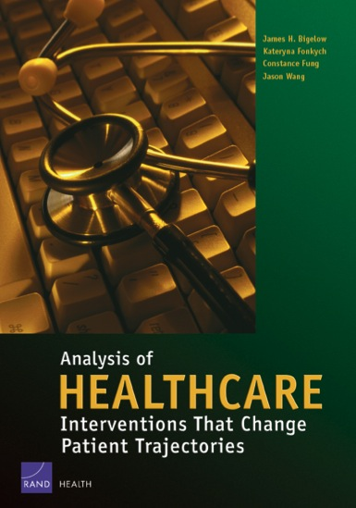
RAND research addresses critical issues

Slide 10


Flagship magazine extends RAND’s reach

Slide 11
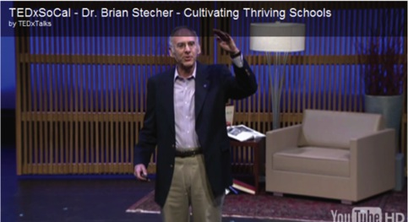
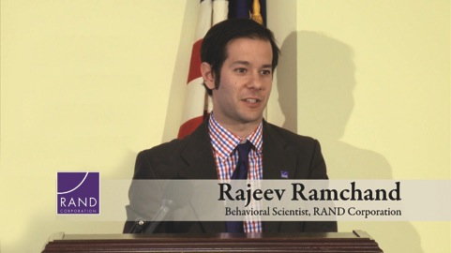
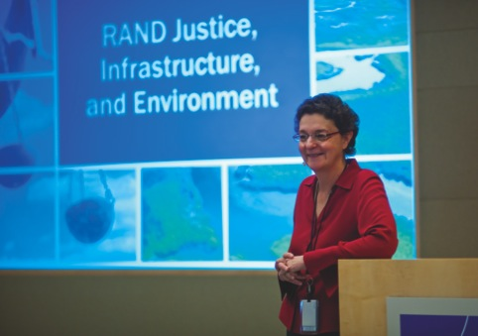
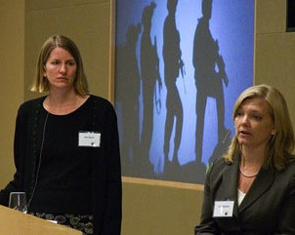
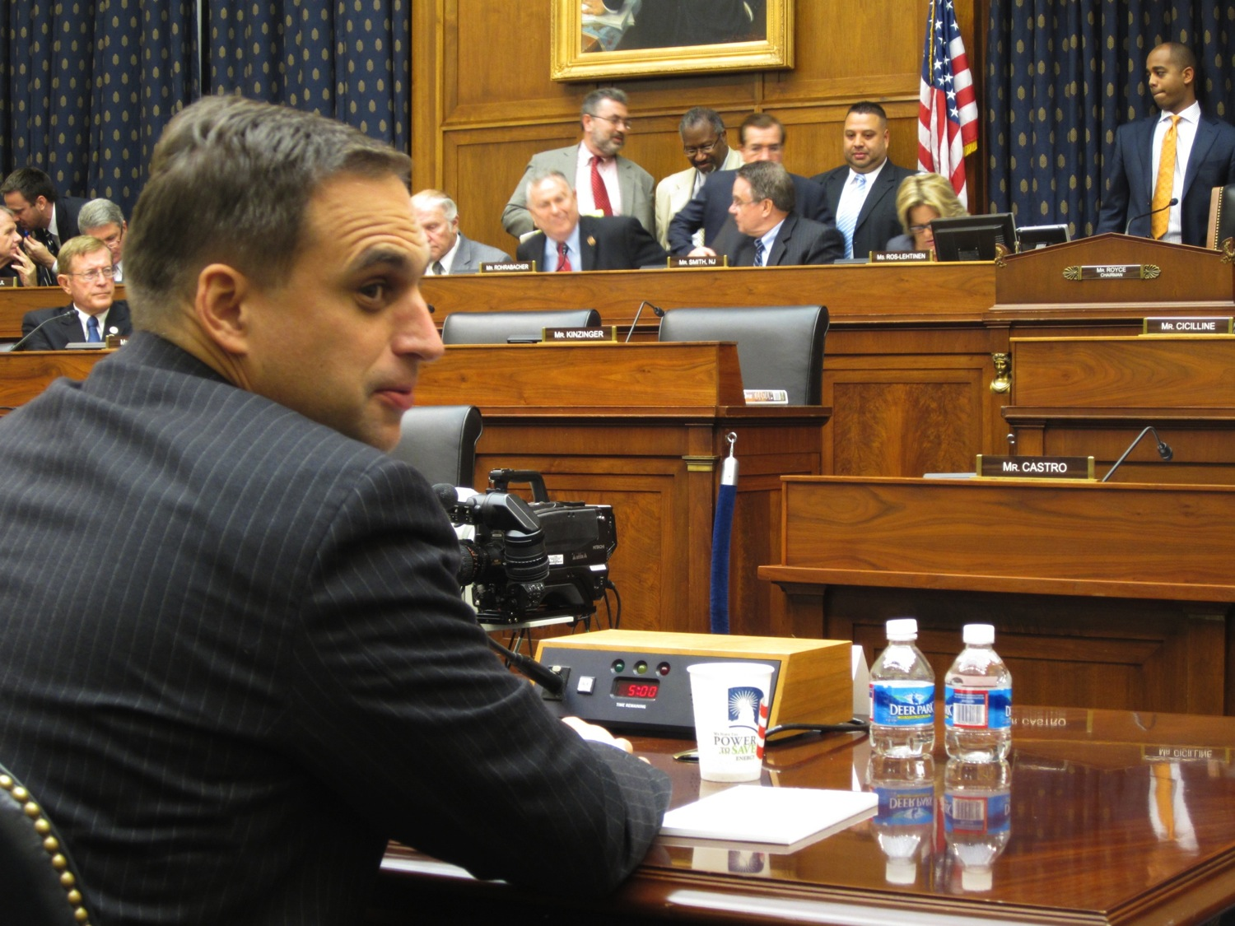
RAND reaches beyond the written page to share its work
Research presentations and discussions
Briefings and testimony for policymakers
Visitors program

Slide 12


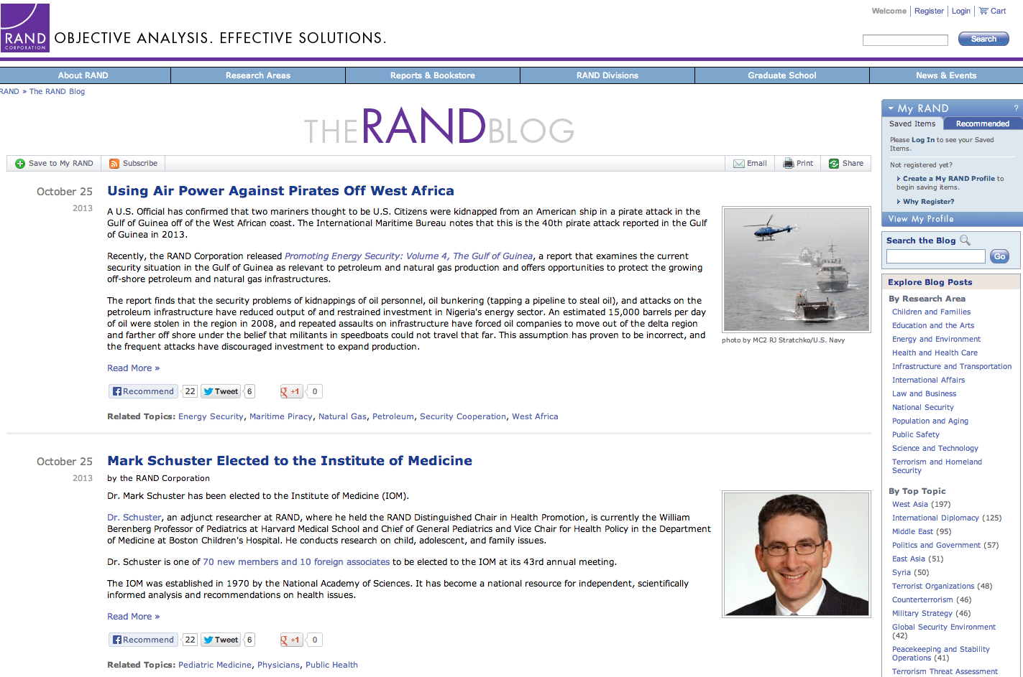






There are many ways to explore
RAND research

Slide 13
RAND’s key resource is its
~800 professional staff
Social
sciences
Arts &
letters
MD
2%
6%
Behavioral sciences
Political sciences
11%
Bachelor’s
9%
8%
Business & law
7%
6%
Policy
analysis
Computer sciences
Master’s
31%
10%
6%
Doctorate
57%
Physical
sciences
5%
14%
7%
Economics
Math, operations
research, statistics
4%
8%
7%
Life sciences
Engineering
International
relations
Supplemented by ~500 adjunct staff

Slide 14

Pardee RAND Graduate School is training the next generation of policy analysts
Produces the largest number of PhDs in policy analysis
Curriculum combines cutting-edge courses with on-the-job training at RAND
PRGS has 101 current fellows,
313 alumni
Graduates can be found in government, business, academia, and nonprofit organizations

Slide 15
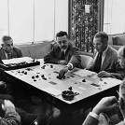
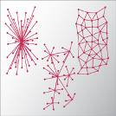

Our research has yielded enduring contributions to knowledge
Game theory
Linear and dynamic programming
Measures of health status and quality
Exploratory modeling
Digital computing
Time-shared computing (seed of email)
Packet switching (seed of Internet)
Practical use of reconnaissance satellites
"Slippery water"
Aerial refueling

Slide 16
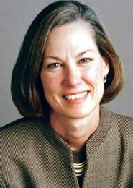
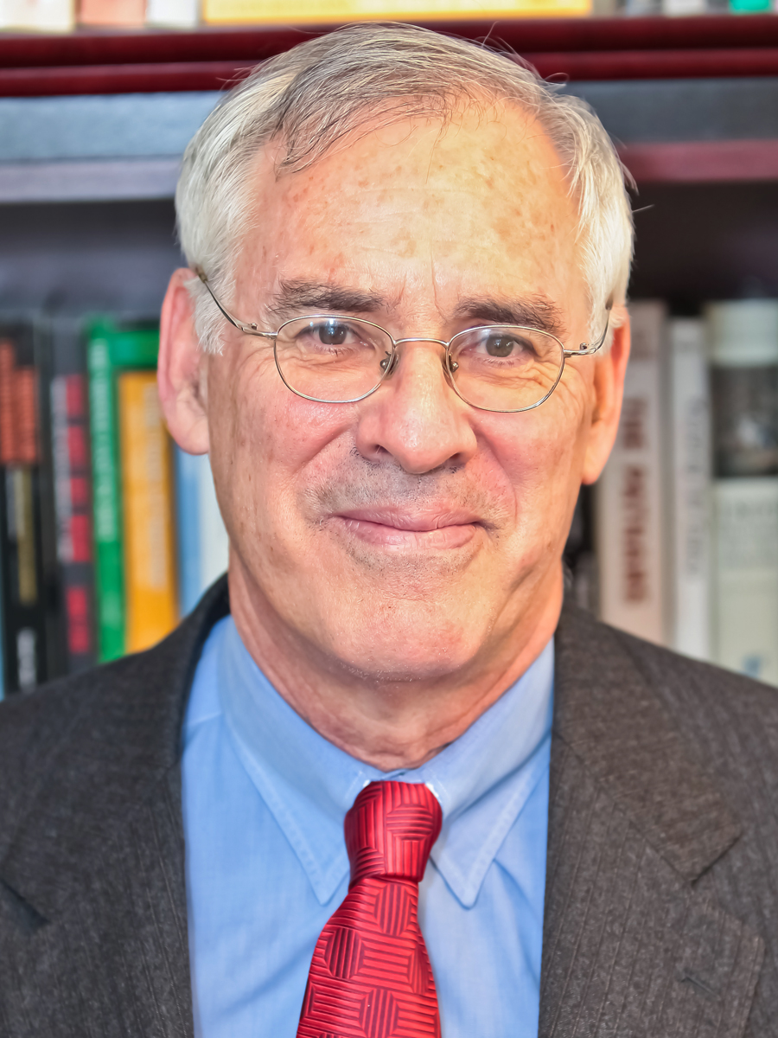
RAND Board of Trustees
Karen Elliott House
Chair
Former publisher,
The Wall Street Journal
Former senior vice president, Dow Jones
and Company, Inc.
Richard J. Danzig
Vice chair
Chairman, Center for a New American Security
Former U.S. Secretary
of the Navy
Barbara Barrett
Kenneth R. Feinberg
Francis Fukuyama
Pedro José Greer
Bonnie Hill
Ann McLaughlin Korologos
Philip Lader
Michael E. Leiter
Peter Lowy
James M. Loy
Michael Lynton
Ronald L. Olson
Mary E. Peters
Donald B. Rice
Michael D. Rich
David K. Richards
Hector Ruiz
Leonard D. Schaeffer
Harold Brown
(Emeritus)
Frank C. Carlucci
(Emeritus)

