Slide 1
Audiovisual Data Curation
Primer by Madina Grace, Lauren Phegley, Meg Valade

Slide 2

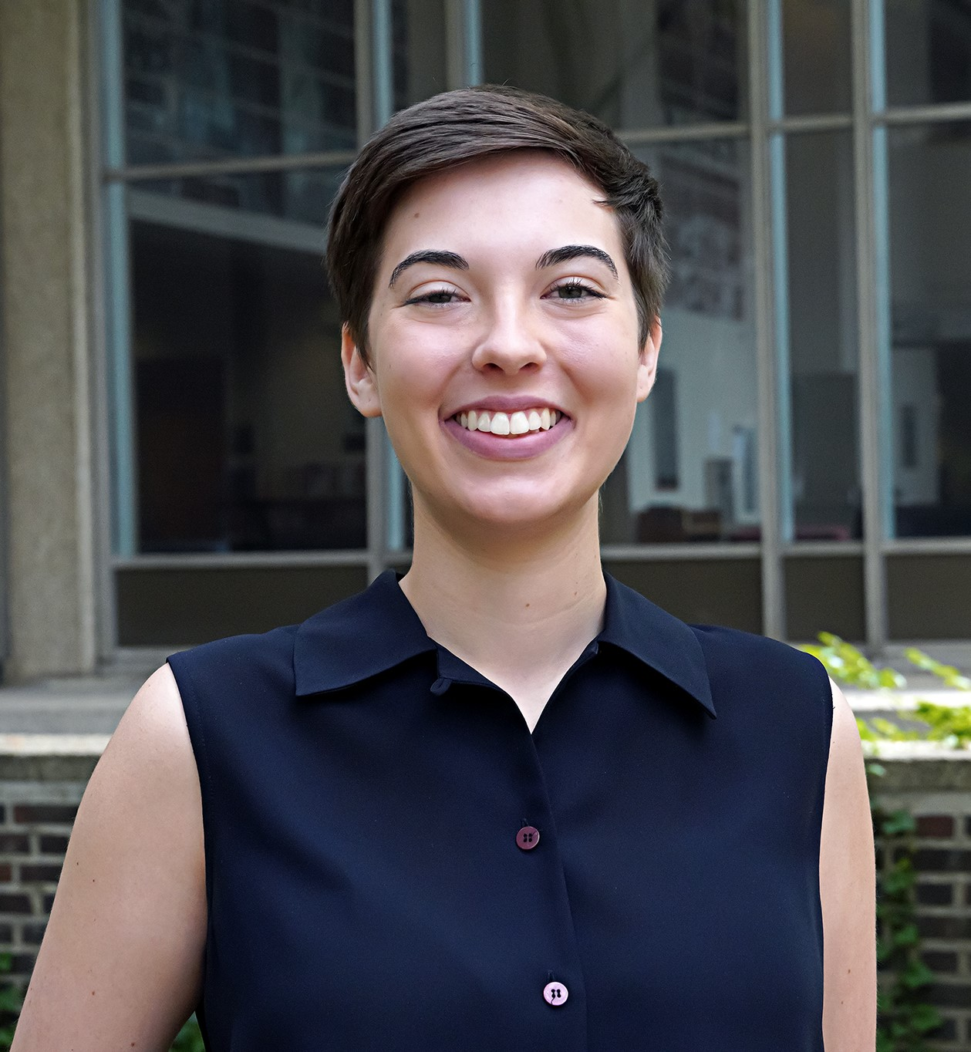
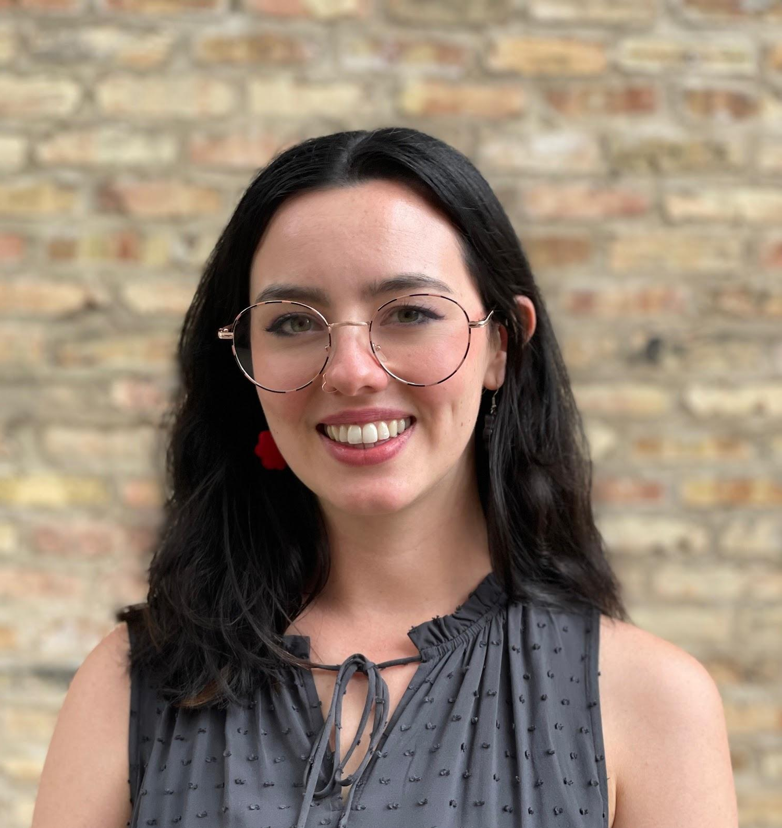
Our Team
Madina Grace
Repository Services Analyst
Duke University
Lauren Phegley
Research Data Engineer
University of Pennsylvania
Meg Valade
Data Project Assistant
ICPSR at the University of Michigan

Slide 3
Audiovisual Primer
Audiovisual data includes a video payload that includes components of audio, captions, time code, etc.
Primer focuses on areas we found as the largest challenges for AV data
Scope: previously digitized or born digital materials

Slide 4
CURATE(D) Steps
Step | Tasks for Audiovisual Data Curation
Check files and read documentation | Review if your repository is able to handle the type/volume/required preservation level of the data Check to see if files open
Understand the data | Check to see if audiovisual materials have obvious technical issues Review the video payload information to check formats, codecs, etc. Determine if there are ethical issues that need to be addressed
Request missing information or changes | Are the changes that need completion within the abilities of the depositor?
Augment metadata for findability | Appropriately describe content of the video, such as with keywords Link to existing publications, project information, and other datasets
Transform file formats for reuse | Transform into a well-established open access file format. If you compress the file, use lossless compression. Retain original format file
Evaluate for FAIRness | Review your actions thus far to see how you can improve the dataset’s FAIRness
Document all curation activities throughout the process | Record actions from metadata changes to depositor communications in your Curators Log
Notes:
We have created an audiovisual format specific CURATE(D) checklist that can be used by curators who are reviewing audiovisual formats. One task that I will point out in the Understand step is the “Review the video payload information to check formats, codecs, etc.” This is not unique to what curators do with other file formats, but the software and method of checking the files will be very different than many may be used to.

Slide 5
Highlights of Primer

Slide 6

Ethical Issues - Human Participants
Human participants are common in video data, especially when dealing with the social sciences
Level of reuse availability: restricted, public-use, combination

Slide 7
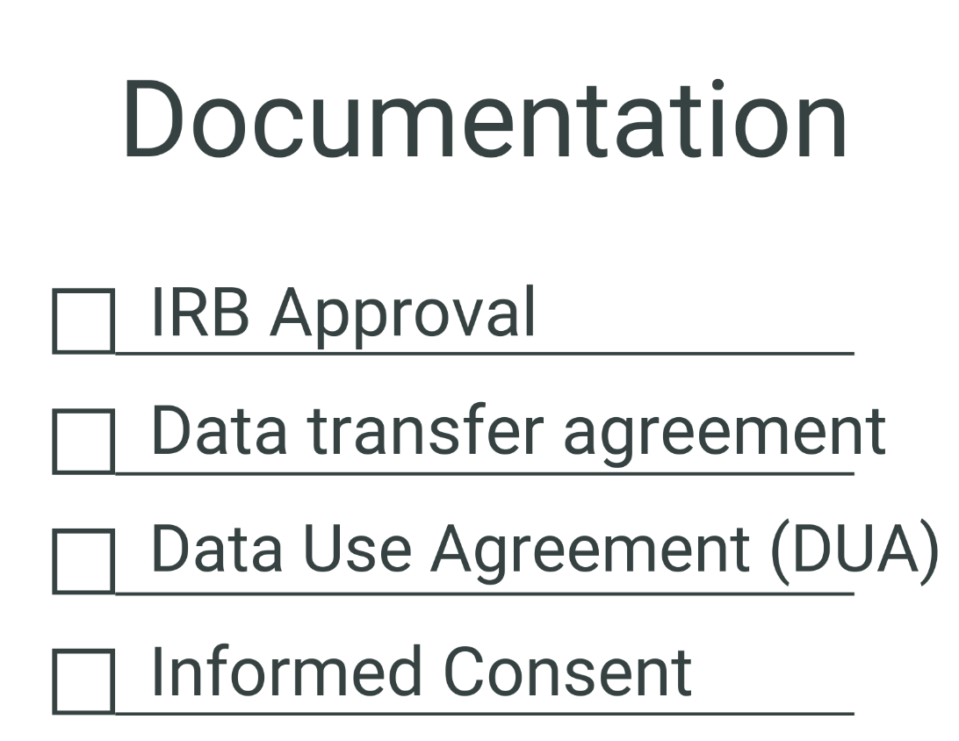
Ethical Issues - What to consider
Questions to ask yourself
How will the data be utilized? Will different types of DUAs be needed for different use types?
What kinds of data has the researcher been given permission to share and at what level (e.g., transcript-only, audio-only files, audio-video files; at a public or restricted level)?

Slide 8

Technical concerns
Staff expertise
Software
Storage space
Questions to ask:
Is there sufficient storage in your network?
Is there a way to transfer files from a depositor?
What level of curation is needed?

Slide 9
Documentation
Submitted by a depositor:
README file
Human Subjects Documentation (blank informed consent, etc.)
Internal documentation:
Data Use Agreements (DUA) for any human subject audiovisual data provided by a depositor.
Curation log documenting any edits and additions
User agreements for any legal access requirements
Manifests
Any preservation documents, e.g. checksum logs

Slide 10

Special considerations
Communication with a depositor
Staffing requirements
Preservation actions

Slide 11
References:
Darragh, J., Hofelich Mohr, A., Hunt, S., Woodbrook, R., Fearon, D., Moore, J., & Hadley, H. (2020, October 6). Human Participants Data Essentials Data Curation Primer. GitHub. https://github.com/DataCurationNetwork/data-primers/blob/master/Human%20Participants%20Data%20Essentials%20Data%20Curation%20Primer/human-participants-data-essentials-data-curation-primer.md
Grace, Madina; Jerrild, Meg; Phegley, Lauren. (2023). Audiovisual Data Curation Primer. Data Curation Network. GitHub. https://github.com/mikalaraethelib/data-primers/blob/master/Audiovisual%20Data%20Curation%20Primer/AV-data-curation-primer.md
Pryse, J. A., Harp, M., Mannheimer, S., Marsolek, W., & Cowles, W. (2022, December 2). Oral History Interview Data Curation Primer. GitHub. https://github.com/DataCurationNetwork/data-primers/blob/c6ec438e76fea49eaaf2806bc79ec2c8c12de7f3/Oral%20History%20Interviews%20Data%20Curation%20Primer/oral-history-interviews-data-curation-primer.md (Original work published 2018)

Slide 12
Thank you!
Contact us:
Meg Valade - mjerrild@umich.edu
Madina Grace - madina.grace@duke.edu
Lauren Phegley - lphegley@upenn.edu

