Slide 1
Creative Commons:
The License to
Share Knowledge
Sarah Wipperman and Katie Rawson
October 20, 2015

Slide 2
Copyright and Representation
I have an idea… (it has no legal protection)
But then I write it down or draw a picture or turn it into a song… (now my expression has legal protection – just by expressing in a durable form!)
My expression cannot be copied without my consent! (*except in cases of fair use)

Slide 3
Rights and Restrictions
Copyright is a collection of rights that you hold, whether you want to or not, when you create something.
They protect reproduction, distribution, and reuse. While they protect your work, they also restrict use of your work.
Notes:
But what if I want people to use and reuse it? How will they get my consent? If it is super-awesome, how will I keep up with all the requests to use it?
What if it is just what Another Person needs to use for their collection of expressions? What do they do?

Slide 4
A License
When people get permission to use copyrighted material – from the copyright holder for free or for a fee – that permission comes in the form of a license. These licenses are agreements between the copyright holder and the user about what they can do with the material.
Creative Commons licenses allow creators to give everyone a license and allow users to know exactly what they can and cannot do with the work!
Notes:
This is where Creative Commons Licenses are helpful.

Slide 5
Creative Commons Licenses
Public
License particular forms of use
Three Layers:
  Legal Code - Effective
  Human Readable - Understandable
  Machine Readable – Findable

Slide 6
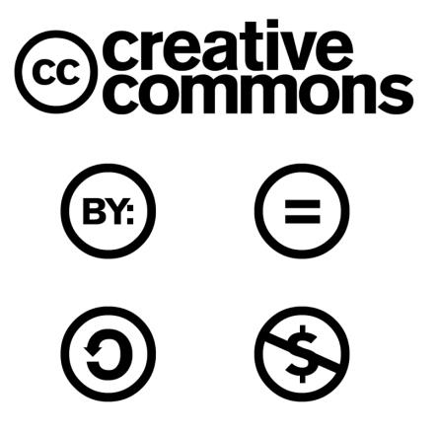
Elements of CC Licenses
By – Attribution
SA – Share Alike
ND – Non-derivative
NC – Non-commercial
CC-0
https://creativecommons.org/licenses/
Notes:
By – Attribution - SA – Share Alike - ND – No Deririv s- NC – NonCommercial - CC-0

Slide 7

CC By - Attribution
Say who it is by
Copyright and Academic Integrity are not the same thing!

Slide 8

CC ND – Non-Derivative
Leave it unchanged, distribute it whole
(Also, say who it is by)

Slide 9

CC SA – Share Alike
Do what you will – but if you make something with it, you have to also CC license it! (and say who it is by)

Slide 10

CC NC – Non-Commercial
Do what you will, but don’t sell it!

Slide 11


CC Mix-and-Match

Slide 12


CC 0 – No rights reserved
https://wiki.creativecommons.org/CC0_FAQ

Slide 13
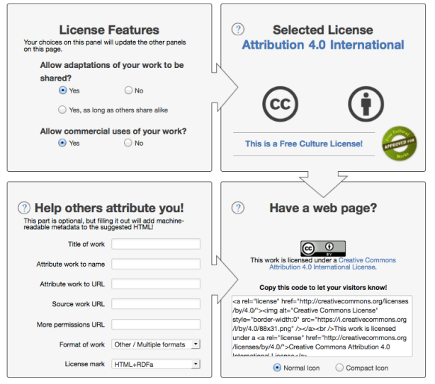
Adding a CC License
https://creativecommons.org/choose/#

Slide 14
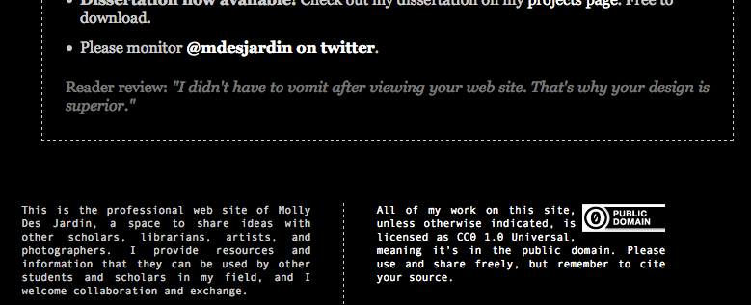
Finding CC Material
Looking for the CC symbol

Slide 15
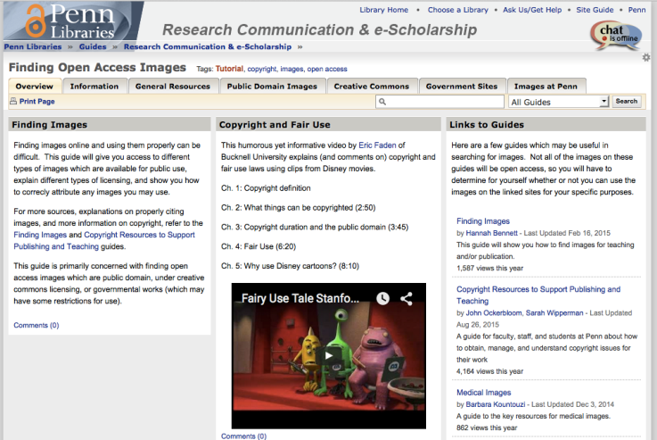
LibGuide: Finding Open Access Images
guides.library.upenn.edu/open_access_images

Slide 16
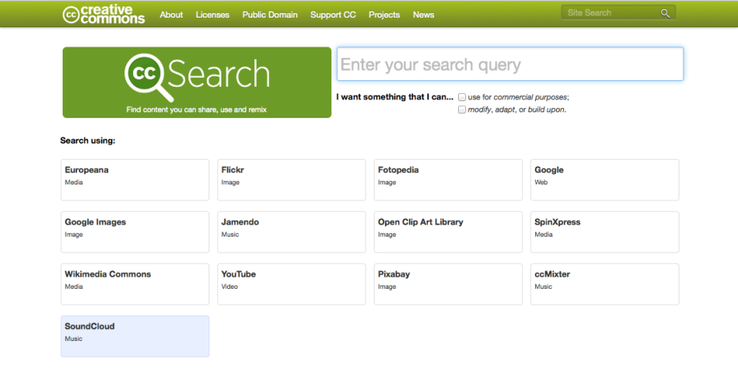
Creative Commons
http://search.creativecommons.org/

Slide 17
On CC Commons, you can search:
Media:
Europeana
Wikimedia Commons
Google
Video:
YouTube
Images:
Google Images
Flickr
Fotopedia
Open Clip Art Library
Pixabay
Music:
Spin Express
SoundCloud
Jamendo
ccMixter

Slide 18
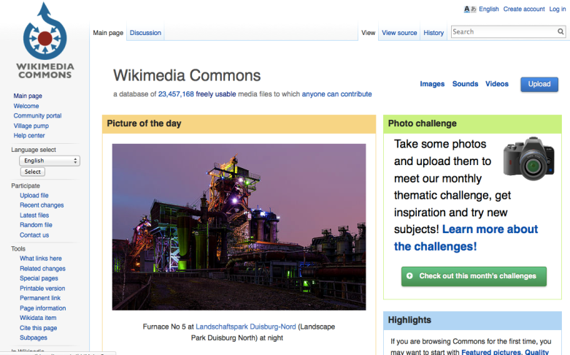
Wikimedia
http://commons.wikimedia.org/

Slide 19
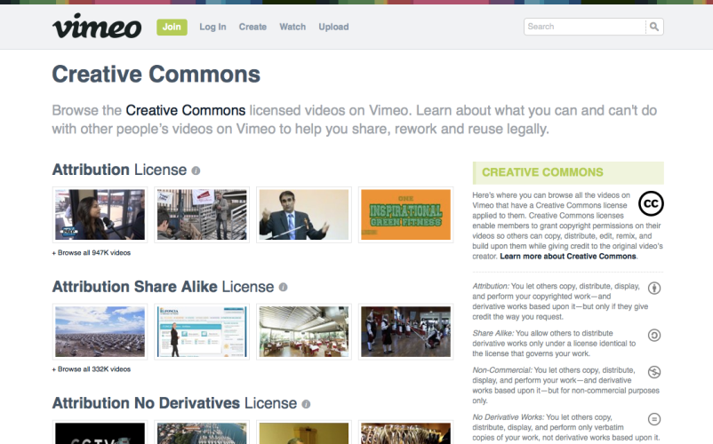
Vimeo
http://vimeo.com/creativecommons

Slide 20
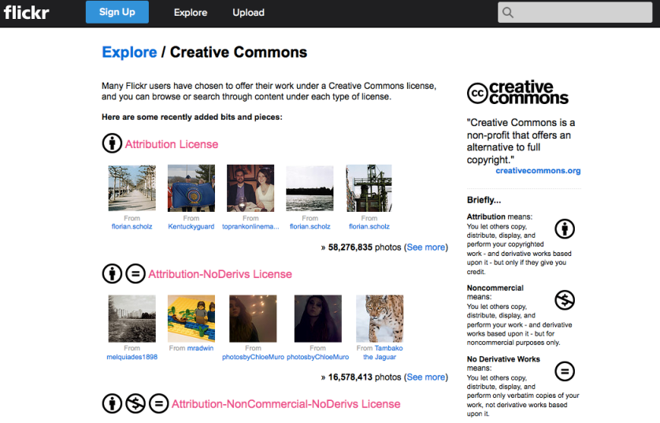
Flickr
https://www.flickr.com/creativecommons/

Slide 21
Licenses, Rights, and Ideas
https://creativecommons.org/
https://wiki.creativecommons.org/FAQ

