Slide 1

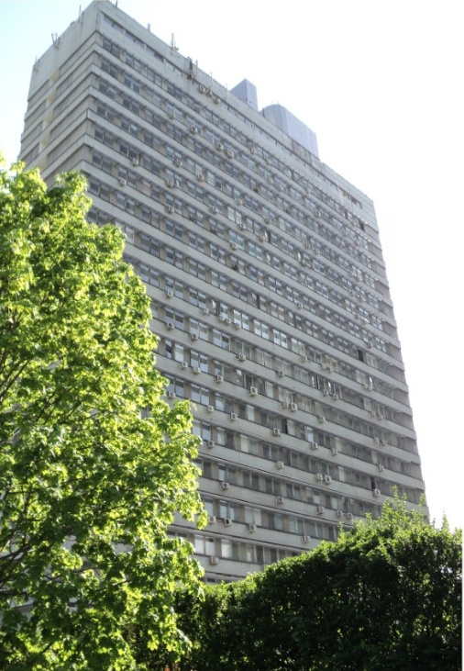
IMEMO – INSTITUTE OF WORLD ECONOMY AND INTERNATIONAL RELATIONS
Moscow, Russia

Slide 2

ABOUT US

Slide 3
OUR MISSION

Slide 4
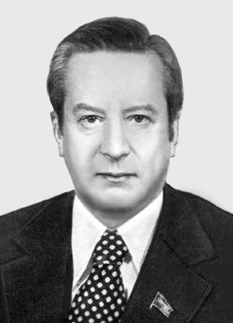
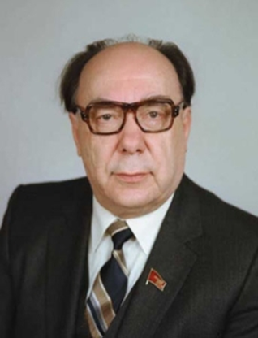
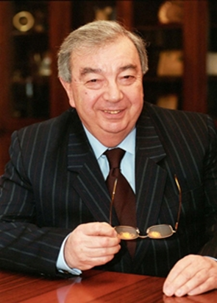
OUR HISTORY
IMEMO is the successor to the first Soviet think tank – Institute of World Economy and Politics which existed from 1925 to 1948 and was headed by prof. Evgeny VARGA
IMEMO was reestablished in 1956 in the first period of Soviet political reforms (Thaw / Ottepel) by its first director Anushavan ARZUMANYAN
Since its inception, the IMEMO has become a highly reputed center for fundamental academic studies and practical social, economic, political and security analysis
Among previous directors – such famous Soviet/Russian political experts and statesmen as:
Nikolai INOZEMTSEV Alexander YAKOVLEV Evgeny PRIMAKOV
Many representatives of Russian political and economic elite, prominent experts and famous journalists worked or studied at the IMEMO

Slide 5
IMEMO is the leading think tank under the auspices of the Division for Global Issues and International Relations of the Russian Academy of Sciences
OUR “FAMILY TREE”
IMEMO (1956)
Institute for Far Eastern Studies (1966)
Institute for the USA and Canada Studies (1967)
Institute of Africa (1959)
Institute of Latin America (1961)
Institute of Europe (1987)
Center for Situation Analysis (2011)
Most of these think tanks were established on the basis of several IMEMO’s departments and we are proud that till today we are continuing strong partnership and collaboration with them all

Slide 6
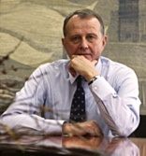
OUR TEAM

Slide 7

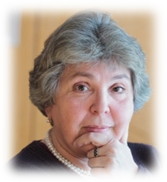
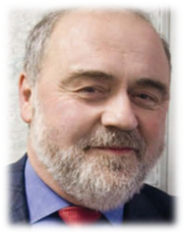
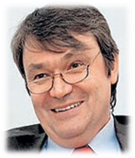
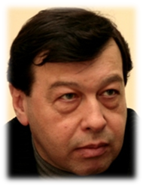
BOARD OF DIRECTORS
Prof. Natalia Ivanova, first deputy director,
full member of RAS
Prof. Vladimir Baranovsky, deputy director,
full member of RAS
Prof. Vasily Mikheev, deputy director,
corr. member of RAS
Prof. Evgeny Gontmakher,
deputy director
Prof. Alexey Kuznetsov, deputy director, corr. member of RAS
Prof. Alexey Arbatov, board of directors member, full member of RAS
Prof. Ivan Korolev, board of directors member, corr. member of RAS
Prof. Gennady Chufrin, board of directors member, corr. member of RAS
Amb Vyacheslav Trubnikov, board of directors member, 4-star General (Ret.)

Slide 8
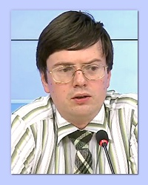
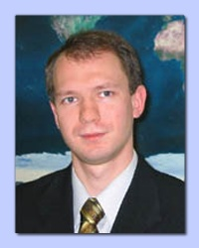
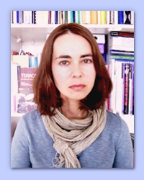
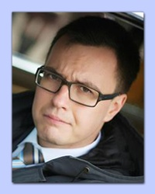
IMEMO’s NEXT GENERATION
scholars under 40 who have already reached professional recognition and contributed significantly to the success of IMEMO:
Prof. Alexey KUZNETSOV deputy director of IMEMO; the youngest member of the Russian Academy of Sciences; was awarded the RAS Medal for the monograph Internationalization of the Russian Economy: an Investment Aspect |  | Prof. Sergey AFONTSEV head of the Department of Economic Theories; was awarded Evgeny Varga Prize for the monograph Political Markets and Economic Policy
Prof. Ekaterina STEPANOVA head of the Research Group for Peace and Conflict Studies; was awarded the RAS Medal for the monograph The Role of Illicit Drug Business in the Political Economy of Conflicts and Terrorism |  | Prof. Feodor VOITOLOVSKY head of Political section at the Center for North American Studies; was awarded the RAS Medal for the monograph Unity and Division of the West

Slide 9
IMEMO’s CENTERS and DEPARTMENTS
Department for Science and Innovation
Department for Global Economic Problems and Foreign Economic Policy
Department for Economic Theories
World Economy Forecasting Section
Department of International Capital Markets
Center for Industrial and Investment Studies
Center for Energy Research
Center for Research in Transitional Economies
Department of International Politics
Section for Political Theory
Center for International Security
Center for North American Studies
Center for European Studies
Department for European Political Studies
Center for Asia-Pacific Studies
Center for Development and Modernization
Center for Comparative Socio-Economic and Socio-Political Studies

Slide 10
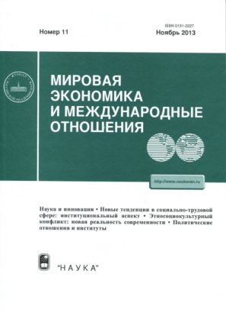
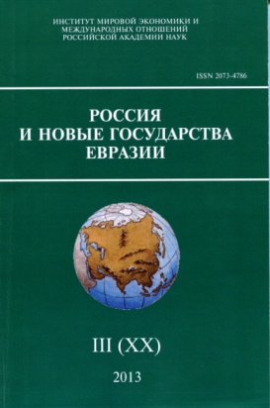
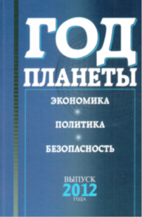
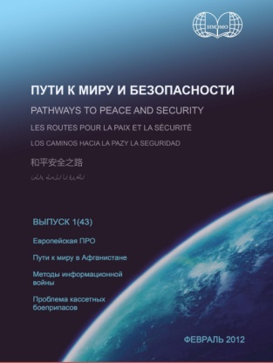

WHAT WE DO
Research – more than 50 Russian and international projects
Policy advice – for federal ministries and other governmental bodies, the Russian parliament and state companies
Events – 60-70 conferences, seminars and round-tables every year
Our own post-graduate and graduate educational programs – in economics, political science and international relations
Several Russian-language monthly and quarterly journals and bulletins
IMEMO’s professors participate in educational programs and teaching at 30 universities in Russia and abroad

Slide 11
MEASURING IMPACT
Fundamental research activities. Our research of global trends (in innovations, foreign direct investments, energy issues, international security, etc.) provides Russian society and decision-makers with an informed view of Russia’s position in a polycentric world.
Consulting of governmental bodies. Our analytical papers provide governmental bodies with ideas to shape Russian foreign policy and economic strategy.
Participation in international projects. We promote Russian scholars’ analytical achievements in world economy, international security and global politics to overcome misperceptions about Russia’s policy, and to foster multilateral cooperation.
Cooperation with universities. We support the Russian higher educational system in social sciences with programs and professors.

Slide 12



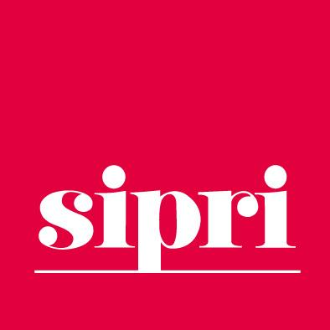







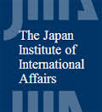












OUR PARTNERS
РГУ нефти и газа
им. И.М. Губкина

Slide 13
OUR PUBLICATIONS
More than 50 books every year
300-400 articles in Russian journals annually
More than 50 articles and chapters in books in English each year
Articles and brochures in English, French, German, Spanish, Arabic, Chinese, Korean, Japanese and some other languages
Digital publications and special policy briefs
Daily comments to Russian and international media and interviews with our experts

Slide 14
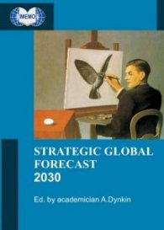
LONG-TERM OUTLOOK
IMEMO has been issuing long-term forecasts of global economic development for the Soviet government since the 1970-s
In the 1990-s our forecasts became open to the public and received international recognition
Now our long-term estimates cover not only economic dynamics, but also international politics and security, global ideological tendencies, shifts to global governance and main trends of social development
The recent Strategic Global Forecast to 2030 was published in Russian and then translated into English, Chinese and Korean
We develop partnership with world-leading forecasting think tanks, such as the Atlantic Council of the US and ESPAS of the EU

Slide 15



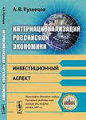
WORLD ECONOMY STUDIES
Research on Innovations
Comparative analysis of technological development in Russia and abroad
R&D policy studies
Globalization of innovation processes and its impact on Russia
Development of the National Innovation System concept
Consulting the Russian state company “ROSTECH”
Foreign Direct Investments Analysis
Emerging markets multinationals
Monitoring of mutual foreign direct investments in the CIS (with the Eurasian Development Bank’s financial support)
Ranking of Russian multinationals (in cooperation with Columbia University)
Foreign Direct Investments theory
Russian Economic Barometer
Analysis of Russia’s microeconomic dynamics
Monthly monitoring activities of Russian industrial and agricultural enterprise and commercial banks
Studies of Industry
Industrial policy studies
Analysis of corporate strategies of companies in key industries
Research on foreign trade

Slide 16



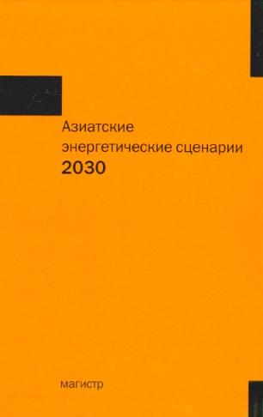
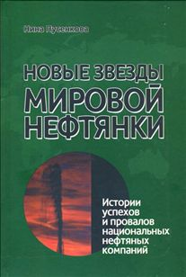
ENERGY STUDIES
INTERNATIONAL FORUM
“Oil and Gas Dialog”
28 conferences since 2009
high-reputed Russian and many international experts and think tanks in energy studies became IMEMO’s partners
Energy commodities markets research
Monitoring and forecasts of energy markets for the leading Russian oil company Rosneft
Analysis of oil and gas industries and world energy system:
Foreign Expansion of Russian Oil and Gas Companies
Instability in the North Africa and in the Middle East: Implications for World Oil Market
Asian Energy Scenarios 2030
Shale Gas Revolution: Scale, Perspectives, Implications for Gas Market

Slide 17
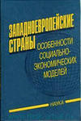

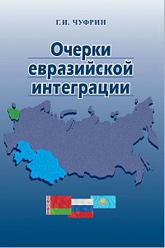
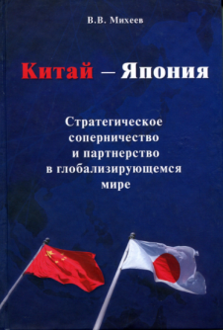
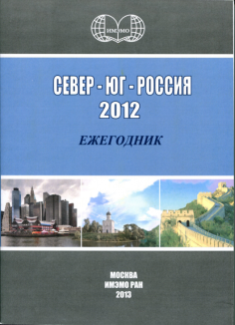
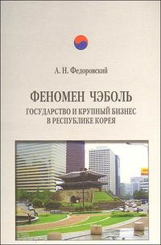
REGIONS OF THE WORLD
Research on the USA Analysis of the US foreign and security policy Research on the US pattern of socio-economic development and domestic politics Analysis of the US role in globalization and the emerging world order Study of Russian-American relations in a changing world |  | European and Eurasian Integration Studies Research on the institutional structure of the EU and its various policy areas (regional, foreign, etc.) Analysis of economic, social and political trends in EU member states Monitoring of Russia-EU economic and political relations Research on Russia’s participation in post-Soviet regional integration
Research on Modern China and the Pacific Region Analysis of economic, social and political trends in China, Japan, North and South Korea Research on regional integration in Pacific Asia Analysis of Russian economic and political relations with China, Japan, South Korea and the ASEAN members |  | Development and Modernization Studies Research on modernization experience of developing and transitional societies Search for innovative methodological approaches to new development processes in the African and Asian societies Monitoring of Center-Periphery relations including the problems of Russia and the CIS

Slide 18
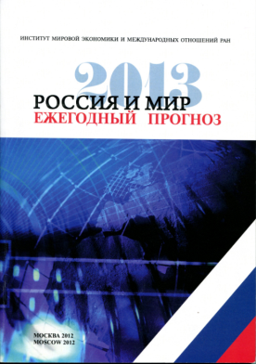
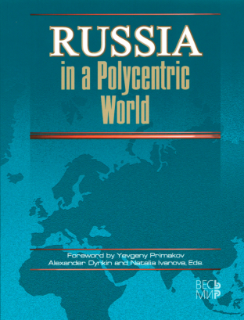
GLOBAL CHALLENGES AND OPPORTUNITIES FOR RUSSIA
Russia in a Polycentric World
Analysis of fundamental changes in global politics, economy and world order and their impact on Russia
Research on opportunities, challenges and risks that Russia is facing in the realm of the forming polycentric world
Study of economic, social and political trends in regional centers of power
Research on international relations in the most unstable areas across Russia' s borders
Comprehensive
monograph issued by IMEMO
and its partners, edited by
Alexander Dynkin and
Natalia Ivanova, with
foreword by Evgeny Primakov
Edited by
Alexander
Dynkin and
Vladimir
Baranovsky
Annual forecasts “Russia and the World: Economy and Foreign Policy”
Part I focuses on Russian foreign trade-economic relations, analysis and forecast of the world economic trends (Russia, Europe, the USA, Japan, China, India), including international financial markets and main Russian export markets
Part II presents the analysis and forecast of international politics and security issues including main challenges for Russia

Slide 19

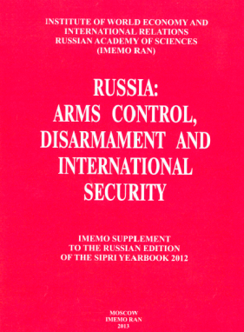

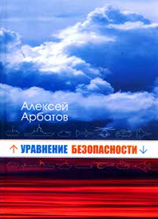
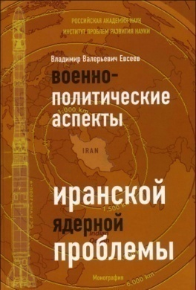
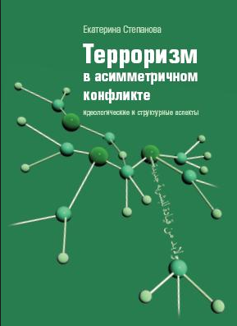
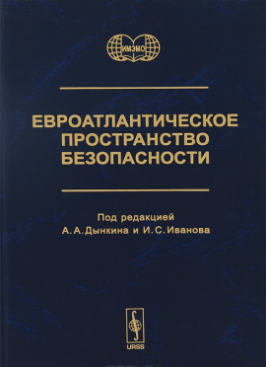

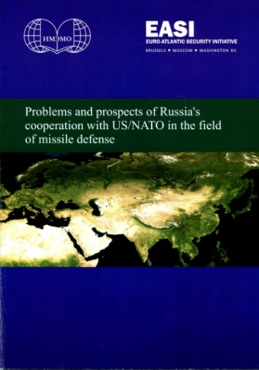
INTERNATIONAL SECURITY STUDIES
Research on global and regional security, arms control, non-proliferation and non-traditional threats
Research of strategic stability and military economy studies
Analysis of Euro-Atlantic
and Trans-Pacific security
Development of Russia – NATO
track II dialogue
Peace studies and conflict
resolution issues research
Partnerships with SIPRI, NTI, Brookings and other international think tanks and NGOs researching international security

Slide 20
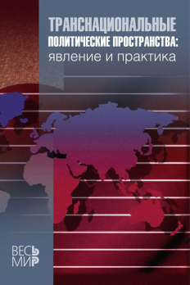


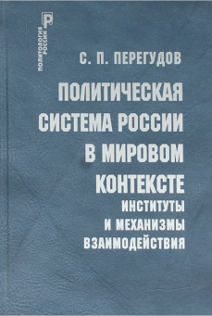
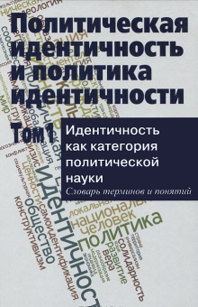

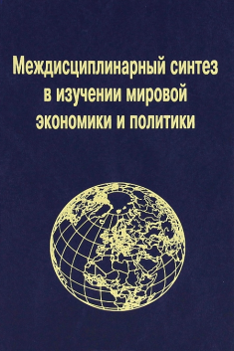
POLITICAL AND SOCIAL STUDIES
Globalization of international politics and global governance
Regional integration
The role of the United Nations and other international institutions
Political ideas and concepts
Modern political systems and forms of democracy
Corporate citizenship and business-state relations
Social and political identity
Theoretical and methodological analysis of global politics
Russia’s foreign and security policy

Slide 21
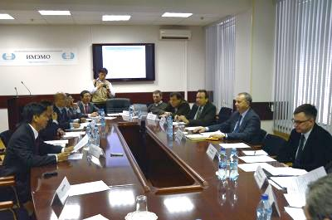


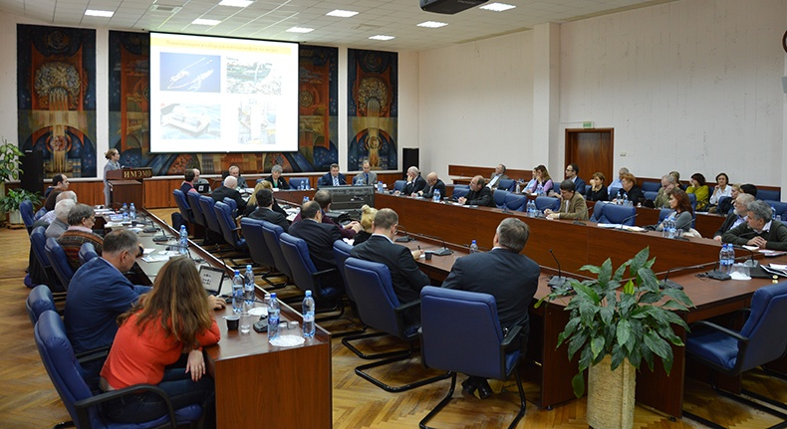
Our CONTACTS
website
http://www.imemo.ru/
http://new.imemo.ru/
address
23, Profsoyuznaya Str.,
GSP-7, Moscow, 117997
Russian Federation

