Slide 1

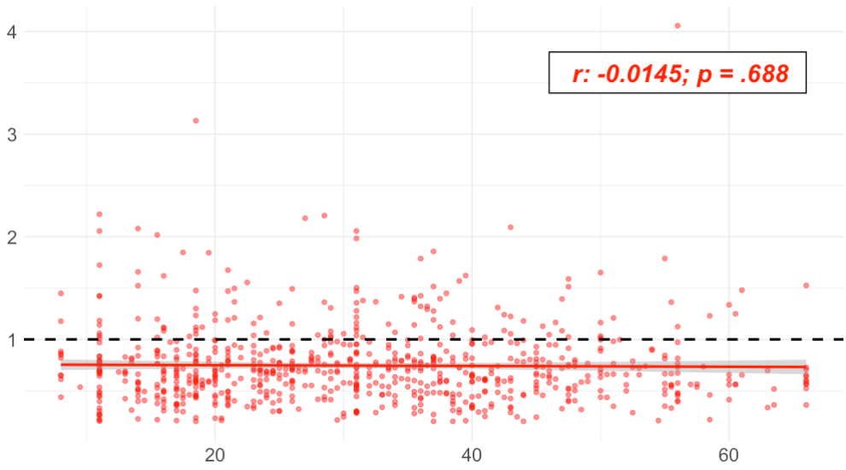
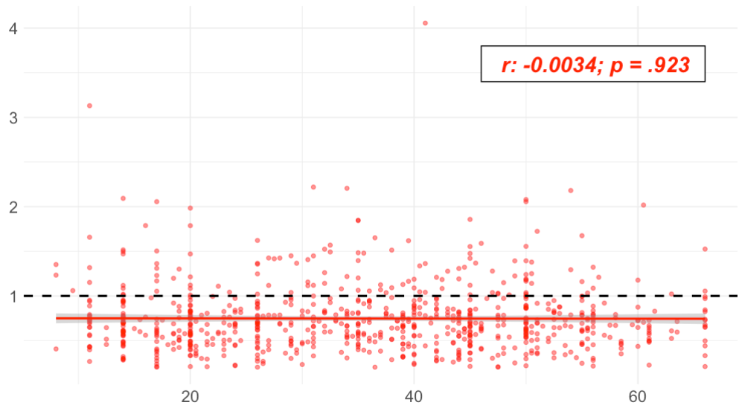

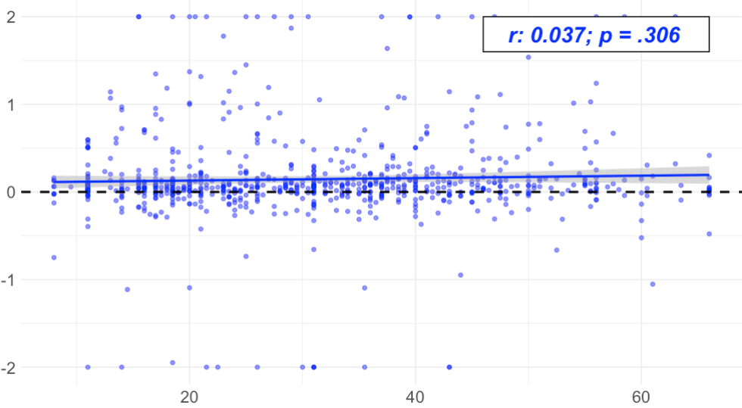
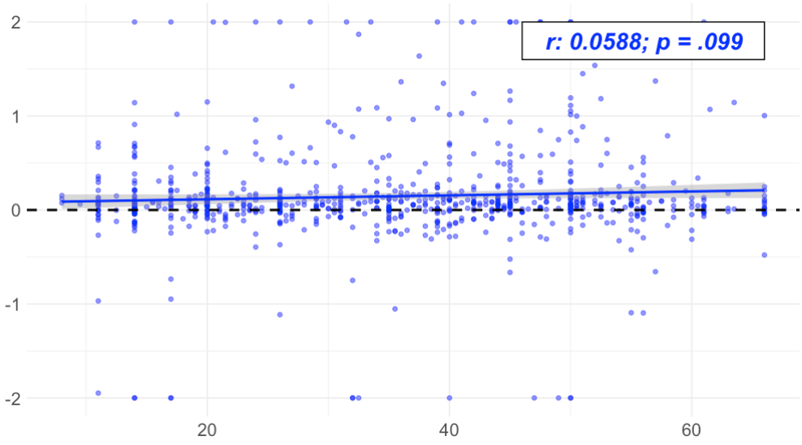
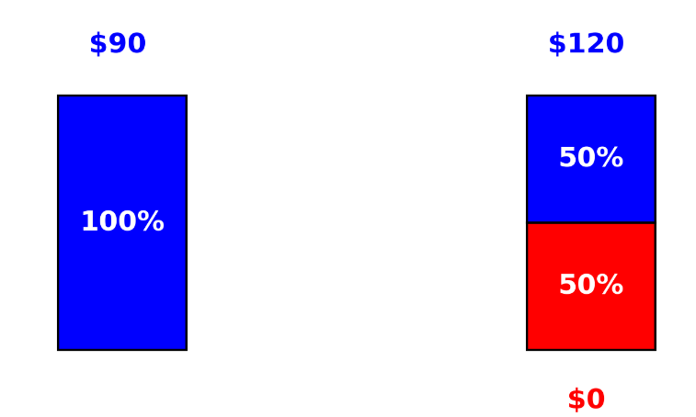
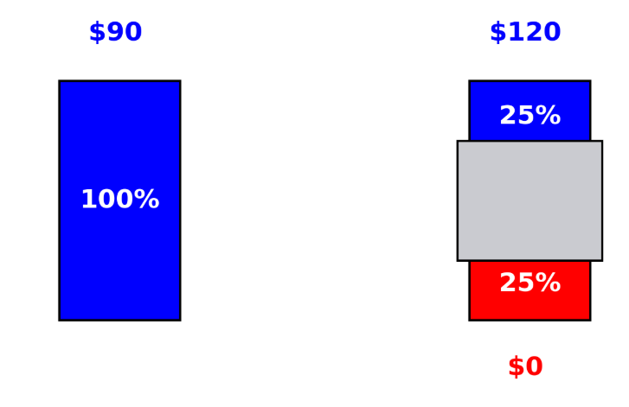
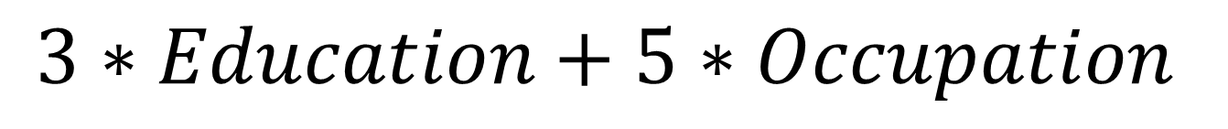
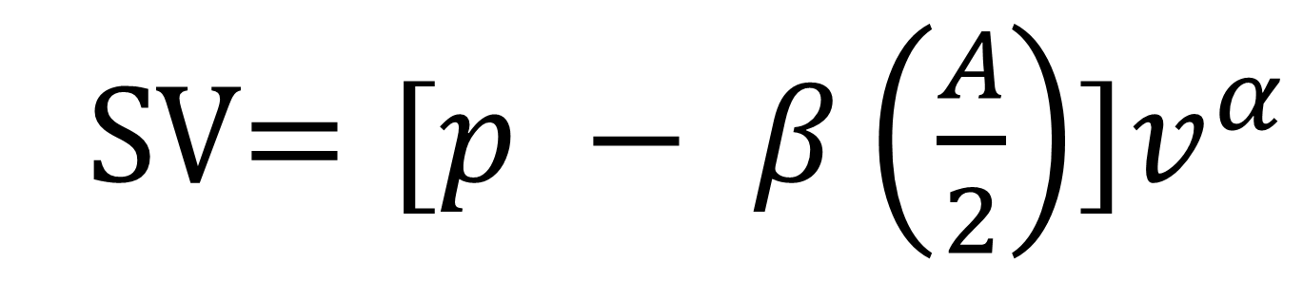
Examining the associations between socioeconomic status and preferences for risk and ambiguity
Sarah Garrison (Class 2025), Christian Benitez, and Joseph W. Kable
College Of Arts and Sciences, Department of Psychology, University of Pennsylvania
College Alumni Society Undergraduate Research Grant: The Millstein Family Undergraduate Research
Background
Risk Preference
Objective: We frequently encounter decisions requiring us to weigh different possible outcomes, with some carrying potentially dire financial and health outcomes (i.e., gambling, smoking, reckless driving). Despite the potential harms, some individuals still choose to take on these real-world risks, this has prompted researchers to better understand what factors influence these types of decisions. Prior research suggests one’s socioeconomic status (SES) may be an important factor, as it has been linked to real-world risk-taking.
However, despite this link, it has not reliably extended to in-lab measures of risk preferences. Some studies find that those lower in SES are more risk-tolerant. Some find that they are less risk-tolerant, while others find no association. One possible explanation for the discrepancy between in-lab and real-world risk-taking is that real-world risk-taking behaviors may not reflect differences in risk preferences (i.e., uncertainty where probabilities are known), but rather differences in ambiguity preferences (i.e., uncertainty where probabilities are unknown).
Aim: This pre-registered study aims to examine the relationship between SES and in-lab measures of risk and ambiguity preferences.
Past SES
Present SES
Alpha
Alpha
Methods
Past SES
Present SES
Demographics:
No association between past SES and risk
No association between present SES and risk
1000 participants will complete a risk and ambiguity decision-making task with a total of 130 binary choices and self-report measures on Qualtrics Surveys via CloudResearch
Risk & Ambiguity Choice Task Tasks:
Ambiguity Preference
Risk Task
Ambiguity Task
Past SES
Present SES
I would rather have…
I would rather have…
Beta
Beta
SES Variable:
Choice Task Analysis:
Past SES
Present SES
Past and Present SES
SV$=[p − β\left(\frac{A}{2}\right)]v^{α}$
No association between past SES and ambiguity
No association between present SES and ambiguity
$$3∗Education+5∗Occupation$$
Current Conclusion
Education
Less than High School (1) –
Graduate Education (7)
p = probability of winning the reward
No association between past and present SES on risk preferences, replicating previous findings
No association between past and present SES on ambiguity preferences
β = participant ambiguity tolerance parameter
Occupation
Service Worker (1) –
Major Professional (9)
A = the level of ambiguity
α = participant risk tolerance parameter
References
v = winning value
1.Amir, D., Jordan, M. R., & Rand, D. G. (2018). An uncertainty management Perspective on long-run impacts of adversity: The influence of childhood socioeconomic status on risk, time, and social preferences. Journal of Experimental Social Psychology, 79, 217–226. https://doi.org/10.1016/j.jesp.2018.07.014 2. Auger, N., Lo, E., Cantinotti, M., & O’Loughlin, J. (2010). Impulsivity and socio-economic status interact to increase the risk of gambling onset among youth. Addiction, 105(12), 2176–2183. https://doi.org/10.1111/j.1360-0443.2010.03100.x 3. Barsky, R. B., Juster, F. T., Kimball, M. S., & Shapiro, M. D. (1997). Preference parameters and behavioral heterogeneity: An experimental approach in the health and... Quarterly Journal of Economics, 112(2), 537. https://doi.org/10.1162/003355397555280 4.Barton, A. W., Brody, G. H., Yu, T., Kogan, S. M., Chen, E., & Ehrlich, K. B. (2019). The Profundity of the Everyday: Family Routines in Adolescence Predict Development in Young Adulthood. Journal of Adolescent Health, 64(3), 340–346. https://doi.org/10.1016/j.jadohealth.2018.08.029 5.Bernstein, D. P., Fink, L., Handelsman, L., Foote, J., Lovejoy, M., Wenzel, K., Sapareto, E., & Ruggiero, J. (1994). Initial reliability and validity of a new retrospective measure of child abuse and neglect. The American Journal of Psychiatry, 151(8), 1132–1136. https://doi.org/10.1176/ajp.151.8.1132 6. Campbell, J. A., Walker, R. J., & Egede, L. E. (2016). Associations Between Adverse Childhood Experiences, High-Risk Behaviors, and Morbidity in Adulthood. American Journal of Preventive Medicine, 50(3), 344–352. https://doi.org/10.1016/j.amepre.2015.07.022 7.Felitti, V. J., Anda, R. F., Nordenberg, D., Williamson, D. F., Spitz, A. M., Edwards, V., & Marks, J. S. (1998). Relationship of childhood abuse and household dysfunction to many of the leading causes of death in adults: The Adverse Childhood Experiences (ACE) Study. American journal of preventive medicine, 14(4), 245-258. 8. Fergusson, D. M., McLeod, G. F. H., & Horwood, L. J. (2013). Childhood sexual abuse and adult developmental outcomes: Findings from a 30-year longitudinal study in New Zealand. Child Abuse & Neglect, 37(9), 664–674. https://doi.org/10.1016/j.chiabu.2013.03.013 9. Griskevicius, V., Tybur, J. M., Delton, A. W., & Robertson, T. E. (2011). The influence of mortality and socioeconomic status on risk and delayed rewards: A life history theory approach. Journal of Personality and Social Psychology, 100(6), 1015-1026. doi:10.1037/a002240310.Hahmann, T., Hamilton-Wright, S., Ziegler, C., & Matheson, F. I. (2021). Problem gambling within the context of poverty: A scoping review. International Gambling Studies, 21(2), 183–219. https://doi.org/10.1080/14459795.2020.1819365 11. Hollingshead, A. A. (1975). Four-factor index of social status. Unpublished manuscript, Yale University, New Haven, CT 12.Konova et al., A. B. (n.d.). Computational Markers of Risky Decision-making for Identification of Temporal Windows of Vulnerability to Opioid Use in a Real-world Clinical Setting | Psychiatry and Behavioral Health | JAMA Psychiatry | JAMA Network. Retrieved October 4, 2024, from https://jamanetwork.com/journals/jamapsychiatry/articleabstract/2757378?casa_token=tT8dgUpe68AAAAA:o18xIR34bYoWiHya-8bkA6efr06Tl1axSviTBFvA7mCbVa9Lwks54PY3EBfC4mqtZbZrq9r5BKqP&casa_token=8c_KgkZ7MBUAAAAA:_g1xBv74Umk43CLvBkTM49MIR58Nt8jrulLWY2DZ8is_m5Jd4JnkpcZH1wqpotlrHTy4wEBzSIKe 13.Ligneul, R., Sescousse, G., Barbalat, G., Domenech, P., & Dreher, J.-C. (2013). Shifted risk preferences in pathological gambling. Psychological Medicine, 43(5), 1059–1068. https://doi.org/10.1017/S0033291712001900 14.Males, M. A. (2009). Poverty as a determinant of young drivers’ fatal crash risks. Journal of Safety Research, 40(6), 443–448. https://doi.org/10.1016/j.jsr.2009.10.001 15. Mukherjee, D., Lee, S., Kazinka, R., Satterthwaite, T. D., & Kable, J. (2020, January 3). The Depressed Decision-Maker: How Value-Based Decision Making Differs in Major Depressive Disorder. https://doi.org/10.31234/osf.io/7gnb916. Pepper, G. V., Corby, D. H., Bamber, R., Smith, H., Wong, N., & Nettle, D. (2017). The influence of mortality and socioeconomic status on risk and delayed rewards: A replication with British participants. PeerJ, 5, e3580. https://doi.org/10.7717/peerj.3580 17 . Tjur, T. (2009). Coefficients of determination in logistic regression models—A new proposal: The coefficient of discrimination. The American Statistician, 63(4), 366-372. 18. Tymula, A., Rosenberg Belmaker, L. A., Roy, A. K., Ruderman, L., Manson, K., Glimcher, P. W., & Levy, I. (2012). Adolescents' risk-taking behavior is driven by tolerance to ambiguity. Proceedings of the National Academy of Sciences of the United States of America, 109(42), 17135–17140. https://doi.org/10.1073/pnas.1207144109 19.Umeda, M., Oshio, T., & Fujii, M. (2015). The impact of the experience of childhood poverty on adult health-risk behaviors in Japan: A mediation analysis. International Journal for Equity in Health, 14(1), 145. https://doi.org/10.1186/s12939-015-0278-4 Developmental Science, 21(2), 1–22. https://doi.org/10.1111/desc.12529 20.Vinokur, A. D., Price, R. H., & Caplan, R. D. (1996). Hard times and hurtful partners: how financial strain affects depression and relationship satisfaction of unemployed persons and their spouses. Journal of personality and social psychology, 71(1), 166. 21.Weber, E. U., Blais, A.-R., & Betz, N. E. (2002). A domain-specific risk-attitude scale: Measuring risk perceptions and risk behaviors. Journal of Behavioral Decision Making, 15(4), 263–290. https://doi.org/10.1002/bdm.41422. Wu, J., Guo, Z., Gao, X., & Kou, Y. (2020). The relations between early-life stress and risk, time, and prosocial preferences in adulthood: A meta-analytic review. Evolution and Human Behavior, 41(6), 557–572. https://doi.org/10.1016/j.evolhumbehav.2020.09.001
Notes:
Poster down r package
Background: Maybe start off with time and then end off with still present-oriented
If running space be better with words
Maybe remove A and B and make everything bigger and have an or in between$k$
Modeling section may help will explain: advantageous and disadvantageous
How important is x and y
SES is the most important portion empahaizie the importance ;
Assume they know about tasks
Be quicker with [poster
Methods mention current SES and parental SES
R before p values
Interaction b etween two ~ strength of relationshtip
Addresses current SES and child SES highly correlated. Your ses similar to parents. Is one or the other driving time preferneces.
P value less than .001
Where financial strain and current education are coming from. Making it clear parental and
Why current SES variables in the mediation model

