Slide 1
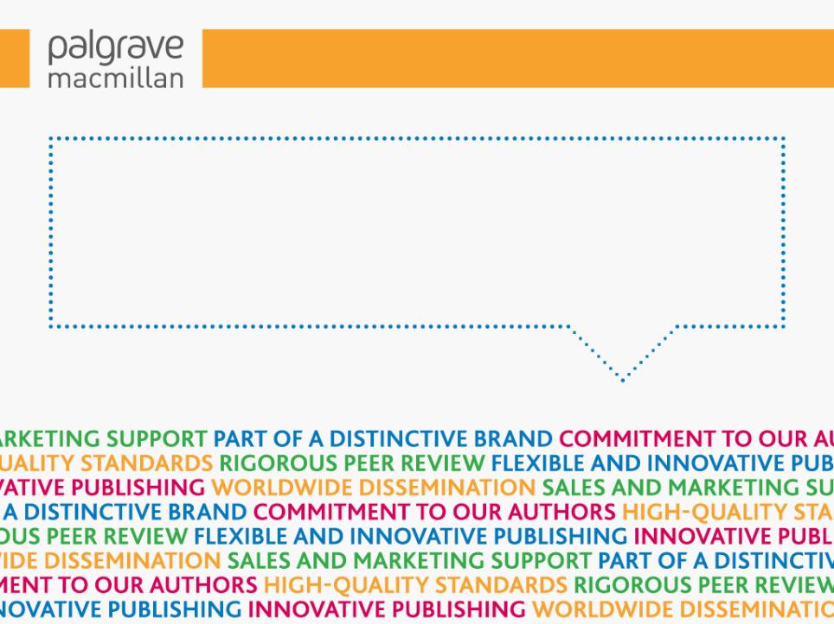
Open Dialogues on Open Access / Publishing for Early Career Faculty & Graduate Students
University of Pennsylvania
Brigitte Shull, Editorial Director of Author and Editorial Services

Slide 2
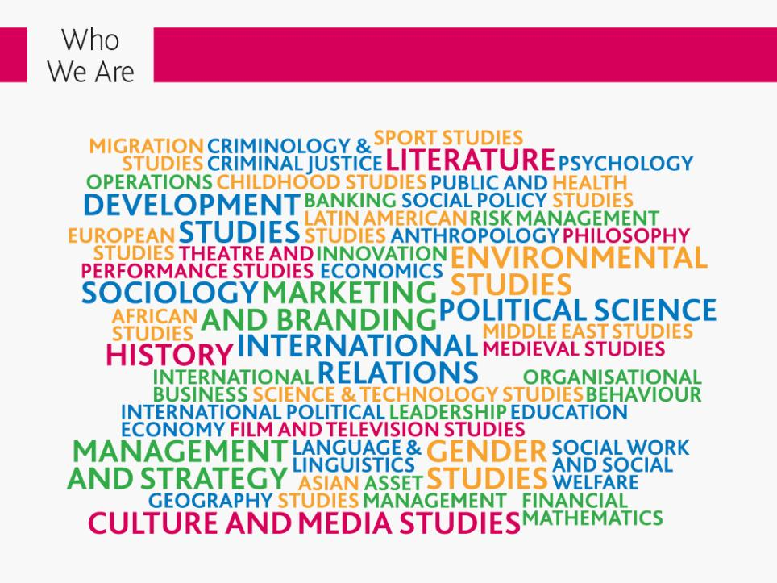

Slide 3
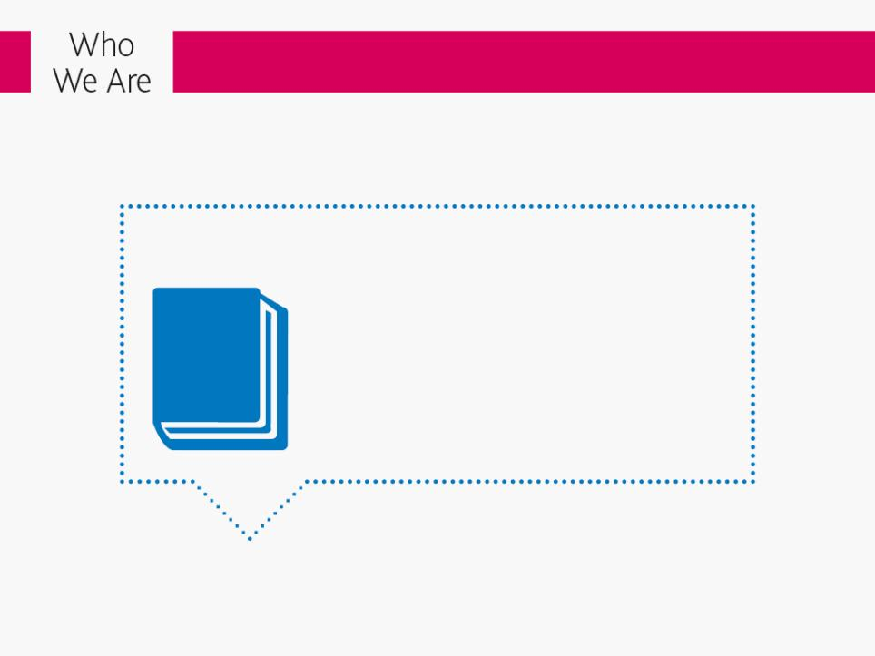
Our publishing program:
Research monographs and edited collections
Palgrave Pivots
Handbooks and reference titles
Selection of professional and practitioner titles
Upper-level textbooks
Journals

Slide 4
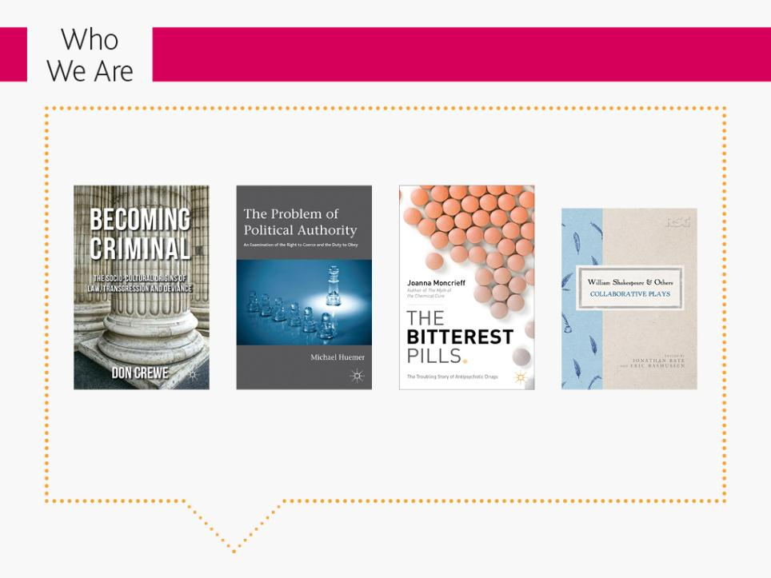
Award-Winning
Co-awarded the British Society of Criminology Book Prize 2014
Winner of the
PROSE Award 2014
Winner of the
PROSE Award 2014
Winner of the
Falstaff Award for Best Book in 2014
Nobel Laureates: 33 Nobel prize-winners

Slide 5
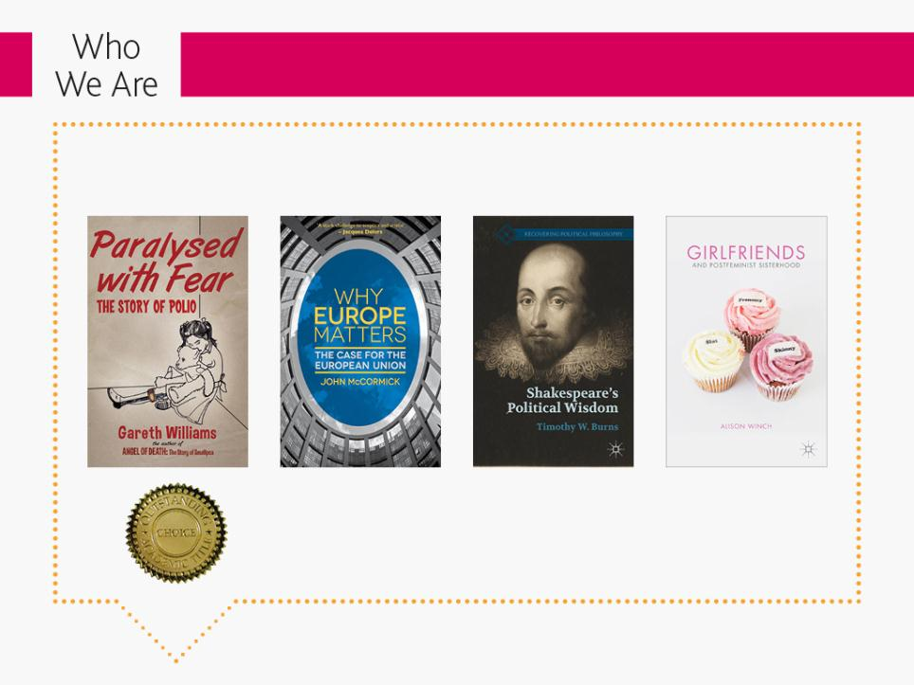
Award-Winning
Choice coverage: over 20 positive reviews per month and Palgrave Macmillan (and clients) won 21 Choice Outstanding Awards in 2013 and 23 in 2014

Slide 6
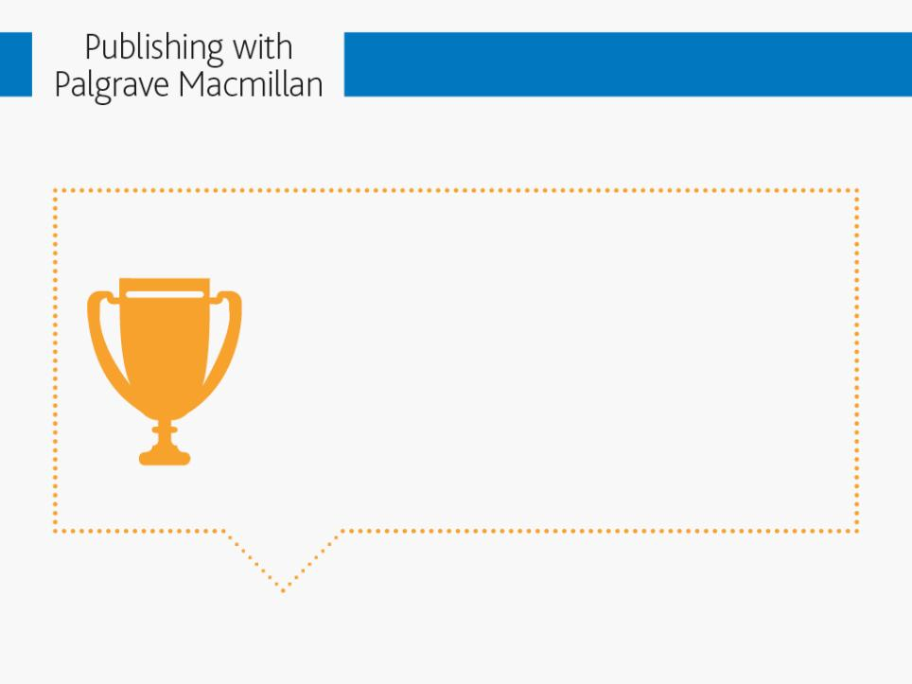
Being part of a distinctive brand:
We are part of an unbroken tradition of over 170 years of academic publishing in the Humanities, Social Sciences and Business. We’ve published some of the leading scholarly works, such as the first Dictionary of Economics, The Golden Treasury and The Shakespeare First Folios. But we are also known for our publishing in new, cutting-edge areas. We are similarly committed to promoting interdisciplinary publishing and providing a venue to publish work in new sub-fields.

Slide 7

Institutional collaborations
ASAN (Asian Policy Institute)
The World Bank
Sciences Po
Middle East & Mediterranean Studies (MEMS) Centre, King’s College London
Inter-American Development Bank
Academy of International Business
Royal Shakespeare Company
Jepson School of Leadership, University of Richmond
Society for the Anthropology of Religion, American Association
of Anthropology
Institute for English Studies
Institute of Historical Research

Slide 8
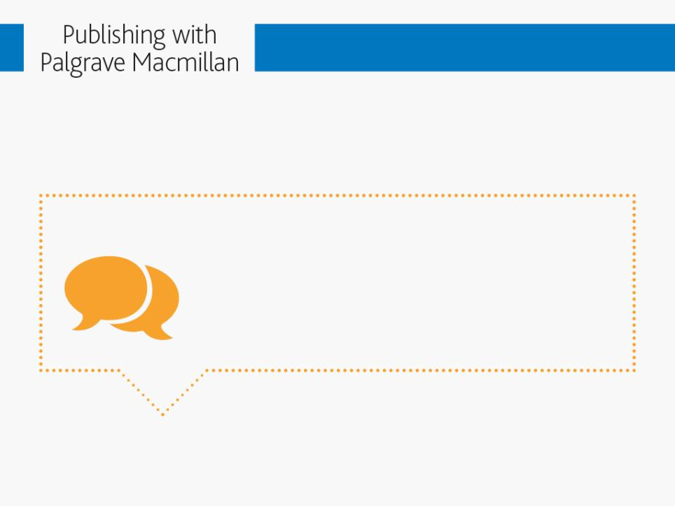
Commitment to our authors:
This means responsive, collaborative editors and author support across our publishing teams. We offer a personal approach, with an individual editor and a dedicated global marketing manager. We welcome proposals from authors at any stage of their career.

Slide 9
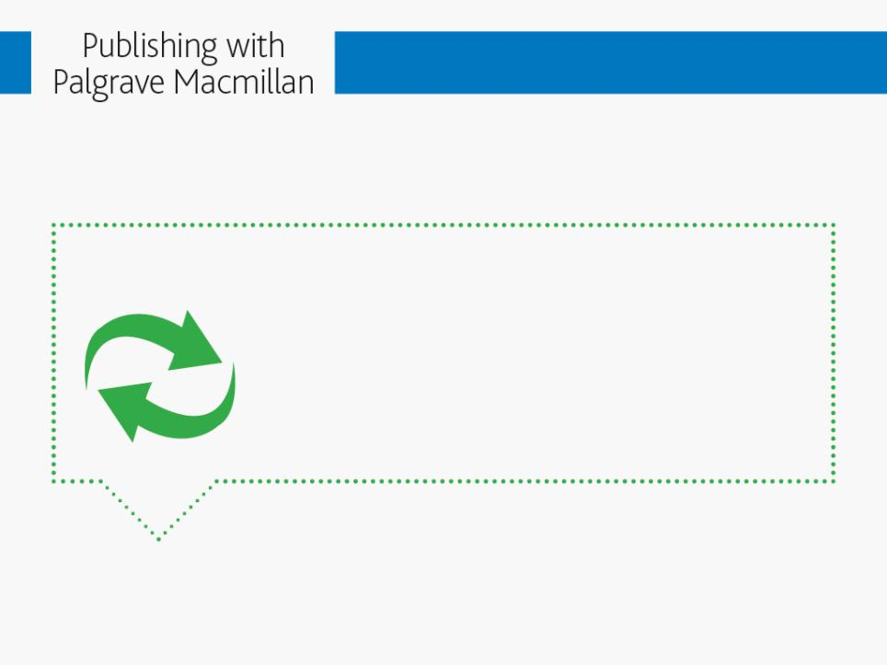
High-quality standards – including rigorous peer review:
We offer full copyediting and proofreading services on accepted manuscripts. We guarantee a thorough peer-review of your project by academic specialists in your field, often at both proposal and final manuscript stage. You can expect the time between the receipt of your manuscript and its publication to be faster than that of many of our competitors.

Slide 10
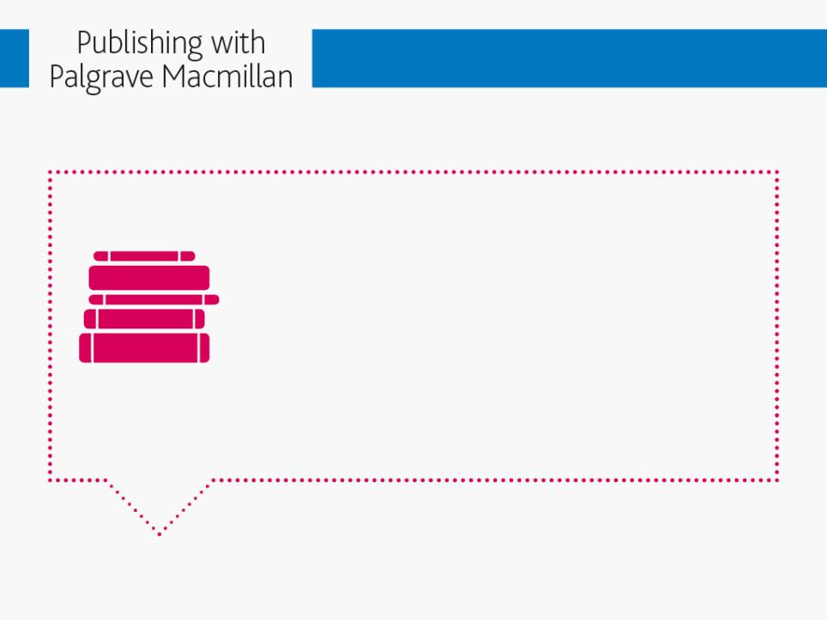
Flexible and innovative publishing:
All scholarly titles are published in simultaneous print and electronic formats, with a bespoke cover design. Ebooks are available via the ebook platform, SpringerLink, and from most major ebook retailers (including Amazon). We offer the opportunity to publish at almost any length – whether a journal article in one of our 50+ acclaimed journals, a traditional scholarly book length, or a Palgrave Pivot. We also offer authors the option to publish open access research across all publication formats via Palgrave Open.

Slide 11
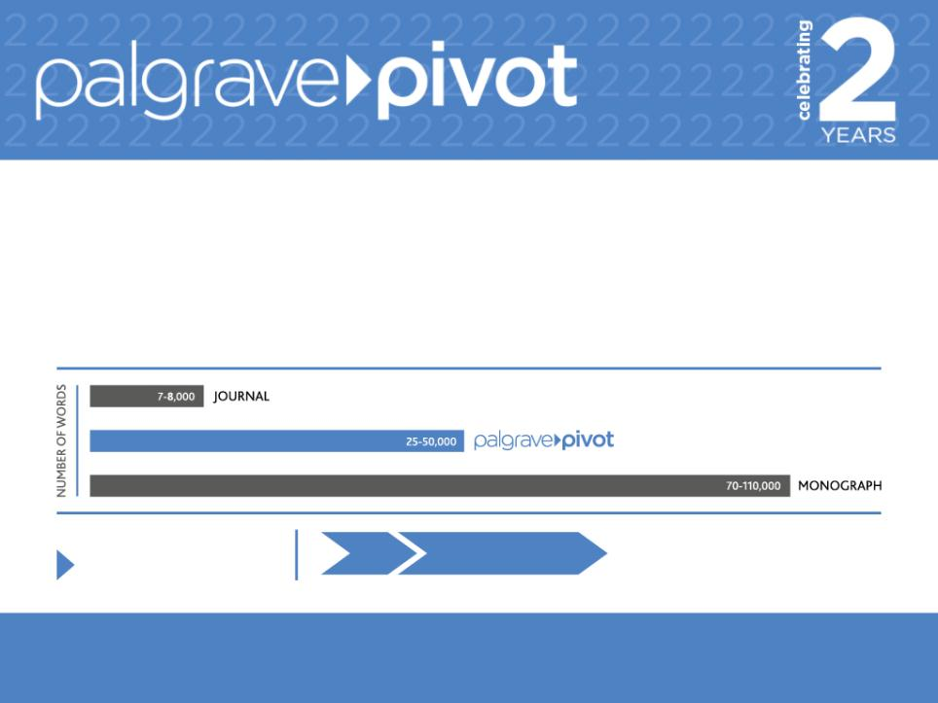
New Directions in Academic Publishing
Palgrave Pivot – fully peer reviewed, short monographs (25,000-50,000 words)
‘A breathtaking example of academic responsiveness to world events’
– the LSE Review of Books on Helen Lenskyj’s recent Palgrave Pivot, Sexual Diversity and the Sochi 2014 Olympics
₄₈₅
Average time to publish: 9 weeks Shortest time to publish: 5.14 weeks
(Sporting Times by Kath Woodward)
Titles published to date:

Slide 12

New Directions in Academic Publishing
Policy Impact: Adoption by Peter Conn was published in January 2013; the following month it was cited numerous times in an Amicus brief submitted to the Supreme Court of the United States in opposition California’s Proposition 8, which restricted the recognition of marriage to same sex couples.
CulturalImpact:TheOlympicMuseuminLausannerananexhibitiononSportingTimes inspiredbyKathWoodward’sPalgravePivot,andKathwentontocuratetheexhibition. Critically Acclaimed: Palgrave Pivots have received very positive reviews from respected venues, including many academic journals, the LSE Review of Books (such as Football’s Dark Side and The Digital Afterlives of Jane Austen) and from Times Higher Education (such as Watching Arabic Television in Europe).

Slide 13
What is Open Access (OA)?
Open access is the free, unrestricted online access to scholarly research¹
OA works are usually free to share and free to reuse without special permission beyond attribution
Often involves publishing under Creative Commons Attribution licenses (CC BY)
As works are free to read without a subscription, the costs of publishing, disseminating and archiving are typically covered through research funding provisions.
1. http://legacy.earlham.edu/~peters/fos/overview.htm
Notes:
No single approach to financing OA dominates the HSS market. Publishers and OA initiatives have begun piloting a range of OA business models, from Library memberships, Freemium memberships, and crowd funding, to mixed models combining APCs with membership.
Gold open access:
Article is made open access immediately on publication.
Usually associated with an Article Processing Charge (APC).
Article is the version of record, i.e. publisher’s typeset PDF.
CC BY licence allows unrestricted reuse of the article providing the author(s) and original source are properly cited. CC BY is the default license for all NPG-owned fully open access titles. Other licences are available.
Green open access:
Open access after an embargo period (though an embargo will not apply in all cases).
Article is made freely available but somewhere other than the publisher’s website, e.g. in a subject or university repository, or the author’s homepage.
Open access article is not necessarily the version of record - it could be the typeset PDF or the author’s final version after peer review but before typesetting.
Rights/re-use may be limited.

Slide 14
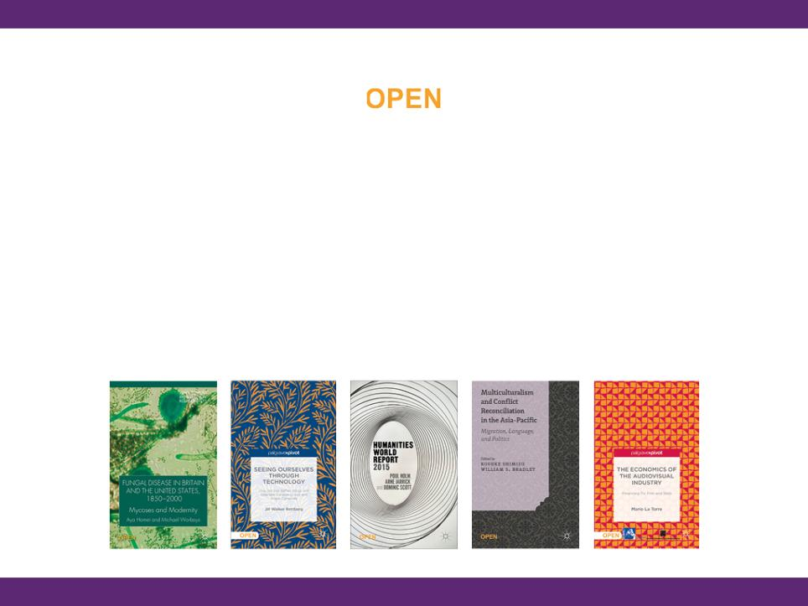
New Directions in Academic Publishing
First publisher to offer OA options across all scholarly formats: journal, mid-form monograph (Palgrave Pivot), and traditional monograph
All work published via Palgrave Open receives the same professional and rigorous peer-review process. In fact, the OA option is not available until the work has been approved for publication, ensuring our research is of the highest standard

Slide 15


The Two Main Routes to OA
Green Open Access
Deposit of author’s accepted manuscript version in a repository
Individual self-archiving policies by publisher/journal
Embargo periods may apply
Gold Open Access
Fully OA journals and Hybrid OA option for subscription-based journals
Final publisher version of OA content is freely available immediately
Gold OA removes permission barriers (most copyright and license restrictions)

Slide 16
Benefits of Open Access
Unrestricted access to knowledge
Potential for research to travel outside the research community (e.g. public, government)
Better return on investment in research for funding bodies
Increased visibility and readership of articles
Increased citation impact¹
Facilitates interdisciplinary collaboration
Text and data mining enabled
Driving innovation in publishing e.g. speed, open data
1. The Open Access Citation Advantage Service http://sparceurope.org/oaca/
Notes:
The challenges of implementing OA are very important but let’s remind ourselves of the bigger picture.
Benefits to society, funders/institutions, other researchers and the authors themselves.
Massive ROI in human genome project. All data were openly accessible and reusable

Slide 17
OA Trends in Humanities and Social Sciences (HSS) in 2015
In 2015, 676 (8.5% of total) fully OA HSS journals listed in Scopus - increase of 20% from 2014
34% increase in no. of articles published in OA journals in 2014 (18,060) vs. 2013 (13,514) according to Scopus
Faster growth compared to STM (9% - journals; 13% - articles)
More than 3,300 titles indexed in Directory of Open Access Books (DOAB) from >100 Publishers http://www.doabooks.org/
Notes:
What is driving the move to OA in HSS?
OA in 2015
10,000 fully open access journals (DOAJ http://doaj.org/)
>1,100 in social sciences
> 250 have APCs
600 open access mandates (http://roarmap.eprints.org/)
Funder (72)
Funder and research organisation (53)
Research organisation (e.g. university or research institution) (450)
Sub-unit of research organisation (e.g. department, faculty or school) (69)

Slide 18
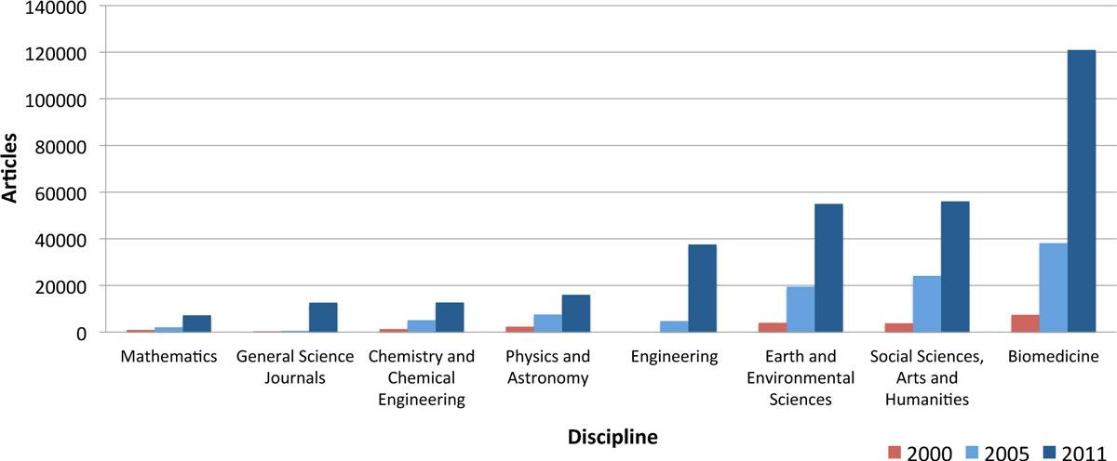
Growth in Open Access by Discipline
Laakso and Björk BMC Medicine 2012 10:124 doi:10.1186/1741-7015-10-124 (Reproduced under CC-BY http://creativecommons.org/licenses/by/2.0)
Notes:
Interesting parallel with where biomedical OA was 5-10 years ago in terms of funders introducing policies and amount of OA content published. Includes green and gold.

Slide 19
Funding and Mandates for OA monographs
Only ten funding bodies fund OA fees for monographs – but this is increasing
All monograph funders support HSS & STM
*Excluding institutions only distributing OA block grants.
Only four OA monograph funders mandate OA for monographs: Wellcome Trust (UK), FWF (Austria), NWO (Belgium), SNSF (Switzerland). Primarily STM funders, and most will accept green OA as an alternative.

Slide 20

Other HSS OA Developments
Forthcoming, 2015: Open Access Publishing in European Networks (OAPEN)-UK report
October 2015: Knowledge Unlatched Round 2 collection opens http://www.knowledgeunlatched.org/
September 2015:
    Open Library of Humanities publishes first articles https://www.openlibhums.org/
    First articles published in a multidisciplinary (including HSS) journal from Elsevier
  August 2015: American Sociological Association (ASA) launches a fully OA journal, Socius

Slide 21
Other HSS OA Developments
January 2015:
    Palgrave Communications, a fully OA journal for HSS disciplines publishes first articles
    HEFCE report on OA monographs finds “there is no single dominant emerging business model”
November 2014: Paul Martin Eve’s (OA) book, Open Access and the Humanities, published
April 2014: British Academy report on OA publishing in HSS http://www.britac.ac.uk/news/news.cfm/newsid/1080
Notes:
Explain background to different models

Slide 22
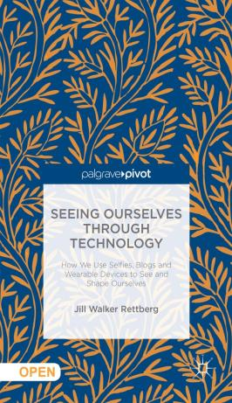
Palgrave Macmillan’s Response to OA
June 2011 | Hybrid open-access offering for Palgrave journals
January 2013 | Open access option for monographs and Palgrave Pivots (short-form books)
November 2013 | First OA monograph published
July 2014 | First “hybrid” OA chapter
October 2014 | First OA Palgrave Pivot
Jan 2015 | Fully OA multidisciplinary HSS journal, Palgrave Communications, launches

Slide 23
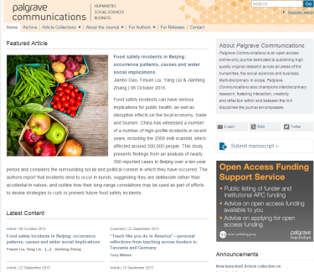
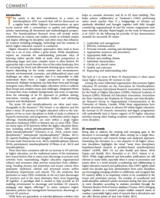
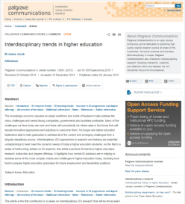
Palgrave
Communications
Scope
    Multi and interdisciplinary in scope, covering all areas of the humanities, social sciences and business
    Journal features regular thematic collections
Editorial Board
    Around 120 members reflecting the journal’s broad scope.
    Thirty associate editors who oversee peer review of submitted papers

Slide 24
Palgrave and OA Books
OA possible for monographs, pivots and individual chapters
Authors/their funding agency charged an ‘Open access publishing charge’
ALL online versions of book are open access (PDF, ePub, Kindle version)
Licensed under CC BY
Print versions sold at cost
Now largest commercial publisher of OA books following joint venture with Springer (Springer Nature)
http://www.palgraveconnect.com/pc/browse/listcollection?pcode=oa
http://www.springeropen.com/books

Slide 25
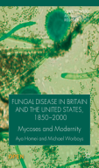
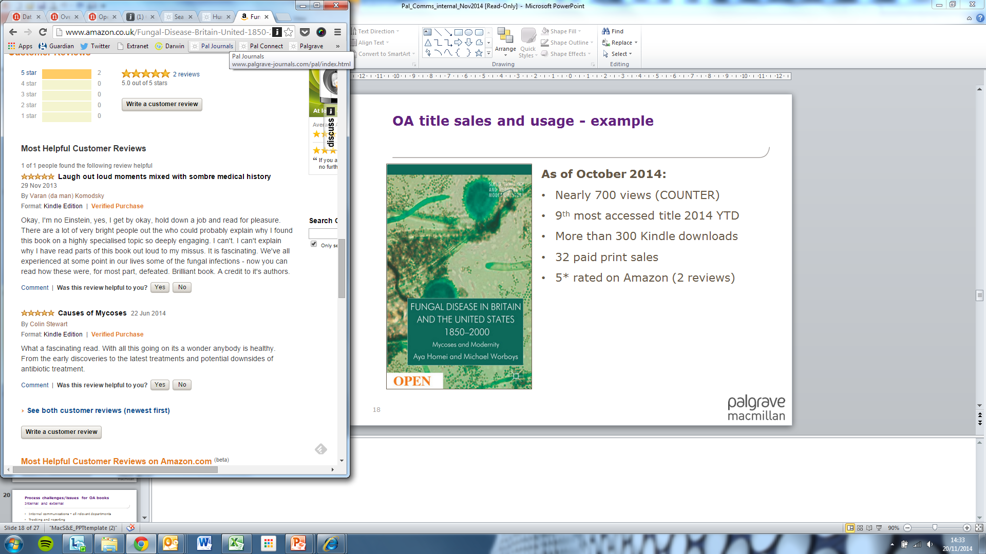
Usage and Sales of OA titles
On average our OA books have received 8 times the usage of non-OA books
All our OA books are in the top 100 most-accessed titles in our ebook collections
Negative effect on print sales; extent of the effect varies significantly by title

Slide 26
Publishing OA – Considerations when Choosing a Journal/Publisher
Open access is well established, some brands have been with us for 15 years
Some open access journals are the most highly ranked in their fields
Open Access journals should be judged on the same criteria as any subscription journal for quality
Use services such as Directory of Open Access Journals (DOAJ), Open Access Scholarly Publishers Association (OASPA), and #thinkchecksubmit to check the credentials of OA publishers

Slide 27
Publishing OA – Considerations when Preparing your Manuscript
Creative Commons attribution license (CC BY)
Legal requirement for attribution of any reuse
    Including a link to the original work and license
  No assumed endorsement of derivative works
  Publisher often offers further protection if there is evidence of infringement of authors’ rights
Authors and institutions can create derivatives and updates easily and efficiently
Commercial use restrictions can vary (including restricting teaching) in some jurisdictions
http://oapen-uk.jiscebooks.org/files/2011/01/CC-Guide-for-HSS-Monograph-Authors-CC-BY.pdf

Slide 28
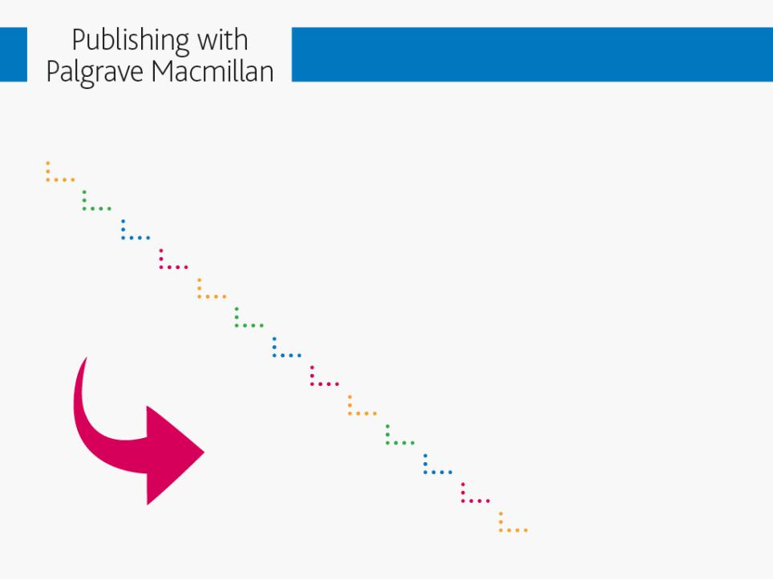
Life cycle of a Palgrave monograph
Proposal submitted and vetted by editor
Top-level editorial work between editor and author Peer review process (2-3 months)
Editorial board
Contract
Manuscript prep
Permissions
Manuscript delivery
2nd peer review / Editorial vet
Manuscript enters production (6 months) Copyediting
Proofs
Publication!

Slide 29
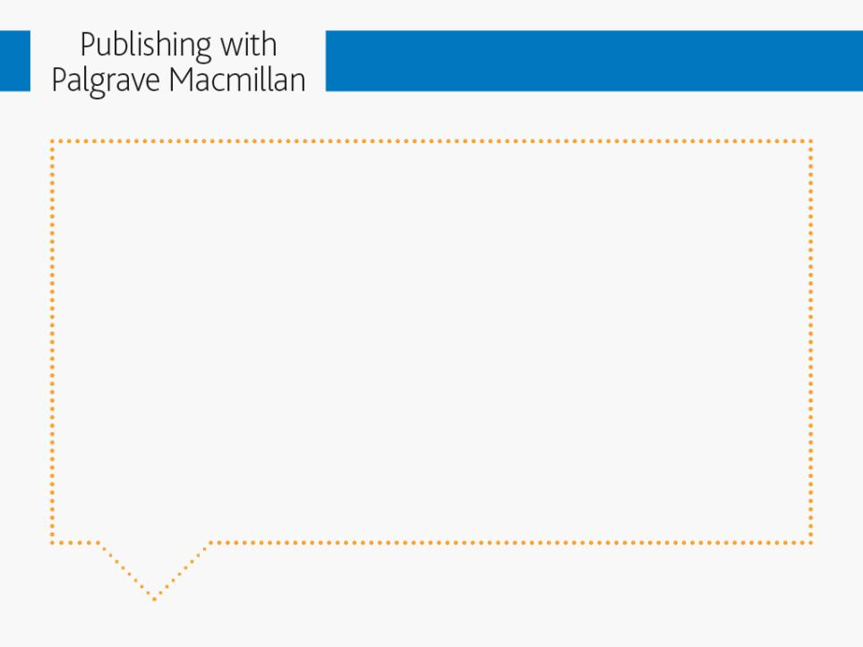
Revising the Dissertation
Do your research: great books available like The Thesis and the Book, From Dissertation to Book, The Future of Scholarly Writing and Stylish Academic Writing –
plus you can email our editors for advice
The audience has changed, so you will need to adapt the book’s scope and approach accordingly
Look at published books in your field
Rethink your content, structure, length, style, readability
Get rid of excessive quotation/documentation
Revise chapter titles, cut notes down, and cut all mention of the book being a thesis in the work (i.e. in acknowledgements page)
Use active, not passive voice

Slide 30

Five Things We Look for in a Book
Original research (new archival discoveries, unique synthesis of ideas, interdisciplinary work)
Relevant to an ongoing debate in the academic field
A clear and persuasive argument
Connects with a defined audience, i.e. has a big enough audience to support the book
Does the book fit with our list? Is there a series your book would fit with? Your proposal or cover letter should demonstrate some familiarity with the press

Slide 31
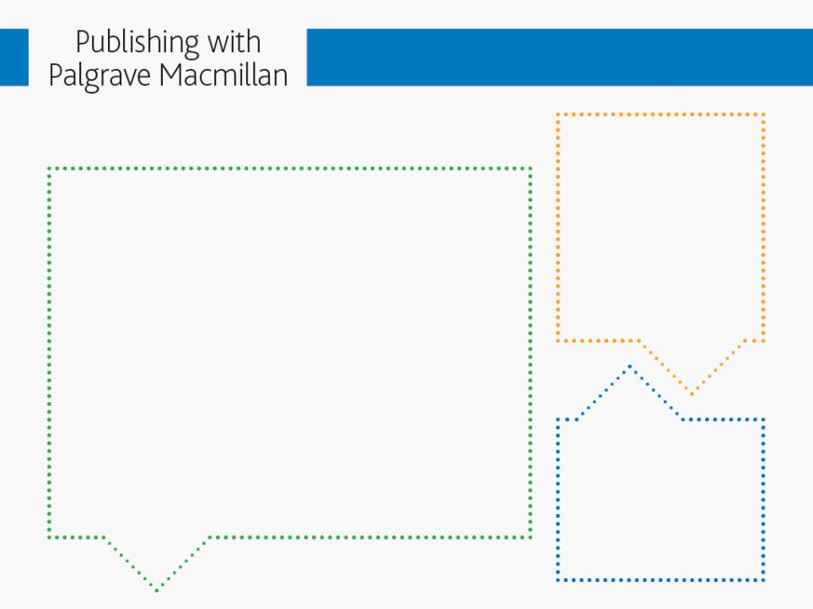
The Proposal – our top tips
2. Description
Think about who’s going to read the proposal and ensure it conveys the aims and contribution of the book
1. Title
Be clear and descriptive. And think about search terms! Some examples:
The Unruly PhD: Doubts, Detours, Departures, and Other Success Stories
Governing Risk: The IMF and Global Financial Crisis
Islam and Controversy: The Politics of Free Speech After Rushdie
Tiananmen Exiles: Voices of the Struggle for Democracy in China
Digitizing Government: Understanding and Implementing New Digital Business Models
3. Content
We’ll need a detailed breakdown + Table of Contents (TOC)

Slide 32
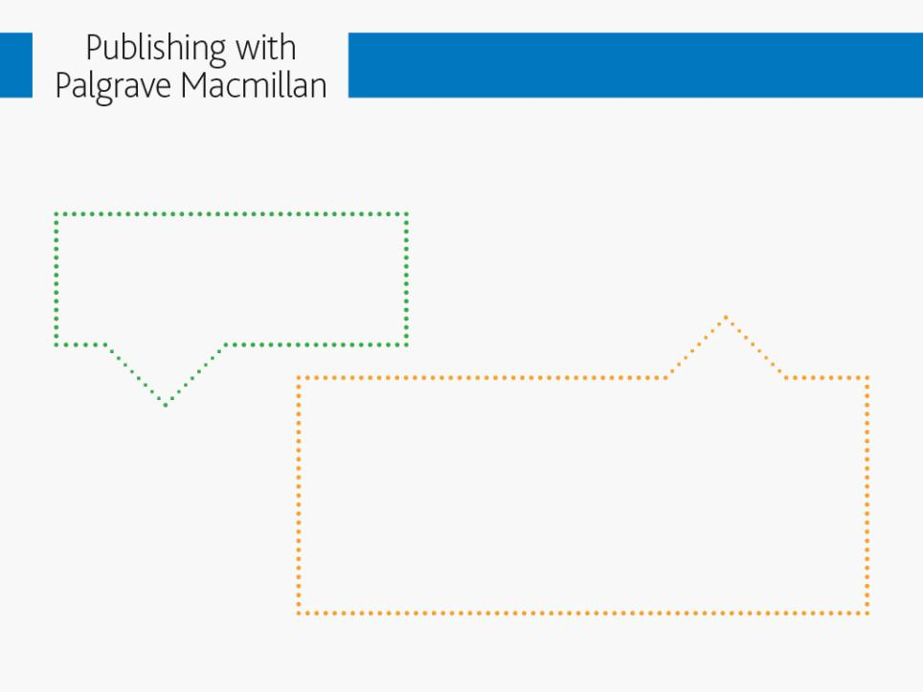
The Proposal – our top tips
4. Market
Primary and secondary; be realistic!
5. Competition – or comparable titles
How will your book fit with the rest of our list? This is worth some research as it tells us how many sales we can expect, whether we have published books that your title can be marketed alongside, and how we might be able to get the edge over competitors in terms of positioning

Slide 33

The Proposal – our top tips
6. 3rd party material
Illustrations, extended quotations, maps – anything that will require permission to use
7. Technical details
Extent, delivery date, contact details

Slide 34
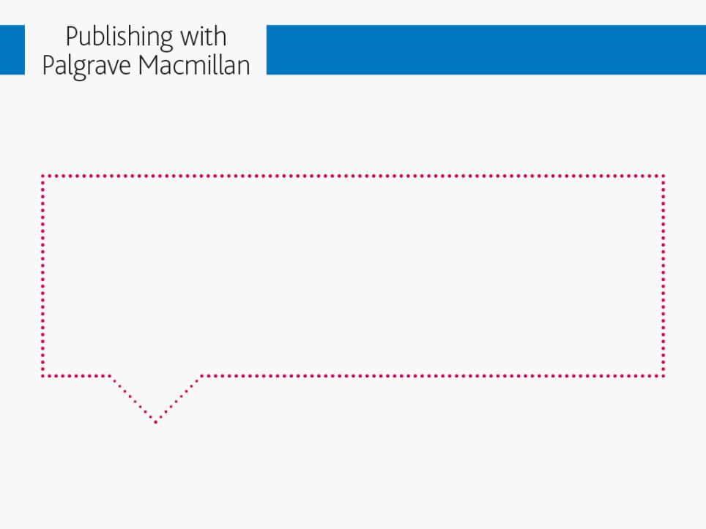
Copyright and Intellectual Property
Palgrave needs permission to be cleared before we’ll put the book into production
Permissions clearance can take a lot of time and cost a lot of money
Only include illustrations and 3rd party material where really necessary to advance your argument
Lots of advice and guidance available online...

Slide 35

Contact Information
To submit a proposal:
http://www.palgrave.com/page/submit-a-proposal/
List of editorial contacts:
http://www.palgrave.com/contacts/editorial-contacts/
More publishing resources: http://www.palgrave.com/page/the-publishing-process/
Author queries regarding marketing and promotion:
authors@palgrave.com

Slide 36
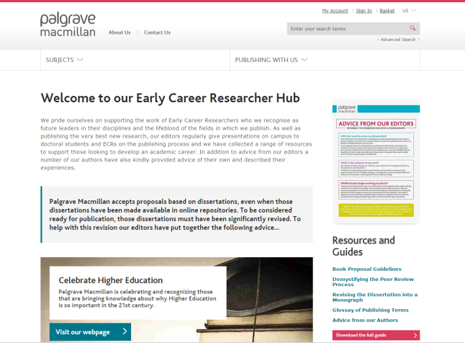
Palgrave’s Early Career Researcher Hub
Notes:
No single approach to financing OA dominates the HSS market. Publishers and OA initiatives have begun piloting a range of OA business models, from Library memberships, Freemium memberships, and crowd funding, to mixed models combining APCs with membership.
Gold open access:
Article is made open access immediately on publication.
Usually associated with an Article Processing Charge (APC).
Article is the version of record, i.e. publisher’s typeset PDF.
CC BY licence allows unrestricted reuse of the article providing the author(s) and original source are properly cited. CC BY is the default license for all NPG-owned fully open access titles. Other licences are available.
Green open access:
Open access after an embargo period (though an embargo will not apply in all cases).
Article is made freely available but somewhere other than the publisher’s website, e.g. in a subject or university repository, or the author’s homepage.
Open access article is not necessarily the version of record - it could be the typeset PDF or the author’s final version after peer review but before typesetting.
Rights/re-use may be limited.

