Slide 1
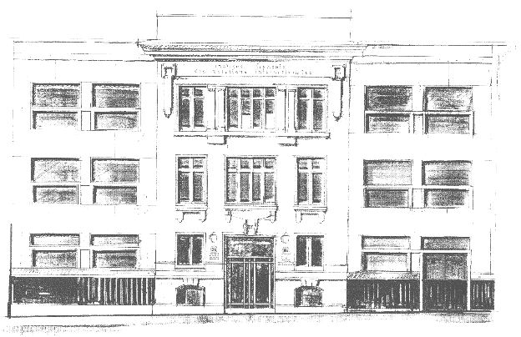
The French Institute of International Relations Paris – Brussels

Slide 2
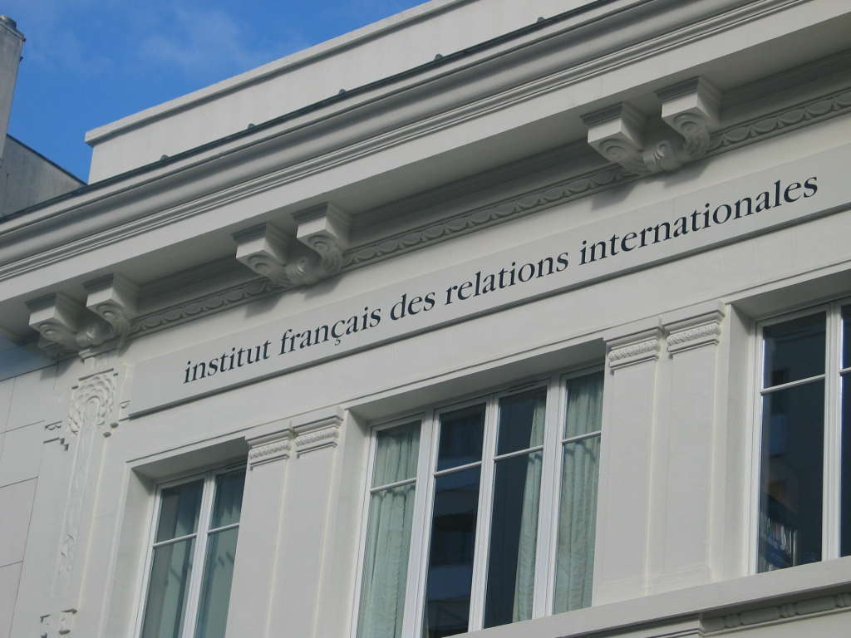
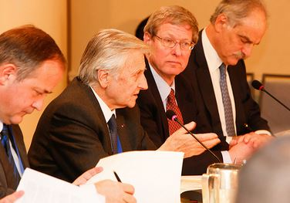
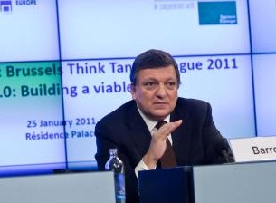
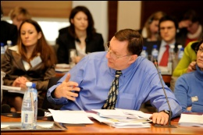
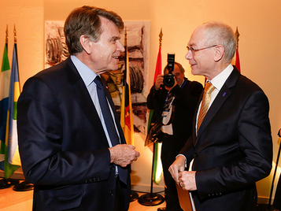
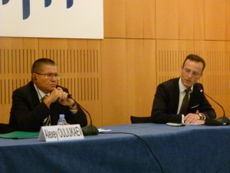
France’s Leading Think Tank on International Affairs
Founded in 1979 by Thierry de Montbrial, Ifri is the principal institution in France for independent analysis of international issues and global governance. It is a non-profit organization, with no political affiliation or any form of government supervision. Since 2005, it has a branch in Brussels.
Ifri brings together political and business leaders, academics and the media.
Through its two main activities – Research and Debate – Ifri aims at:
Analyze and foresee
Producing policy-oriented research on international affairs and the most important emerging trends and put them in perspective.
Structure and enlighten
Fostering dialogue and constructive interaction between decision-makers, academics, public-opinion leaders and civil society representatives at both the national and international levels.

Slide 3




Research
More than 30 researchers from a wide range of backgrounds and disciplines work at Ifri permanently.
Ifri’s research is organized around regional and cross-disciplinary areas:
Comparative regional approaches: Europe, Russia/NIS, Asia, United States, North
Africa, Sub-Saharan Africa, Turkey and Middle East
Cross-disciplinary approaches: Security and Strategic Affairs, Energy, Space, Migrations & Citizenship
Research is reflected in Ifri’s main publications:
Politique étrangère, the oldest French journal on international relations
RAMSES, the annual survey of major world trends – Ifri’s reference book
Digital series of publications - 150 online articles, 70 policy papers in 2013

Slide 4
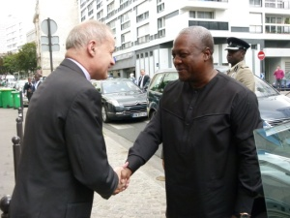
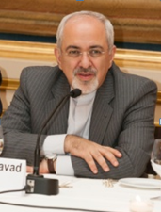
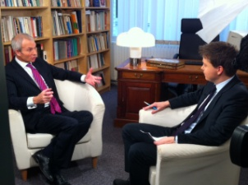
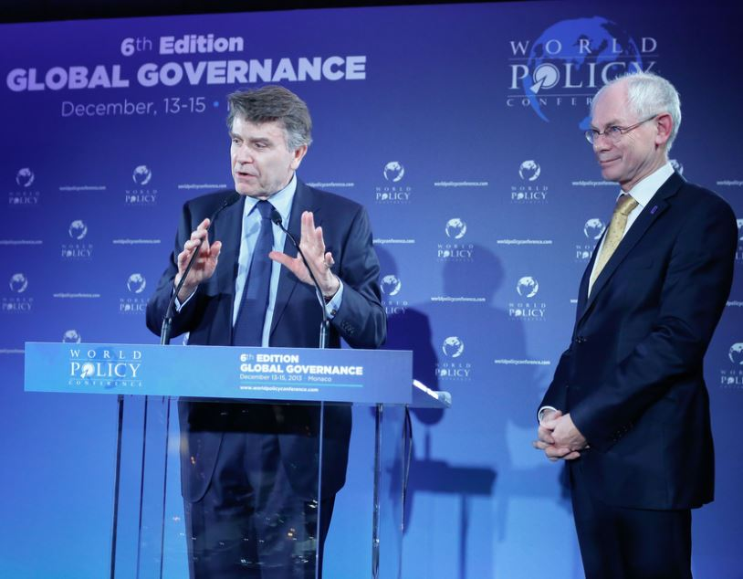
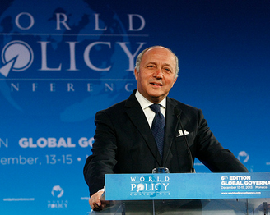
Debate
Ifri’s debates take place in an informal and nonpartisan setting, promoting an exchange between experts and decision-makers, from both private and public sectors.
Each year, Ifri organizes more than 120 events and debates in Paris and Brussels in various formats: public conferences, program seminars, workshops, dinner and lunch debates.
In 2013, Ifri notably hosted John Dramani Mahama, President of Ghana, Mohammad Javad Zarif, Minister of Foreign Affairs of the Islamic Republic of Iran, Robert Hormats, Under Secretary of State for Economic, Business, and Agricultural Affairs, Alexey Ouliukaev, Minister of the Economic Development of Russia, David Lidington, Minister of State for Europe of the United Kingdom…
World Policy Conference (WPC)
Initiated in 2008 by Ifri, the WPC is an international meeting to encourage the emergence of global governance appropriate for the realities of the 21st century.
The sixth World Policy Conference 2013 was held in Monaco with, among others, the participation of Herman Van Rompuy, President of the European Council and Laurent Fabius, Minister of Foreign Affairs of France.

Slide 5

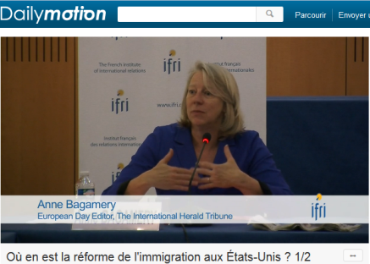
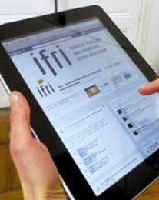
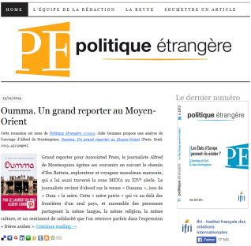
Dissemination
Permanent Interaction with media
360 articles and interviews
More than 5,000 quotes in the French and foreign press
350 television and radio appearances
Website: www.ifri.org
A growing digital presence
Ifri is active on major social networks including Facebook, Twitter, LinkedIn, Google+ and Dailymotion.
Active presence of Ifri’s digital publications on Pearltrees, Scribd, Calaméo
Over 250 videos with prominent decision-makers and experts
Blogs: Ultima ratio and politique-etrangere.com

Slide 6
Status and Resources
Ifri is non-partisan and independent from all administrative and financial regulatory authorities. Its diverse funding sources allow it to maintain its independence.
Ifri benefits from the support of its members and corporate partners:
Over 60 corporate members and sponsors
63 embassies and institutional members
More than 200 individual members
Ifri’s budget was of nearly 6.6 millions Euros in 2012:

Slide 7



The French Institute of International Relations
Contact :
Emmanuelle Farrugia, Deputy Manager for Strategic Development
Phone: +33 (0)1 40 61 60 21 / farrugia@ifri.org
www.ifri.org
Ifri Paris
27, rue de la Procession, F-75740 Paris Cedex 15 Tél. +33 (0)1 40 61 60 00 • Fax : +33 (0)1 40 61 60 60 Ifri Brussels Rue Marie-Thérèse, 21, B-1000 - Brussels Tél. +32 (0)2 238 51 10 • Fax : +32 (0)2 238 51 15

