Slide 1
_{The Global Think Tank}
_{January} ₂₀₁₄

Slide 2

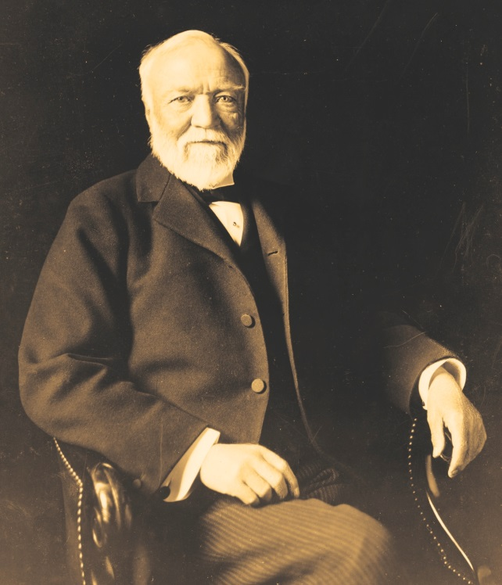
CARNEGIE’S FOUNDING
Founded in 1910 by Andrew Carnegie, the Carnegie Endowment for International Peace is the oldest international affairs think tank in the United States.
“…to advance the cause of peace among nations; to hasten the renunciation of war as an instrument of national policy; to encourage and promote methods for the peaceful settlement
of international differences and for the increase of international understanding and concord; and to aid in the development of international law and the acceptance by all nations of the principles underlying such law.”
—from the Carnegie Endowment Charter, February 20, 1929

Slide 3

CARNEGIE’S MISSION
The Carnegie Endowment for International Peace is a unique global network of policy research centers in Russia, China, Europe, the Middle East, and the United States. Our mission, dating back more than a century, is to advance the cause of peace through analysis and development of fresh policy ideas and direct engagement and collaboration with decisionmakers in government, business, and civil society. Working together, our centers bring the inestimable benefit of multiple national viewpoints to bilateral, regional, and global issues.

Slide 4
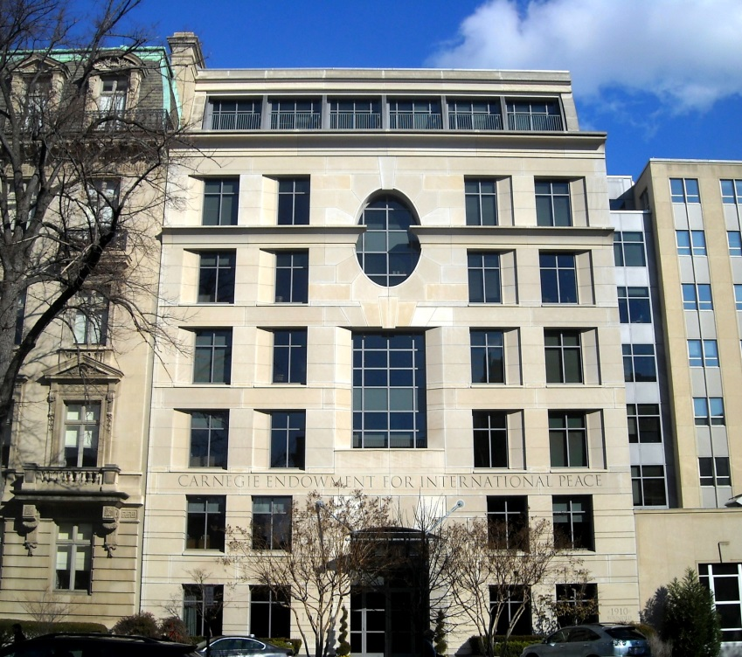
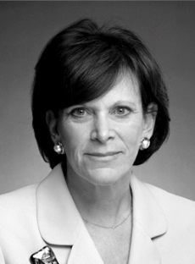
CARNEGIE’S CENTERS
In 2006, Carnegie launched a revolutionary plan to build the first global think tank and now has research centers in Beijing, Beirut, Brussels, Moscow, and Washington.
WASHINGTON
With 100 employees, the Washington office serves as the institution’s headquarters through which Carnegie’s centers collaborate on issues of shared interest.
Jessica T. Mathews
President
Carnegie Endowment for International Peace

Slide 5

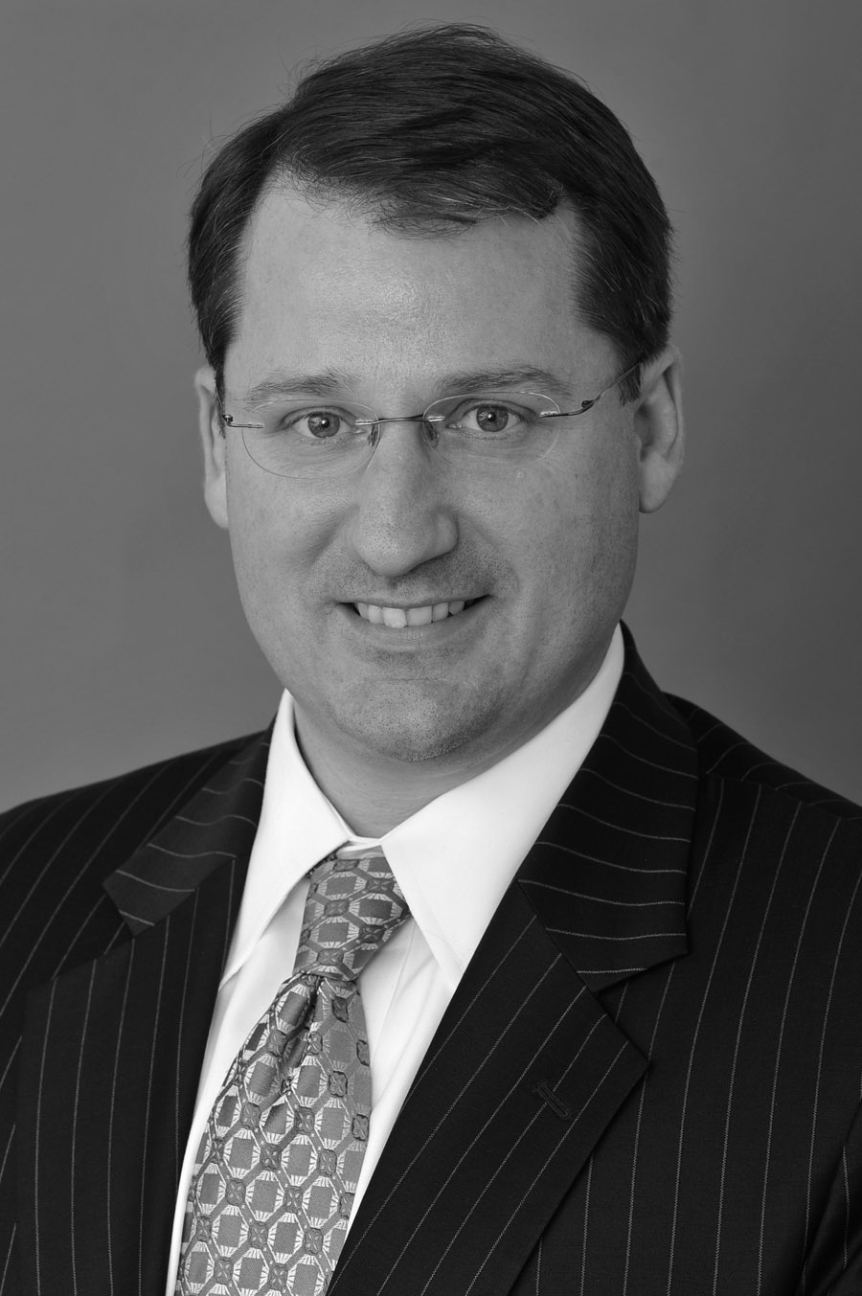
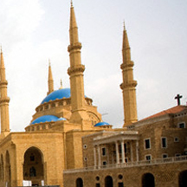
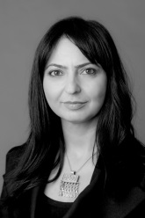
CARNEGIE’S CENTERS
BEIJING | 2010
The Carnegie–Tsinghua Center for Global Policy brings together top experts from China, the United States, and the international community for collaborative research on common global challenges.
Paul Haenle
Director Carnegie–Tsinghua Center for Global Policy
BEIRUT | 2006
The Carnegie Middle East Center aims to better inform the process of political change in the Arab world and deepen the understanding of the complex economic and security issues that face it.
Lina Khatib
Director
Carnegie Middle East Center

Slide 6
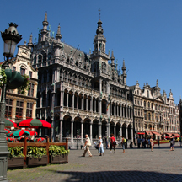
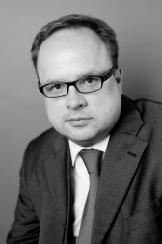
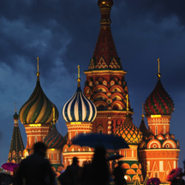
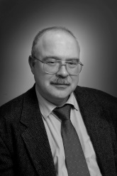
CARNEGIE’S CENTERS
BRUSSELS | 2007
Carnegie Europe focuses on the external issues that are facing Europe and the European Union, and aims to foster new thinking in Brussels and European capitals on Europe’s role as a strategic actor.
Jan Techau
Director CarnegieEurope
MOSCOW | 1994
The Carnegie Moscow Center brings together researchers in Moscow and from Carnegie’s global centers to provide a free and open forum for the discussion and debate of national, regional, and global issues.
Dmitri Trenin
Director
Carnegie Moscow Center

Slide 7
CARNEGIE’S PROGRAMS
Asia Democracy and Rule of Law
Energy and Climate International Economics
Middle East
Nuclear Policy
Russia and Eurasia
South Asia

Slide 8
CARNEGIE’S LEADERSHIP
Jessica T. Mathews, President
Paul Balaran, Executive Vice President and Secretary
Tom Carver, Vice President for Communications and Strategy
Charles F. Gauvin, Chief Development Officer
Thomas Carothers, Vice President for Studies
Marwan Muasher, Vice President for Studies
Douglas H. Paal, Vice President for Studies
George Perkovich, Vice President for Studies
Andrew S. Weiss, Vice President for Studies
Paul Haenle, Director, Carnegie–Tsinghua Center for Global Policy
Lina Khatib, Director, Carnegie Middle East Center
Jan Techau, Director, Carnegie Europe
Dmitri Trenin, Director, Carnegie Moscow Center Harvey V. Fineberg, Chairman of the Board

Slide 9
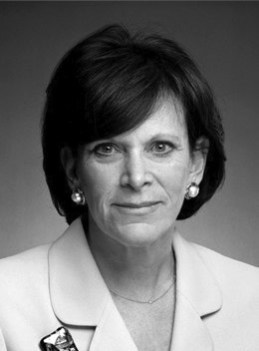
CARNEGIE’S LEADERSHIP
Jessica T. Mathews
President
Jessica Tuchman Mathews has served as president of the Carnegie Endowment for International Peace since 1997. She was director of the Council on Foreign Relations’ Washington program and a senior fellow from 1994 to 1997. While there she published her seminal 1997 Foreign Affairs article, “Power Shift,” chosen by the editors as one of the most influential in the journal’s seventy-five years.
From 1982 to 1993, she was founding vice president and director of research of the World Resources Institute, an internationally known center for policy research on environmental and natural resource management issues.
She served on the editorial board of the Washington Post from 1980 to 1982, covering energy, environment, science, technology, arms control, health, and other issues. Later, she became a weekly columnist for the Washington Post, writing a popular weekly column that appeared nationwide and in the International Herald Tribune.
From 1977 to 1979, she was director of the Office of Global Issues of the National Security Council, covering nuclear proliferation, conventional arms sales, and human rights. In 1993, she returned to government as deputy to the Undersecretary of State for Global Affairs. Earlier she served on the staff of the Committee on Energy and the Environment of the Interior Committee in the U.S. House of Representatives.

Slide 10
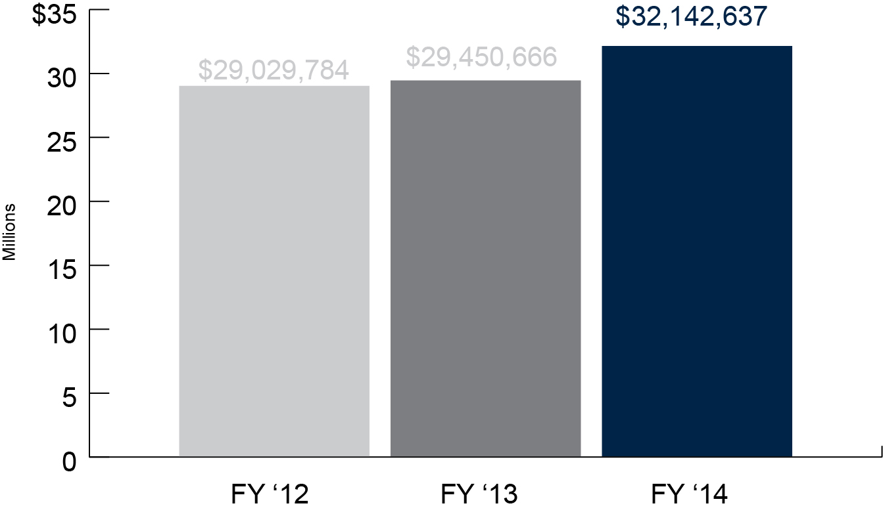
CARNEGIE’S BUDGET

Slide 11
CARNEGIE’S 2012 RANKINGS
THE UNIVERSITY OF PENNSYLVANIA’S GLOBAL GO TO THINK TANK RANKINGS
Carnegie Endowment for International Peace: #2 in the United States and #3 worldwide
Carnegie Middle East Center: #1 the Middle East and North Africa
Carnegie Moscow Center: #2 in Central and Eastern Europe
Carnegie–Tsinghua Center for Global Policy: #7 in China, India, Japan, and South Korea, #3 in China, and #1 among non-governmental affiliated Chinese think tanks
Carnegie Europe: #17 in Western Europe

Slide 12
For more information, please visit our website: www.carnegieendowment.org
_{or}
contact Tom Carver, vice president of Communications & Strategy tcarver@ceip.org

