Slide 1


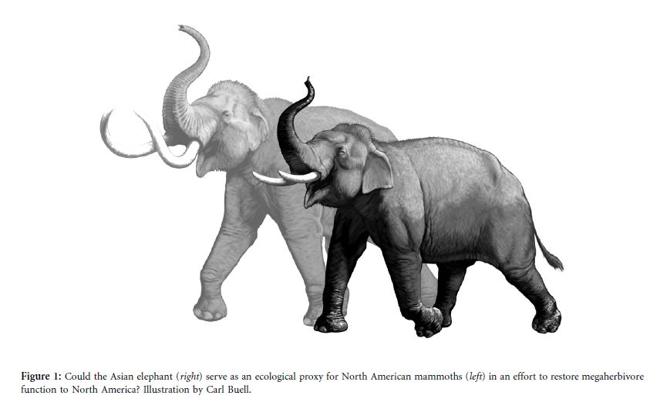
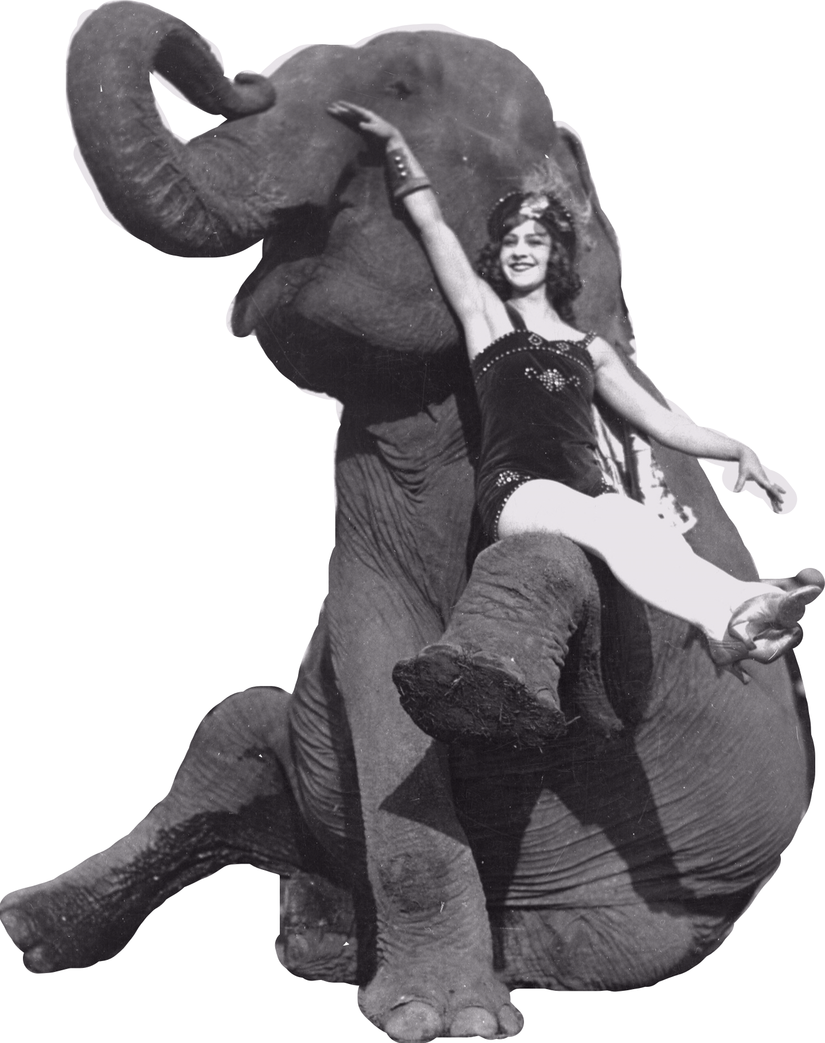
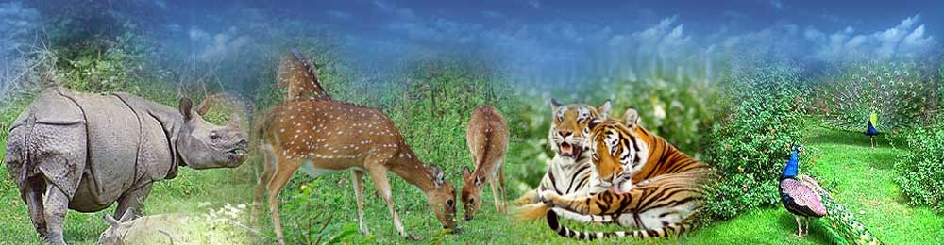
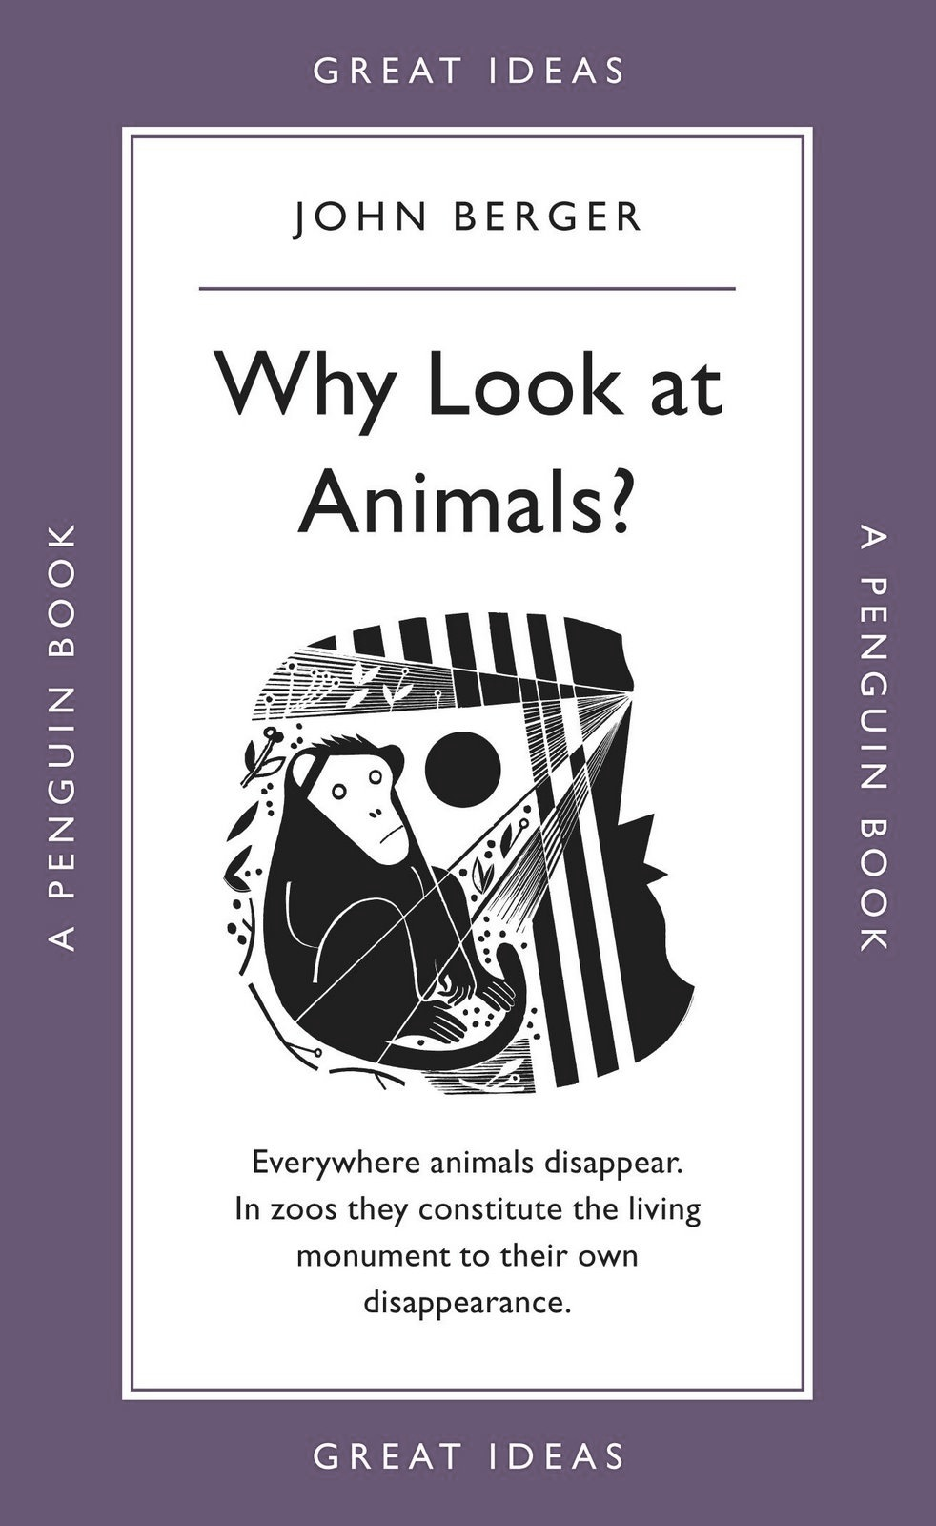
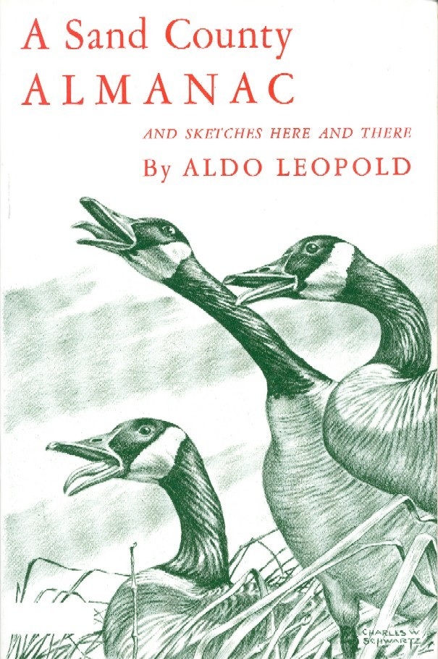

THE AMERICAN ELEPHANT
The Controversy of Keeping Elephants in the United States
Senior Thesis by Randa Atkins
Advised by Dr. Ann Greene
Philosophy
~AND CONTRADICTIONS~
Modes of Existence in the United States
Proposal for the Recognition of an ~American Elephant Species~
The elephant is unique. It’s a representation of various human traits across the world to many peoples. The elephant’s relationship with humans is as old as the human fascination with the animal, but also as variable. The giant pachyderms are often thought of as human-like and are thought to have similar cognitive capabilities. This, among many other reasons, is why their existence in the U.S. today is so controversial.
Elephants are representative of the way in which Americans think of the environment today. There’s really no consensus. Between only three philosophers, their ideas vary greatly:
Aldo Leopold argues that the wilderness is not necessarily separate from civilization and that there are proper ways to interact with nature.
Peter Singer argues that animals are entitled to equal consideration as long as are capable of suffering.
John Berger argues that animals have a dual existence where they can be treated humanely, yet still be subject to domestication and its hardships.
Elephants are interesting to look at because they exist in a variety of modes in the U.S. each with its own pros and cons.
THE CIRCUS
Pleistocene Rewilding is the idea that we can re-wild the American environment by introducing ecological proxy animals to the ecosystem. Ecological proxies are animals that, genetically, closely resemble animals that have gone extinct. In this specific case, the elephant is a proxy for the woolly mammoth, so some scientists are fairly certain it would survive well on the North American continent.
Pros:
The circus is a huge part of American history and culture. We’ve developed a unique relationship between man and animal and elephants can to amazing things
Cons:
The training methods circuses employ often harm animals. The elephants are poked and prodded with bull hooks, shocked, and forced into unnatural positions
Pros:
The elephants never interact with humans and aren’t subjected to abuse.
Pros:
The zoo brings animals to the masses, making education possible, and often swaying public opinion towards conservation efforts
NATURAL HABITAT
THE ZOO
Instead of focusing on African and Asian elephants and how their enclosures fail to accurately simulate their wild environments, I argue that we should treat the elephants in America as if they were their own species. Elephants in the Americas have been featured in shows or confined to small enclosures, and often times, they’ve had long-lasting relationships with humans. These elephants have different needs then their wild counterparts, and should be treated as such.
Cons:
Once an elephant has been brought to the U.S. and trained, a life in the wild isn’t necessarily preferable. In addition, their natural habitats are shrinking, putting their populations at risk.
Cons:
There are few ways one can put an elephant on display and at the same time ensure they have enough stimuli and space to be mentally and physically healthy
The history of performing with elephants is a long one. This is a photo from the Collection of the Ringling Circus Museum (1870-1950)
U.S. SANCTUARY
Pros:
These elephants are rescued and allowed to live their lives in a way that closely resembles life in the wild
Cons:
Some sanctuaries deny human-elephant contact. While the animals are treated more humanely, there is value in the long history of domestication that exists.
I’ve only studied and considered elephants as an example. There are many animals considered both wild and domesticated, as elephants are and they too should be thought of in the context of the United States, rather than only their wild habitats. To be “wild” is not easily defined. We can reimagine what wild will mean to the animals that live and will continue to live in our country.

