Slide 1

The Hungarian Institute of International Affairs

Slide 2
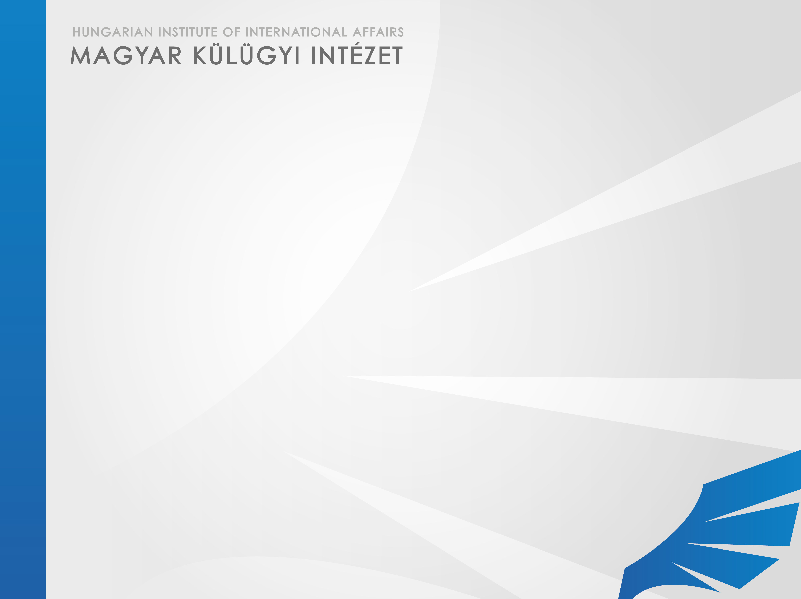
The mission
The HIIA was established as a background support institution to the MFA “to strengthen the academic background of foreign policy analysis and strategic planning”.
The basic function of the HIIA is to conduct academic research, provide education and training as well as the dissemination of knowledge on international relations, global trends, European integration, issues of interest in the focus of Hungarian foreign policy, etc.

Slide 3
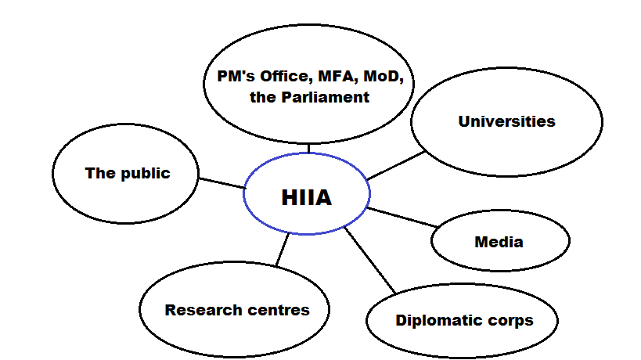

Slide 4
The domestic context
The HIIA is a specific interface between the “classical” foreign policy analysis/research and the public including the universities and the media. Its main functions are
  Consulting the decision-makers on foreign policy issues by preparing analyses and forecasts;
  Networking with Hungarian and foreign research units;
  Organizing conferences, workshops and seminars;
  Contributing to the public debate on foreign policy issues, and thus to the relevant social consensus;
  Publishing position papers and academic research essays in its journal and on its website;
  Participating in the training of diplomats, experts and students.

Slide 5


The international context
The HIIA is a member of academic and research networks focusing on foreign and security policy issues including the European Policy Institutes Network (EPIN), the EU Non-Proliferation Consortium, the European Defence and Security Network (ESDN) and the Euro-Mediterranean Study Commission (EuroMeSCo).
The HIIA works closely together with its partners in the Visegrad countries contributing to several joint projects financed by the International Visegrad Fund.
The HIIA also maintains relations on a bilateral basis with several European, American and Asian research institutes.
The HIIA has recently launched a joint program with the Fulbright Program.

Slide 6

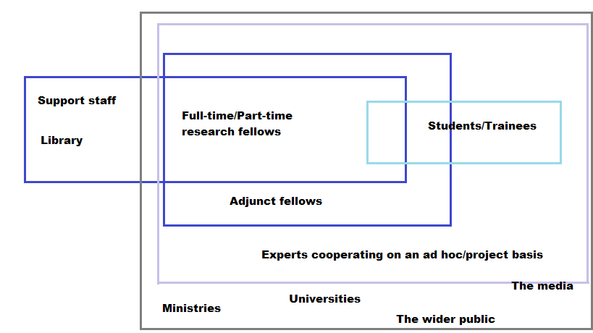
The staff
The Institute is directed by András Király.

Slide 7
The fields of research
The HIIA conducts its activities in harmony with the main directions of Hungarian foreign and security policy.
Each research fellow is typically an expert on a theoretical subject as well as on a region or a state (or group of states).
The theoretical topics covered by the HIIA include the theory of international relations, European and regional integration, trans-Atlantic relations, the Visegrad cooperation, NATO, security and defense policy, the global economic crisis, terrorism, etc.
Regions/countries in focus are Hungary’s direct neighborhood, East and Central Europe, the EU (including specifically the United Kingdom, France and Germany), the USA, East Asia (specifically China), the Middle East and North Africa, and Africa.

Slide 8
The projects
The current projects of the HIIA include
  IRSEC hub;
  Think Visegrad;
  Az antiszemitizmus nem fér össze az emberiséggel [Antisemitism is incompatible with humanity];
  Increasing human security as an instrument of conflict resolution: the case of the Serbian minority in Kosovo;
  Raising Awareness – Finding Common Ground: The V4 and the Maghreb.
For other current and already concluded projects see the HIIA website at
http://www.hiia.hu/web/guest/projektjeink

Slide 9
The publications
The HIIA publishes the Külügyi Szemle four times a year in Hungarian and the Foreign Policy Review once a year, both in print and electronically. The Editor-in-Chief is Prof. Dr. László J. Kiss.
The HIIA Papers and the Quick Analyses are published electronically.
The Asian Studies has been published twice so far. Editor: Tamás Matura
The HIIA has published conference proceedings as well as monographs written by its researchers.

Slide 10
The library
The library has a collection of some 12,500 volumes and 90 periodicals in the field of international relations.
The library is open to the public, researchers and students as well.
The catalogue of the library can be accessed at http://mki.asp.hunteka.hu

Slide 11
The budget
The HIIA has received most of its budget from the state budget (the HIIA is a separate title under the MFA budget).
Recently, the HIIA has started to diversify its resources by increasingly relying on such possibilities as the International Visegrad Fund and others.
The HIIA is currently working on cooperating and forming coalitions with other partner institutions in applying for research funds in the Horizont 2020 program launched by the EU.
The total budget of the HIIA in 2013 was 202 million HUF (approx. 650,000 Euros) – from the state budget and from different project funds.

