Slide 1



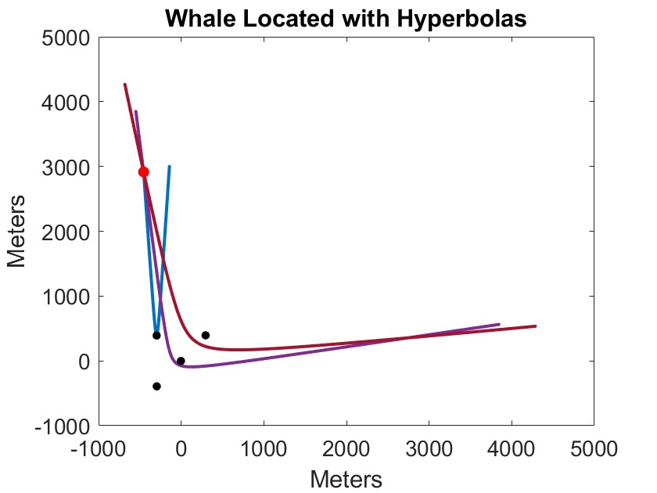


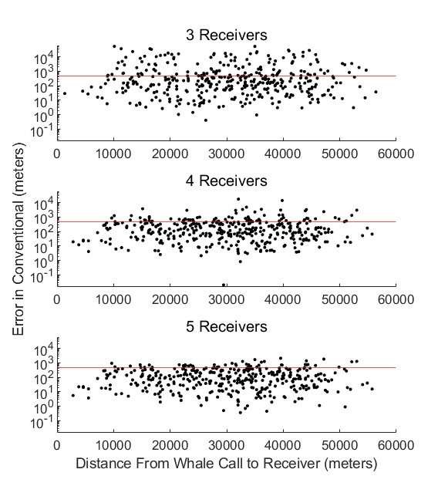
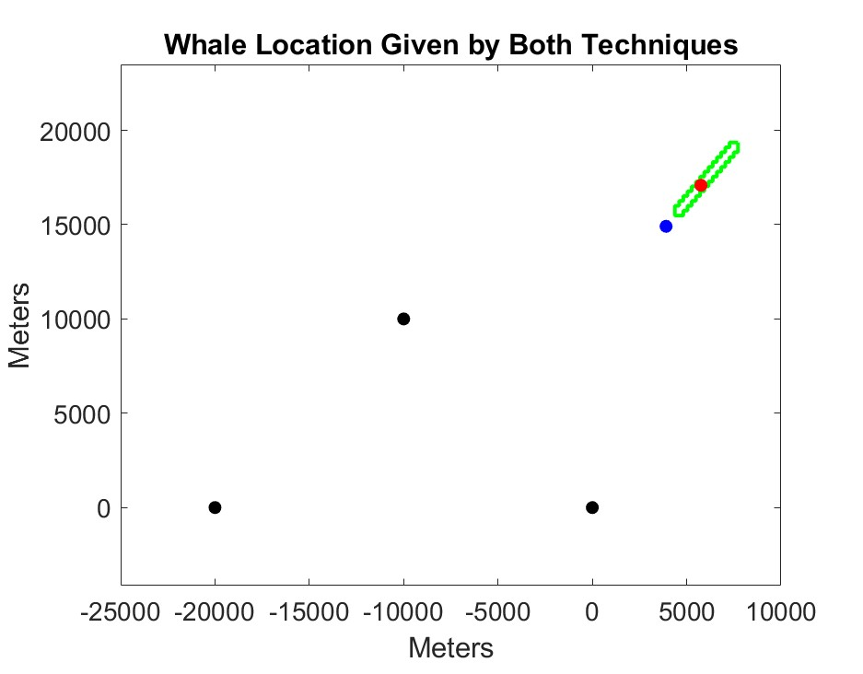
Risk to Endangered Right Whales Decreased with Modern Location Technique
John Spiesberger, Ph.D., University of Pennsylvania
David K. Mellinger, Ph.D., Oregon State University
Devin Pascoe
Master of Environmental Studies ‘23
Introduction
Conventional Method Error
North Atlantic right whales (Eubalaena glacialis) are under stress due to anthropogenic sounds in their environment, including sounds from construction and operation of offshore wind farms, as well as danger from ship strikes. Marine mammals can be located using detection of their calls by for a range of 10-100 km. Marine acoustic localization is often selected over other localization techniques due to this large detection range as well as the fact that it is less expensive than other methods. In this study, a modern marine acoustic localization method was compared to a conventional method to determine and compare their accuracies. The output of the modern model, Sequential Bound Estimation (SBE; http://www.scientificinnov.com/current-work), yields a 100% confidence interval of location. The output of the conventional method in Ishmael 3.0 (http://www.bioacoustics.us/ishmael.html) is a specific coordinate with unidentified accuracy.
Fig. 1. View of ocean from above. Calling whale located by collecting call sounds on four receivers (black dots) and computing time difference of call sound arrival between pairs of receivers. Under ideal circumstances, all possible locations of whale for one pair of receivers becomes a hyperbola and hyperbola intersections give whale location.
Methods
Software was written to compute the errors of the modern and conventional techniques to locate calling whales. The starting point, presented here, compares the accuracy of both techniques under ideal circumstances, where measurement error is negligible, and all the animals and receivers are on the same horizontal plane with a known constant speed of sound (Fig. 1).
Results and Discussion
The errors of both methods were evaluated for cases with 3, 4, and 5 receivers and 400 whale call locations chosen randomly in space. The modern technique contained the true whale location 100% of the time and the conventional method never output the true location. Under these ideal circumstances with practically no error (Figs. 2 and 3), the conventional solution had errors exceeding 500 yards, the distance required between any vessel and North Atlantic right whale to avoid vessel strikes and whale injury or death (Minimum Approach Rule, 50 CFR 224.103(c)). The error of the conventional solution exceeded 500 yards 34.5 % of the time with 3 receivers, 19.5% with 4 receivers, and 12.25% with 5 receivers.
Fig. 3. Error of conventional method (Ishmael) as function of distance from whale to mean receiver position for case with negligible measurement error when there are 3,4, and 5 receivers. Red line = 500 yards
Fig. 2. View of ocean from above. Modern technique (green outline) gives area with 100% confidence of location. Conventional techniques gives one coordinate (blue dot). Receivers (black dot), calling whale (red dot)

