Slide 1
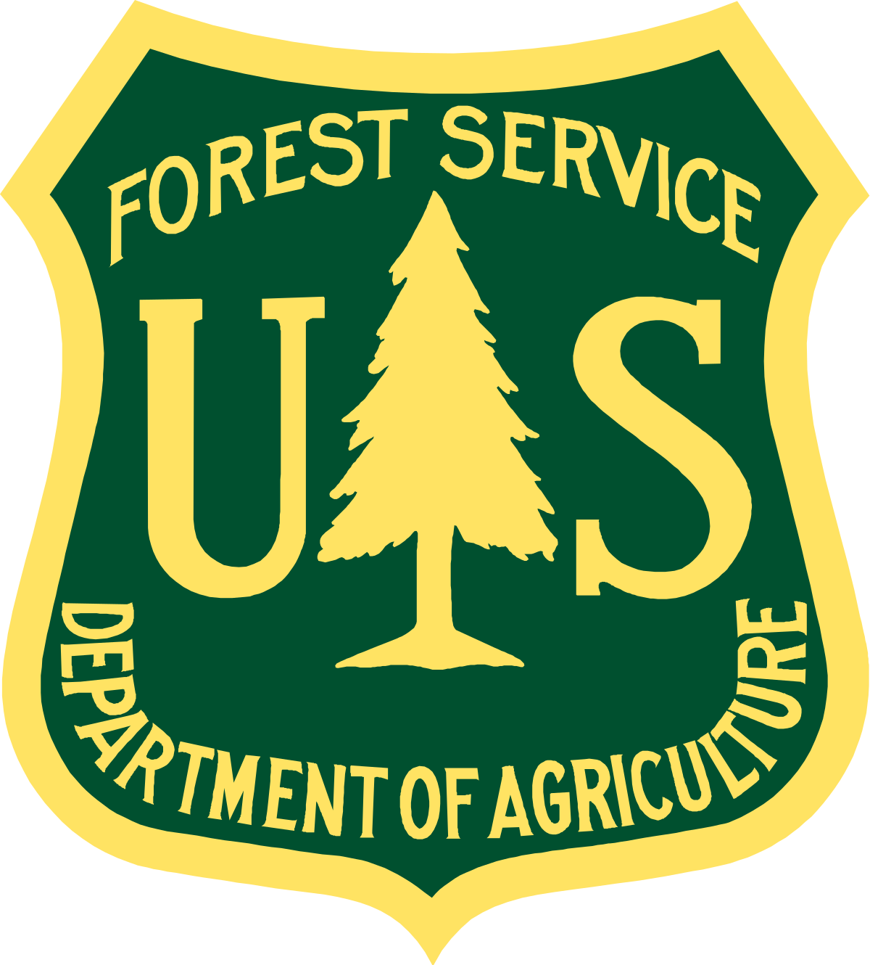

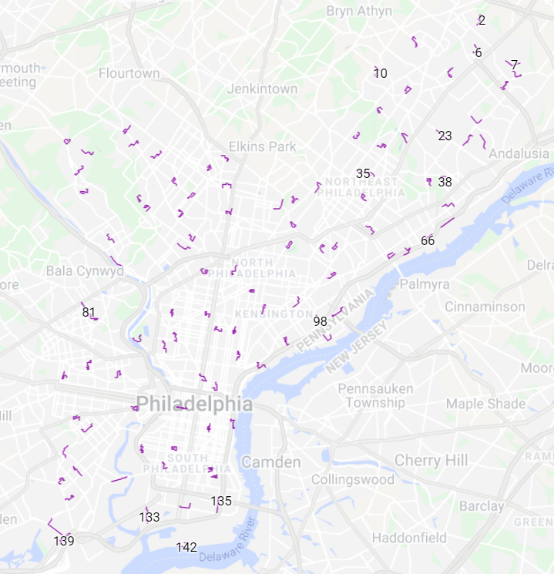

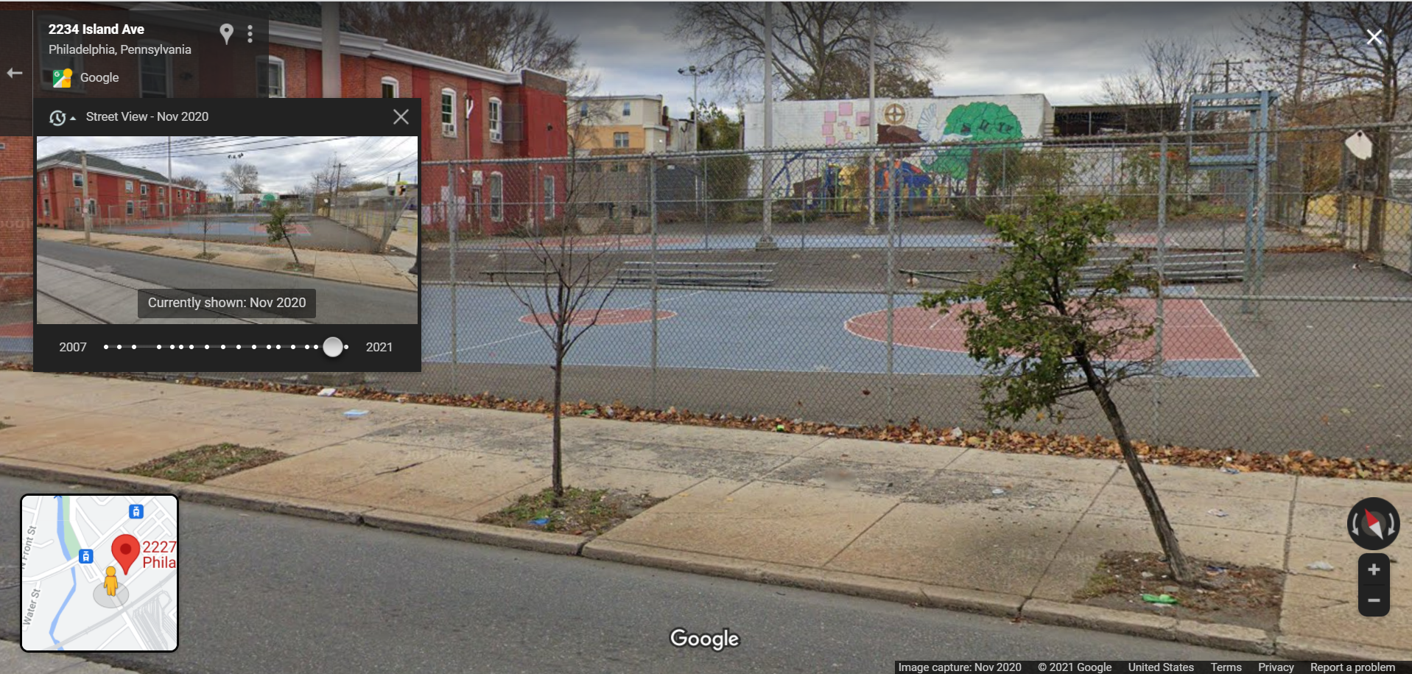
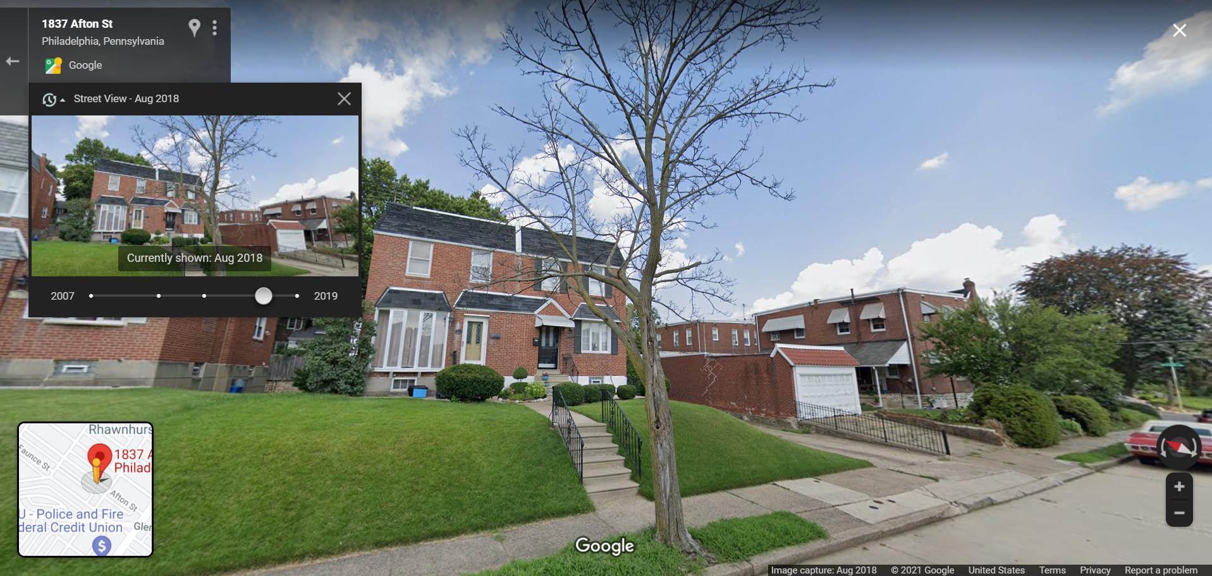
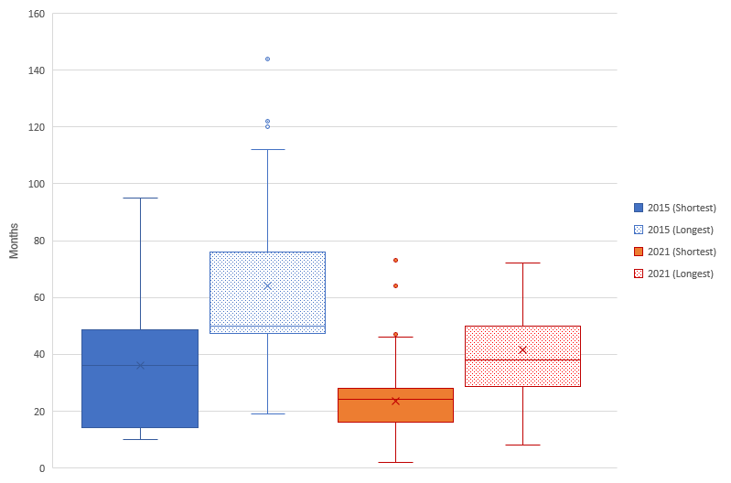
The Fate and Persistence of Standing Dead Street Trees in Philadelphia, PA
Primary Reader:
Lara Roman, Ph.D
Regan R. Wilson
MES 2021
Secondary Reader:
Sally Willig, Ph.D
INTRODUCTION
RESULTS & ANALYSIS
DISCUSSION & CONCLUSION
Fig 1. The variation of year availability in GSV. Some locations have a wide array of years available (left), making fate and persistence easy to track. Some locations have very few years available (right), making it difficult to estimate the fate of a particular tree and its persistence over time.
Street trees are an integral component of urban forests. Streetscapes are often challenging habitats, with poor conditions compared to natural forested areas (Hilbert et al., 2019; Scharenbroch et al., 2017; Urban, 2008). This leaves standing dead street trees to persist on the landscape for years (Roman et al., 2014; Breger et al., 2019). Little is known about the removal and replacement of dead trees that change the structure of the community. In this study, I observed the fate, persistence, and change in the standing dead street tree community between 2015 and 2021 in Philadelphia, PA.
The number of standing dead street trees increases from 1.5% (2015) to 2.0% (2021).
The persistence on streetscapes decreases from a median of 36-50 months (2015) to 24-38 months (2021) (Fig 2).
The average diameter-at-breast height (DBH) decreases from 15.3-30.4 cm (2015) to ≤7.6 cm (2021) (Fig 3).
Increased number of dead trees in 2021 suggests an increased rate of failed plantings of new trees.
Decreased persistence of dead trees suggests that Philadelphia Parks and Recreation (PPR) have been more proactive in tree removal between 2015 to 2021.
DBH in 2021 further supports an increased rate of failed plantings of new trees.
DBH in 2015 and 2021 suggests that old, large trees are also more likely to be removed as a form of risk management.
Results from this study can be applied to future urban forestry management efforts, tree inventories, and research.
REFERENCES
Image 1. The study plots (n=103) in Philadelphia, PA via Google Maps.
METHODS
Berland, A. & Lange, D.A. (2017). Google Street View Shows Promise For Virtual Street Tree Surveys. Urban Forestry & Urban Greening. 21: 11-15. https://doi.org/10.1016/j.ufug.2016.11.006
Berland, A., Roman, L.A., Vogt, J. (2019). Can Field Crews Telecommute? Varied Data Quality from Citizen Science Tree Inventories Conducted Using Street-Level Imagery. Forests. 10(4): 349. https://doi.org/10.3390/f10040349
Breger, B.S., Eisenman, T.S., Kremer, M.E., Roman, L.A., Martin, D.G., and Rogan, J. (2019). Urban Tree Survival and Stewardship in a State-Managed Planting Initiative: A Case Study in Holyoke, Massachusetts. Urban Forestry & Urban Greening. 43: 126382. https://doi.org/10.1016/j.ufug.2019.126382
Hilbert, D.R., Roman, L.A., Koeser, A.K., Vogt, J., and van Doorn, N.S. (2019). Urban Tree Mortality: A Literature Review. Arboriculture & Urban Forestry. 45(5): 167-200. https://doi.org/10.13140/RG.2.2.25953.15204
Roman, L.A., Battles, J.J., and McBride, J.R. (2014). Determinants of Establishment Survival for Residential Trees in Sacramento County, CA. Landscape and Urban Planning. 129: 22-31. https://doi.org/10.1016/j.landurbplan.2014.05.004
Scharenbroch, B.C., Carter, D., Bialecki, M., Fahey, R., Scheberl, L., Catania, M., Roman, L.A., Bassuk, N., Harper, R.W., Werner, L., Siewert, A., Miller, S., Hutyra, L., Raciti, S. (2017). A Rapid Urban Site Index for Assessing the Quality of Street Tree Planting Sites. Urban Forestry & Urban Greening. 27: 279-286. https://doi.org/10.1016/j.ufug.2017.08.017
Urban, J. (2008). Up by Roots. International Society of Arboriculture, Champaign, IL. 479 pp.
Field-based street tree monitoring data collected in 2015 and 2021 and Google Street View (GSV) were used to observe the fate and persistence of dead trees.
GSV has been shown to be useful in tracking the inventory of dead trees over time (Berland & Lange, 2017; Berland et al., 2019).
A comparative analysis was conducted to observe the differences in fates, lengths of persistence, and overall changes between inventories.
Fig 2. The shortest and longest amount of time (months) street trees from the 2015 and 2021 field seasons were found standing dead on streetscapes. The ‘x’ in each boxplot indicates the mean and the line through each boxplot indicates the median.
Table 1. The summary set of data representing the boxplot (Fig 2) of the shortest and longest amount of time (months) standing dead street trees persisted on streetscapes
 | Minimum | Q1 | Median | Q3 | Maximum | Range | Outliers
2015 (Shortest) | 10 | 14 | 36 | 49 | 95 | 85 | n/a
2015 (Longest) | 19 | 47 | 50 | 76 | 144 | 125 | 120, 144
2021 (Shortest) | 2 | 16 | 24 | 28 | 73 | 71 | 47, 64, 73
2021 (Longest) | 8 | 29 | 38 | 50 | 72 | 64 | n/a
ACKNOWLEDGEMENTS
This study and the University of Pennsylvania occupy the ancestral, traditional, and contemporary lands of the Lenni-Lenape people: the Nanticoke Lenni-Lenape Tribal Nation, the Ramapough Lenape Nation, the Powhatan Renape Nation, the Nanticoke of Millsboro Delaware, and the Lenape of Cheswold Delaware. We acknowledge the Lenni-Lenape as the original people of this land and their continuing relationship with their territory.
This study was conducted as a part of the Masters of Environmental Studies (MES) Capstone project. I would like to thank Lara Roman, Capstone advisor, and Sally Willig, MES advisor, for their ongoing support, advice, and knowledge. I would also like to thank the 2021 street tree monitoring field advisor Levon Bigelow (University of Connecticut) and the other 2021 field crew members for their assistance in data collection. Lastly, I would like to thank my friends and family for their continual support.
Fig 1. The variation of year availability in GSV. Some locations have a wide array of years available (left), making fate and persistence easy to track. Some locations have very few years available (right), making it difficult to estimate the fate of a particular tree and its persistence over time.
Fig 3. The diameter at breast height (DBH) of standing dead street trees from the 2015 (right) and 2021 (left) inventory that fall within the following 7 DBH classes: 1 (≤7.6 cm), 2 (7.7–15.2 cm), 3 (15.3–30.4 cm), 4 (30.5–45.6 cm), 5 (45.7–60.8 cm), 6 (60.9–76 cm), and 7 (>76 cm).

