Slide 1

CREAM Centre de Recherches, d’Etudes et d’Appui à l’Analyse Economique à Madagascar Research Center for Study, Support and Economic analysis in Madagascar
March 2014

Slide 2
OUTLINE - Overview on Madagascar - CREAM in brief : status, historical background, goal and vision, activities, financial sources, assets … - CREAM Technical staff : members, work organization. - CREAM Communication Department : members and missions, dissemination and campaign activities .

Slide 3
Overview on MADAGASCAR

Slide 4
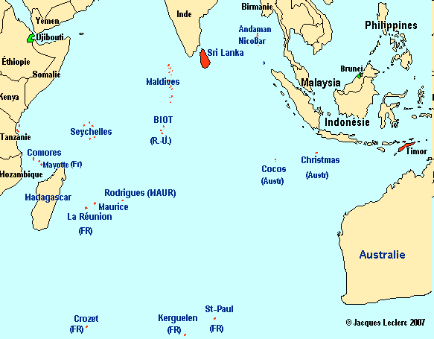

Malagasy’s flag
Adam Smith 1776

Slide 5

Madagascar is
the 4th largest island in the world,
located in the Indian Ocean, at 400 km from the southeastern coast of Africa (Mozambique and Tanzania).
Square : 587 041 sqkm – coastline : 4 828 km.
Climate: Coastal Tropical - Inland Temperate - South Arid * Hot and rainy from November to April * Cooler and dry from May to October
Capital City : Antananarivo
Decentralized local government :
22 regions, 119 districts, 1.579 communes

Slide 6
Population : 20 696 070 hab (INSTAT 2011)
National language (mother tongue): Malagasy
Religions :
- Traditional 52%
- Christian 41%
- Muslim 7%
Currency : Ariary - abbreviations: Ar or MGA.
(1 USD = 2.320 and 1 EUR = 3.202) ( fin fev 2014)
Member of COMESA (1994) and SADC (2005)
Colonized by France from 1985 to 1960

Slide 7
GDP per capita (USD) 486 (INSTAT, 2011)
GDP per sector
Agriculture 28.7%
Industry 16.5%
Services 54.8%
Sources of growth: Tourism, textile,mining, aquaculture...
Poverty rate: 76,5% (INSTAT, 2010)
Inflation rate : around 6%
Actual President :
Hery RAJAONARIMAMPIANINA

Slide 8
CREAM in brief

Slide 9
CREAM’status
Status:
Public Administrative Institute, under the supervision of the Ministry of Economy and Industry.
Supported by the African Capacity Building Foundation (ACBF).
Office: Antananarivo
Lot II A 78 U A Immeuble Manambina
Soavimbahoaka – 101 Antananarivo MADAGASCAR
Site web : http://www.cream.mg
E-mail : cream@cream.mg HP : 261 20 34 14 450 01

Slide 10
CREAM Historical background
1999 : Project Document + Technical committee.
2002 : Grant agreement for CREAM I
2003 : Settling of CREAM l
2006 : Mid-term Revue
2010 : Official Closing CREAM I
March 2011 : Grant agreement for CREAM II

Slide 11
CREAM’s goal and vision
Improve the capacity of
Malagasy institutions,
dealing with economic
management through :
analysis, formulation,
monitoring and
evaluation of economic
policies.
Sustainability
Center of excellence

Slide 12
CREAM Activities
Conduct economic research, with the goal of providing advice to the policy makers of the Government, the stakeholders, the private sector and the civil society.
Capacity building of the human resources dealing with economic management, in the government and other institutions.
Disseminate the results of research and study.

Slide 13

CREAM’s Financial sources
ACBF
African
Capacity
Building
Foundation
STATE
GOVERNMENT
Ministry of
Economy and
Industry
other donors
CREAM
Provisions
from CREAM’ prestation
services

Slide 14
Recipients of CREAM’s activities
Government and all institutions dealing with economic management such as :
the Ministry of Economy, the Ministry of Trade, the Ministry of Finance and Budget, the National Institute of Statistics (INSTAT), the Central Bank of Madagascar, Malagasy Institute of Technical Planning (IMaTEP), the Economic Department of the University of Madagascar)
Private sector, Civil society.

Slide 15
CREAM’s assets
The Center’s advantages lie on :
its clear financial procedures
that assures its accountability and liability.
its objectivity.
its staff competencies.

Slide 16
CREAM’s work plan conception
GRANT AGREEMENT
CREAM BOARD
MULTI-YEAR
WORK PLAN
CREAM ANNUAL WORK PLAN
EXTERNAL ENTITIES
CREAM
- Technical staff
- Communication Department
- Administration entity

Slide 17
CREAM Technical staff

Slide 18
Technical members
CREAM Technical staff is made up of seven economists :
The Managing Director
Three Chief Economists
Two Senior Economists
One Junior Economist

Slide 19
Research activity organization
Annual Action plan
Economists
Result
1st version
Revised
version
Reading comment
Experts meeting
Final version
Printed
or electronic
version
Public presentation

Slide 20
CREAM Communicative Department (CCOM)

Slide 21
CCOM members and mission
Members :
One responsible of public relation
One documentation specialist
One informatic technician
Mission :
To carry out activities to increase CREAM’s visibility and notoriety through :
Dissemination activities
Campaign activities

Slide 22
Dissemination activities
CREAM disseminates the results of its study by means of :
PUBLICATION : WORKING PAPER (CAHIER du CREAM) for experts and POLICY BRIEF (Note de politique du CREAM) for decision makers and public at large.
WEBSITE : http://www.cream.mg
WORKSHOP and CONFERENCE :
Aims : provide opportunity for researchers (Economists) and communication members , to benefit from discussions and exchange.

Slide 23
Campaign activities
Participation in Economic events (Economic fair, trade show) especially in collaboration with the Ministry of Economy and Industry, and donor (ACBF).
Organization of PRESS MEETING :
a platform given to the Press members so as for them to meet CREAM’s technical staff, ask questions, exchange information.

