Slide 1
About NUPI

Slide 2
Who are we?
NUPI is a leading centre for research on international issues in areas of particular relevance to Norwegian foreign policy
We communicate research-based insights to the Norwegian public and professionals, as well as to international audiences
We are committed to excellence, relevance and credibility in all our work

Slide 3
Organization
NUPI was established by the Norwegian Parliament in 1959
The institute is a state body under the Ministry of Education and Research
Operates independently as a non-political institution in all its professional activities
The Director is Ulf Sverdrup
The Chair of the Board is Kate Hansen Bundt

Slide 4
Research principles
NUPI undertakes basic as well as applied research and advisory services
We strive for sound theory-informed foundations in all our work
A large part of our research is based on extensive fieldwork
A central principle is interdisciplinary collaboration, both within the institute and with other institutes in Norway and abroad

Slide 5
Three main pillars of research and expertise:
Security and risk
  Traditional security and defence policy
  Peace operations
  Norwegian foreign policy in a globalized world
Growth and development
  Emerging powers and international development
  International economics
International order and governance
  The multilateral system and regional organizations
  Diplomacy

Slide 6

Security and defence
Security and defence policy
Crisis management and warfare
Non-traditional security threats
Political violence
Non-state armed actors
Military strategy
Geopolitics
EU foreign and security policy
Terrorism and organized crime
Privatization of security

Slide 7

Russia, Eurasia and the Arctic
Energy politics and economics
  Oil and natural gas
  Renewable energy
Ethnicity
Nation building and nationalism
Democracy
Human rights
Russian foreign and security policy
Indigenous peoples
Geopolitics of natural resources
Relations with China and other significant neighbours

Slide 8

Emerging powers and international development
Political and socio-economic development in the Global South
Politics of development in
  The Middle East
  Africa
  Asia
  Eurasia
Governance
Democratization
The role of civil society
Development assistance

Slide 9

Peace operations and peacebuilding
How to prevent relapse into violence in countries emerging from conflict?
Security sector reform
International police reform
The rule of law
Gender issues
Local peacebuilding
Protection of civilians
Civilian capacities
Youth in conflict
Child soldiers
Organized crime and war crimes

Slide 10
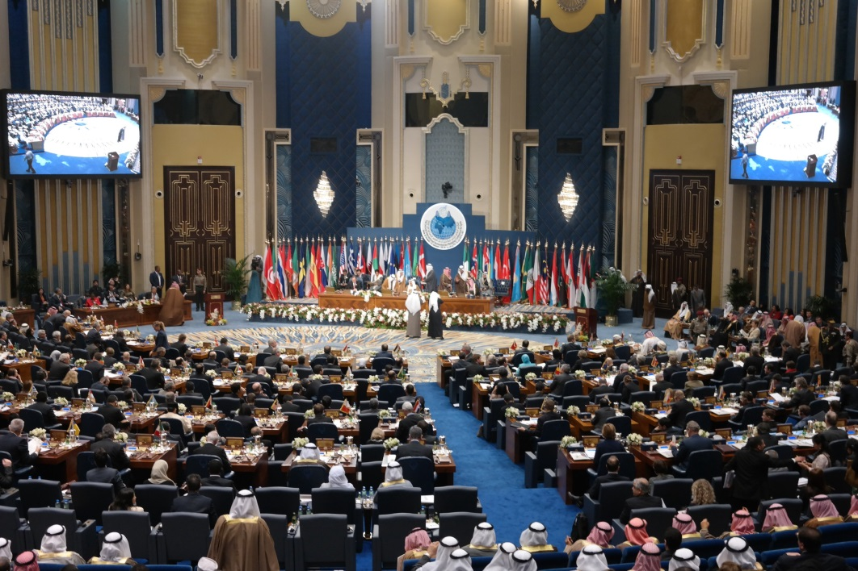
Foreign policy and diplomacy
International relations
Norwegian foreign and security policy
How global developments influence Norwegian policies
Changing character of diplomacy and diplomatic interaction
Both current and historical events

Slide 11

International economics
International trade
Innovation and economic
growth
International political economy
  Corruption
  Poverty
  Development

Slide 12
Funding
The main sources of funding for research at NUPI are
  The Research Council of Norway
  The Norwegian Ministry of Foreign Affairs
  The Norwegian Ministry of Defence
  Private companies and international sources, such as the EU
NUPI has an annual turnover of 75 to 80 million NOK (approx. 10 million Euro)
75 per cent of our funding comes from project acquisition

Slide 13
Activity
NUPI researchers author more than 80 scholarly publications and 100 popular publications in the form of op-eds and policy briefs each year
We organize more than 80 public seminars annually
NUPI edits three academic journals
  Internasjonal Politikk [International Politics]
  Nordisk Østforum [Nordic East Forum]
  Forum for Development Studies
Hvor Hender Det? [Where is it happening?]
  A regular series of short articles explaining current events in international politics in a style aimed at the general public and school students

Slide 14
NUPI’s own publication series
NUPI Reports
  reports on completed research to clients
  also other forms of reporting from seminars and conferences, results of internal research, literature studies, etc.
NUPI Working Papers
  research topics and findings presented in a concise and readily accessible way to the public, to stimulate discussion and critical comment
NUPI Policy Briefs
  short summaries of projects and research topics, presenting research findings, conclusions and highlighting policy measures.

Slide 15
Publication rates

Slide 16
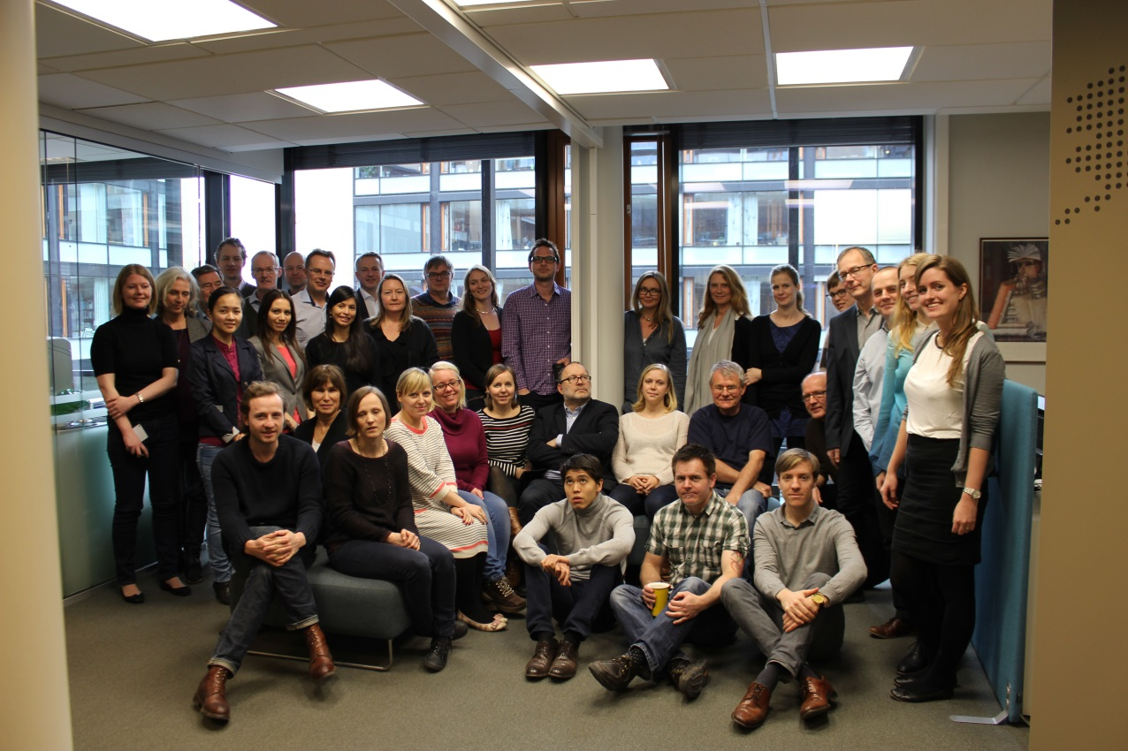
Staff
NUPI has a highly international staff
45 full-time research positions
15 positions in administrations and communications
‘Balance’ programme to increase the number of female leaders and female researchers at professor level

