Slide 1

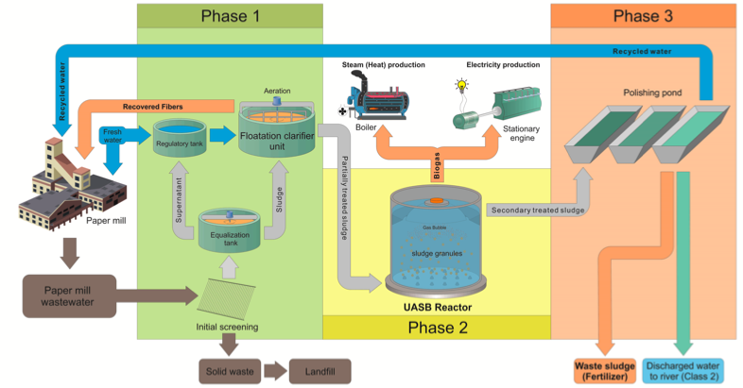
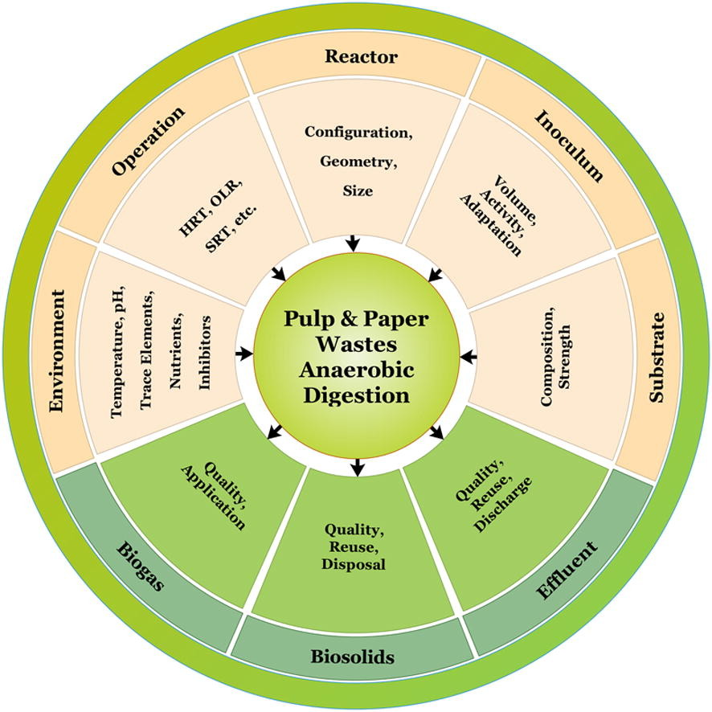
FUNCTIONING INDUSTRIAL SYMBIOSIS MODEL APPLICATION TO ORGANIC WASTE
A CASE STUDY OF A PAPER MILL COMPANY IN COCHABAMBA, BOLIVIA
Primary Reader: James Hagan, Ph.D., University of Pennsylvania
NATALIA MENDOZA ABUJDER, Master in Environmental Studies 2022
Secondary Reader: Rich Pepino, M.S., University of Pennsylvania
INTRODUCTION
DISCUSSIONS
Wastewater treatment plants across the world can transform themselves from energy consumers into energy producers and not only convert their operations into a circular economy, but also reduce their disposal and energy costs, ultimately benefitting their triple bottom line. This field study and research created a model specific to a paper mill company in Cochabamba, Bolivia, Copelme S.A., to investigate if its waste streams can be converted into a value stream and if its organic sludge waste can be transformed into energy. The model included an analysis of the application of an Up-Flow Anaerobic Sludge Blanket (UASB) reactor on the wastewater treatment plant to digest organic material and capture and burn gas to produce energy (Fig.1). This model could then be applied and used to power the company, resulting in an industrial symbiosis microcosm example with an additional financial and environmental benefit. The application of UASBs across other industries could take all of its waste streams and convert them into energy – benefiting the local communities, improving the health of the water systems and potentially sharing that energy generated through the creation of microgrids. By determining an initial model that works in transforming the company’s waste to energy, the same can be implemented on a larger scale, starting with a company and ending by converting itself into an example for future applications of energy recovery and waste management facilities.
Industries with wastewater treatment plants across the world can transform themselves from energy consumers into energy producers, reducing both their disposal and energy costs, ultimately benefitting their triple bottom line. There are only a few technologies available for industries such as paper and pulp that can convert their organic waste into energy in the form of biogas. The nutrient load coming from paper and pulp wastewater is significantly smaller than the nutrient load coming from municipal or animal waste. The optimal functioning of the effluents plant in industries is important to guarantee the stability of the production process and the reuse of water allows these plants to reduce the consumption of well water as well as increase awareness of it. Industrial wastewater treatment plants must become a cornerstone of facility operation, producing water fit for a purpose, recovering nutrients, and reducing fossil fuel consumption by recovering the energy inherent in wastewater.
Figure1: A UASB schematic of a paper & pulp mill company for simultaneous wastewater treatment and bioenergy/biomaterial recovery (Ferreira et al., 2019)
CONCLUSIONS
This study found that for Copelme S.A., adopting a UASB reactor in the current aerobic treatment plant would result in a theoretical incurred investment of at least $USD 1.362.980, with savings of $USD 90 per day. In turn, the company’s return of investment (ROI) would signify approximately 39 years. Using calculations taken from the Global Energy Interconnection Development and Cooperation Organization (GEIDCO), an estimate of 171,3 Mt CO2/year would be expected. Although the ROI in years is high, the environmental impact that this signifies is enormous. If sustainable energy from waste can be produced in a paper & pulp mill company in Cochabamba, it may be feasible for any industry that has a wastewater treatment plant, to do the same and have an industrial symbiosis around organic waste. This would not only recover power and nutrients but also result in a reduced methane production in landfills and a creation of microgrids to power entire facilities.
The results could have a larger impact on the field as it decouples the environmental impact that waste has on the planet and the economy.
METHODS
Data Collection
External Evaluation:
Scholarly review articles such as research studies and case studies done on UASB to recover nutrients and energy, specifically in Paper & Pulp Mill companies. UASB supplier companies’ websites/sources that give schematic information on production processes.
Internal Evaluation:
Challenges faced when implementing an UASB (costs associated with this technology, how well it will accept the consistency of the organic sludge waste, and the ROI for the company.
The advantages gained when implementing an UASB (cost savings, energy created, as well as CO₂ reduced).
Anaerobic Digestion factors (Fig. 2)
Tables
This data will be shown on charts and graphs that will visually portray the different factors and procedures that go into implementing UASB technology. Schematics will also be created as they will be used to explain the transition from a CAS-WWTP to a water resource recovery facility (WRRF) as seen on fig. 1 example.
Figure2: Factors involved in the Anaerobic Digestion (AD) of P&P mill (Kamali et al., 2016)
WORKS CITED
Ferreira, S., Buller, L., Berni, M., Bajay, S., Forster-Carneiro, T. (2019). An integrated approach to explore UASB reactors for energy recycling in pulp and paper industry: a case study in Brazil. Biofuel Research Journal, 6(3), 1039-1045. doi: 10.18331/BRJ2019.6.3.4
Kamali, M., Gameiro, T., Costa, M. E. V., & Capela, I. (2016). Anaerobic digestion of pulp and paper mill wastes – an overview of the developments and improvement opportunities. Chemical Engineering Journal, 298, 162-182. doi: 10.1016/j.cej.2016.03.119
Tanja Rauch-Williams, Ph.D., P.E. Madison R. Marshall Danielle J. Davis. (2018). Baseline data to establish the current amount of resource recovery from WRRFs. Water Environment Federation. doi:WSEC-2018-TR-003
Fig.3: Drone view of COPELME S.A Pulp & Paper Mill Industry in Cochabamba, Bolivia
Notes:
Alternative Title:
Functioning Circular Economy Model On Renewable Waste and Alternative Energy
A Case Study of a Paper Mill in Cochabamba, Bolivia

