Slide 1

Beprexit: Rethinking Repository Services in a Changing Scholarly Communication Landscape
Laurie Allen, Director for Digital Scholarship
Sarah Wipperman, Scholarly Communications and Digital Repository Librarian
Kenny Whitebloom, Digital Scholarly Publishing Librarian
Margaret Janz, Scholarly Communications and Data Curation Librarian
Notes:
Hello and welcome!

Slide 2
Introductions
Notes:
You'll hear more later about why we think it's been useful for us to think about the IR in the context of the larger Digital Scholarship department, so I'm going to start with just situating where we work. The department we work in is less than 2 years old, and nearly everyone in it is new in their job, or in a new job. So, it's very much a work in progress.

Slide 3
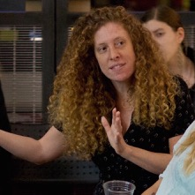

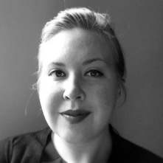
Scholarly communications
Digital
Scholarship
Notes:
Digital Scholarship - we three

Slide 4

Data management
Digital
Scholarship
Scholarly communication
Notes:
You may remember Margaret as one of the drivers of the Data Refuge project, which I'll return to at the end of this project.

Slide 5




Data management
Mapping & spatial data
Digital
Scholar-ship
Scholarly communication
Digital Humanities
Notes:
The rest of the DS department includes two Digital Humanities Specialists who work to expand capacity for Humanities in the Digital Age and a new mapping and GIS librarian

Slide 6
Teaching, Research, & Learning
Digital
Scholarship
Fine Arts/Museum Libraries
Courseware
Information Literacy
Digital Media
Notes:
Our group is in TRL

Slide 7
Teaching, Research, & Learning
Library Technology Services & Strategic Initiatives
Collections & Liaisons
Kislak Center for Special Collections, Rare Books, & Manuscripts
User Services & Resource Management
Notes:
And, it's worth pointing out that, of course, ours is not the only department that manages or maintains something like a repository. They're really all over. We are one of the many libraries where one might say we somehow have too many repositories and simultaneously not enough repositories. So, this is the state we find ourselves in.
Talk about the other areas where there are repositories. Parts of the library where we store digital collections – OPENN, SCETI, Collections of digital content produced elsewhere, etc.
But it’s important that, at Penn, and this is only in the last 3 years, that the services surrounding Scholarly Commons and Open Access publishing are now in TRL.

Slide 8
Overview
Notes:
So, to cut to the point.

Slide 9

We are planning to leave bepress
Photo by Erwan Hesry on Unsplash
Notes:
We are leaving bepress, and we made a statement that says as much. I'm going to read the statement.

Slide 10
This fall, the Penn Libraries will begin exploring open source options for hosting Penn’s institutional repository, ScholarlyCommons, which provides free and open access to scholarly works created by Penn faculty, staff and students.
For 13 years, Penn Libraries has hosted ScholarlyCommons on the platform Digital Commons, which we contract from the commercial company bepress. Through ScholarlyCommons and other initiatives, the Penn Libraries has enabled Penn authors to lower barriers to accessing scholarship, publish new research, and take advantage of library services that benefit not only our own community but those around the world.

Slide 11
For 13 years, bepress was a partner in this endeavor.In August, bepress sold their company to Elsevier, a business with a history of aggressive confidentiality agreements, steep price increases, and opaque data mining practices. In their acquisition of bepress and other companies like SSRN and Mendeley, Elsevier demonstrates a move toward the consolidation and monopolization of products and services impacting all areas of the research lifecycle.We are worried about the long-term impacts from these acquisitions and are concerned that such changes are not in the best interests of the library community. Therefore, we feel obligated to begin exploring alternatives.With this decision, the Penn Libraries hopes to provide a better solution for openly sharing Penn’s scholarship and asserting author rights.

Slide 12
We believe that scholarly research should be made freely available for the greatest global and local good. We wish to support a scholarly ecosystem in which authors can decide how to publish their work, and we will continue to provide platforms for Penn authors who find their work has greatest impact when it is shared openly and without barriers.We call on the academic community to join us in this endeavor—to partner with us, to collaborate, and to find solutions that align with our values as researchers, libraries, and universities and serve our collective communities’ needs.
Notes:
You'll notice that this statement doesn't include a timeline. We're leaving, but...

Slide 13

We are not rushing
Photo by Andy Beales on Unsplash
Notes:
You'll hear us say this throughout the presentation, but this is honestly a phenomenal opportunity for us. We're not running away from bepress into some wild unkown. Instead, we're taking our time. And this makes sense for so many logistical and timing reasons. So,

Slide 14
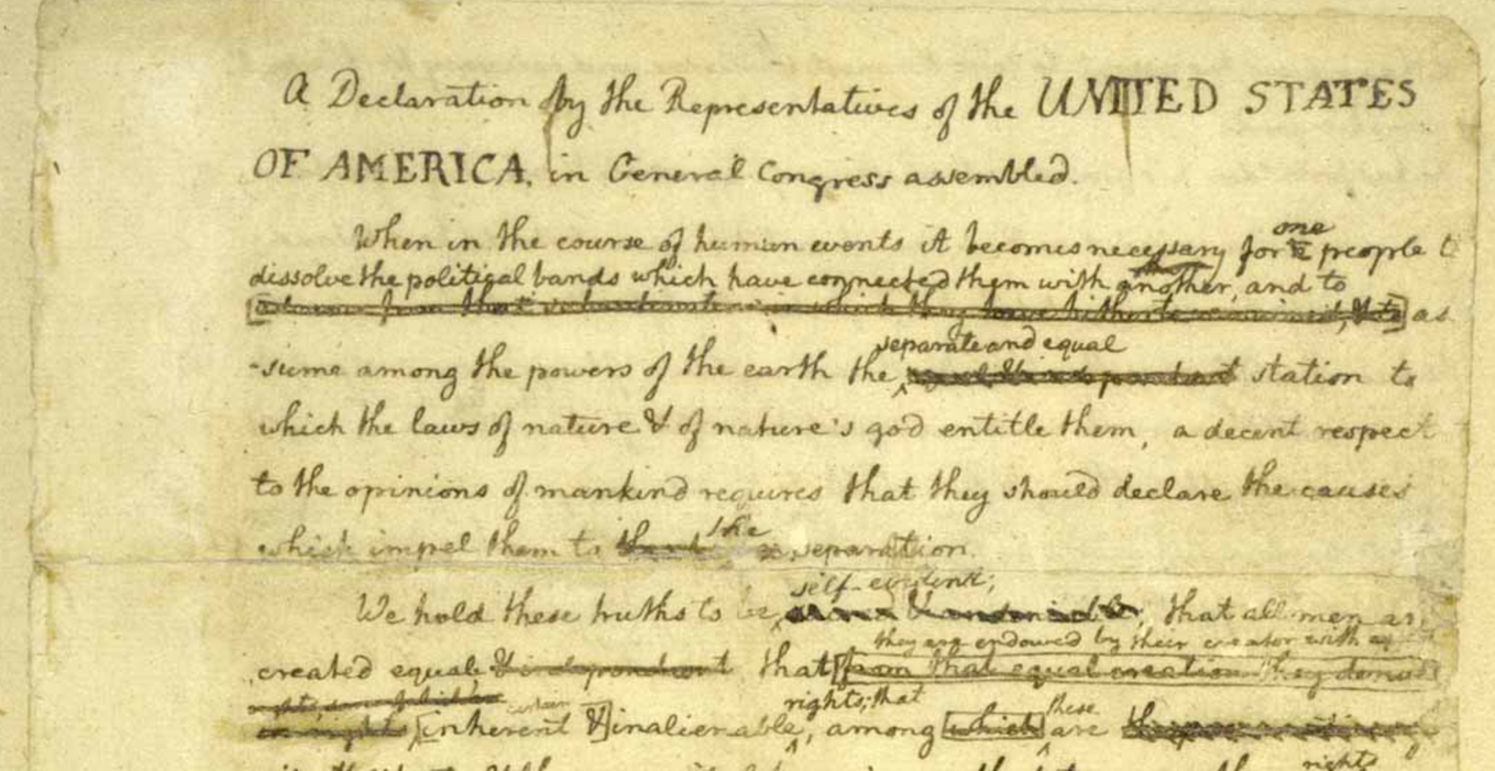
Why the statement?
Notes:
There were a lot of reasons. One is that Sarah and Kenny go around campus having conversations with faculty, students, and administrators in centers and departments inviting them to trust the library with their publications, and the output of their scholarship. When they have those conversations, we want them to believe that the trust is warranted. And the fact is, we've been describing scholarly commons as an alternative to elsevier for a while, so if they have to stop saying that, we want them to be able to say something else.
Another reason was that Penn is a big institution. And making the statement was a way, while we figure out what's next, to provide some cover for other folks to raise this conversation. Plus, quite selfishly, we wanted to gather ideas and hear what other people were doing. You'll hear from Sarah about the outpouring of interest in this and how many institutions are already ahead of us in this exodus. But making a statement helped us gather their stories and learn from them. So, those are some of the reasons for the statemtent.
Just one last thing

Slide 15
We have a responsibility…
Notes:
As you hear from Sarah and Kenny, you'll get some sense of how straight up awesome they are. They're magical people who are able to do incredible work. I have no doubt that they can stretch whatever set of software platforms we come up with to meet the needs of our community. That they can work around and through and over and under whatever tools they have at their command if I can do my work in both getting out of their way and getting them the support that they need. They're going to do their work responsibly, efficiently, thoughtfully, and well. I trust them. And our communities trust the libraries. They trust us to ensure that they can access the scholarship they need for their work, and, when they give us their scholarly works, they trust that we're going to share them in keeping with our values. We have a responsibility to that work efficiently, to steward resources wisely, and to make informed technical decisions. AND!! We have a responsibility to take care of the stuff they give us. That doesn't mean that everything in our collection has to be stored in an acid-free box in a cold room. But it does mean that, for stuff we want to take extra care of, we should probably invest our resources in actually understnding exactly how it needs to be stored, served, etc. I've taken to replacing the word "repository" with the word "library" in lots of reading. It works, it's fun. You should try it. And I don't think we should outsource the library. I think we should be the library, And I think the stuff our community entrusts us with that they made themselves is exactly the stuff we should treat with the most care. Ok. End of preachy lecture - you'll hear no more of that, and at the end, I'll get into some of the more technically tricky stuff! On to Kenny to tell you what actual stuff we put in the repository.

Slide 16
Notes:
What’s actually in ScholarlyCommons? The largest block of content are papers produced by Penn researchers, 2/3 of which come from faculty members with previously published materials, with the other third of that number comprised of working papers, reports, policy briefs, and undergrad and graduate writings. The second largest collection of material is journals and magazines, followed by theses and dissertations. Theses and dissertations are a steadily growing subset of our collections as a result of a 2015 university policy which requires the deposit of PhD dissertations into the repository. We’ve also begun to receive more inquires from departments looking to provide long-term public access to undergraduate and graduate theses. The smaller three groups – multimedia, other (which comprises conference, lectures, and a range of additional things), and data – make up the remaining 6% of the repository’s holdings. Interestingly, video, which is the single largest object type within multimedia, has grown quite rapidly for us over the past couple of years with the addition of MOOC content and other recorded lecture series.

Slide 17
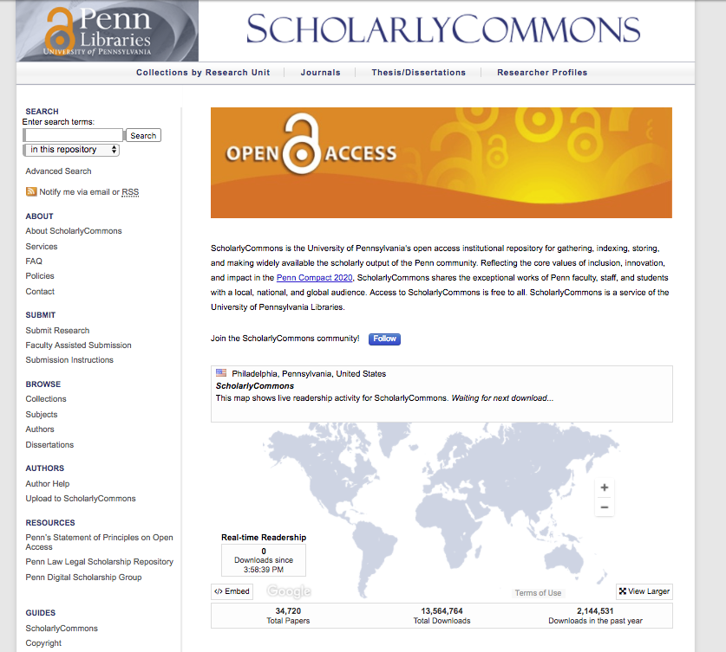
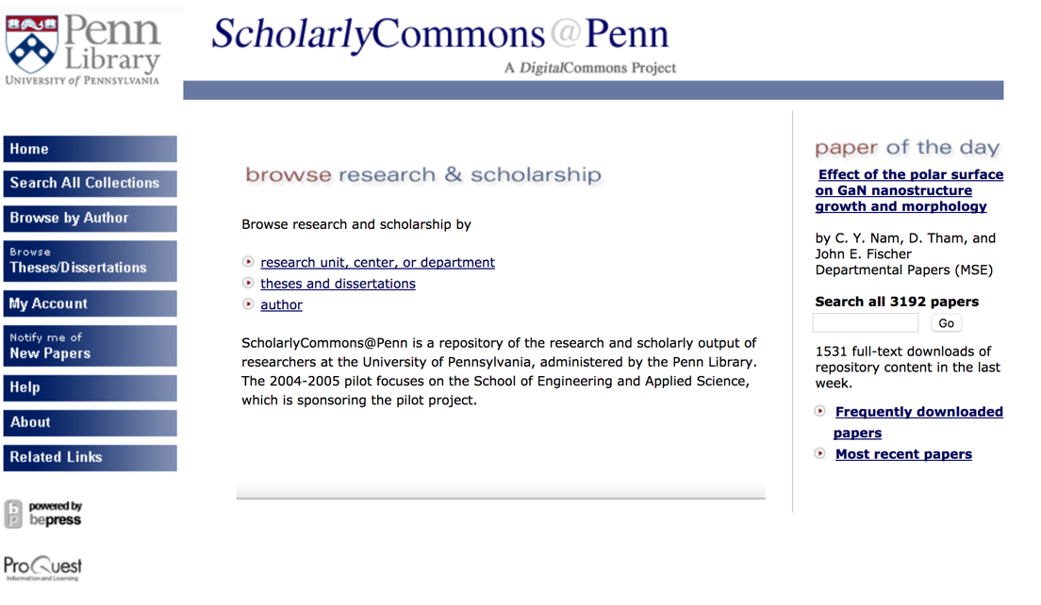
Notes:
To back up a bit and provide a bit of history, ScholarlyCommons has been around for 13 years. It launched in early 2005 on the Digital Commons platform as an initiative of the School of Engineering and Applied Sciences as a place to deposit preprints and working papers.
In the beginning, there was a tepid amount of growth. Participating groups added materials and new collections were added, but it was largely a “if you build it they will come” mentality.
But beginning in 2014, ScholarlyCommons began to grow at a much faster clip.
This was the result of a concerted effort on the part of the new IR manager at the time, Sarah, to focus on actively recruiting content and offering services that extended beyond mere self-inspired upload.
The repository is now used for a wide variety of projects and collections – theses and dissertations, departmental papers, journals, research center publications, and many other -- with more than 34,000 total objects and some 2.1 million downloads per year.

Slide 18
By 2017, ...the Library will be known for a well-articulated portfolio of researcher services.
Penn Libraries Strategic Plan 2015-2017
Notes:
So, what prompted this change in approach that has yielded such impressive growth? In June 2014, the Penn Libraries released a two-year strategic plan which emphasized that “by 2017...the library would be known for a well-articulated portfolio of researcher services.”

Slide 19
mediated deposit
permissions
build collections
for research
researcher services
open access
support
copyright and
author rights
access to
dissertations
Notes:
Building on that strategic plan, Sarah, over the course of 2015 and 2016, began to approach the IR less as a place to simply store materials and more as a vehicle to provide scholarly services. These included:
Offering Mediated deposit service for faculty to encourage the growth of departmental papers collections
Providing publisher permissions expertise, training, and consultations
Working with faculty, research centers and departments to create to tailored collections (and training those folks on how to steward these collections in the long-term)
Supporting faculty and researchers on Open Access and how they can make their work OA
Offering consultations, workshops, and customized trainings on copyright, author rights, and scholarly communication trends.
And facilitating public access to Penn dissertations through University policy enacted in 2015 which required PhD graduates to deposit a copy of their dissertation in the repository
Sarah talked to everyone who would listen about these nascent services and she started to build rapport and support within the Libraries and the larger Penn community.
During this time the library also began to increase its investment in the IR by hiring student employees to assist with permissions and professional staff to support growth.

Slide 20
Refining the services-oriented approach
Notes:
I arrived in 2016 as the main repository manager, and one of the first things that I did was refine this constellation of services and turn it into a coherent slate of services – a menu – that we could market to faculty, librarians, and researchers at Penn.

Slide 21
Standardized workflows for mediated faculty deposit
Comprehensive student employee training program
Clearly articulated repository services and outreach materials
Notes:
We did this a few ways.
First, we rebranded mediated deposit as Faculty Assisted Submission and developed a robust set of workflows for handling permissions at scale, as well as developed supplementary tools to improve efficiency and reliability of our permissions research. We moved the whole permissions workflow into Google Sheets, which provided us with more options for sharing, working remotely, version control, and for faculty to follow progress. We also implemented more project management tools to keep track of template emails, among other frequently used resources, and the path of faculty CVs through the pipeline. Furthermore, we built and populated a Publisher Policy Database to help us capture the the findings of our publisher policy research and to make it quicker for us to lookup publishers and journals moving forward (and to provide a quick and easy way for external partners to see policies). This new workflow has made our mediated deposit a far more rounded and open service in which faculty are included as part of the process from the outset.
Secondly, and in tandem with my first point, we developed a comprehensive training programming for student employees so that we can offer these services on a systemic basis (e.g., Wharton) and can get students up to speed and semi-autonomous within a week or two. This training process includes crash course in copyright, author rights, and open access, and other key scholarly communication ideas, and we started doing so that we were not simply training them on how to run permissions and investigate publisher policies, it but why we do it and why it’s important to Penn (and the world). We also created more training opportunities for outside collaborators who wanted the flexibility and independence to manage their own collections. It is this reliable labor force and training process which has ensured the marketability of FAS as a service faculty can rely upon and subject librarians can look good marketing.
And speaking of marketing, we also created an informational website and set of marketing materials that clearly spelled out how our team could help scholars. We articulated the slate of services that we offer, akin to a ”menu” of options (again, defining these things as services, not products). Once we developed a reliable permissions workflow and training program, we worked hard to educate liaisons and other key allies so that they could market/advertise FAS and our other services to their communities without fear that we would drop the ball.
It’s important to note that 90% of this service-based work that I just described does not even happen on the bepress platform – it’s about offering scholarly communication consultations and services and using the platform as one tool in support of those goals. In support of our goals, we routinely collaborate with colleagues in the Digital Scholarship group on projects that intersect with Omeka, Scalar, Shared Shelf and others, and seeing ScholarlyCommons as one piece in that puzzle has allowed us to offer a more wide-ranging suite of services to our communities.

Slide 22
Identifying unmet needs
Notes:
The growth has been wonderful and the result of concerted marketing and outreach, but in some ways we’ve started to reach the edge of our capacity for certain types of projects. I want to provide a few brief examples of some unmet needs that we’ve identified over the past year or so (these don’t encompass everything though).

Slide 23
Support for researcher data and data-intensive projects
Interactive publications and non-traditional digital projects
Multimedia and other large file types
Notes:
First, support for researcher data and data-intensive projects. While we do have some data collections in ScholarlyCommons, they tend to be small-scale, one-off type projects that don’t require a tremendous amount of storage. At this stage, we aren’t able to support the majority of researchers and projects that come to us with projects involving large data sets, apart from recommending external platforms or tools, which disappoints them and us.
Second, interactive publications and digital projects that combine non-traditional file types or non-traditional ways of expressing/arranging content. While there is a lot to love about Digital Commons all-in-one setup, we’re encountering a number of projects in which researchers want the long-term reassurance of an institutionally-stewarded platform like an IR but who also crave the visual and curatorial flexibility of something like an Omeka or Scalar. We’ve been active proponents of the IR as a platform for a wide variety of materials, not simply previously published journal articles or book chapters, but there are limits to an all-in-one solution, especially with more multimodal digital projects demanding greater flexibility and options coming our way.
Third, multimedia and other large file types, including Augmented Reality, Virtual Reality, and 3D file types. We’ve noticed a growth in projects that include video, image, or immersive technologies. The question of long-term storage and access to these scholarly works is one that likely intersects with the IR in some way. For instance, our directorate is spearheading an initiative to explore the possibility and promise of immersive technologies at Penn. One of the things that we’re actively considering is how we can provide long-term access to immersive scholarship produced by Penn faculty and researchers. We aren’t sure that this is going to be solved by a new repository solution or solutions, but it is certainly something that we are contemplating.
These unmet needs – and others that Sarah and Laurie will discuss in a bit – were thrown into relief by the bepress acquisition and have really prompted us to rethink what we’re doing and to further refine or expand how we can support and accommodate new and emerging forms of scholarly expression.

Slide 24

The Stars Align
Organizational restructure
Growing demand
More staff support
Streamlined training and workflows
Notes:
Photo by Redd Angelo on Unsplash

Slide 25

How do we want to grow?
What does our future IR look like?
Notes:
Up to this point, there wasn’t a huge push to look for other platforms - always said we would leave bepress, but we decided to stay as long as they continued their level of service and aligned with our values
All-in-one repository allowed us to grow our services, but it eventually started constraining us
Announcement that Elsevier acquired bepress was the final piece to the puzzle - the push we needed to start thinking more actively about our IR’s future

Slide 26
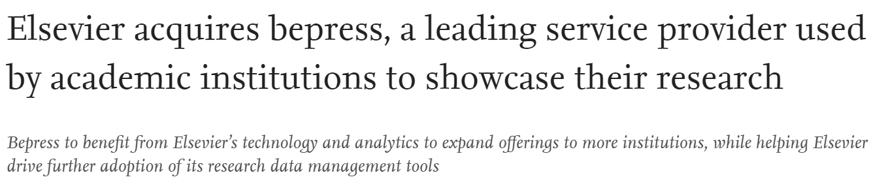

Slide 27

Opportunity
Notes:
Photo by Terry Tan De Hao on Unsplash

Slide 28
Our Approach
Notes:
Approach helps describe why the acquisition was important to us and why we are proceeding the way we are

Slide 29
Simon Sinek’s
Golden Circle
WHY
HOW
WHAT

Slide 30
“People don’t buy WHAT you do…
They buy WHY you do it.”
-Simon Sinek

Slide 31
WHY
HOW
HOW
WHAT

Slide 32






What is an IR?
Notes:
No shared understanding/different definitions of what an IR is, what it does, what it holds
How can we collaborate if we’re not talking about the same thing?
Hoping to have these conversations as we proceed
(Even bepress has been moving to a “showcase” terminology)

Slide 33
Library Stewardship

Slide 34

We have questions.
Notes:
Photo by Emily Morter on Unsplash

Slide 35
we learn.
Before we plan…

Slide 36

What is being created, and how is it being disseminated?
Notes:
Kenny, Margaret, and I are the “experts” on this, and we don’t know. Every week, we’re faced with a new project or type of object that we may have never thought of, and we’ve turned down a lot of projects in the past because bepress wasn’t able to fully support it. WHAT IS AN IR? WHAT IS THE PURPOSE OF A REPOSITORY? - SHARED UNDERSTANDING We’re not just dealing with the material we have in the IR - we’re dealing with a lot of unknowns, and we need to do some research to find out what those “unknown” things are so that the Libraries can make an informed decision about what it does and does not want to support.
Photo by Eugenio Mazzone on Unsplash

Slide 37
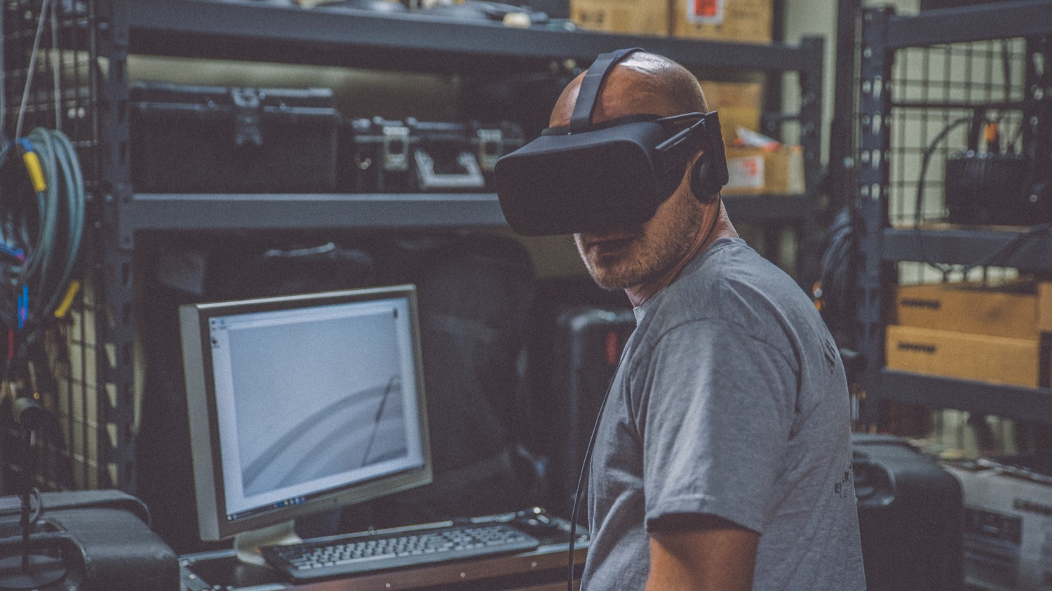
What are current uses, needs, and desires for new repository systems?
Notes:
We need to check our assumptions about current uses, figure out what user needs are (which may or may not be how they are currently using the system), and learn more about what users’ desires - if we started with a blank slate, what sort of capabilities would they want in the repositories we develop? This would allow us to, again, make more informed decisions about what users want and we want to support.
Photo by Eddie Kopp on Unsplash

Slide 38

What are the options for alternative repository systems?
Notes:
Repository landscape has changed a lot. Bepress today is not the same bepress I was hired to manage. DSpace today is not the same DSpace 5 years ago. Stories. Why you like/don’t like? Is it how you implemented? Look at each for what it is good for and what it isn’t - Kalinda can’t do journals.
What is out there? Which solutions can best support community needs? What are the technological considerations for those platforms? What can they support? What would that look like?
What would it take for the Libraries to adopt various solutions and continue to support them?
What can we predict about the future directions of these platforms (both at Penn and in their respective open source communities)?
What are user stories of people using these platforms (why do you love/hate DSpace? What do you think it’s good/bad for?)?
We need know what’s out there in order to be able to thoroughly vet our options.
Photo by Evan Dennis on Unsplash

Slide 39
Taskforce
Charge
This taskforce is charged with carrying out an environmental scan and campus discovery research over a 9 month period. The taskforce will research platform options; explore collaboration opportunities; and ascertain the Penn community’s current uses, needs, and desires for repository services.
Goals
Learn about current uses of ScholarlyCommons and collaboration opportunities
Determine user needs and desires for new repository services
Conduct an environmental scan of platform options, requirements, and feasibility (staff, time, cost, etc.)
Benchmark services we have offered or could offer against institutions included in the environmental scan

Slide 40



Research
User Research
Environmental Scan
Surveys → Interviews → Design thinking
Conversations and Collaborations
Informal Conversations
Internal Collaborations
External Collaborations

Slide 41
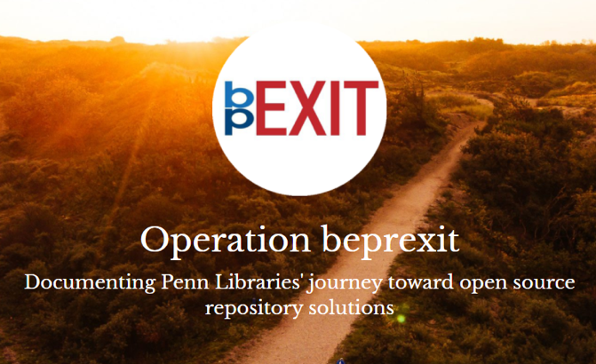

Making things open
beprexit.wordpress.com
@beprexit

Slide 42
Re-imagine the scope of what we collect
Consider scholarly expression at a range of scales
Accept the need for multiple tools, platforms, and approaches

Slide 43
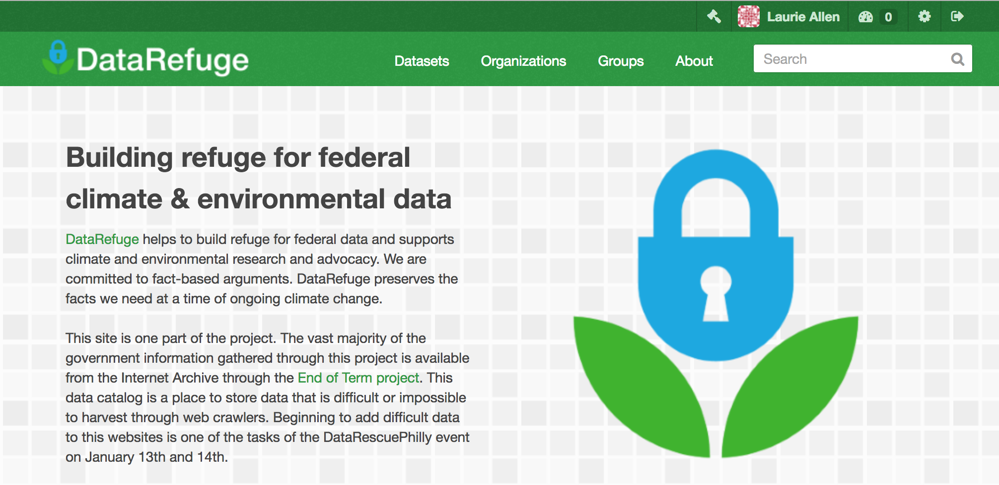
scope

Slide 44


Slide 45

Multiple scales
Notes:
Giant datasets – the kind that need to be moved in trucks. Maybe we make agreements with creators about stewardship that don’t involve duplicating but involve agreeming to take care of in different ways. That’s how data.gov is built, an I think it’s incredibly smart.

Slide 46
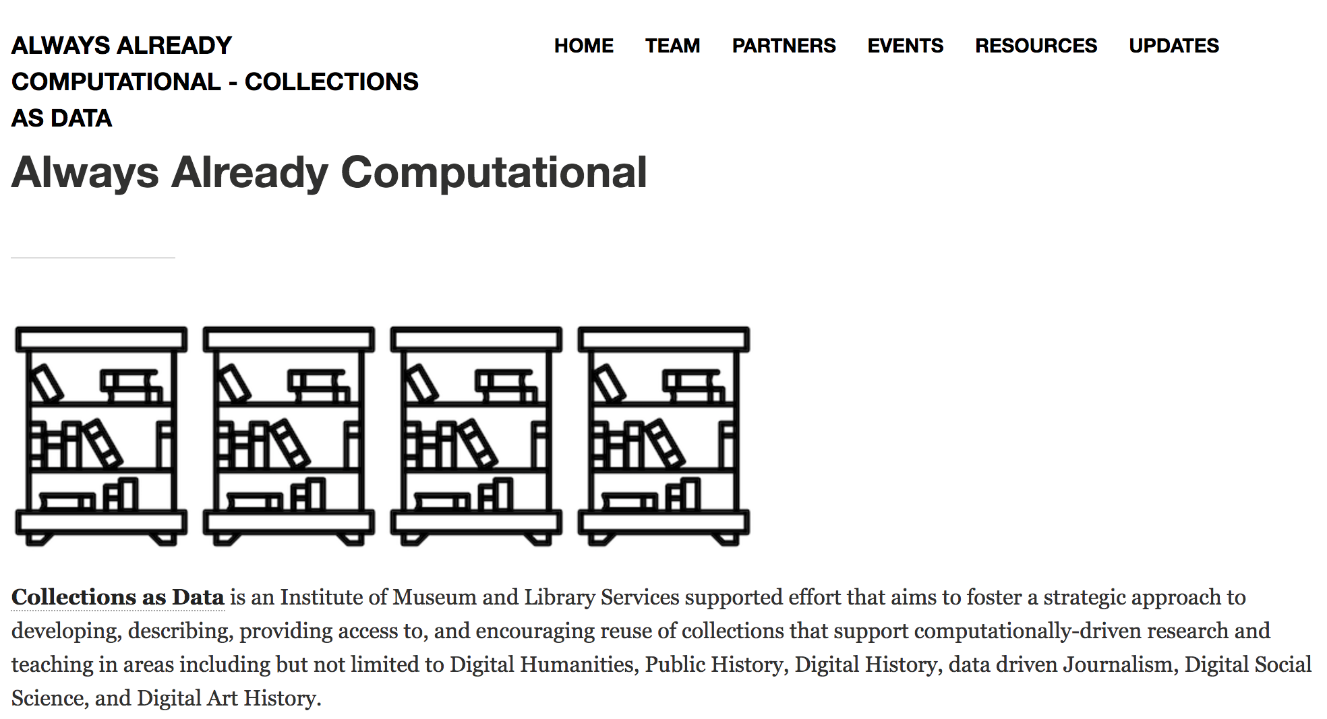
collectionsasdata.github.io
Notes:
Brief reference to IMLS support, project site, thank you IMLS --- picks up on a lot of work that has already been done …. E.g.

Slide 47
Unstable resources
Notes:
Public scholarship

Slide 48
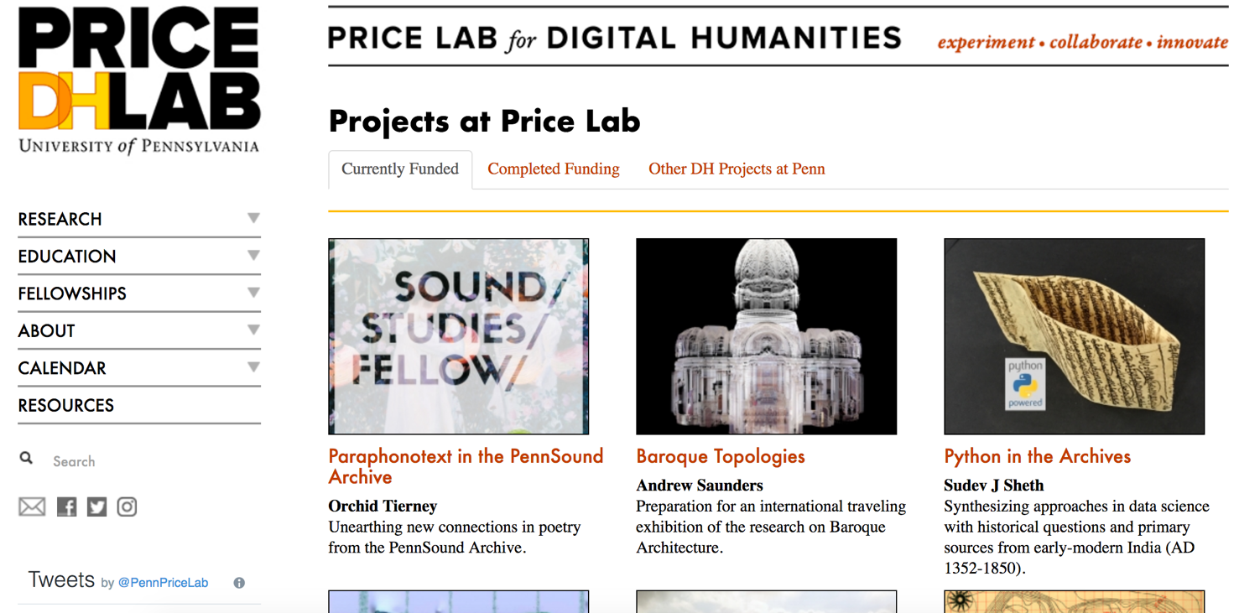
Notes:
Docker containers

Slide 49
Variety of platforms

Slide 50

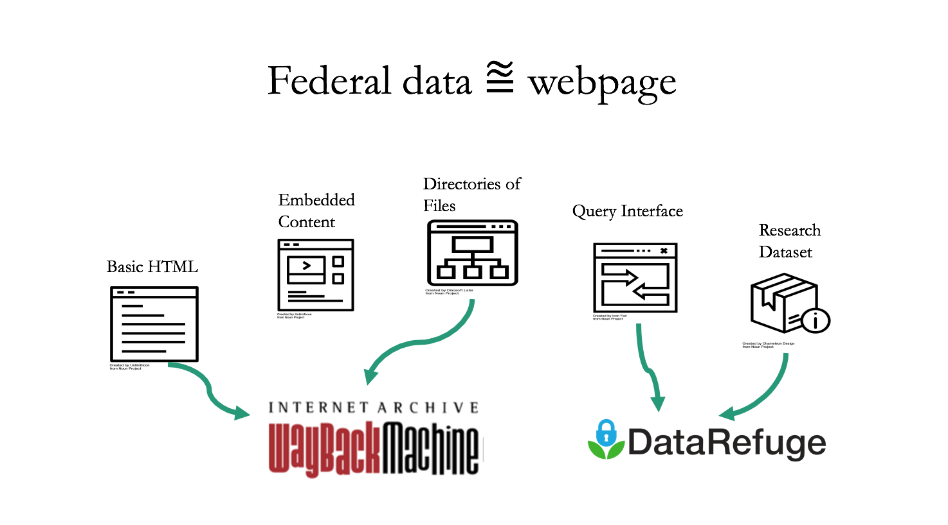
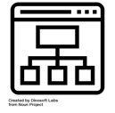






Federal data ⩰ webpage
Directories of Files
Embedded Content
Query Interface
Research Dataset
Basic HTML
Notes:
the notions that we know what data is. yes. there’s are pedabytes, but there’s also a website helping school teachers teach kids about climate change. technically, that’s just an html page, but it’s also data.

Slide 51
Platforms
Functions
Services
Notes:
Repositories – technologies
Functions – capacities of those technologies
Services – ways of relating to our communitiess.
Infrastructure is usually conceived of as the technology. And then services sit on top of that. We want to see a set of services & relationships and affordances, and technologies sitting on top of that.

Slide 52

Photo by Dakota Corbin on Unsplash
Notes:
I don’t imagine we’re going to have a single solution

Slide 53

Photo by Clark Street Mercantile on Unsplash
Notes:
Different approaches.

