Slide 1


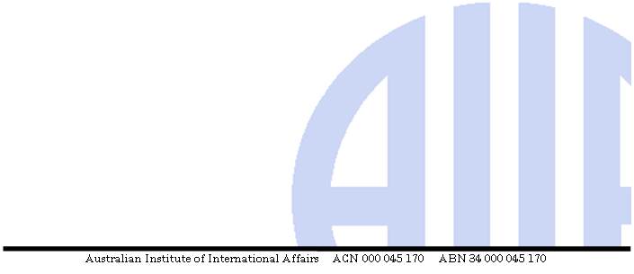
Australian Institute of International Affairs
Organisational Profile

Slide 2
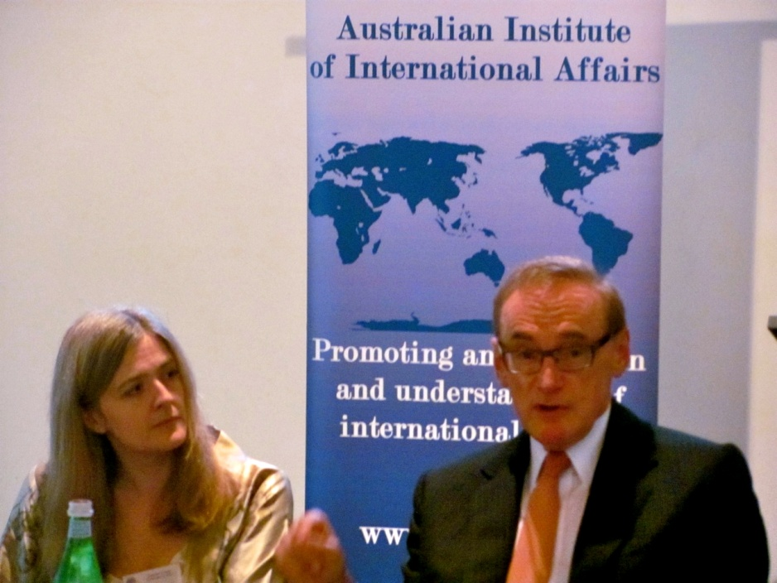
Organisational Model
The AIIA is an independent, non-profit, civil society organisation.
1924: established as branch of Chatham House
1933: became independent
Size of organisation:
1,400+ members
150+ volunteers nationwide
Small paid staff

Slide 3
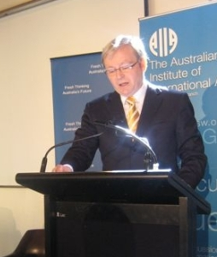
AIIA as a Knowledge-Broker
Mission:
To promote interest in and understanding of international affairs in Australia
Role:
To act as a platform for debate.
The AIIA’s constitution prevents it from expressing an opinion on any topic in international affairs.

Slide 4
How the AIIA Works

Slide 5
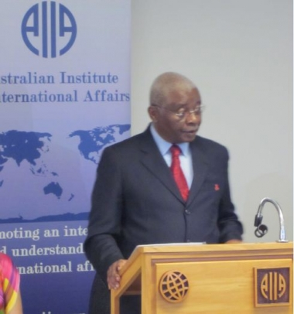
How the AIIA Works: Events
More than 150 events organised annually across Australia
Most are events for the general public organised in states and territories
National Office organises policy events

Slide 6

How the AIIA Works: Events
Recent events:
80th Anniversary National Conference
Windows to the World Embassy Open Day series to celebrate the Cententary of Canberra attracting 35,000 people
Former Ministers for Foreign Affairs Forum at Government House

Slide 7
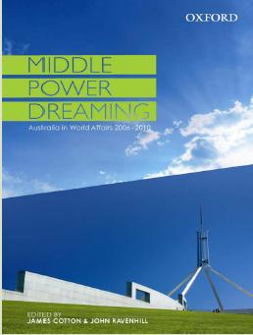
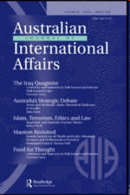
How the AIIA Works: Publications
Australian Journal of International Affairs
Published since 1947
Regularly ranked among the top 50 international affairs journals globally (highest-ranked outside Europe and North America)
Australia in World Affairs series
Published since 1950
Five-yearly series published by Oxford University Press

Slide 8

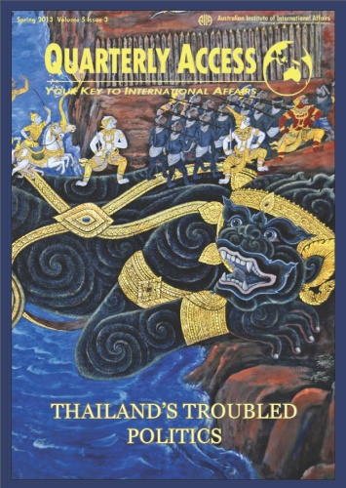
How the AIIA Works: Publications
Policy Commentaries
Bite-sized publications that reprint key documents and expert views on topical issues
Youth publications
Emerging Scholars: features writing from scholars who have interned at the AIIA
Quarterly Access and Monthly Access produced by young members

Slide 9
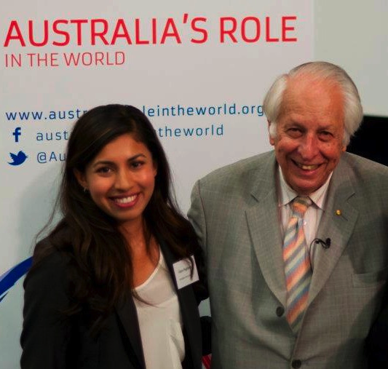
How the AIIA Works: Youth
Initiatives for/by the AIIA’s young members:
Bursaries and scholarships
Schools program
Young professionals networks
Youth publications
Careers fairs
Internships in national, state and territory offices

Slide 10
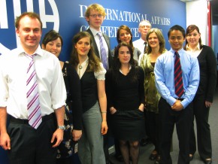
How the AIIA Works: Youth
Case study: Internships
Australian and international students
Up to 30 National Office interns per year
Part-time or full-time placement for 3 – 12 months
Varied academic backgrounds (mainly international relations but also media, design, information technology)
All interns complete a customised program
Many interns receive academic credit

Slide 11
How the AIIA Works: Dialogue
Dialogues allow the AIIA to contribute to international affairs policy debates
Organisational cooperation with other international institutes
Second-track dialogue allows the AIIA to serve as a bridge between official and civil society

Slide 12
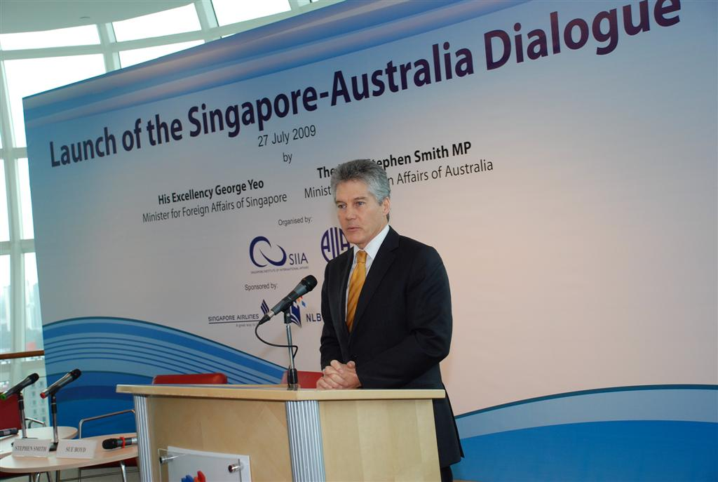
How the AIIA Works: Dialogue
Recent examples include:
Indonesia-Australia Dialogue (Jakarta 2011; Sydney 2013)
Dialogue with the Japan Institute of International Affairs, Griffith University 2012)
Singapore-Australia Dialogue (Singapore 2009)
Various roundtables for institutes of international affairs at the International Studies Association Convention

Slide 13
What AIIA Offers Stakeholders
Key audiences
Policy makers
Academics
Students and young professionals
Diplomatic corps
Business community
Media
Interested public
Global think tank community
Products/services
Publications
Policy events
Public events
Study tours
Dialogues
Youth programmes
Youth publications
Opinion

Slide 14
What AIIA Offers Stakeholders

Slide 15
Funding
The AIIA is funded through:
Membership fees
Donations
Event attendance
Publication royalties
Property rent
Government grants (especially the Department of Foreign Affairs and Trade)

Slide 16
Research Focus
Key priorities for Australian foreign policy
For example, in 2013–14 these include the UN Security Council, G20 and current trade negotiations
Key bilateral relationships
Regional and international organisations
The changing practice of diplomacy, including public diplomacy

Slide 17
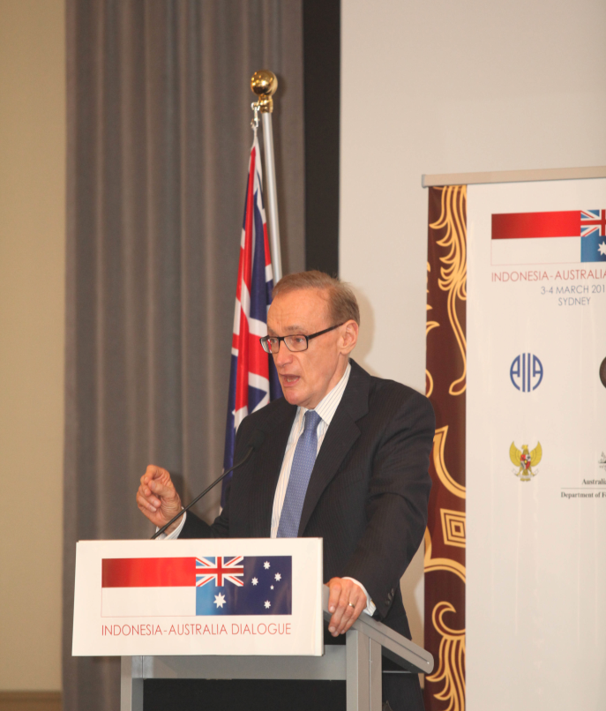
Political Affiliations
The AIIA does not have any political affiliation.
It is an independent, not-for-profit organisation.

Slide 18
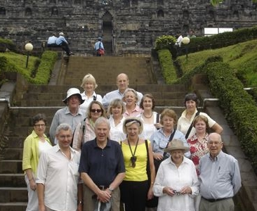
Current Challenges
Funding
Volunteer support
Federal and State/Territory structure
Newer think tanks
Adapting to changing demographics and technology

Slide 19
Broader Challenge
What is the AIIA’s long-term future?
The AIIA operates across a range of audiences
Resource limitations mean it is spread thinly across these
However, reaching a range of audiences is a core part of the AIIA’s mission to spread awareness of international affairs in Australia

Slide 20
New Initiatives
Youth-oriented initiatives :
Euan Crone Asian Awareness Scholarship
youth-led young professionals network
youth publications
Creation of Director of Communications role
Complete website upgrade/redesign
Increased engagement with online opinion and blogs

Slide 21
Our People: National Executive

Slide 22
Our People: National Executive

Slide 23
Our People: National Executive

Slide 24
Our People: States and Territories

Slide 25
Our People: States and Territories

Slide 26
Impact

Slide 27
Impact

Slide 28
Impact

Slide 29
Impact

Slide 30
2013: AIIA in Numbers
Fourth in Asia in Global Go To Think Tanks Index 2012
55th worldwide in ISI citation ranking for AJIA
22 languages spoken by national office staff and interns
67 years of the AJIA
150+ events annually across Australia
1,400+ members
120+ interns and volunteers nationwide
Seven state and territory offices
Networked with 116 sister institutes worldwide

