Slide 1
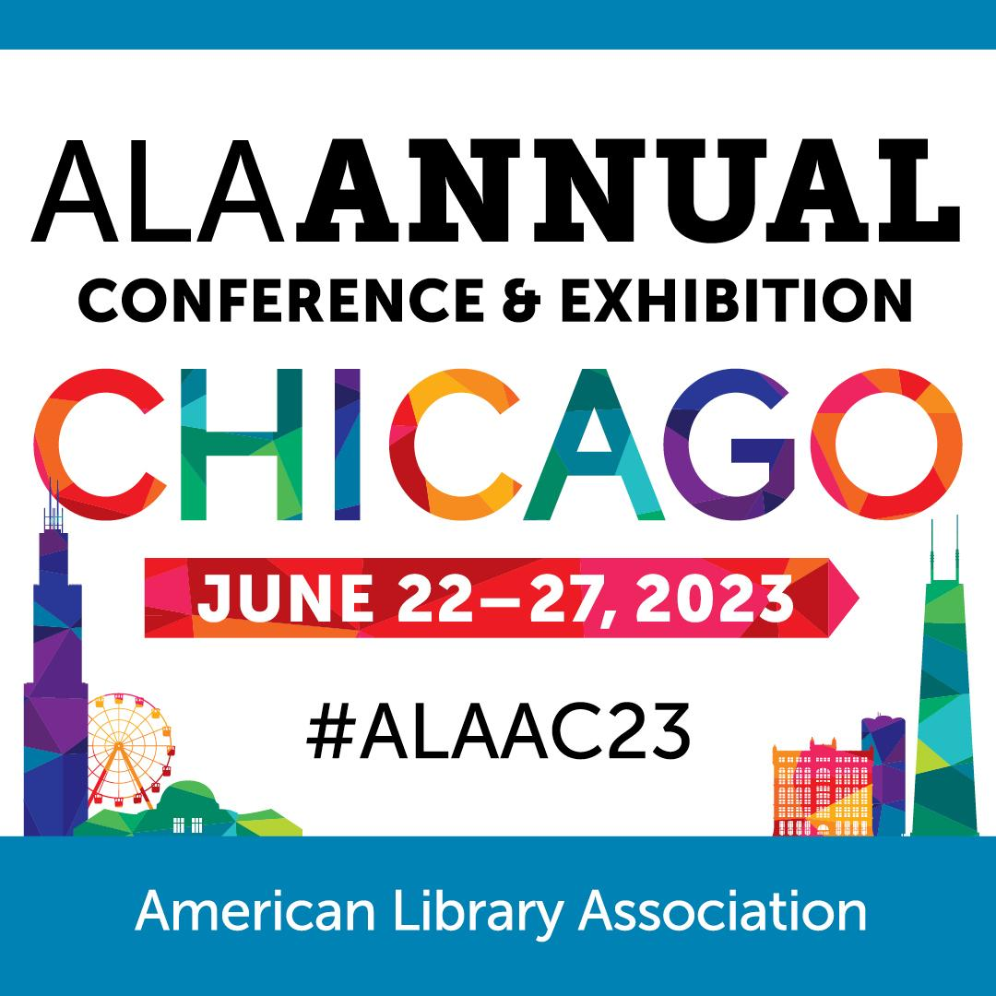
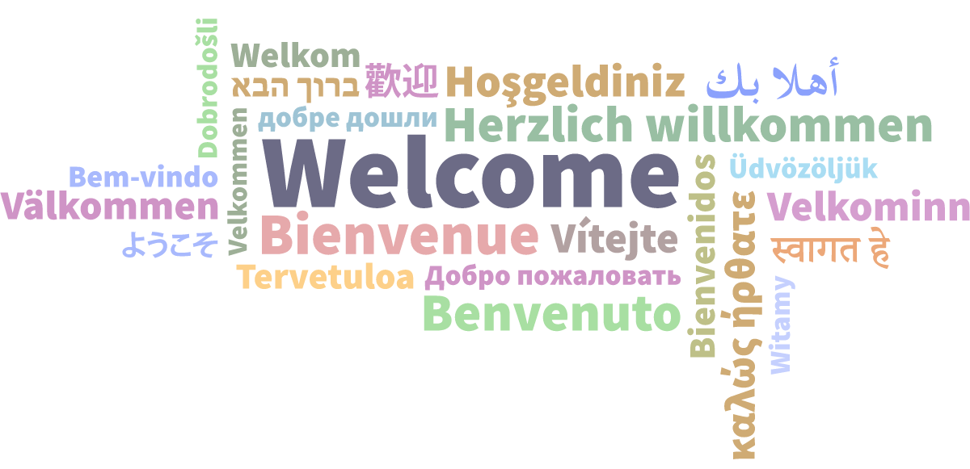

LIBRARY LINKED DATA STRATEGIES IN ACTION
Abigail Sparling, Ian Bigelow, Jim Hahn, Kaylin Blount, and Beth Picknally Camden
University of Alberta & University of Pennsylvania
Notes:
Slides 1 & 2 - Welcome to the Core program on Library Linked Data Strategies in Action. Your presenters are Abigail Sparling, Jim Hahn, Kaylin Blount and Beth Picknally Camden.

Slide 2


Educational & Practical
Networking & Fun
40+ thought-provoking sessions
Poster sessions
Preconferences, tours, and workshops
Opening reception
Dine-arounds
Game night
Informal, unconference discussions
coreforum.org
Notes:
Before I turn the mic over to them, I'd like to say a quick plug for the Core Forum in New Orleans (show slide). Registration is now open for the 2-day event that consists of over 40 program sessions. We'd love to see you there! Now it is my pleasure to turn the floor over to Beth to begin the program.

Slide 3
LIBRARY LINKED DATA STRATEGIES IN ACTION
Institutional linked data frameworks for collections, discovery, and access

Slide 4
OUTLINE
Shared Background (10 minutes)
LD4P
Share-VDE
University of Alberta (15 minutes)
Linked Data Implementation Plan
Current activities
Sinopia
Share-VDE
Linked data considerations for ILS/LSP migration
University of Pennsylvania (15 minutes)
Current activities
Linked data editors and ILS integration
From linked data description to linked data discovery/ access
Questions (20 minutes)
Notes:
Previous UAL presentation: https://docs.google.com/presentation/d/1vEZuJZHklJ7WmnYVEsv1tRjAiKJiIQD2hHmyf_XQZkA/edit#slide=id.g116d5e8c259_0_55

Slide 5
Shared Background
LD4, SHARE-VDE

Slide 6

LD4P=Linked Data for Production
LD4P2 - PCC cohort (2018-2020)
LD4P3
LD4 Community ld4.io
LD4 Conference July 2023
Sinopia Linked Data Editor sinopia.io
Notes:
PCC LD4P2 Cohort was established to engage a much broader audience to ensure the transition from the current MARC-based system to linked data-based workflows is successful. Cohort members will receive intensive training and a stipend from the LD4P grant to help member institutions transition to linked data. Penn & Alberta were part of this cohort
Since then we continue to participate in the LD4 community
Key product of the grant is the Sinopia tool

Slide 7
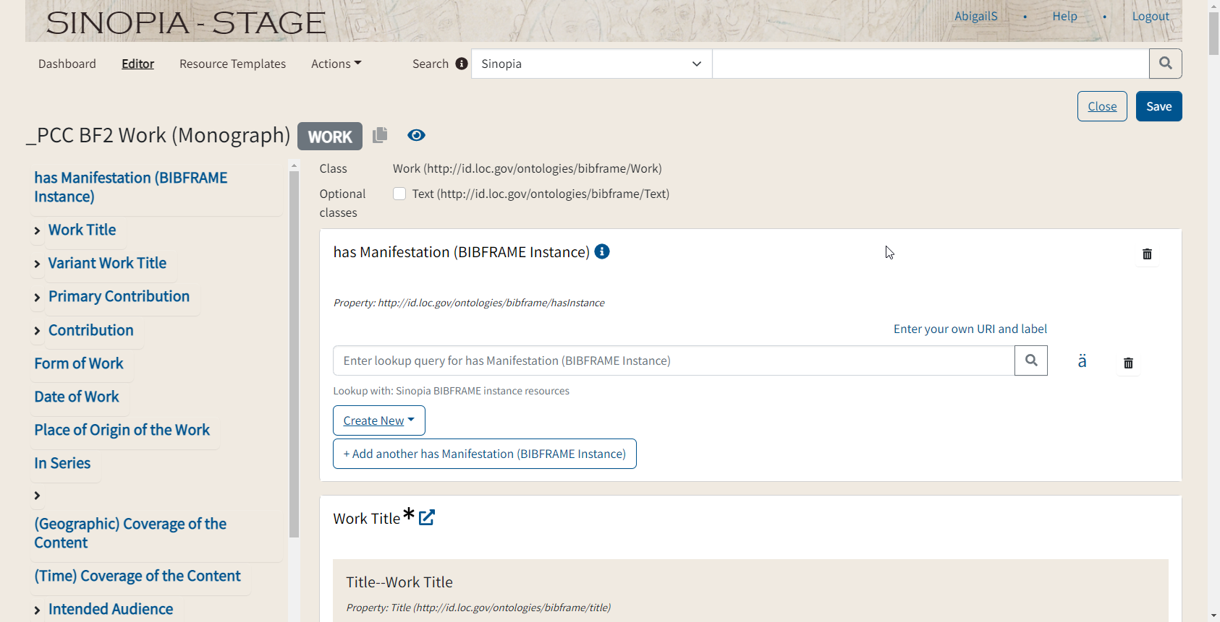
Sinopia
Notes:
A key product of the LD4P grant is the Sinopia LD editor, which allows for creation and editing of BF and other LD
Here we have an image capture of the Sinopia editor, showing a PCC profile/template for Monographs. Penn has been using the PCC templates, but
Sinopia also allows for creation of institutional templates.

Slide 8
Sinopia
Original and copy cataloguing in BIBFRAME
Connection with LD sources, including id.loc.gov
Connection with Share-VDE to populate a larger data pool, including the PCC data pool
Sinopia Middleware allowing for BIBFRAME to generate MARC for use in existing ILS/LSP
Notes:
So what is Sinopia and what does it mean for us?
Initially training and experimentation in BF
Original and copy cataloguing in BIBFRAME --Continued practice and training on cataloguing with BF
Connection with LD sources, including id.loc.gov
Connection with Share-VDE to populate a larger data pool, including the PCC data pool
Sinopia Middleware allowing for BIBFRAME to generate MARC for use in existing ILS - Sinopia middleware - critical use case for cataloguing with bf
Current/Upcoming work
Reviewing and assessing available profiles for description at UAL … transitioning from our own to PCC

Slide 9
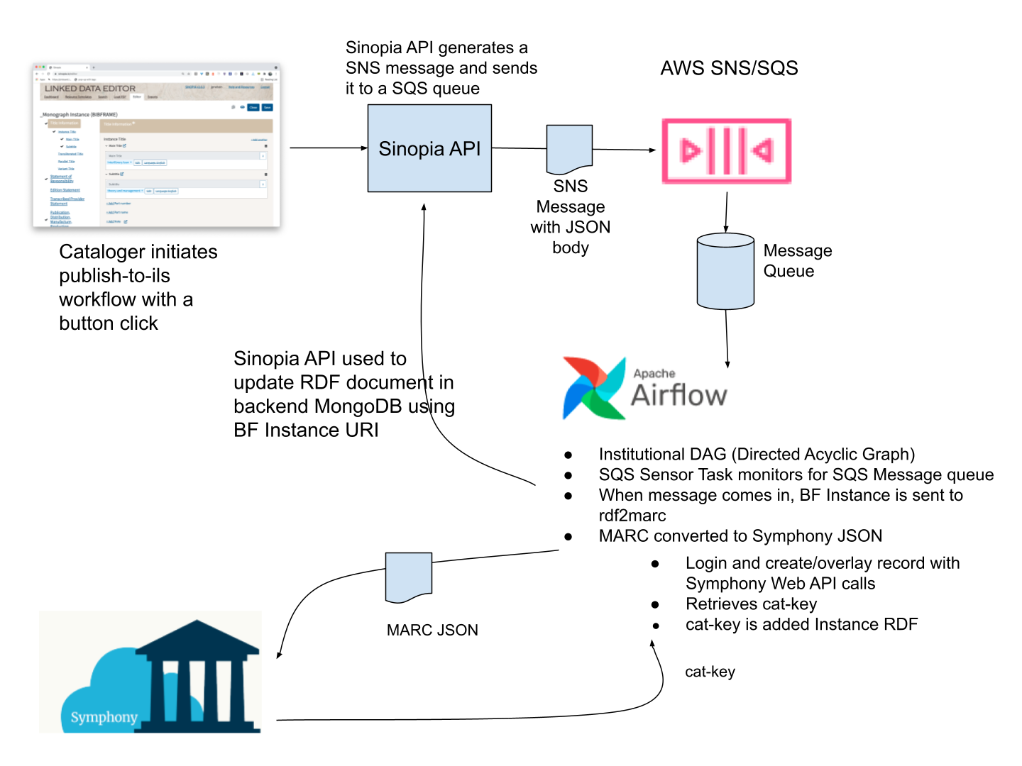
Sinopia MiddleWare
https://github.com/LD4P/ils-middleware/wiki/ILS-Integrations
Notes:
Sinopia middleware - critical use case for cataloguing with bf; one of the complexities for moving towards implementation is connecting new systems to other existing ones where MARC is still needed.
https://github.com/LD4P/ils-middleware/wiki/ILS-Integrations
Here we have a high level overview of Sinopia Middleware for Sirsi Symphony (AUL’s ILS) - Developed through LD4P3, and UAL is now working on setting this up. Penn has a similar middleware connector from Sinopia to our Alma ILS. Similar integration also being developed for FOLIO.
This allows us to describe in bf:, but then output MARC for our ILS.

Slide 10

Share-VDE
Discovery Environment https://www.svde.org/
Institutional Instances
PCC BIBFRAME Data Pool
MARC2BIBFRAME Conversion
Share-VDE Sapientia Cluster Knowledge Base (Stardog triplestore backend)
Authority Control/Entity Management Workflows
J. Cricket Cluster Knowledge Base Editor
Notes:
Moving on to another key partnership: Share-VDE.
What is SVDE? A library-driven initiative which brings together the bibliographic catalogues and authority files of a community of libraries in a shared discovery environment based on linked data. Share-VDE expanded its scope to embrace a wider community of over thirty institutions also from the art and music domains, building the Share Family.
Share-VDE is providing support for a number of key areas and projects that listed on screen, but we will cover them in more detail next.
The discovery environment is entity-based; Penn and Alberta have instances with local branding
The PCC data pool contains all PCC metadata converted to BF by the SVDE project. All of this data is openly available

Slide 11
Share-VDE and MARC to BIBFRAME Conversion
Initial data conversion and clustering
Ongoing updates to our data sets in Share-VDE from our ILS/LSP
Workflow options:
Catalogue in BIBFRAME with Sinopia
Catalogue in MARC and convert via Share-VDE
Notes:
First, Share-VDE provides a pathway to convert and enrich our MARC data into BIBFRAME on an ongoing basis, allowing us the flexibility to catalogue and load records in MARC to our MARC-based ILS while also cataloguing natively in BIBFRAME in the Sinopia editor.
The implication here is that we can either catalogue in BIBFRAME with Sinopia, or we can add to our collection in BIBFRAME by continuing to catalogue in MARC as needed.
Local work in conversion includes review and contribution to Share-VDE conversion and clustering logic and related working groups, as well as assessment of our local needs and the steps required to support local MARC data conversion.

Slide 12
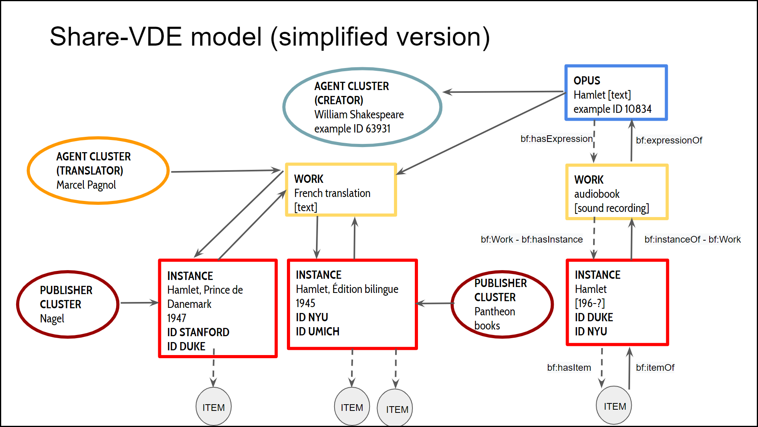
Sapientia Cluster Knowledge Base
Shared BIBFRAME datastore to support cataloguing and discovery
Community-developed data model
BIBFRAME extension
Notes:
Our converted data, along with descriptions contributed by the many Share-VDE partners, make up the Sapientia Cluster knowledge base which underlies the Share-VDE discovery portal. This is another key component for us, a shared BIBFRAME datastore, to leverage for cataloguing and discovery.

Slide 13
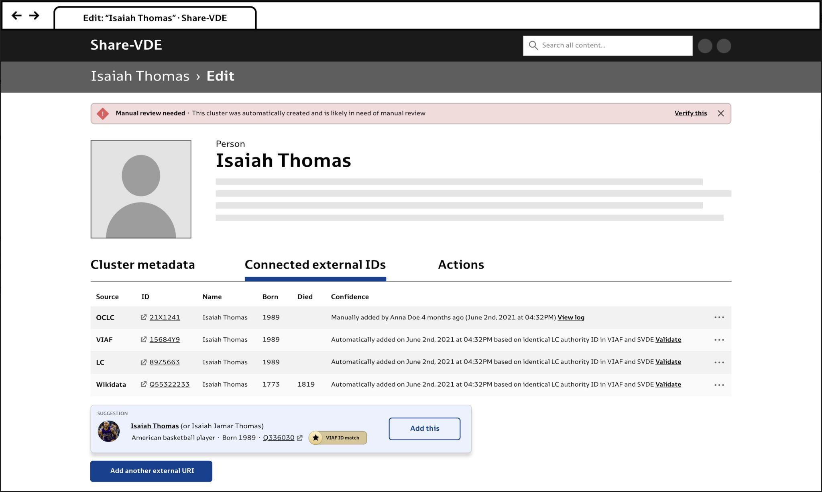
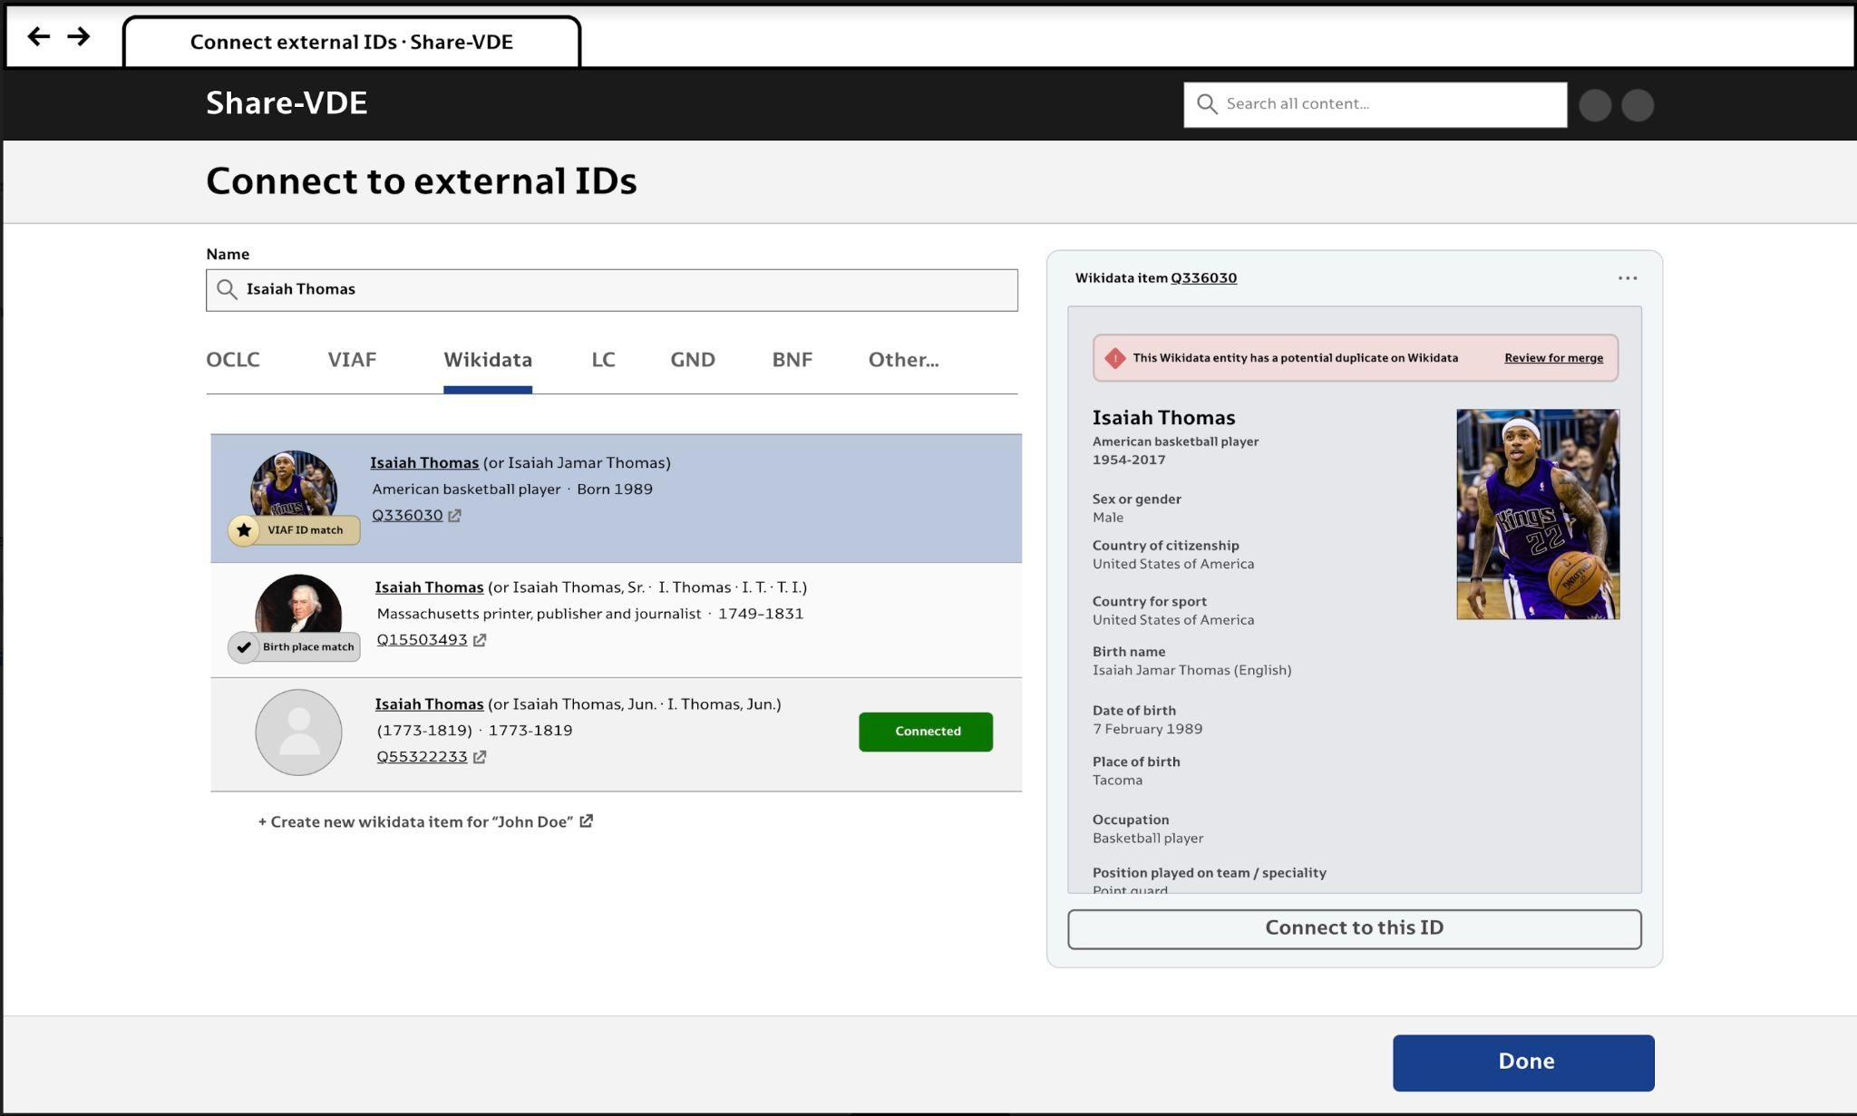
JCricket Editor - The Entity Management System
Notes:
The soon to be released J.Cricket editor is then an integral tool to be in conjunction with the cluster knowledge base that will enable entity and authority management workflows in a BIBFRAME environment while supporting the interaction with library systems both in MARC and in RDF formats. Our goal is for metadata creation and editing infrastructure to be set up in connection with Sinopia and J. Cricket. A phased approach is being take to analyse and work with these tools, beginning with an evaluation of the functionality of the J. Cricket Editor, Sinopia integration, and Sapientia data as part of the Share-VDE working groups, followed by an in-house evaluation of the J.Cricket editor and any related entity management workflows.
The J.Cricket editing tool will allow for editing entity clusters in Sapientia, enabling several actions including creation, modification, merge of clusters of works, of agents etc.
J.Cricket will extend authority capabilities through the integration with external data sources such as Wikidata and ISNI.

Slide 14
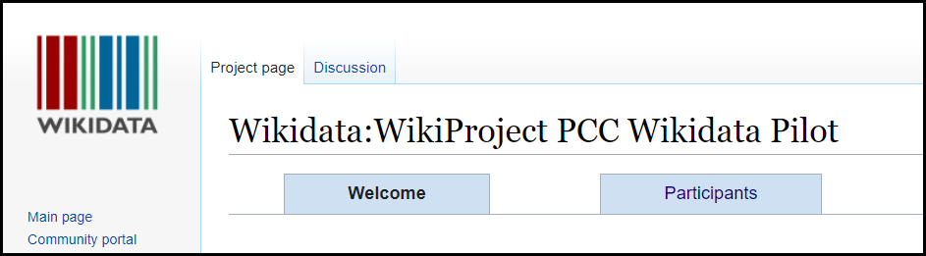
PCC WIKIDATA PILOT
Wikidata: identifier hub; community creation of LD
NACO-Lite: lower the barrier to authority creation and maintenance by PCC members
https://www.wikidata.org/wiki/Wikidata:WikiProject_PCC_Wikidata_Pilot
Notes:
Another example of collaborative linked data projects to increase understanding and develop LD skills

Slide 15
UNIVERSITY OF ALBERTA LIBRARY:
CURRENT ACTIVITIES
Strategic Planning, Testing, & Supporting Local Needs
Notes:
Thanks Beth. I’m going to be giving an overview of the strategic and hands on work we’ve been doing at the University of Alberta library to prepare for linked data implementation using many of the tools and partnerships highlighted by Beth.

Slide 16
Overview
Linked Data Development Trajectory at UAL
Experimentation and exploration, xxxx-2017
Moving Forward with Linked Data, 2017-2019
Assessment and planning, 2019-2022
Linked Data Implementation Plan (LDIP), 2022-2027
LSP Migration, 2023-2025
Notes:
As we know, cataloguing and metadata standards are in a period of significant change. Linked data is being incorporated into core standards, resulting in large scale data migrations and related implications for library systems.
At UAL we’ve been exploring and working with the international BIBFRAME community since early 2016 (LD well before that in various ways).
Between 2017 and 2019 though, we became increasingly involved with the PCC, Share-VDE, and LD4P, allowing us to see the potential for wider implementation, but also that an institutional effort would be required, which resulted an internal direction policy outlined in Moving forward with linked data
2019-2022 was a strange time overall with the pandemic, but allowed us to look at outcomes from LD4P2 and outputs from LD4P3 for Sinopia, continued participation in Share-VDE and really start planning out how we could sustainably work towards linked data implementation - Thus the LDIP which is meant to carry us through the next five years.

Slide 17
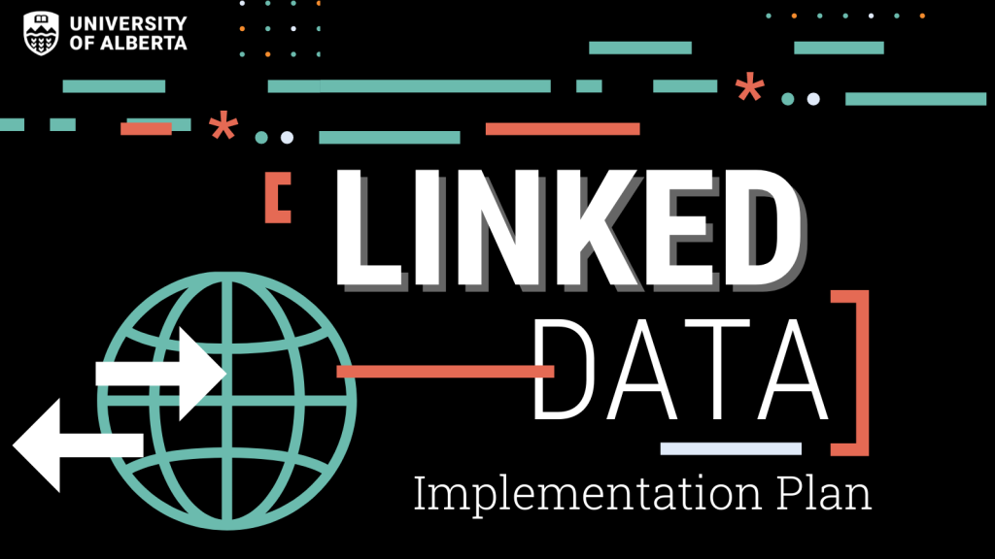
https://docs.google.com/document/d/1heSEuYO_9fry764ywAZak2Zc5J5vpvMB-zqEg4cAPY8/edit?usp=sharing
Notes:
We launched our LDIP in 2022 and have been utilizing it since. This plan is a living document that outlines our goals, projects and gradual steps towards linked data implementation in both our cataloguing and metadata units. This document is available on our library website.

Slide 18
LDIP Goals
Facilitate different modes of discovery for enhancing user discovery experiences.
Enable new modes of discovery within and across collections (ours and others’).
Provide open access to our metadata for the widest of audiences.
Support cataloguing and metadata practices to incorporate more appropriate and respectful terminology in our vocabularies.
Improve workflows for data transformation, migration, assessment, and enhancement.
Support long term data preservation with emerging linked data standards.
Notes:
A key aspect of the plan was to identify the high level goals linked data implementation supports. In our case these range from enhancing resource discovery and user experience, making our catalogue data openly available as LOD, and supporting new ways of working with, leveraging, and preserving our data.
Being able to reach a point where we can begin to map out systems and tools to support these goals is a big deal and we are excited, even with so much work ahead

Slide 19
Creating a new ecosystem with LD tools and metadata
Hybrid LD Cataloguing Ecosystem
bf2mrc
Share-VDE
Test LD Discovery; Access to Data
Entity Management in Share-VDE J. Cricket
mrc2bf
Sapientia +J Cricket
bf-bf harmonization
LSP
Original and copy cataloguing in Sinopia
Sinopia
bf2mrc
Notes:
As you can see in this high level diagram, we now have the tools and can begin realizing the workflow for BIBFRAME cataloguing and discovery, with key connectors for data going to new and current systems being actively developed and refined.
We have a bf:based cataloguing editor (Sinopia), we have a data source and discovery tool in (Share-VDE and Sapientia) as well as an entity management tool with the J Cricket editor and ways to connect to our MARC based system to support MARC to bf conversion and vice versa.
Making these tools and connections a reality in our local context are key pieces to LDIP

Slide 20
Challenges and Adaptation
Institutional Change
Budget cuts and associated reductions of support for in-house technical experimentation
Shift focus to support community projects and associated integrations
New priorities and limitations introduced by upcoming LSP migration
LSP Migration!
2023-2025 - Shorter timeline than Linked Data Implementation Plan
Linked data and BIBFRAME based needs assessment and requirement building
Need to re-evaluate what could be built into a new system rather than having external integrations
*Updating the Linked Data Implementation Plan is a work in progress
Notes:
Of course this doesn’t mean plans are set in stone and we’ll be the first to admit that since starting work on the LDIP we’ve faced challenges that require adaptation. Since 2020 we’ve faced a number of institutional changes, including budget cuts, University wide IT restructuring and staffing reductions. In tandem, we’ve recently begun an LSP selection and migration project that’s introduced new priorities and timelines for linked data implementation work.
As a results we’ve had to shift our efforts from a focus on in house technical development to contributing to community initiatives to support further development of these tools and workflows. Here, we’ve had to acknowledge the significant staff time and resources needed to plan and complete an LSP migration. The upcoming migration has also meant new work to translate LDIP objectives into our LSP needs assessment and high level requirements, specifically looking at what can be built into a new system.

Slide 21
2023 LDIP Objectives
Build competency with, and work with key partners to establish practices for resource description with BIBFRAME in general, and Sinopia in particular.
Testing and feedback on identified areas such as local and Canadian specifications, languages and scripts to ensure accurate coverage in BIBFRAME resource descriptions.
Work with project partners on the creation and maintenance of Sinopia templates to meet UAL needs.
Test and evaluate Sinopia middleware for UAL’s LSP.
Test and provide feedback on the Share-VDE J.Cricket Entity Management system to improve entity management processes and tools in a native linked data system.
Evaluate and provide feedback on the implementation of a UAL Share-VDE Portal instance/tennant to improve usage and discovery of UAL data in the Share-VDE system.
Notes:
With this in mind, we are currently working to update our LDIP, and have scoped our goals for this year to focus on advancement and review of external projects to support UAL future needs. These include continuing to build competency with BIBFRAME resource description in Sinopia and the refinement of cataloguing templates, evaluation of middleware to connect Sinopia to UAL’s LSP (current and also future), and working with the Share-VDE community to test, evaluate and provide feedback on their core infrastructure, including data clustering and use in the Share-VDE discovery portal and the J-Cricket cluster knowledgebase entity manager.

Slide 22
Integrating Canadian and Local Specifications
Examples of Canadian and local specifications that need attention include:
Canadian Classification
Canadian Subject Headings / RVM
Discovery support for French language users
Local practice and impact on data conversion, clustering, et cetera
What do we mean by “local”?
Notes:
Digging into these further, an important aspects of our current work is simultaneously:
Working on investigations where we bring a unique value
Addressing “local” requirements that will be needed to make the toolings ready for use. If we are to build these tools into systems for production they need to handle our specific needs.

Slide 23
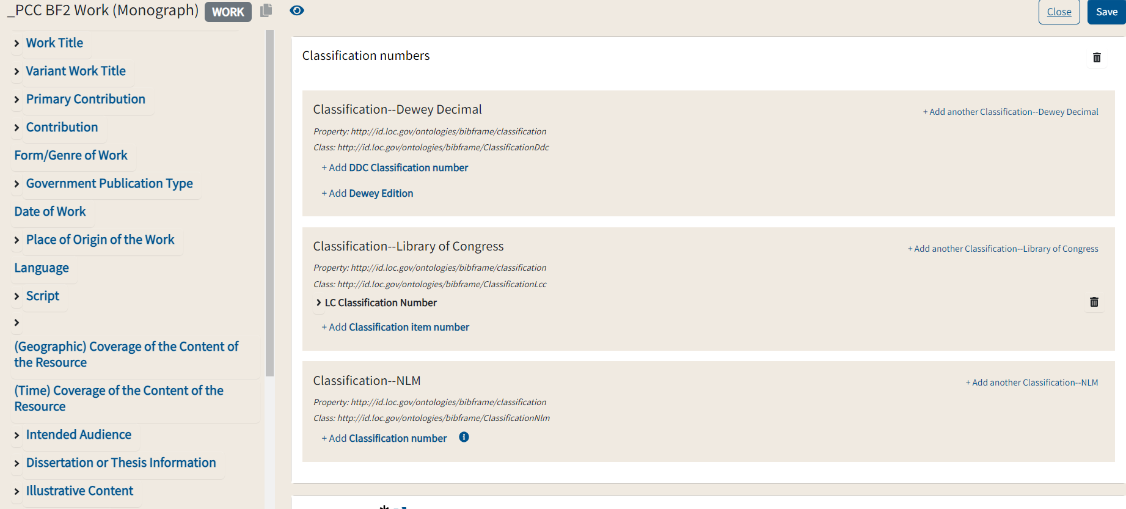
Application of Canadian and Other Classification
Notes:
These strands include working with the PCC Sinopia community to advocate for inclusion of core Canadian elements like classification and subject headings. For instance, in the current Sinopia PCC work templates, there is no ability to specify and utilize Canadian classification schemes or subject headings. While this work is important to UAL it also speaks to need for internationalization more generally. Our feedback in this area is currently being considered by PCC.

Slide 24
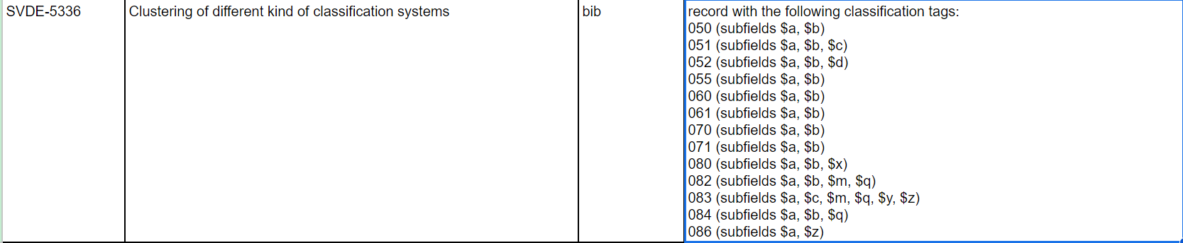
Related Canadian/Local Considerations for Share-VDE
Canadian access points clustering
Use of local approaches for classification (055, 090) and impact on conversion and clustering
Notes:
Related work is also ongoing with Share-VDE. Here we’re beginning to look at how we can utilize Canadian access points for clustering and other processes, particularly where there are no linked data vocabularies for re-use such as Canadian Subject Headings and Canadiana authorities. We want to ensure that where we’ve used these access points that they are clustered with equivalents from other vocabularies such as LC And VIAF so Canadian entities aren’t siloed.
Similarly, Local field use also has impact on conversion and clustering of our data in BIBFRAME that need to be investigated, such as our use of the 090 field to record local classification.

Slide 25
Share-VDE User Experience/User Interface Analysis
Provide feedback on Share-VDE discovery interface:
PCC Share-VDE data review
Contributions to Share-VDE UX/UI Working Group
UAL Share-VDE portal tennant analysis
French language user interface
Notes:
Discovery and user experience is another area we’ve been able to continue contributing to support overall improvements, but also to ensure local use cases are covered. Examples here include leadership of the Share-VDE UX/UI working group, but also analysis of our local Share-VDE tennant to ensure it will meet the unique needs of the UAL community.

Slide 26
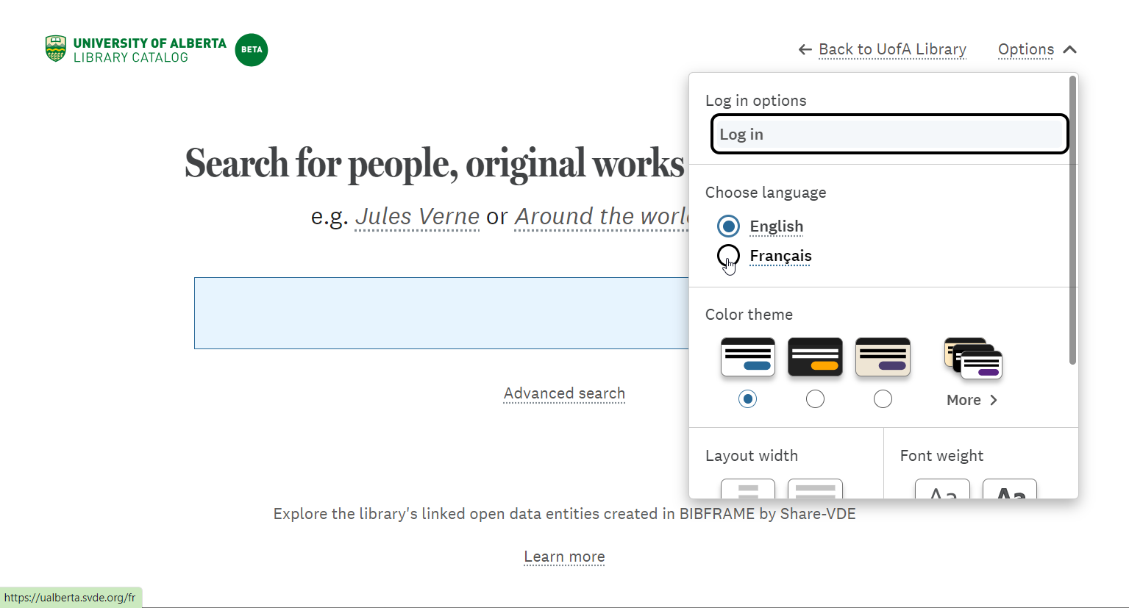
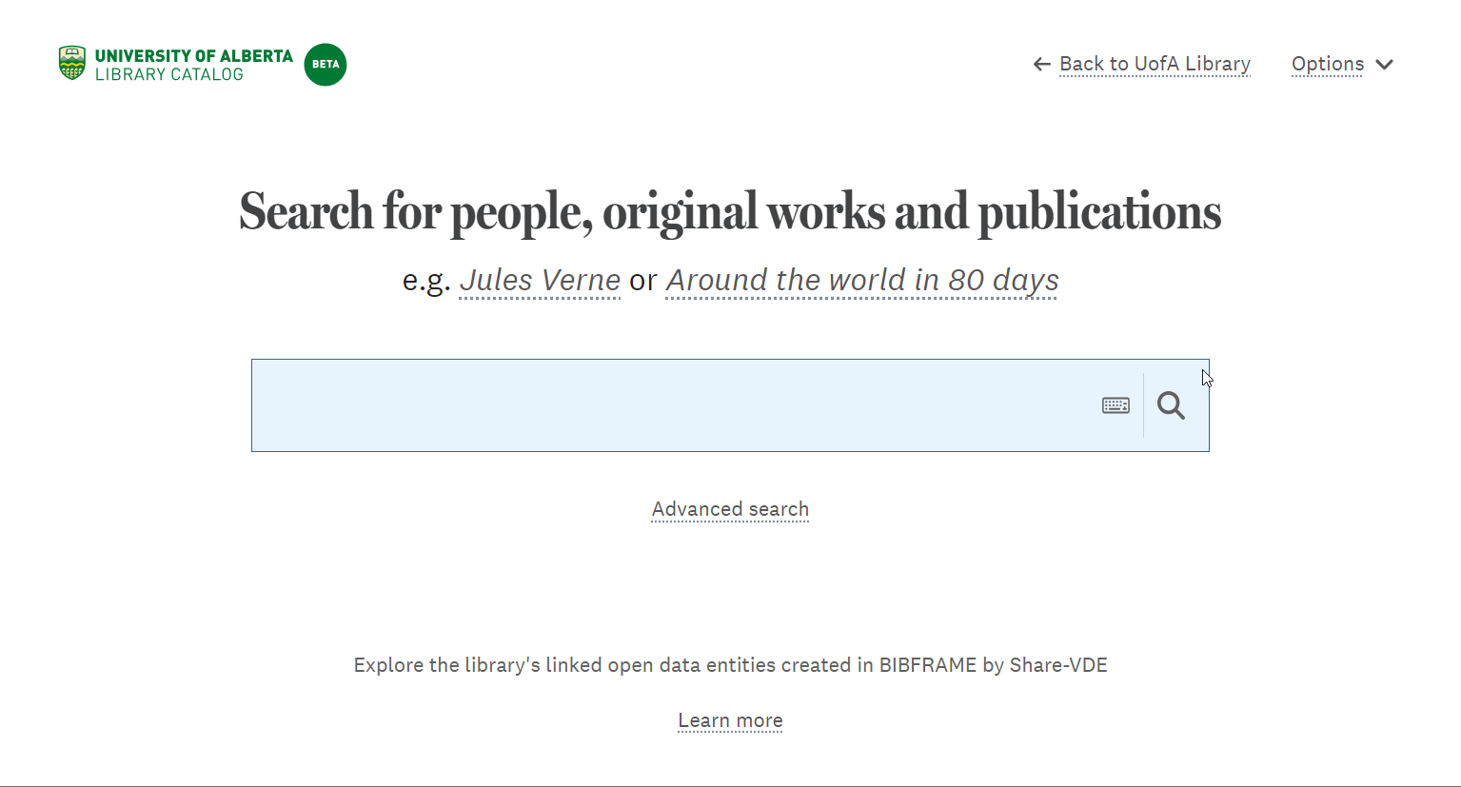
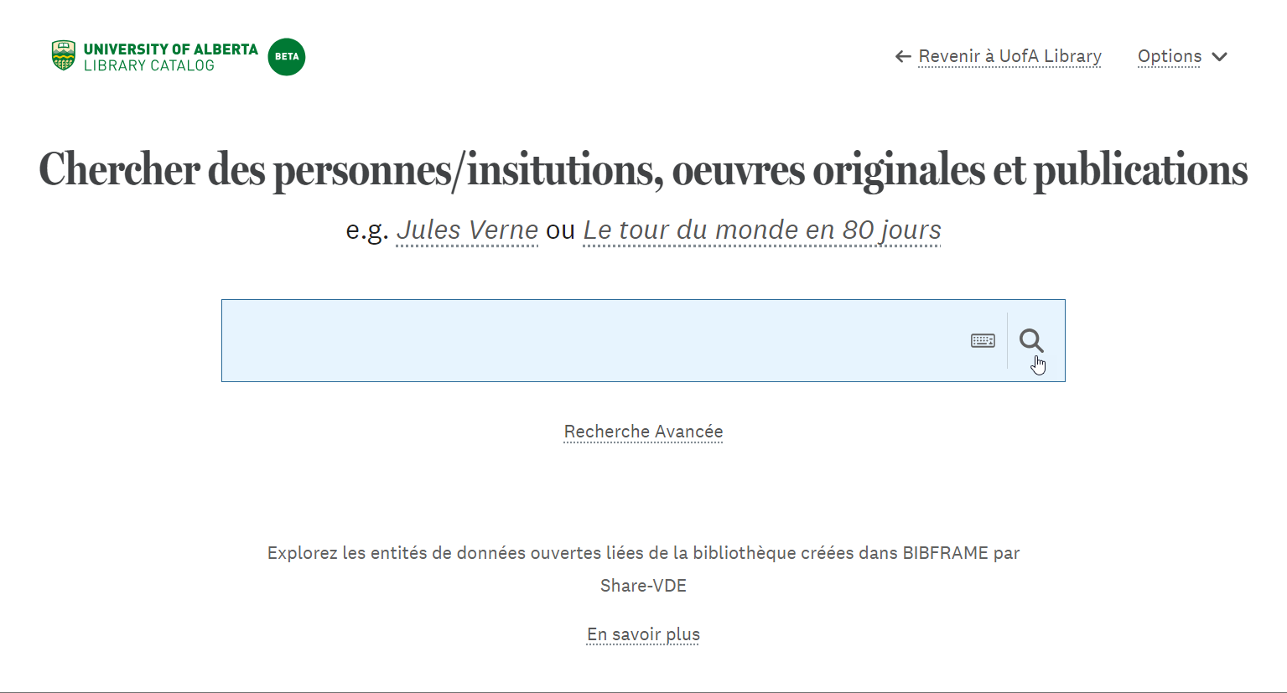
Notes:
One of these needs is for a French user interface to serve our French campus. Here we are leveraging the language skills of our staff to review and provide feedback on interface translation.

Slide 27
LSP Migration Project Charter
Project Objectives
To migrate the existing legacy ILS to an LSP with the latest library system technologies, scalable system architecture and infrastructure that can support the strategic goals and long-term needs of the UAL;
To have a single enterprise-level LSP that can cover majority of the core library functions of the UAL, and have a centralized platform in managing print and digital collections and client files (patron accounts) and identity management for various client groups;
To enhance usability, accessibility, and discoverability of its collections by having an enhanced discovery ecosystem through seamless system integration between the front-end discovery function with the back-end LSP modules and databases;
To streamline the existing workflows and processes with reference to the best practices in the library industries;
To enhance the system availability, stability, security while lowering the system maintenance and support costs by migrating to a cloud-based LSP;
To lay down the system foundation for the implementation of Linked Data and migration to BIBFRAME.
Notes:
So this brings us to one of our biggest projects now for this year which is to select and migrate to a new LSP. There have been discussions about this for some time, but now this migration plan is very real and on a tight timeline. A large driver of this migration is to move to a scalable modern system that supports our strategic goals, including linked data implementation.
While significant resources need to be routed to this project, it gives us the opportunity to build needs and requirements for transitioning to linked data into the LSP design and begin to lay down the system foundations and workflows with external vendors.
This also means reflecting on what will need to be external integrations vs what can be built in, similarly, what can be supported at the point of migration and what will be developed and implemented post-migration

Slide 28
Desired Sinopia and Share-VDE Connections at UAL (5 year goal)
Create and manage
external entities
Discover and borrow resources
CKB / Sapientia
LD Catalog
Discovery Index
LC Vocabs
ISNI
Create and manage bibliographic metadata
ILL
Discovery User Interface
Wikidata
Others..
Sinopia/JCricket
Digitized Collections
Acquire materials and metadata
Shelf Ready Providers
LSP API
Manage collections
MARC e-record sets
BIBFRAME Data Pools (including PCC)
Updated LSP
Desired new connections
Existing one-way connection
Notes:
While the LSP migration has impacted our short term planning, we’re still hopeful that the workflows and connections outlined in our five year plan on the screen can be realized. Where previously we were thinking about many of these tools as external integrations, we are now very curious to see what LSP systems will provide to include equivalent processes built in … and how implementation ready some of these tools will be with the timelines for our LSP migration in the next 2-3 years. So for the time being, we are continuing work related to Share-VDE, Sinopia, and the PCC data pool, but also working to capture the underlying functions of each of these tools (bf editor, entity management tools, LOD data pools, …) at a high level for our LSP RFP. A key aspect of these needs is flexibility. At the 5 year mark the hope is for our own systems to be LD native, but we still need to consider that many others will be using MARC and that we will need to use those descriptions for copy cataloguing/reuse.
From our work so far we know that tools are maturing and look forward to strong vendor responses support our needs.
For those interested I do encourage you to take a look at our published linked data implementation plan … keeping in mind that it will be updated in the coming days to reflect recent efforts and account for LSP project scoping. This plan includes much more detail on the individual projects and components that are needed to support linked data implementation, along with the associated goals, risks and dependencies, which you may find useful for your own planning purposes.

Slide 29
PENN LIBRARIES: CURRENT ACTIVITIES
Linked Data Editors to Alma ILS
Notes:
At Penn, we’re testing original cataloging in two linked data editors
Sinopia (mentioned earlier)
Marva, Library of Congress’s LD editor
Our testing involves:
Creating descriptions in both editors, comparing the different cataloging experiences in each system
Exporting MARC that the editors have converted from BIBFRAME into our ILS’s testing environment, called Alma Sandbox

Slide 30
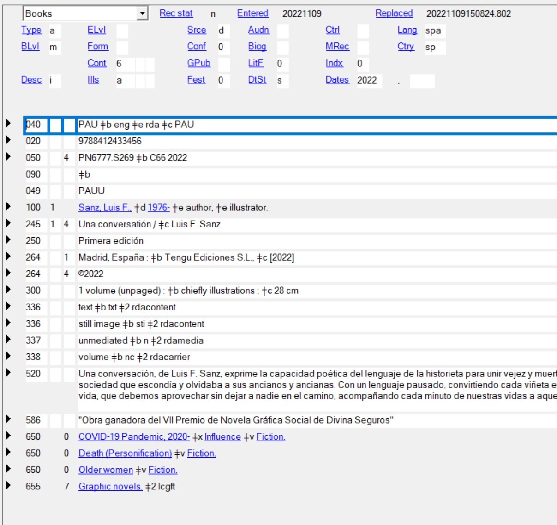
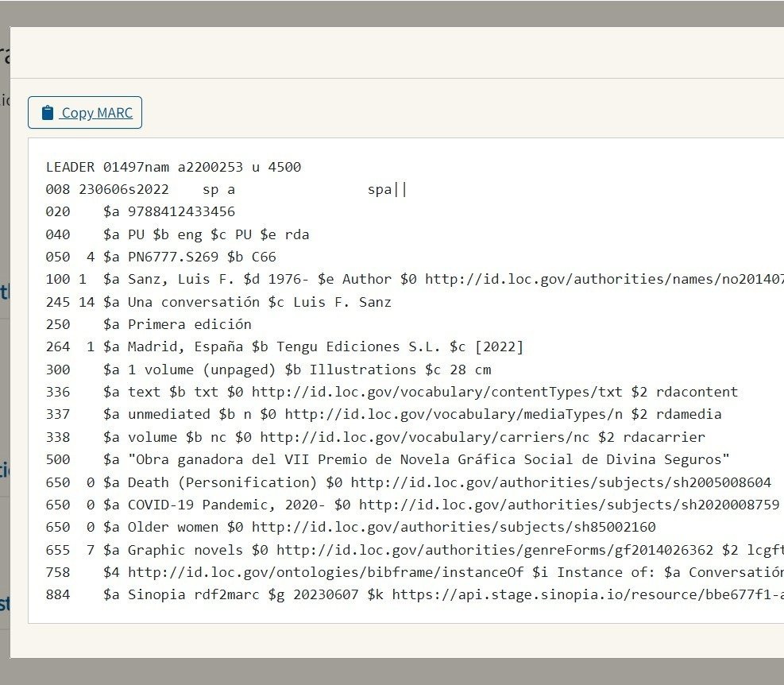
TESTING THE EDITORS
Cataloging in OCLC Connexion & Sinopia
Notes:
Our testing so far has been in two stages
First stage: cataloging a resource two times:
Once in OCLC Connexion (left)
Once in Sinopia, which is the editor we began testing first
After creating the work and instance descriptions in Sinopia, we had Sinopia convert the BIBFRAME into MARC (right)
Purpose: be able to look both MARC records and compare them side by side

Slide 31
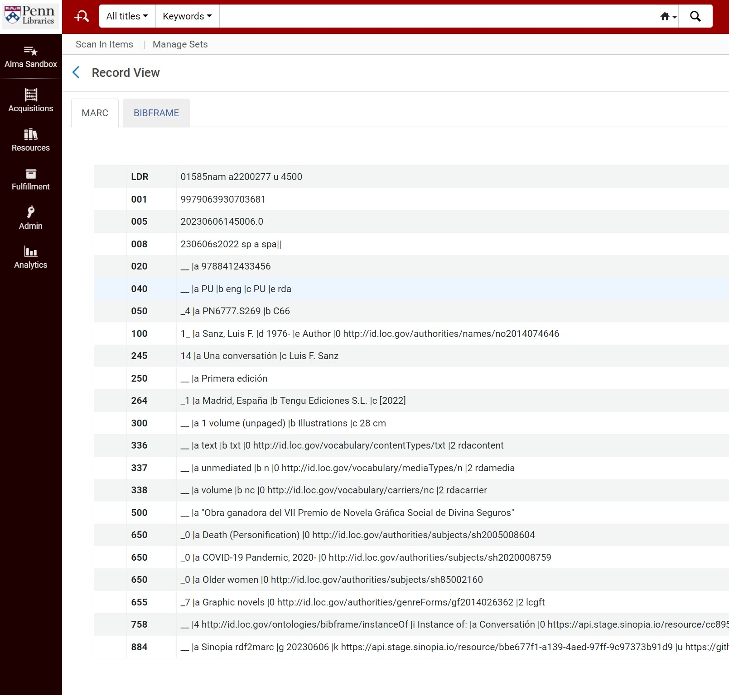
TESTING THE EDITORS
Exporting from Editors to Alma ILS
Notes:
Next stage: exporting MARC generated from both editors into our ILS testing environment, Alma Sandbox
On screen:
This is what the bib record looks like in Alma Sandbox

Slide 32
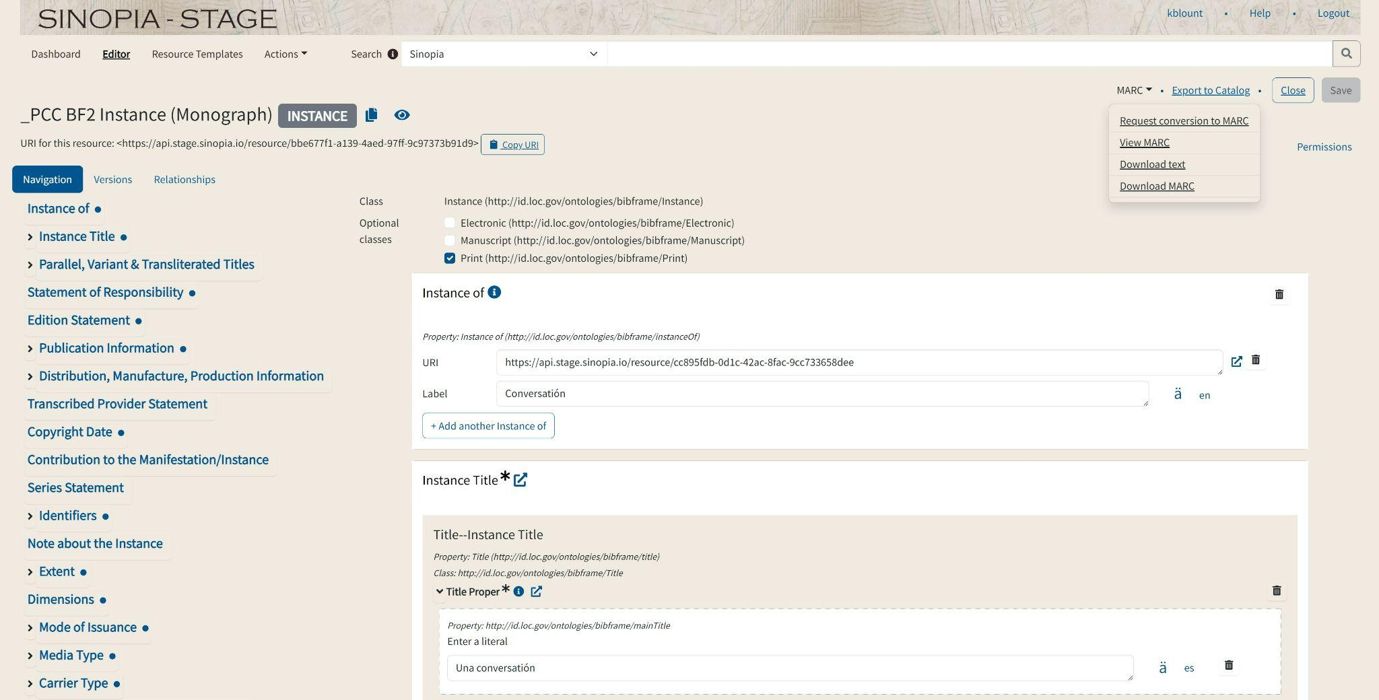
Cataloging in Sinopia
Notes:
Brief overview of what each editor looks like and how the experiences cataloging in them are slightly different
Screenshot of Sinopia’s Stage environment
Upper right hand corner – two important features that we used during testing
First: MARC button, which leads to some dropdown options
After creating your work and instance BIBFRAME descriptions, you can use this button to:
Request a conversion from BIBFRAME to MARC
View the generated MARC
Download the description a couple of different ways
Second: Export to catalog button
That has been configured to send that generated MARC to our ILS testing environment

Slide 33
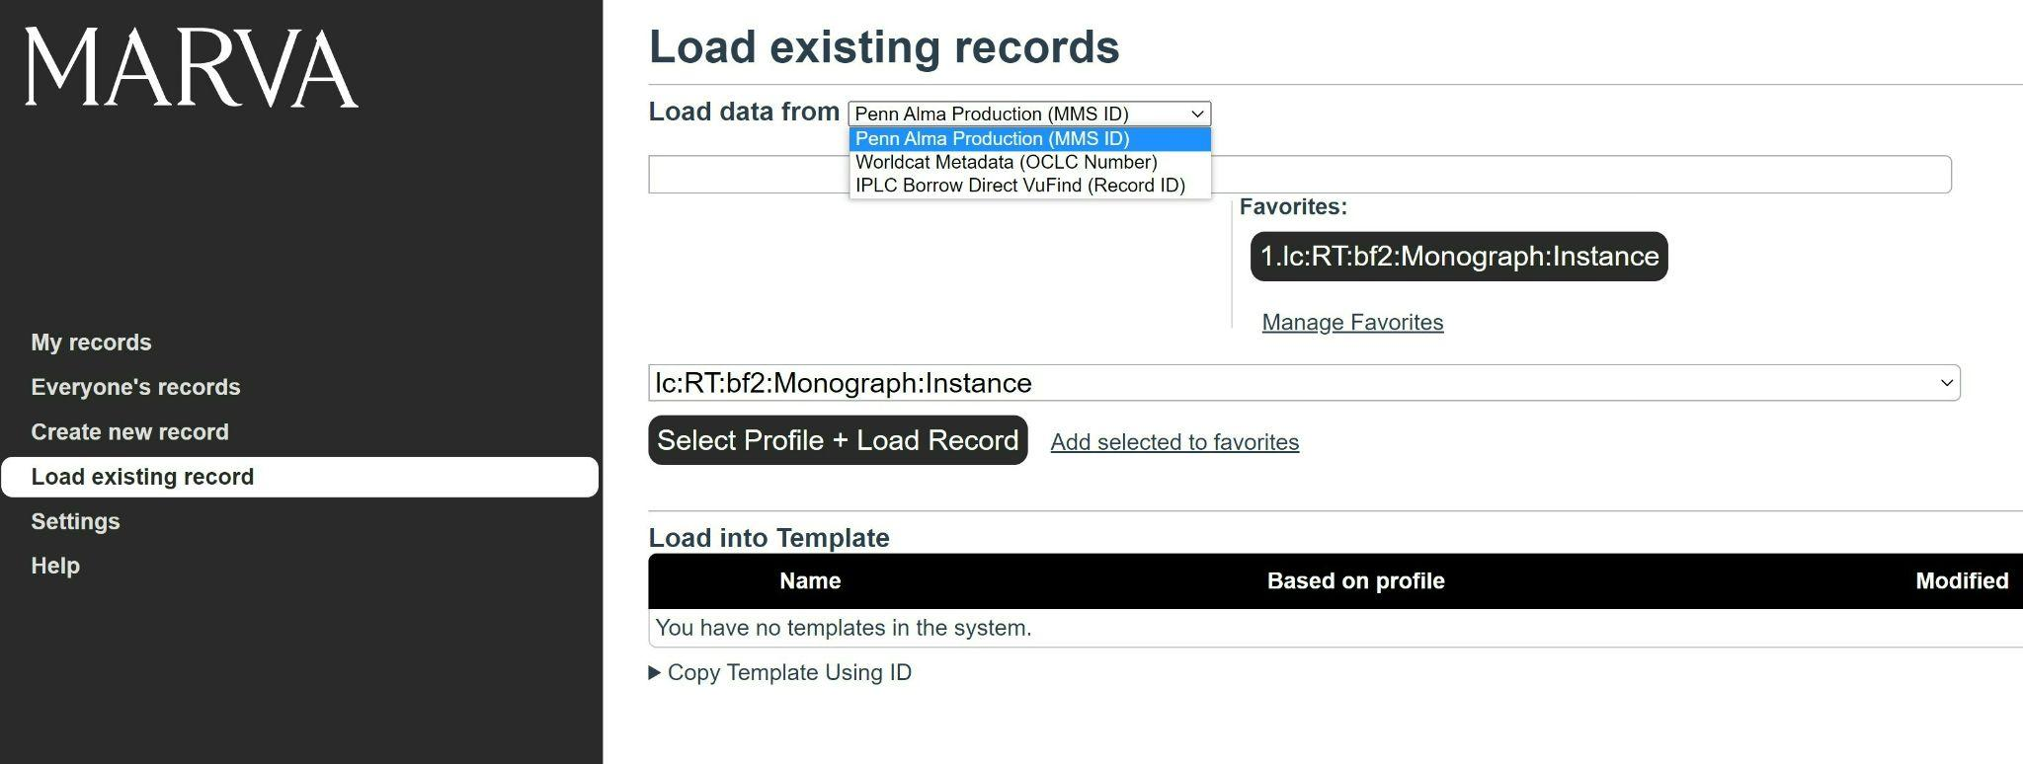
Cataloging in Marva
Notes:
On screen: what you see when you log onto Penn’s instance of Marva
This an editor designed by Library of Congress
We've downloaded and made a local copy of that, so that we can use it and have it send MARC to our Alma Sandbox
One exciting feature that we’ve been testing
Our instance of Marva has been configured to pull in data from already created MARC records and have that data prepopulate the BIBFRAME fields
Right now, we can pull data from MARC records in a few different places – the 1 that we’ve tested the most:
WorldCat via OCLC number
Particularly helpful – many of the items that I’m cataloging for this testing are non-English language books that don’t have English copy in OCLC but do have non-English copy
Can pull data from the non-English record, and use that as the basis for creating an English record

Slide 34
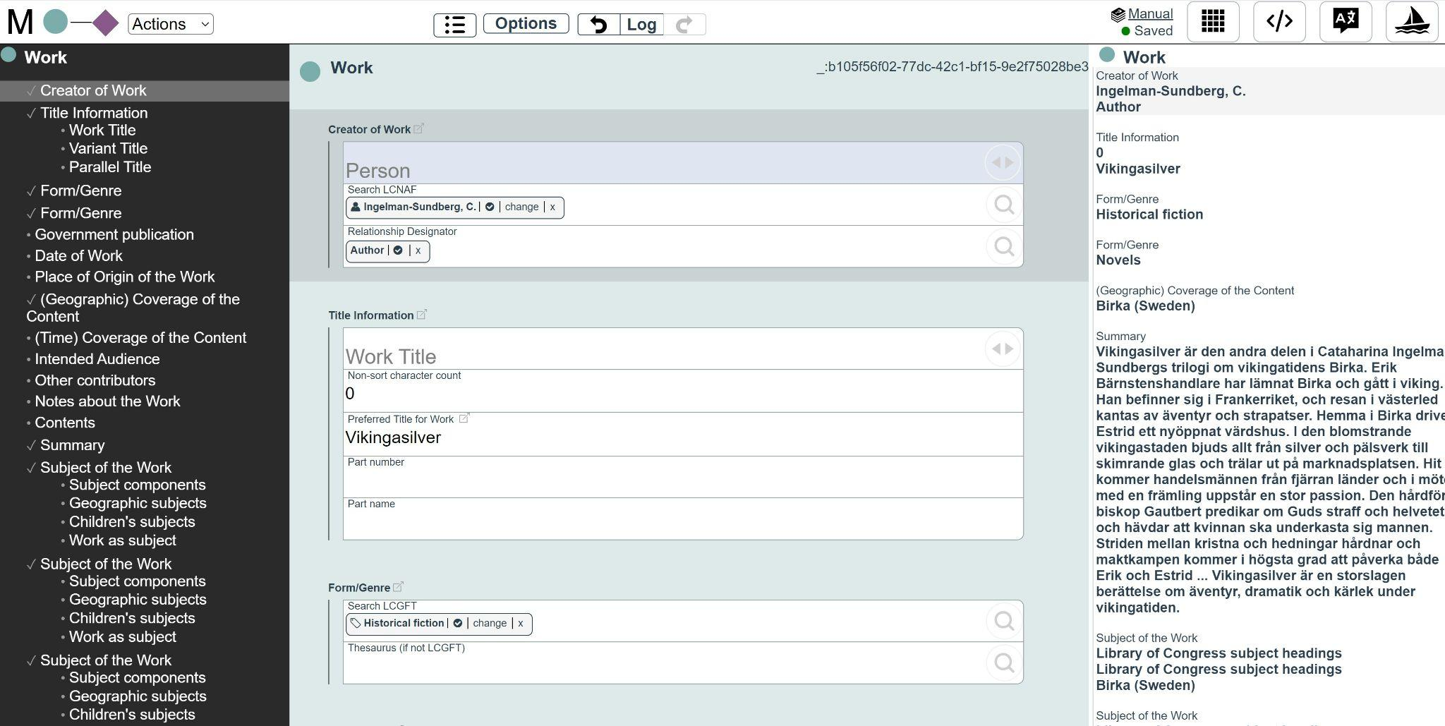
Cataloging in Marva
Notes:
This is what Marva looks like when you’re working on a description
Similar to Sinopia in that you’re still filling out what looks like a form – but there are some differences, which I’ll go into in the next slide

Slide 35
COMPARING THE EDITORS
Sinopia
Marva
Customizable templates
Multi-tab layout
Cannot import records from other sources
Lookups for multiple vocabs
Can add your own URI and label if not found in lookup
One template
Single page layout
Can import records from other sources
Lookups for LC vocabs
Cannot add your own URI and label if not found in lookup
*MARC mapping differences
Notes:
The way you create data is slightly different in each system
Sinopia: customizable templates (profiles) -- can use ones already created (we used ones created by the PCC), but you could also use others or create your own
Marva: the one template that you can use
Layouts are different
Sinopia: multi-tab layout – open up one tab for work, another for instance, another for item, can go back and forth between them
Marva: one big page, with the work description at the top, followed by the instance description below it
Other differences
As I mentioned before, our instance of Marva has been configured to import records from other sources
This capability doesn’t currently exist in Sinopia
Sinopia: can look up and use terms from different vocabs (e.g. FAST)
Marva: only LC vocabs
Sinopia: if can't find a term via lookup, you can add your own uri and label
Marva cannot
Differences in MARC mappings
Means that the MARC exported from Sinopia will look different in our ILS than the MARC exported from Marva

Slide 36
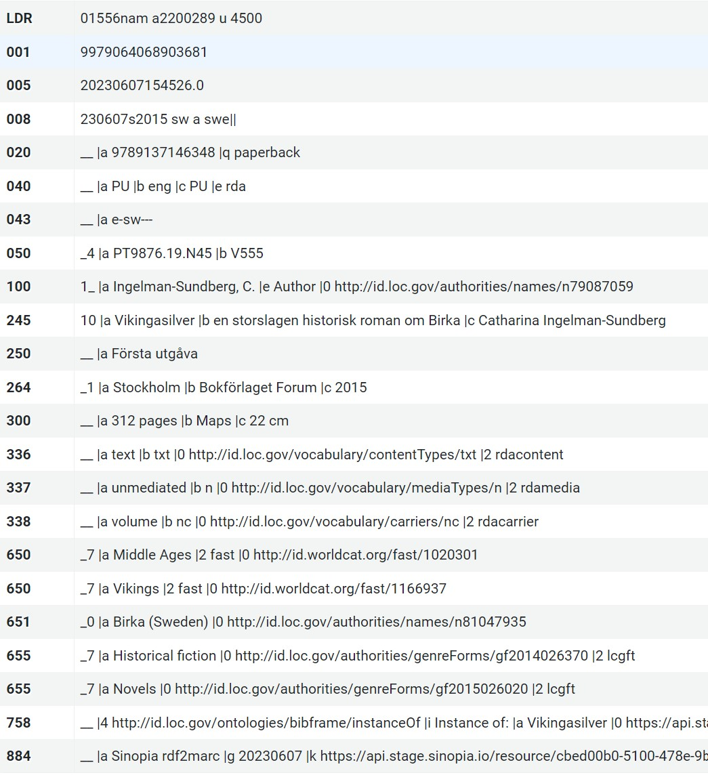
From Sinopia to Alma ILS
Notes:
Now to take a look at what some of those generated MARC records look like in our testing environment
This is an example of a MARC record generated by Sinopia and exported into Alma Sandbox
Looks small – briefly go over some things we can learn from this record
Something you’ll notice in this record right away, and the one from Marva I show later:
no ISBD punctuation
We have these uris generated in the $0
Other things I’ll touch on
264: no copyright date
Similarly No 520 summary note
300$b: will only show 1 illustration, map etc
Many notes that you might expect to see in specific 5XX notes are in a generic 500 notes field
Subjects: Are not in cataloger order
Nice thing about Sinopia: we have the ability to submit tickets to the Sinopia team
Some of these mapping issues may be bugs, they’re something we can bring to the attention of the Sinopia team and get resolved

Slide 37
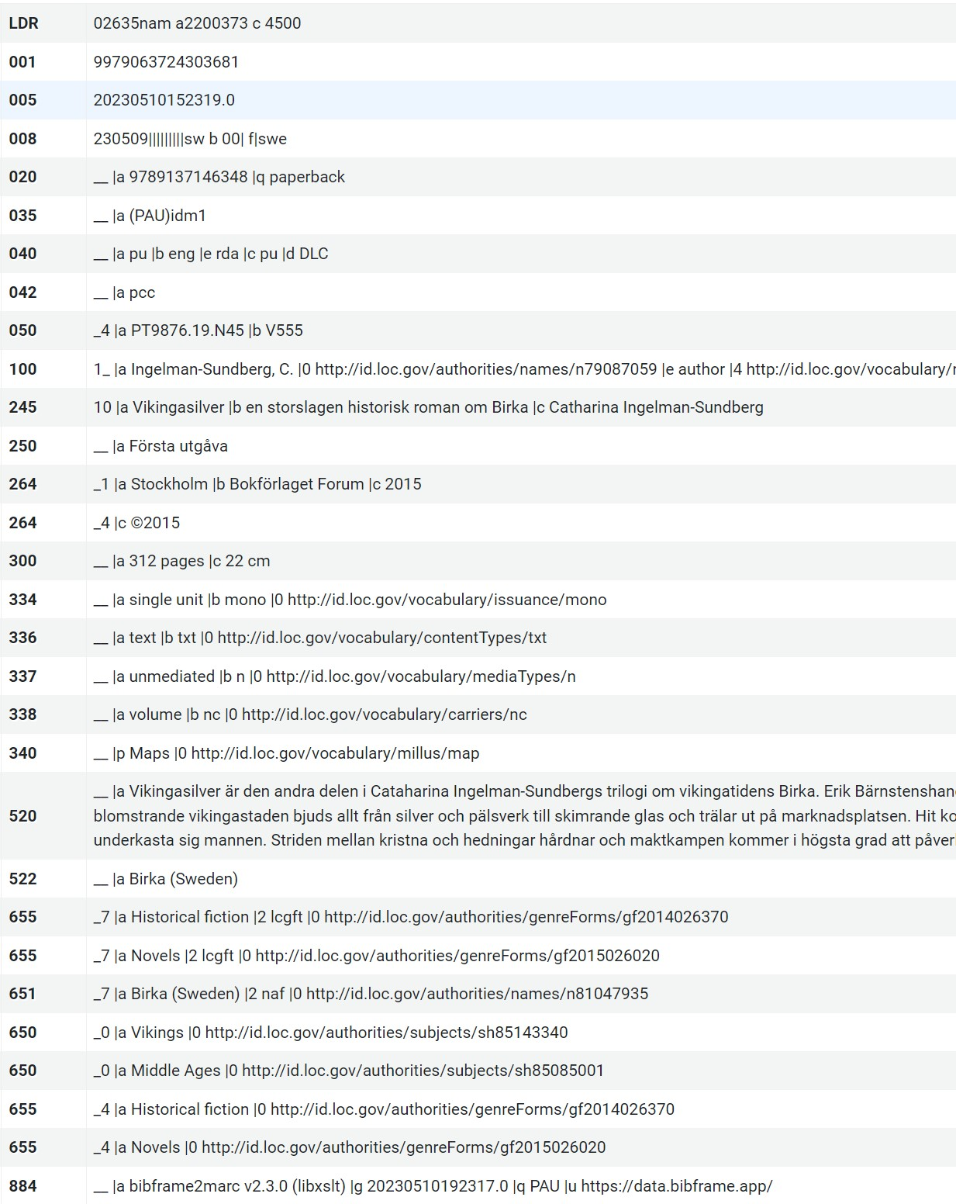
From Marva to Alma ILS
Notes:
264 does show copyright date
Does show 520 summary note
Illustrative content doesn’t map to 300, but to 340
655s display twice – with different indicators

Slide 38
TESTING TAKEAWAYS
Successes
Challenges
Ability to view sets of records in ILS
Showing to BIBFRAME Working Group, generating discussion, best practices, next steps
Comparing editors side by side
Troubleshooting, adding tickets, figuring out workarounds
MARC mappings not perfect → records need to be edited further after export
Editors are evolving as we test
How to incorporate testing into production workflows?
Notes:
Successes
Ability to view sets of records in ILS
Showing to BIBFRAME Working Group, generating discussion, best practices, next steps
Comparing editors side by side
Troubleshooting, adding tickets, figuring out workarounds
Challenges
MARC mappings not perfect → records need to be edited further after export
Editors are evolving as we test
How to incorporate testing into production workflows?

Slide 39
Future Plans for Testing
Non-Latin scripts
Incorporating OCLC
Continued discussions about best practices
Display of converted MARC in catalog
Moving to production
Notes:
Non-Latin scripts
Incorporating OCLC
Continued discussions about best practices
Display of converted MARC in catalog
Moving to production

Slide 40
CURRENT ACTIVITIES
Linked Data Description to Linked Data Discovery

Slide 41
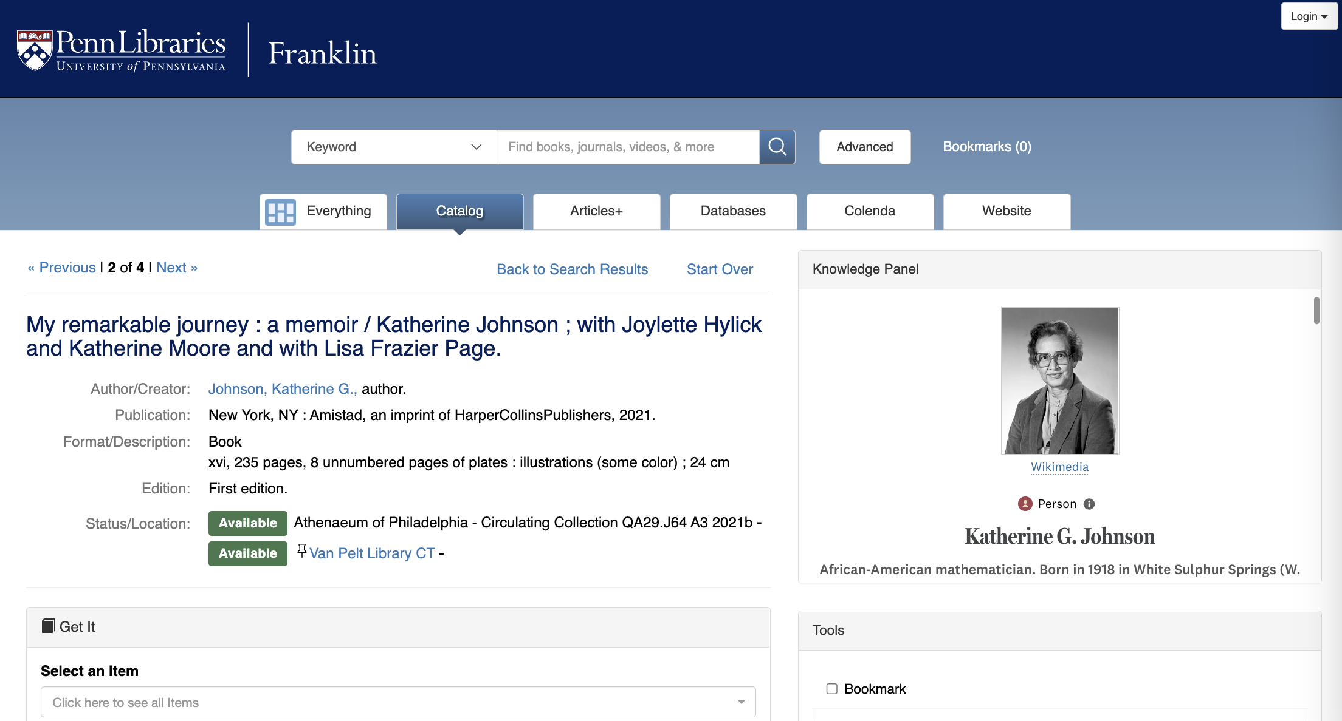
KNOWLEDGE PANELS FROM SHARE-VDE

Slide 42
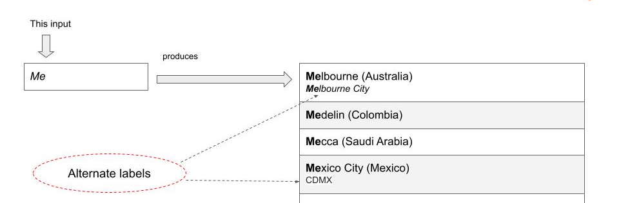
TYPEAHEAD USING Share-VDE APIS
Prefix lookup

Slide 43
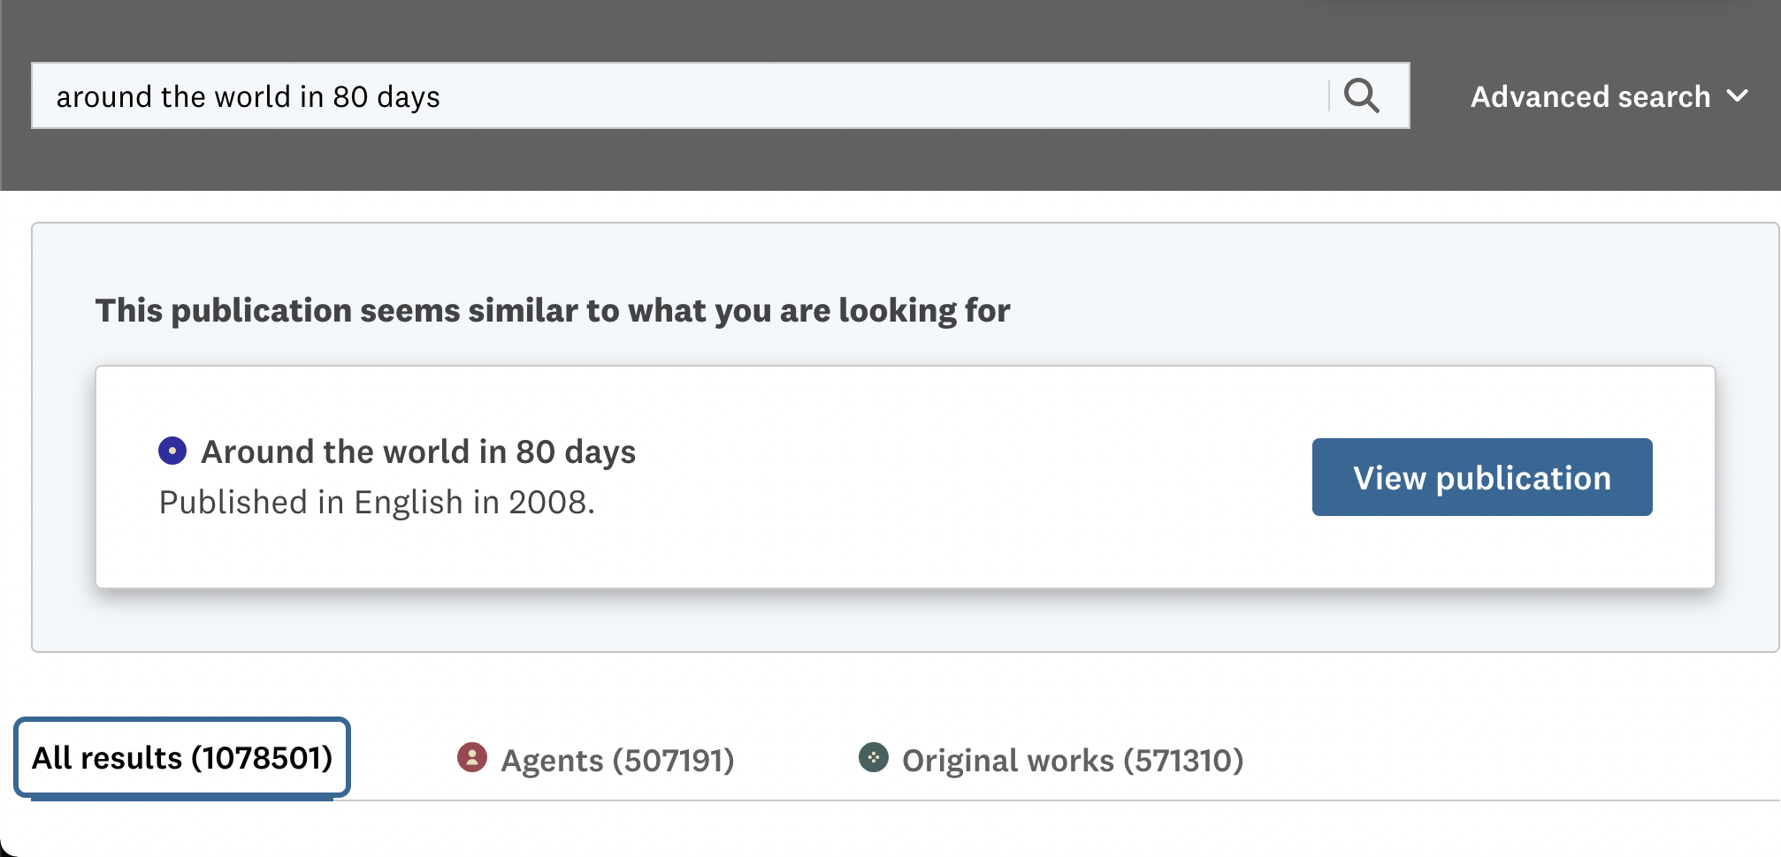
EXACT MATCH: Share-VDE API
“Publication is similar to what you are looking for”

Slide 44
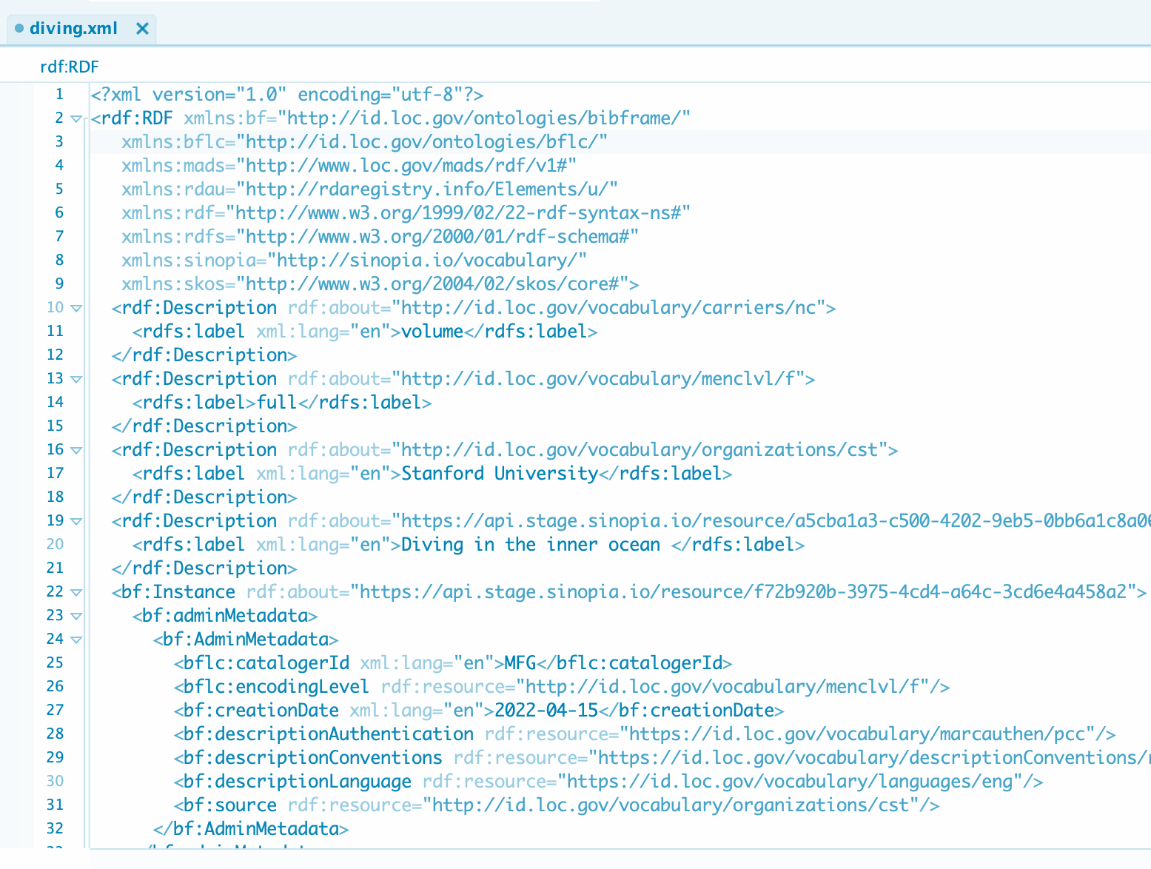
FUTURE: SINOPIA INSTANCE RDF TO ALMA
Bring in Native Sinopia Instance RDF to Alma

Slide 45
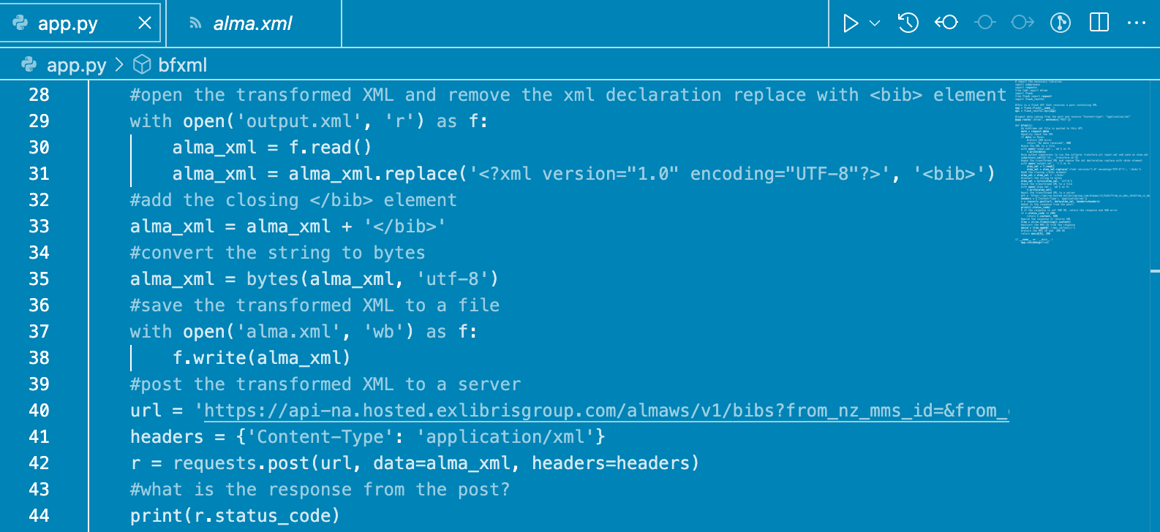
FUTURE: MARVA ENRICHED MARC TO ALMA PRODUCTION
Bring in Enriched MARC from MARVA to Alma

Slide 46
Examples underscore the hybrid linked data environment
Experimentation and focus areas for current systems are mixed-format or “hybrid” linked data environments as they are expected to be the most common way in which linked data is used in production in the next few years. This is reflective of sentiments shared at both libraries.

Slide 47
Future goals for linked data strategy
For the foreseeable future, linked data strategy is based on experimentation, innovation, and collaboration.
This will encompass work in a hybrid environment that will include MARC records, sometimes enhanced with linked data identifiers, as well as more “native” linked data formats in native linked data editors.
Currently, there is no one single technology or information system that will implement the hybrid approach to linked data. Rather, both libraries see a need for close collaboration among a variety of external groups and a reliance upon multiple technologies that will address our linked data goals.

Slide 48
Questions…?
Thank you!

Slide 49




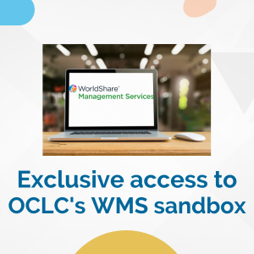
Exclusive Core Member Benefits
Notes:
Thank you for attending today's Core program. We'd love to encourage you to join Core and become involved in an Interest Group or Committee. You can learn about Core on our website at www.ala.org/core.

Slide 50


Please take a moment to evaluate this program
ala.org/core
alacore.org/go/to/alaac23-survey
Notes:
Finally, please take a few minutes to complete the evaluation form. You can use the QR code shown here or you can click the link to the evaluation form on the program page in the conference site.

