Slide 1
Soft Lithography

Slide 2
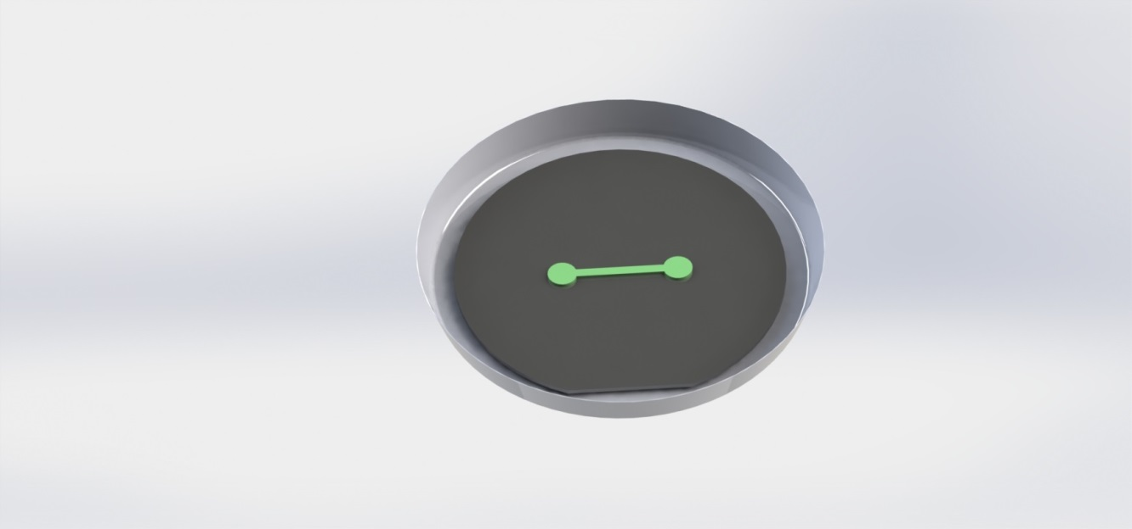
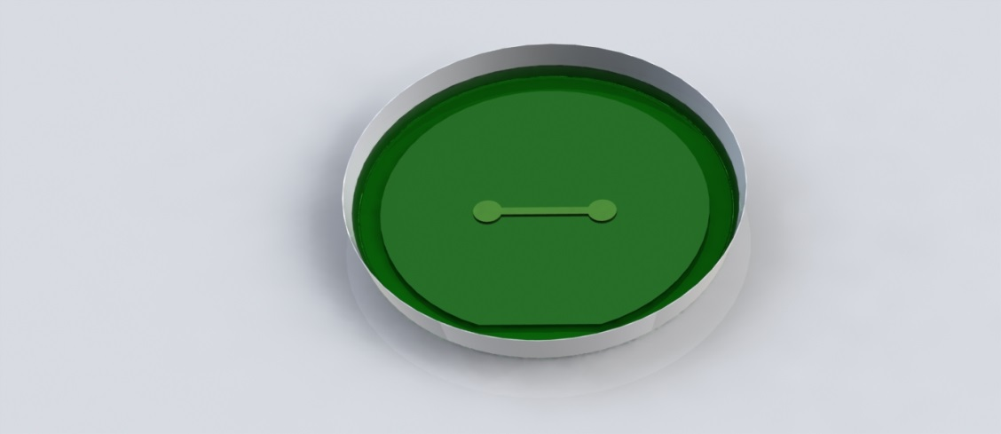
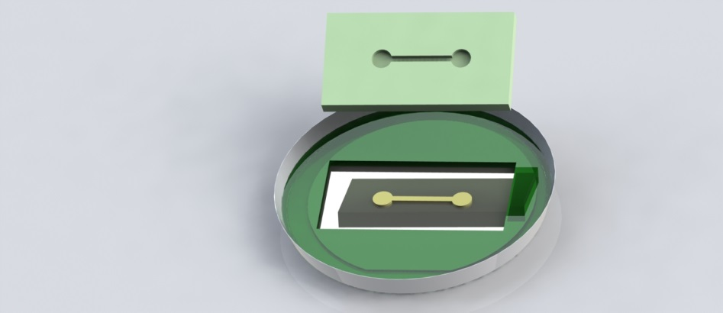
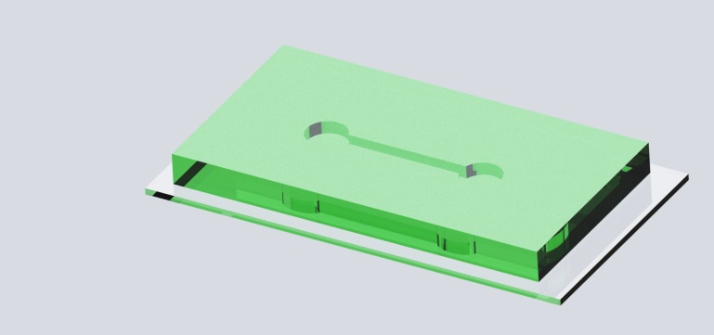
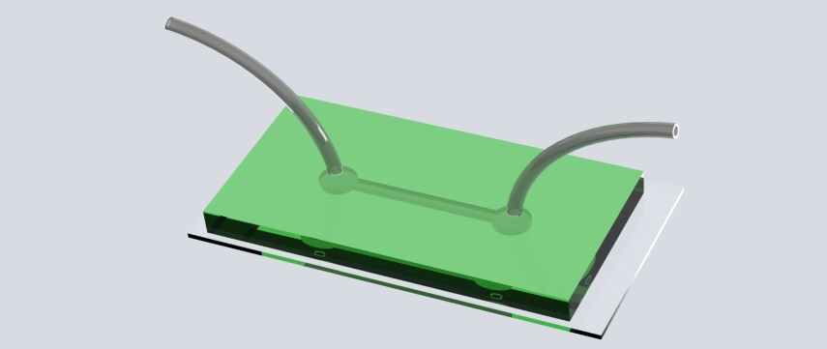
What is “Lab-on-a-Chip”?

Slide 3
We will cover:
Designing a mask (I can help with this)
Making a master
  Surface preparation of wafer
  Photoresist
  Exposing of photoresist through mask
  Post exposure bake
PDMS Device
  Casting
  Punching holes
  PDMS Bonding
  Filling

Slide 4
Designing a Mask
Designing a mask (I can help with this)
Making a master
  Surface preparation of wafer
  Photoresist
  Exposing of photoresist through mask
  Post exposure bake
PDMS Device
  Casting
  Punching holes
  PDMS Bonding
  Filling

Slide 5
Designing a Mask
Free software:
    Layout Editor (we have monthly training)
    DraftSight
Shapes to be closed polygons.
Chrome masks with Heidelberg
    $200 flat rate ($300 commercial) from our mask shop
Polymask vendors (20um+):
  outputcity.com
  fineline-imaging.com

Slide 6
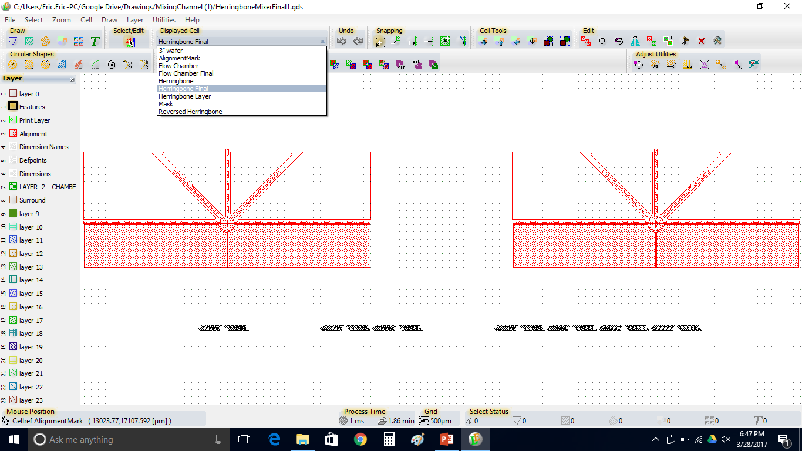
Layout Editor

Slide 7
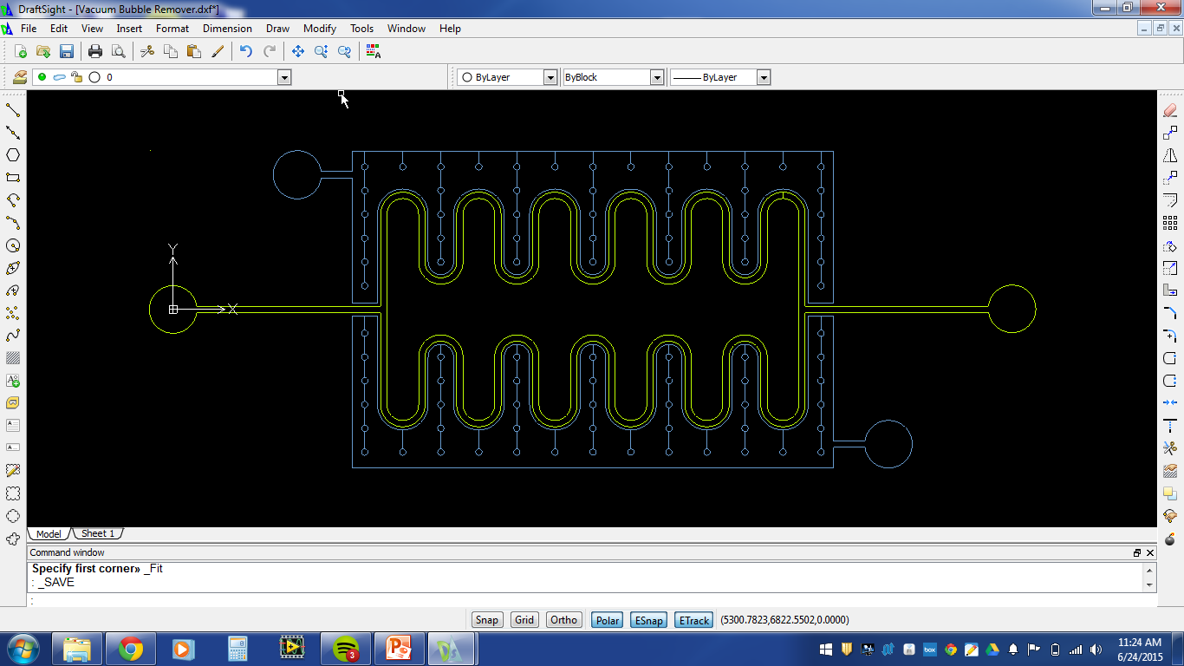
DraftSight

Slide 8
Making a Master
Designing a mask (I can help with this)
Making a master
  Surface preparation of wafer
  Photoresist
  Exposing of photoresist through mask
  Post exposure bake
PDMS Device
  Casting
  Punch holes
  PDMS Bonding
  Filling

Slide 9
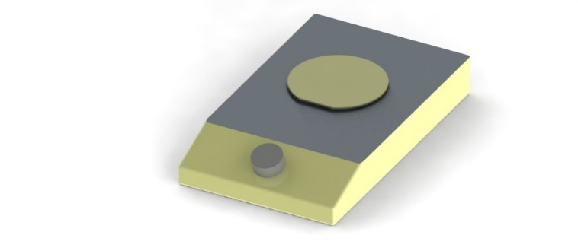
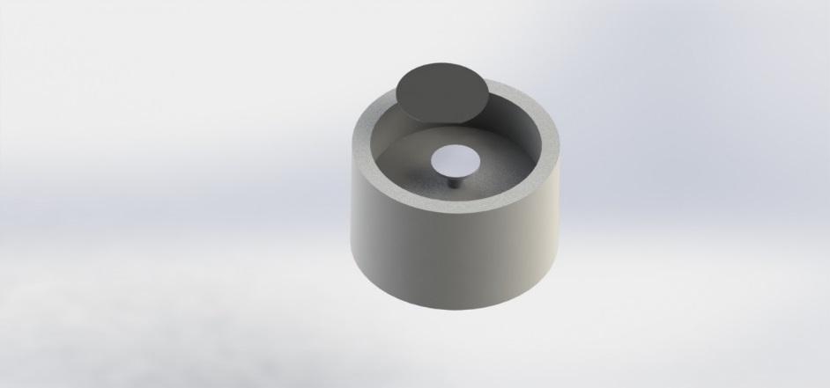
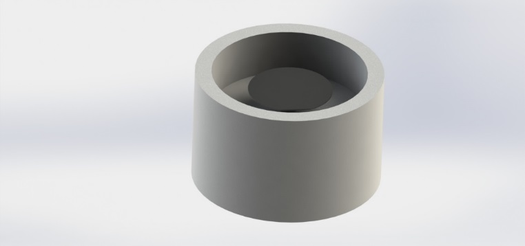
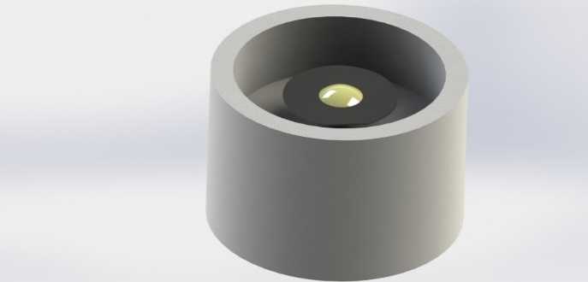
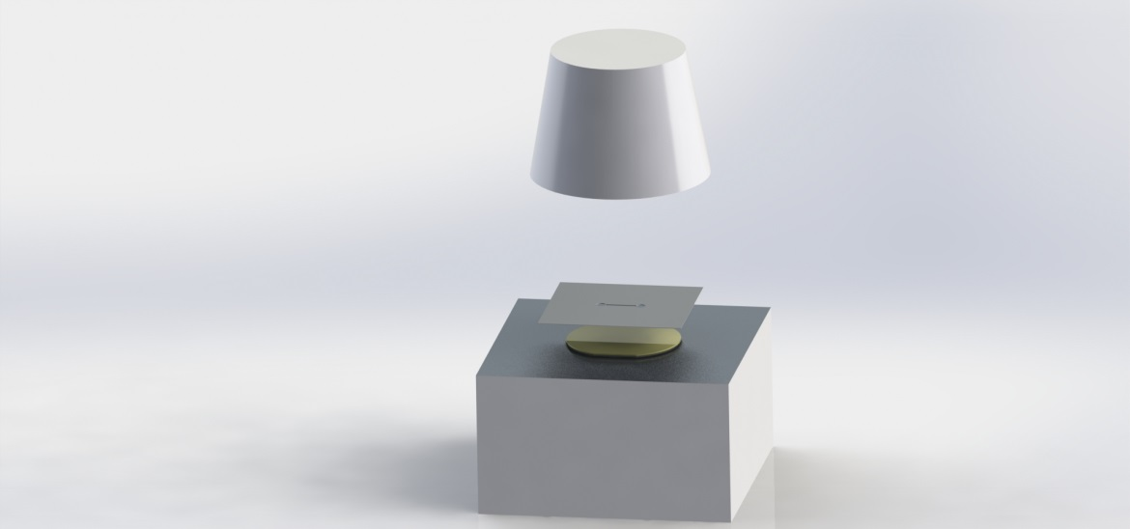
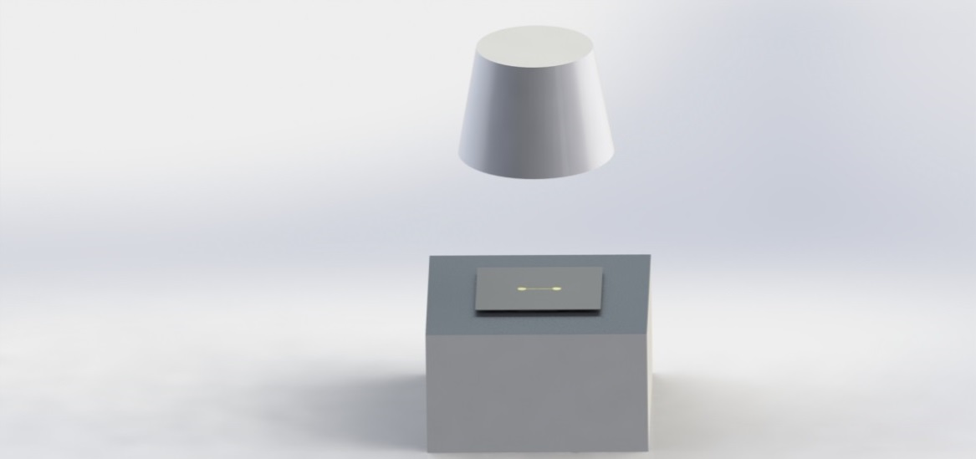
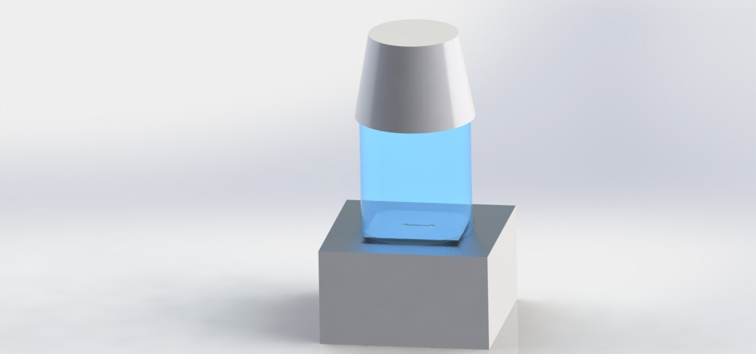
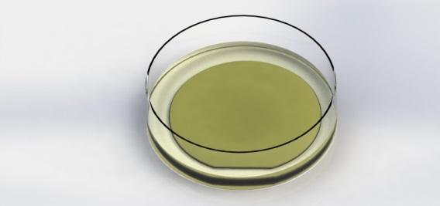

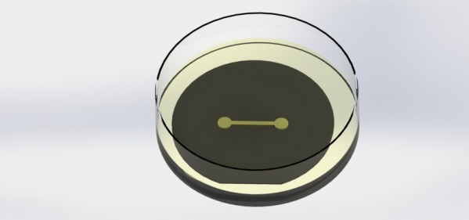
Making a Master
200C
100C
100C

Slide 10
Surface Preparation
Designing a mask (I can help with this)
Making a master
  Surface preparation of wafer
  Photoresist
  Exposing of photoresist through mask
  Post exposure bake
PDMS Device
  Casting
  Punching holes
  PDMS Bonding
  Filling

Slide 11
Substrate Surface Preparation
SU-8 Resist:
Make surface hydrophobic
  Silicon is hydrophobic, but SiO₂ (due to exposure to atmospheric oxygen) is hydrophilic
Two possible treatments to promote adhesion:
  Removal of native oxide with HF (nasty)
  Prime wafer with HMDS in priming oven
Dehydration bake at 200C to drive off water molecules
KMPR Resist:
Dehydration bake at 200C only

Slide 12
Photoresist
Designing a mask (I can help with this)
Making a master
  Surface preparation of wafer
  Photoresist
  Exposing of photoresist through mask
  Post exposure bake
PDMS Device
  Casting
  Punching holes
  PDMS Bonding
  Filling

Slide 13
Negative Photoresist – How it works
Mask
Photoresist
Substrate

Slide 14
Negative Photoresists
SU8-2000 series photosensitive epoxy
SU8-3000 series
KMPR-1000 series
QNF supplies SU8-2050, KMPR 1050

Slide 15
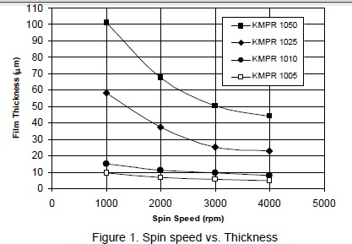
Photoresist Spin Coating, Baking

Slide 16
Exposure
Designing a mask (I can help with this)
Making a master
  Surface preparation of wafer
  Photoresist
  Exposing of photoresist through mask
  Post exposure bake
PDMS Device
  Casting
  Punching holes
  PDMS Bonding
  Filling

Slide 17
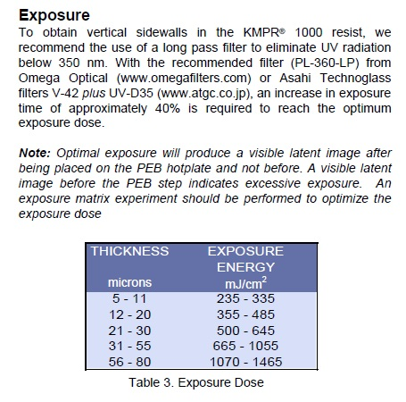
Photoresist Exposure

Slide 18
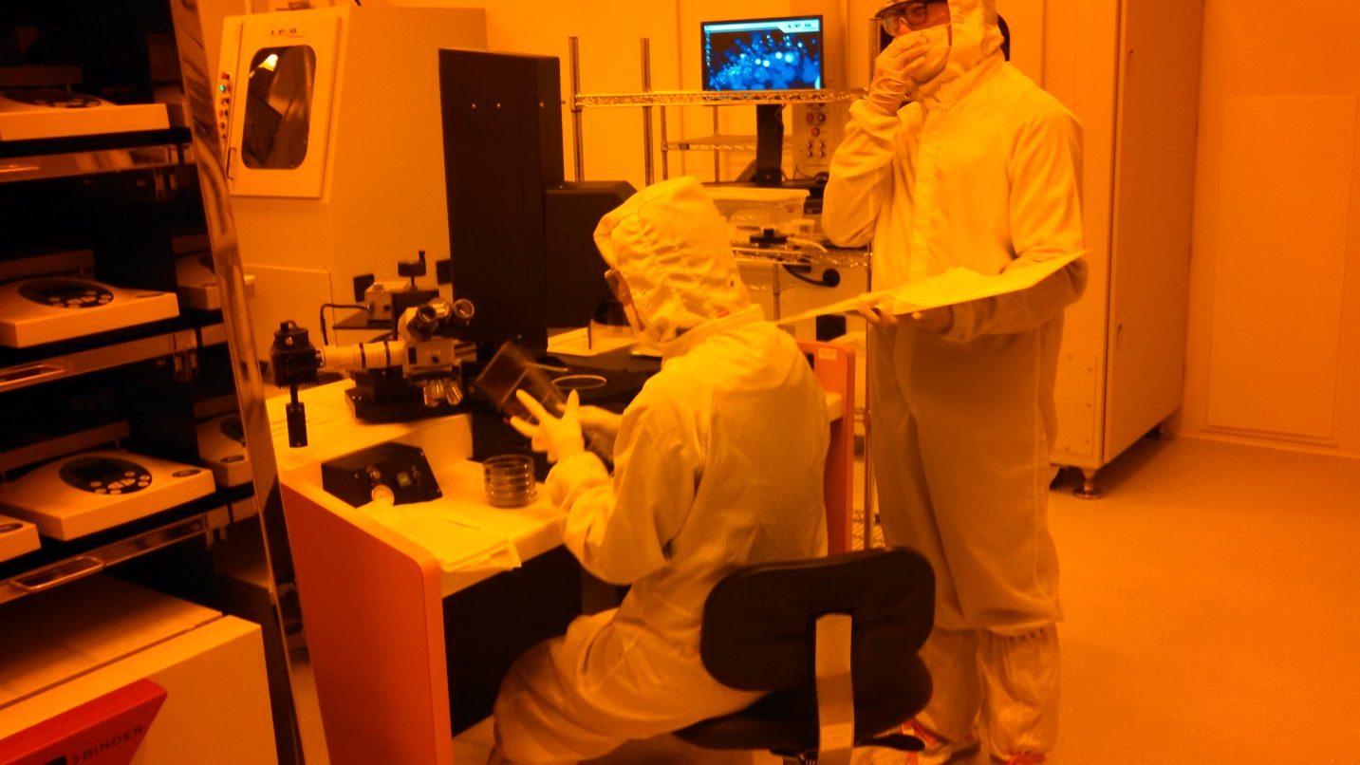
Photoresist Exposure
ABM Mask Aligner

Slide 19
Exposure Problems: Short Exposure
Result: delamination

Slide 20
Exposure Problems: Long Exposure
Result: T-Topping
Solution: 360nm long pass filter

Slide 21
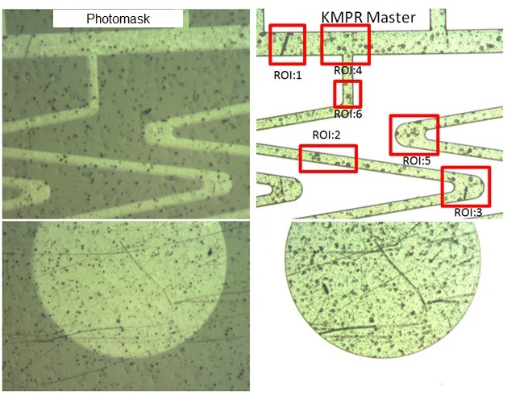
Exposure Problems: Film Masks
Film masks have inherent defects not found in chrome masks

Slide 22
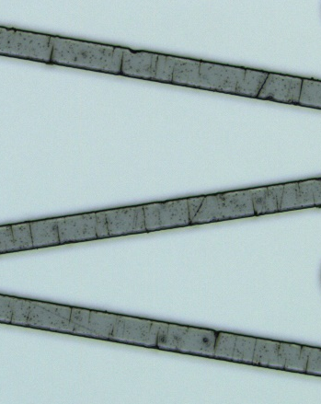

Exposure Problems: Film Masks with 360LP filter
With 360LP filter
Without 360LP filter

Slide 23
Exposure Problems: Film Masks with Thin Features
Film mask, 5um high features
Chrome mask, 5um high features
This problem is aggravated by the contrast caused by the LP filter.

Slide 24
Post Exposure Bake
Designing a mask (I can help with this)
Making a master
  Surface preparation of wafer
  Photoresist
  Exposing of photoresist through mask
  Post exposure bake
PDMS Device
  Casting
  Punching holes
  PDMS Bonding
  Filling

Slide 25
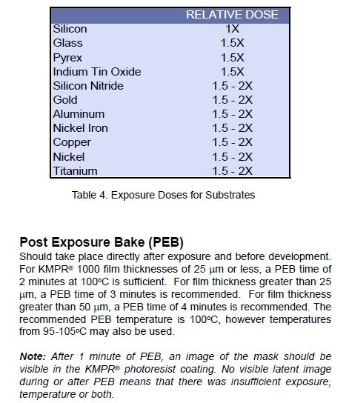
Post Exposure Bake Time

Slide 26
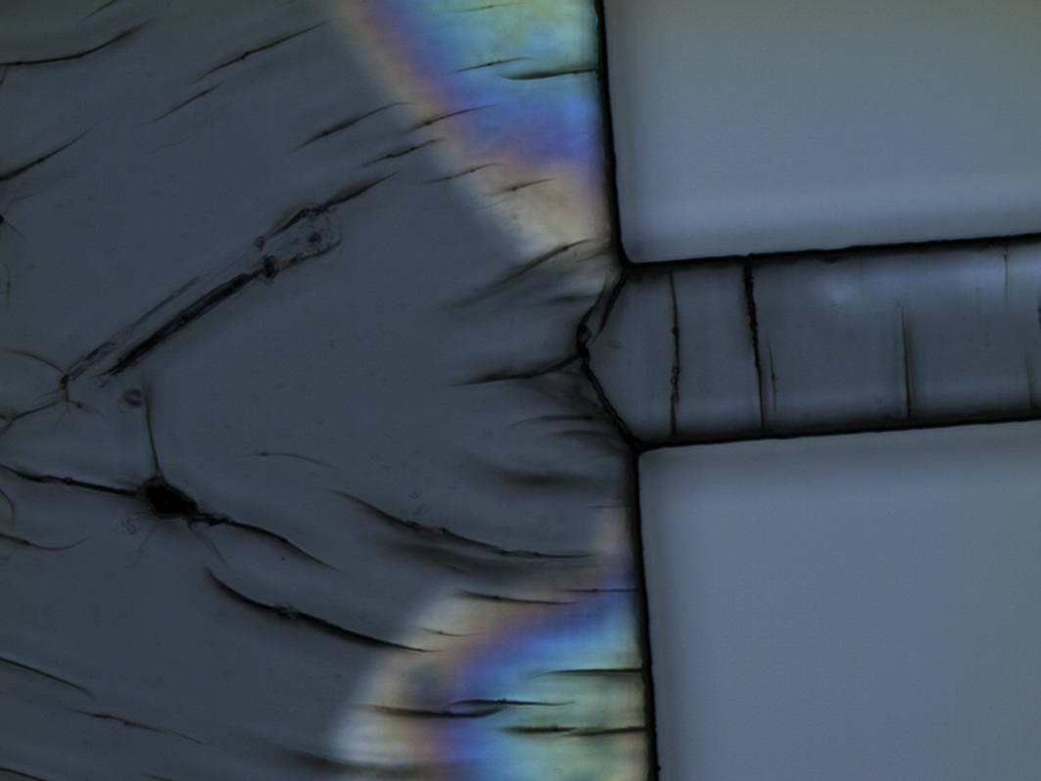
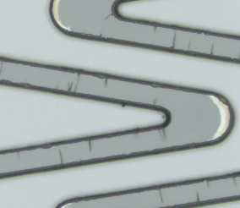

PEB Problems: Thermal Stress
Stress cracks due to crosslinking and sudden temperature changes
Solutions:
Lower PEB temperature for longer bake time.
Annealing at 150C for 10 minutes after development

Slide 27
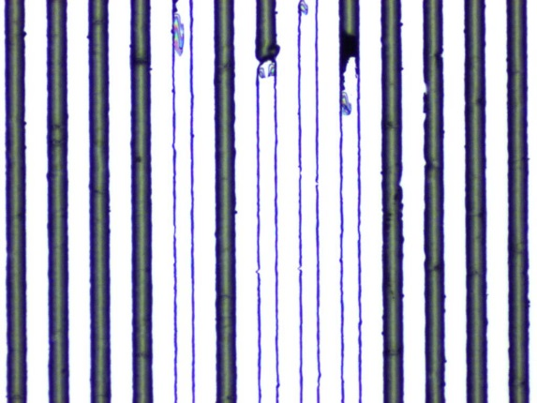
PEB Problems: High Aspect Ratio Features
Delamination of high features with small footprints (related to thermal stress)
Solutions:
Better wafer preparation
Low PEB bake temperature
Annealing at 150C for 10 minutes after development

Slide 28
PDMS
Designing a mask (I can help with this)
Making a master
  Surface preparation of wafer
  Photoresist
  Exposing of photoresist through mask
  Post exposure bake
PDMS Device
  Casting
  Punching holes
  PDMS Bonding
  Filling

Slide 29
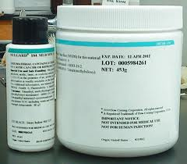
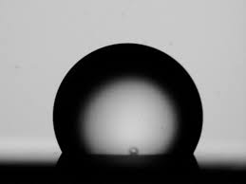
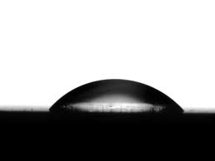
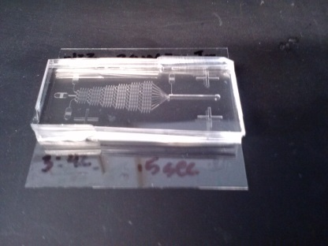
The Miracle of PDMS
Inexpensive 2-Part silicone elastomer
Hydrophobic native state
Surface of PDMS can be rendered hydrophilic with oxygen plasma
  Treatment last approximately 30 minutes
  Allows bonding to glass or to PDMS
  Allows functionalization of PDMS surface with hydrophilic molecules.
Gas permeable
Generally biocompatible, Food grade
Transparent in UV down to 240nm, ideal for fluorescence imaging
brandinside.deu
www.cchem.berkeley.edu
www.cchem.berkeley.edu

Slide 30
Casting
Designing a mask (I can help with this)
Making a master
  Surface preparation of wafer
  Photoresist
  Exposing of photoresist through mask
  Post exposure bake
PDMS Device
  Casting
  Punching holes
  PDMS Bonding
  Filling

Slide 31
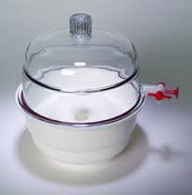
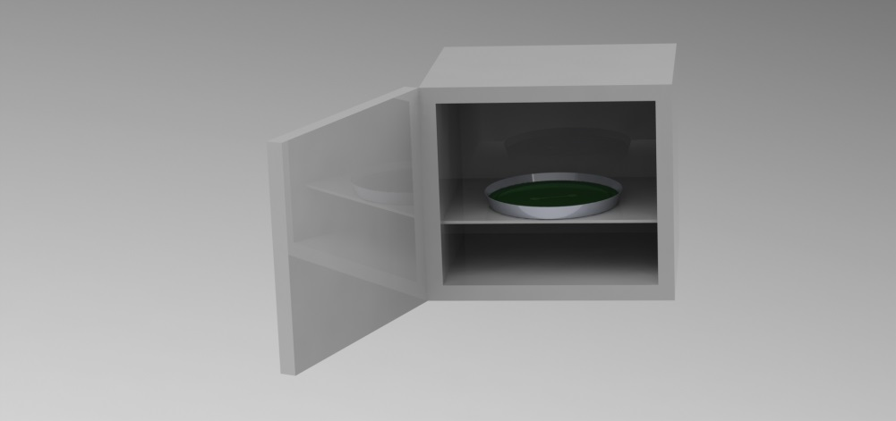
PDMS Casting

Slide 32
Punching Holes
Designing a mask (I can help with this)
Making a master
  Surface preparation of wafer
  Photoresist
  Exposing of photoresist through mask
  Post exposure bake
PDMS Device
  Casting
  Punching holes
  PDMS Bonding
  Filling

Slide 33
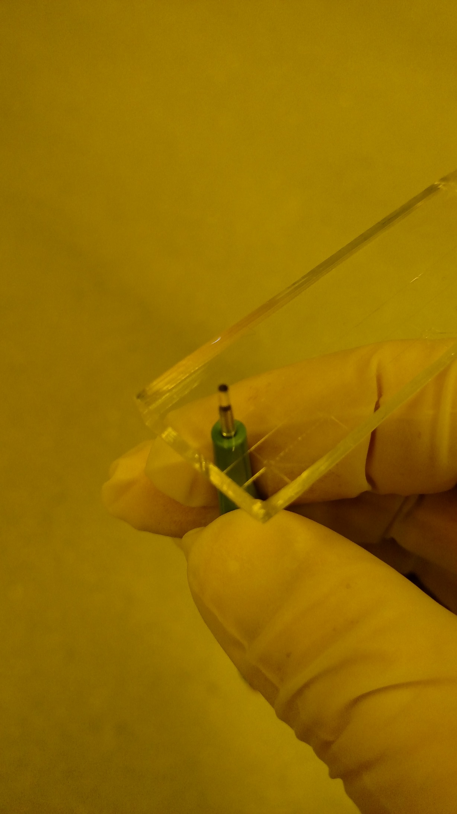
Punch Holes (before bonding!)

Slide 34
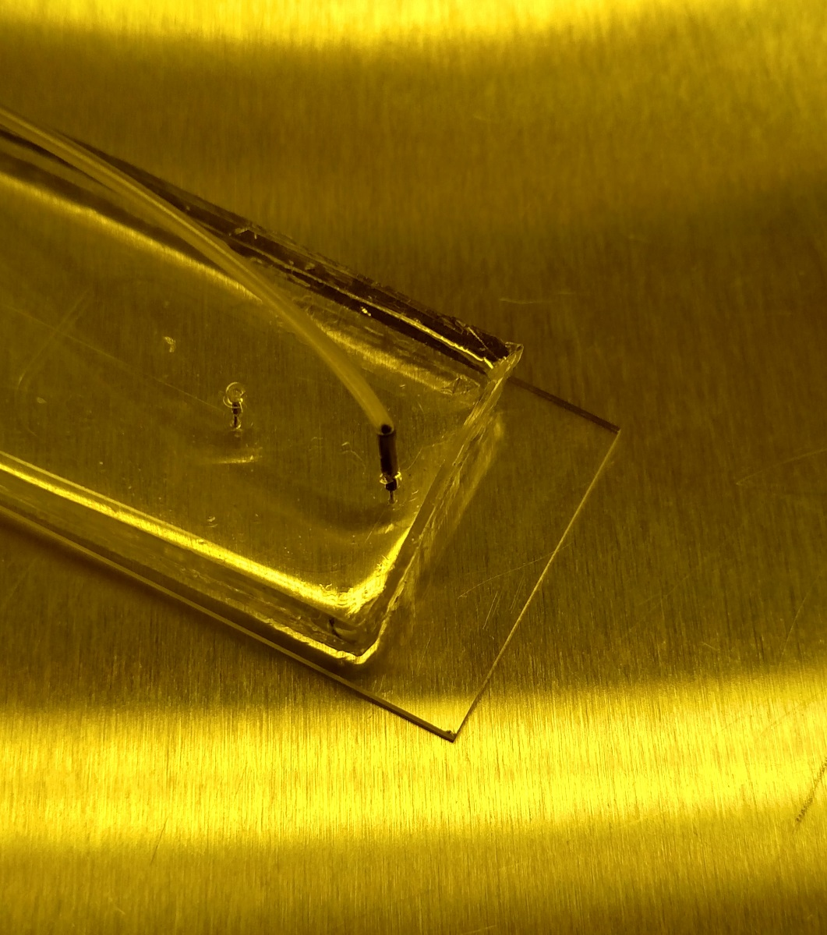
Tubing

Slide 35
Bonding
Designing a mask (I can help with this)
Making a master
  Surface preparation of wafer
  Photoresist
  Exposing of photoresist through mask
  Post exposure bake
PDMS Device
  Casting
  Punching holes
  PDMS Bonding
  Filling

Slide 36
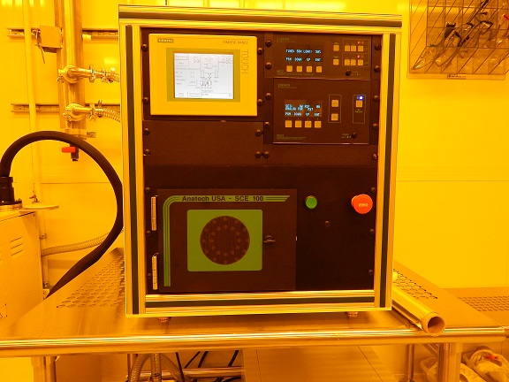
Plasma Treatment for PDMS Bonding
PDMS-Glass: 50sccm O₂, 30W, 30s (PDMS recipe)
PDMS-PDMS: 50sccm O₂, 30W, 60s(PDMS-PDMS recipe)

Slide 37
Filling
Designing a mask (I can help with this)
Making a master
  Surface preparation of wafer
  Photoresist
  Exposing of photoresist through mask
  Post exposure bake
PDMS Device
  Casting
  Punching holes
  PDMS Bonding
  Filling

Slide 38
Filling
Priming the device soon after plasma bonding (within 3 hours) yields better results.
Fully submerging the device inside a vacuum chamber for 20 minutes yielded the best results.

Slide 39

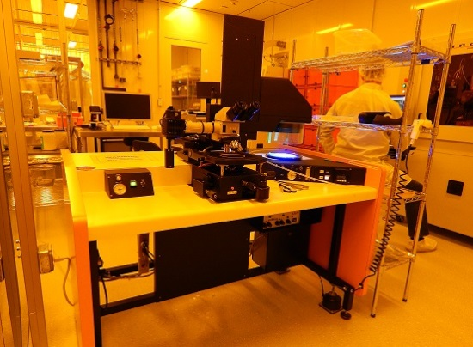
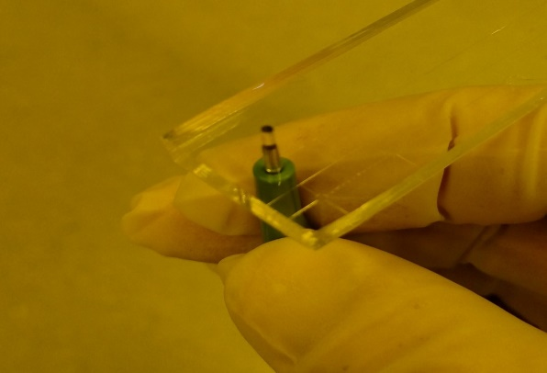
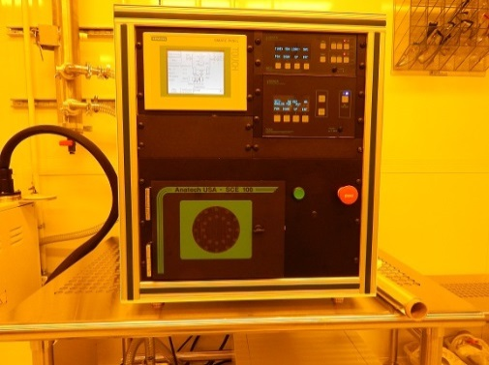
Preview of Hands-On Lab Work

Slide 40
Soft Lithography Examples
Microfluidics
Stamping
Force Measurement

Slide 41
Soft Lithography Examples
Microfluidics
Stamping
Force Measurement

Slide 42
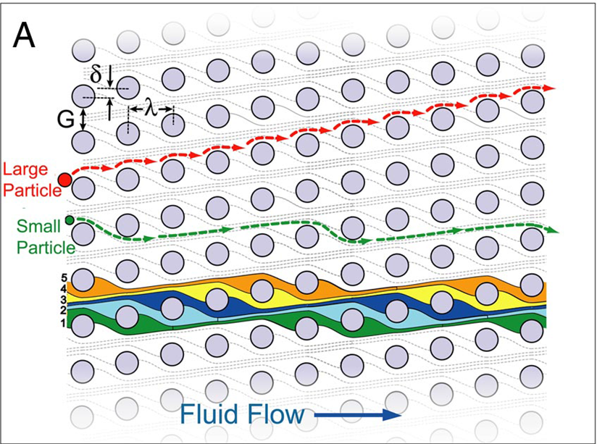
Soft Lithography Examples - Particle Separation

Slide 43
Soft Lithography Examples – Gradient Generator

Slide 44
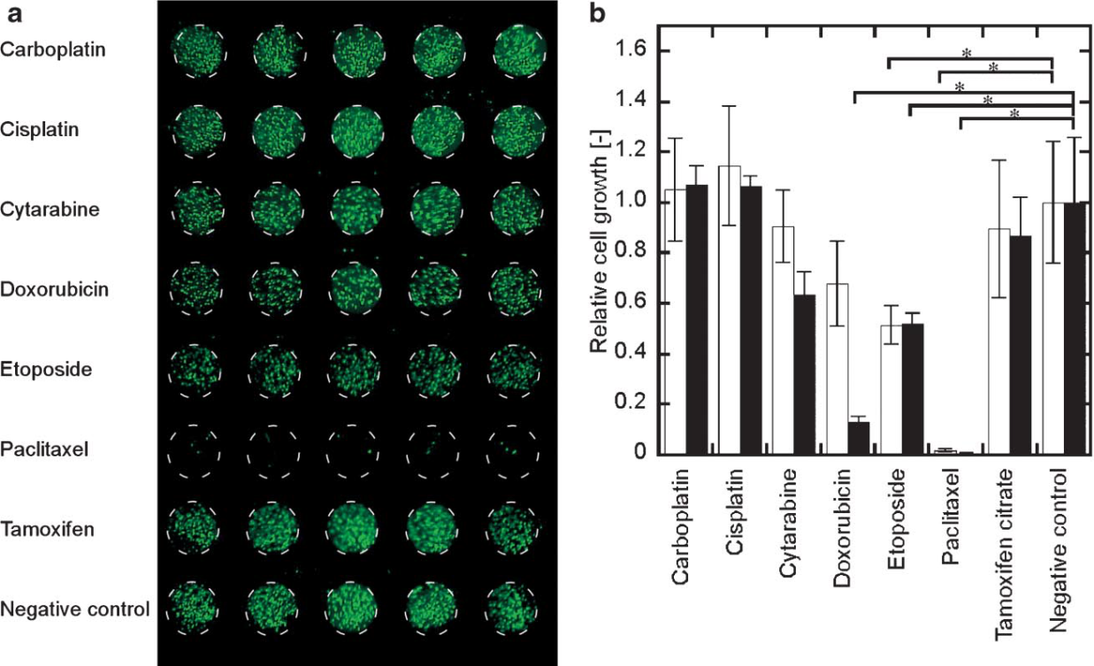
Soft Lithography Examples – Cell Culture
Sugiura et al., Biotechnol. Bioeng. 100, 1156–1165 (2008)

Slide 45
Soft Lithography Examples
Microfluidics
Stamping
Force Measurement

Slide 46
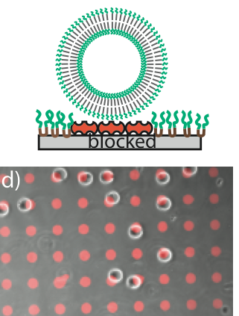
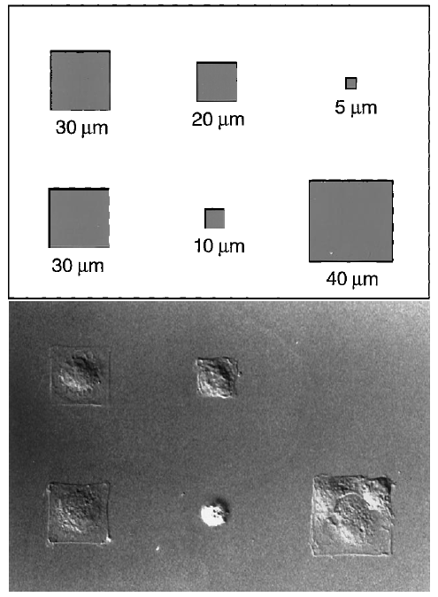
Soft Lithography Examples - Stamping
Forced Cell Morphology
Vesicle Adhesion
Chen et al (1997) Science, 276:1425
DOI: 10.1126/science.276.5317.1425
Kamat et al (2013) Small, 9:2272
DOI: 10.1002/smll.201202627

Slide 47
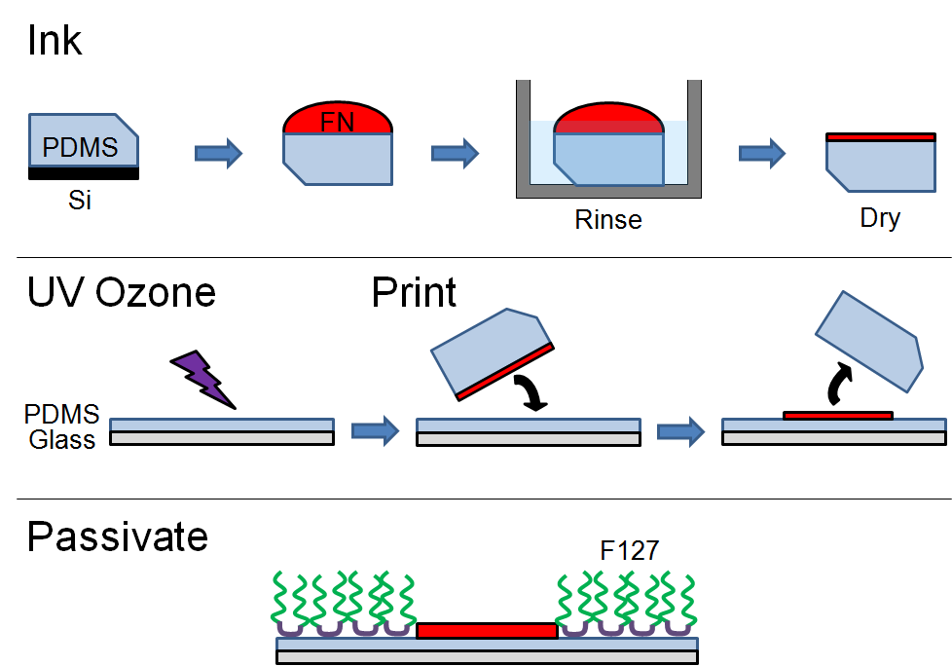
Soft Lithography Examples - Stamping
Schematic by Steven Henry

Slide 48
Soft Lithography Examples
Microfluidics
Stamping
Force Measurement

Slide 49
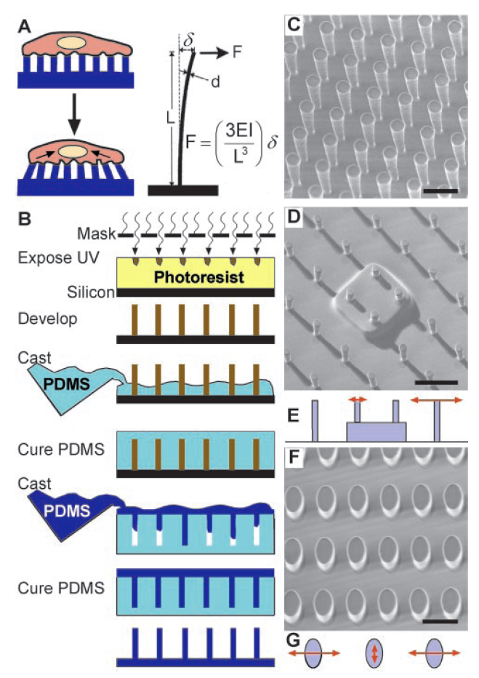
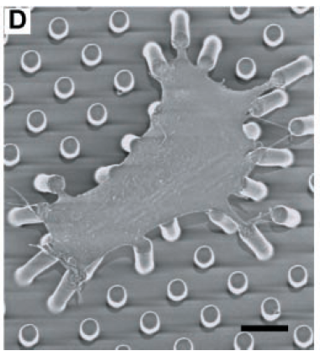
Soft Lithography Examples
Tan et al (2002) PNAS, 100:1484
DOI: 10.1073pnas.0235407100

Slide 50

Questions?

