Slide 1

CEDEM – Centre for Democracy and Human Rights
Organisational Profile

Slide 2
ESTABLISHMENT AND DEVELOPMENT
CEDEM was founded in 1998 in Podgorica, Montenegro as a non-profit association of citizens.
CEDEM was the first organization in Montenegro which provided capacity building courses and programs not only for CSO representatives, but for government officials and media as well.
In years, the focus of CEDEM moved towards creating argument-based policies and studies, with the specific emphasis on socio-economic analyses.

Slide 3
MISSION AND VISION
MISSION: “To contribute to Montenegro as a strong participatory democracy integrated into European Union and fully committed to the European values”
VISION: “To advance and spread conscience on importance of proper and successful democratic transition; to research, analyze and follow relevant socio-economic topics as well as to contribute to strengthening civil society and democratization process as a whole.”

Slide 4
VALUES
Affirmation of pluralistic, democratic and open society values
Rule of Law
Equality and respect for human rights
Social Justice
Transparency
Professionalism and objectivity
Communicativeness

Slide 5
GOALS
Affirmation of pluralistic, democratic, and open society values;
Advancing democracy and human rights in Montenegro;
Affirmation and providing researches on the scope and consequences of the system transition in Montenegro;
Examination of comparative practice of countries in transition;
Improving the knowledge in the field of democratic policy and social system based on human rights and freedoms;
Fostering partnerships with other organizations and institutions at national, regional and international level with the aim to achieve its programmatic goals.

Slide 6
STAKEHOLDERS
Parliament of Montenegro (especially the Committee for Political System, Judiciary and Public Administration legislation; Committee for Constitutional Affairs and legislation and the Committee for Human Rights and Freedoms)
Government of Montenegro (respective ministries, public agencies and institutions from the area of justice and human rights, interior affairs, security and defence; social and health care; education and science
Ombudsman’ Office
Judiciary (Supreme Court of Montenegro, Supreme State’ Prosecution Office)
Civil society organizations (NGOs, CGs, LAGs, SMEs)
Volunteers and interns (mostly students)
Media (independent print and electronic media, public media service)
Citizens of Montenegro

Slide 7
FUNDING SOURCES
European Commission/Delegation of the European Union to Montenegro (EU funds)
Foreign embassies' funds
International and intergovernmental organizations and CSOs (UNDP, UNDEF, OSCE, NUPI, DCAF)
Grant-making foundations (Open Society Foundations, Konrad Adenauer foundation, Friedrich Ebert foundation, Pontis Foundation, Balkan Trust for Democracy)
Public (domestic) funds (Government’s Commission for Allocation of Funds for NGOs, Minority Fund, local authorities)
Sub-grants of domestic and international NGOs
Donations of private corporations
Self-financing sources

Slide 8
PROGRAM AREAS
Rule of Law and Human Rights
Reform of Public Administration
Social Inclusion
Security and Defence

Slide 9
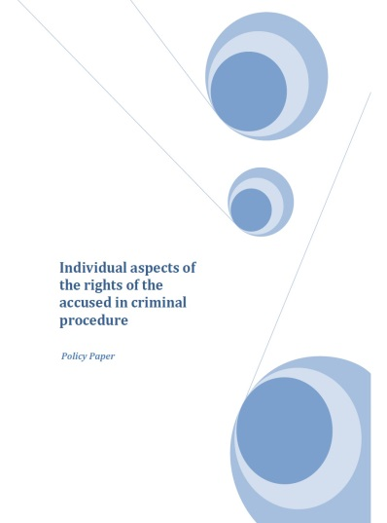
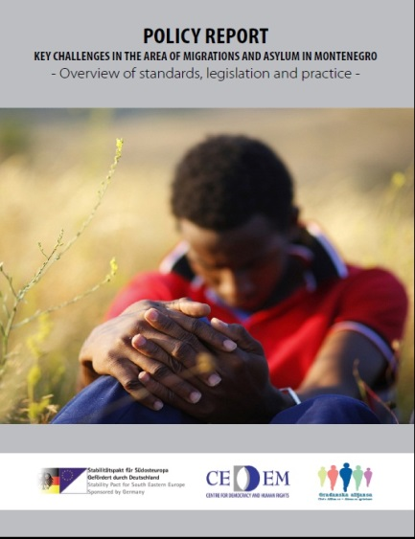
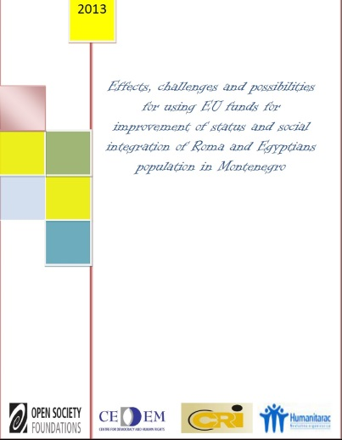

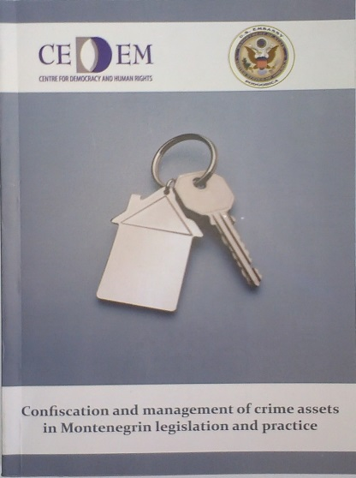
Recent Policy Proposals and Studies

Slide 10
Monitoring and Evaluation Mechanisms
Regular monthly, quarterly and annual progress reports prepared by employees and evaluated by Executive Director;
Regular bi-weekly staff meetings in order to discuss ongoing and planned activities and ensure team cohesion, group discussion development and information sharing;
Evaluation reports which prepared by the Evaluation Committee on quarterly and annual basis, depending on the matter and the area concerned;
Available context and stakeholders analyses, questionnaires and group interviews with beneficiaries and stakeholders;
External peer evaluation.

Slide 11
PARTNERSHIPS
PASOS (Policy Association for an Open Society) – a network of an independent policy centres in Central and Eastern Europe and Central Asia
Western Balkan Consortium, members: Analytica (Skopje, Macedonia), Belgrade Centre for Security Policy (Serbia), CEDEM (Podgorica, Montenegro), Centre for Security Studies (Sarajevo, Bosnia and Herzegovina), Institute for Democracy and Mediation (Tirana, Albania), IRMO (Zagreb, Croatia), Kosovo Centre for Security Studies (Prishtina, Kosovo)
Domestic partners: Civic Alliance, Centre for Roma Initiatives, Centre for Monitoring and Research – CEMI,

Slide 12
CEDEM – Centre for Democracy and Human Rights
Address: Bulevar Dzordza Vasingtona 51, 3/48
81000 Podgorica, Montenegro
Phone / Fax: +382 20 234 114; + 382 20 234 368;
Web Address: www.cedem.me
E-mail: info@cedem.me

