Slide 1
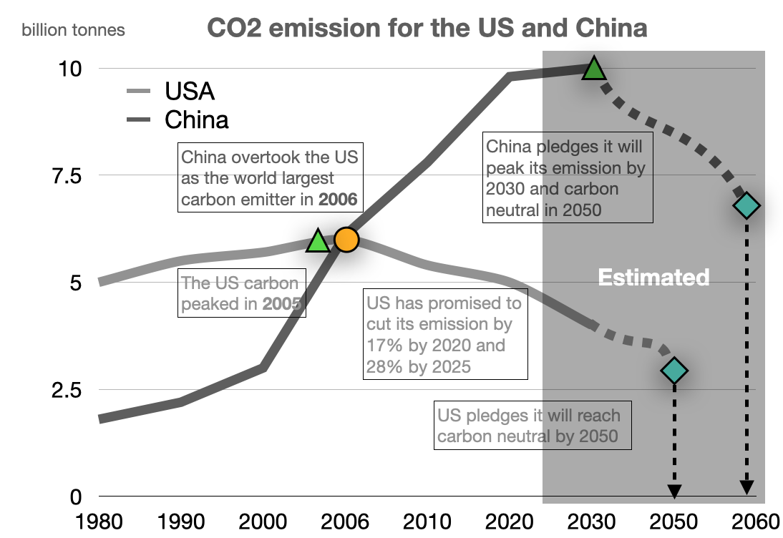
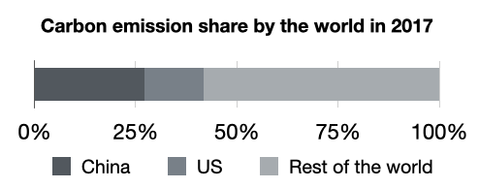
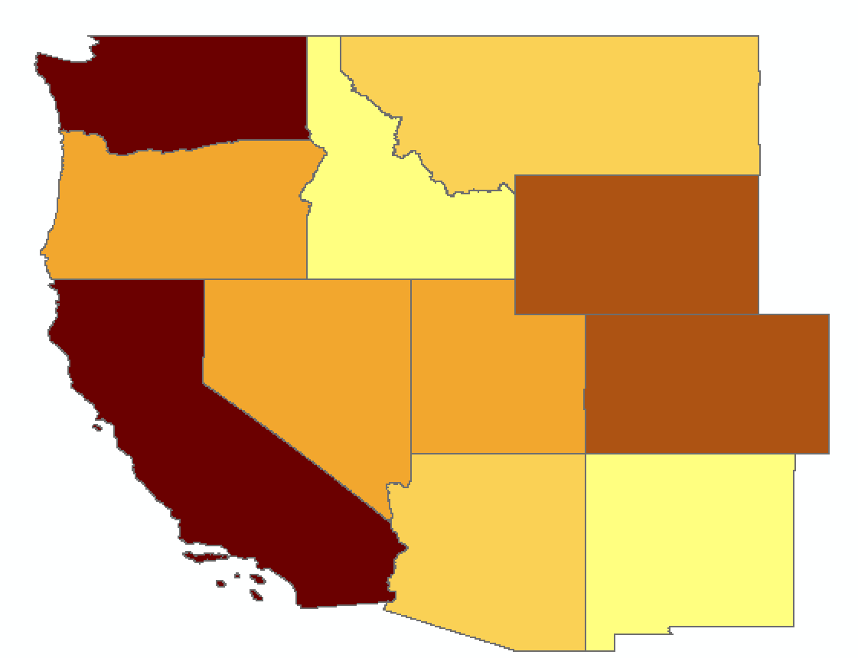
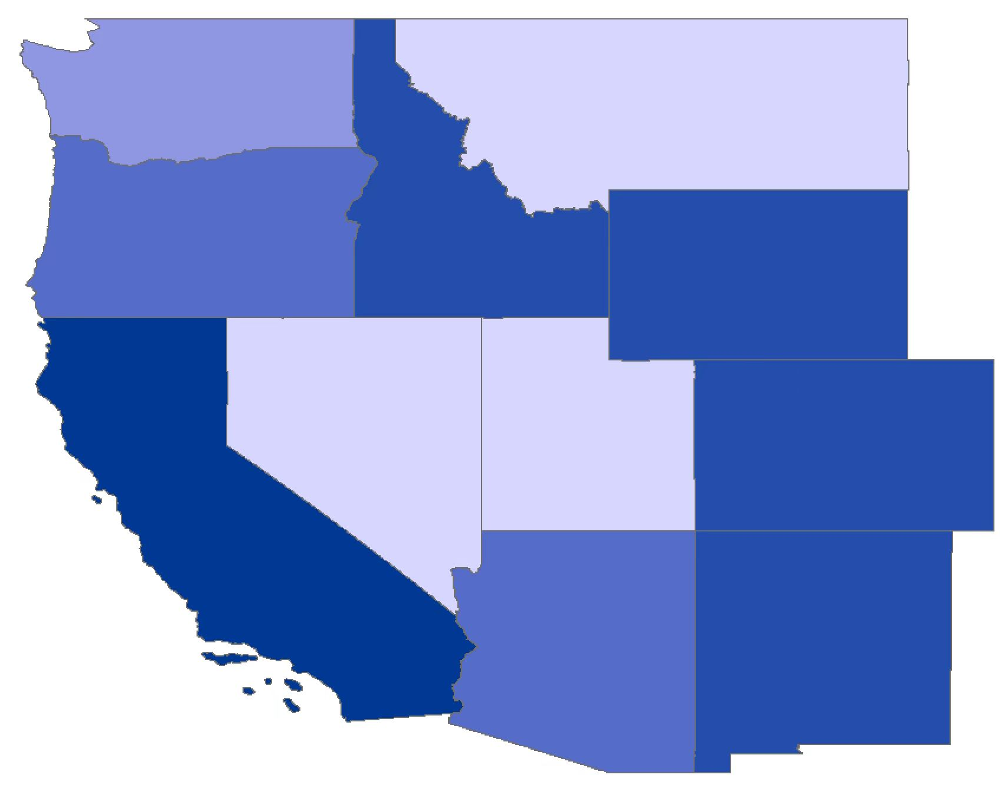
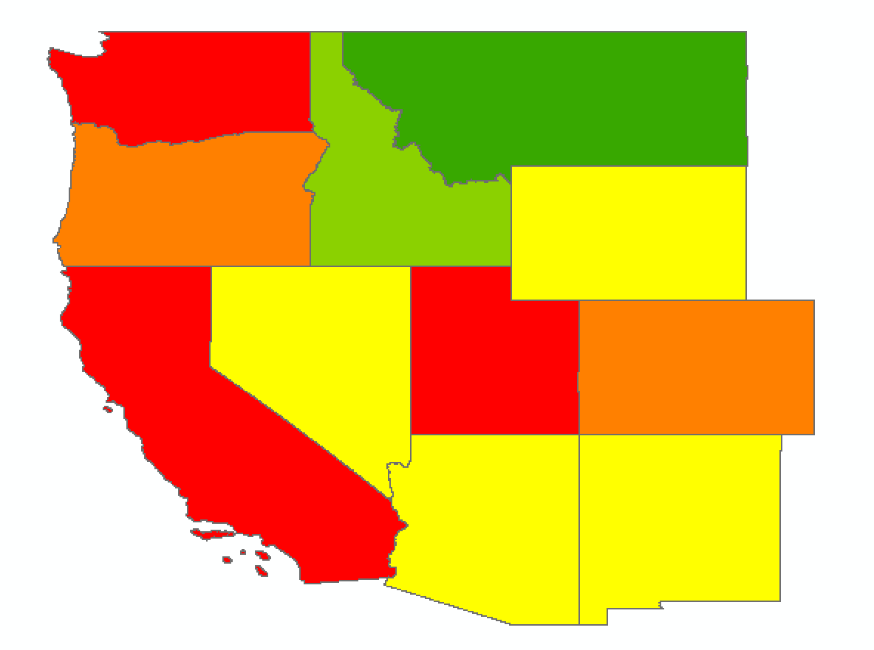
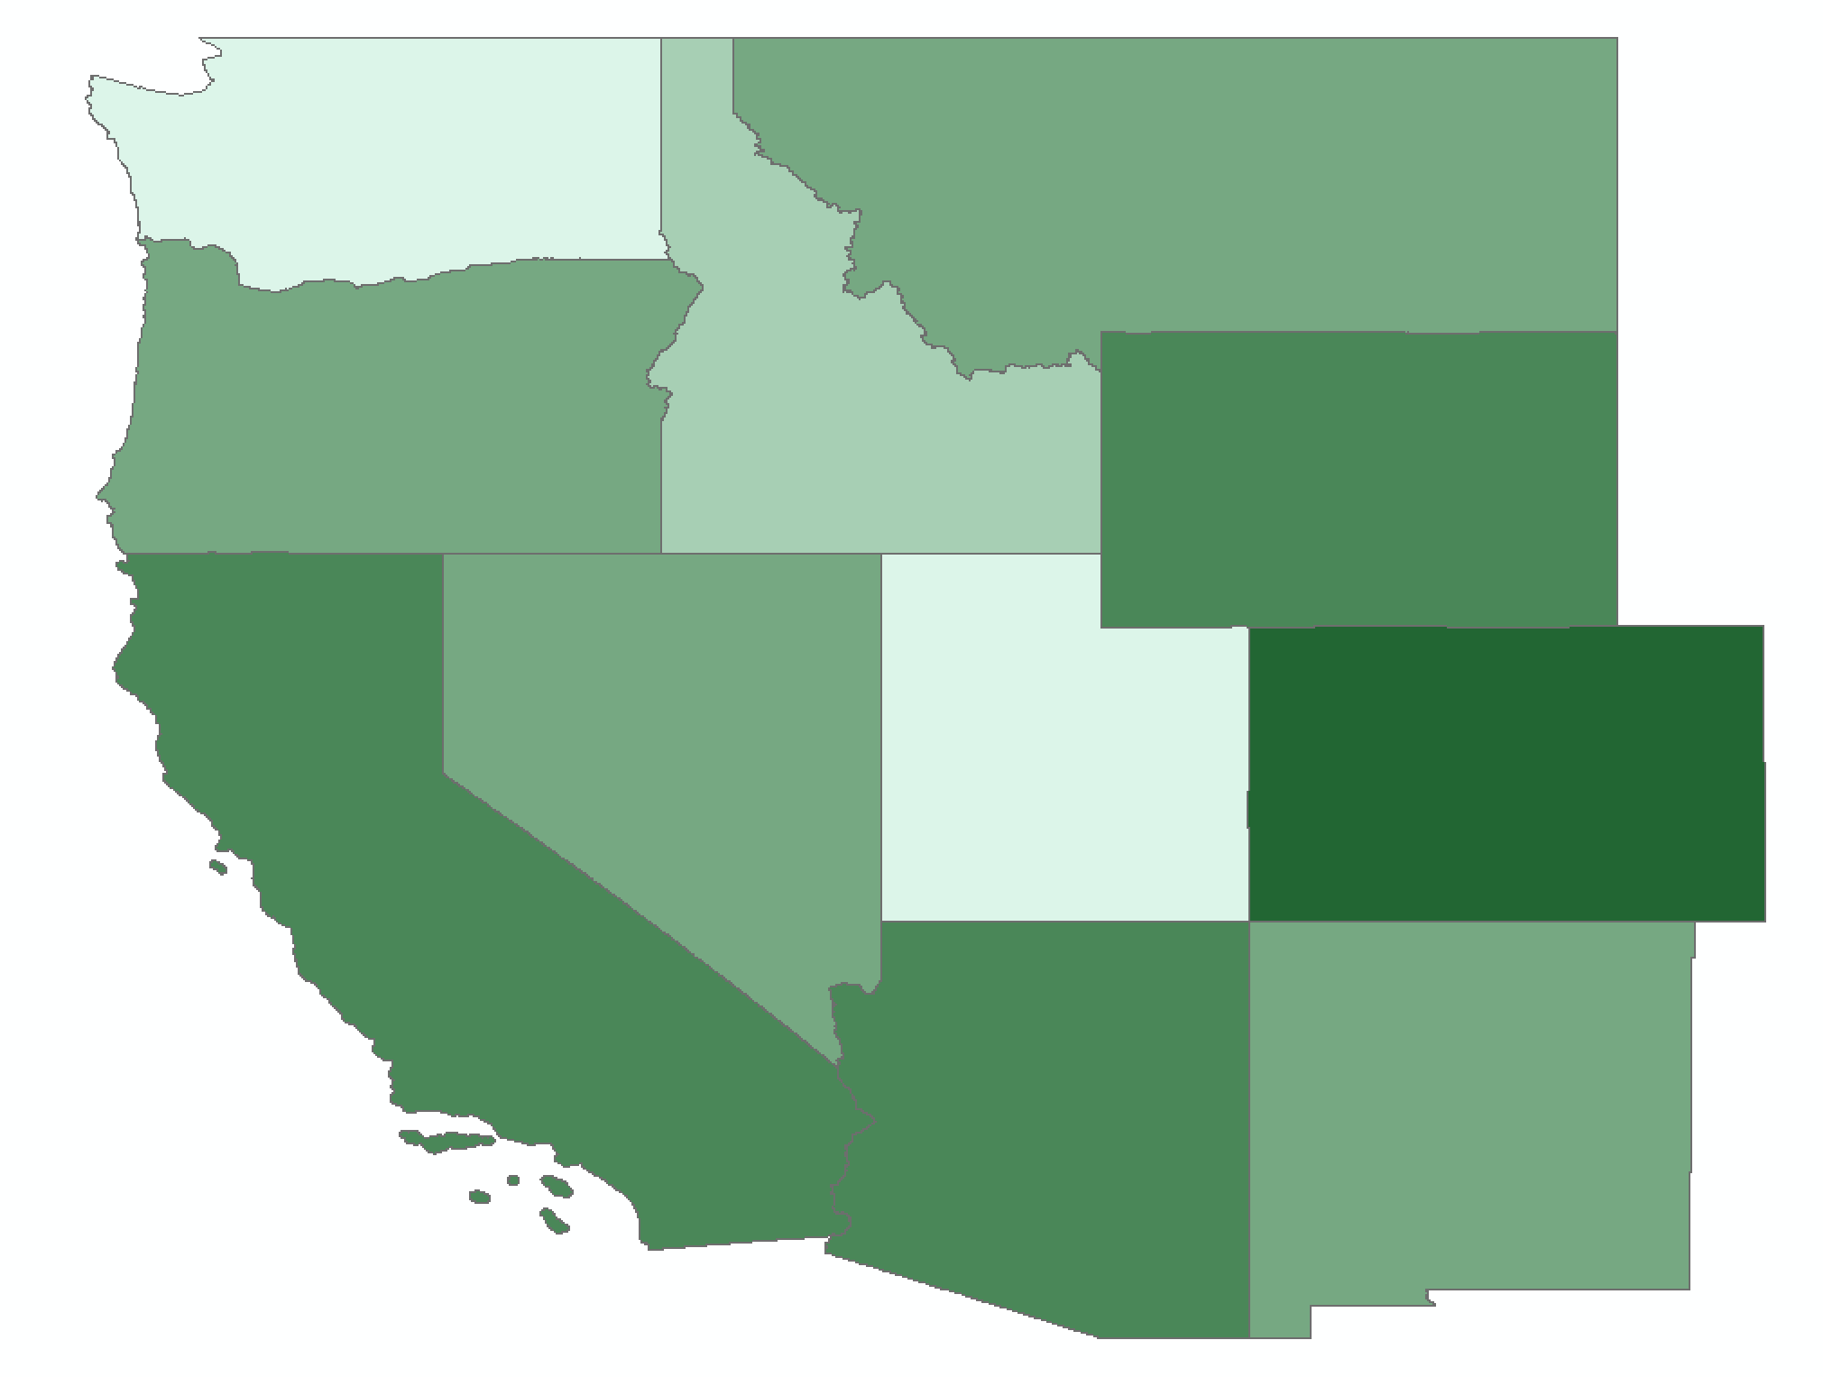
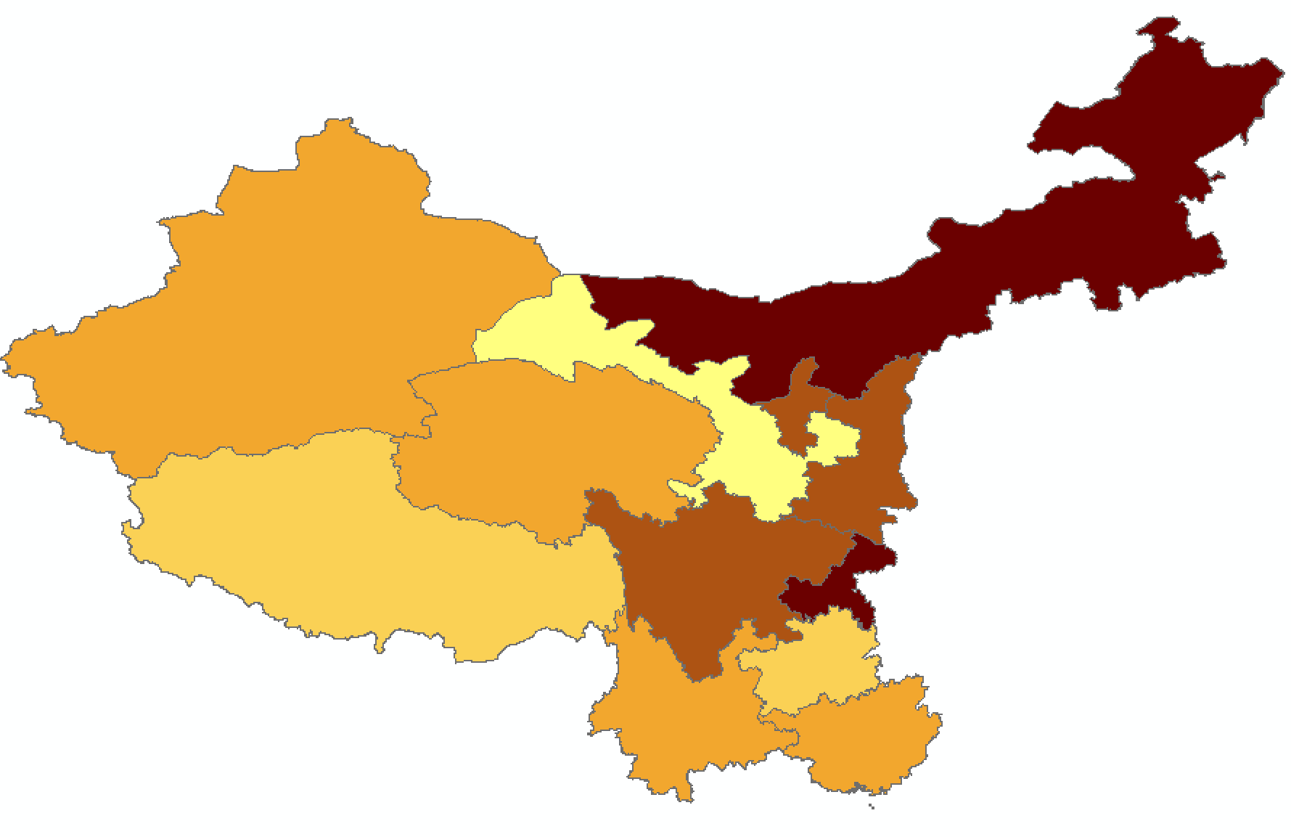
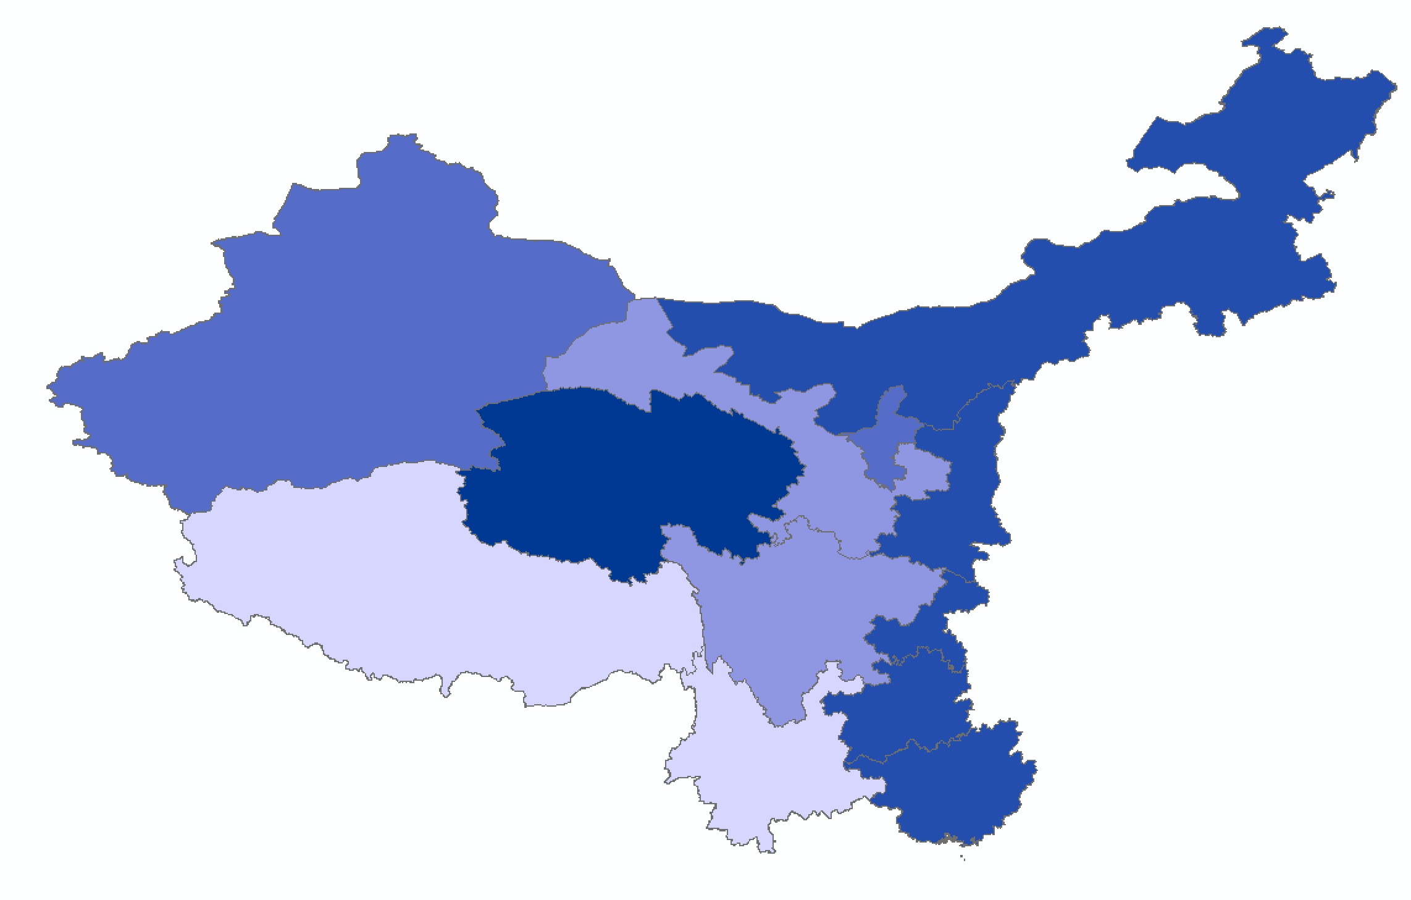
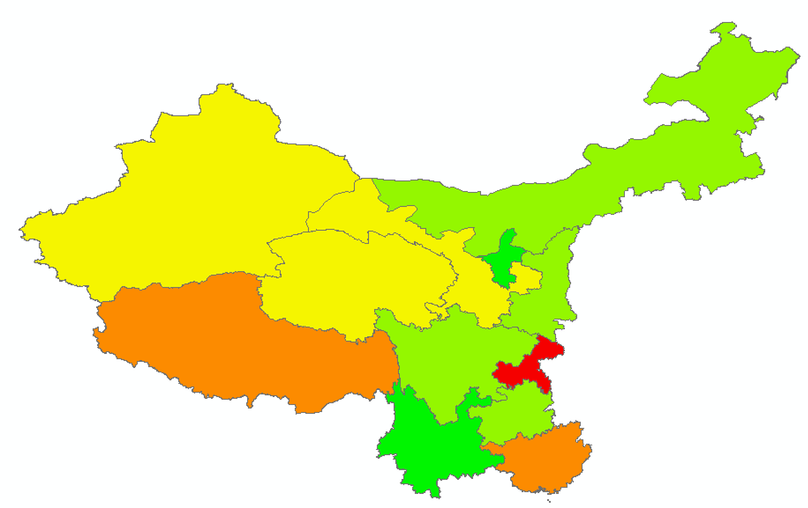
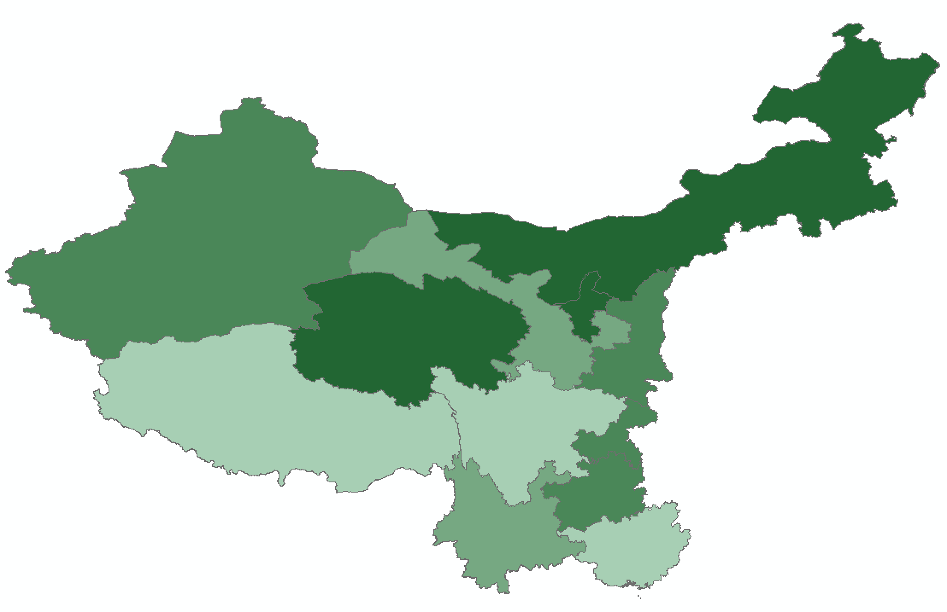
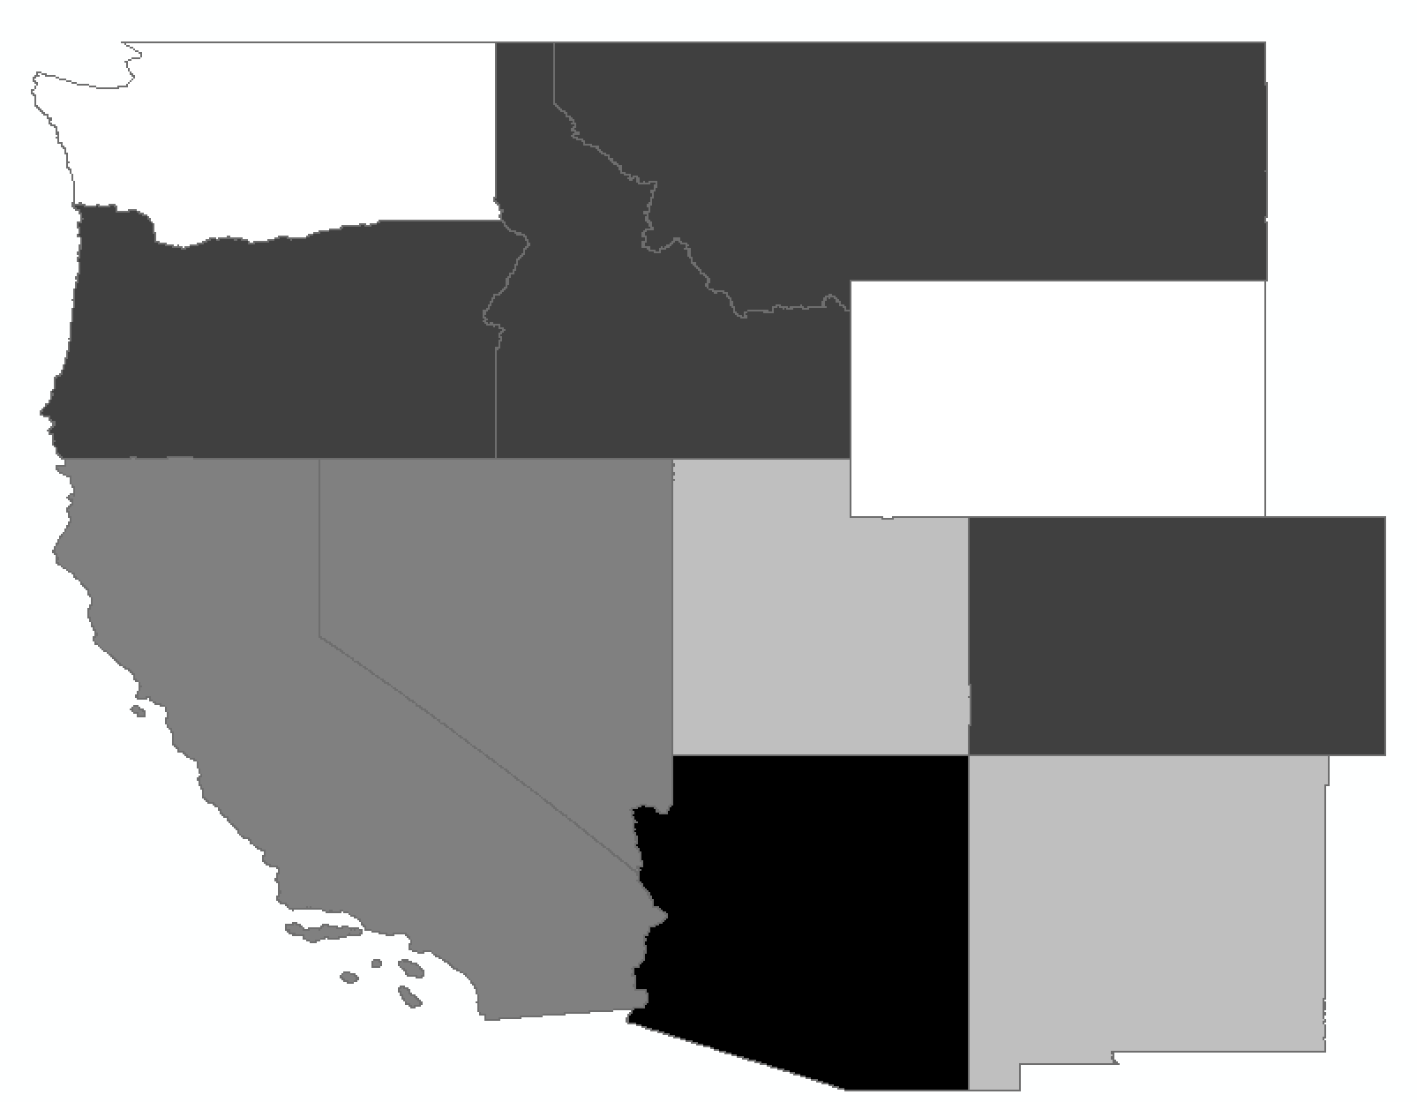
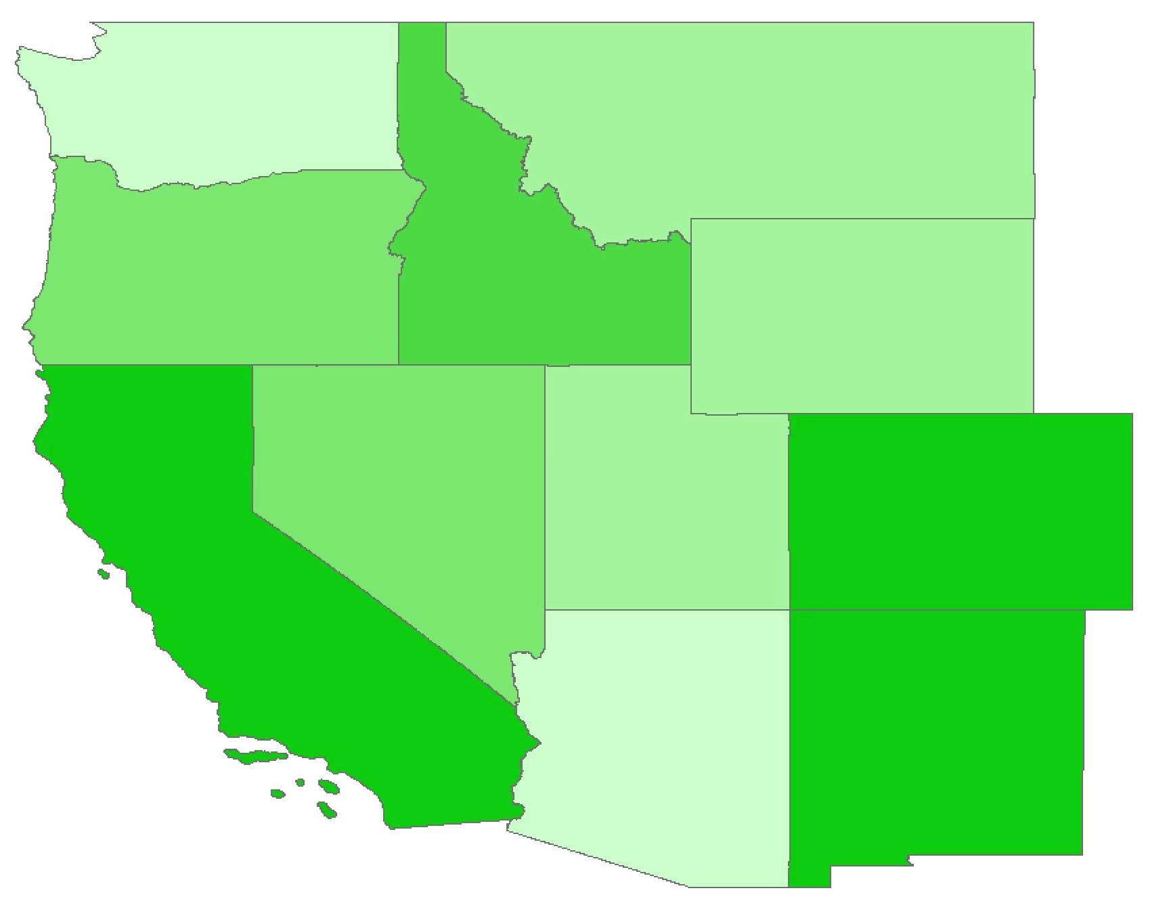
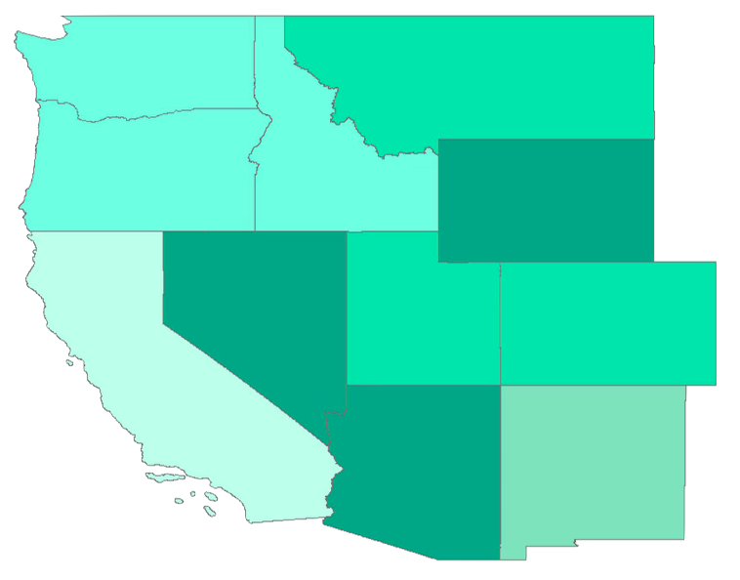
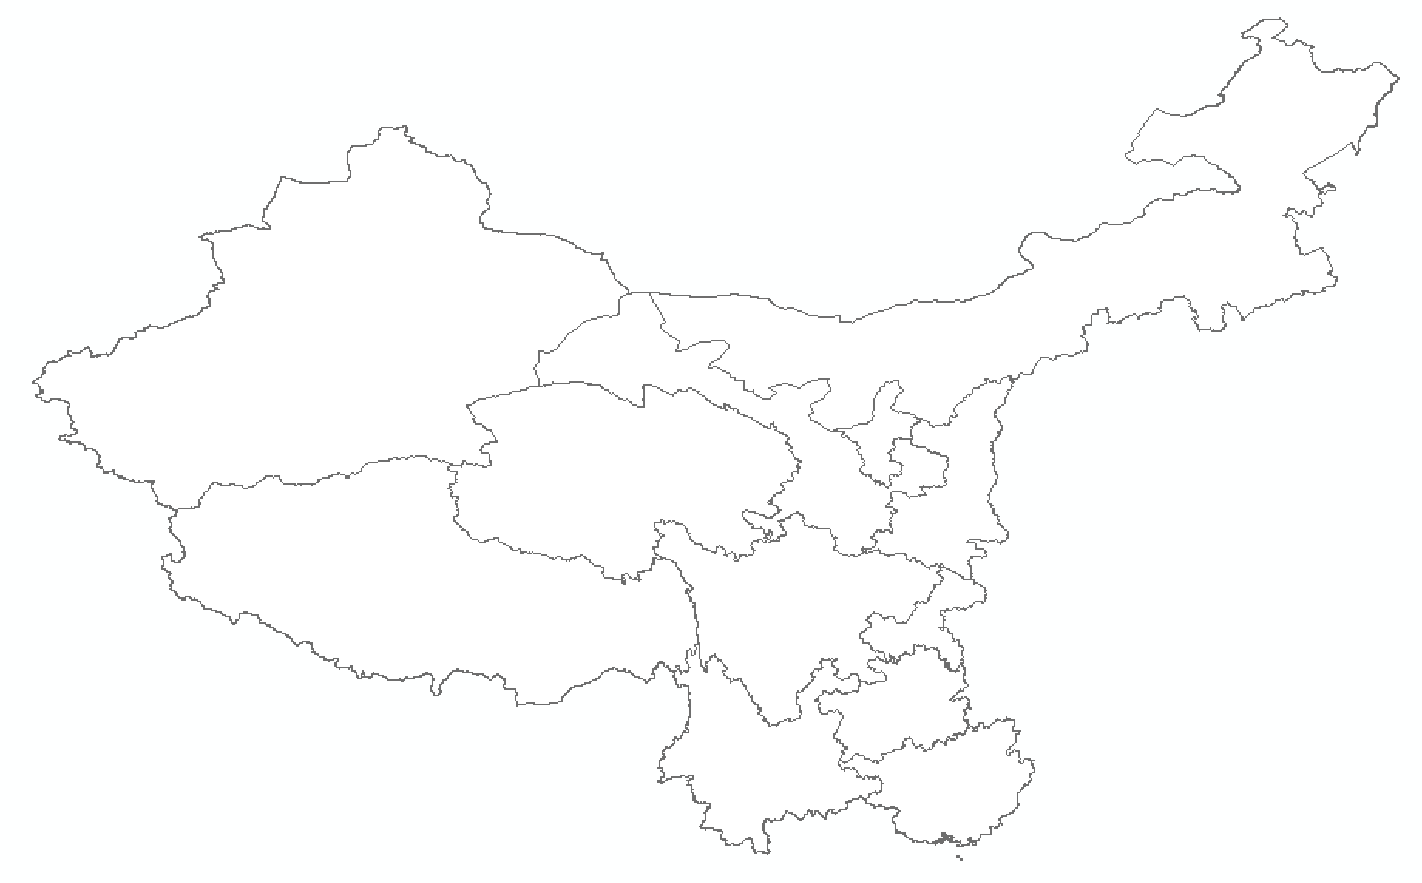
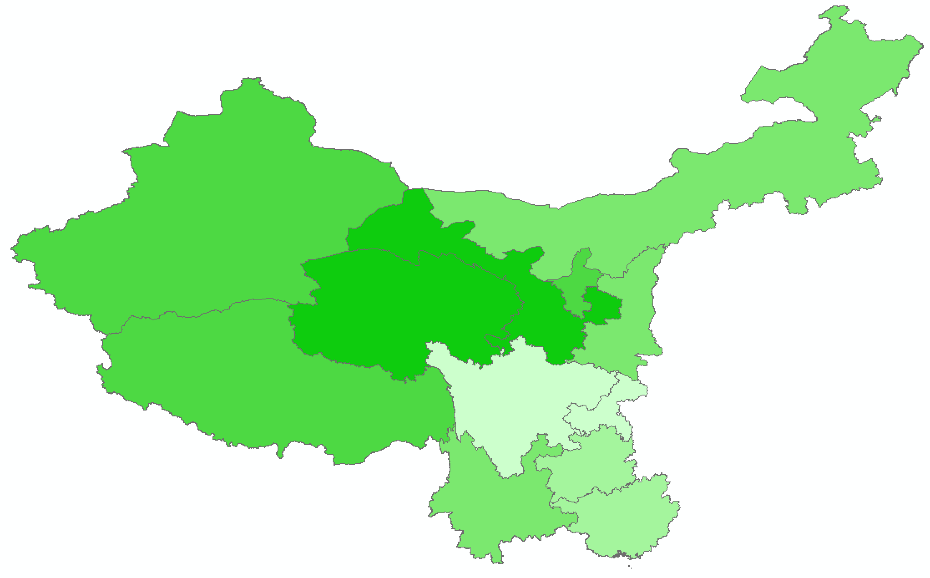
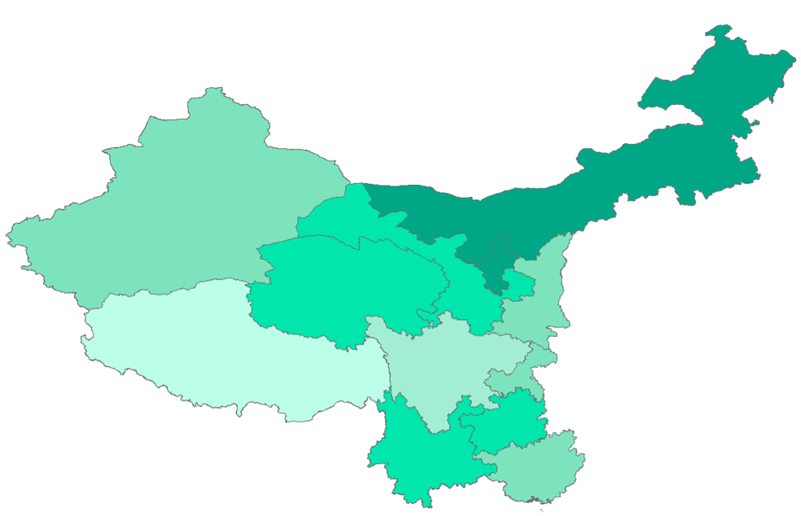
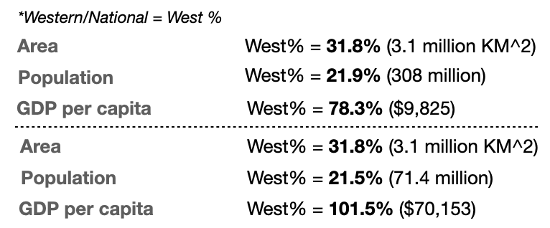
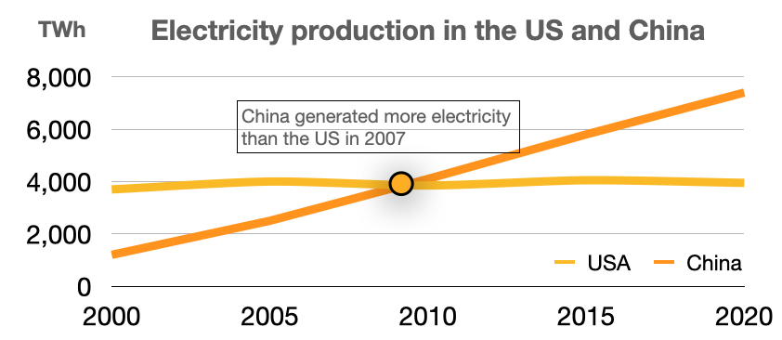
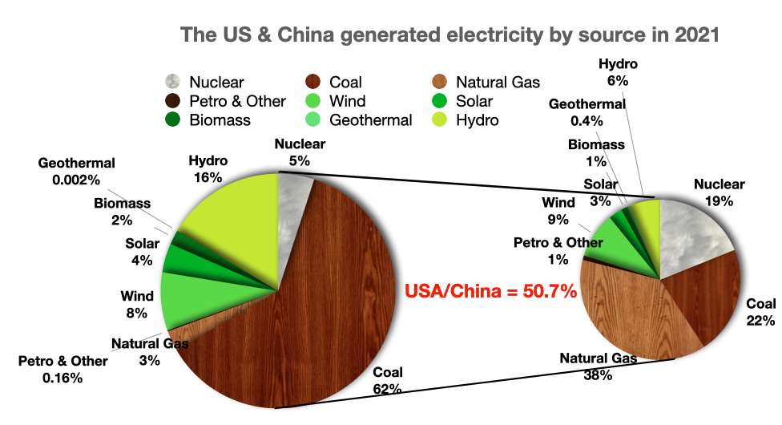
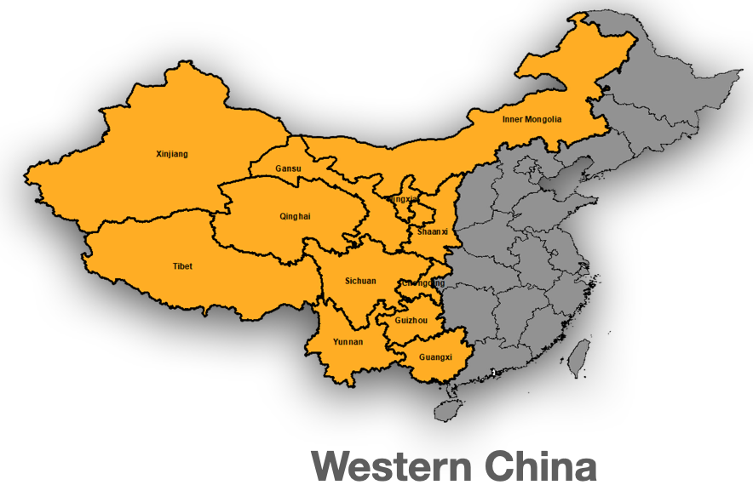
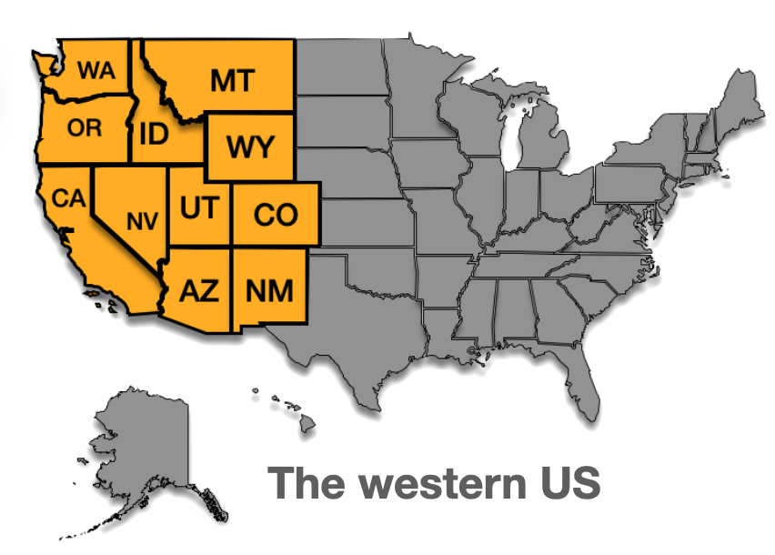
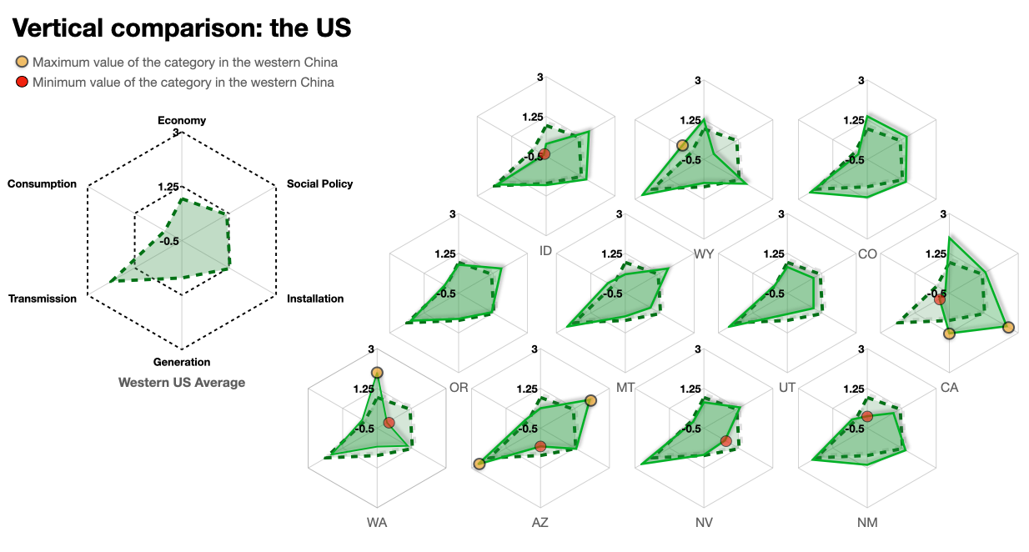
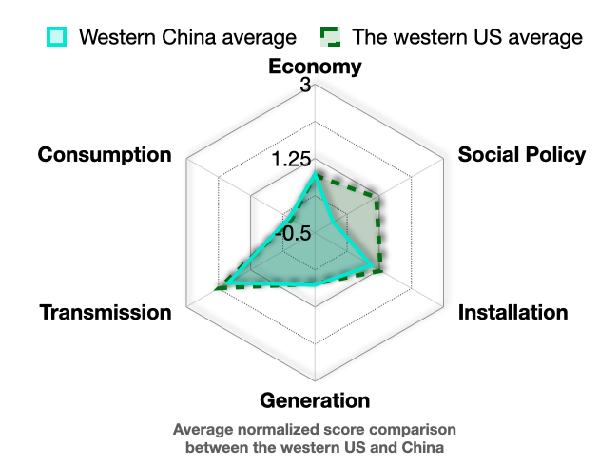
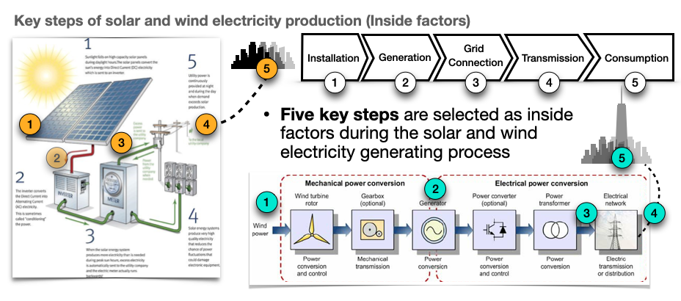
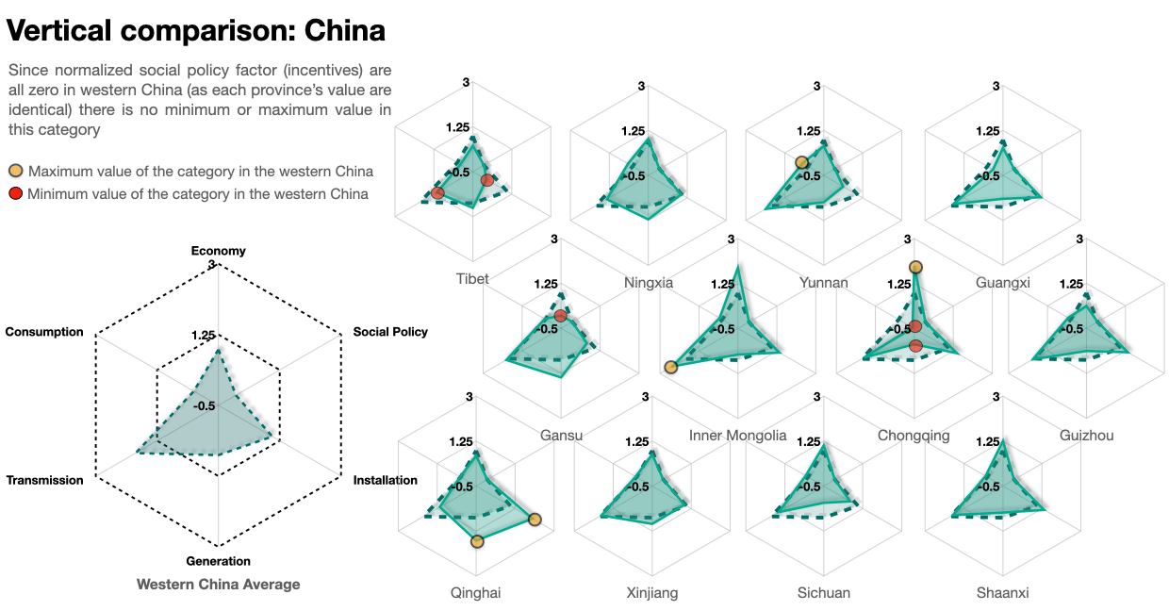
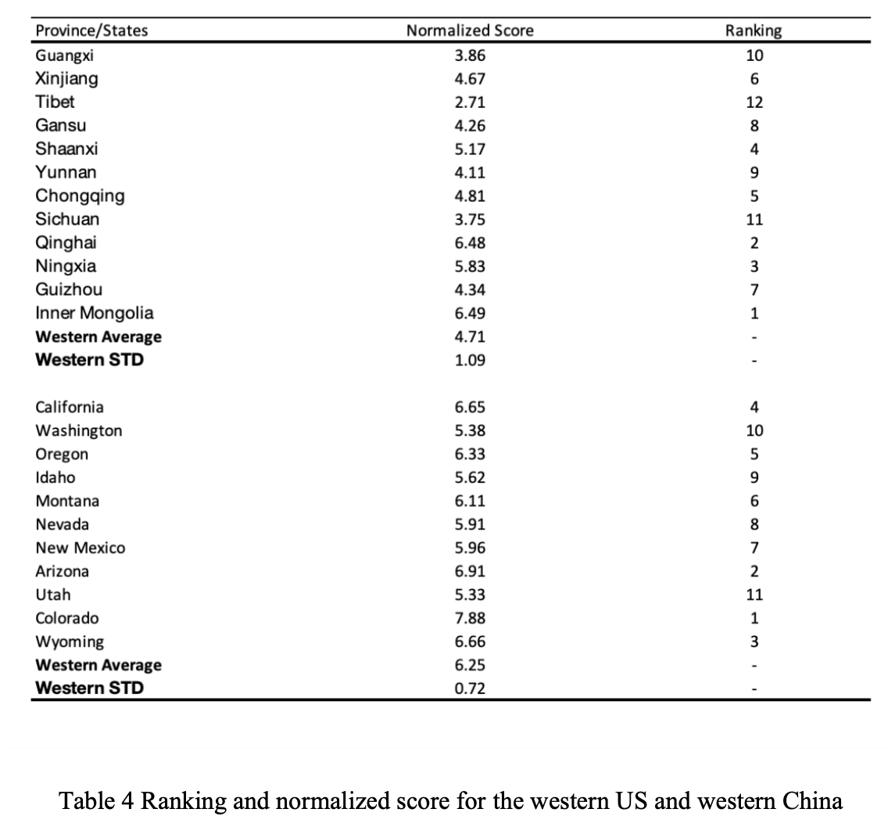
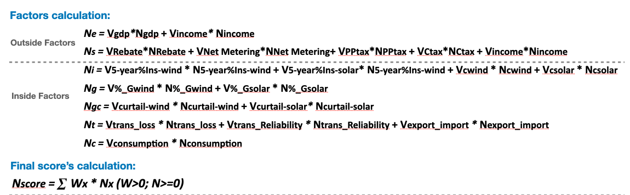
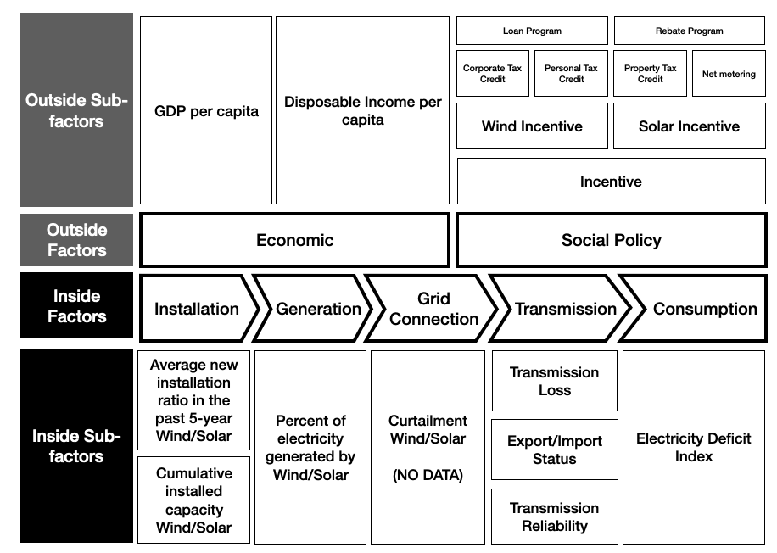
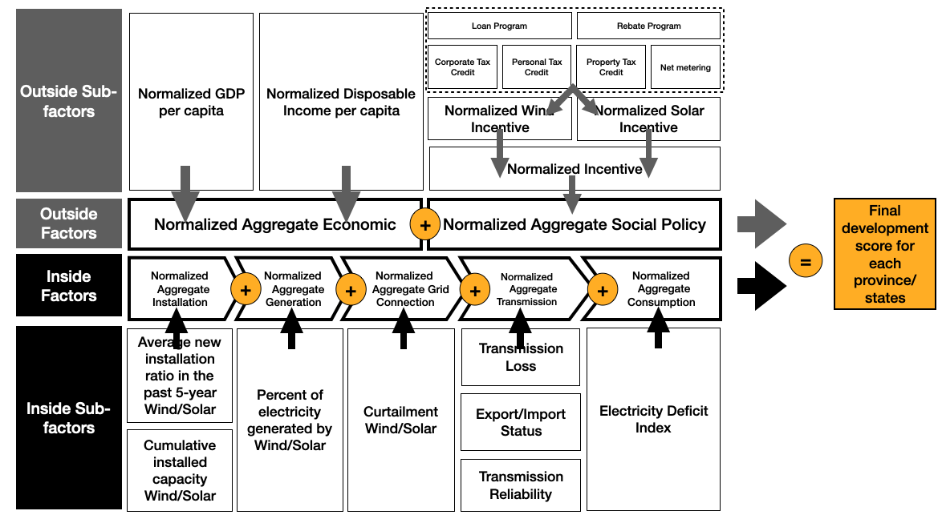




A comparison of solar and wind energy development between western China and the western US
Author:
Haoge Xu, Fall 2022, MES, Multi-Master’s Degree in International Environmental Management (IEM)
Reader:
Yvette Bordeaux, Ph.D., University of Pennsylvania
Jinping Tian, Ph.D., Tsinghua University
Introduction
Normalized Results
Both China and the US are pursuing carbon neutrality targets
US and China are the largest electricity generators and consumers
Both countries are the world’s largest emitters. The two countries combined share 42%+ of total carbon emission since 2017
Solar and wind energy are selected as the research targets because they have the best potential in the future
Western regions are important for both countries' carbon neutrality goals and renewable energy development
Based on the definition, there are 12 provinces in western China and 11 states in the western US
Both western regions share Similarities in solar and wind resources, area, and population ratio
+
+
+
+
Economics
Installation
Consumption
=
Economics
Installation
Consumption
=
“Why China and the US”
Both countries are the world largest emitters
+
+
+
+
“Why solar and wind”
Social Policy
Generation
Transmission
Final normalized score
Social Policy
Generation
Transmission
Final normalized score
Key purpose: To evaluate the performance of solar and wind energy development in each western state/province in the US and China in 2020
“Why western areas”
The darker color is, the higher the index is for each factor’s result and the final normalized result. The top three performers in the western US are Colorado, Arizona, and Wyoming
The top three performers in western China are Inner Mongolia, Qinghai, and Ningxia
Results & Framework Application
Vertical comparison: within each western region
Average comparison: between the two average
Both countries are the world’s largest electricity generators
Both countries are the world’s largest electricity consumers
Yellow-shaded areas are selected western areas in both countries
Literature Review
Total covered 50+ academic articles and industry reports
Among them, 18 are related to China’s renewable energy, from which there are only 4 regional studies focused in western China; 15 are related to the US renewable energy, but only 6 are focused in the western US
Total covered 50+ academic articles and industry reports
The rest 17+ are general studies regarding renewable energy or solar and wind development status in other countries
4 articles are considered as the reference methodology for this research, Wang et al. (2020) used a multidimensional assessment approach to conduct regional renewable energy development in China. However, it is an assessment of renewable energy overall in 32 provinces of China from 2008 to 2014 to explore the improvement. However, this research primarily focuses on solar and wind development
Research gap: Limited articles or reports compare two western regions directly regarding solar and wind energy development
Without considering the timing bias (as we know, both countries are in different development phases), both regions showed a similar pattern in five factors except social policy
Methodology
Horizontal comparison: between two regions
Key Assumptions: all weights are identical (W/V=1) as there is no evidence to assume which factor plays a more important role than the other
Normalization: to re-scale different factors’ value (in different units) within the same range, to make them add-able and calculate-able
  Electricity deficit: NConsumption = 1 - D
  A deficit is not a positive indicator, so that’s why we need to find its negative value
  Other factors: N = (X – Xmin)/(Xmax- Xmin)
Each province in China can pair with each state with the same regional ranking as a long-term target
The above graphs show the key steps during the solar and wind electricity generation process
Economics and social policy are selected as two outside factors
The sub-factors of economics are GDP per capita and disposable income per capita
The sub-factors of social policy is the incentive, including Loan Programs, Rebate Programs, Corporate Tax Credits, Personal Tax Credits, Property Tax Credits, and Net metering
W represents the weight of factors, V represents the widget of sub-factors, N represents a normalized score
Conclusion
This study designed a framework to assess two comparable regions’ solar and wind development statuses. Development biases can be limited by using the normalized value
Normalized value can also provide convenience to different index different factors
This framework can be applied to other renewable energy assessments if needed
In this study, the top three performers in the western US are Colorado, Arizona, and Wyoming; in western China, they are Inner Mongolia, Qinghai, and Ningxia
Western China, at the current stage, performed as well as the western US, except for the availability of solar and wind incentives
Economically, China should only build girds to transfer green electricity from west to east. They should be consumed at the local level. Thus, Western China should build more load centers such as industrial parks, given that western China has a great foundation of chemical industries and natural resources.
Western China can build more "zero" emission parks after Ordos' "zero" emission parks have been tested successfully.
The western US should upgrade its current grid system
Reference
China’s Greenhouse Gas Emissions Exceeded the Developed World for the First Time in 2019. (2021, May 6). Rhodium Group. https://rhg.com/research/chinas- emissions-surpass-developed-countries/
Climate Action. (n.d.). Climate Action. https://www.climateaction.org/news/china- pledges-carbon-neutrality-by-2060
Country Rankings. (n.d.). https://www.irena.org/Data/View-data-by-topic/Capacity- and-Generation/Country-Rankings
Data Highlights - 41: U.S. Carbon Dioxide Emissions Down 11 Percent Since 2007 | EPI. (n.d.). http://www.earth-policy.org/data_highlights/2013/highlights41
Database of State Incentives for Renewables & Efficiency®. (2022, April 28). DSIRE. https://www.dsireusa.org
Electric Power Annual 2021 - U.S. Energy Information Administration. (n.d.). https://www.eia.gov/electricity/annual/
Gustavo, M., & Enrique, P. (2011). Modelling and Control Design of Pitch-Controlled Variable Speed Wind Turbines. Wind Turbines. https://doi.org/10.5772/15880
Modelling and Control Design of Pitch-Controlled Variable Speed Wind Turbines
Normalization | Machine Learning |. (n.d.). Google Developers. https://developers.google.com/machine-learning/data- prep/transform/normalization
Swanepoel, J. P. (2020, February 24). How Do Solar Panels Work? BHG Power Storage Solutions. https://bhgpower.co.za/how-do-solar-panels-work/
东西中部和东北地区划分方法. (n.d.). National Bureau of Statistics of China (NBS). http://www.stats.gov.cn/ztjc/zthd/sjtjr/dejtjkfr/tjkp/201106/t20110613_71947.html
The framework above shows all influential factors and sub-factors
The calculation flow shows above. All factors' value is calculated by aggregating all normalized sub-factors’ value, and the final score is the aggregate of all normalized factors' score

