Slide 1
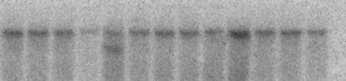

A.
PCR primer 1
NdeI
11117
PCR primer 3
NdeI
26173
Wild-type allele
1
2
3
4
5
6
5’ Probe
3’ Probe
Targeting Vector
I-CeuI
1
NdeI
2
LoxP
Neo
LoxP
3
TK
LoxP
5.1kb
0.6kb
2.1kb
3.3kb
NdeI
11117
PCR primer 1
NdeI
26173
Mutant allele
1
NdeI
2
3
4
5
LoxP
Neo
LoxP
5’ Probe
LoxP
3’ Probe
5.1kb
0.6kb
2.1kb
3.3kb
PCR primer 1
PCR primer 3
NdeI
11117
NdeI
KO allele
1
3
4
5
6
PCR primer 3
B.
*
C.
BP
+/+
+/-
-/-
wt
1000
WT allele
500
NULL allele
recombinant
300
200
100
Figure 3.1. Generation of Fbx4^{+/-} and Fbx4^{-/-} mice. (A) Targeted disruption of the mouse Fbx4 locus. Exon 2, encoding the F-box, is flanked by LoxP sites with a downstream neomycin (NEO) resistance cassette flanked by a third LoxP site. (B) Southern blot of a targeted ES clone (denoted by *) using 5’ probe shown in A. (C) Genotyping of Fbx4^{+/+}, Fbx4^{+/-}, and Fbx4^{-/-} d14 embryos from a heterozygous cross using tail DNA and PCR primers denoted in A.
80

Slide 2
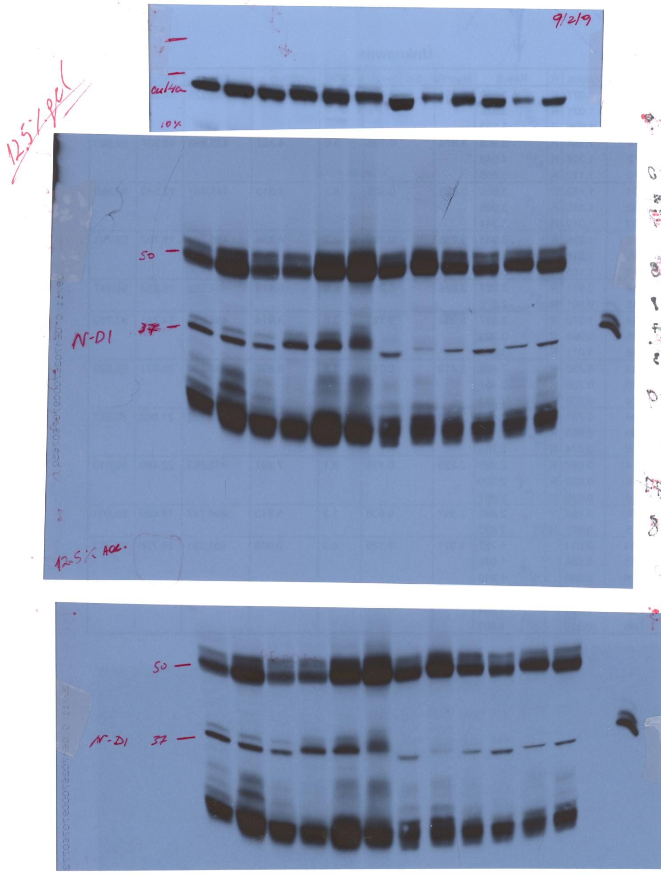


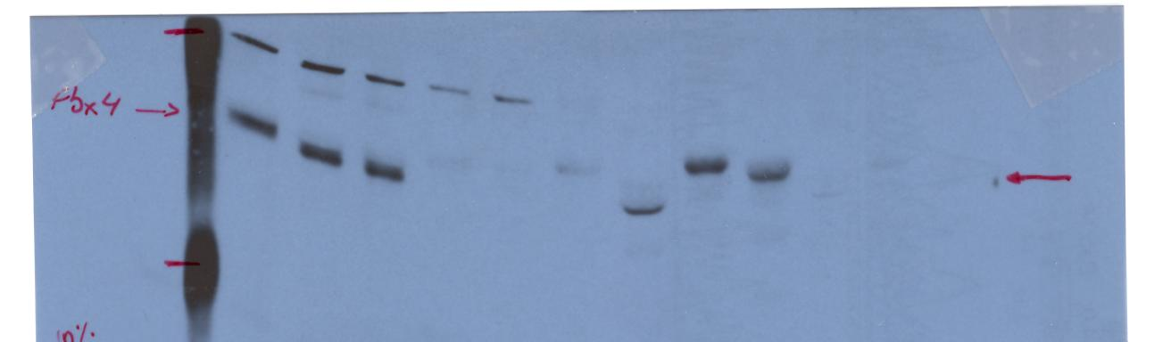


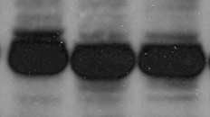
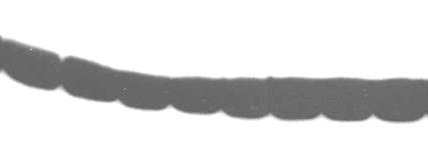
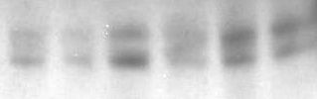



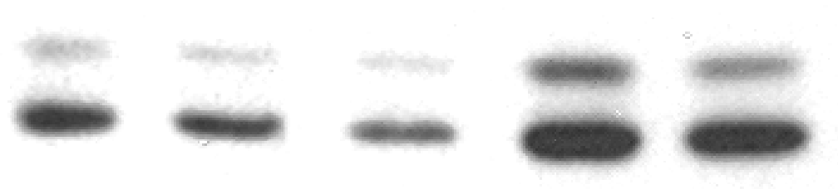

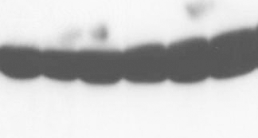

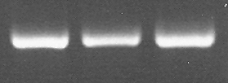
A.
B.
C.
+/+
+/-
-/-
+/+
-/-
+/+
+/-
-/-
Cyc D1
Cyc D1
Cyc D1
Fbx4
Fbx4
Fbx4
Loading
Cul1 (Loading)
β-Actin
Mammary
Gland
Lung
Thymus
D.
+/+
+/-
-/-
E.
F.
+/+
+/+
+/+
+/-
-/-
Cyc D1
+/+
-/-
+/-
Fbx4
Cyc D1
Fbx4
Cyc D1
Fbx4
β-Actin
Cul1
HPRT
Spleen
Early passage MEFs
Figure 3.2. Cyclin D1 accumulation in Fbx4^{+/-} and Fbx4^{-/-} tissues and MEFs. Tissues were harvested from young (1-2 month old) mice of each genotype, and lysates prepared for SDS-PAGE and immunoblotted as indicated. Cyclin D1 accumulation was assessed in mammary glands (A), lungs (B), thymus (C), spleen (D), and primary MEFs (E). (F) Cyclin D1 message is equivalent in Fbx4^{+/+}, Fbx4^{+/-}, and Fbx4^{-/-} MEFs. RT-PCR was performed on total RNA isolated from MEFs of the indicated genotype using PCR primers specific for cyclin D1 and the housekeeping gene HPRT as a control.
81

Slide 3
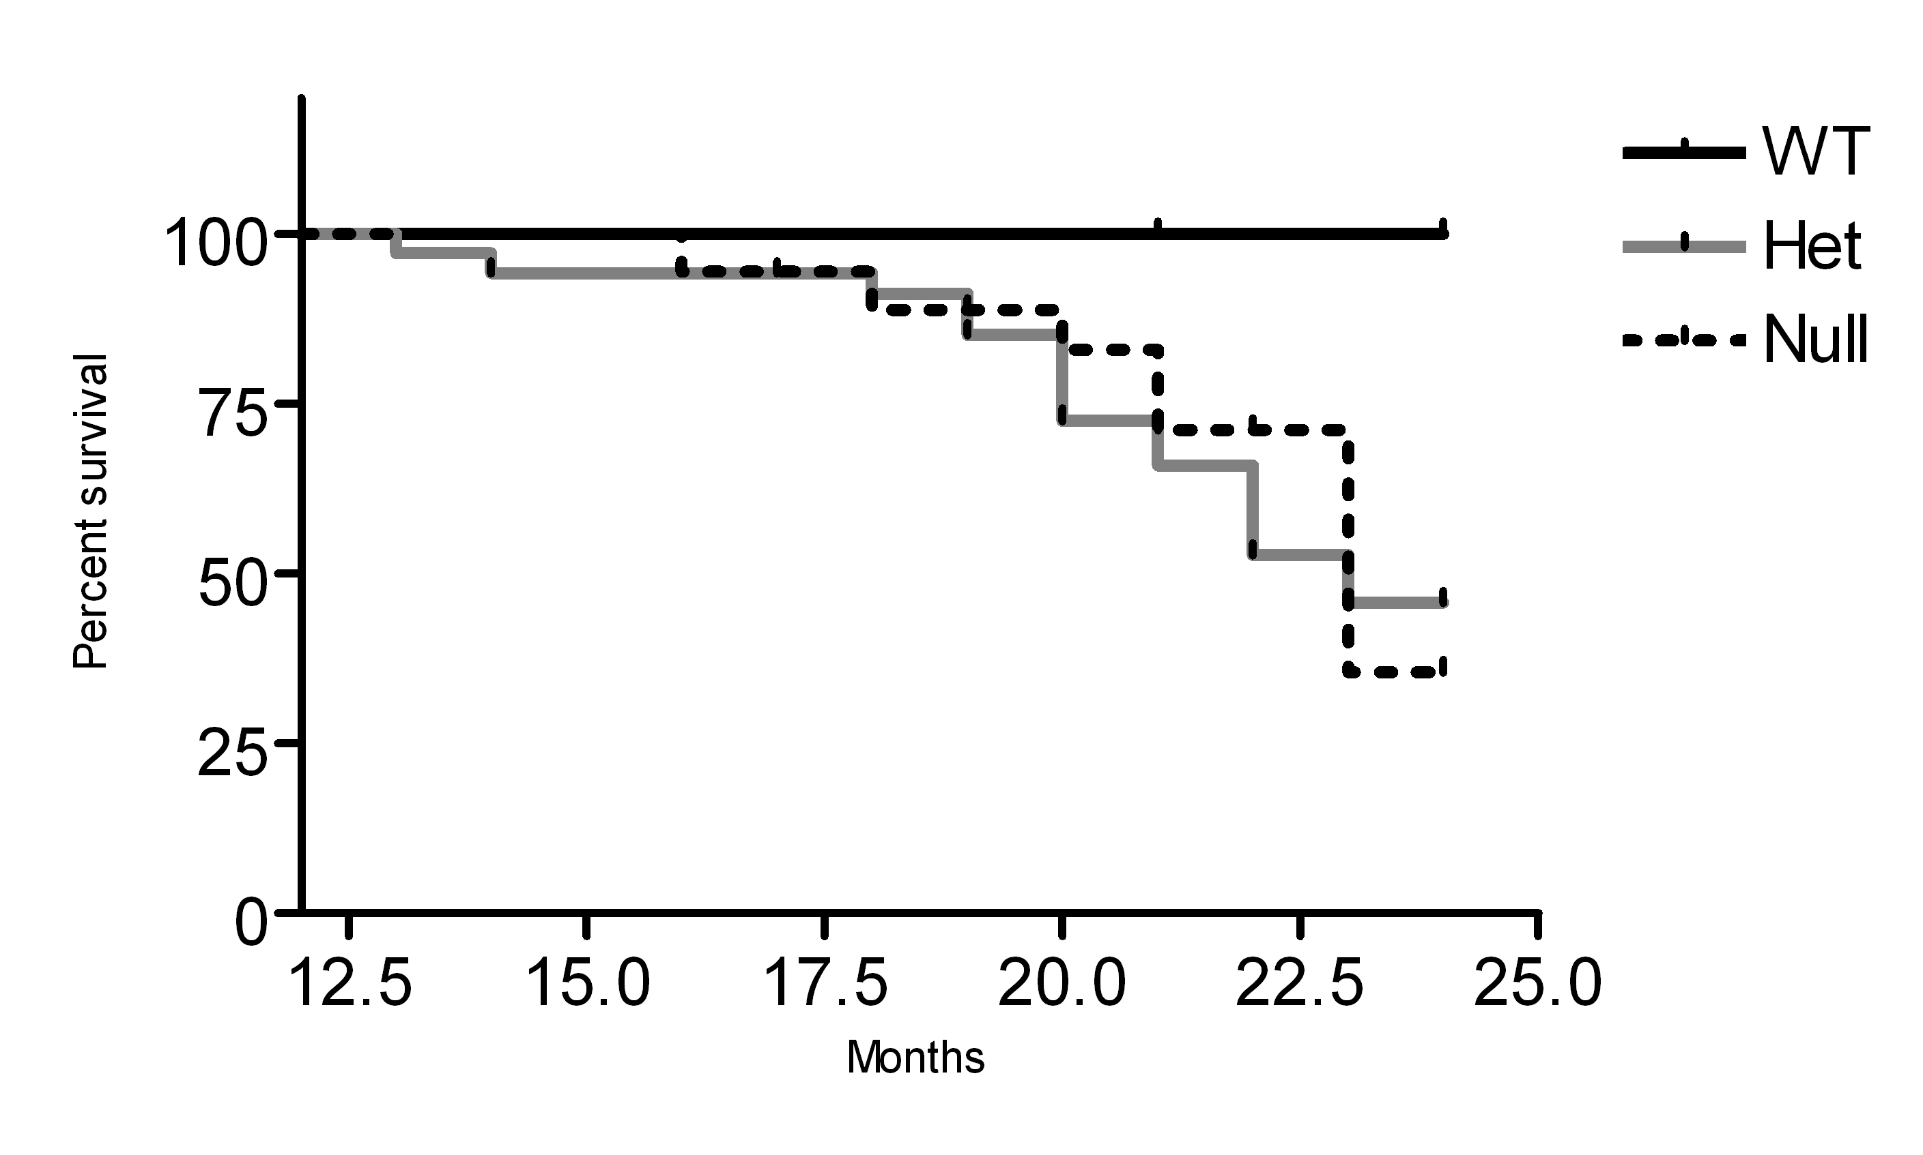


A.
Fbx4^{+/+}
Fbx4^{+/-}
Fbx4^{-/-}
Percent Survival
Months
B.
7796
6280
1371
40
57
46
69 (MN)
Mouse ID
Fbx4
Fbx4^{+/-}
Ponceau S
Fbx4^{+/+}
Figure 3.3. Fbx4^{+/-} and Fbx4^{-/-} mice succumb to tumorigenesis. (A) Kaplan-Meier curves showing percentage tumor-free survival of Fbx4^{+/+}, Fbx4^{+/-}, and Fbx4^{-/-} mice to 24 months. (B) Fbx4 haploinsufficiency. Representative tumors arising in Fbx4^{+/-} mice were assessed for Fbx4 protein expression by western blot; only one of four tumors analyzed downregulated Fbx4 expression.
82

Slide 4
Table 2. Pathology observed in Fbx4^{+/-} and Fbx4^{-/-} mice.
Pathology | No. of Mice | Incidence
Lymphoblastic Lymphoma (Spleen, Thymus, Mesenteric Node, Liver, Intestine) | 18/47 | 38.3%
Extramedullary Hematopoiesis/Intense Myeloid Proliferation (Spleen, Liver) | 11/47 | 23.4%
Hemangioma/Angioinvasive Tumor (Liver, Lung) | 3/47 | 6.4%
Dendritic Cell Tumor (Spleen, Thymus)/Histiocytic Sarcoma (Intestine) | 3/47 | 6.4%
Early Myeloid Tumor | 1/47 | 2.1%
Mammary Carcinoma | 1/47 | 2.1%
Uterine Tumor | 1/47 | 2.1%
Table 2. Summary of pathology observed in Fbx4^{+/-} and Fbx4^{-/-} mice. Fbx4^{+/-} and Fbx4^{-/-} mice included as events in the Kaplan-Meier survival analysis frequently develop large cell lymphoblastic lymphomas involving the mesenteric lymph node, spleen, thymus, Peyer’s patches of the intestine, and liver. A large percentage of mice also exhibit extramedullary hematopoiesis (EMH) and intense myeloid proliferation in the spleen and less frequently, liver. This is also associated with early myeloid tumor formation. Less commonly observed malignancies include dendritic cell/histiocytic sarcomas, hemangioma, uterine tumor, and mammary carcinoma. Analysis of several mice independent of the Kaplan-Meier cohort also revealed an additional case of intestinal histiocytic sarcoma and a case of hepatocellular carcinoma.
83

Slide 5
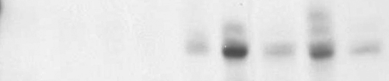
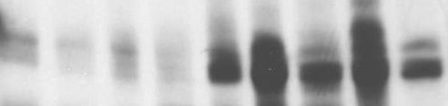
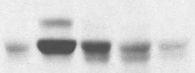


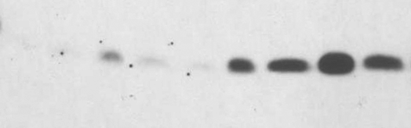
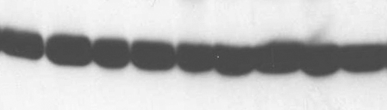
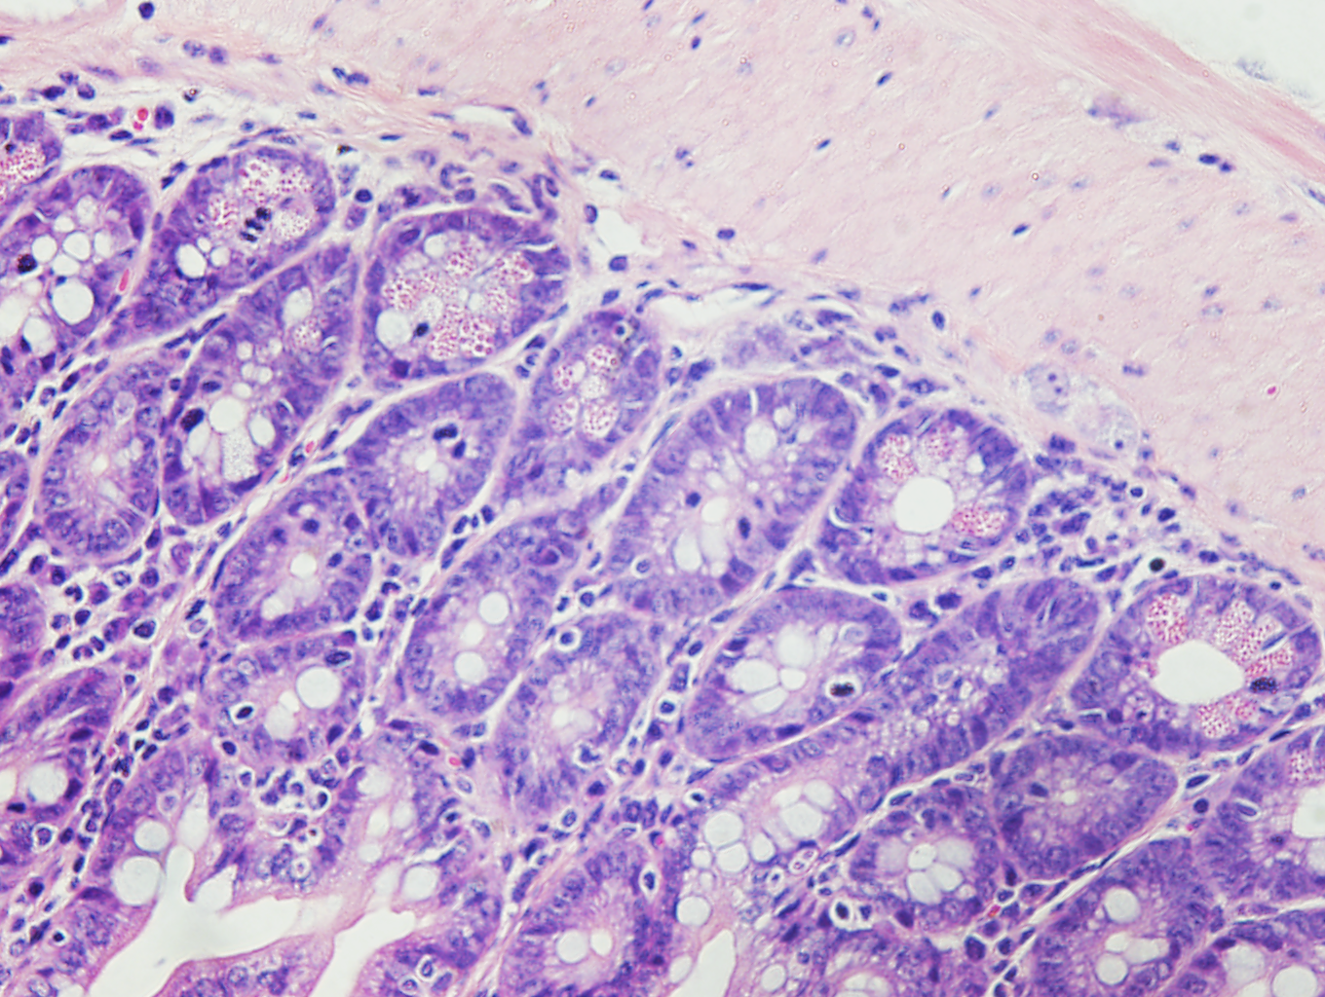
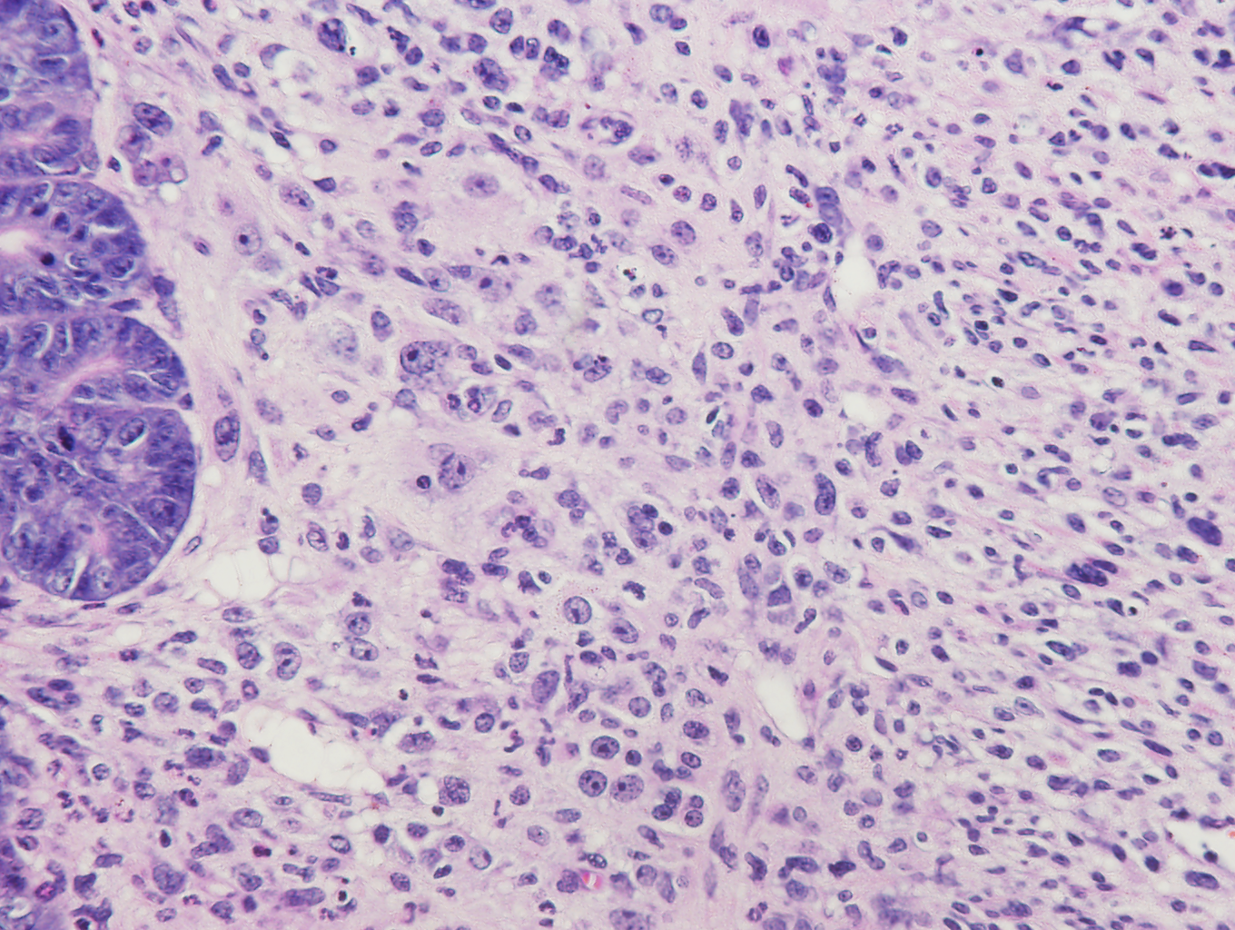
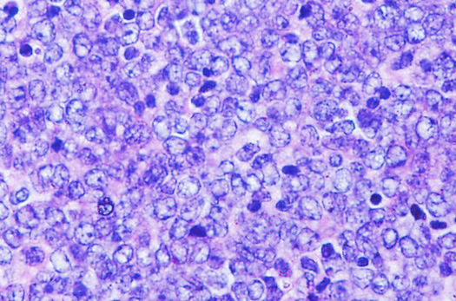
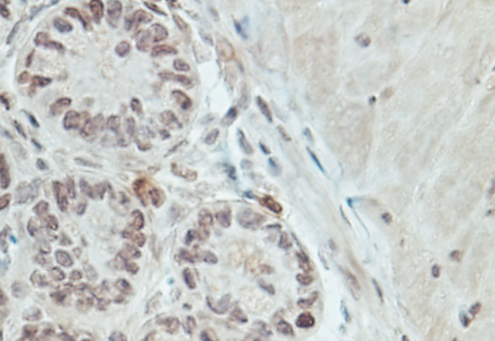
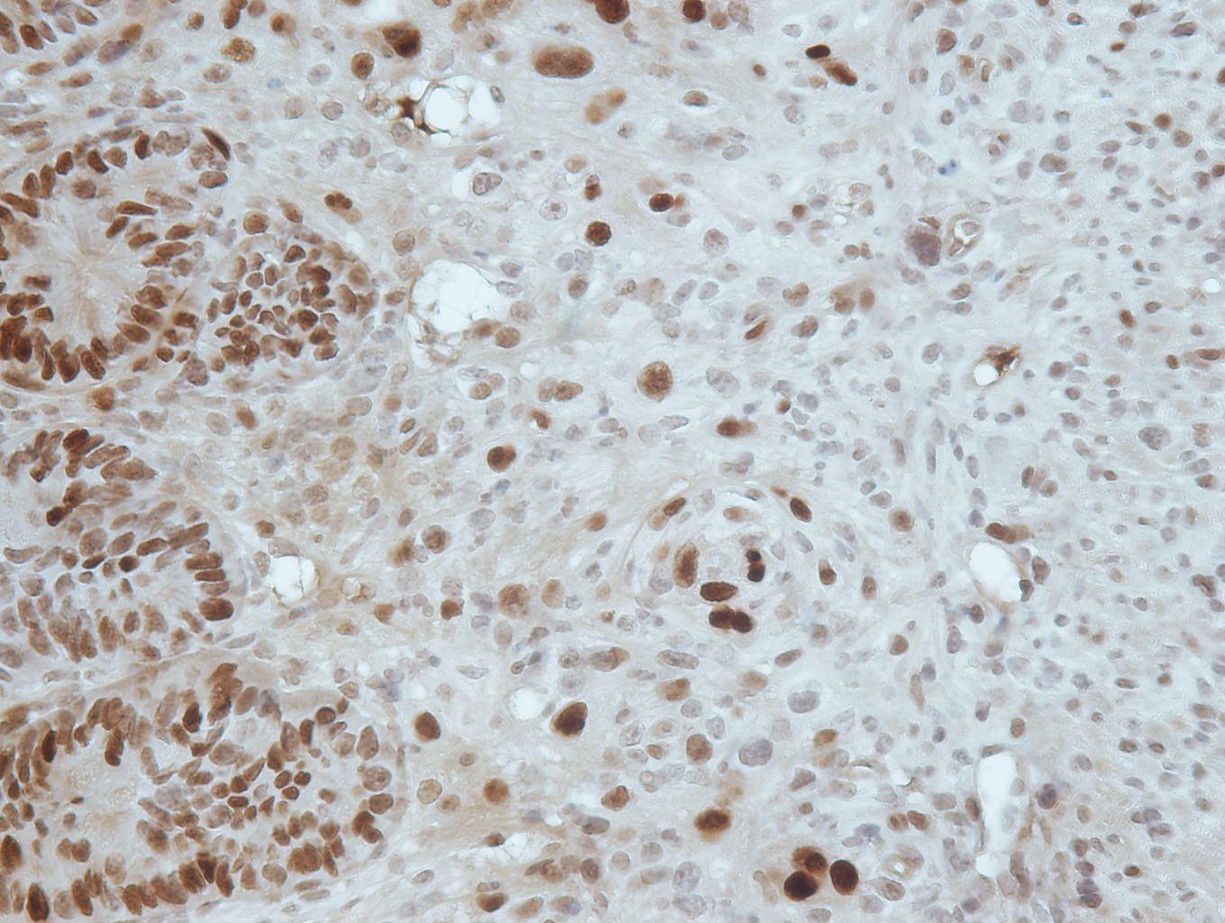
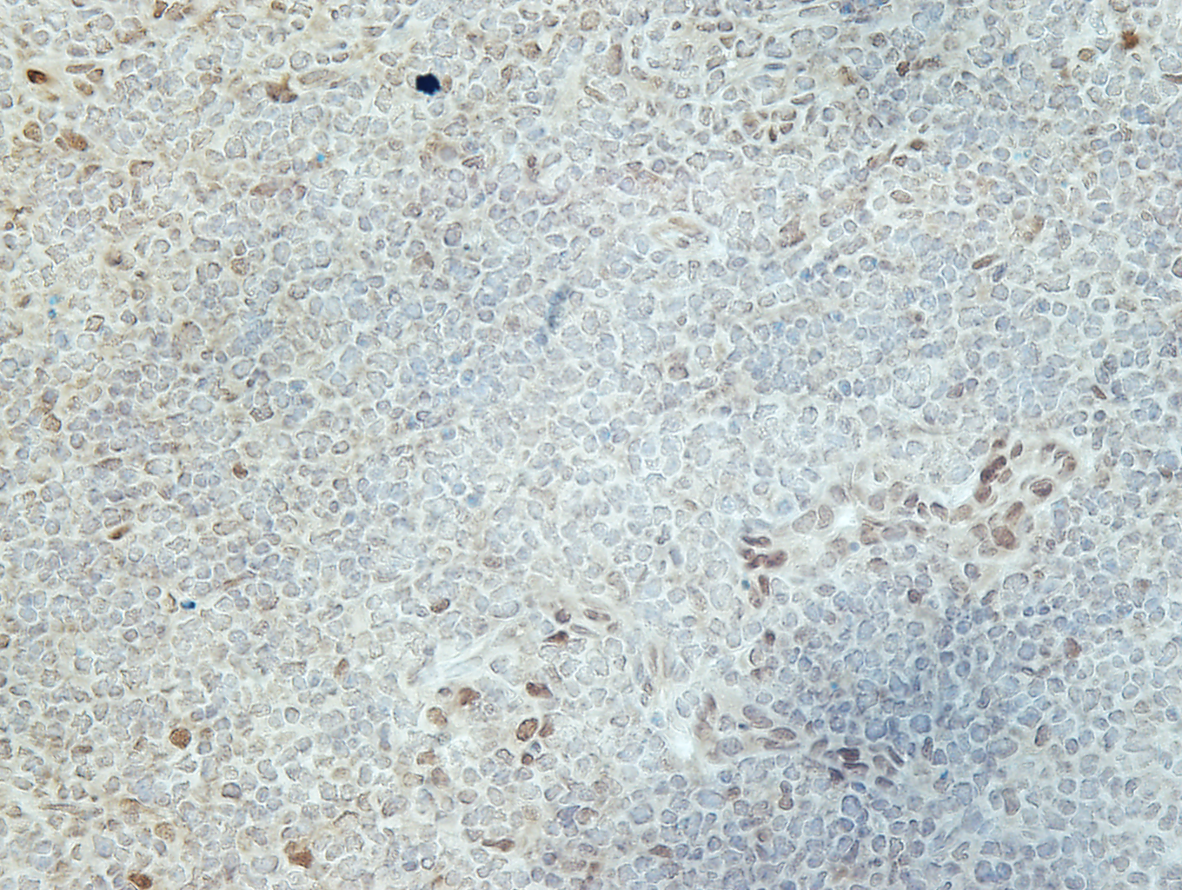
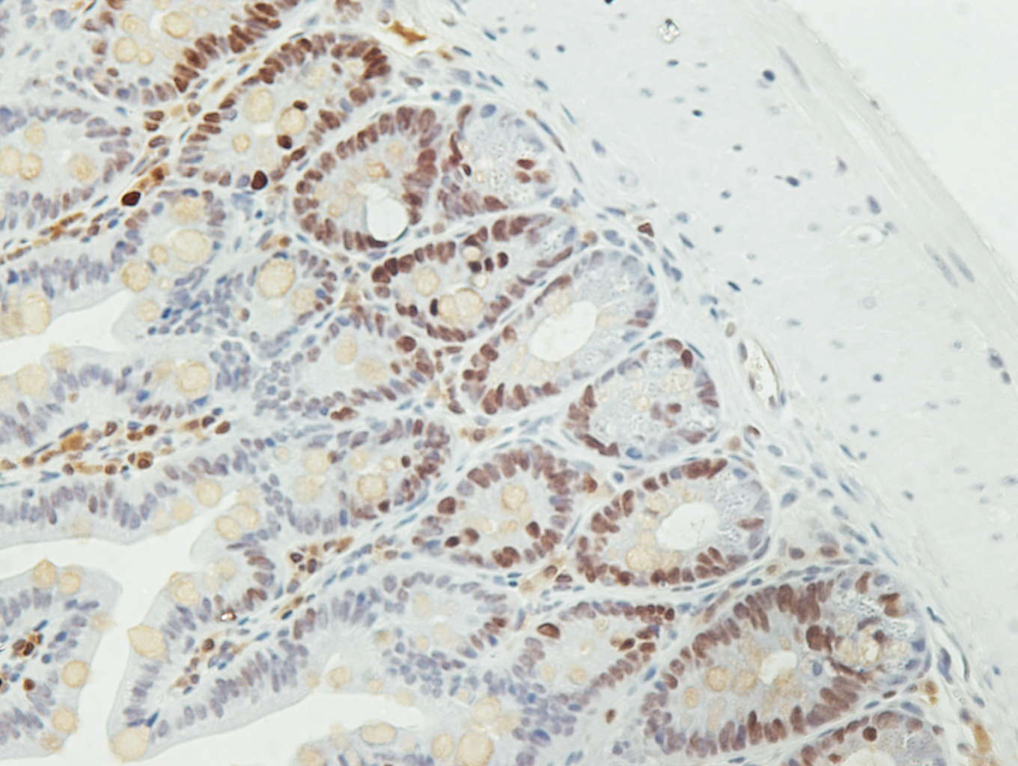
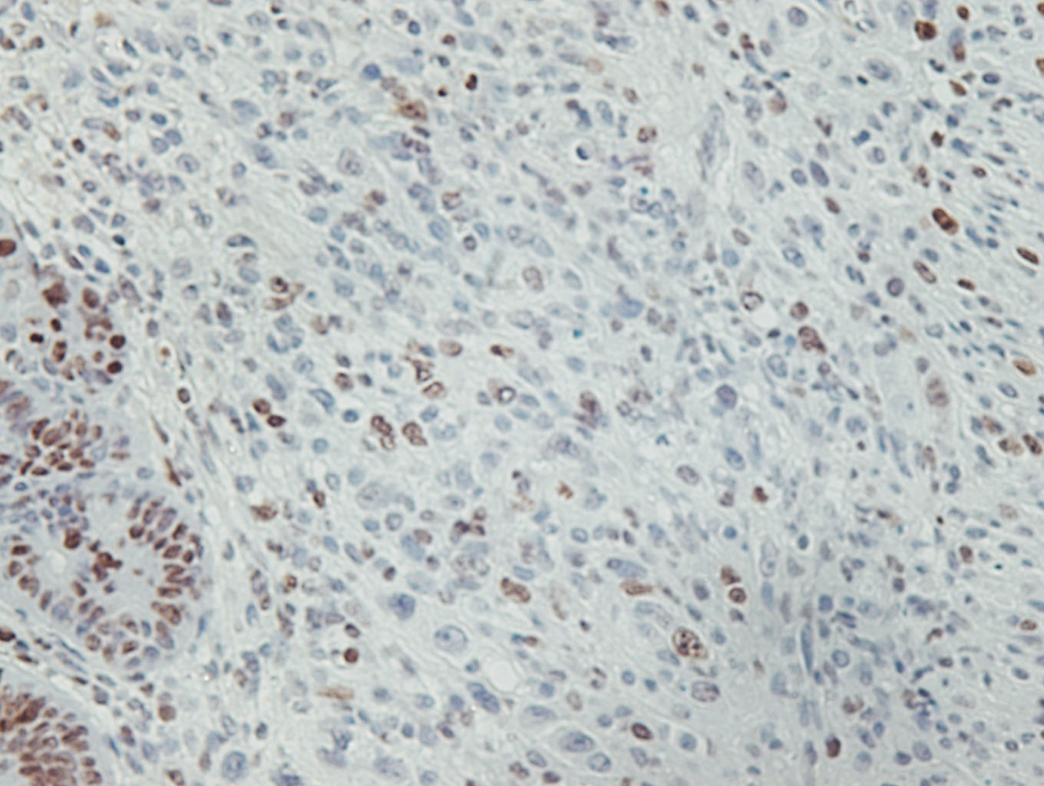
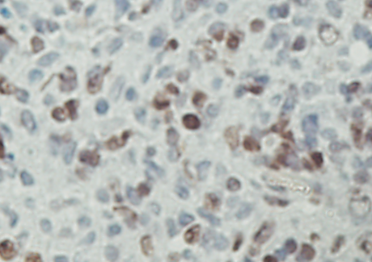
A.
Mesenteric LN
Lymphoma
B.
Spleen
3018
3017
5934
8366
+/- Lymphoma, HCC
6285
+/+ Normal
+/- Lymphoma
+/- Hemangioma
40
48
57
61
Mouse ID
+/- Normal
Cyc D1 (lt.)
Cyc D1 (dark)
Cyc D1
Fbx4
Ponceau S
H4R3
Liver
β-actin
Fbx4^{+/+}
Fbx4^{-/-}
Fbx4^{+/-}
C.
H&E
Cyc D1
Ki-67
Normal
Intestine
Histiocytic Sarcoma
Intestine
Lymphoma
Mesenteric Node
Figure 3.4. Cyclin D1 accumulation in Fbx4^{+/-} and Fbx4^{-/-} tumors. (A) Fbx4^{+/-} and Fbx4^{-/-} lymphomas exhibit cyclin D1 accumulation. Lysates prepared from wild type age matched spleens, Fbx4^{-/-} spleens, and mesenteric node lymphomas were subjected to SDS-PAGE and immunoblotting as indicated. (B) Fbx4^{+/-} liver tumors exhibit cyclin D1 accumulation. Lysates prepared from Fbx4^{+/-} livers harboring lymphoma, hepatocellular carcinoma (HCC) or hemangioma and normal age-matched livers were analyzed by immunoblot analysis for cyclin D1 levels. (C) Representative H&E and immunohistochemical (IHC) staining for cyclin D1 and Ki-67 as a marker of proliferation in normal intestinal epithelium, Fbx4^{+/-} histiocytic sarcoma of the intestinal muscle wall, and Fbx4^{-/-} primary lymphoma of the mesenteric node.
84

Slide 6
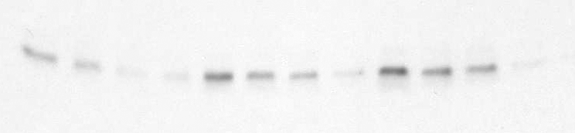
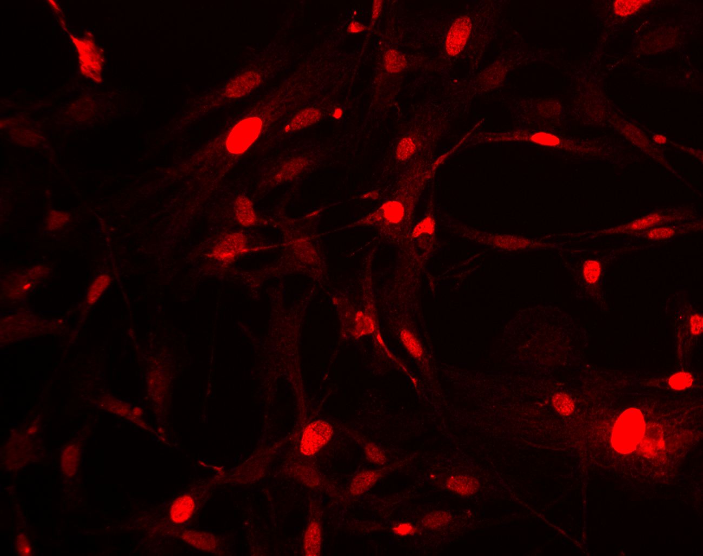
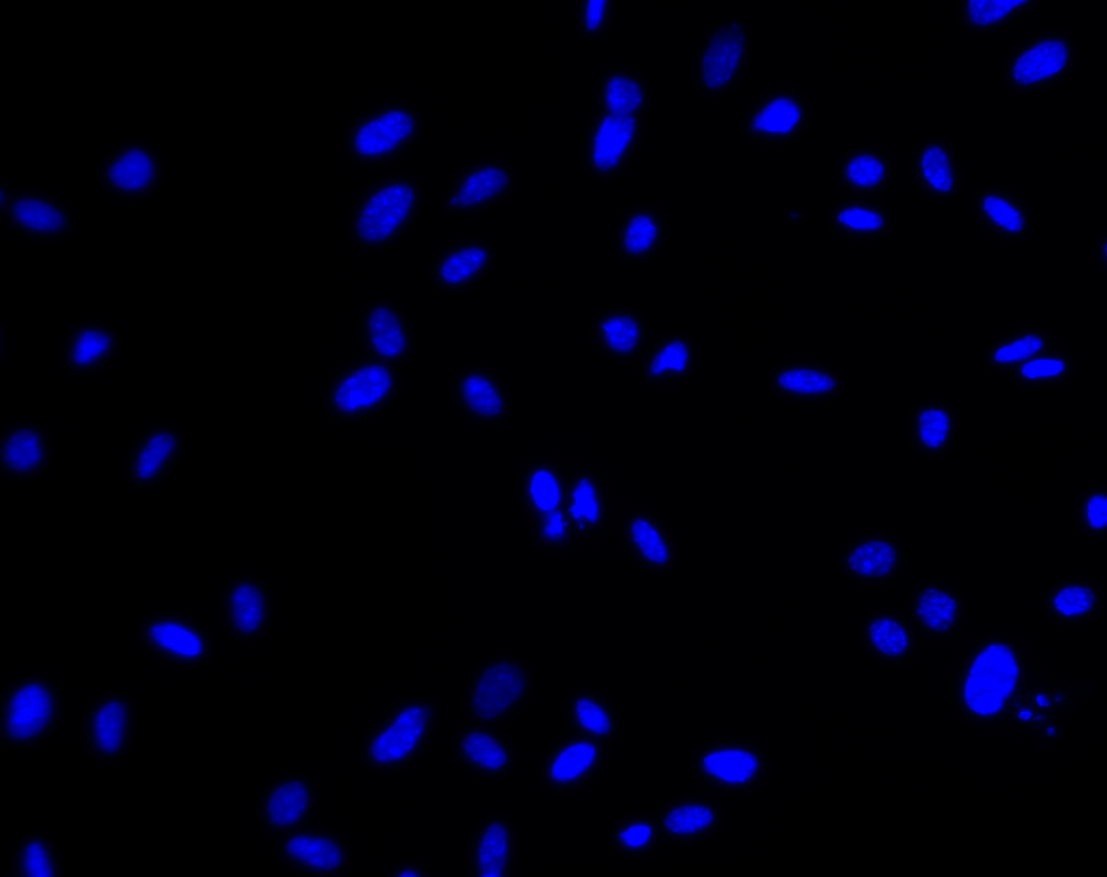
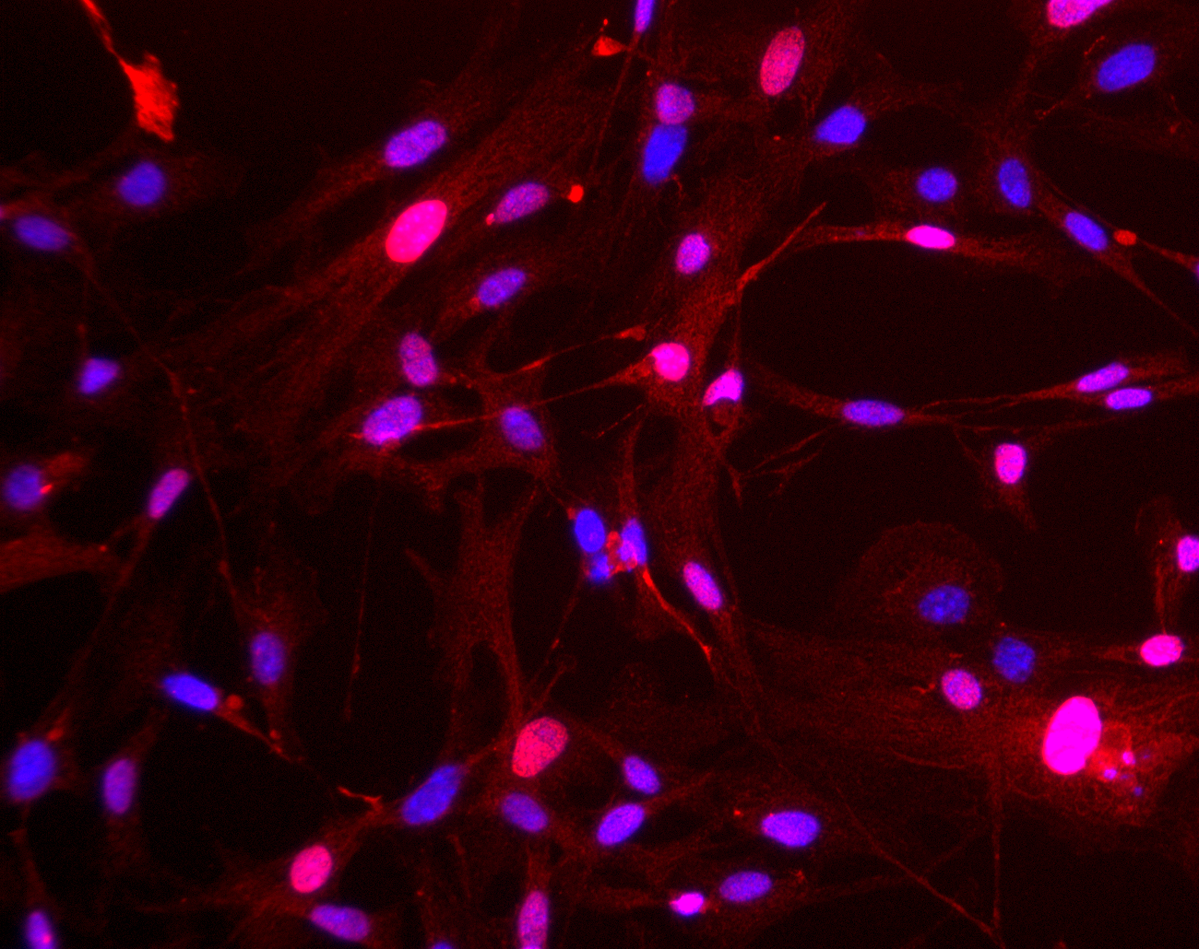
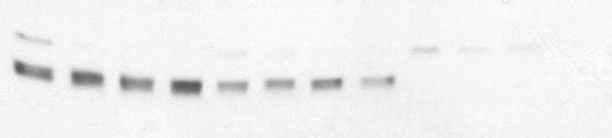
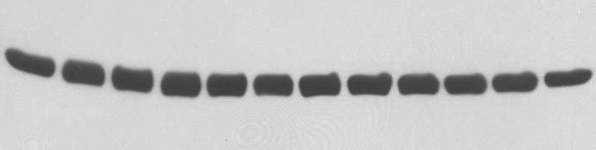
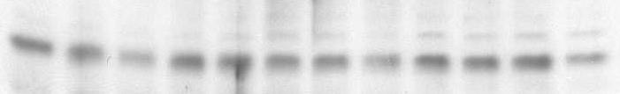
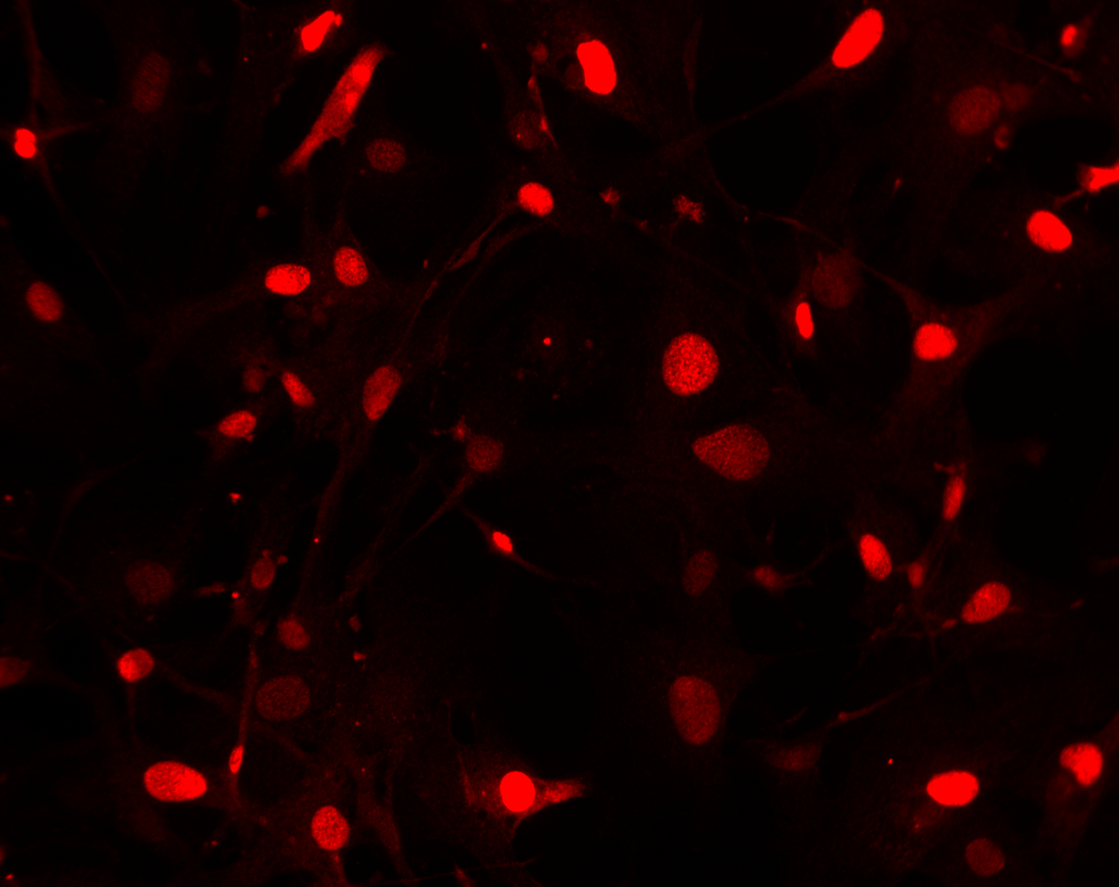
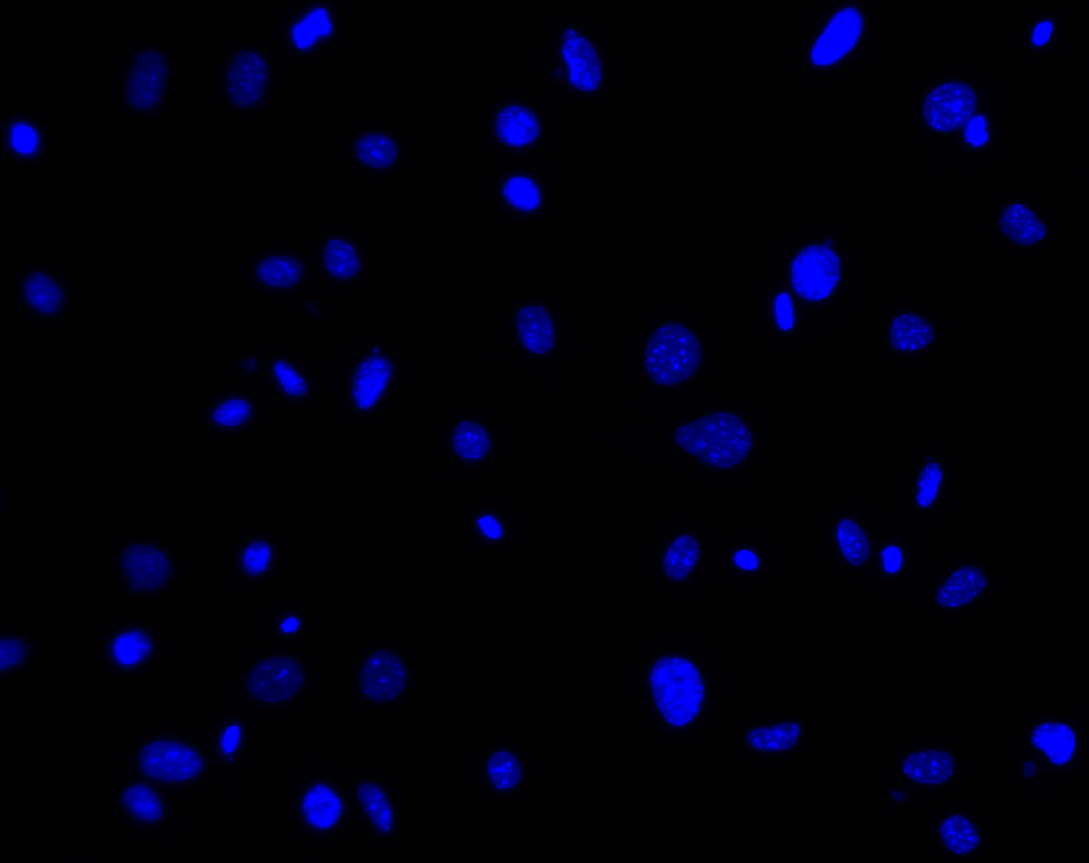
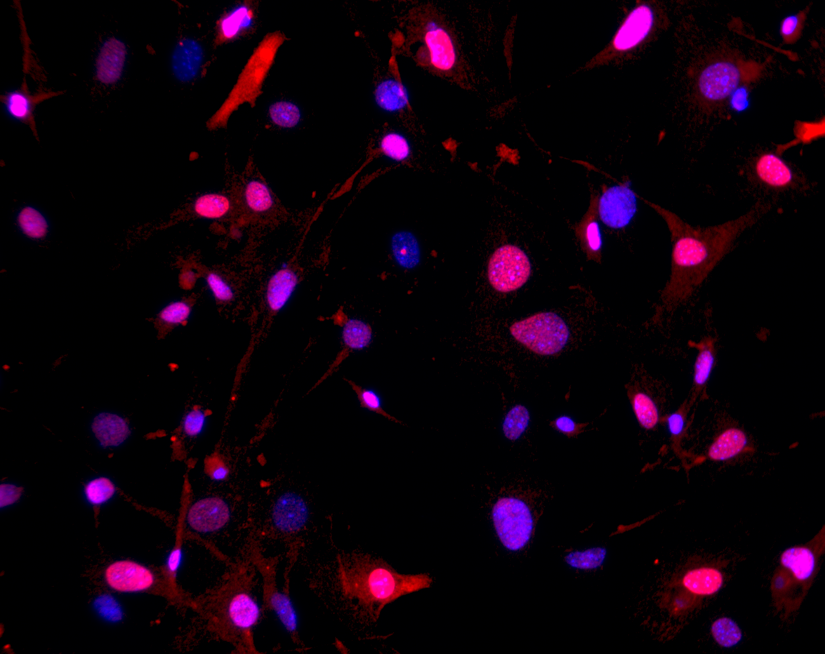
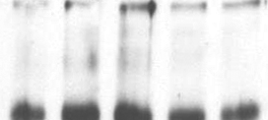
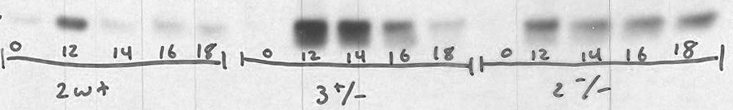

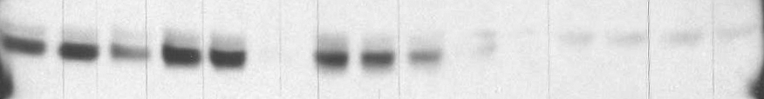

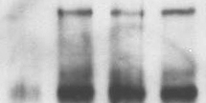
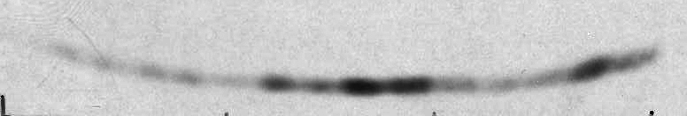
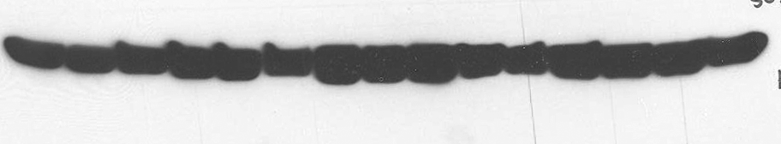

A.
B.
0
20
Cyc D1
DAPI
Merge
40
60
0
20
40
60
0
20
40
60
CHX (min)
Cyc D1
Fbx4
+/+
β-Actin
Cyc A
Fbx4^{+/+}
Fbx4^{+/-}
Fbx4^{-/-}
-/-
MEF line | +/+ t_{1/2} | -/- t_{1/2}
1 | 18 min | 35 min
2 | 17 min | 30 min
C.
+/+
% of Cells
-/-
Cells (10⁵)
+/+
-/-
Nuclear
Only
Nuclear
+
Cyto
D.
Days in Culture
E.
NRS
F.
-/-
+/+
Cyc D1 IP
IP: Cyc D1
IB: pT286 Cyc D1
Late G1
NRS
G1/S
Early S
Mid S
Late G1
G1/S
Early S
Mid S
-/-
Cyc D1
+/+
pT286 D1
pT286 Cyc D1
(lt. exposure)
*
Fbx4
Cyc D1
IP: Cyc D1
IB: Cyc D1
γH2AX
β- Actin
Cyc D1
(lt. exposure)
Fbx4^{+/+}
Fbx4^{-/-}
Figure 3.5. Fbx4 loss promotes cyclin D1 stabilization and nuclear accumulation in MEFs. (A) Cyclin D1 t_{1/2} is extended in S-phase Fbx4^{-/-} MEFs. Top panel: synchronous S-phase MEFs were treated with cycloheximide (CHX) as indicated. Cell lysates were subjected to SDS-PAGE and immunoblotted for cyclin D1, Fbx4, and cyclin A as an S-phase marker. Bottom panel: calculated cyclin D1 t_{1/2} for two independent biological replicate MEF lines. (B) Nuclear cyclin D1 accumulation in Fbx4^{-/-} MEFs. Top panel: passage 3 primary MEFs were stained with cyclin D1-specific antibodies and DAPI. Images were captured at 20x magnification, with equal exposure. Bottom panel: quantification of nuclear cyclin D1 staining. (C) Primary Fbx4-/- MEFs exhibit increased proliferation. 1x10⁵ Fbx4^{+/+} and Fbx4^{-/-} MEFs (passage 2) were plated in duplicate on 35mm plates and counted daily for 6 days. (D) Elevated cyclin D1 protein in S-phase Fbx4^{-/-} cells. p19shRNA-immortalized cells were synchronized by serum starvation, harvested at the indicated cell cycle phases and immunoblotted as indicated. (E) Phosphorylated cyclin D1 accumulates in S-phase Fbx4^{-/-} cells. Total cyclin D1 was immune precipitated from S-phase cell lysates and immunoblotted for phospho-T286 cyclin D1 (pT286 D1) and total cyclin D1. C) Cyclin D1 ubiquitylation following the G1/S transition is impaired in Fbx4^{-/-} cells. Cells were synchronized by serum starvation and stimulated to enter early S-phase. Total cyclin D1 was immune precipitated from cell lysates, subjected to SDS-PAGE, and immunoblotted to visualize cyclin D1 laddering. Top panel: pT286 cyclin D1 immunoblot. Bottom panel: total cyclin D1 immunoblot.
85

Slide 7
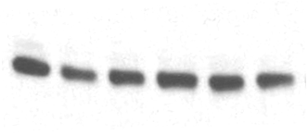

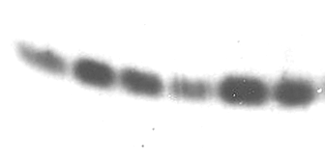
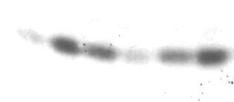
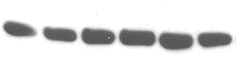
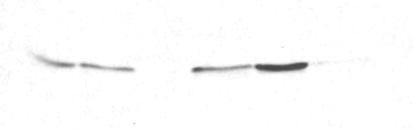

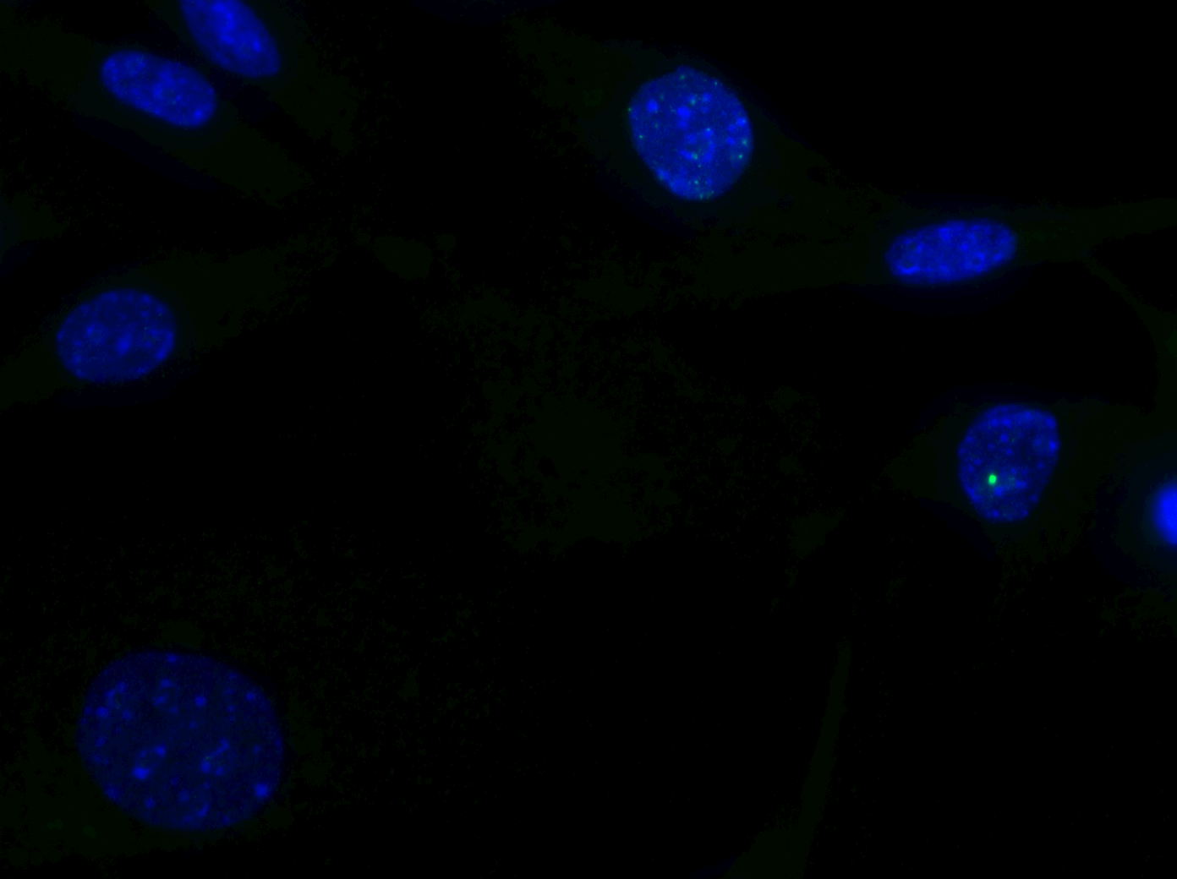
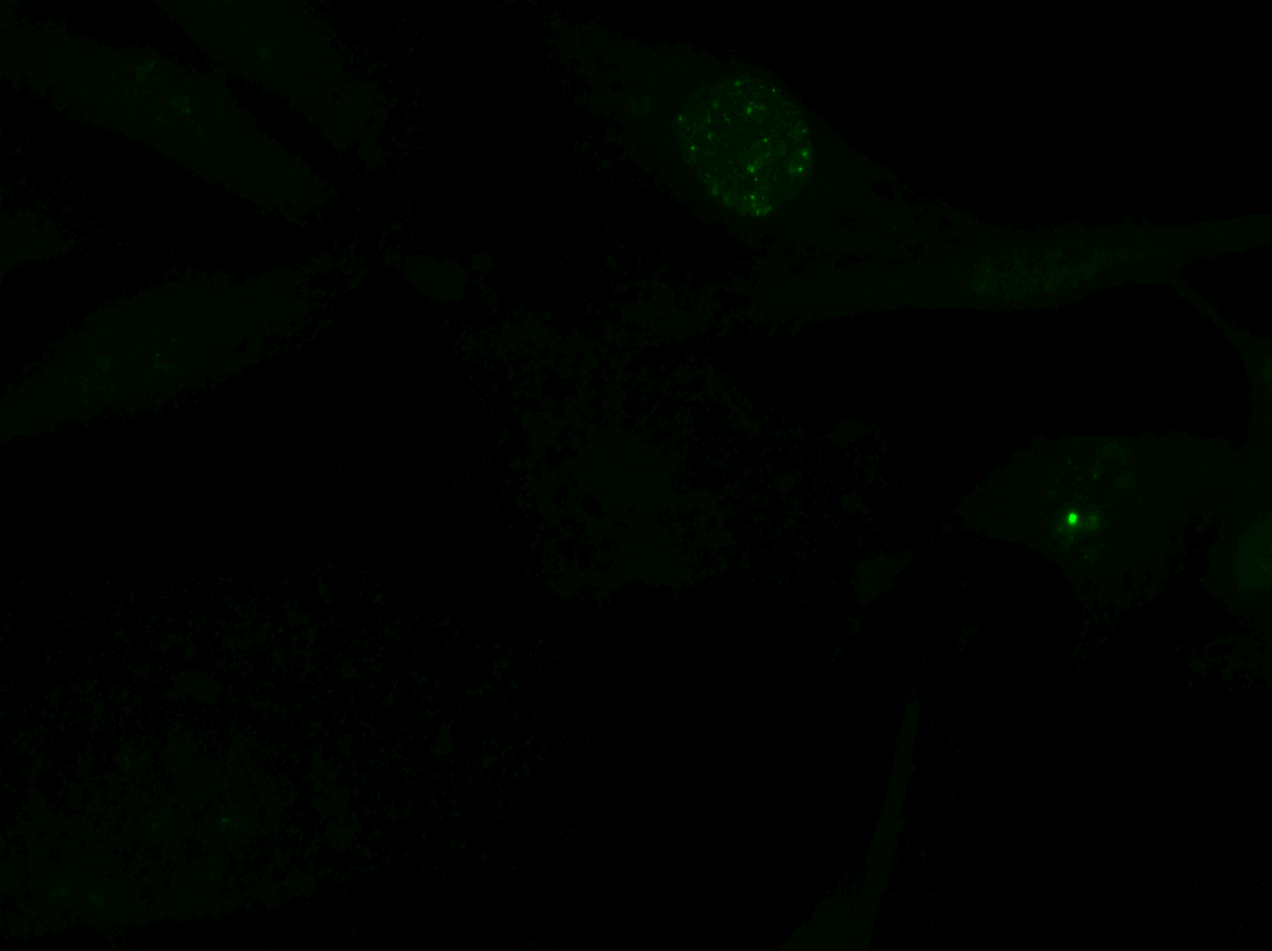
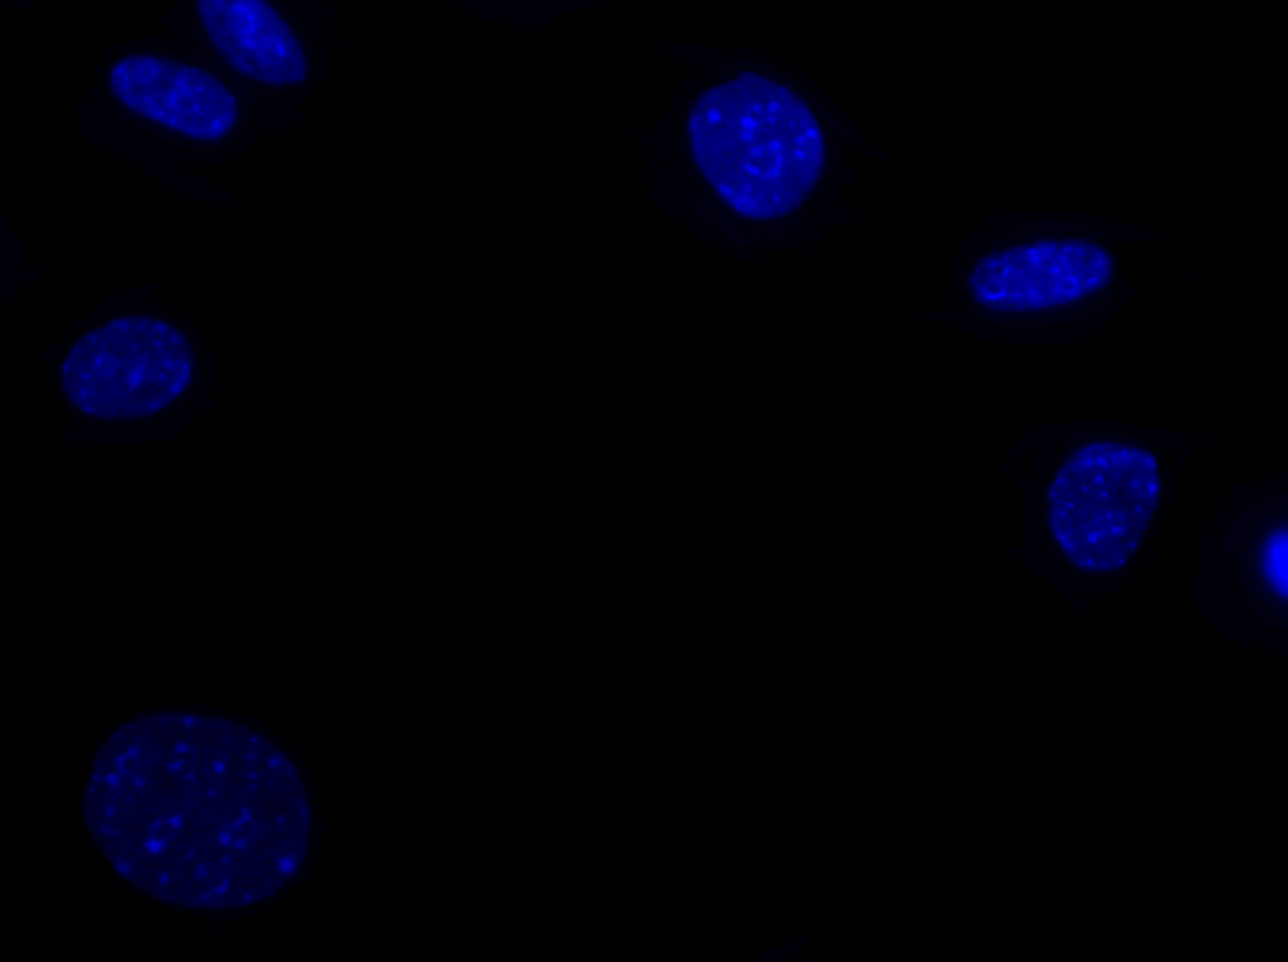


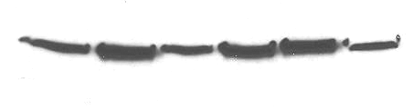

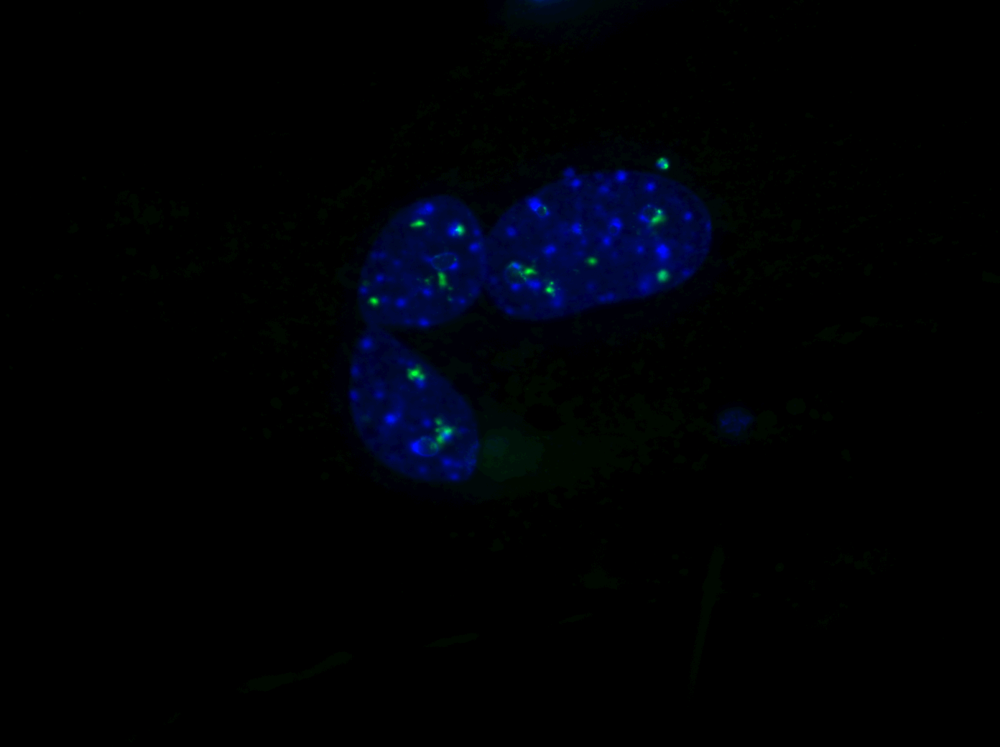






A.
B.
C.
+/+
3
5
7
3
5
7
Passage #
+/-
Cyc D1
-/-
Fbx4
Cells (10⁵)
Cells (10⁵)
p19^{Arf}
p16^{Ink4a}
β-Actin
Passage Number
+/+
-/-
Passage Number
D.
E.
*
F.
Merge
γH2AX
DAPI
2
4
6
2
4
6
Passage #
p53
γH2AX
p21
+/+
Fbx4
*
β-Actin
γH2AX
Fbx4
+/+
*
-/-
+/+
-/-
β-actin
-/-
G.
**
-/- 3 % O₂
-/- 21 % O₂
+/+ 21 % O₂
Avg. # breaks/cell
1.79
% of Cells
0.13
-/-
+/+
-/-
+/+
Foci/Cell
Figure 3.6. Enhanced proliferation is antagonized by DNA damage in Fbx4^{-/-} MEFs. (A) MEFs were cultured on a 3T9 passage protocol (9x10⁵ cells passaged every three days, at least two biological replicates/genotype). Absolute cell count at each passage is displayed. (B) Expression of senescence-associated p19^{Arf} and p16^{Ink4a} in primary MEFs. (C) Knockdown of p19^{Arf} rescues cellular senescence, promoting immortalization. Black curves represent passages of uninfected MEFs; gray curves represent MEFs infected with p19^{Arf} shRNA at passage 4. Immortalized cells proliferate indefinitely beyond passage 8. (D) Enhanced γH2AX in Fbx4^{-/-} primary MEFs. (E) Enhanced p53 induction in Fbx4^{-/-} MEFs. Passage 4 primary MEF lysates were prepared from two independent isolates/genotype and immunoblotted as indicated. (F) Fbx4^{-/-} MEFs accumulate DNA damage foci. Top panel: Passage 3 MEFs were cultured on coverslips under normoxia (21% O₂) or physiological oxygen (3% O₂). Cells were fixed, stained with γH2AX antibodies, and visualized by immunofluorescence. Images were taken at 60x magnification with equal intensity and exposure time. Bottom panel: quantification of the percentage of cells exhibiting DNA damage foci. (G) Increased incidence of chromosome alterations in Fbx4^{-/-} MEFs challenged with hydroxyurea (HU). Two independent immortalized MEF lines per genotype were synchronized by serum starvation, and cells in mid-S-phase were treated with 2mM HU for 2 hours, followed by HU washout and colcemid treatment for 2 hours for metaphase arrest. Metaphase spreads were prepared and stained with Giemsa to visualize chromosome alterations. Left panel: representative images of chromatid breaks. Right panel: quantification of the average number of chromatid breaks per cell.
86

Slide 8















A.
Myc-CDT1
B.
-
1
4
-
1
4
2mM HU (h)
12
14
16
18
12
14
16
18
Serum Stimulation (h)
Cyc D1
Myc-CDT1
Endo. CDT1
γH2AX
CUL4A
Fbx4
Fbx4
β-Actin
γH2AX
-/-
+/+
β-Actin
S-phase
+ γIR
NRS
+/+
-/-
D.
S-phase
C.
NRS
-
+
10Gy γIR
-
+
-
+
IP/IB: pS12 Fbx4
IP: Fbx4
Fbx4
WB: pT286 D1
pT286 CycD1
Input
Cyc D1
IgG
Asyn
Chk2
pT286 D1 (lt. exposure)
12h
16h
Serum stimulation
Figure 3.7. DNA damage regulates cyclin D1 stability and Fbx4 ligase activation. (A) Stabilization of Cdt1 in immortalized, S-phase-synchronized Fbx4^{-/-} cells. Cells synchronized by serum starvation, were serum stimulated for the indicated time (12h=late G1; 14, 16, 18h=G1/S, mid-S, and late S-phase, respectively), harvested, and subjected to SDS-PAGE and immunoblot analysis for the indicated proteins. (B) S-phase DNA damage-mediated cyclin D1 degradation is attenuated in Fbx4^{-/-} MEFs. Immortalized cells were synchronized by serum starvation followed by treatment with 2mM HU; cell lysates were immunoblotted as indicated. (C) Enhanced Fbx4 phosphorylation following S-phase DNA damage. Asynchronous NIH 3T3 cells, or cells synchronized by serum starvation and stimulated (12h=G1, 16h=S-phase) were irradiated, followed by recovery for 30 minutes. Cells were harvested and lysates were immune precipitated with phospho-serine 12 (pS12 Fbx4) specific antibodies (top panel) to visualize induction of phosphorylation. Total input lysate immunoblots are shown below. (D) SCF^{Fbx4} ligase activity toward cyclin D1 substrate is enhanced following S-phase DNA damage. SCF^{Fbx4} complexes were immunoprecipitated from S-phase NIH 3T3 cells with or without induction of DNA damage using Fbx4-specific antibodies. Fbx4-containing complexes served as a ligase source for in vitro ubiquitylation reactions with Sf9-purified cyclin D1/CDK4 as substrate, in the presence of E1, E2, ubiquitin, and ATP.
87

Slide 9


A.
B.
Puro
Ras
Biological Replicate Lines
+/+
+/+
+/-
+/-
-/-
-/-
Avg. # Foci/
35mm plate
+/+
+/-
-/-
Figure 3.8. Fbx4 loss cooperates with RasV12 in vitro. (A) Loss of Fbx4 synergizes with oncogenic Ras to promote cell transformation. Primary MEFs (passage 3) were infected with retroviruses harboring empty vector (Puro) or Ha-RasV12 (Ras) constructs. 1.5x10⁵ cells were plated in duplicate on 35mm plates, grown for 21 days to allow foci formation, and stained with Giemsa to visualize foci. Bottom panel: quantification of foci number for duplicate plates of each genotype. (B) Spontaneous transformation in immortalized cells. p19shRNA-immortalized cells of each genotype (two independent biological replicate cell lines) were plated at a density of 1.5x10⁵ cells on 35mm plates in triplicate. Cells were grown for 21 days to allow foci formation and stained with Giemsa to visualize foci.
88

