Slide 1
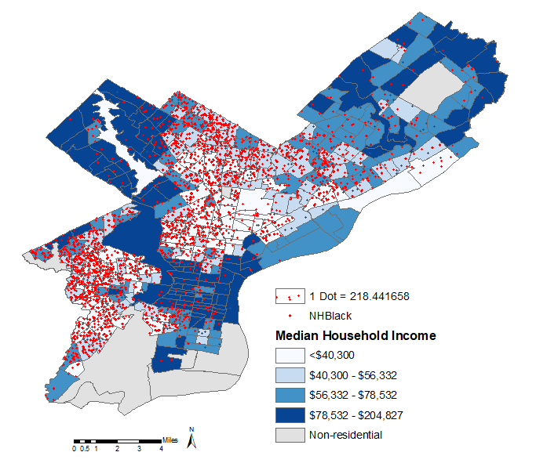
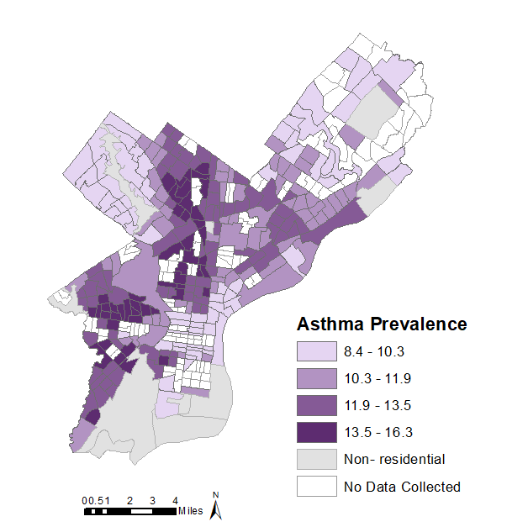
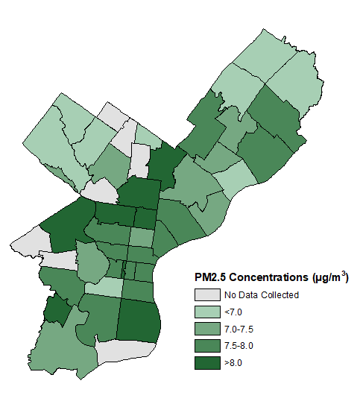
Socioeconomic Status, Air Quality, and Asthma Prevalence
To Assess Environmental Justice in Philadelphia
Paula Kwasniewska
Master of Environmental Studies, Summer 2021
Sarah Willig, PhD Maria-Antonia Andrews, MS
INTRODUCTION
RESULTS
DISCUSSION
Parts of North Philadelphia and West Philadelphia have a relatively high number of non-Hispanic Black residents and a relatively low annual median household income (Figure 1), relatively high asthma prevalence (Figure 2), and relatively high PM2.5 concentration (Figure 3)
Median household income is significantly negatively correlated with asthma prevalence (Figure 4A). The number of non-Hispanic Black residents living in a community is significantly positively correlated with asthma prevalence (Figure 4B). PM2.5 concentration is significantly positively correlated to asthma prevalence (Figure 4C)
These findings are consistent with results found in other major metropolitan areas, including specific citywide studies in New York, Baltimore, and Chicago⁸⁻¹¹
Around 25 million people in the United States suffer from asthma¹
Air quality and socioeconomic status are key risk factors for asthma
In the City of Philadelphia, studies have looked at the relationship between asthma prevalence and these risk factors²⁻⁴
This study aims to determine how community demographics, median household income, and PM2.5 concentration are related to asthma prevalence
By establishing a geospatial correlation of median household income, race, and PM2.5 concentration to asthma prevalence, policy recommendations can be put forth in order to improve social and environmental justice in the City of Philadelphia
Figure 1: Socioeconomic status of the Philadelphia area. The two socioeconomic traits shown are median household income (blue gradient) and race (dot density). Data acquired from U.S. Census( 2010). Data is shown for each Census Tract.
Figure 2: Asthma prevalence within Philadelphia city limits. The proportion of individuals that have been diagnosed with asthma are shown in this geospatial map. Data acquired from Centers for Disease Control and Prevention, 500 Cities Project.
METHODS
CONCLUSION
By studying the relationship between asthma, air quality, and socioeconomic status of individual neighborhoods within the city limits, more equitable policymaking can be established in order to optimize city funding with equity and justice as the priorities
Recommendations for improving air quality and public health include reducing PM2.5 sources, planting more vegetation to reduce PM2.5 levels, promotion of equitable health services, reduction of systemic racism, and implementation of policy-driven reform to promote equity leading to social and environmental justice
Geospatial analysis was performed using ESRI’s ArcMap Software (v10.7.1)
Correlational analyses were performed in MATLAB 2020b
City demographic and median household income data were obtained from the 2010 US Census Bureau⁵
Air quality data, as measured by PM2.5 concentration, was obtained from the 2020 Philadelphia Air Quality Survey⁶
Demographic, economic, and asthma prevalence were analyzed at the census tract geospatial level
PM2.5 concentrations were extrapolated to the zip code of the measurement site
Asthma prevalence data was collected from the CDC 500 Cities Project⁷
Regions in which no data was collected were marked accordingly in geospatial maps and were excluded from correlational analyses
Statistical significance was determined with a p-values less than 0.05
Figure 3: PM2.5 concentrations within the city of Philadelphia. Air particulate matter acquired from the Air Management Services of the Department of Public Health of the City of Philadelphia (Air Management, 2020). 12-month average PM2.5 concentrations are shown from 50 individual measurement locations. Measurements that were collected were extrapolated to the entire zip code for this geospatial map.
WORKS CITED
Akinbami, O. J. (2012). Trends in asthma prevalence, health care use, and mortality in the United States, 2001-2010 (No. 94). US Department of Health and Human Services, Centers for Disease Control and Prevention, National Center for Health Statistics.
Conway, M., (2020). Mapping Social Vulnerability to Air Pollution in Philadelphia, PA. Veritas: Villanova Research Journal. 2, 122-130.
Plaugic, M. (2019). Neighborhood air quality and health: Quantifying outdoor air pollution risk in Philadelphia.
Zerbo, R., Koerner, K., Minott, J., Li, J. C. (2018). Community Air Quality Monitoring.
U.S. Census Bureau (2010). Profile of General Population and Housing Characteristics. Decennial Census.
Air Management Services (2020). Philadelphia Air Quality Survey-Neighborhood Air Quality. City of Philadelphia Department of Public Health.
500 Cities Project. (2017). Centers for Disease Control and Prevention, Division of Population Health, National Center for Chronic Disease Prevention and Health Promotion.
Moorman, J. E., Akinbami, L. J., Bailey, C. M., Zahran, H. S., King, M. E., Johnson, C. A., & Liu, X. (2012). National surveillance of asthma: United States, 2001-2010. Vital & health statistics. Series 3, Analytical and epidemiological studies, (35), 1-58.
Maantay, J. (2007). Asthma and air pollution in the Bronx: methodological and data considerations in using GIS for environmental justice and health research. Health & place, 13(1), 32-56.
Kimes, D., Ullah, A., Levine, E., Nelson, R., Timmins, S., Weiss, S., ... & Blaisdell, C. (2004). Relationships between pediatric asthma and socioeconomic/urban variables in Baltimore, Maryland. Health & place, 10(2), 141-152.
Persky, V. W., Slezak, J., Contreras, A., Becker, L., Hernandez, E., Ramakrishnan, V., & Piorkowski, J. (1998). Relationships of race and socioeconomic status with prevalence, severity, and symptoms of asthma in Chicago school children. Annals of Allergy, Asthma & Immunology, 81(3), 266-271.
Figure 4: Linear regression analysis of socioeconomic factors and PM2.5 concentrations with asthma prevalence. Census tract-level geospatial linear regressions between asthma prevalence and (A) Median Household Income and (B) Number of non-Hispanic Black residents. (C) Linear regression between PM2.5 concentration and asthma prevalence at a zip code geospatial level. Pearson correlation coefficient and associated p-values are displayed for each regression analysis.

