Slide 1

The Ongoing Assessment Project (OGAP) Impact Findings Implementation Puzzles & Next steps
Jonathan Supovitz
Caroline Ebby
Janine Remillard
Consortium for policy research in education
University of Pennsylvania
This presentation is based on work supported by the National Science Foundation under Grant No. DRK-12 1316527.

Slide 2
The OGAP study is an NSF-funded two-year RCT and implementation study of a mathematics formative assessment initiative in two Philadelphia-area school districts
Study Overview

Slide 3
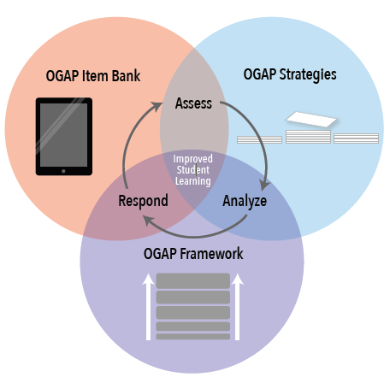
What is OGAP?
A formative assessment system
Supplements existing curriculum
Ongoing professional development
Multiplication and fractions
4 days of PD on how students learn math and how to analyze student work to guide instruction
Ongoing support through PLC meetings facilitated by trained teacher leaders

Slide 4
Underlying Theory of OGAP: Formative Assessment and Learning Progressions
Assessment
Learner
Goal
Learning Progression
Teacher

Slide 5
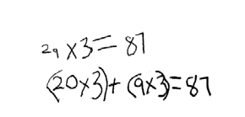
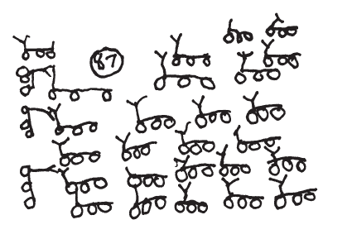
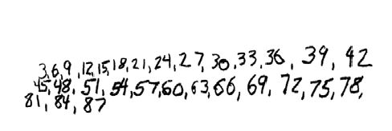
OGAP: Analysis of Student Work
One tricycle has three wheels. How many wheels do 29 tricycles have?
Multiplicative
Sam’s Response
Samir’s Response
Transitional
Additive
Ava’s Response
Non- Multiplicative

Slide 6
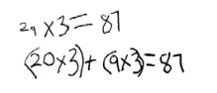

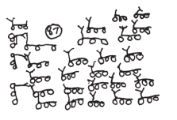
OGAP: Classification of Student Work
Samir’s Response
Multiplicative Strategies
Ava’s Response
Transitional Strategies
Sam’s Response
Additive Strategies
Non-Multiplicative Strategies

Slide 7
Study of OGAP in Philadelphia Area
 | Treatment (n=30) | Control (n=30)
School District of Philadelphia Schools | 18 | 19
Philadelphia Charter Schools | 7 | 6
Upper Darby Schools | 5 | 5
Teachers in grades 3-5 | 314 | 286
Students in grades 3-5 | ~7,000 | ~7,000

Slide 8
Implementation and Impact Study: Data
Implementation Data
Teacher Log
Teacher Survey
Qualitative data from fieldwork in schools
State test data
Teacher Outcome Data
CPRE’s Teacher Analysis of Student Knowledge (TASK)
Mathematical Knowledge for Teaching (Ball & Hill)
Set of Scales (trust, comfort with technology, formative assessment practice, etc.)
Student Outcome Data
Project-developed assessment scores
State Test Data

Slide 9
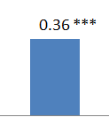
Impacts on Teachers
Measure of Teacher Analysis of Student Thinking (TASK)
Authentic assessment of teacher ability to analyze student work, assess their developmental levels, and plan responsive instruction
Seven-item open-ended assessment, each item on a 4 point scale
~ 600 teachers
Difference between treatment and control teachers on TASK’s four point scale.
*** p < .001

Slide 10
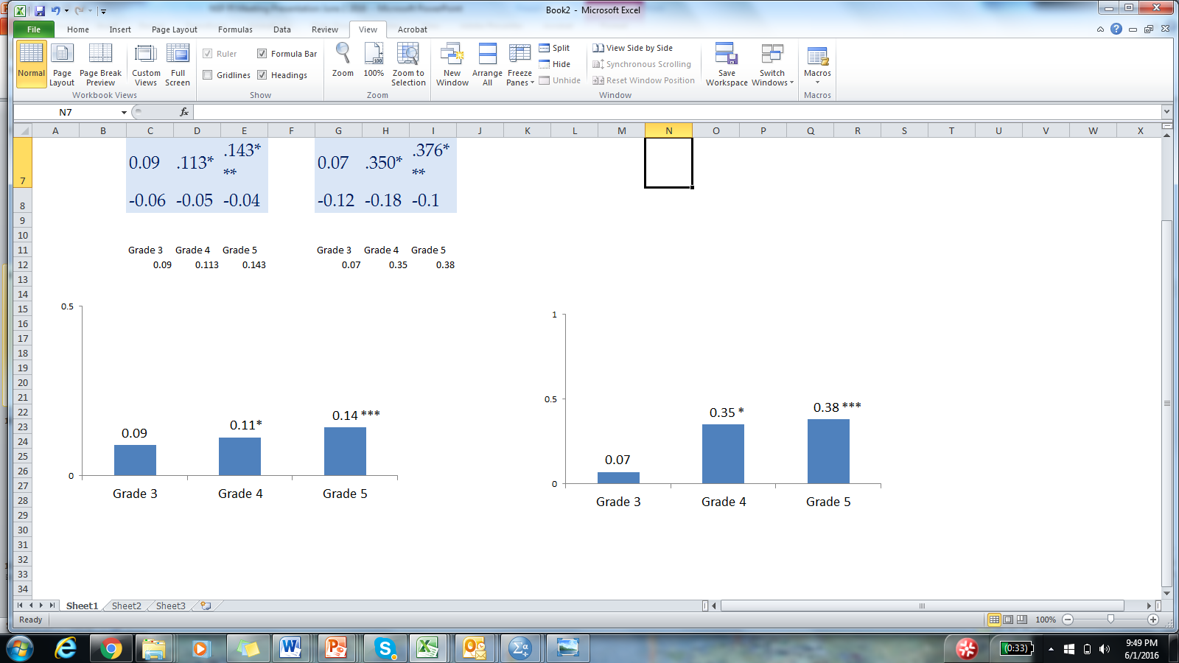
Impact on Students
OGAP Aligned Assessment
Vertically scaled 7 item open-ended assessment on multiplicative reasoning developed & piloted by CPRE
Scored for both correctness and sophistication
Pre-test: Fall, 2014, Post-test, Spring 2015
~14,000 assessments scored by trained raters in Summer, 2015
Correctness (2 point scale) Sophistication (5 point scale)
*** p < .001 * p < .05

Slide 11
Posttest Score Distribution: 4th Grade
Correctness
Percent of Students
Score Range

Slide 12
Posttest Score Distribution: 4th Grade
Solution Sophistication
Percent of Students
Non- Multiplicative
Early Additive
Additive
Early Transitional
Transitional (Models)
Multiplicative

Slide 13
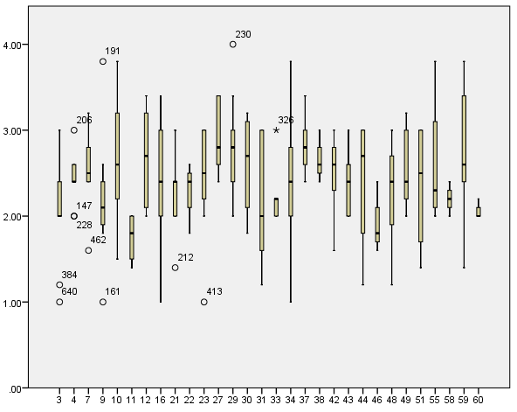
Variation in Implementation
Implementation correlated with:
Regular PLCs Principal support
Teacher Leader support
Interactions with Peers around math
5 item OGAP Implementation Scale
School
μ = 2.4 s.d. = .60

Slide 14
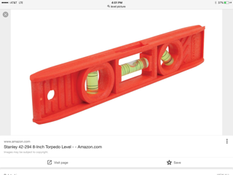
What we are learning about deepening implementation: Operating at Two Levels Simultaneously
Organizational Shifts
Regular PLC meetings
Math Leaders
Principal Support & Press
Conceptual Shifts
Seeing data as insight into student thinking rather than performance levels.
Shift from an achievement to a learning perspective.

Slide 15
Summary
We see impacts on: a. Teacher knowledge of formative assessment practices b. Student outcomes on OGAP-aligned assessment
There is tremendous variation in school-level implementation
Next Steps
Lots of additional analyses to do.
OGAP is moving this summer from an external program to district-sponsored implementation in 40 schools.
We are embarking on a research-practice partnership with the district to strengthen leadership support to deepen implementation.

Slide 16
The Ongoing Assessment Project (OGAP) Impact Findings Implementation Puzzles & Next steps
Jonathan Supovitz
Caroline Ebby
Janine Remillard
Consortium for policy research in education
University of Pennsylvania
June 2, 2016
This presentation is based on work supported by the National Science Foundation under Grant No. DRK-12 1316527.

