Slide 1

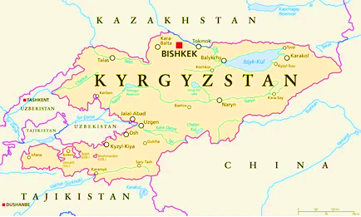
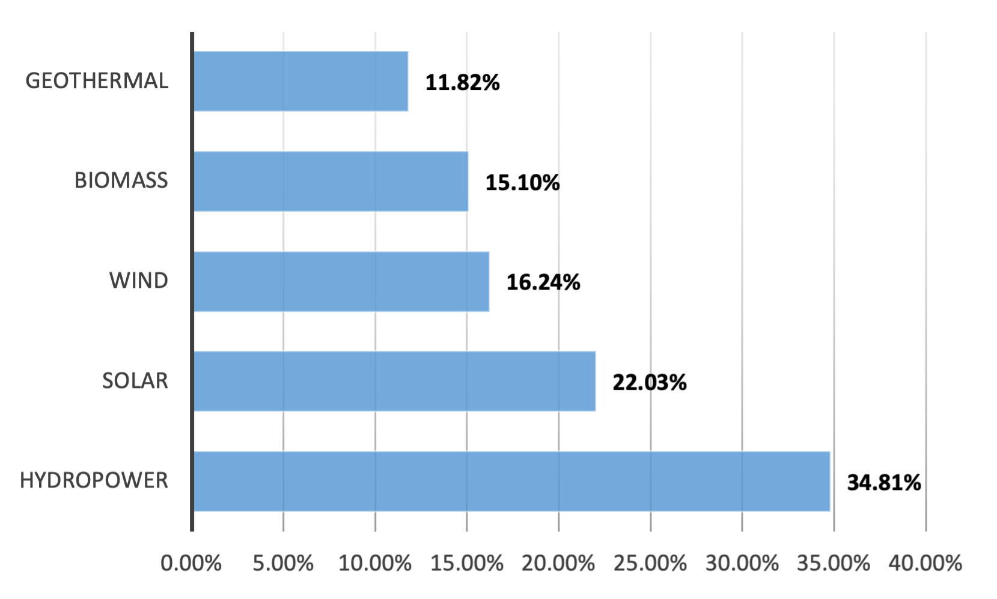
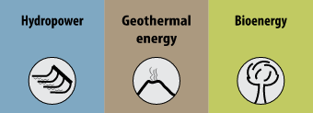
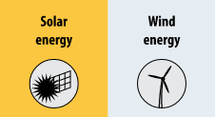
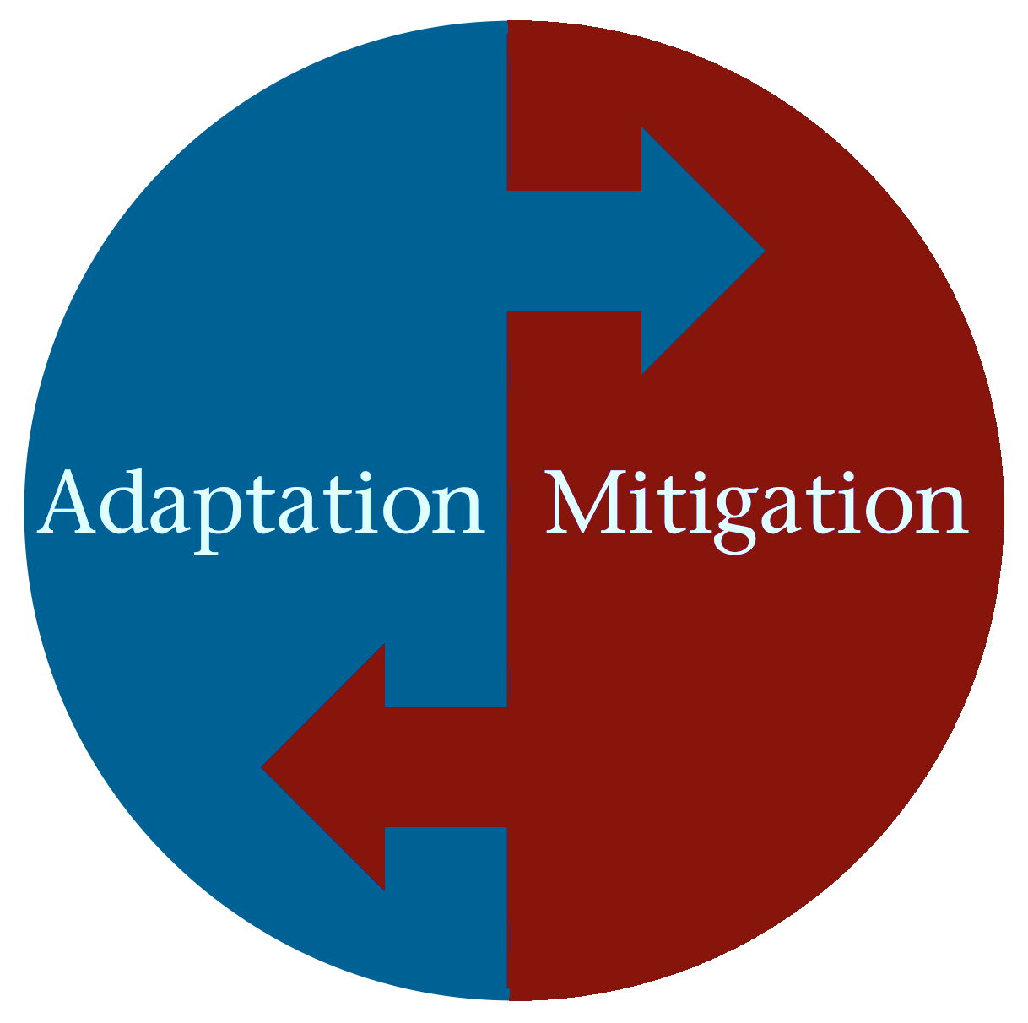
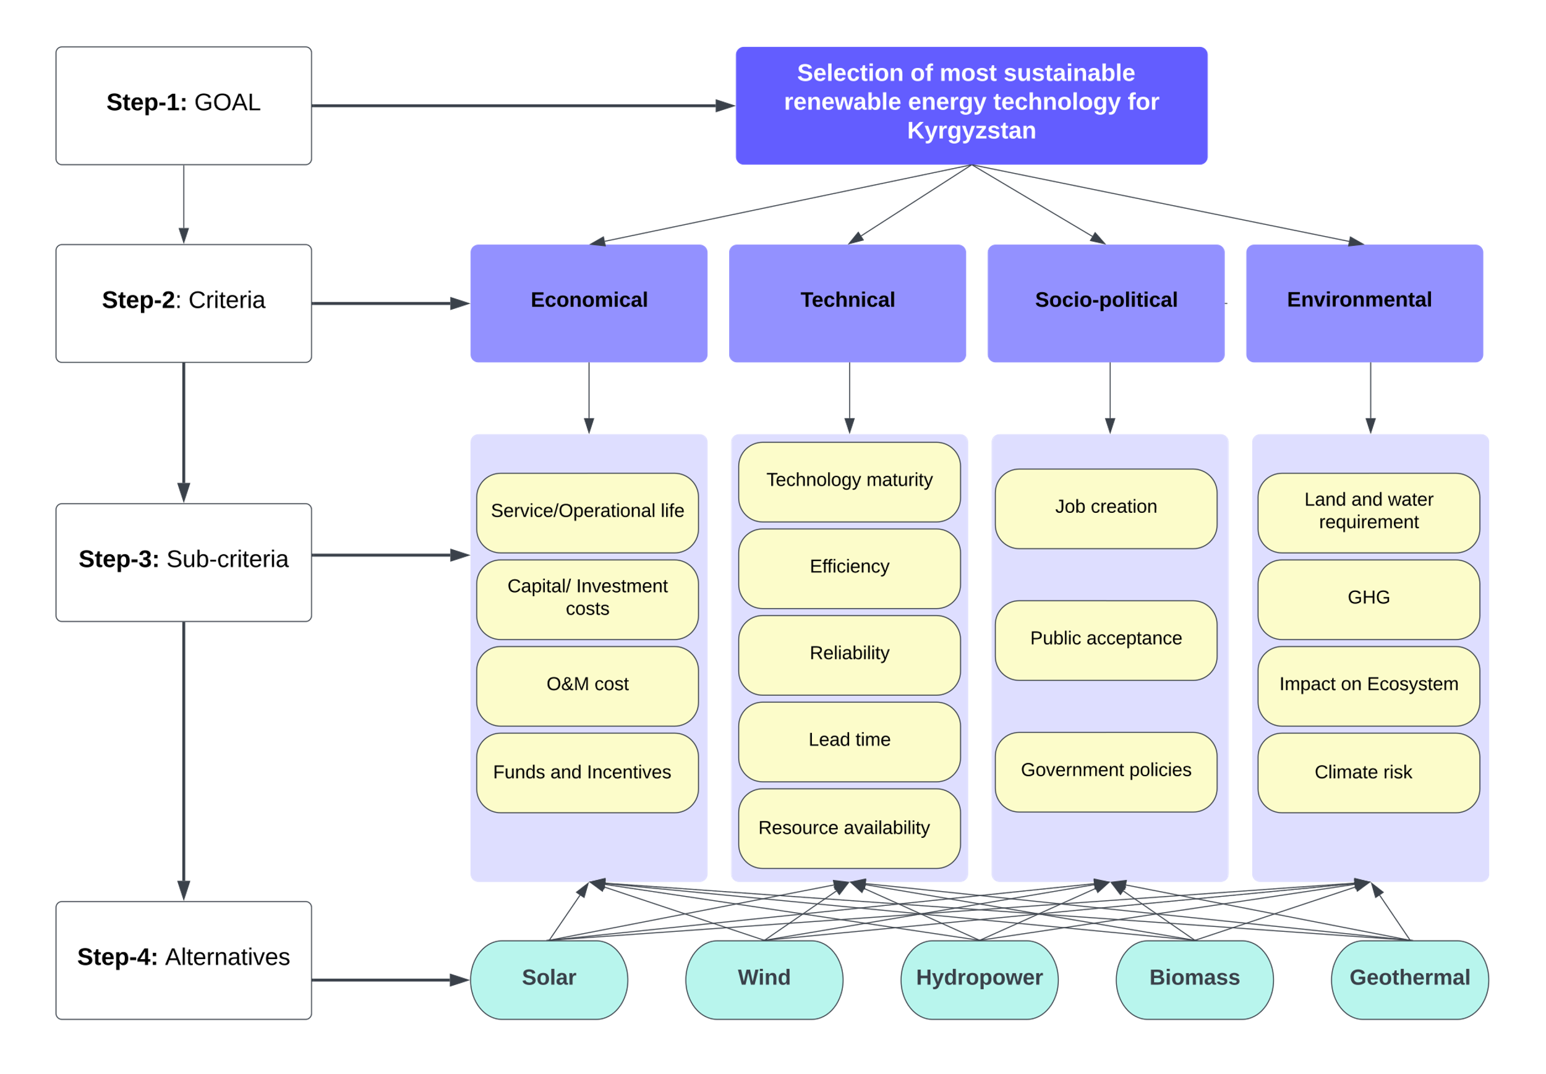
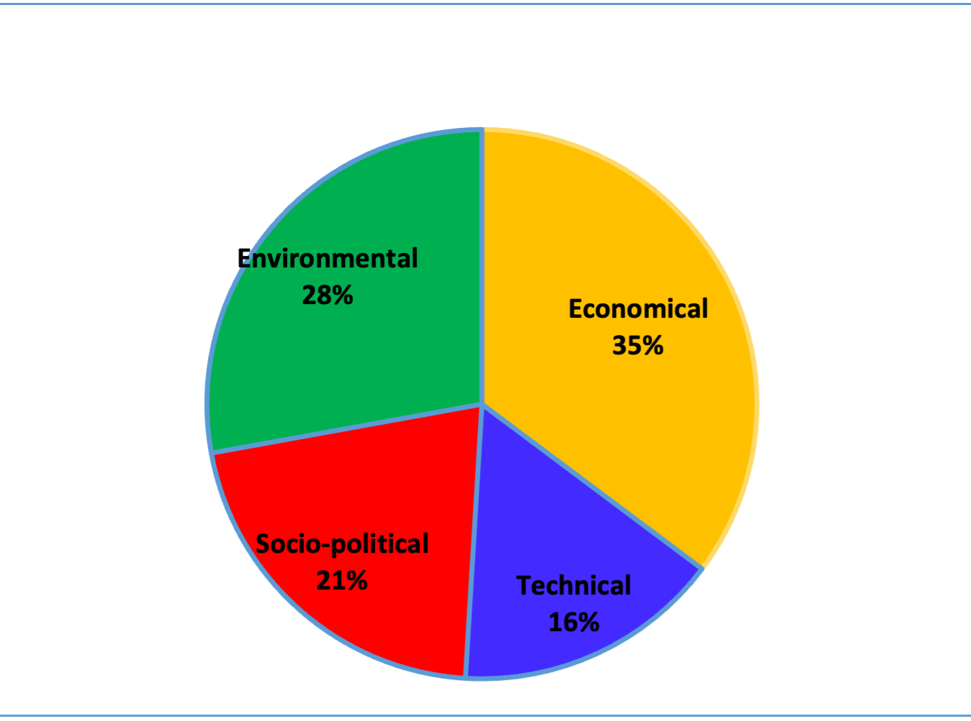
THE SUSTAINABILITY ASSESSMENT OF RENEWABLE ENERGY TECHNOLOGIES IN KYRGYZSTAN WITH THE MCDM MODEL.
By: Yrysbu Zhumashova, MES candidate 2023
Primary Reader: James Hagan, Ph.D., Penn Earth & Environmental Science
Secondary Reader: Steven O. Kimbrough, Ph.D., Professor of Operations, Information, and Decisions.
University of Pennsylvania, Earth, and Environmental Studies Department
INTRODUCTION
DISCUSSION
Kyrgyzstan is rich in enormous alternative energy resources like hydro, solar, wind, and biomass. The total installed capacity is 3,713 MW, with hydropower dominating electricity generation. Domestic energy production covers 45% of the country's needs; the remaining imported 55% are fossil fuels, consisting of about 59% of coal and 98% of gas. However, the country’s renewable energy balance is currently less than 1%.
Possessing no fossil fuels of significance, Kyrgyzstan relies heavily on imports and depends profoundly on hydropower for electricity generation. Moreover, the country is one of the most vulnerable to climate change in Central Asia due to low-income economic dependency and outdated, low-efficiency energy systems. Consequently, there is a significant need for a systematic diagnosis of renewable energy sources to identify the most sustainable, reliable, and socially affordable options that can be deployed on a massive scale that will serve the country in the long run.
Therefore, this paper will identify the most sustainable renewable energy technology for Kyrgyzstan for the long term by employing the Multi-criteria decision-making (MCDM) model using the AHP (analytic hierarchy process) approach. The study will answer the following questions:
  Which renewable energy technologies are more sustainable for Kyrgyzstan in the long run?
  What should key sustainability indicators be considered in deploying RET solutions?
Development of AHP method for Kyrgyzstan:
1st STEP: Structure a problem as a hierarchy with the goal of the model at the top, the second level with the main criteria, the third level with sub-criteria, and the fourth level alternatives.
2nd STEP: Elicit and represent judgments based on the results derived from weights performed by experts through pairwise comparison.
3rd STEP: Aggregate and synthesize the evaluations across the various levels of the hierarchy.
4th STEP: Analyze sensitivity to changes in judgments and rank the alternatives.
Five primary resources: hydropower, solar, wind, biomass, and geothermal energy options, are considered. The AHP method considers economic, technological, environmental, and socio-political pillars and determines the weights of criteria based on the survey results collected from experts. The pairwise comparisons were conducted for each level, and the geometric mean was derived. The priority weight is calculated, which reveals that the economic aspect is the most critical criterion, with a weight of 0.35, followed by the environmental aspect at 0.28. Socio-political aspects rank third with a weight of 0.2, while the technical aspect is considered the least important at 0.16. The priority weight for each of the 16 sub-criteria was calculated, which found that land and water management as the most important and GHG emissions as the least important criterion. Sensitivity analysis was performed using different weights for criteria in the multi-criteria method.
DATA RESULTS
METHODOLOGY
CONCLUSION
The model identifies hydro as the most sustainable option, followed by solar, with wind and biomass ranking third and fourth, respectively, and geothermal being the least favorable alternative. Consequently, it is recommended that the Kyrgyz government should prioritize the development of hydro, solar, wind, and biomass technologies while geothermal energy development can be postponed. A Sensitivity Analysis confirmed the research results by ranking hydropower highest, solar second, wind third, biomass fourth, and geothermal last. Although hydropower is identified as the most sustainable option, the government should pursue energy diversification by combining various technologies and sources. By doing so, the country can pave the way for the sustainable utilization of biomass in preparation for future challenges related to increased biomass volume arising from population growth and economic expansion. Additionally, for the first time, this paper introduces the AHP model in the context of Kyrgyzstan, and conducted evaluations can offer guidance to policymakers in formulating and developing long-term energy strategies.
REFERENCES
Amer, M., & Daim, T. U. (2011). Selection of renewable energy technologies for a developing county: a case of Pakistan. Energy for sustainable development, 15(4), 420-435.
Evans, A., Strezov, V., & Evans, T. J. (2009). Assessment of sustainability indicators for renewable energy technologies. Renewable and sustainable energy reviews, 13(5), 1082-1088.
Mainali, B., & Silveira, S. (2015). Using a sustainability index to assess energy technologies for rural electrification. Renewable and Sustainable Energy Reviews, 41, 1351-1365.

