Slide 1


Slide 2
About the Baker Institute
Rice University’s Baker Institute (the James A. Baker III Institute for Public Policy) is a nonprofit, nonpartisan think tank in Houston, Texas. The institute produces independent research on domestic and foreign policy issues with a focus on providing decision-makers in the public and private sectors with relevant and timely policy assessments and recommendations.
By bringing statesmen, scholars and students together, the institute broadens the content and reach of its policy assessments and recommendations, and provides an open forum for debate and discussion.
The institute educates students on public policy issues and related subjects by offering courses at Rice University and sponsoring student intern and mentoring programs at home and abroad.

Slide 3
Advisory Board
E. William Barnett
Chair, Board of Advisors, James A. Baker III Institute for Public Policy
Retired Chair, Rice University Board of Trustees
Retired Managing Partner, Baker Botts L.L.P.
J.D. Bucky Allshouse
Attorney, J.D. Bucky Allshouse, P.C.
His Excellency Sheikh Abdulla bin Ali Al-Thani, Ph.D.
Vice President of Education, Qatar Foundation
President, Hamad Bin Khalifa University
Chairman, World Innovation Summit for Education
The Honorable Hushang Ansary
Chairman, Parman Capital Group
James A. Baker IV
Partner, Baker Botts L.L.P.
Clarence P. Cazalot Jr.
Chairman, President and CEO, Marathon Oil Corporation
James W. Crownover
Former Director, McKinsey & Company
Retired Chair, Rice University Board of Trustees
The Honorable Linnet Deily
Director, Chevron Corporation and Honeywell International
Former U.S. Ambassador to the World Trade Organization
The Honorable Charles W. Duncan Jr.
Chairman, Duncan Interests
Former U.S. Secretary of Energy
Claudio X. Gonzalez
Chairman and CEO, Kimberly-Clark de México
Gerald D. Hines
Founder and Chairman, Hines
Joseph D. Jamail
Founder, Jamail & Kolius
Steven L. Miller
Chairman and President, SLM Discovery Ventures, Inc.
Former President, Chairman and CEO, Shell Oil Company
Harry M. Reasoner
Partner, Vinson & Elkins LLP
Former Managing Partner, Vinson & Elkins LLP
Wilhelmina E. "Beth" Robertson
President, Cockspur, Inc.
President, Westview Development, Inc.
The Honorable John F.W. Rogers
Executive Vice President, Chief of Staff and Secretary to the Board of Advisors, Goldman Sachs & Company
Former U.S. Under Secretary of State for Management
Former U.S. Assistant Secretary of the Treasury
Marc J. Shapiro
Non-Executive Chairman, Chase Bank of Texas
Former Vice Chairman, JP Morgan Chase & Co.
L.E. Simmons
Founder and President, SCF Partners
Jeffery A. Smisek
President and CEO, United Continental Holdings, Inc.
The Honorable Warren W. Tichenor
U.S. Ambassador to the United Nations in Geneva
President, W. W. Tichenor & Co., Inc.
Bobby Tudor
Chairman and CEO, Tudor, Pickering, Holt & Co.
Sandy Weill
Former Chairman and CEO, Citigroup
John Eddie Williams Jr.
Founder and Managing Partner, Williams Kherkher
Wallace S. Wilson
Retired Chairman, Wilson Industries
Ex Officio Members
The Honorable Madeleine Korbel Albright
64th U.S. Secretary of State
Chair, Albright Stonebridge Group
The Honorable James A. Baker, III
61st U.S. Secretary of State
Honorary Chair, Baker Institute
The Honorable Edward P. Djerejian
Founding Director, Baker Institute
Former U.S. Ambassador to Syria and to Israel
David W. Leebron
President, Rice University
Gen. Colin L. Powell, USA (ret.)
65th U.S. Secretary of State
Former Chairman, Joint Chiefs of Staff

Slide 4
Senior Leadership
The Honorable James A. Baker, III
  Honorary Chair
  The Honorable Edward P. Djerejian
    Founding Director
Allen Matusow, Ph.D.
  Director of Academic Affairs
Vince McElligott
  Executive Director of Development
Ryan Kirksey
  Director of Operations and Finance
To be named
  Director of Strategic Communications

Slide 5
Research Centers
Center for Energy Studies
  Electricity Policy
  Energy and Cybersecurity
  Energy and Environment and Regulatory Policy
  Global Oil
  Natural Gas
Center for the Middle East
  Israeli-Palestinian Negotiations
  Syria
  Women and Human Rights in the Middle East
  States in Transition (Arab Awakening)
Mexico Center

Slide 6
Research Programs
Drug Policy
Health Policy Forum
  Health Economics Program
  Disease and Poverty
  Health and Technology Policy
Information Technology Policy
International Economics
Latin America Initiative
  Americas Project
  Vecinos Lecture Series
Politics and Elections
Religion and Public Policy
Science and Technology Policy
  Civic Scientist Program
  International Stem Cell Policy Program
  Medicine, Research & Society Public Policy Issues Series
Space Policy
Tax and Expenditure Policy
China Studies

Slide 7
Student Programs
Baker Institute Student Forum
Baker Institute program and administrative internships
French Institute of International Relations (IFRI)
Institute for International Political Studies (ISPI)
Jesse Jones Leadership Center Summer in D.C. Policy Research Internship Program
Moscow Summer Intern Program
Public Diplomacy and Global Policymaking in the 21st Century
Baker Institute undergraduate introduction to public policy course
Undergraduate classes taught by Baker Institute fellows and scholars

Slide 8
New Initiatives
Mexico Center for binational public policy research, programs and events
Proposed Center for Public Finance
Proposed Center for Health Policy
Proposed joint Rice University and Baker Institute Master’s of Global Affairs graduate level program

Slide 9
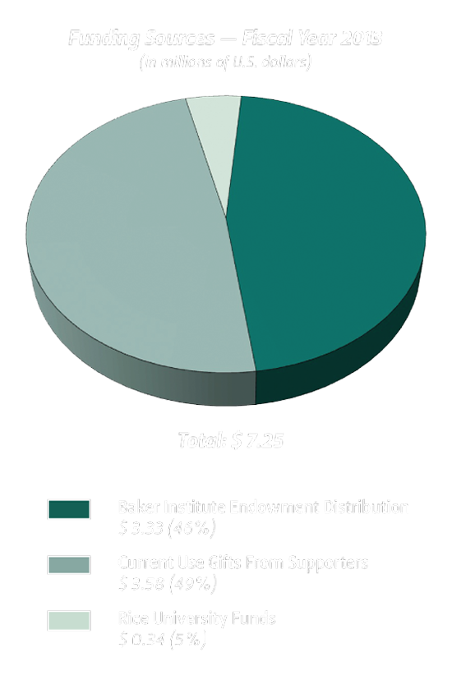
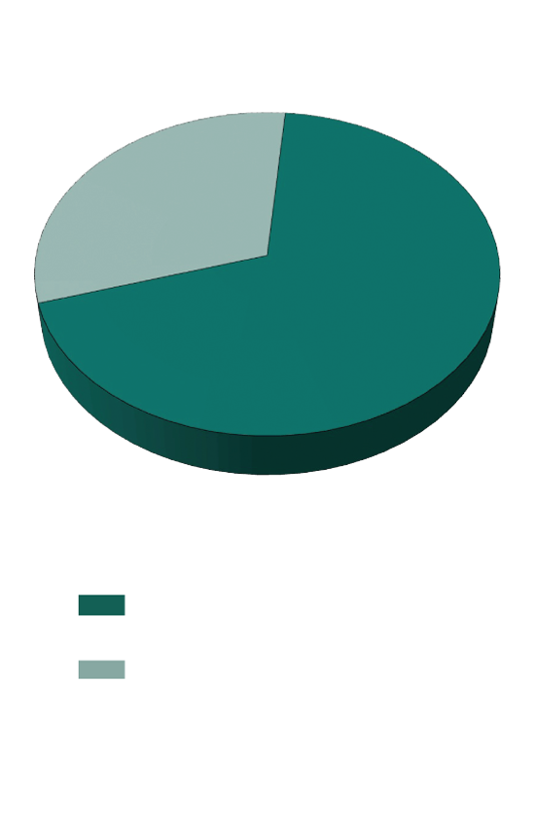
Funding

Slide 10
Baker Institute at a Glance
20 research programs
23 Rice faculty scholars
40 fellows and policy researchers
73 student interns
87 classes taught
136 publications
146 blog posts
196 countries reached on the web
7,398 media citations

Slide 11
Join the conversation online for the latest news, research, policy reports, events and opinions from
Rice University’s Baker Institute
www.bakerinstitute.org
www.bakerinstitute.org/research
www.bakerinstitute.org/events/search
www.chron.com/bakerblog
www.bakerinstitute.org/e-newsletter
www.facebook.com/bakerinstitute
www.twitter.com/bakerinstitute
To support the institute, please contact Vince McElligott, executive director of development, at vmcelligott@rice.edu.
Direct all media inquiries to Jeff Falk, associate director of national media relations, at 713.348.6775 or jfalk@rice.edu or to David Ruth, director of national media relations at 713.348.6327or druth@rice.edu.

