Slide 1

implementing ogap mathematics in the school district of Philadelphia, an emerging partnership
Jonathan Supovitz
Consortium for policy research in education
University of Pennsylvania
March 3, 2016
This presentation is based on work supported by the National Science Foundation under Grant No. DRK-12 1316527.

Slide 2
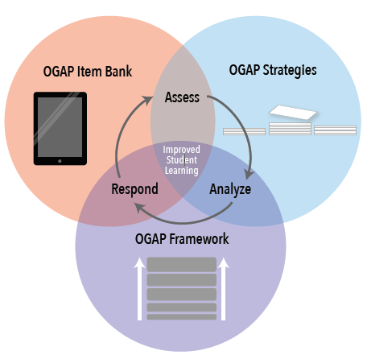
What is OGAP?
A formative assessment system
  Supplements existing curriculum
Ongoing professional
development & Support
  Summer PD
  Trained Teacher Leaders
  Regular PLCs

Slide 3
Formative Assessment Cycle
Assessment
Learner
Goal
Learning Progression
Teacher

Slide 4
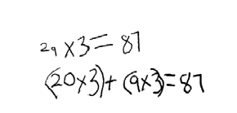
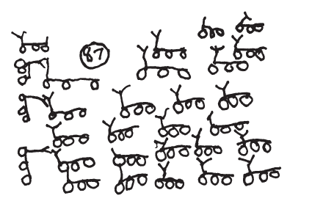
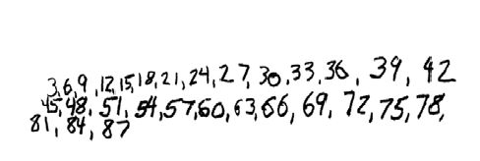
OGAP: Analysis of Student Work
One tricycle has three wheels. How many wheels do 29 tricycles have?
Multiplicative
Sam’s Response
Samir’s Response
Transitional
Additive
Ava’s Response
Non-
Multiplicative

Slide 5
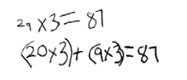

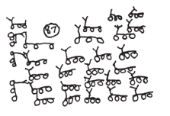
OGAP: Classification of Student Work
Samir’s Response
Multiplicative
Strategies
Ava’s Response
Transitional Strategies
Sam’s Response
Additive Strategies
Non-Multiplicative
Strategies

Slide 6
Completing an NSF Funded two-year RCT and implementation study of a mathematics formative assessment initiative in two Philadelphia-area districts.
60 schools
600 teachers
14,000 students

Slide 7
Summary of First Year Results
Impacts on:
Teacher knowledge of formative assessment practices
Student outcomes on OGAP-aligned assessment
But:
Variable teacher and school implementation
Light effects on students

Slide 8
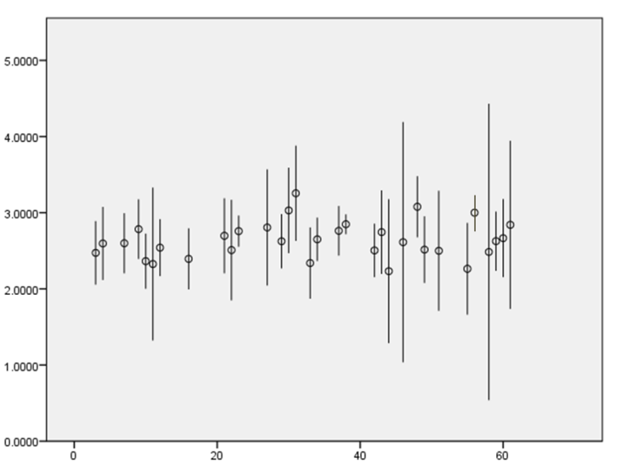
School Variation of TASK Performance
TASK SCORE
School

Slide 9
Posttest Score Distribution: 4th Grade
Multiplication Solution Sophistication
Percent of Students
Non-
Multiplicative
Early
Additive
Additive
Early
Transitional
Transitional
(Models)
Multiplicative

Slide 10
Phase II
How to deepen implementation?
Bring program inside the district
Integrate
Align

Slide 11
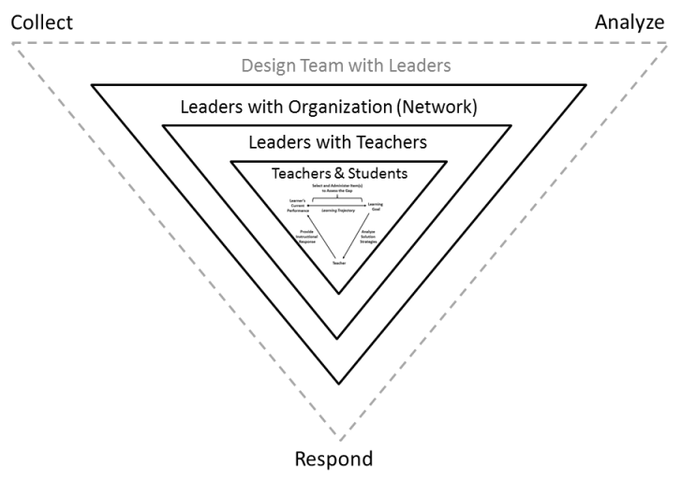
Phase II

Slide 12
Implementation Development Curve
Degree of Design Adjustments
Young
Mature
Intervention Development

Slide 13
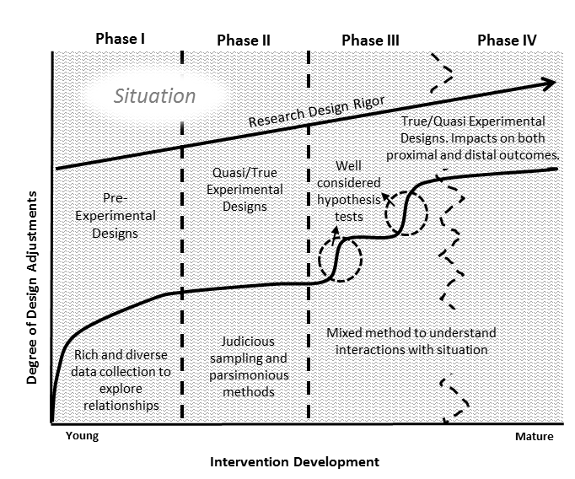

Slide 14
implementing ogap mathematics in the school district of Philadelphia, an emerging partnership
Jonathan Supovitz
Consortium for policy research in education
University of Pennsylvania
This presentation is based on work supported by the National Science Foundation under Grant No. DRK-12 1316527.

