Slide 1
Microfluidics for Biological Applications
Eric Johnston

Slide 2
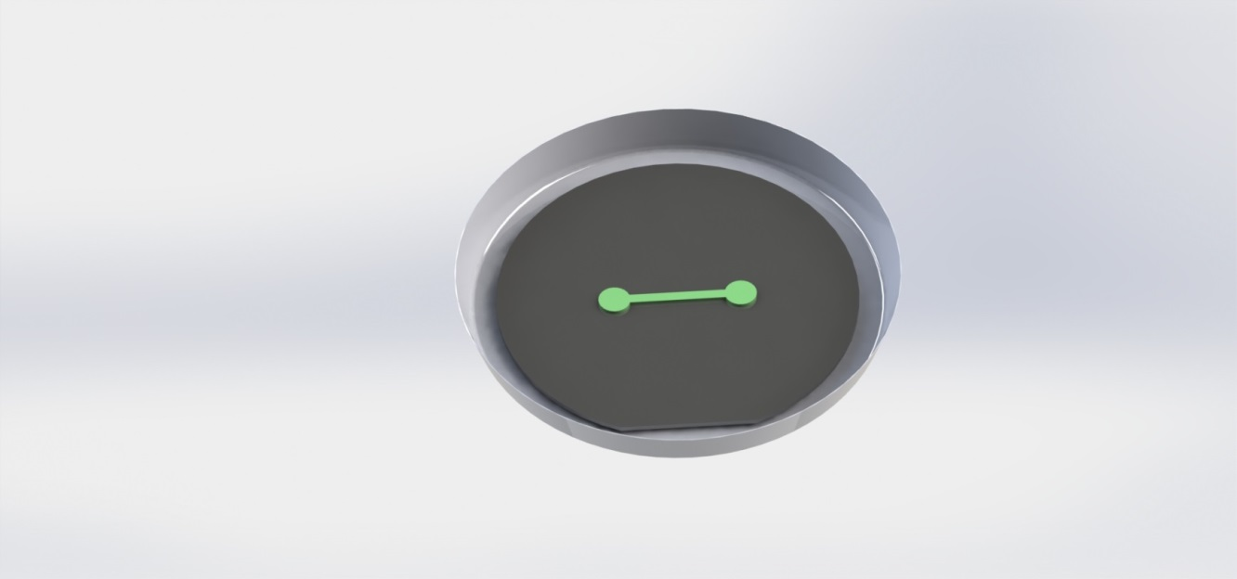
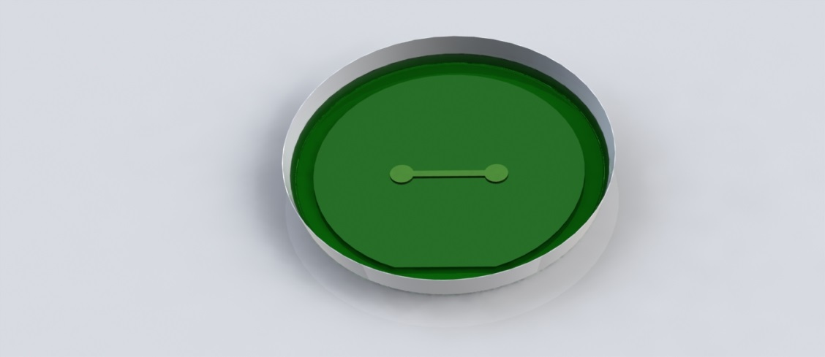
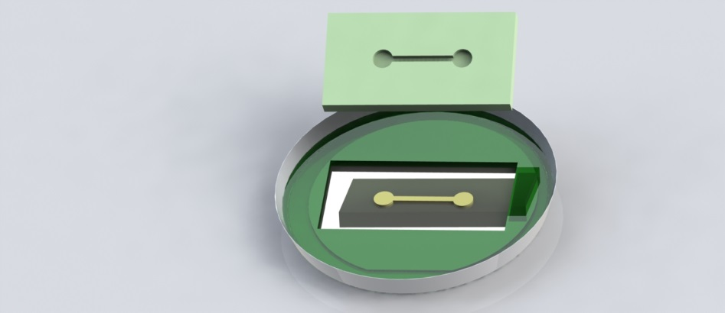
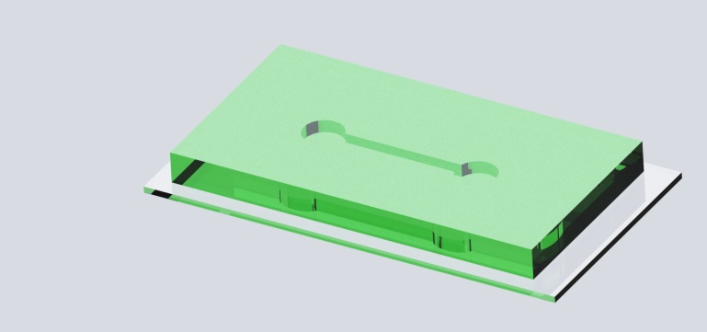
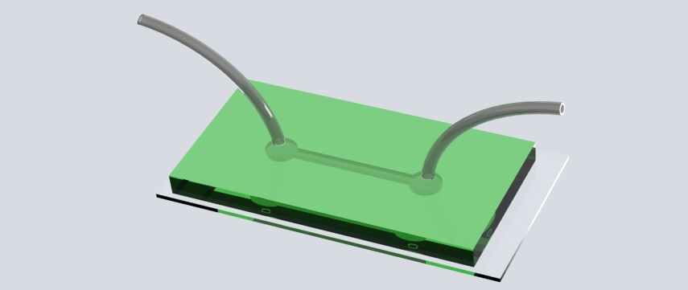
What is Microfluidics?

Slide 3
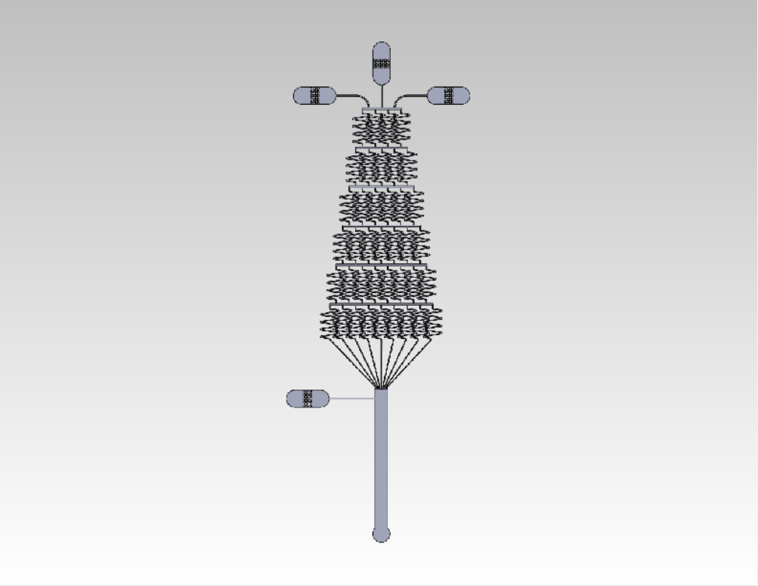
A Gradient Generator
Device designed at Penn (Ref 1)

Slide 4
Chemical Gradients: Why do we Care?
Concentration
x
Notes:
Cells will chemotax in response to a gradient
Cells have receptors to some chemicals in their microenvironment
Can detect concentration differences across the cell body
Here’s an excellent example of a cell chemotaxing in response to a gradient

Slide 5
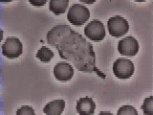
Chemical Gradients
David Rogers, Vanderbilt University
Notes:
You may have seen this. This is a neutrophil pursuing a bacterium. It was recorded in 1956 by Dave Rogers at Vanderbilt University with a 16mm camera.
chemoattractant called fMLP - neutrophils have receptors for.
neutrophils can sense 1-2% change across the cell body
phagocytose
neutrophils respond to the location of bacteria as a point source and chemotax in the direction of a gradient
Complex environment – cannot answer questions

Slide 6
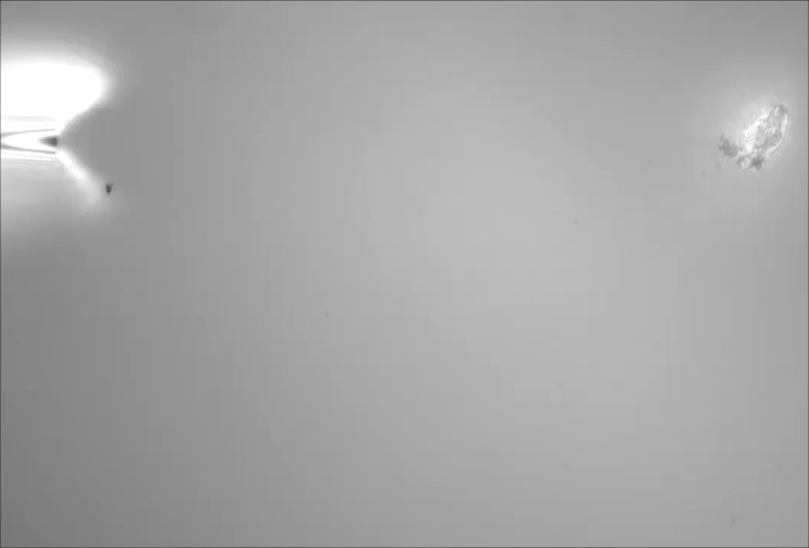
Point Source Gradient
Smith (Ref 3)
Notes:
Point source of fMLP in a more controlled environment.
Human neutrophil viewed under reflectance interference microscopy - Intimate contact with coverslip - Focal adhesions
This was experiment was designed to image the process of cell turning, so the gradient was not important.

Slide 7
Stable, Time-Invariant, Linear Gradient
Concentration
x
Notes:
How do we get this as a stable gradient?
We’re going to do it with microfluidics.

Slide 8
Gradient Generator
Device designed at Penn (Ref 1)
Notes:
I want to look at one category of soft lithography device, and at one specific device among those. But first I want to give you the motivation for why you would use a gradient generator.

Slide 9
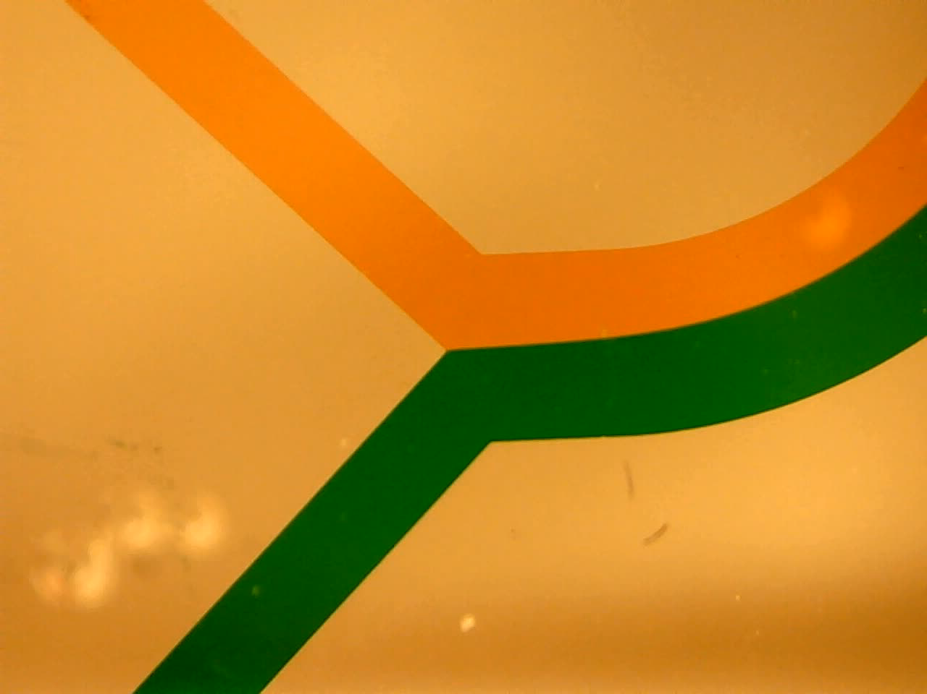
Simple Flow – An Example

Slide 10
Gradient Generator

Slide 11
Stable gradient
G. Whitesides, et al
Notes:
Concentration gradient, variation of concentration laterally
Cell migration, motility
Chemotaxis, chemoattractants, chemical cues, tripeptide fMet-Leu-PhefMLP – neutrophils can sense 1-2% change across cell body
Dunn chamber
Micropatterned gradients (stamped spatial gradient)
Dozens of gradient devices
Concentration gradients are fundamental to signaling in a vast array of processes, such as inflammation, migration, differentiation and development.
For non-achorage dependent cells, no-flow

Slide 12
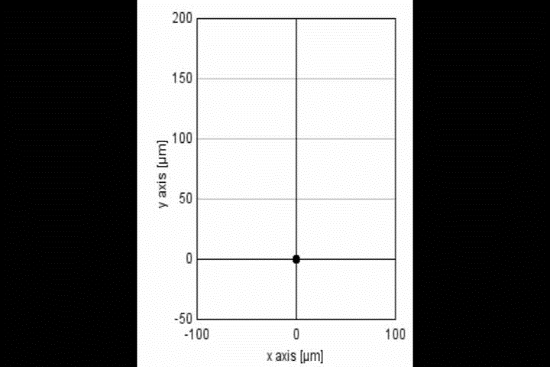
Response to Gradient (Dendritic Cells)
Ricart, Hammer Group
Dept of Bioengineering, University of Pennsylvania

Slide 13


Mixing in Microfluidics
G. Whitesides et al.

Slide 14
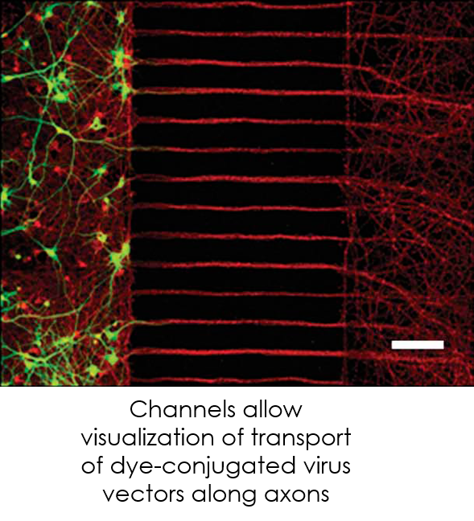
Protein Visualization
Holzbaur Lab, University of Pennsylvania

Slide 15
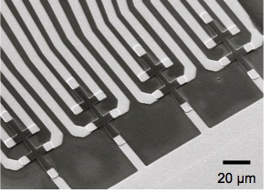
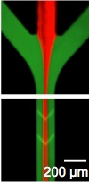
Cell Counting

Slide 16
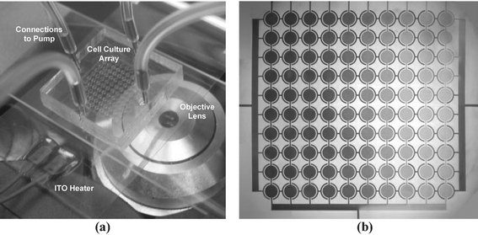
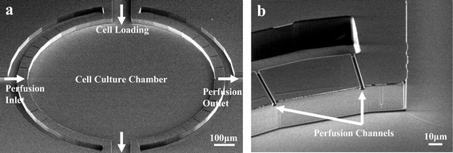
Semi-Automated Cell Culture
DOI: 10.1039/B410743H (Paper) Lab Chip , 2005, 5, 44-48
Paul J. Hung†, Philip J. Lee†, Poorya Sabounchi, Nima Aghdam, Robert Lin and Luke P. Lee

Slide 17
Cell Positioning
Frimat et al., Lab Chip 11, 231–237 (2011). Copyright 2011 by The Royal Society of Chemistry.

Slide 18
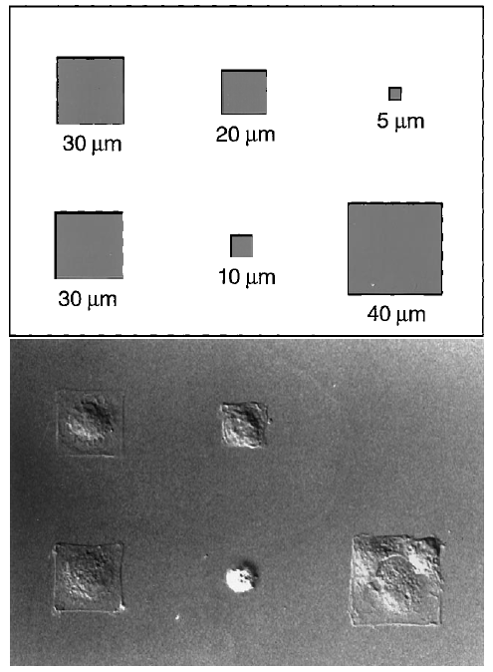
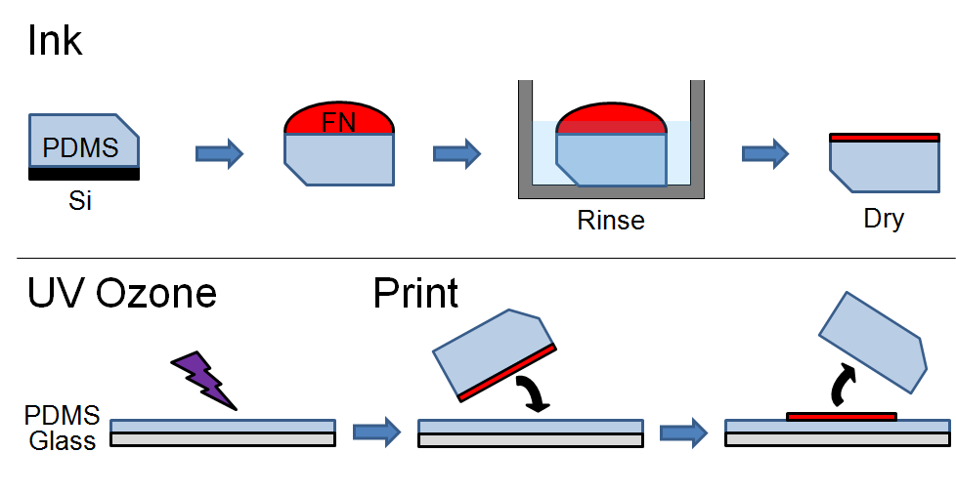
Cell Counting
Schematic by S. Henry
Chen et al (1997) Science, 276:1425
DOI: 10.1126/science.276.5317.1425

Slide 19
We will cover:
Designing a mask (I can help with this)
Making a master
  Surface preparation of wafer
  Photoresist
  Exposing of photoresist through mask
  Post exposure bake
PDMS Device
  Casting
  Punching holes
  PDMS Bonding
  Filling

Slide 20
Designing a Mask
Designing a mask (I can help with this)
Making a master
  Surface preparation of wafer
  Photoresist
  Exposing of photoresist through mask
  Post exposure bake
PDMS Device
  Casting
  Punching holes
  PDMS Bonding
  Filling

Slide 21
Designing a Mask
Free software:
    Layout Editor (we have monthly training)
    DraftSight
Shapes to be closed polygons.
Chrome masks with Heidelberg
    $200 flat rate ($300 commercial) from our mask shop
Polymask vendors (20um+):
  outputcity.com
  fineline-imaging.com

Slide 22
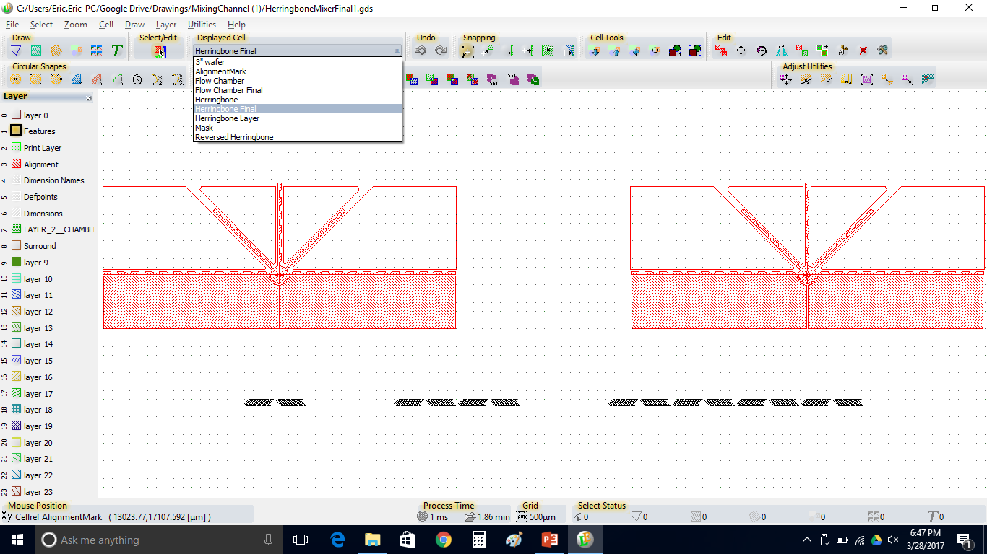
Layout Editor

Slide 23
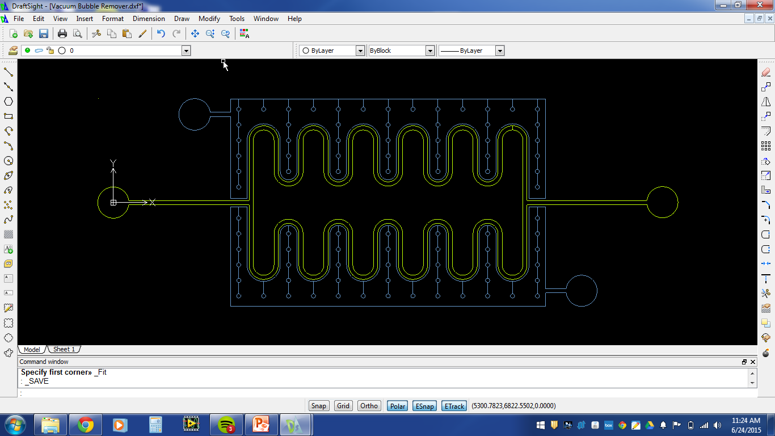
DraftSight

Slide 24
Making a Master
Designing a mask (I can help with this)
Making a master
  Surface preparation of wafer
  Photoresist
  Exposing of photoresist through mask
  Post exposure bake
PDMS Device
  Casting
  Punch holes
  PDMS Bonding
  Filling

Slide 25
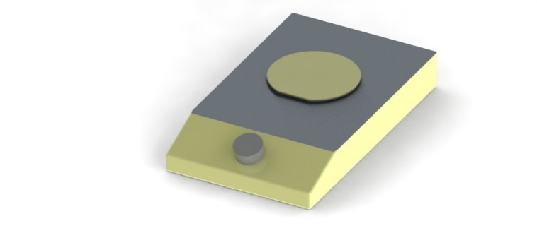
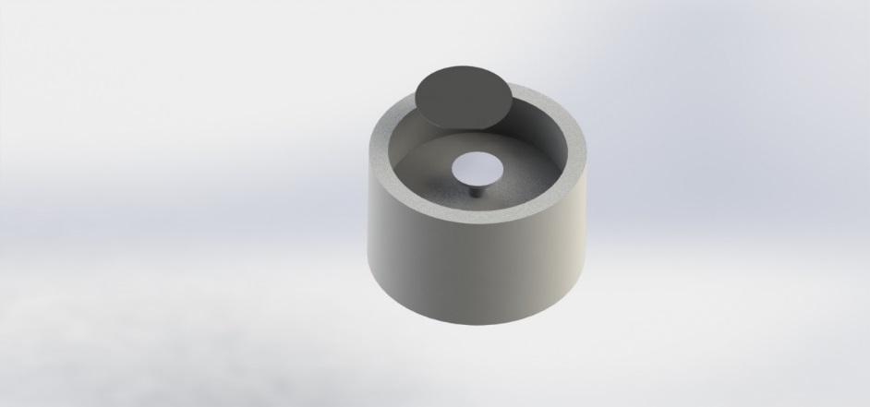
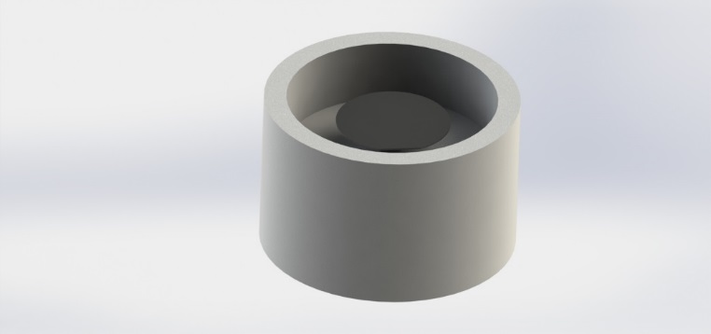
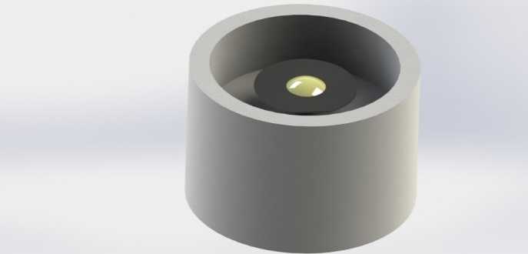
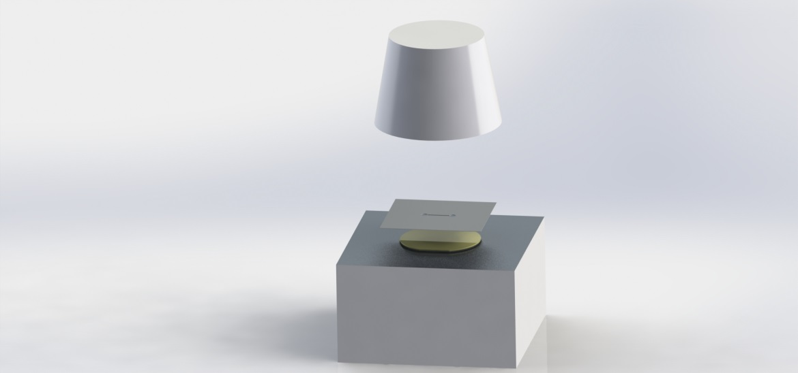
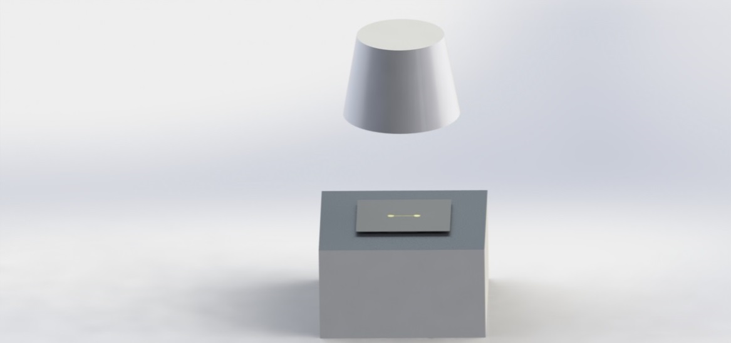
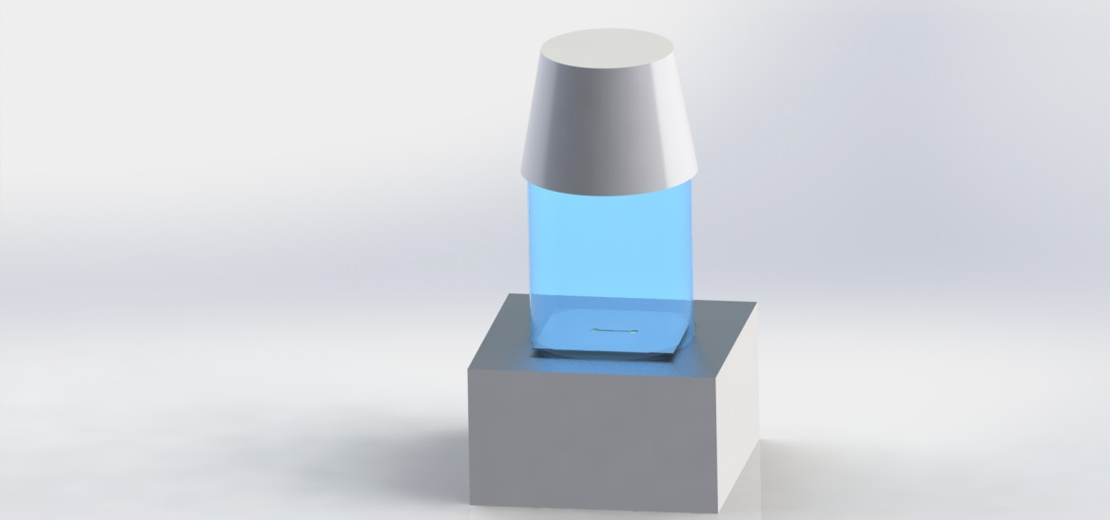
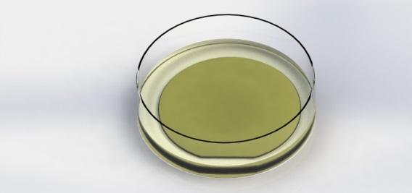

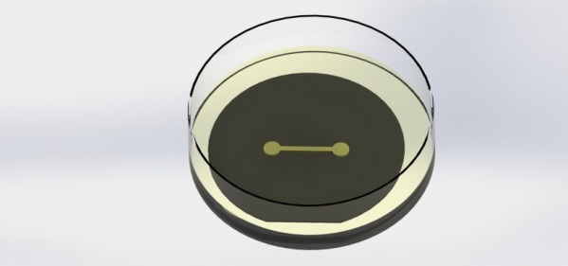
Making a Master
200C
100C
100C

Slide 26
Surface Preparation
Designing a mask (I can help with this)
Making a master
  Surface preparation of wafer
  Photoresist
  Exposing of photoresist through mask
  Post exposure bake
PDMS Device
  Casting
  Punching holes
  PDMS Bonding
  Filling

Slide 27
Substrate Surface Preparation
SU-8 Resist:
Make surface hydrophobic
  Silicon is hydrophobic, but SiO₂ (due to exposure to atmospheric oxygen) is hydrophilic
Two possible treatments to promote adhesion:
  Removal of native oxide with HF (nasty)
  Prime wafer with HMDS in priming oven
Dehydration bake at 200C to drive off water molecules
KMPR Resist:
Dehydration bake at 200C only

Slide 28
Photoresist
Designing a mask (I can help with this)
Making a master
  Surface preparation of wafer
  Photoresist
  Exposing of photoresist through mask
  Post exposure bake
PDMS Device
  Casting
  Punching holes
  PDMS Bonding
  Filling

Slide 29
Negative Photoresist – How it works
Mask
Photoresist
Substrate

Slide 30
Negative Photoresists
SU8-2000 series photosensitive epoxy
SU8-3000 series
KMPR-1000 series
QNF supplies SU8-2050, KMPR 1050

Slide 31
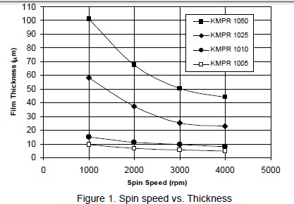
Photoresist Spin Coating, Baking

Slide 32
Exposure
Designing a mask (I can help with this)
Making a master
  Surface preparation of wafer
  Photoresist
  Exposing of photoresist through mask
  Post exposure bake
PDMS Device
  Casting
  Punching holes
  PDMS Bonding
  Filling

Slide 33
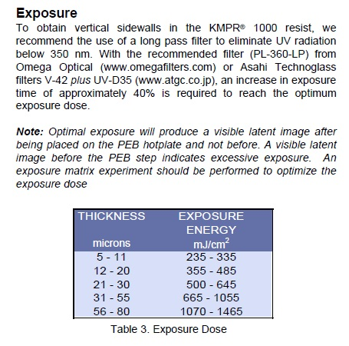
Photoresist Exposure

Slide 34
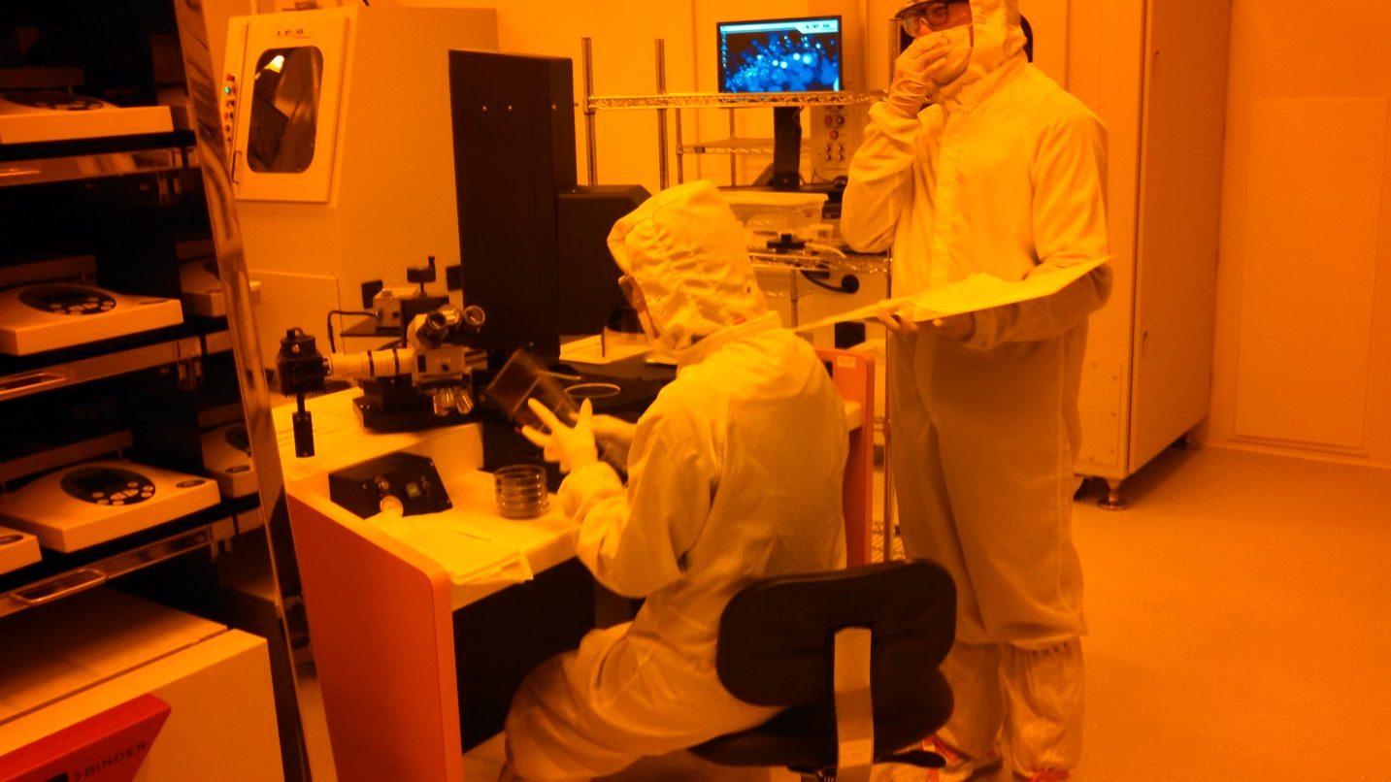
Photoresist Exposure
ABM Mask Aligner

Slide 35
Exposure Problems: Short Exposure
Result: delamination

Slide 36
Exposure Problems: Long Exposure
Result: T-Topping
Solution: 360nm long pass filter

Slide 37
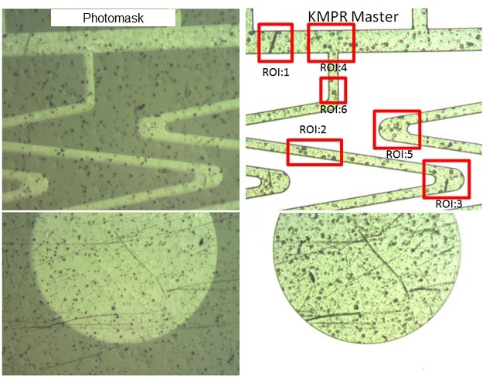
Exposure Problems: Film Masks
Film masks have inherent defects not found in chrome masks

Slide 38
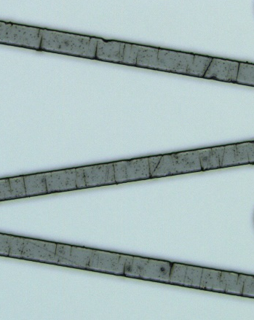

Exposure Problems: Film Masks with 360LP filter
With 360LP filter
Without 360LP filter

Slide 39
Exposure Problems: Film Masks with Thin Features
Film mask, 5um high features
Chrome mask, 5um high features
This problem is aggravated by the contrast caused by the LP filter.

Slide 40
Post Exposure Bake
Designing a mask (I can help with this)
Making a master
  Surface preparation of wafer
  Photoresist
  Exposing of photoresist through mask
  Post exposure bake
PDMS Device
  Casting
  Punching holes
  PDMS Bonding
  Filling

Slide 41
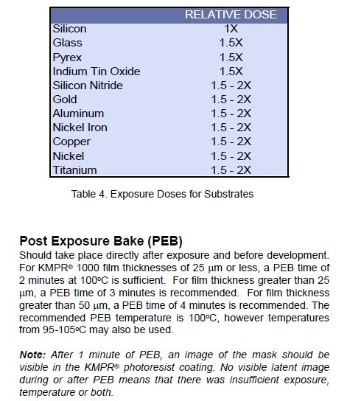
Post Exposure Bake Time

Slide 42
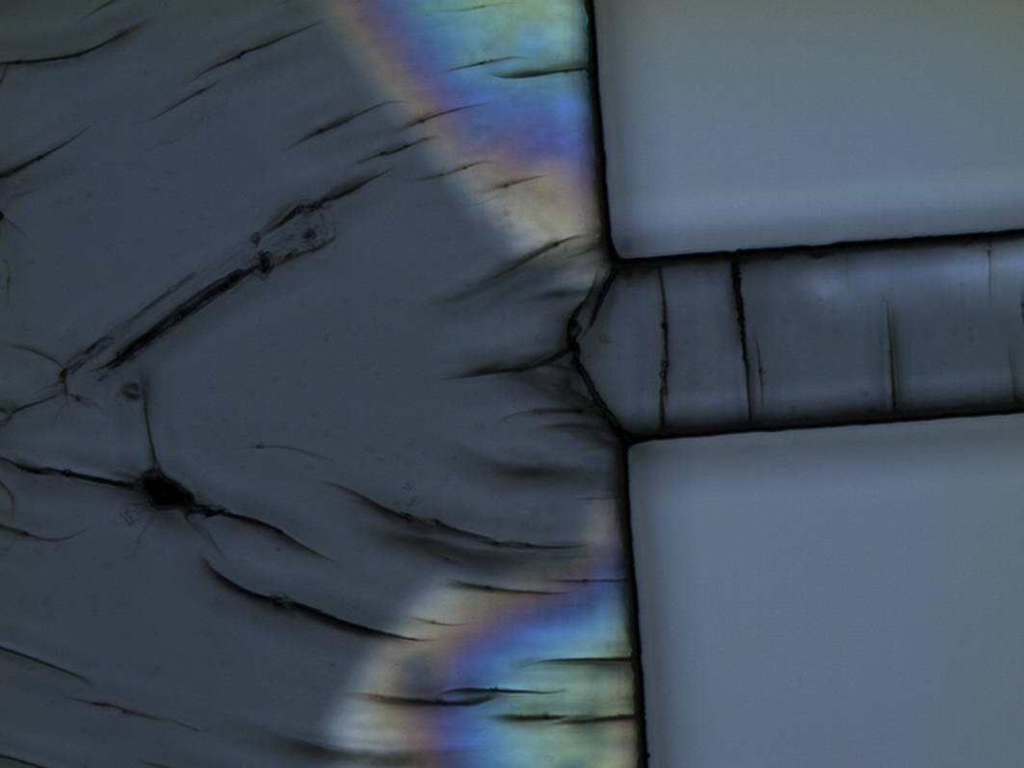
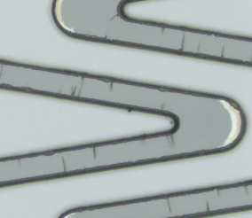

PEB Problems: Thermal Stress
Stress cracks due to crosslinking and sudden temperature changes
Solutions:
Lower PEB temperature for longer bake time.
Annealing at 150C for 10 minutes after development

Slide 43
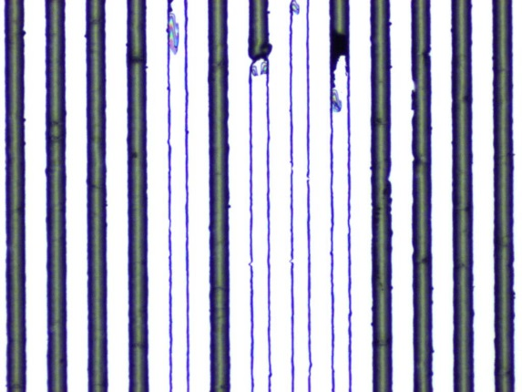
PEB Problems: High Aspect Ratio Features
Delamination of high features with small footprints (related to thermal stress)
Solutions:
Better wafer preparation
Low PEB bake temperature
Annealing at 150C for 10 minutes after development

Slide 44
PDMS
Designing a mask (I can help with this)
Making a master
  Surface preparation of wafer
  Photoresist
  Exposing of photoresist through mask
  Post exposure bake
PDMS Device
  Casting
  Punching holes
  PDMS Bonding
  Filling

Slide 45
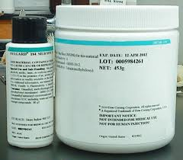
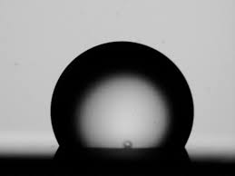
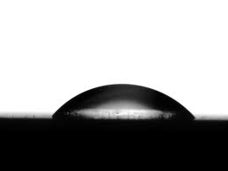
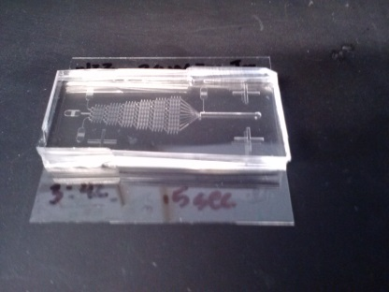
The Miracle of PDMS
Inexpensive 2-Part silicone elastomer
Hydrophobic native state
Surface of PDMS can be rendered hydrophilic with oxygen plasma
  Treatment last approximately 30 minutes
  Allows bonding to glass or to PDMS
  Allows functionalization of PDMS surface with hydrophilic molecules.
Gas permeable
Generally biocompatible, Food grade
Transparent in UV down to 240nm, ideal for fluorescence imaging
brandinside.deu
www.cchem.berkeley.edu
www.cchem.berkeley.edu

Slide 46
Casting
Designing a mask (I can help with this)
Making a master
  Surface preparation of wafer
  Photoresist
  Exposing of photoresist through mask
  Post exposure bake
PDMS Device
  Casting
  Punching holes
  PDMS Bonding
  Filling

Slide 47
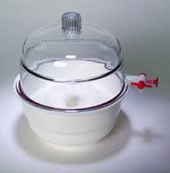
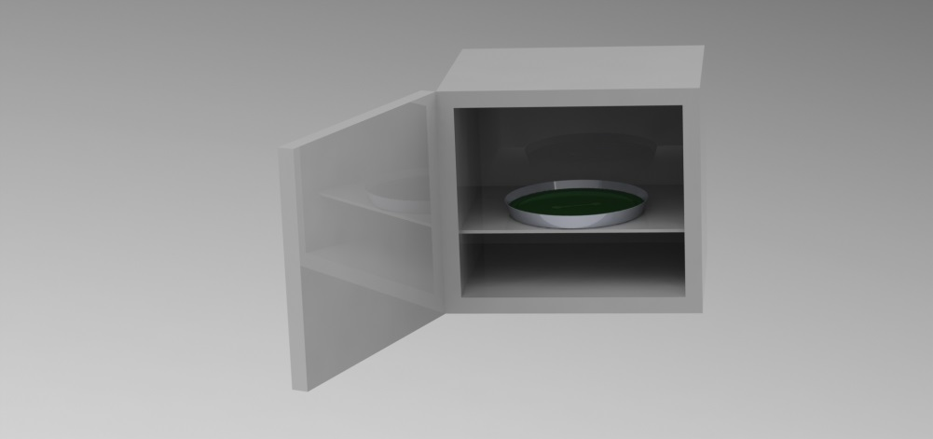
PDMS Casting

Slide 48
Punching Holes
Designing a mask (I can help with this)
Making a master
  Surface preparation of wafer
  Photoresist
  Exposing of photoresist through mask
  Post exposure bake
PDMS Device
  Casting
  Punching holes
  PDMS Bonding
  Filling

Slide 49
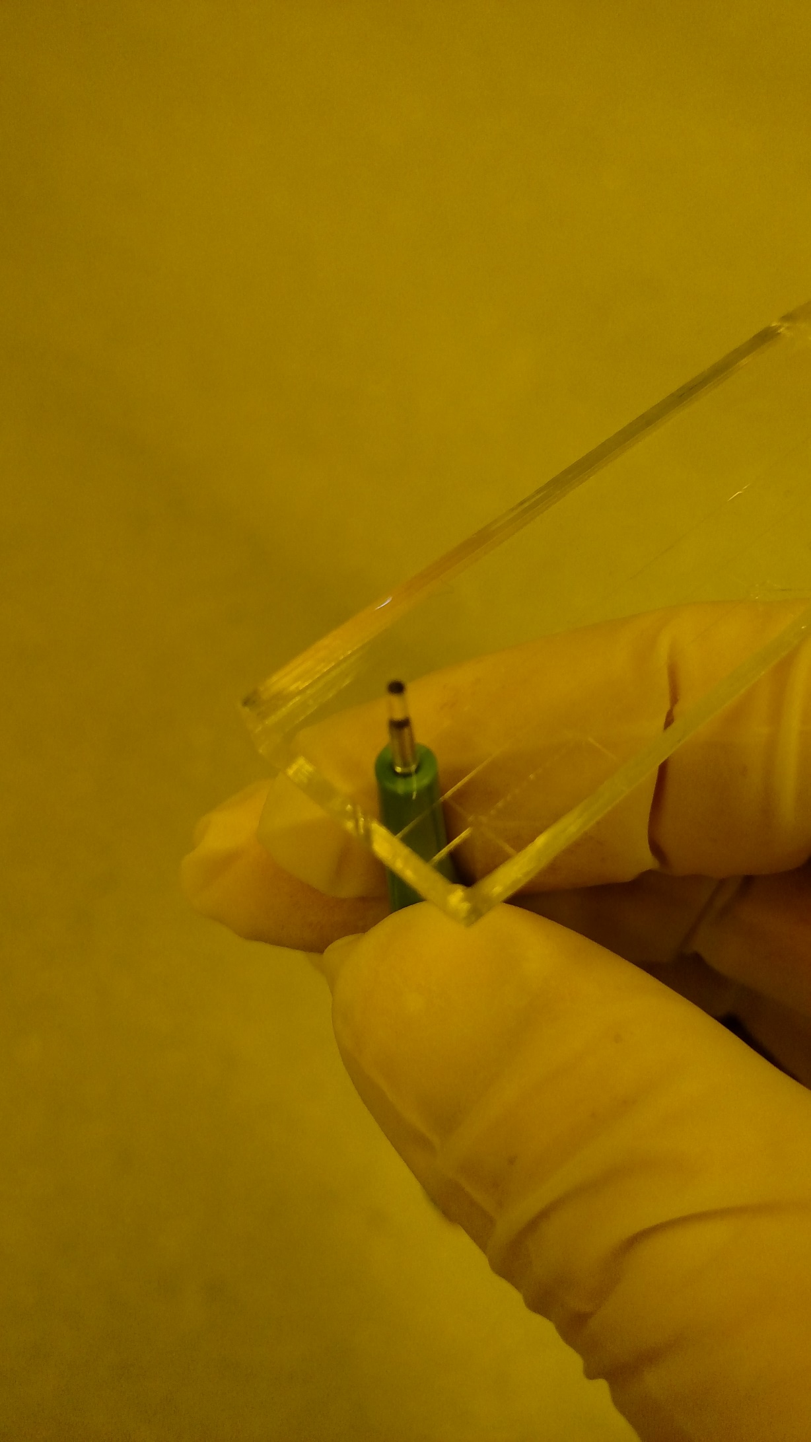
Punch Holes (before bonding!)

Slide 50
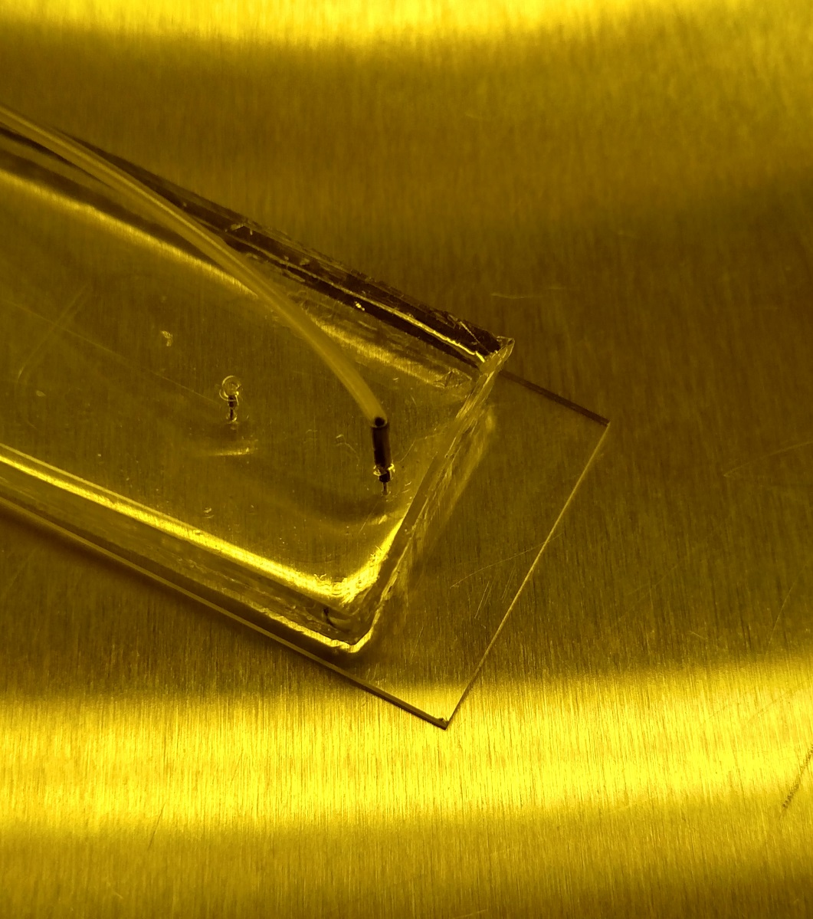
Tubing

Slide 51
Bonding
Designing a mask (I can help with this)
Making a master
  Surface preparation of wafer
  Photoresist
  Exposing of photoresist through mask
  Post exposure bake
PDMS Device
  Casting
  Punching holes
  PDMS Bonding
  Filling

Slide 52
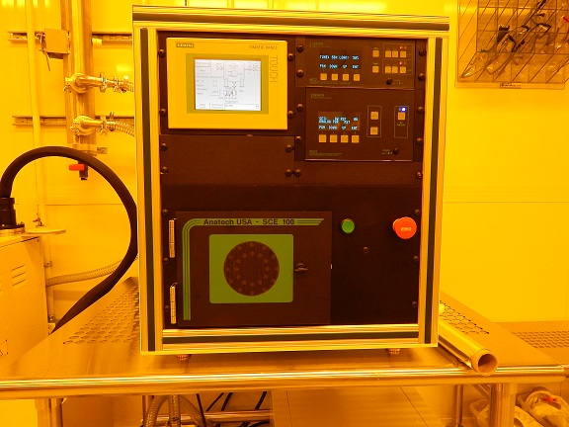
Plasma Treatment for PDMS Bonding
PDMS-Glass: 50sccm O₂, 30W, 30s (PDMS recipe)
PDMS-PDMS: 50sccm O₂, 30W, 60s(PDMS-PDMS recipe)

Slide 53
Filling
Designing a mask (I can help with this)
Making a master
  Surface preparation of wafer
  Photoresist
  Exposing of photoresist through mask
  Post exposure bake
PDMS Device
  Casting
  Punching holes
  PDMS Bonding
  Filling

Slide 54
Filling
Priming the device soon after plasma bonding (within 3 hours) yields better results.
Fully submerging the device inside a vacuum chamber for 20 minutes yielded the best results.

Slide 55

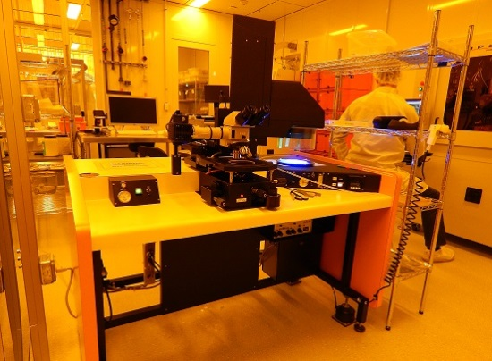
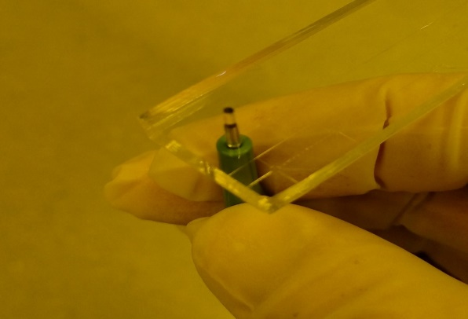
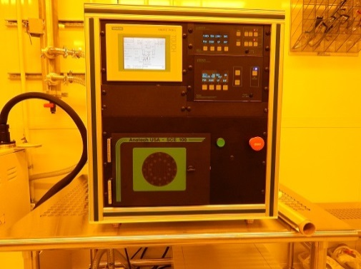
Preview of Hands-On Lab Work

Slide 56

Questions?

