Slide 1
The Ecological, Economic, and Ethno-Cultural Frontiers of North China: State Formation in the Eastern Intermediate Zone—A History of the Qai 奚
Zachary Hershey
East Asian Languages and Civilizations
University of Pennsylvania
Notes:
Hello everyone! My name is Zachary Hershey, and the topic of my dissertation is “The Ecological, Economic, and Ethno-Cultural Frontiers of North China: State Formation in the Eastern Intermediate Zone,” but in many ways the result is more A History of the Qai 奚 people, known in Chinese as Xi or Kumo Xi and in Turkic sources as the Tatabi. The goal of this study is to demonstrate the diversity of economic activities within the various cultures of North Asia towards dispelling the idea, championed by Owen Lattimore, of a fixed dichotomy between Chinese, sedentary agricultural economies in the south and non-Chinese, mobile pastoral economies in the north.

Slide 2
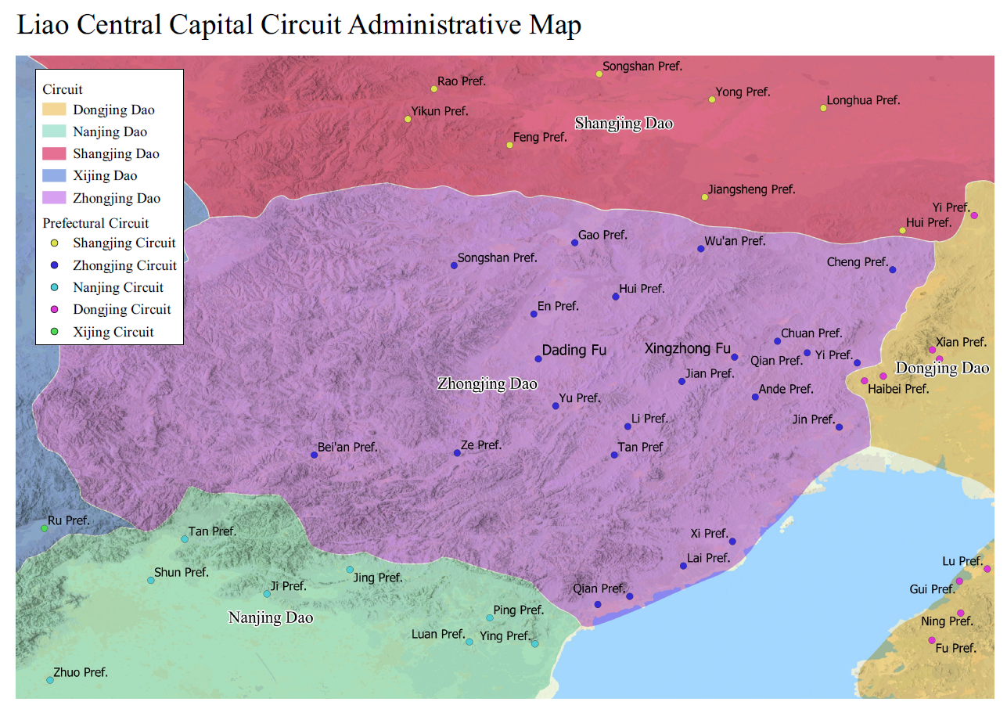
Orienting the Project
What did the historical environment of the Eastern Intermediate Zone look like?
What is “Qai”?
How were states formed in the Eastern Intermediate Zone?
How can we use the Chinese pseudo-ethnographies?
What ecological data is available?
What happened to the Qai under the Kitan Liao?
What can Kitan sources tell us about the Qai?
Notes:
The starting point for my dissertation was to explore environment and land use in the northern frontier zones of China Proper which can be divided into three intermediate zones: the Eastern Intermediate Zone stretching roughly from Chifeng in the north to the Yellow River in the south and from Zhangjiakou in the west to Liaodong in the east; the Western Intermediate Zone falling within the loess region of the Ordos loop of the Yellow River, and the Central Intermediate Zone falling between the two, in the northern portion of modern-day Shaanxi Province. The scope of this project was limited to the Eastern Intermediate Zone, which roughly corresponds to the purple region here.
To understand the area, we need to understand the people that lived there and the ecology of the region. First, we must start with, Qai, which is fundamental vocabulary for the rest of the talk. After that, I will present a new approach for understanding state formation on the northern frontier, before moving on to the available ecological data, and talk briefly about a new tropological approach to using Chinese accounts of foreigners (I term these accounts “pseudo-ethnographies). Then I will fill in our picture of the region with information from the Liao-Song period and introduce new materials on the Qai coming from developments in reading Kitan language sources.

Slide 3
The Vocable: “Qai”
Qai 奚 (X Qai)
*Ghur Qai 紇奚
*Kumak Qai 庫莫奚
Wuma Mountain Qai 烏馬山奚
*Qai 稽
*Qai Barbarians 稽胡, Northern *Qai Barbarians 北稽胡
Fenzhou Prefecture Barbarians 汾州胡，Fen Barbarians 汾胡，Lishi Barbarians 離石胡，Tujing Barbarians 吐京胡
步落稽
*Qa 胡 (X Qa)
Eastern *Qa 東胡
Forest *Qa 林胡
Mountain *Qa 山胡
Notes:
So here we have a non-Chinese vocable, roughly Qai, being used for a wide variety of northern peoples. The similarity in pronunciation and usage of these terms is suggestive, for there are numerous late structures of the form “X Qai” (i.e. *Ghur Qai 紇奚) using the character *qai (xī 奚) as well as numerous earlier structures of the form “X Qa” (i.e. Qai Qa 稽胡). Qai thus seems to be a kind of ethnonym element used for various peoples along the Chinese border. This idea of a vague term for those along the northern border reminds us of the term hú 胡, which by the Han had become a similarly vague term for people along the northern border. Strikingly, this term would have been pronounced *qa during the Han. Qa may not seem very similar to Qai but Atwood (2015, 47-51) has argued that Qai and *Qa can be linked as -i suffixed and zero-suffixed variants of the same word. In other words, the Warring States-Han era Hú 胡, and the Northern Dynasties-era Jī 稽, and Xī 奚 all appear to be Chinese transcriptions for a word that whatever its original meaning soon came to be a general term for the northern “barbarians.”

Slide 4
Big Man Polities
Marshall Sahlins
“Big Man” polities
Petty commander attains and maintains position through persona, popularity, and strength
Eastern Qa 東胡 → Serbi 鮮卑/Awar 烏丸
Tabghach (Tuōbá 拓跋), Murong (Mùróng 慕容), Tufa (Tūfà 禿髮), Qifu (Qǐfú 乞伏), Yuwen (Yǔwén 宇文), Duan (Duàn 段)
Development of hereditary houses
Yuwen 宇文→ Qai 奚/Kitan 契丹
*ñoġur-ǰu (rǔhézhǔ 辱紇主)
*maġa-pur (mòhèfú 莫賀弗)
eltäbär
irkin
Notes:
Let’s take a look at the progression of state formation in the region to dispel some misconceptions about the origins of peoples in the region. The region is characterized by a series of developments from “Big Man” polities to hereditary monarchies. In his study of Polynesian and Melanesian polities, Marshall Sahlins compared the structure of an analogous “Big Man” system to a chiefdom based on inheritance. According to Sahlins, Melanesian tribes consist of many autonomous kinship-residential groups which are both economically self-governing and are equal politically. Within these groups, men can compete for renown within the society which allows them to rise in status to a position of “Big Man.” The influence of these Big Men usually develops out of the ability to amass and redistribute wealth, meaning that elevation to the status of Big Man comes at the end of a series of acts. Big Men usually start by enlarging their own families through multiple marriages (as Sahlins says, more wives equal more pigs) or the patronage of client individuals. Big Men can exercise a certain level of command ability within their faction, but in the external sector they are usually only able to exercise indirect influence through their renown. These positions are generally not inherited, meaning that each Big Man must earn and maintain his status through the exercise of his personal power. Inherent instability exists within this system which could result from the resentment of faction members or in the calamity of the death of the Big Man. The death of the Big Man usually results in the dissolution or fracturing of his faction.
The origins of the Kitan and Qai are generally recounted in studies as progressing from the Eastern Qa to the Serbi/Awar to the Kitan/Qai, usually suggesting that each successive group was a descendant of the previous, but in reality, the most likely explanation is that successive groups were under the control of the leaders of the previous groups were not necessarily related to those leaders in any way. For example, the Qai and the Kitan are said to be descendants of the Yuwen Serbi, but the Yuwen are an example of a family that was pushing the development from Big Man polity to hereditary house, similar to the Murong or the Tabgach, and the Qai and Kitan were member groups that separated off after the house of Yuwen was defeated by the house Murong, and the Yuwen fled southward. The development of hereditary houses appears to relate to interactions between these frontier groups and other large power in the region such as the Rou-ran, Turks, or Chinese. Early accounts of Kitan and Qai political organization clearly demonstrate the use of foreign titles like irkin and magapur which were carried into the state formation period in the late Tang.

Slide 5
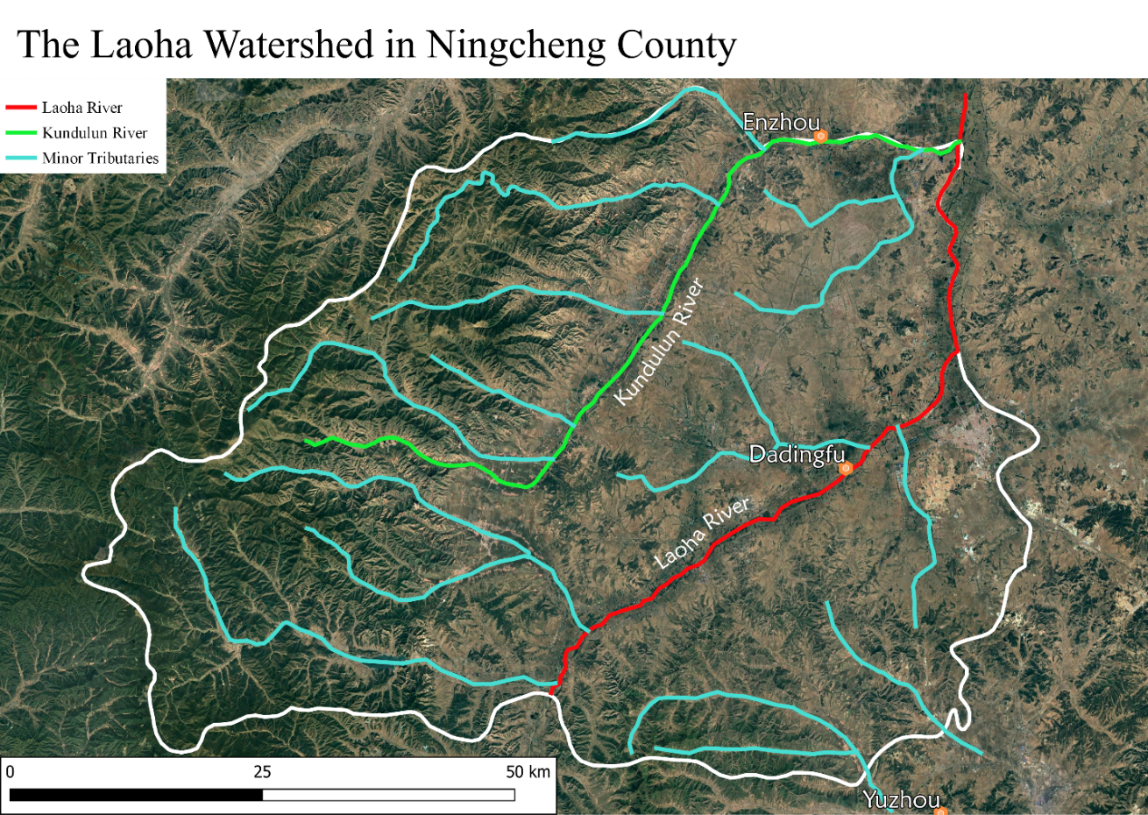
Notes:
This portion of the project is best summarized through a few images. I have had to limit the ecological portion of this project, which I initially imagined addressing each of the three intermediate zones, to the heartland of the Liao-era Qai, partially due to limitations on time, but also constructively as the region is a good case study to get at the core goals of the project. This first image provides an overview of the Laoha River watershed with the white boundary denoting the modern-day boundaries of Ningcheng county, south of Chifeng. I have included this boundary as the modern data incorporated in the study comes from the modern official gazetteers from this region. Most of the rainfall in the region falls in the mountains to the south and west and flows into the valleys of the Kundulun and Laoha Rivers.

Slide 6
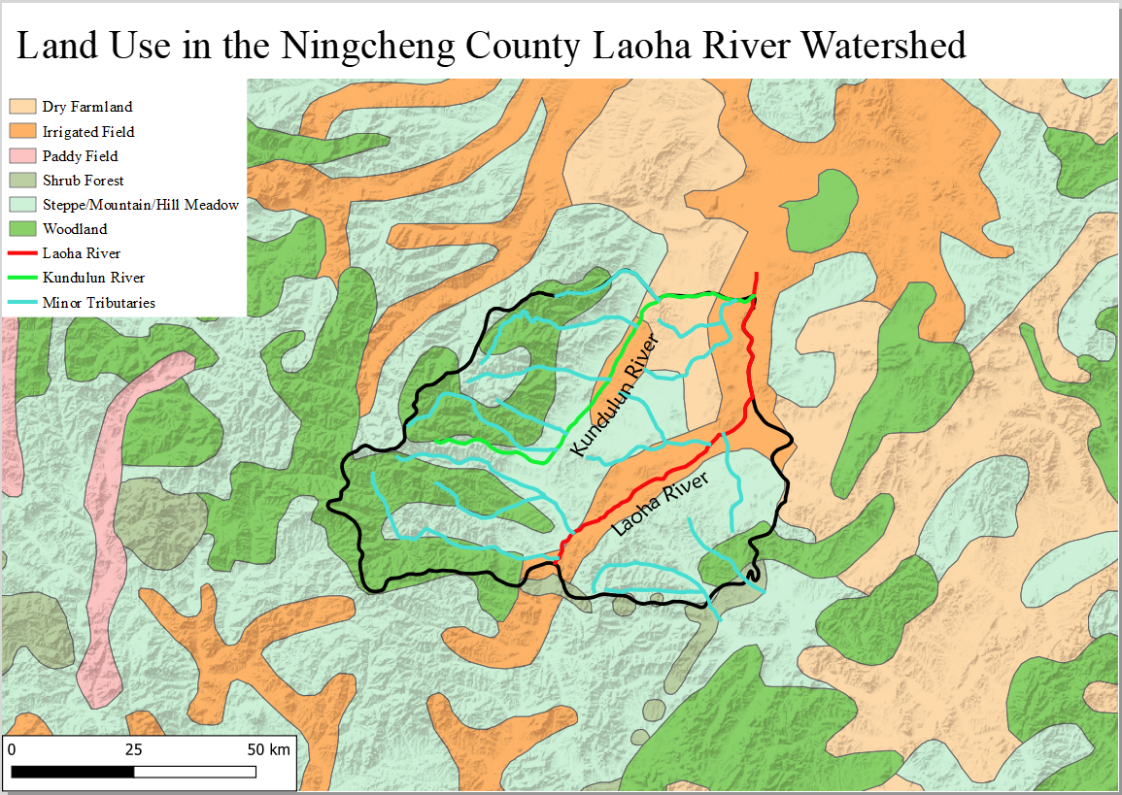
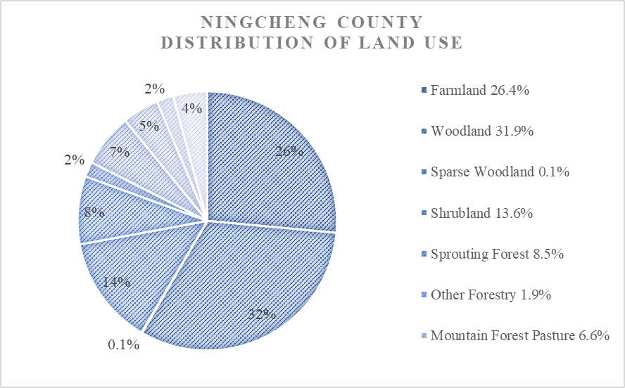
Modern Environment of Ningcheng Region
Notes:
As you can see on the diagram on the left, much of the modern farmland in Ningcheng is located along these rivers, allowing for irrigation (the dark orange), but dry farmland is also found in the northeast (the lighter orange). The past few decades have seen extensive projects to “afforest the mountains” and “regreen the pastures” which can be seen in the dark green and light green respectively on the right, but the latest data from the recently published Ningcheng gazetteer suggests that the woodland has expanded at the expense of the meadows (seen in the pie chart to the right as shrubland).

Slide 7
The Ancient Environment of the Ningcheng Region
Depth (cm) | Period | Liao Zhongjing A and B Samples
 |  | Pollen Types | Ancient Vegetation | Ancient Climate | Pollen Group
10-50 | Late Holocene (500 BCE-1500 CE) | Pinus, Artemisia, Fagopyrum esculentum, Asteraceae, Athyriaceae, Selaginella sinensis | Sparse coniferous steppe | Alternating Cool and Moist, Semi-arid, and Arid | IV
30-50 | Middle Holocene (5500-500 BCE) | Pinus, Betula, Corylus, Artemisia, Fagopyrum esculentum, Gramineae, Selaginella sinensis | Sparse coniferous and broadleaf woodland and shrubby steppe | Warm and Moist | III
40-70 | Early Holocene (8000-5500 BCE) | Pinus, Ephedra, Chenopodium, Artemisia, Gramineae, Malvaceae, Labiatae, Campanulaceae, Dennstaedtiaceae, Selaginella sinensis | Sparse coniferous woodland and shrubby to semi-shrubby steppe | Mild and Humid to Cool and Dry | II
30-80 | (>8000 BCE) | Pinus, Corylus, Betula, Ulmus, Artemisia, Chenopodium, Asteraceae, Humulus, Fagopyrum esculentum, Cyperaceae, Selaginella sinensis, Athyriaceae, Pteris, Hymenophyllaceae, Polypodiaceae | Mixed coniferous and broadleaf forest to sparse steppe | Warm and Moist | I
Notes:
For the sake of time here, I want to highlight two aspects of the historical environment which can be seen from a limited soil sample analysis from along the Laoha river around the old Liao Central Capital area of Ningcheng published by Guo Dianyong in 2007. Based on his analysis, the details of which can be found in my dissertation, Guo divided up the soil layers into four periods which leave much to be desired in term of chronological resolution, the ranges of which can be seen here. He developed this periodization based on soil composition and pollen. First, note the decline in pollen and spore diversity moving forward chronologically. Guo is conservative in his judgement of why this is happening, but notably the plants which tend to be dying off are those that favor wetlands regions including various ferns. Evidence of agriculture and the raising of pigs (sedentary livestock) in the region can be found as early as the Lower Xiajiadian Culture from around 2200-1600 BCE, but likely predated that period. The decline in wetland plants probably corresponded to the progressive draining of the wetlands near the river in favor of farmland.

Slide 8
Ecology from the Pseudo-Ethnographies
Accounts of foreigners in the Standard Histories 正史
Tropological Analysis
Identify the tropes to get at the usable data
“Following the Water and Grass” (suí shuǐcǎo 隨水草)
“nomadic pastoralists”
Raising pigs, farming, hunting
Travel accounts
Farming, houses, and pigs
Notes:
Study of the early people of Northern and Central Asia relies heavily on records within the Chinese historical tradition, and thankfully, Chinese historiographers were in the habit of describing the customs of people deemed important to the defense of the state. Starting in the Han dynasty, these descriptions began to take the form of pseudo-ethnographies, monographs on various peoples contained within the dynastic histories which contain information thought to be politically relevant, including a summary description of their customs based on documents accessible to court historian which may include mode of living, economic production, marriage practices, military style, and significant events related to their rulers and their interactions with the relevant Chinese dynasty. Such accounts are rife with stereotypical characterizations, or tropes, which are used to provide concise reasons for how and why these peoples differ from the way one should act—like the standardized image of a good Han person in the eyes of the court historian (i.e. sedentary agriculturally focused, filial, wearing silk, etc.).
I speak more about the pseudo-ethnographies in the dissertation, but I just want to highlight here the importance of isolating the tropes within the pseudo-ethnographies to get at the useable information within each account. One of the common tropes, “following the water and grass,” for example, brings to mind ideas of nomadic pastoralists and was even used in some accounts to describe the Qai. However, other elements of the accounts reveal that the Qai practiced agriculture, raised pigs (sedentary livestock), and were skilled hunters. The Qai were a sedentary people with diverse economic practices and later accounts from travelers in Song times confirm this.

Slide 9
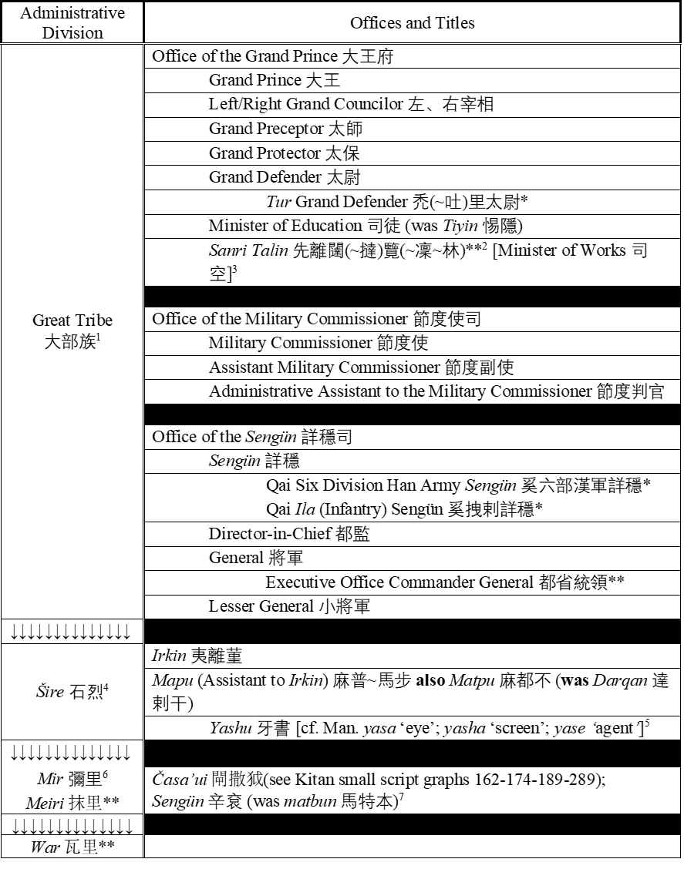
The Liao-era Qai Administration
923: Qai Princely Establishment 奚王府
Qai princes were not necessarily Qai
Appointed by the house of Yêrud 耶律
1007: Central Capital
Great Prince of the Qai Six Divisions (Xī liùbù dàwáng 奚六部大王)
Administrative Clerk to the Great Prince of the Qai Six Divisions (zhī Xī liùbù dàwáng shì 知奚六部大王事)
Notes:
The Qai Princely Establishment was created by Abaoji in 923, and I’ve combined various references to its structure to propose a reconstruction which I reproduce here on the right. The names of the offices appear to change throughout the dynasty as can be seen in the Basic Annals, but these changes in terminology likely reflect a difference in sources more than any real shifts in the structure or conduction of the administration. That said, the key fact throughout all of this is that the Qai administration was not inherently Qai in composition and was controlled entirely by the Kitan dominated Liao administration. The Qai Prince was not Qai, the position was not hereditary, and was more a provincial governor who was also often responsible for important military commands.

Slide 10
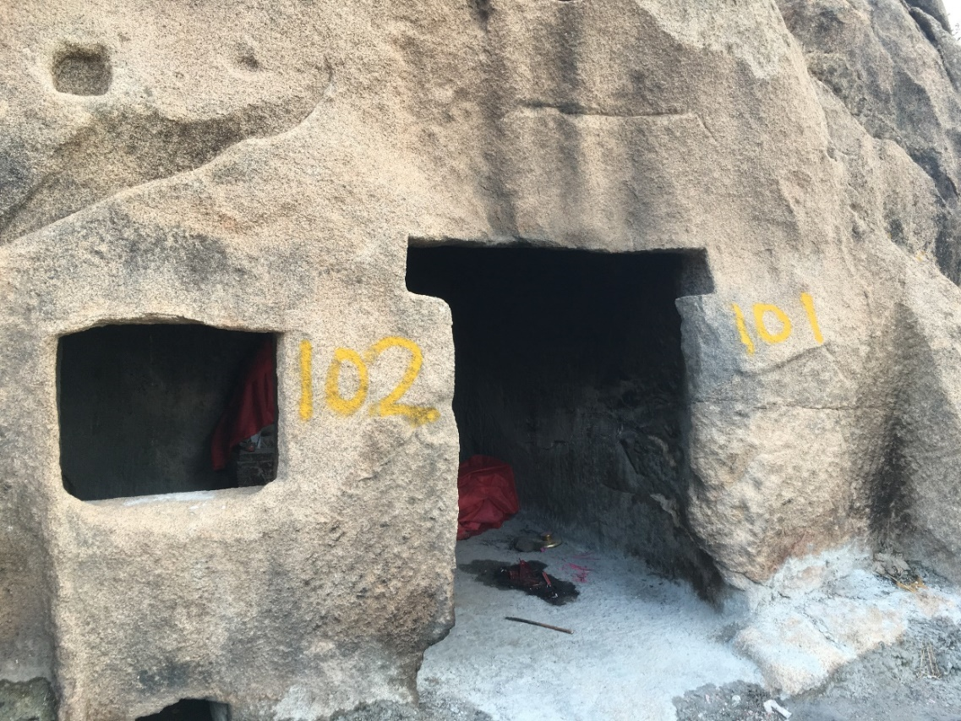
Qai Material Culture
Cliff Sites
Yanqing Cliff Site 延慶崖居
Lamadong 喇嘛洞
Qai Mortuary Culture?
Bi Deguang 2016
Kitan-style, Han-style, and “other”
10 potential burials
Inconclusive
Notes:
I won’t spend much time on Qai material culture as my conclusion is that no uniquely Qai material culture has yet to be confidently identified. There have been discussions about Qai living in cliff dwellings like the Yanqing Cliff site near Beijing (top right) or the Lamadong site which I visited to the south of Ningcheng, the site of the Liao Central Capital and heartland of the Qai (bottom right), but no compelling evidence has yet to come to light which can be relied on to say that these were once occupied by Qai people. Yet the association remains common in Chinese scholarship. The most recent detailed attempt to find evidence of Qai material culture can be found in Bi Deguang’s 2016 book where he talks about mainly “potentially” Qai sites, but fails to produce anything conclusive. The most compelling section deals with mortuary culture and relies on characterizing “Kitan burials” and “Han burials” to try to find ones that do not fit these characterizations. He identifies 10 burials that he suggests may be Qai, but nothing that I have seen in the reports or in his analysis suggests to me that this conclusion can be drawn. Sadly.

Slide 11
Qai, Tatabï, and Tatayar
Orkhon Turkic: Tatabï
Tibetan: Turkic dad.pyi and Chinese hi
Kitan: Tatayar
Small script graph 023 ~ 016: <t(a)>
Jāmiʿ al-tawārīkh
“in the Khïtayan language, the nation (ahl) of the Qara-Khïtay is called J̌īdān yār.”
Notes:
I mentioned earlier that the name, Tatabi, was used in Turkic sources for the people we know in the Chinese sources as Qai. A correspondence between the two names was identified in an 8th century Tibetan source. Liao-era Chinese sources consistently refer to the Qai as just that, Qai. The Kitan small script block which corresponds to the Kitan name for the Qai has been known for some time, but the reading of the block remains in dispute. The problem with reading the ethnonym involves understanding the Kitan small script graph number 023, which I propose should be read as a <t> carrying an implied <a>. I based this identification on a correspondence between number 23 and number 16, which is known with a high degree of certainty to also represent a <t>. Alloglyphs—structurally variant glyphs which denotes the same or similar sounds—are common throughout the small script, so this is unproblematic. Following this, I reconstruct the Kitan Qai ethnonym as Tatayar, consisting of the same root, Tata-, as the Turkic name with a Kitan suffix -yar, denoting “people”. Interesting to note, the Jāmiʿ al-tawārīkh of Rašīd al-Din̄ notes that the “in the Khïtayan language, the nation (ahl) of the Qara-Khïtay is called J̌īdān yār.”

Slide 12
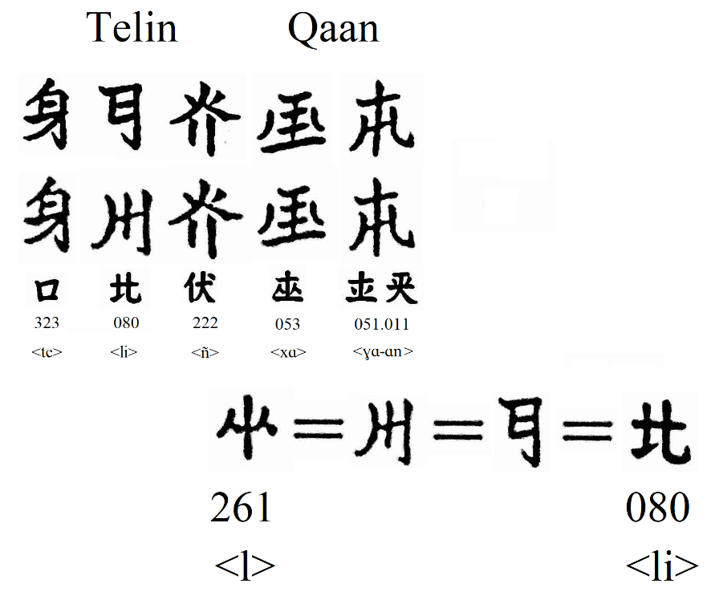
The “Qai” Prince and the Tatayar Qaġan
Chinese
“Qai chief” (Xī qiúzhǎng 奚酋長)
“Qai Prince” (Xī wáng 奚王)
Great Prince of the Qai Six Divisions (Xī liùbù dàwáng 奚六部大王)
Kitan
“Grand Prince” (tai-ġuang 374-075)
nir ñulien Tatayari Tai-Ong
qaġan (qa-ġa-an 053-051-011)
Qai Huilibao (Xī Huílíbǎo 奚回離保)
Great Qai (Dà Xī 大奚)
Shensheng emperor (Shénshèng huángdì 神聖皇帝)
Notes:
With the same data, we can also draw some conclusions about the titles used by the leaders of the Qai in the Kitan language. The most important revelation is that three Qai qaghans can be found in the Kitan inscriptions: Telin, Bo’un, and another which may be something like Chulen. Their names can be seen in the graphic in the bottom right. Only a single appearance of tai wang in Kitan transcription exists, the remainder follow the qaghan title. Of these, we confidently know the identity of Bo’un. He was the first Liao appointed leader of the Qai in 923. Telin qaghan, however, is the most commonly referenced throughout the published corpus, but we only have a single reference to him in Chinese, as an ancestor of the only known Qai emperor, Huilibao. In the final years of the Liao, Huilibao was the Liao-appointed Qai Grand Prince. After failing to support Yerud Chun in seizing control of Liao, Huilibao returned to the Central Capital and declared himself the Shensheng emperor of the “Great Qai” state but was killed by his own people within six months. In his biography, he is said to be a descendant of a Qai Prince Telin.

Slide 13
Conclusions and Future Directions
Eastern Intermediate Zone characterized by cycles of “Big Man” polities developing hereditary houses and moving towards larger powers
Populated (likely at least 2000 BCE) by people practicing mixed agriculture characterized by grain agriculture, sedentary animal husbandry, hunting, and other economic activities
The administration of the Qai under the Liao, including the Qai prince, was appointed by the house of Yêrud
The Kitan name for the people known in Chinese as Qai 奚 was Tatayar, related to the Turkic name, Tatabï
There is no uniquely Qai material culture which has been confidently identified
Low resolution of environmental data
Requires new field work in the region
The Kitan language and script problem
Requires morpheme-level analysis of the Kitan language
Notes:
The Eastern Intermediate Zone was populated (likely at least by 2000 BCE) by people practicing mixed economies characterized by grain agriculture, sedentary animal husbandry, hunting, and other economic activities. The Eastern Intermediate Zone was characterized by cycles of “Big Man” polities developing hereditary houses and moving towards larger powers. The administration of the Qai under the Liao, including the Qai prince, was appointed by the house of Yêrud. The Kitan name for the people known in Chinese as Qai 奚 was Tatayar, related to the Turkic name, Tatabï. There is no uniquely Qai material culture which has been confidently identified.
Low resolution of environmental data
Requires new field work in the region
The Kitan language and script problem
Requires morpheme-level analysis of the Kitan language

Slide 15
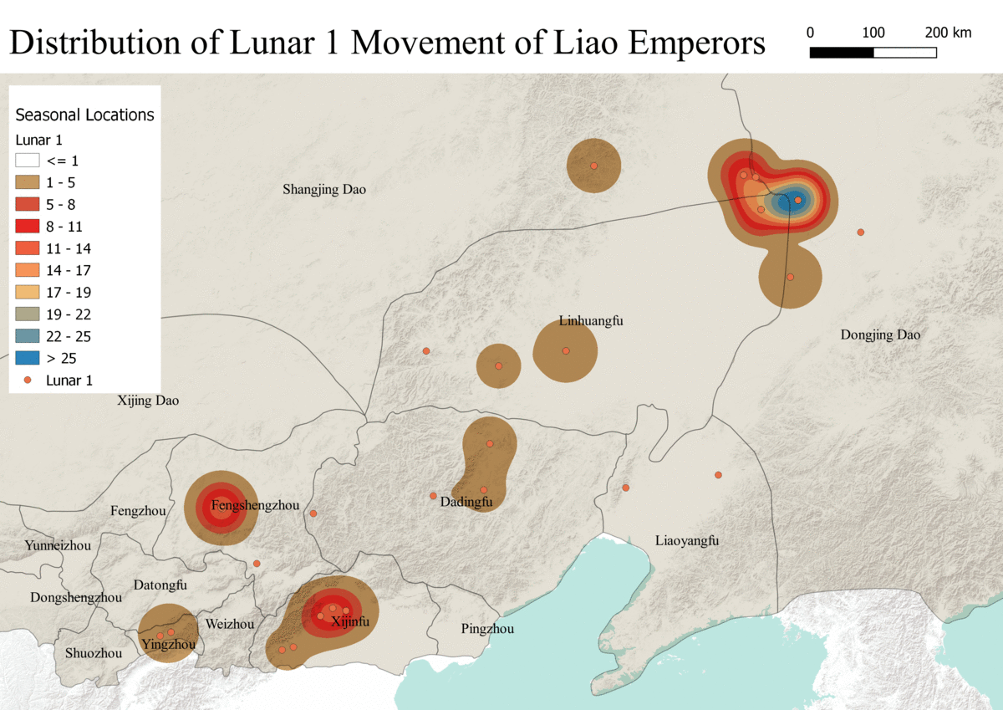

Slide 16
