Slide 1

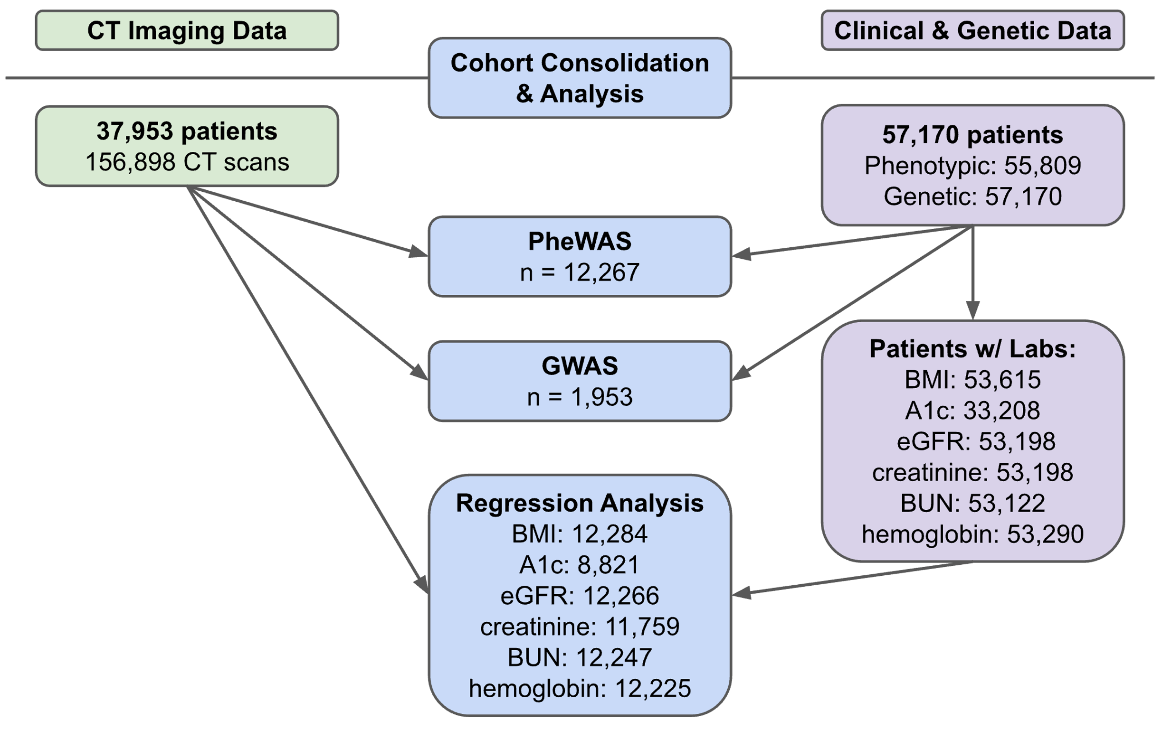
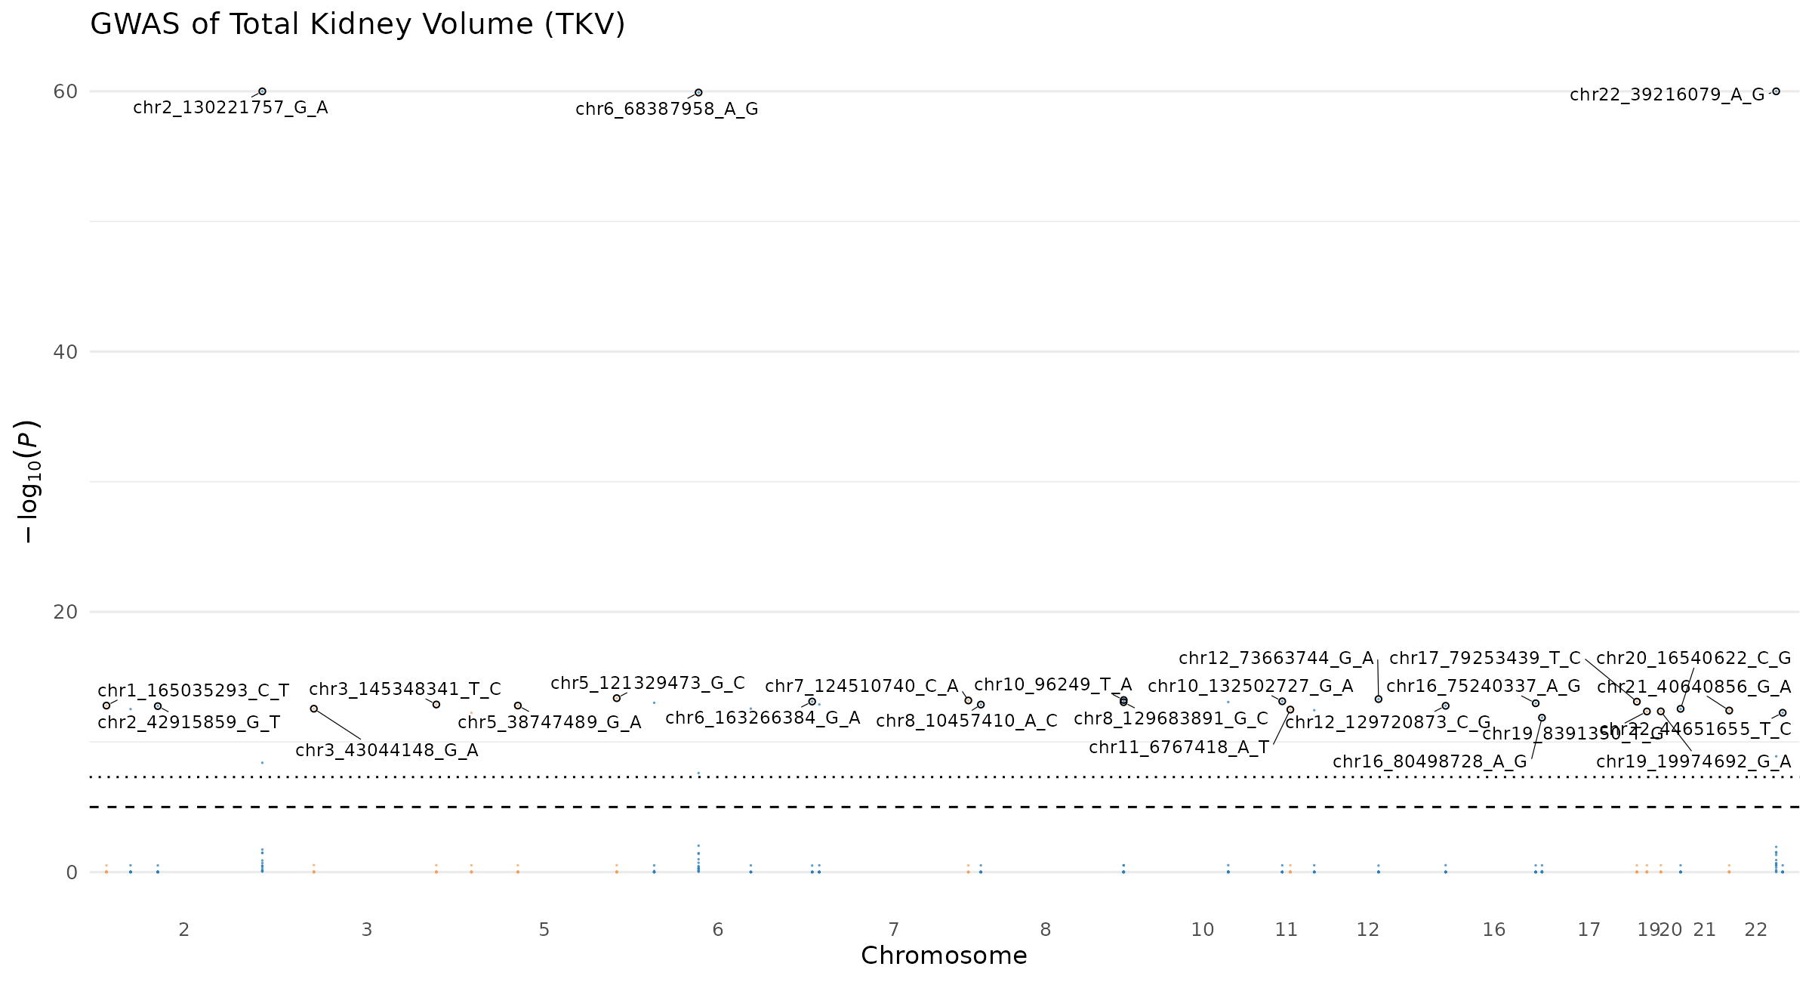
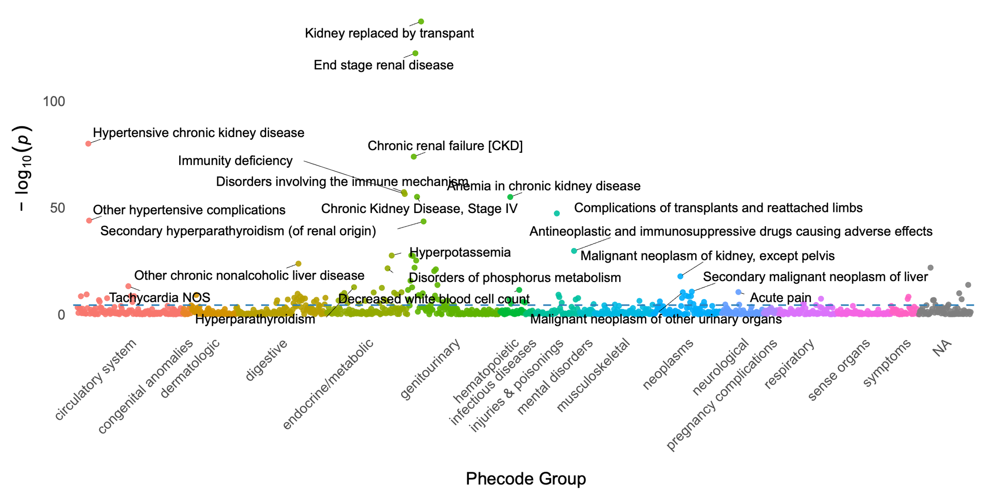
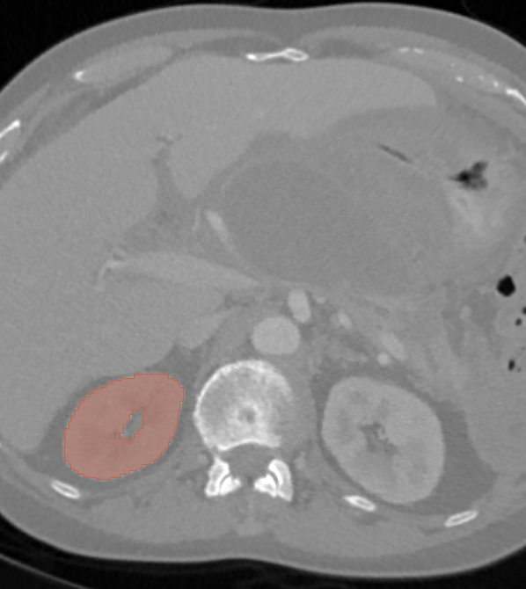
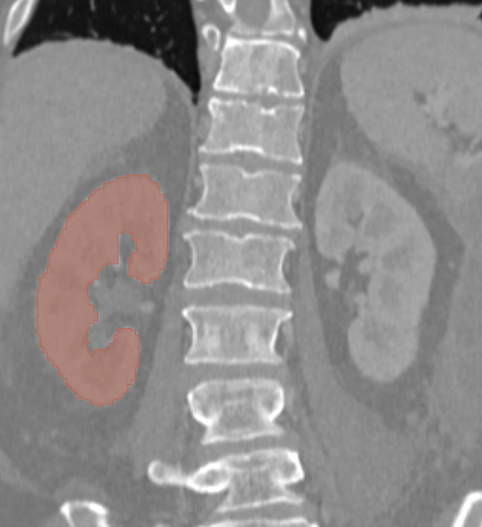
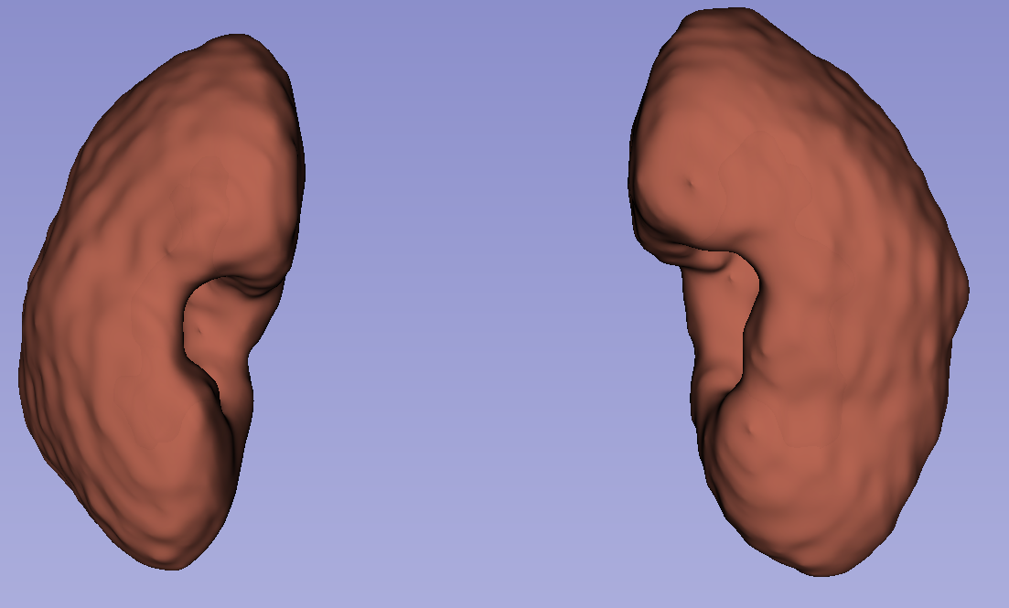
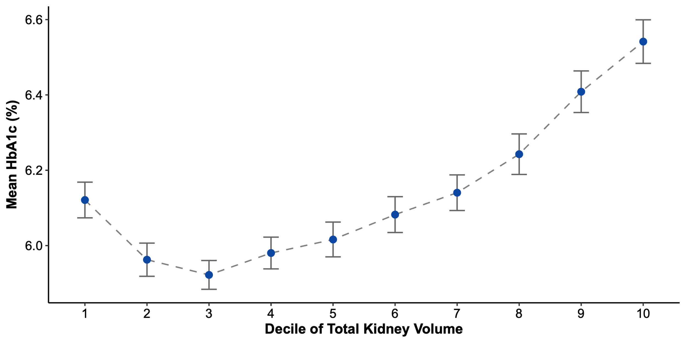
CT-Derived Kidney Volume: A Biomarker Defined by Clinical and Genetic Associations
Luke Ni¹, Hersh Sagreiya^{2 *}
¹School of Engineering and Applied Sciences (’28), University of Pennsylvania
²Department of Radiology, Perelman School of Medicine, University of Pennsylvania
Study Aims
Methods
Findings (Continued)
Data Extraction
Data Extraction
Data Extraction
Routine diagnostic abdominal computed tomography (CT) exams are conducted on millions of patients yearly for purposes other than evaluating kidney health.
These scans contain rich, underutilized clinical data where extracted kidney image-derived phenotypes (IDP) can serve as biomarkers, aiding in early disease detection.
Goal: This study aims to examine these IDPs in a large, diverse cohort and their corresponding links to demographic, clinical, phenotypic, and genetic data.
Lab Outcome | Estimate | Std. Error | Statistic | P-Value | R-squared | Obs. (n)
eGFR | 8.7E-05 | 2.2E-06 | 40 | 0 | 0.27 | 12,266
BUN | -2.7E-05 | 9.9E-07 | -27 | 3.9E-153 | 0.11 | 12,247
Creatinine | -1.9E-06 | 8.3E-08 | -23 | 1.1E-113 | 0.094 | 11,759
BMI | 2.1E-06 | 2.6E-07 | 8.2 | 2.9E-16 | 0.88 | 12,284
A1c | 1.1E-06 | 1.6E-07 | 6.9 | 5.4E-12 | 0.075 | 8,821
Hemoglobin | 1E-06 | 1.7E-07 | 5.9 | 3.6E-09 | 0.14 | 12,225
Table 2. Clinical Labs Regression Summary
Data
Data Extraction
Clinical, genetic, and demographic data was retrieved from the Penn Medicine BioBank (PMBB) [1].
Cohort: 12,288 individuals w/ CT imaging & clinical data.
Conclusion and Future Work
Variable | Category | Obs. (n) | Percentage | Mean + Std. Dev.
Total Patients | NA | 12,288 | 100 | NA
Age (Years) | NA | 12,288 | 100 | 57.5 ± 15.0
BMI | NA | 12,284 | 99.9 | 29.8 ± 7.27
Sex | Female | 6,165 | 50.2 | NA
Sex | Male | 6,123 | 49.8 | NA
Ethnicity | African | 3,429 | 27.9 | NA
Ethnicity | European | 8,347 | 67.9 | NA
Ethnicity | Other | 512 | 4.2 | NA
Figure 2. Cohort Consolidation
Findings
Figure 5. Continuous Genome-Wide Association Study of Kidney Volume
Table 1. Cohort Baseline Characteristics
Conclusion
Data Extraction
Novel clinical insights: kidney volume is significantly linked to clinical, medical, and genetic outcomes in a large, diverse PMBB cohort.
Improved Patient Outcomes: this research elucidates the renal volume relationship with clinical, genetic, and demographic mechanisms. Understanding these broad, comprehensive clinical conclusions can provide insights that ultimately advance population health.
Future Work:
Exploring Renal Cyst & Substructure IDPs links to clinical/genetic data.
Validating TotalSegmenatator Segmentations.
Figure 3. Phenome-Wide Association Study of Kidney Volume
Figure 1. Axial, Coronal, and 3D view of Sample CT with Segmentation
Acknowledgments
Methods
Data Extraction
Data Extraction
*We would like to thank Cameron Beeche, Rakesh Sharma, Jeffrey T. Duda, PhD, Arijitt Borthakur, PhD, MBA, James C. Gee, PhD, Dan Rader, MD, Charles E. Kahn, Jr., MD, MS, Walter R. Witschey, PhD, and contributing members of the Cardiovascular Imaging Lab for their efforts to make this project possible. The authors have no conflicts of interest to disclose.
I, Luke Ni, acknowledge the Penn Undergraduate Research Mentorship (PURM) program for funding my Summer 2025 research.
[1] We acknowledge the Penn Medicine BioBank (PMBB) for providing data and thank the patient- participants of Penn Medicine who consented to participate in this research program. We would also like to thank the Penn Medicine BioBank team and Regeneron Genetics Center for providing genetic variant data for analysis. The PMBB is approved under IRB protocol# 813913 and supported by Perelman School of Medicine at University of Pennsylvania, a gift from the Smilow family, and the National Center for Advancing Translational Sciences of the National Institutes of Health under CTSA award number UL1TR001878.
[2] Wasserthal, J., Breit, H. C., Meyer, M. T., Pradella, M., Hinck, D., Sauter, A. W., ... & Segeroth, M. (2023). TotalSegmentator: robust segmentation of 104 anatomic structures in CT images. Radiology: Artificial Intelligence, 5(5), e230024.
Total Kidney Volume was extracted from abdominal CTs using the publicly available TotalSegmentator tool, an nnU-net computer vision framework for CT segmentation [2].
Subsequent analyses: regressions and genome/phenome-wide association studies (GWAS, PheWAS) performed in R (version 4.3).
Figure 4. HbA1c (%) across Total Kidney Volume (TKV) Deciles

