Slide 1
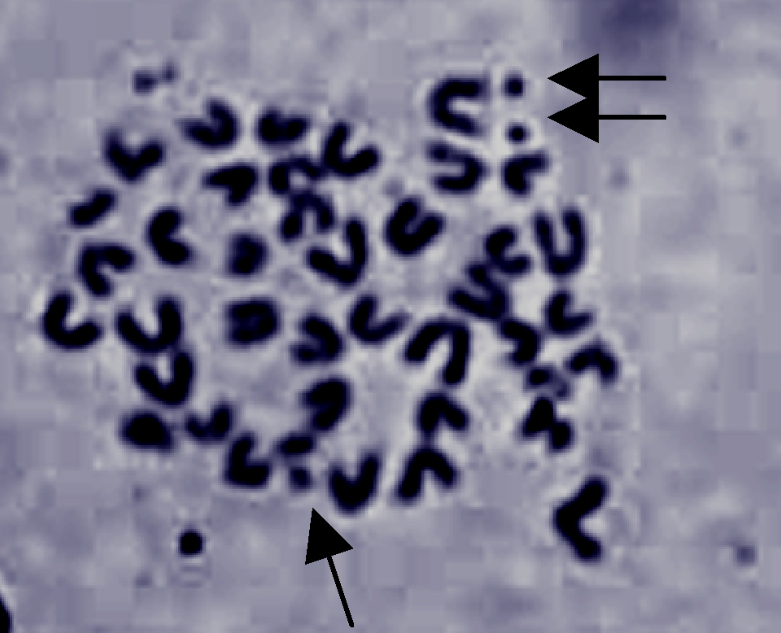
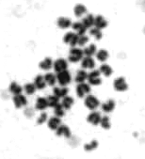
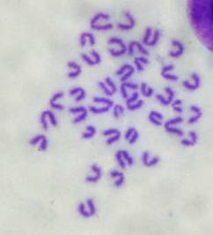
A.
B.
a
b
a
b
Eμ-D1T286A + MMC
Non-Tg + MMC
Eμ-D1T286A + HU
Non-Tg + HU
# Chromatid Breaks/
Cell
# Chromatid Breaks/
Cell
Eμ-D1T286A
MMC
Non-Tg
MMC
Eμ-D1T286A
HU
Non-Tg
HU
C.
a
b
Eμ-D1T286A Untr
Non-Tg Untr
# Chromatid Breaks/
Cell
Eμ-D1T286A
Untr
Non-Tg
Untr
Figure 2.1. Expression of cyclin D1T286A generates chromosomal instability following DNA damage. (A and B) Chromatid breaks following MMC (A) or HU (B) treatment occur at a greater frequency in splenocytes expressing Eμ-D1T286A. Splenocytes derived from non-transgenic or Eμ-D1T286A premalignant mice were cultured for 24h in the presence of 100μM MMC or cultured for 24h, followed by a 2h pulse with 2mM HU and resuspension in fresh media. Cells were then treated with colcemid for 2h to allow arrest in metaphase. (C) Untreated non-transgenic and Eμ-D1T286A splenocytes do not exhibit a significant number of chromatid breaks. Representative images of metaphase spreads are shown, and the average number of chromatid breaks per metaphase spread was quantified for each treatment.
54

Slide 2
A.
B.
-
+
-
+
-
+
-
+
MG132
+
-
+
-
+
-
DMSO
-
0.5
1
2
5
10
mM HU (3h)
-
-
+
+
-
+
-
-
Flag-D1
+
+
2mM HU
Endo. Cyc D1
Cyc D1
γH2AX
γH2AX
3T3-D1
β-Actin
3T3-D1
3T3-T286A
β-Actin
C.
-
1
3
6
-
1
3
6
2mM HU (h)
D.
CHX (min)
0
10
20
30
60
0
Cyc D1
10
20
30
60
γH2AX
Cyc D1
β-Actin
β-Actin
3T3-D1
3T3-T286A
Untreated
2mM HU
Normalized Cyclin D1 Levels
*
*
2mM HU (h)
CHX (min)
E.
-
1
3
6
-
1
3
6
10Gy γIR (h)
Cyc D1
*
Normalized Cyclin D1 Levels
p-Chk2
*
Chk2
*
γH2AX
3T3-D1
3T3-T286A
β-Actin
10Gy γIR (h)
F.
G.
H.
0.5
2
0.5
-
-
0.5
-
-
2
Time (h)
0.5
2
-
-
20μg/mL Bleo
2
Time (h)
+
+
p-T286
p-T286
Cyc D1
Cyc D1
p-Chk1
Cyc D1
p-Chk1
Chk1
Chk1
p-Chk2
γH2AX
p-Chk2
Chk2
β-Actin
Chk2
γH2AX
D1
T286A
2mM HU
5μM Aph
β-Actin
β-Actin
2mM HU
5μM Aph
Figure 2.2. Phosphorylation-dependent proteolysis of cyclin D1 following DSB induction. (A) Synchronous 3T3-D1 cells were treated with increasing doses of HU as indicated, and cell lysates were prepared for immunoblot for cyclin D1 and γH2AX as a marker of DSB induction. (B and C) Cyclin D1 degradation is phosphorylation and proteasome dependent. (B) Synchronous 3T3-D1 or D1T286A cells were treated with MG-132 and HU for 4h. (C) 3T3-D1 or D1T286A cells were treated with HU as indicated, and cyclin D1 levels were assessed. (D) HU treatment decreases cyclin D1 half-life. S-phase 3T3 cells were pretreated with HU, followed by 100μg/mL cycloheximide (CHX) as indicated. (E) Cyclin D1 levels rapidly decline following γIR. 3T3-D1 or T286A cells were subjected to 10Gy γIR, and cyclin D1 levels were assessed. Chk2 mobility shift and γH2AX are DSB markers. (F) Bleomycin promotes cyclin D1 degradation. Asynchronous 3T3-D1 or T286A cells were treated with 20μg bleomycin/mL (bleo) for 2h, and cyclin D1 levels were assessed. (G and H) Stalled DNA replication is not sufficient to induce cyclin D1 proteolysis. Synchronous 3T3 cells (G) or 3T3-D1 cells (H) were treated with HU (DSB induction) or aphidicolin (Aph, stalled DNA replication).
55

Slide 3
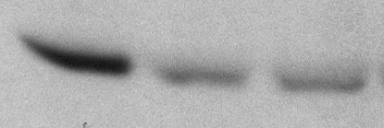
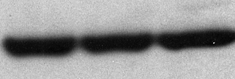
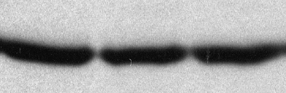
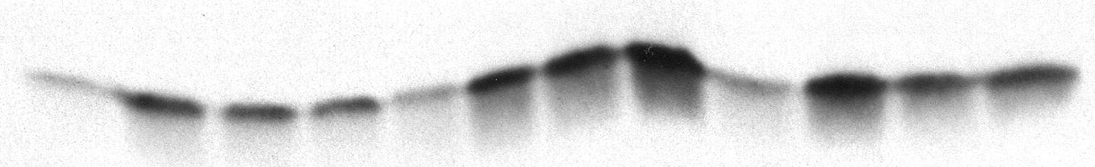
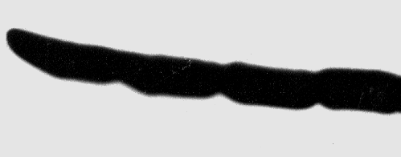

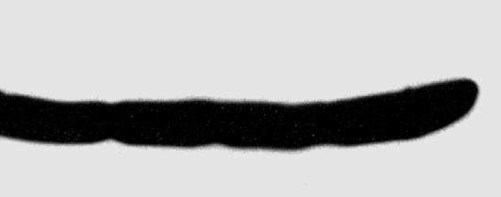


A.
-
-
-
1
3
1
3
1
3
12Gy γIR (h)
Cyc D1
γH2AX
KYSE 520
TE3
β-Actin
TE7
B.
-
1
3
-
1
3
-
1
3
20Gy γIR (h)
Cyc D1
p-Chk2
KYSE 520
β-Actin
TE3
TE7
C.
-
1
3
10 Gy γIR (h)
Cyc D1
Cyc D2
Cyc E
3T3-D1
β-Actin
Figure 2.3. γIR-induced degradation is specific to wild-type cyclin D1 protein. (A and B) Cyclin D1 is refractory to degradation in esophageal carcinoma cells harboring the endogenous P287A mutation. Asynchronously proliferating cells expressing wild-type cyclin D1 (KYSE 520) or P287A mutant cyclin D1 (TE3/TE7) were irradiated with a moderate dose (A) or high dose (B), and the cyclin D1 levels and checkpoint activation were assessed by immunoblotting as indicated. (C) Cyclin D1, but not cyclin D2 or cyclin E, is degraded following DNA damage. Asynchronously proliferating NIH 3T3 cells stably expressing cyclin D1 were irradiated, followed by recovery at 37°C. Protein stability was assessed by direct immunoblot.
56

Slide 4


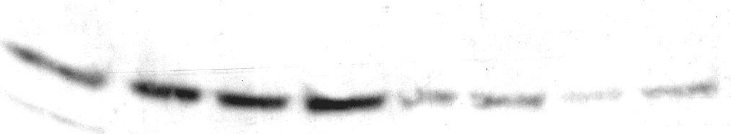

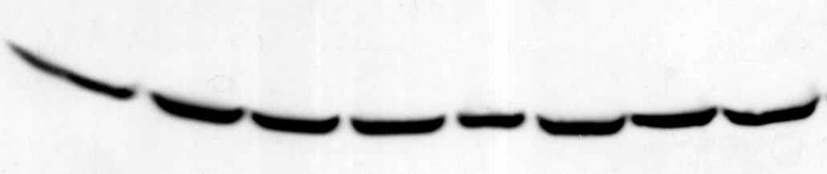
A.
B.
-
-
-
0.5
1
3
-
0.5
1
3
10Gy γIR (h)
20
20
10Gy γIR (min)
p-T286
p-T286
Cyc D1
Cyc D1
p-Chk2
Myc-Kd GSK3β
Chk2
Chk2
β-Actin
Kd-GSK3β
β-Actin
C.
3T3-D1
3T3-290/95A
GFP
-
-
-
+
+
+
10 Gy γIR
-
-
25
25
SB216763 μM
40
-
-
-
-
40
*
-
-
LiCl mM
*
p-T286
Cyc D1
p-Chk2
Chk2
β-Actin
E.
-
5
D.
NRS
15
30
60
10Gy γIR (min)
-
-
10Gy γIR (h)
³²P γATP MBP
0.5
1
2
0.5
1
2
p-T286
GSK3β
Cyc D1
F.
-
+
-
+
GSK3β
-
-
+
20μM SB203580
+
γH2AX
2mM HU
β-Actin
Cyc D1
Control sh
GSK3β sh
p-p38
γH2AX
β-Actin
Figure 2.4. GSK3β catalyzes rapid cyclin D1 T286 phosphorylation following DNA damage. (A) Cyclin D1 phosphorylation is induced by DNA damage. Asynchronous 3T3-D1, D1290/95A, or D1T286A cells were subjected to γIR, followed by immunoblot analysis as indicated. (B) Expression of kdGSK3β abrogates cyclin D1 phosphorylation. 3T3 cells transiently expressing GFP or myc-tagged kdGSK3β plus GFP were irradiated and immunoblotted for p-T286, cyclin D1, and myc tag. (C) Inhibition of GSK3β attenuates cyclin D1 phosphorylation following DNA damage. 3T3-D1 cells were pretreated with the GSK3β inhibitor LiCl or SB216763, followed by γIR. Cyclin D1 phosphorylation was assessed by immunoblot for p-T286 and total cyclin D1. (D) shRNA-mediated knockdown of GSK3β attenuates cyclin D1 phosphorylation. 293T cells were transfected with control or GSK3β-specific shRNA, cyclin D1, and CDK4 constructs. Cells were subjected to γIR and recovery for the times indicated, and cyclin D1 phosphorylation, efficiency of GSK3β knockdown, and checkpoint activation were assessed by immunoblotting. (E) GSK3β is activated following DNA damage. Endogenous GSK3β precipitated from cells following γIR was utilized as a kinase for in vitro reactions with recombinant myelin basic protein substrate. (F) Cyclin D1 is rapidly degraded following DNA damage in the presence of p38 inhibitor. Synchronous 3T3 cells were pretreated with 20µM SB203580 or DMSO for 30 min, followed by HU treatment for 2.5 h. Cell lysates were prepared and probed for p-p38 and cyclin D1.
57

Slide 5
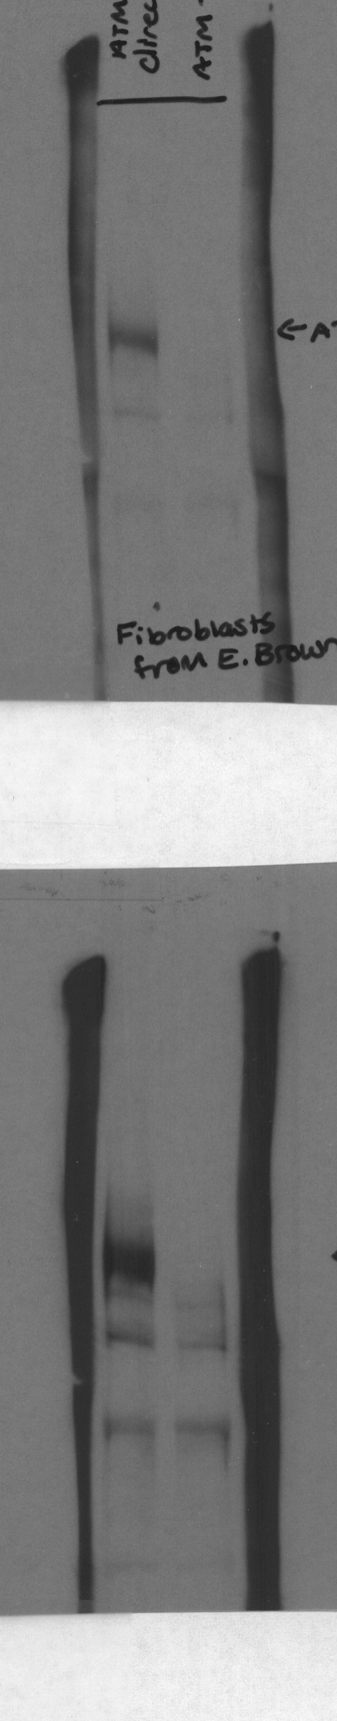

A.
B.
-
1
3
-
1
3
10 Gy γIR (h)
IP Control
Cyc D1
-
20
p-p53
ATM
-
20
10 Gy γIR (min)
p53
Loading
p-T286
M2-IP
+/+
-/-
Cyc D1
β-Actin
Cyc D1
ATM +/+
ATM -/-
γH2AX
Input lysate
Normalized Cyc D1
Levels
β-Actin
+/+
-/-
Time post-10 Gy γIR (h)
C.
-
-
-
+
+
+
15μM KU-55933
-
15
30
-
15
30
10 Gy γIR (min)
p-T286
Cyc D1
β-Actin
p-ATM
ATM
Figure 2.5. ATM signaling is required for cyclin D1 phosphorylation following DSB induction. (A) Cyclin D1 degradation is attenuated in cells lacking ATM expression. Immortalized ATM^{+/+} or ATM–/– MEFs expressing Flag-tagged cyclin D1 were gamma irradiated, and cyclin D1 levels were assessed. p-p53/total p53 induction served as markers of checkpoint activation in these cell lines. (B) DNA damage-induced cyclin D1 phosphorylation is only detected in cells expressing ATM. Immortalized ATM^{+/+} or ATM–/– MEFs expressing Flag-tagged cyclin D1 were irradiated as indicated, and lysates were precipitated with M2-agarose to detect Flag-tagged protein. Cyclin D1 phosphorylation and total levels were assessed by immunoblot. (C) ATM signaling is required for cyclin D1 phosphorylation. 3T3 cells were pretreated with DMSO or the specific ATM inhibitor KU-55933 for 30 min, followed by γIR and recovery for 15 or 30 min. Phosphorylated and total cyclin D1 were detected by immunoblot. A second Western blot was performed with these lysates to probe for phosphorylated ATM and total ATM to ensure efficacy of ATM inhibition.
58

Slide 6
A.
-
-
B.
.75
-
-
1.5
3
1.5
3
10Gy γIR (h)
3
6
3
6
2mM HU (h)
Cyc D1
Cyc D1
Chk2
γH2AX
β-Actin
β-Actin
ATR
ATR
Loading
Loading
DMSO
TAM (24h)
DMSO
TAM (24h)
C.
-
0.5
-
1
3
0.5
1
3
10Gy γIR (h)
p-T286
Cyc D1
ATR
γH2AX
Loading
ATR si
Control si
β-Actin
Control si
ATR si
Figure 2.6. ATR is dispensable for DSB-induced cyclin D1 loss. (A and B) ATR deletion does not alter cyclin D1 degradation following DNA damage. ATR^{flox/–} CET fibroblasts were treated with 4-OH tamoxifen (TAM) for 24h, followed by incubation at 37°C for 12h to allow sufficient ATR depletion. Cells were then irradiated (A) or treated with 2 mM HU (B) as indicated, and the cyclin D1 levels were assessed by immunoblotting. Significant ATR deletion was obtained by TAM treatment. (C) siRNA-mediated attenuation of ATR expression does not inhibit cyclin D1 phosphorylation or degradation. U20S cells were transfected with ATR-specific siRNA and irradiated as indicated 60h after siRNA delivery. Cyclin D1 phosphorylation and total cyclin D1 and the efficiency of ATR knockdown were assessed by immunoblot.
59

Slide 7

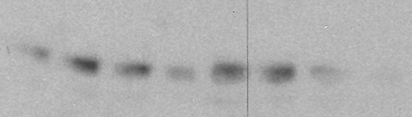
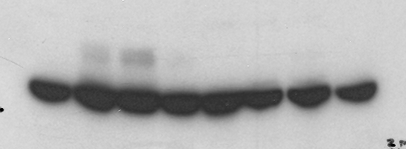
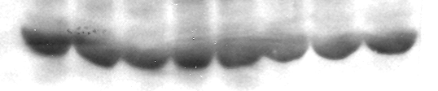
A.
B.
-
-
-
-
5μM SB218078
+
-
0.5
-
+
+
+
1
3
0.5
-
1
3
2mM HU (h)
0.5
3
-
0.5
3
10 Gy γIR (h)
p-T286
Cyc D1
Chk2
Cyc D1
β-Actin
p-Chk1
Luc siRNA
Chk2 siRNA
Chk1
β-Actin
C.
-
-
D.
Untr
0.5
3
Untr
0.5
3
10Gy γIR (h)
0.5
1
3
0.5
1
3
2mM HU (h)
-
-
-
-
-
-
p-T286
+
+
+
+
+
+
5μM SB218078
Cyc D1
Cyc D1
Chk1 (Lt exp)
Chk2
p-Chk1
Chk1
Chk1 (Dk exp)
γH2AX
p-Chk2
Chk2
β-Actin
Scramble shRNA
Chk1 shRNA
β-Actin
Control siRNA
Chk2 siRNA
Figure 2.7. Examining the role of Chk1 and Chk2 kinases in cyclin D1 regulation. (A) Chk2 knockdown modestly attenuates DNA damage-induced cyclin D1 degradation. U20S cells were transiently transfected with Chk2-specific or luciferase control siRNAs. At 60h post-transfection, the cells were gamma-irradiated, and cyclin D1 levels were assessed. (B and C) Chk1 activation is not required for cyclin D1 phosphorylation. Synchronous 3T3-D1 cells were pretreated with the Chk1 inhibitor SB218078 for 30 min (B), or 3T3 cells were transduced with Chk1 shRNA lentivirus (C). Cells were treated with HU, and cyclin D1 phosphorylation and total protein levels were assessed by immunoblot. (D) Chk1 and Chk2 activity is not synergistic in regulating cyclin D1. U20S cells expressing Chk2-specific siRNA were treated with the Chk1 inhibitor SB218078. Cyclin D1 levels were assessed by immunoblot following DNA damage.
60

Slide 8
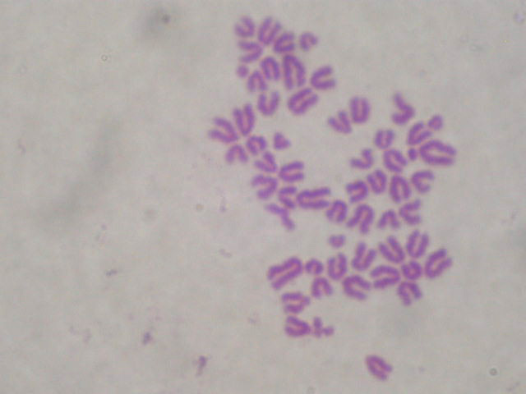
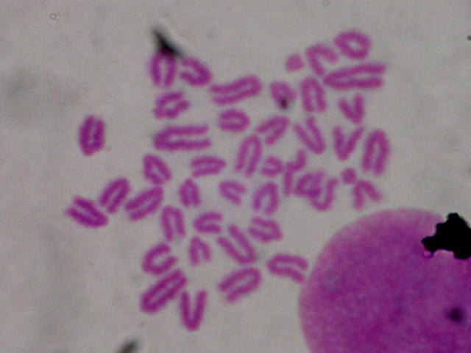
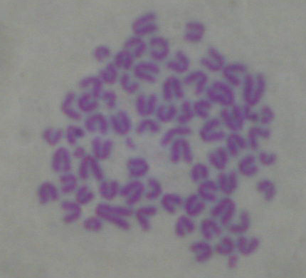
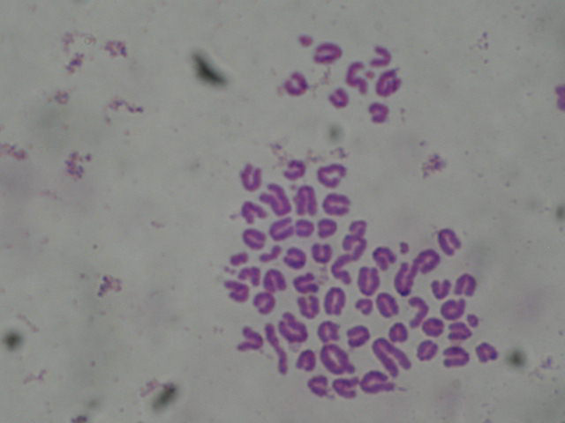
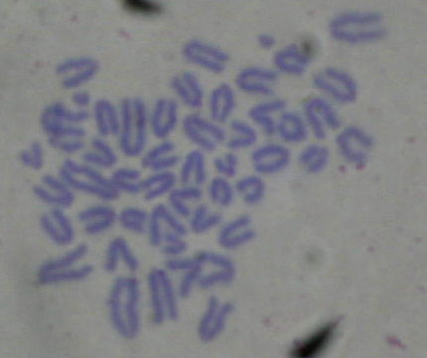
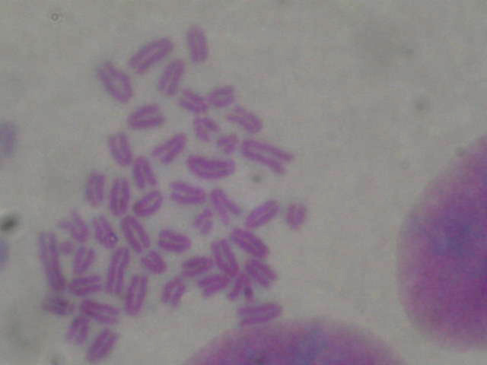
A.
-
2
4
-
2
4
2mM HU (h)
B.
Cyc D1
-
2
4
-
2
4
-
2
4
2mM HU (h)
Fbx4
Cyc D1
β-Actin
αB-Cry
3T3-Mock
3T3-Fbx4sh
3T3-Mock
Clone 1
Clone 4
β-Actin
C.
D.
3T3-αB Cry shRNA
-
1
3
-
1
3
10Gy γIR (h)
αB-Cry
Untx
Vector
Input
NRS
Cyc D1 IP
Cyc D1
-
-
3
Cyc D1
-
3
-
-
3
-
3
10 Gy γIR (h)
γH2AX
FLAG-D1
β-Actin
αB-Cry
CDK4
Vector
αB-Cry
D1
L32A
D1
L32A
E.
F.
a
b
Untreated
Vector Untr
Vector HU
# Chromatid Breaks/Cell
c
d
Fbx4sh Untr
Fbx4sh HU
2mM HU
e
f
# Chromatid Breaks/Cell
*
*
D1T286A Untr
D1T286A HU
Figure 2.8. SCF^{Fbx4} regulates cyclin D1 stability following DNA damage. Fbx4 and αB crystallin are required for cyclin D1 degradation following DNA damage. (A and B) Synchronous 3T3 cells expressing control and either Fbx4 (A) or αB crystallin-specific shRNAs (B) were treated with HU, followed by immunoblot as indicated. (C) MDA-MB 231 cells expressing empty vector or αB crystallin were irradiated, followed by recovery at 37°C, and cyclin D1 stability was assessed by immunoblot. Confirmation of exogenous αB crystallin expression in this cell line is shown. (D) Mutation of leucine 32 within the RxxL motif does not alter DNA damage-induced cyclin D1 degradation. 293T cells were transfected with Flag-tagged wild-type D1 or D1L32A, along with CDK4 and GFP. Cell lysates were prepared and precipitated with M2 agarose beads to recognize Flag-tagged protein. Immunoprecipitates and inputs were probed to assess cyclin D1 and CDK4 association. (E) Disruption of SCF^{Fbx4} sensitizes cells to genomic instability after HU treatment. 3T3 cells stably expressing control or Fbx4-specific shRNA were treated with 2mM HU for 3h, followed by nocodazole treatment to arrest cells in metaphase and metaphase spreads were prepared. Representative images of chromatid breaks are shown (E), and the average number of chromatid breaks/spread was quantified for each treatment (F). 3T3 cells expressing cyclin D1T286A served as a positive control for chromatid breaks following HU.
61

Slide 9





A.
B.
3
6
3
-
-
6
0
10Gy γIR (h)
0.5
1
2
0
0.5
1
2
Bleo (h)
MCM3
CDT1
PCNA
γH2AX
KYSE 520
TE 3
Loading
β-Actin
-
Chromatin-Bound
1
3
6
-
1
3
6
Cyc D1/CDK4
Cdt1
T286A/CDK4
Cdt1
10Gy γIR (h)
MCM3
KYSE 520
TE 3
β-Actin
C.
D.
Soluble
E.
*
*
DNA Synthesis
Relative to control
*
DNA Synthesis
Relative to control
DNA Synthesis
Relative to Control
F.
γIR
G.
γIR
γIR
-
2
-
2
Bleo (h)
Fbx4
Cyc D1
% Sub-G1
*
*
Cyc D2
γH2AX
DMSO
25μM
DMSO
25μM
50μM
β-Actin
CPT
CPT
CPT
Mock
Fbx4sh
24h Treatment
48h Treatment
Figure 2.9. Failure to degrade cyclin D1 compromises the intra-S-phase checkpoint response to DNA damage. (A) CDT1 stabilization following DNA damage in cells expressing cyclin D1T286A. HeLa cells were transfected with wild-type or cyclin D1T286A, CDK4, and Cdt1. Cells were treated with 10µg/mL bleomycin as indicated, and CDT1 levels were assessed by immunoblot. (B) Cyclin D1 stabilization promotes MCM maintenance on chromatin. Esophageal carcinoma cell lines expressing endogenous wild-type or D1P287A were irradiated and harvested as indicated. Cell lysates were fractionated into chromatin-bound and soluble fractions; MCM3 binding to chromatin was assessed by immunoblot on chromatin-bound fractions. Ponceau-S stain served as a control for equal loading of chromatin-bound fractions, and PCNA is a representative chromatin-bound protein. (C) Expression of D1T286A results in RDS. RDS assays were performed in synchronous 3T3, 3T3-D1, and 3T3-D1T286A cells. Equal concentrations of DNA were counted for [³H] and [¹⁴C]thymidine incorporation. DNA synthesis (calculated ratio of [³H] to [¹⁴C]) was normalized to the non-irradiated control for each cell line. (D) Disruption of SCF^{Fbx4} promotes RDS. RDS assays were performed as in (C) utilizing cells stably expressing luciferase, αB cry, or Fbx4-specific shRNA. (E) Fbx4 attenuation in cyclin D1-null cells does not result in RDS. RDS assays as in (C) were performed in wild-type or cyclin D1-null MEFs stably expressing shRNAs as indicated. (F) Fbx4 levels are attenuated in cyclin D1-null MEFs stably expressing Fbx4-specific shRNA. (G) Failure to degrade cyclin D1 sensitizes cells to CPT. 3T3-D1 or D1T286A cells were treated with CPT as indicated for 24 or 48 h. Cells were fixed and stained with propidium iodide and subjected to FACS analysis; a sub-G₁ population is indicative of apoptotic cells.
62

