Slide 1
Decoding and Negotiating Publisher Contracts: Know What You're Signing Away When You Publish
Sarah Wipperman
Penn Libraries

Slide 2
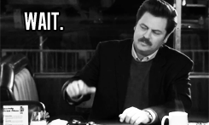

Before we begin…

Slide 3


What is copyright?
Notes:
Copyright isn’t just one thing. [click] It is actually multiple rights – “copy rights” – that make up the copyright over a work.

Slide 4
Author
Notes:
As soon as you create something in a *fixed, tangible form* [click], you have copyright over it. Automatically. (give examples.)

Slide 5
Notes:
As soon as you create something in a *fixed, tangible form* [click], you have copyright over it. Automatically. (give examples.)

Slide 6
Exclusive Rights of a
Copyright Holder:
Put on Fridge
Give to Mom
Reproduction
Make a movie
Distribution
Public display and performance
Post online
Remix
Creation of derivative work
Translate
Notes:
As noted previously, there are multiple rights associated with copyright that you own as the author. For example, you have the right to redistribute your work…etc.

Slide 7





Republish
Republish
Redistribute
Redistribute
Make a movie
Post online
Remix
Translate
Translate
Translate
Translate
Post online
Remix
Notes:
Since you own all of the copyright, when someone else wants to reuse your work, they need to ask you permission to do so (give example). You, in turn, can grant them that permissions. So, [click] you might let someone redistribute your work…etc.
As long as you don’t give someone the exclusive right to something, you can give multiple people the right to, for example, redistribute your work – the non-exclusive right to do so.

Slide 8
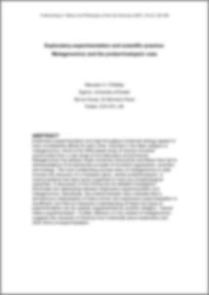
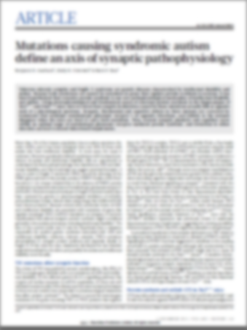
The Publishing Process (Journals)
Copyright Transfer & Publisher Formatting
Original Version
Preprint
Peer-Review
Postprint
Publisher PDF
Published Version
You own
You own
Publisher owns
Notes:
When you publish something, your work goes through various stages before it gets published in a journal, for example.
The original version you create – the version you submit to the journal – is called a “preprint.”
If the journal decides that your work looks like something they would want to publish, they send it off for peer-review, where people in your field evaluate your work and suggest revisions. After you make all of the changes from the peer-review process, your work is now a “postprint.”
Once your postprint is accepted by the journal for publication, the publisher will usually require that you sign a Copyright Transfer Agreement (more on this to come) and will apply publisher formatting, typesetting, and other design aspects to your article.
Once this process is complete, your work is published in its final form with all of the publisher applied formatting. This is called the “Publisher PDF.”

Slide 9


Transfers vs Licenses
Transfer = Ownership
Give up rights
Needs to be done in writing
Licenses = Grant of Permission
Can have time limits

Slide 10

What happens when you sign a Copyright Transfer Agreement?
Author
Publisher
Notes:
You still own all the copyright over your article until you sign a copyright transfer agreement with the publisher. Since you are the author, remember, you have the option to give away certain rights to certain people [click] and retain rights for yourself [click]. Publishers typically ask that you transfer all your rights over to them [click], and they, in turn, will give certain rights back to you [click].
When you transfer your copyright, though, you no longer own rights over the work.

Slide 11
Why is it Important?

Slide 12
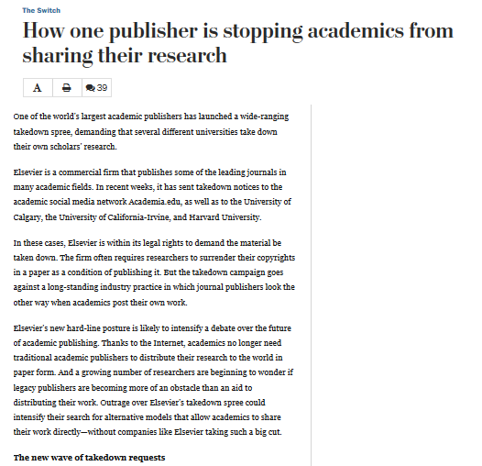
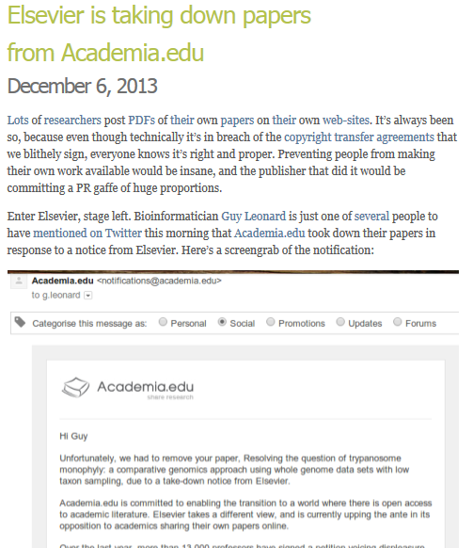

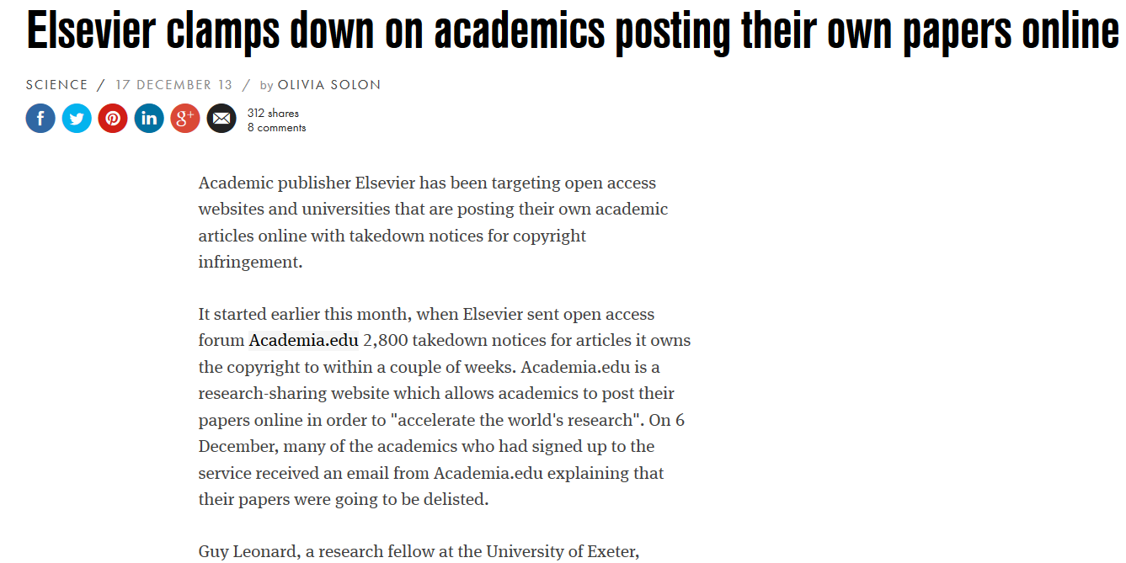
Takedown Notices
http://svpow.com/2013/12/06/elsevier-is-taking-down-papers-from-academia-edu/
But the takedown campaign goes against a long-standing industry practice in which journal publishers look the other way when academics post their own work.
https://www.washingtonpost.com/news/the-switch/wp/2013/12/19/how-one-publisher-is-stopping-academics-from-sharing-their-research/
http://www.wired.co.uk/news/archive/2013-12/17/elsevier-versus-open-access
Notes:
Elsevier sent thousands of take down notices to authors who posted their papers on the site Academia.edu. The authors no longer owned copyright, so they were posting their work in violation of the publisher’s copyright.

Slide 13
To Retain Your Rights, Know Your Rights

Slide 14








Know Your Author Rights
Notes:
6 major commercial pubs; 2 major university pubs

Slide 15
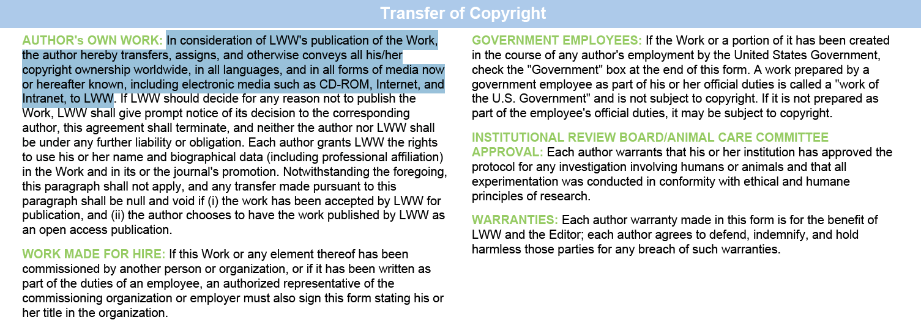
Wolters Kluwer/Lippincott Williams & Wilkins
Notes:
Here is a basic transfer of copyright statement.

Slide 16
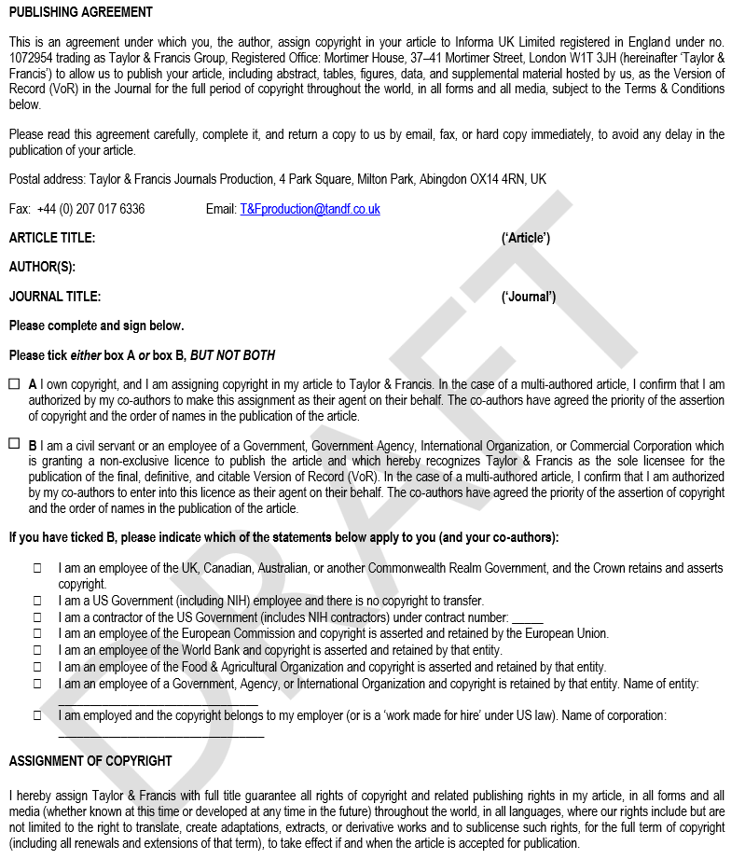
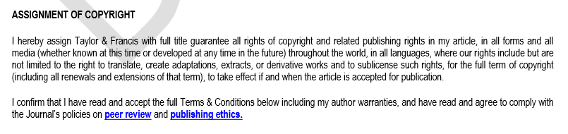
Taylor & Francis
http://authorservices.taylorandfrancis.com/wp-content/uploads/2015/07/sample-publishing-agreement.pdf
Notes:
Here is another CTA example from T&F. Notice the similar phrasing for the CTA

Slide 17
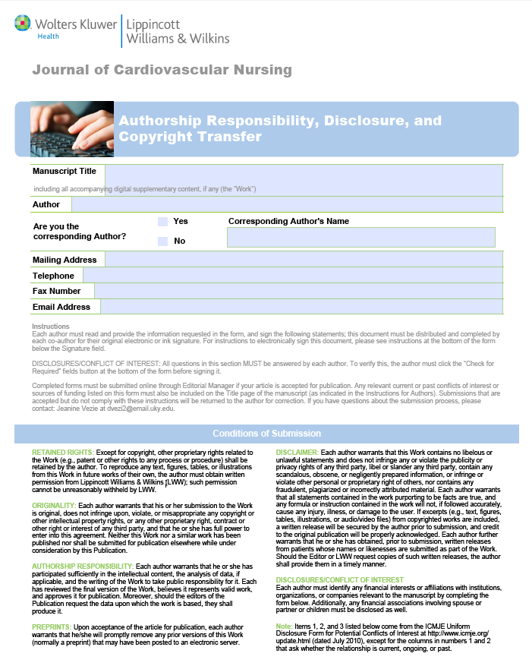
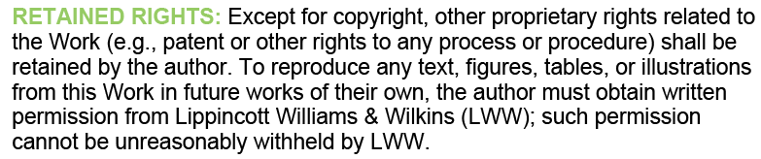
Wolters Kluwer/Lippincott Williams & Wilkins
Notes:
Going over a few CTAs from the 6 major pubs
As seen here, copyright is typically transferred but not other rights, like patents

Slide 18
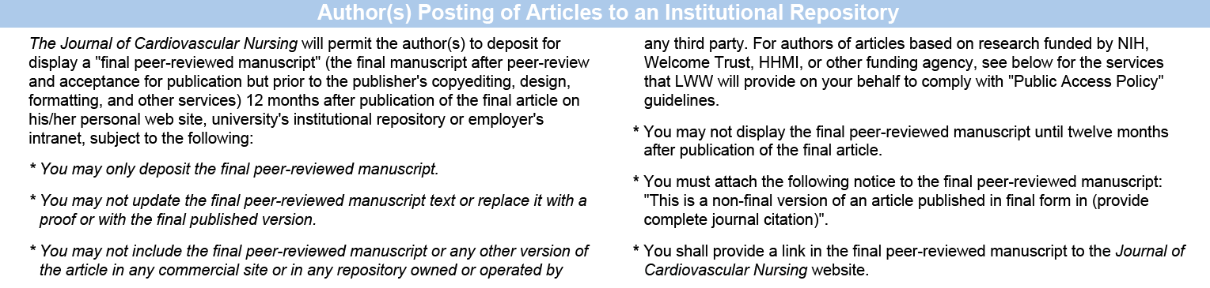
Wolters Kluwer/Lippincott Williams & Wilkins
Required Statement/Other Restrictions
What
When
Where
Notes:
LWW has a specific area that deals with posting to an IR; not all pubs will have this.
3 things are included in a statement about posting policies: what, when, where (go through it). When=embargo
Some might include a required statement or other restrictions that we need to follow.
Don’t need to worry about linking or citations – we do those already. Looking for quoted statements and requests to include a copyright statement, mostly.
NOTE: You will see information about depositing for funding agencies. IRs are NOT the same. Ignore these.

Slide 19
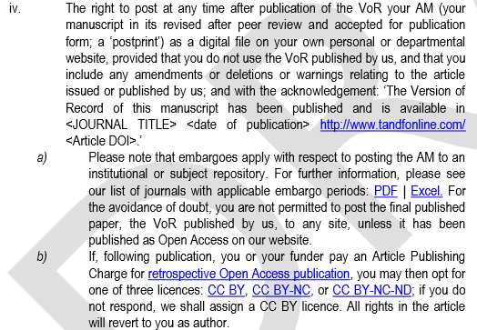
Taylor & Francis
What: AM (postprint)
When: after embargo (PDF)
Where: “to an institutional or subject repository”
Required statement:
“The Version of Record of this manuscript has been published and is available in <JOURNAL TITLE> <date of publication> http://www.tandfonline.com/<Article DOI>.”
Notes:
VoR = Version of Record

Slide 20
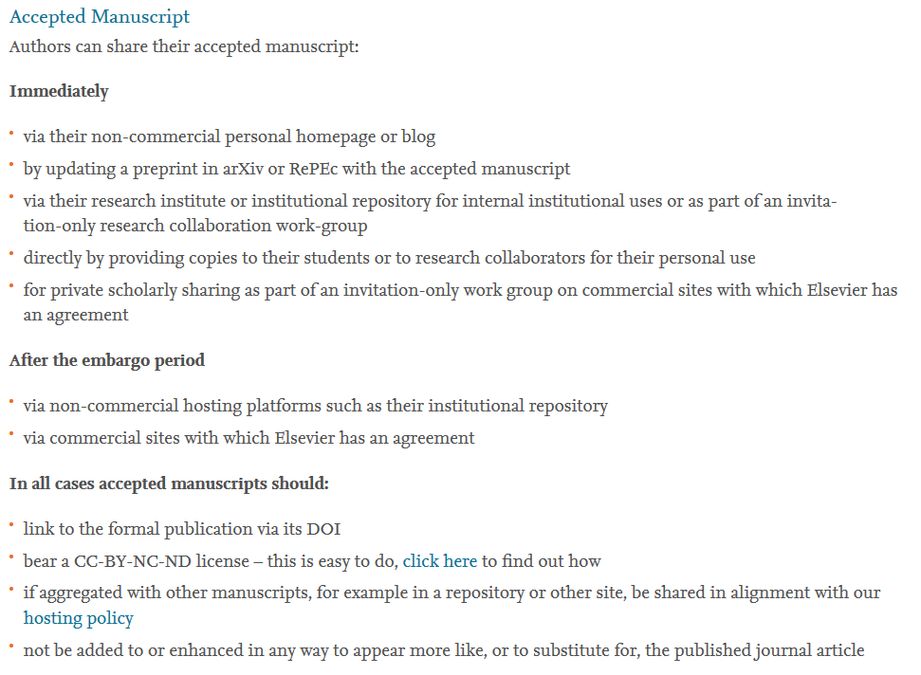
Elsevier: Scholarly Sharing
What
When/Where
Requirements
Sharing Policy: https://www.elsevier.com/about/company-information/policies/sharing

Slide 21
Contact Exercise
Compare the publication agreements.
What rights does the author give away?
What rights does the author retain?
Which contracts are favorable to the author? Which are unfavorable?
Exclusive Rights of a Copyright Holder:
Sharing Questions:
Reproduction
Distribution
What
When
Where
Public display and performance
Creation of derivative work
Required Statement/
Other Restrictions

Slide 22
PNAS
Exclusive Rights of a Copyright Holder:
Sharing Questions:
Reproduction
Distribution
What
When
Where
Public display and performance
Creation of derivative work
Required Statement/
Other Restrictions

Slide 23
Wiley
Exclusive Rights of a Copyright Holder:
Sharing Questions:
Reproduction
Distribution
What
When
Where
Public display and performance
Creation of derivative work
Required Statement/
Other Restrictions

Slide 24
JAMA
Exclusive Rights of a Copyright Holder:
Sharing Questions:
Reproduction
Distribution
What
When
Where
Public display and performance
Creation of derivative work
Required Statement/
Other Restrictions

Slide 25
PLoS
Exclusive Rights of a Copyright Holder:
Sharing Questions:
Reproduction
Distribution
What
When
Where
Public display and performance
Creation of derivative work
Required Statement/
Other Restrictions

Slide 26
Where Can I Find Journal Policies Before I Publish?

Slide 27
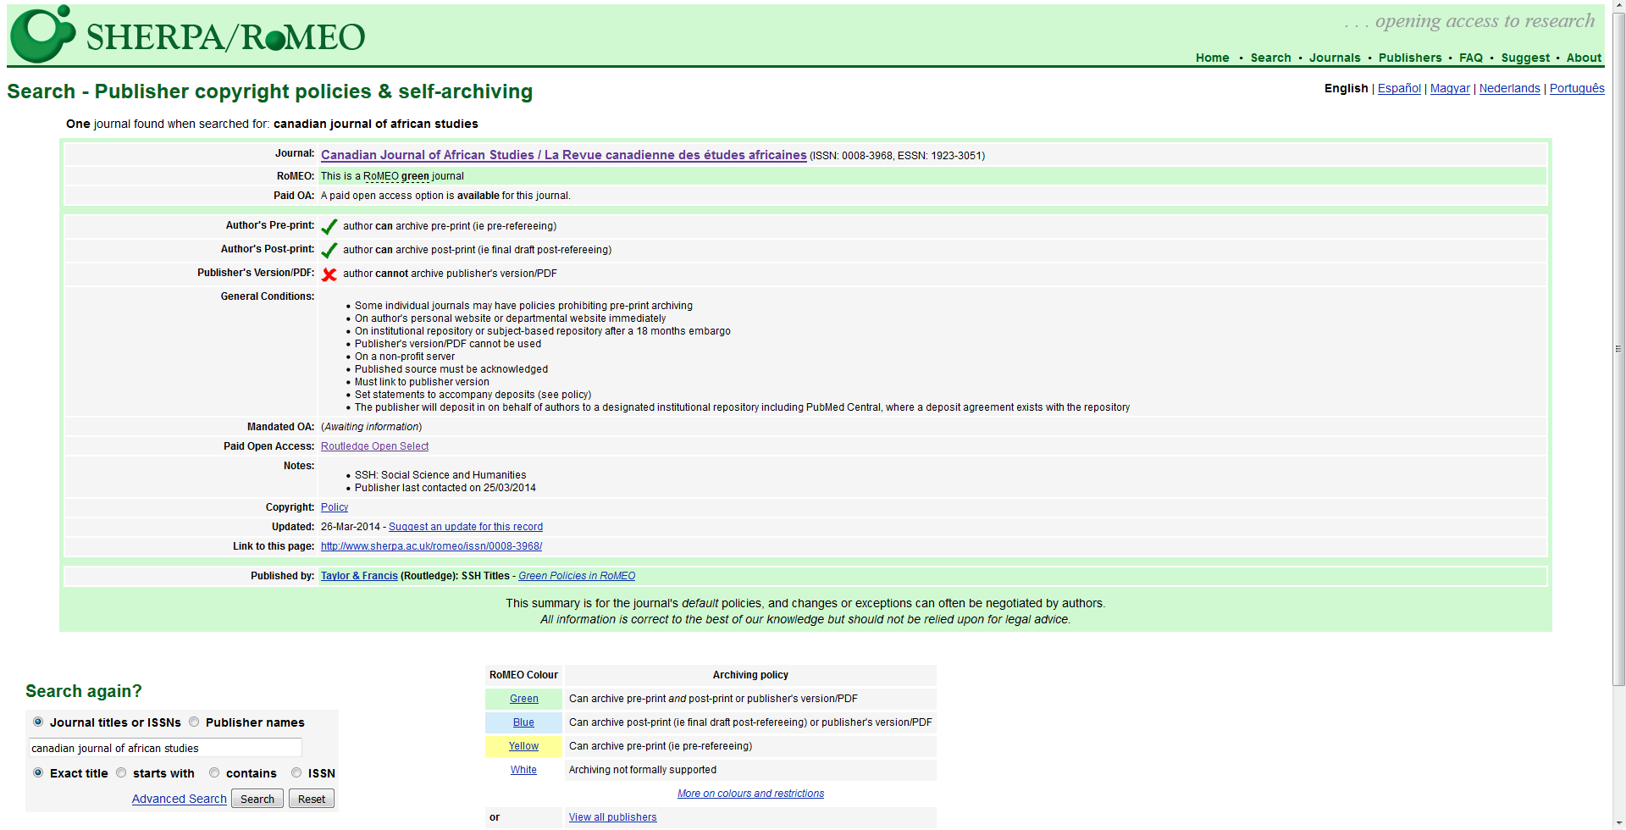
SHERPA/RoMEO
http://www.sherpa.ac.uk/romeo/
Notes:
SHERPA/RoMEO is a good tool to get you started in understanding what publishers allow an author to do/not do, but it is not always rights.
Use for quick links to policies to check
Go over the versions again
Remember to check when it was last updated
PDF resources may be outdated.
Generally, take S/R as a starting point, not the answer.

Slide 28
“Buzz” words to help find policies sections on publisher sites:
Self-archiving
Instructions for authors/author instructions
Author guidelines
Copyright
Permissions/permissions requests
Copyright Transfer Agreement (CTA)
Author Portal/Gateway/Corner/etc.
Reuse
For Authors
FAQ
Depositing
Sharing/reuse
Policies
Open Access
Posting policy

Slide 29
How Can I Retain More of my Rights?

Slide 30
Fight for Your Rights!
NEGOTIATE
Choose Gold open access
SPARC Author Addendum to Publication Agreement
Keep a postprint to use on your personal website or institutional repository
Use Creative Commons licenses (http://creativecommons.org/)

Slide 31
When in doubt…
…contact the publisher.

Slide 32
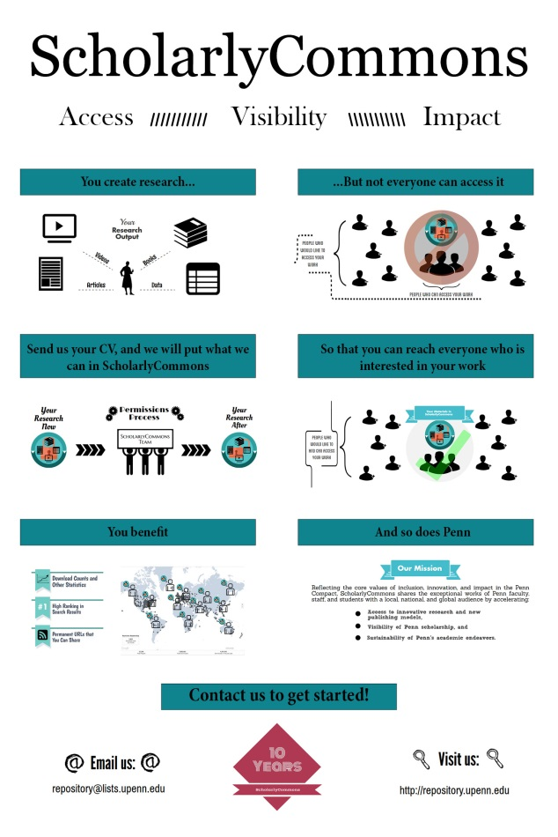
ScholarlyCommons Faculty Assisted Submission Service
Send us your CV or a list of publications
We determine rights/permissions
We post what we can to ScholarlyCommons
You receive statistics, permanent URLs, High ranking in search results
Use the information to post your work elsewhere

Slide 33
Questions?
Contact: Sarah Wipperman swipp@upenn.edu
Eric Halpern ehalpern@upenn.edu

