Slide 1

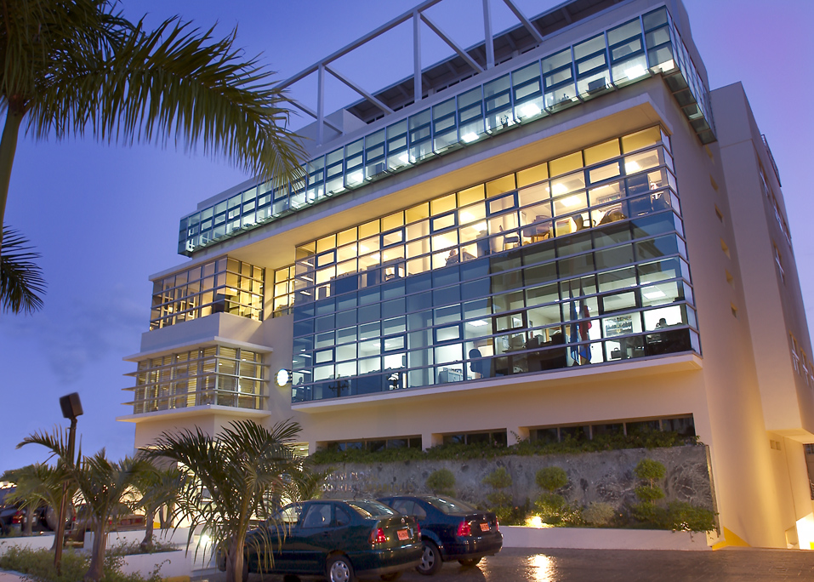
Fundación Global Democracia y Desarrollo
(FUNGLODE)

Slide 2
History
FUNGLODE was created in the year 2000 as a think tank and policy center, with the objective of discussing, debating and promoting public policies in the Dominican Republic and in Latin America and the Caribbean.
Vision
To be a plural think tank of rigorous research, academic excellence and creativity, in order to produce the best choices of public policies, aimed at the strengthening of democracy, respect of human rights, sustainable development and the modernization of the Dominican Republic.

Slide 3
Mission
1) To analyze subjects that are fundamental in promoting human development and the democratic strengthening of the Dominican Republic, based on national and international experiences, policy research, exchange programs, publications, conferences, seminars and workshops.
2) To develop proposals of public policies and action plans that offer responses to our main national programs applying a multidisciplinary approach in benefit of the Dominican Republic.
3)To contribute to the formation of a critical mass in Dominican society, through academic excellence and exchanges with universities and think tanks of national and international prestige.
4)To promote and incentivize creativity and innovation through artistic and cultural initiatives.

Slide 4
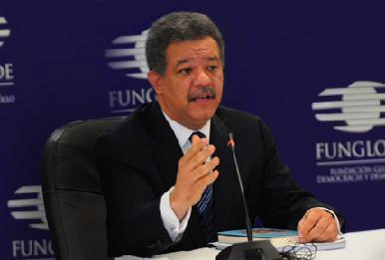
Leadership.
Dr. Leonel Fernández, former President of the Dominican Republic, founded the organization after finishing his first term in the year 2000.
Dr. Fernández has been the most influential politician in the Dominican Republic during the last 20 years; a strong leader that is considered one of the most seasoned and prestigious statesmen in Latin America and the Caribbean.
During his time as president he achieved a sustained and unprecedented growth of the economy of an average of 7% a year and was able to reduce extreme poverty by approximately 10%.
After leaving office in 2012, he reassumed his duties as President and Chairman of the Board of FUNGLODE.

Slide 5
Centers of Studies.
FUNGLODE engages in policymaking and implements its academic agenda through its the centers of studies; comprised by renowned professionals and academics in each field of study that collaborate with the center by meeting and working periodically in order to:
Engage in discussions about the current state of their field of study.
Assess the effectiveness of the policies in that area.
Prepare proposals of new policies.
Organize seminars, conferences and workshops in order to cover new global trends in the subject.

Slide 6
Fields of Study
Democracy
Law
Human Rights
Constitutional Studies
Electoral Studies
Technology and the Law
Education
K-12 Education
Higher Education
International Standards in Education
Technology and Education
Energy and Environment
Sustainable Development
Climate Change
Natural Resources
International Relations
Dominican Council of Foreign Relations
Dominican-Haitian Global Forum
Middle East Studies
European Studies
Future Studies
Global Trends
Singularity
Security and National Defense

Slide 7
Fields of Study
Communication
Media
Political Campaigns
Journalism Studies
Medicine and Health
Public Health System
Trends in Health Care
Education
K-12 Education
Higher Education
International Standards in Education
Technology and Education
Culture
Literature
Music and Arts
Business and Finance
Business Creation
Financial Literacy
Start Up Process
Science, Technology and Innovation
Information society
Internet Studies
Technology and Development
Film and Digital Media
Multimedia studies
Film training
Storytelling

Slide 8
Impact in Public Policy
FUNGLODE seeks to have an effect in national and international policies through a systematic and active agenda that is implemented through many different means:
Conferences: World-class speakers and leaders come to our headquarters on a regular basis to deliver talks and presentations on current global trends, politics, international relations, tendencies in education, technology and new areas of knowledge.
Training: Workshops, intensive programs and short courses are available in a periodic manner in all fields of studies, delivered by first rate professors and professionals.
Research: Our partners and collaborators join with members of our Centers of Studies to engage in research projects in social sciences, public administration, among other subjects.

Slide 9
Impact in Public Policy
All the resulting knowledge is compiled in our publications, or used as a basis for proposals for public policy in all areas of study. In 13 years, FUNGLODE has successfully engaged in a participative political process in order to influence policies in the following areas:
Reform of the Constitution of the Dominican Republic
Civil Code Reform
Environmental policies
Film Laws and Regulation

Slide 10
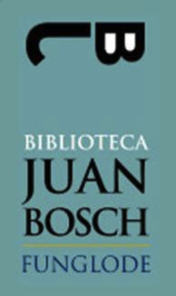
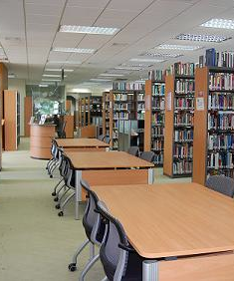
Information Resources
Juan Bosch Library
FUNGLODE’s library and main hub of information resource. Over 450,000 volumes, hundreds of periodical publications and access to over 100 databases all over the world. Open to the general public, It is the most complete privately funded library in the Dominican Republic.
http://www.bibliotecajb.org

Slide 11

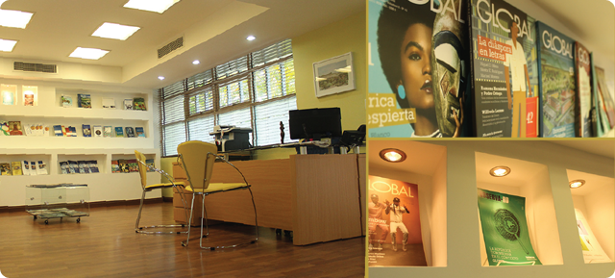
Publications
Editorial Funglode is the FUNGLODE publishing house. It has published over 60 books and periodical publications in which high quality content reaches our public and our partners, both nationally and abroad.
http://www.editorialfunglode.com/

Slide 12
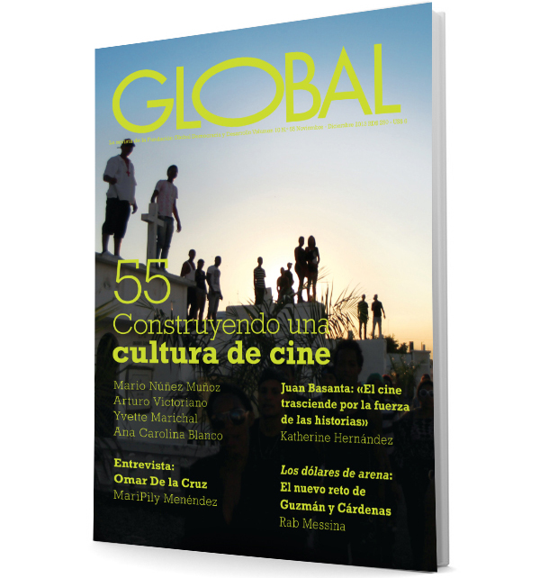
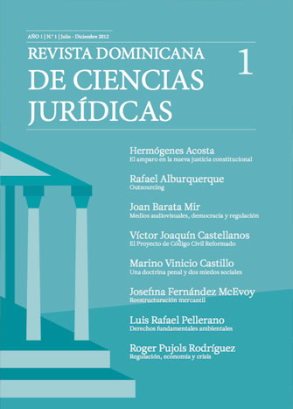
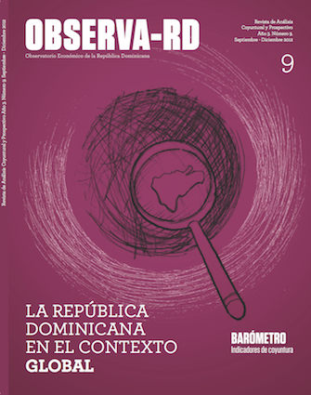
Publications
Revista Gobal Published every 2 months, it aims to publish high quality content from our region’s most distinguished scholars, in all the fields of study at FUNGLODE.
Revista Dominicana de Ciencias Juridicas Published each semester. It is one of the main sources of legal doctrine in the Dominican Republic, and it is comprised by legal essays by Latin America’s most prestigious practitioners and academics.
Observa RD Periodical research and economic indicators prepared by our center of studies in economy. Each issue covers a general subject related to or that affects our national economy, financial markets or international trade
Available issues of magazines:
http://www.editorialfunglode.com/index.php/revistas/revistas-gratis#observa-rd

Slide 13
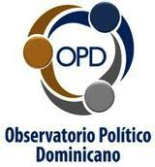
Observatorio Politico Dominicano (OPD)
OPD stands for “Political Observatory of the Dominican Republic”. Created by FUNGLODE, It comprises a team of social researchers that analyze the social and political reality of the Dominican Republic in a systematic and consistent manner, with the objective of generating and sharing the findings and the knowledge through publications and events, in order to elevate the level of discussions related to public policies in the Dominican Republic. Its main subjects of research are:
Public Policies
Civil Society
Local Government
Political Parties
Judicial Observatory
http://www.opd.org.do

Slide 14

Consejo Dominicano de Relaciones Internacionales (CDRI)
The Domincan Council of International Relations is an international relations research center created by Funglode in order to integrate experts and researchers of international relations, in order to analyze and comprehend the most relevant events and processes on the International Community. CDRI also seeks to assess the impact on the country and the region, of some events that even while taking place on the other side of the globe, its effect can have a material impact for the Dominican Republic, Latin America and the Caribbean.
http://cdri.funglode.org.do

Slide 15

Interdom Internships Program.
The most successful program of this nature in the Dominican Republic, InteRDom is a competitive internship, research and study program that promotes professional, academic and cultural exchanges between students, universities, professionals, businesses and non-governmental organizations on both national and international scales. Its objectives are
To organize internship programs that contribute both to the professional development of the intern and the institutional development of the recipient organization.
To offer students academic programs that correspond with their interests and permit in-depth understanding of Caribbean reality.
Organize meetings between international interns, professionals, professors and Dominican students to facilitate the exchange of knowledge and experience.
Positively impact the Dominican labor force by providing competent and enthusiastic interns.
http://www.interdominternships.org

Slide 16

The Fellows Program
The Fellows Program, is an extension of the internship and academic exchange program InteRDom. It was developed in 2009 by GFDD, FUNGLODE’s sister institution in the United States, to develop a community of scholars that contributes to the Foundations' growing body of research on matters of international concern that directly impact the Dominican Republic, complementing the overall mission of GFDD and FUNGLODE to promote academic exchange, generate scholarship, and influence the creation of public policy related to economic and social development both at the national and international level.
http://www.drfellowsprogram.org

Slide 17

The United Nations Association of the Dominican Republic (UNA-DR)
One of the initiatives that has impacted more the Dominican youth population is The United Nations Association of the Dominican Republic (UNA-DR), created and supported by FUNGLODE and GFDD in the year 2002. UNA-DR is a nonprofit, non-governmental organization dedicated to supporting the work of the United Nations. It coordinates educational and cultural initiatives to raise awareness of the United Nations' work and encourage participation in UN-related activities. Its main projects are the Model UN and Model of the Inter-American System, providing valuable learning and networking experiences for thousands of youths.
Since its creation, more than 24,000 young men and women have participated in this life-transforming experience.
http://www.unadr.org.do

Slide 18
Arts and Culture

Slide 19

Premios FUNGLODE /GFDD
Every Year, we organize a national arts and culture awards ceremony, premios FUNGLODE. Divided into 7 categories, we receive close to 400 entries and submissions the winner is awarded a financial incentive and publication of the piece. It is to date, one of the most important literary prizes in the Dominican Republic. The categories are:
Short Stories
Novels
Essays
Journalism
http://www.funglode.org/premiosfunglode/portada.php
Poetry
Documentary
Photography

Slide 20

http://www.radiofunglode.org
RADIO FUNGLODE is the organization’s digital radio that arose with the goal of bringing content that contributes to the cultural and intellectual growth of the community.
RADIO FUNGLODE comes as a space for dialogue, meeting, sharing, idea generation, creation and promotion open to the entire Dominican society cultural events, projected to the Dominican Republic and to the world.

Slide 21

Global Film Festival
What started as an effort to impact the national economy through effective public policies that would create a film industry, FUNGLODE followed that initiative with the creation of the most important film festival in the Dominican Republic.
The Dominican Republic Global Film Festival presents a selection of the best international, documentary and dramatic films to enrich the country’s cinematic culture and take the seventh art to all sectors of Dominican society. The Festival contributes to raising awareness and understanding of global issues through stories about events and people that have left a mark on our lives. It uses film as a way to promote and encourage discussion about social issues, politics and economics.
http://festivaldecineglobal.org/2013/

Slide 22

The DR Environmental Film Festival
The DR Environmental Film Festival aims to raise awareness and deepen the understanding of environmental issues among Dominican audiences. At the same time, the Festival celebrates the beauty and diversity of the Dominican Republic's natural heritage and offers insights into attitudes and actions that will contribute to its appreciation, conservation and sustainable use. By screening a diverse selection of high quality films that deal with pressing issues, and by organizing discussion panels with environmental experts, filmmakers and other stakeholders, the Festival seeks to promote dialogue and inspire Dominican audiences to adopt practices that will ensure the country's environmental sustainability and health.
http://www.dreff.org

Slide 23

I-Global University

Slide 24
I-Global University
I-Global University is a higher education institution created by FUNGLODE, that offers masters and postgraduate degrees in several fields in social sciences and law.
History
From its early years, training and education was an integral part of FUNGLODE’s work. In every field of study, our centers of studies always included workshops and courses in the working agenda in addition to our presentations and seminars. Our workshops became one week courses, then certificate programs, and eventually FUNGLODE started offering Master Degree Programs in alliance with some of the most prestigious universities in Europe. That led to the creation of the “Instituto Global de Altos Estudios en Ciencias Sociales (Iglobal)”.

Slide 25
I-Global University
Programs. Iglobal currently offers one PhD program, 11 masters degrees and several certificate programs in a diverse array of fields and subjects.
Masters Degrees:
Master in Political Science Offered jointly with the Universidad de Salamanca, Spain
Master in Administrative Law Offered jointly with the Universidad de Salamanca, Spain
Master in Public Administration Offered jointly with the Universidad Ortega & Gasset, Spain;
Master in Security and Defense Offered jointly with the Universidad Ortega & Gasset, Spain;
Master in Constitutional Law Offered jointly with the Sorbonne University, Paris, France;

Slide 26
I-Global University
Masters Degrees:
Master in Urban Planning and Development Offered jointly with the Universidad Ortega & Gasset, Spain;
Master in Electricity Regulation Offered jointly with the Universidad de Comillas, Spain;
Master in International Relations Offered jointly with the Universidad Complutense de Madrid, Spain;
Master in International Business Offered jointly with the Universidad Pompeu Fabra, Spain;

Slide 27
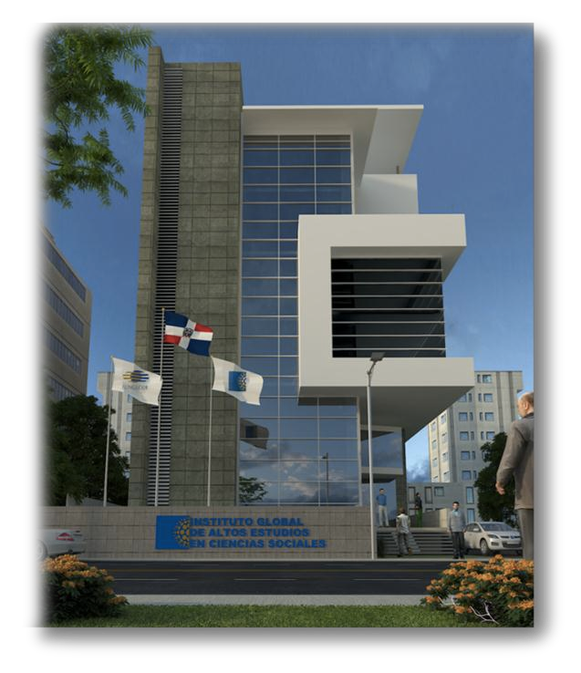
I-Global University
Future Plans.
Within the next 24 months, Iglobal is planning an expansion, both in its curricular offer and in pshysical infrastructure. A new building that will offer 20 new classroom, an auditorium and space for administrative offices will take I-global into a new stage of development.
The curricular offer will also be expanded to include more programs in business and technology, and to offer executive education in new traits and trends required to succeed in an complex globalized environment.

Slide 28
Offices in the US and Europe

Slide 29

Global Foundation for Democracy and Development (GFDD)
GFDD is the sister institution of FUNGLODE in the United States. It is also a non profit, non partisan organization dedicated to the advancement of global collaboration and exchange relevant to Dominican professionals, general audiences and institutions in the Dominican Republic and abroad. GFDD promotes better understanding and appreciation of Dominican culture, values and heritage in the Dominican Republic, US and worldwide.
GFDD manages all FUNGLODE initiatives in the United States. It has offices in New York, and Washington, D.C., where it works closely with the United Nations system and the Organization of American States, respectively.
http://www.globalfoundationdd.org

Slide 30
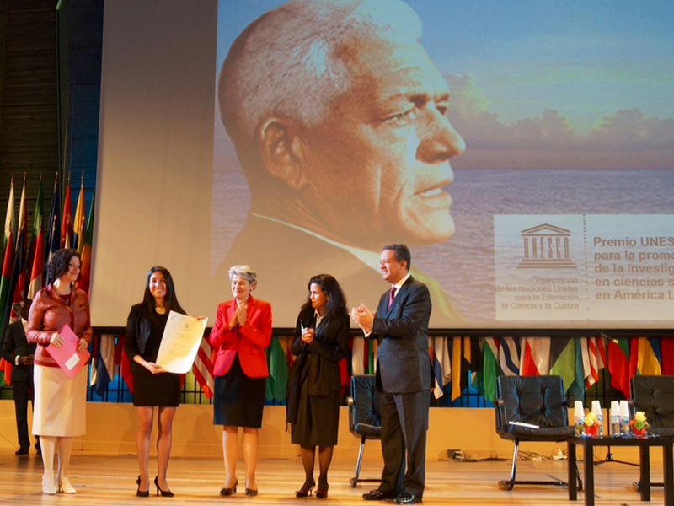
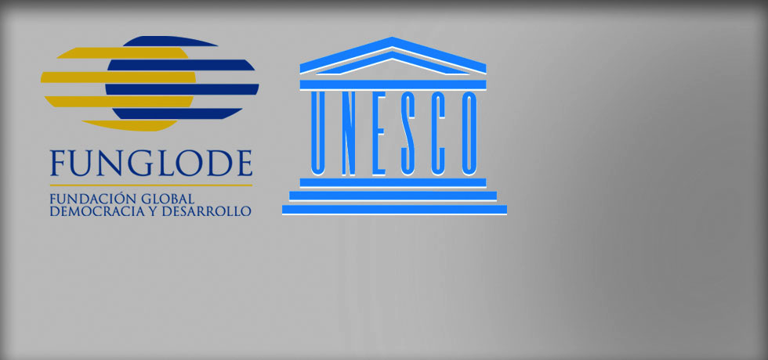
Funglode-Unesco, Paris
In the year 2013, FUNGLODE opened a satellite office inside the headquarters of UNESCO, in Paris, France. This office is the main representation of FUNGLODE in EUROPE, and follows closely all initiatives in education and culture set forth by this international organization.

Slide 31
Stakeholders and Partners

Slide 32

EU-LAC FOUNDATION
Created in May 2010 by the 6th Summit of Heads of State and Government, the European Union-Latin America and Caribbean Foundation (EU-LAC Foundation) took up its activities in November 2011. It has its seat in the city of Hamburg, Germany. The EU-LAC Foundation has 62 members: the 33 states of Latin America and the Caribbean, the 28 members of the European Union, and the European Union institutions.
The Foundation aims at transforming the strategic partnership between the European Union, Latin America and the Caribbean, which was adopted in 1999, into a strengthened and visible reality in which all societies participate actively. By election of the 62 countries represented in both regions, EULAC has 2 strategic partners in Latin America; the Economic Council of Latin America and the Caribbean (ECLAC), and the Fundación Global Democracia y Desarrollo (FUNGLODE). As strategic partner to EU-LAC, FUNGLODE assists in executing the foundation’s agenda in the region, particularly in the Caribbean.
http://eulacfoundation.org

Slide 33
Work with UN System
FUNGLODE/GFDD is fully dedicated to promoting and advancing issues at the forefront of the United Nations' agenda. Its Fellows Program chooses areas of research that are fully aligned with ECOSOC topics of interest. Research outcomes and results are then presented during ECOSOC regular sessions at UN Headquarters in New York. FUNGLODE/GFDD regularly participate in UN agencies discussions and meetings and contribute to their reports and position papers.
Both FUNGLODE and GFDD have consultative status with the United Nations through the Economic and Social Council (ECOSOC); it has special status with the UN Conference on Trade and Development (UNCTAD), the Department of Public Information (DPI), the Global Compact Office, the Office on Drugs and Crime, and the World Summit on Information Society (WSIS), and the United Nations Educational, Scientific and Cultural Organization (UNESCO), with whom FUNGLODE has a special collaboration agreement and hosts a satellite office in UNESCO’s headquarters.

Slide 34
Work with the OAS and the Inter-American System
FUNGLODE AND GFDD are both affiliated with the Organization of American States (OAS) and active supporters of the organization's objectives, of the Inter-American System and the Summit of the Americas program. As members of this community of the civil society, FUNGLODE is always part of the annual OAS General Assembly and the Summit of the Americas process. Joint specific programs in the following fields are regularly developed and implemented with different departments and divisions of the OAS; democracy, regional integration, trade, environment, education, culture, drug abuse prevention, as well as internships and professional training opportunities.

Slide 35
Collaboration Agreements.
Inter American Dialogue
Georgetown University
George Washington University
The Earth Institute, Columbia University
New York University School of Law
New York Institute of Finance
Carnegie Endowment for International Peace
IDEA International
Fundación Getulio Vargas
Red Iberoamericana de Estudios Internacionales (RIBEI)
Fundación IDEAS
Secretaría General Iberoamericana (SEGIB)
Fundación Latinoamericana para las ciencias sociales (FLACSO)
Consejo Económico de América Latina (CEPAL)
Institue Des Ameriques (iDa)
FUNGLODE maintains an active working relation with hundreds of think tanks, policy centers, universities and academic organizations all over the world. These agreements allow the permanent exchange of academic resources, scholars, speakers and researchers, in order to maintain a dynamic flow of conferences, courses, publications and cultural activities in the organization.

Slide 36
Financials
As outlined in this presentation, FUNGLODE offers hundreds of academic and cultural initiatives and projects, all of them for the benefit of social advancement of the Dominican Republic and Latin America. Funding for all these endeavors come from different sources, and we are constantly innovating in order to come up with new ways of financing our operations.
Main Sources of Funding
Revenues from our seed capital
I-Global University
Fundraising activities with Private Sector
Multilateral institutions (IDB, CAF)
European Union Cooperation
Corporate Sponsors

Slide 37
Contact Information
Dr. Marco Herrera
Executive Director
Fundación Global Democracia y Desarrollo (FUNGLODE) Calle Capitán Eugenio de Marchena 26
La Esperilla, Santo Domingo, Dominican Republic
809.685.9966
m.herrera@funglode.org
www.Funglode.org

