Slide 1

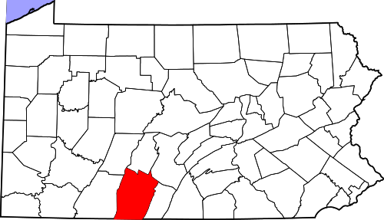
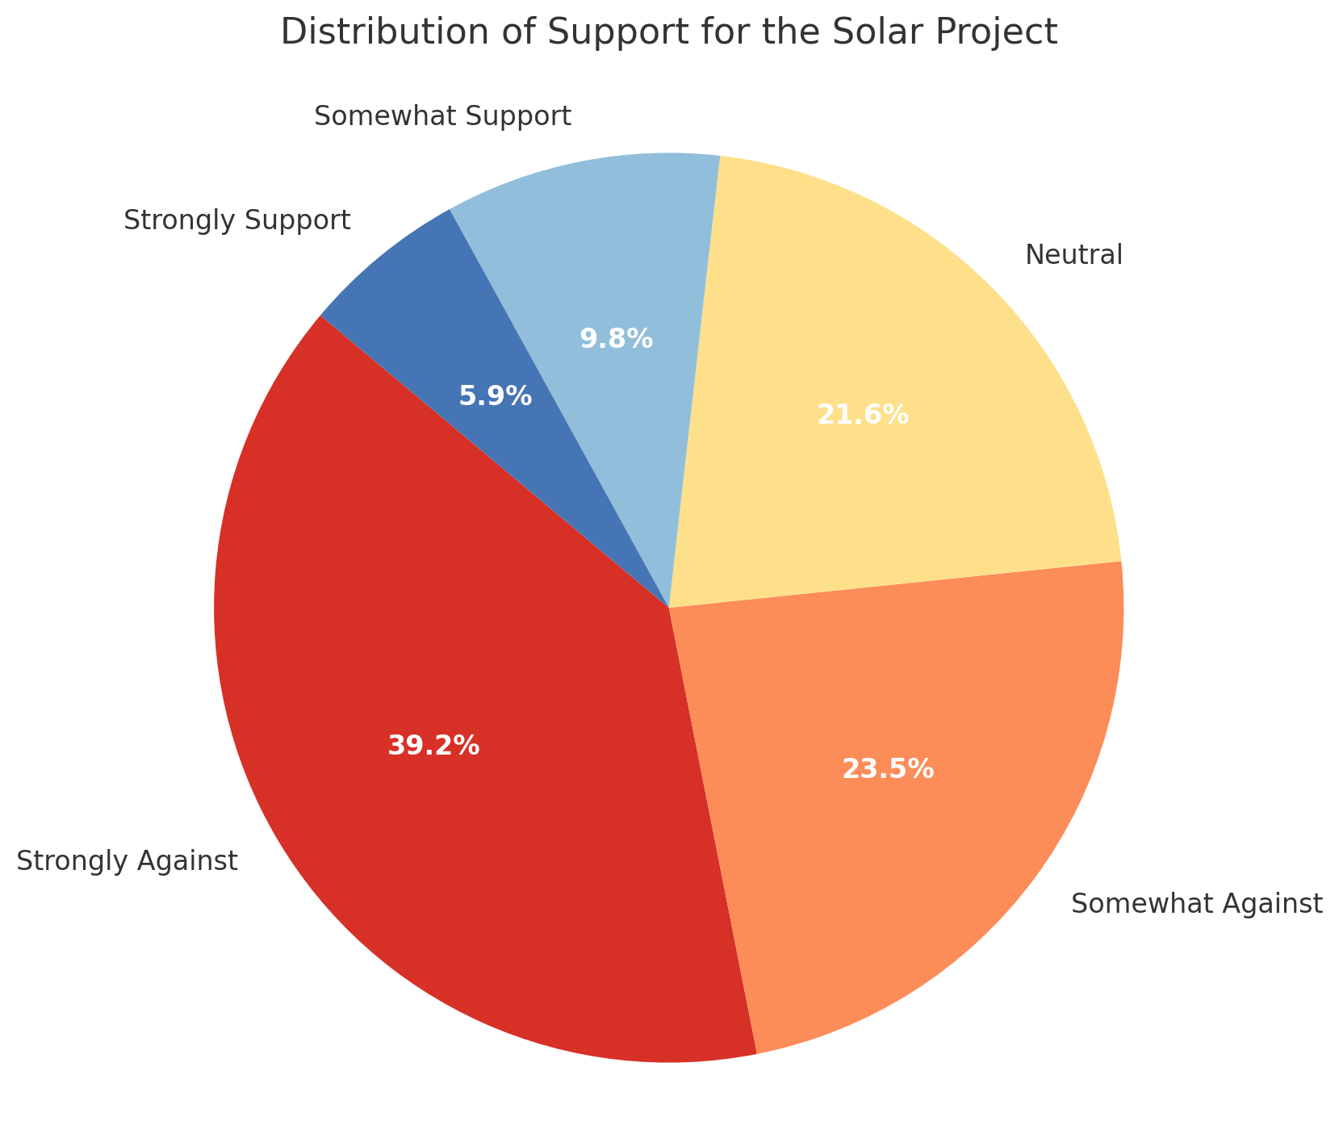
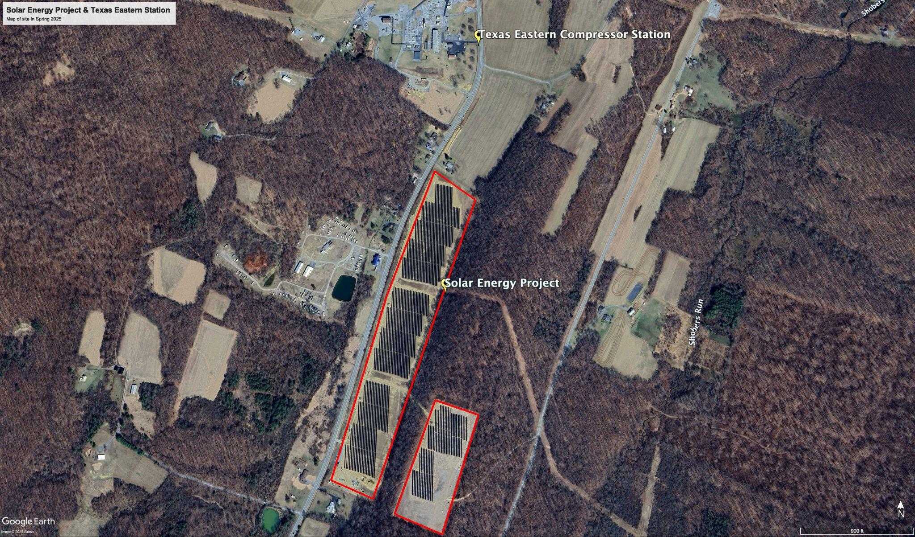
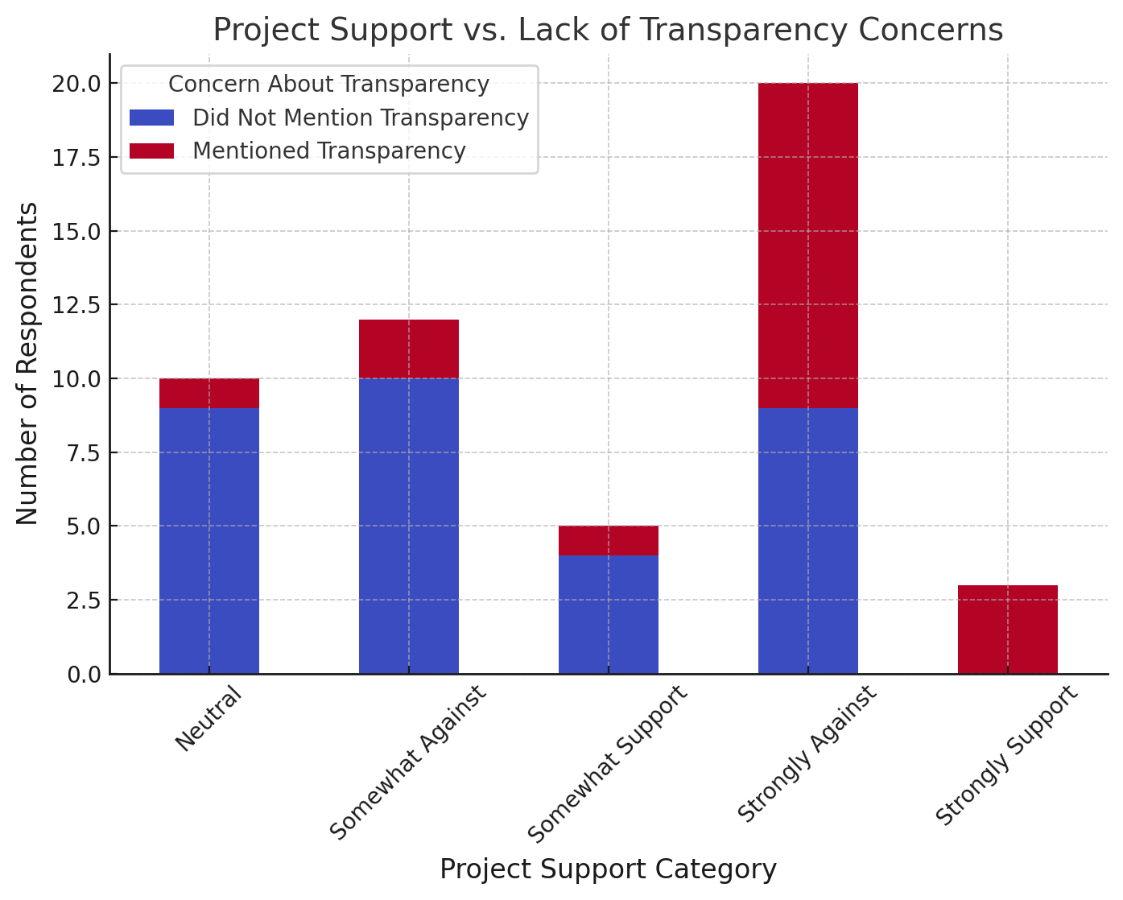
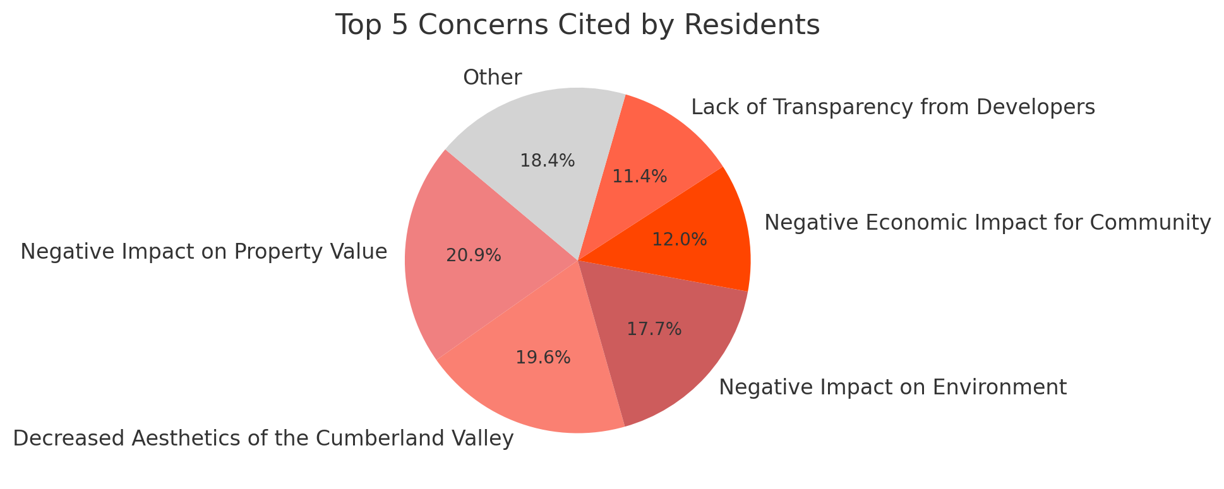
Rural Resistance to Renewable Energy: A Case Study of Cumberland Valley Township, PA
Mentor: Joseph Lisa
Professor: Dr. Jane Dmochowski
By: Elijah Cook
Environmental Studies | University of Pennsylvania
Abstract
Methods
Results / Analysis
The United States’ energy transition relies on rural communities to host renewable infrastructure, yet many residents view these developments as threats to their identity and land. This case study examines community perspectives on a 7MW solar project in Cumberland Valley, Pennsylvania, using original survey data and interviews. Findings show that opposition is rooted in concerns over land use, aesthetics, lack of transparency, and limited community engagement. Place attachment and historical relationships to the land shape how residents respond. To succeed, renewable energy projects must include rural voices and align with local values and priorities.
Case Study
Location: Cumberland Valley Township, Pennsylvania.
Project: 7MW solar development to power Texas Eastern natural gas compressor station
Mixed-Methods Approach:
  56 survey responses from residents within an 8-mile range
  1 in-depth interview with neighbor adjacent to the site
  Analysis to identify resident perspectives and opinions
Survey Findings
94% response rate
Majority of residents were opposed to the project (Figure 3).
Those who cited lack of transparency as a concern were more likely to be opposed to the solar energy project (Figure 4).
Figure 3: This pie chart shows the distribution of support for the solar project in Cumberland Valley. The red colors represent opposition, yellow is neutral, and the blue represents support.
Background
Climate Change:
Rising emissions are escalating environmental and societal risks. In order to prevent these effects, rapid transition away from fossil fuels is needed.
Solar energy is a solution to this crisis, but it demands certain criteria for energy production.
Rural America:
Areas like this offer what solar developers need, vast amounts of open land sun exposure.
Rural communities often bear the costs of this renewable infrastructure, sacrificing landscapes without input or benefits.
Resistance
It is often oversimplified as ignorance or an anti-renewable sentiment from residents.
Resistance is rooted in community identity, cultural values, and attachment to place
Outside developers that impose themselves on the community and landscape violate these values.
Figure 4: This bar graph shows the relationship between residents who cited lack of transparency as a concern and project support.
Figure 1: This map illustrates the location of the solar project in relation to nearby homes and the Texas Eastern Compressor Station.
Rural resistance is not a rejection of renewables, but a response to exclusion and disregard for local values.
Developers and policymakers must prioritize trust and transparency with rural communities.
Conclusion
Figure 2: This pie chart illustrates the top five concerns cited by residents in the survey. This encompasses residents’ negative perceived impacts on property value, aesthetics, the environment, economics, and lack of transparency from developers.
Devine-Wright, P. (2009). Rethinking NIMBYism...
Spangler, K. et al. (2024). Just energy transitions...
Gamper-Rabindran, S. & Ash, J. (2024). Farming the sun or coal legacy...?
The White House. (2021). Fact Sheet: 2030 Climate Goals.
IEA. (2023). Renewables 2023 Report.

