Slide 1
How to Share Your Scholarship and Reach a Global Audience Using ScholarlyCommons
Feb 9, 2017 / Kenny Whitebloom / Digital Scholarly Publishing Librarian

Slide 2
What is ScholarlyCommons?

Slide 3
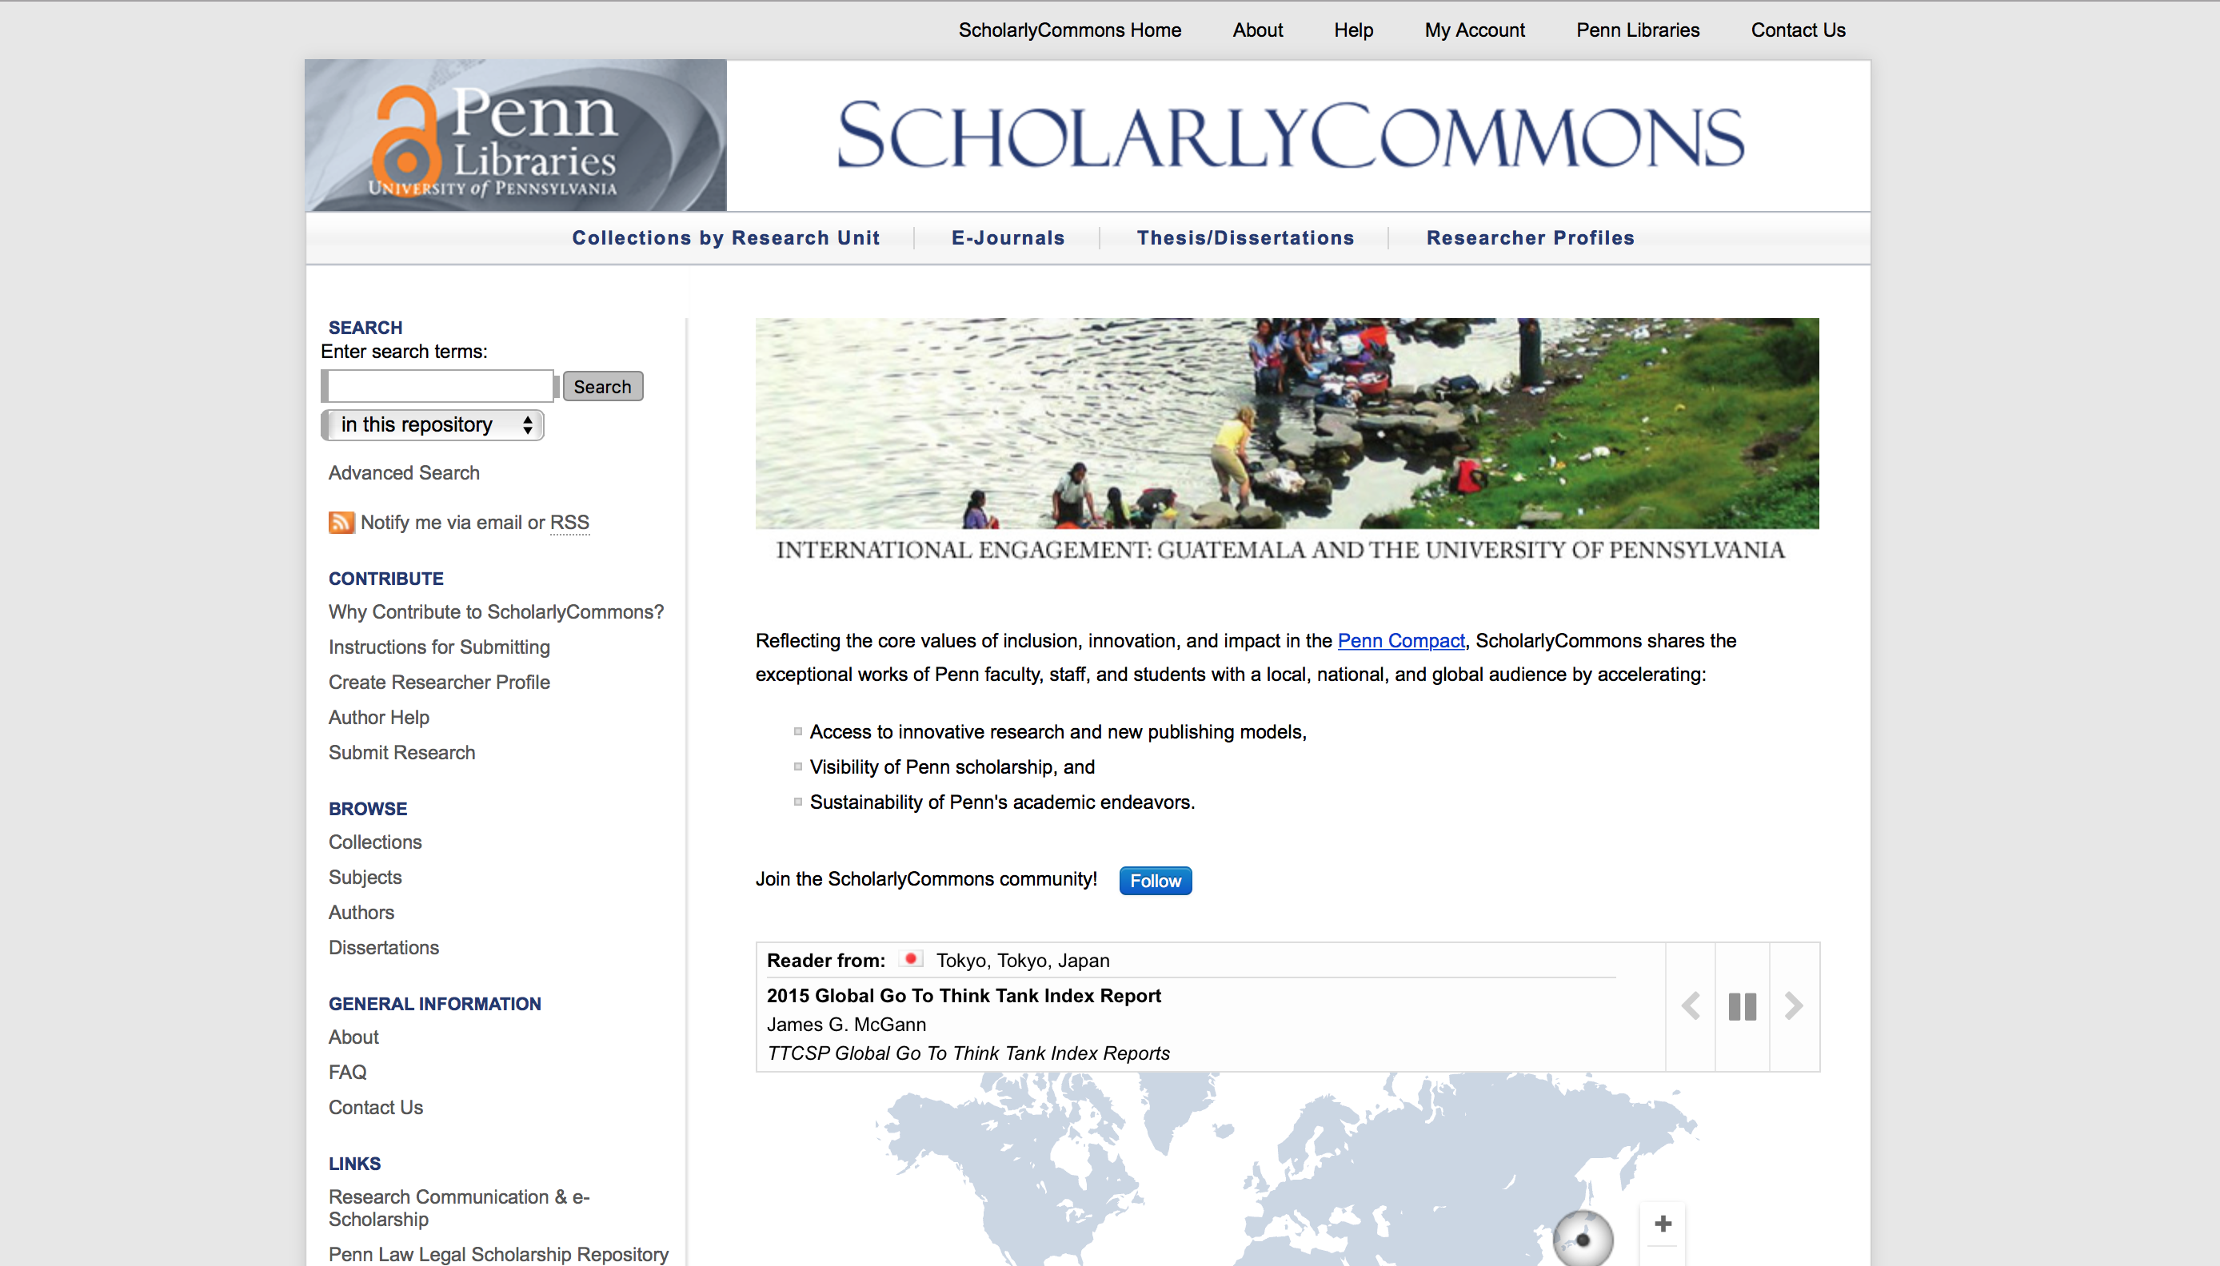
Notes:
ScholarlyCommons (http://repository.upenn.edu/) is an open access repository for gathering, indexing, storing, and making available the scholarly output of the University of Pennsylvania community. ScholarlyCommons launched in early 2004 as a pilot project with Penn’s School of Engineering & Applied Science (SEAS). The success of the pilot drew in other campus units to participate over the following years and has grown considerably since then. Institutional repositories, or IRs, are quite common amongst academic libraries.

Slide 4
What types of materials are included?

Slide 5
journal articles, lab papers, reports, policy briefs, books, ebooks, instructional materials, working papers, instructional videos, MOOCs, class projects, interviews, supplemental content, audio, 3D objects, datasets, tool data, toolkits, magazines, undergraduate journals, faculty journals, proceedings, images, posters, dissertations, masters theses, capstones, senior honors theses, conferences, symposia, lecture series, blog posts, comic books, maps, academic posters, and much more…
Notes:
Papers: journal articles, book chapters, conference presentations, working papers, etc.
Videos & Audio: instructional videos, MOOCs, oral histories, class projects, audio interviews, etc.
Data: 3D objects, data sets, tool data, supplemental data, etc.
Full Publications: departmental/alumni magazines, undergraduate magazines, journals, proceedings, etc.
Images: class projects, supplementary images, etc.
Dissertations, Theses, Capstones, and Senior Honors Projects: dissertations ((all Penn dissertations from 2015 on are required to be deposited in ScholarlyCommons), theses, capstones, senior honors projects, and other materials.
Conferences, Symposia, & Other Events: lecture series, conference agendas and materials, etc.
Other Materials: posters, comic books, blog posts, maps, etc.

Slide 6
Who has access?

Slide 7
Notes:
The world! Anyone with an internet connection can access the works included in the repository. ScholarlyCommons is what’s known as an open access repository.

Slide 8

Thomas Ulrich (flickr) via CC BY-SA 2.0 license
Notes:
Open Access is the free, immediate, online availability of research articles coupled with the rights to use these articles fully in the digital environment. Open Access ensures that anyone can access and use these results—to turn ideas into industries and breakthroughs into better lives.

Slide 9
Who can contribute?

Slide 10
Penn affiliated faculty, students, and researchers

Slide 11
Why contribute?

Slide 12

Visibility
Guillaume David (flickr) via CC BY-NC-ND 2.0 license
Notes:
Visibility: Your work will be openly accessible to researchers around the world and showcased alongside other members of the Penn community.

Slide 13
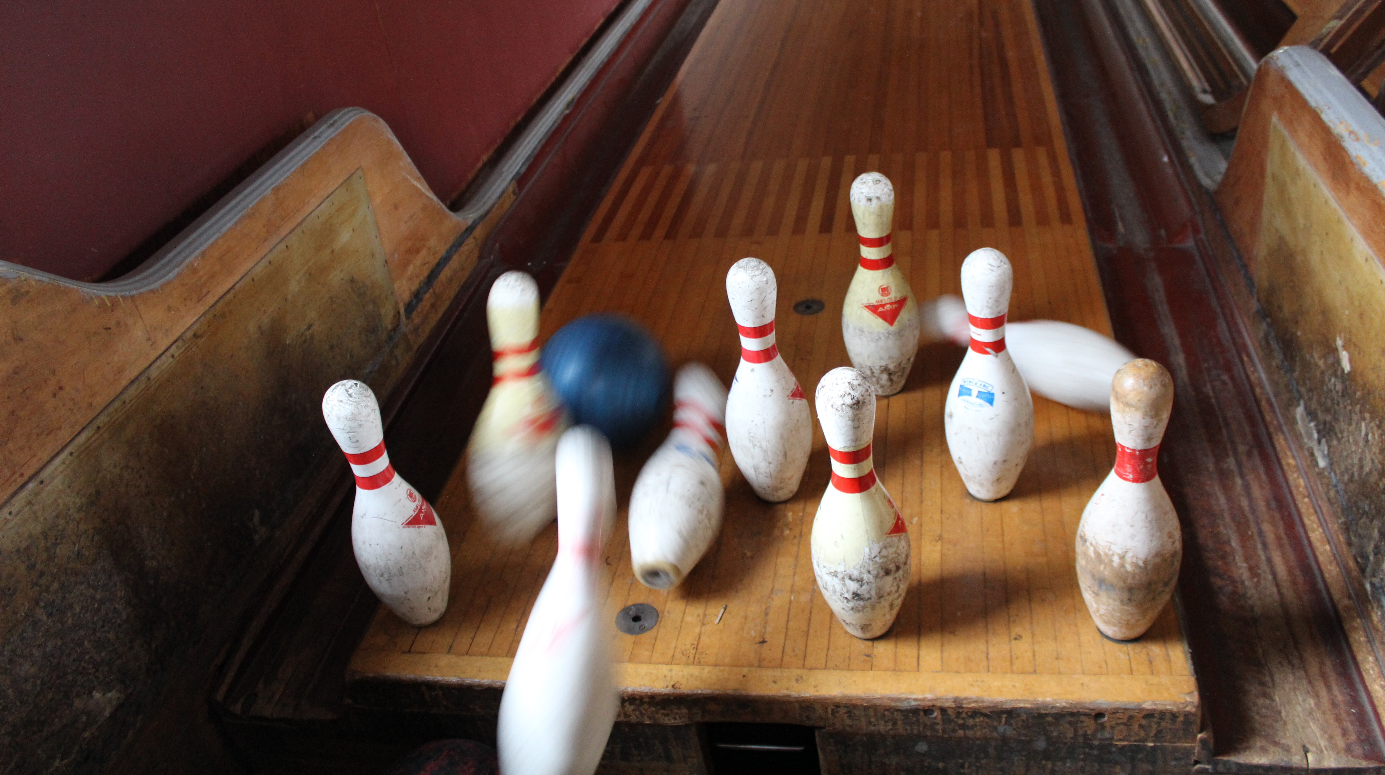
Impact
Bethany (flickr) via CC BY-NC-ND 2.0 license
Notes:
Impact: All materials in ScholarlyCommons are fully indexed in search engines like Google and Google Scholar, making your material more easily discoverable online.

Slide 14

Statistics
Anssi Koskinen (flickr) via CC BY 2.0 license
Notes:
Statistics: Authors and collection administrators receive access to on-demand analytics, monthly readership reports, and compelling maps depicting use of their work around the world.

Slide 15

Preservation
Lindsey Turner (flickr) via CC BY 2.0 license
Notes:
Preservation: ScholarlyCommons provides permanent URLs, a multi-tiered disaster recovery plan for all of its contents, and ongoing support through bepress and the Penn Libraries.

Slide 16
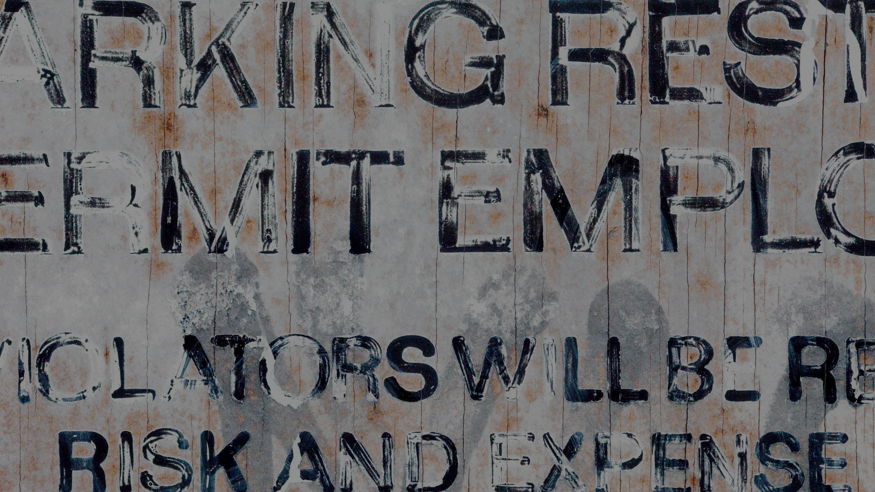
Permissions Expertise
Thomas Hawk (flickr) via CC BY-NC 2.0 license
Notes:
Permissions Expertise: Authors taking advantage of our free assisted submission will receive detailed permissions information for all of their works, making it easy to share on other platforms like Academia.edu and ResearchGate or on personal or departmental websites.

Slide 17

Branding
Derek Gavey (flickr) via CC BY 2.0 license
Notes:
Branding: Collections can be customized with individual introductory text, links, banners, images, cover pages, and other options that fit your group. Journal and conference series can be further customized with unique designs and peer review workflows.

Slide 18
What services do you provide?

Slide 19
Assisted
(faculty) submission
Notes:
Assisted submission: comprehensive permissions review and deposit of previously published materials (Penn faculty only),

Slide 21
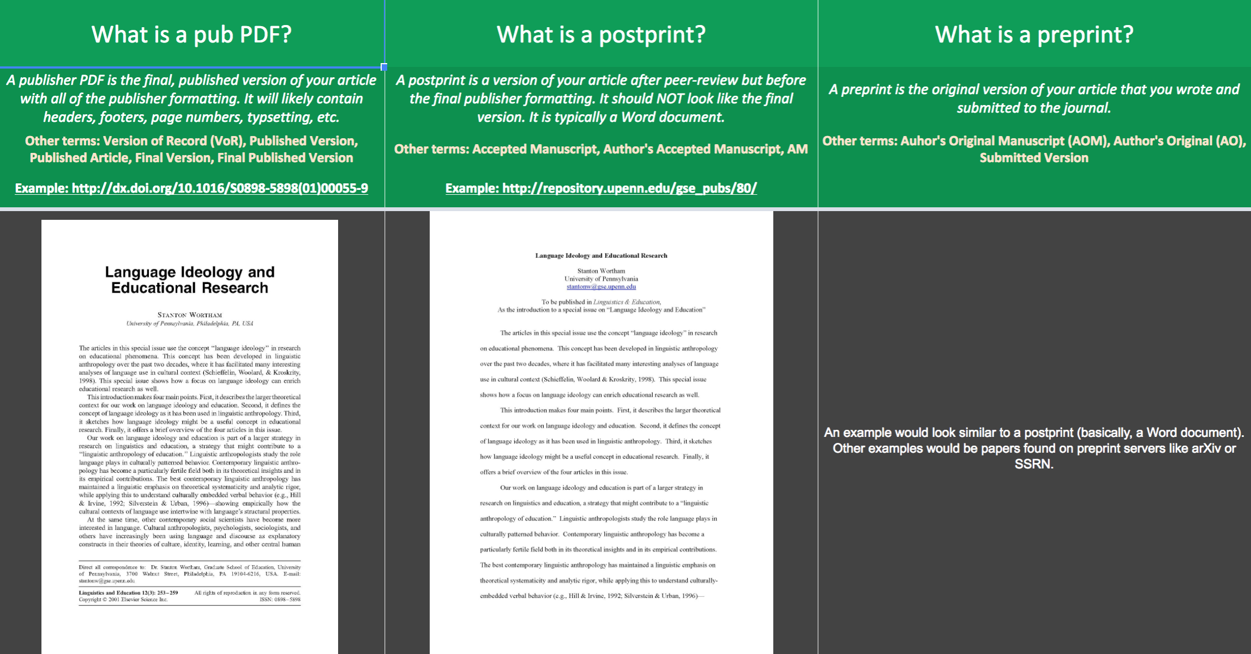

Slide 22
Journal publishing
Notes:
Journal publishing: journal publishing and access to archival content.

Slide 24
Digital projects
Notes:
Digital Projects: Penn projects in support of course work, research, teaching, and departmental activities.

Slide 25
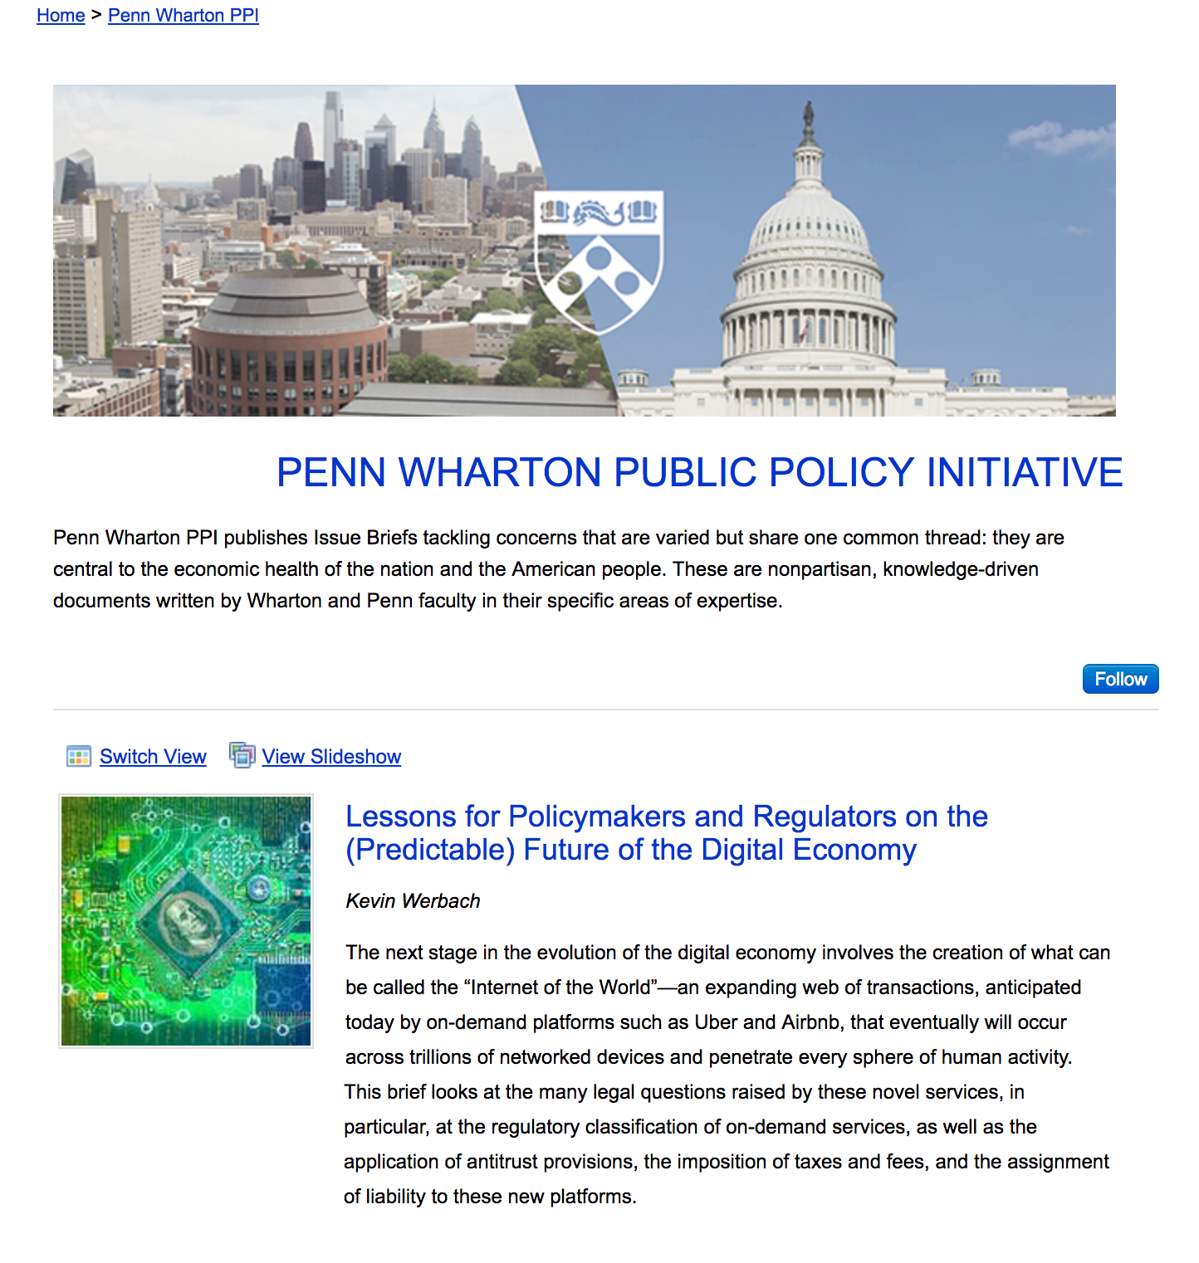
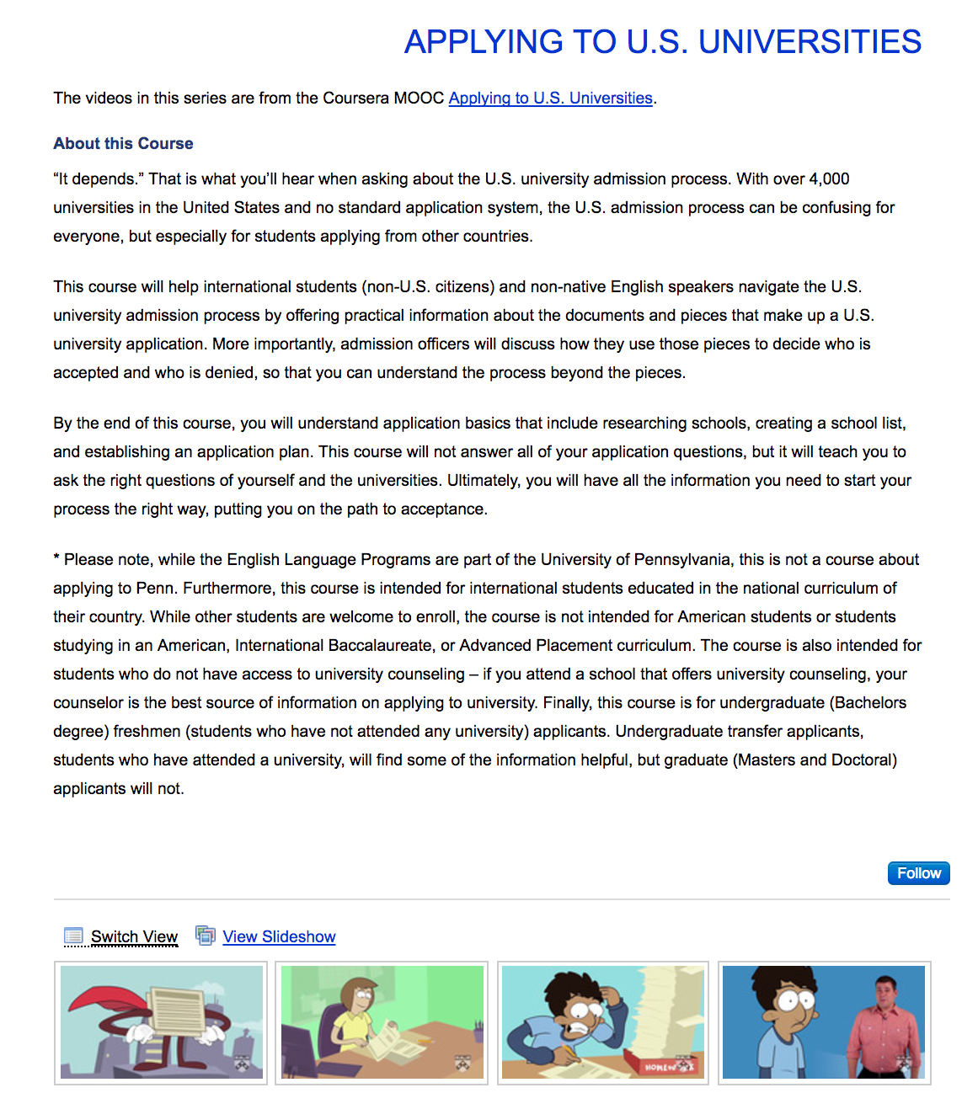

Slide 26
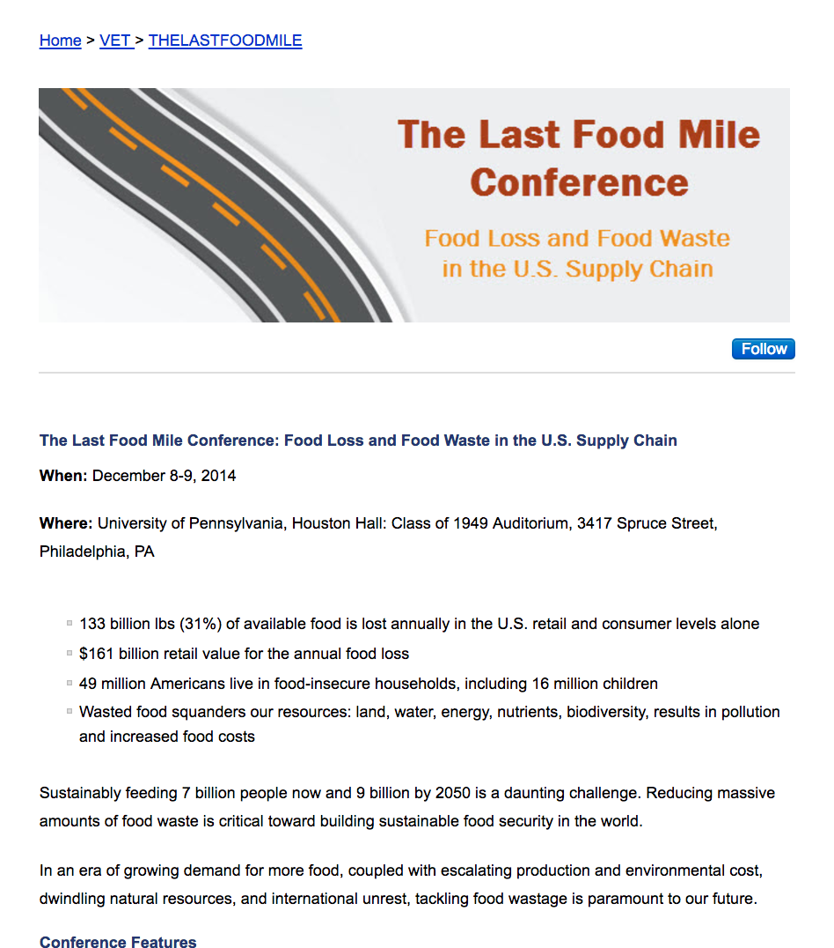
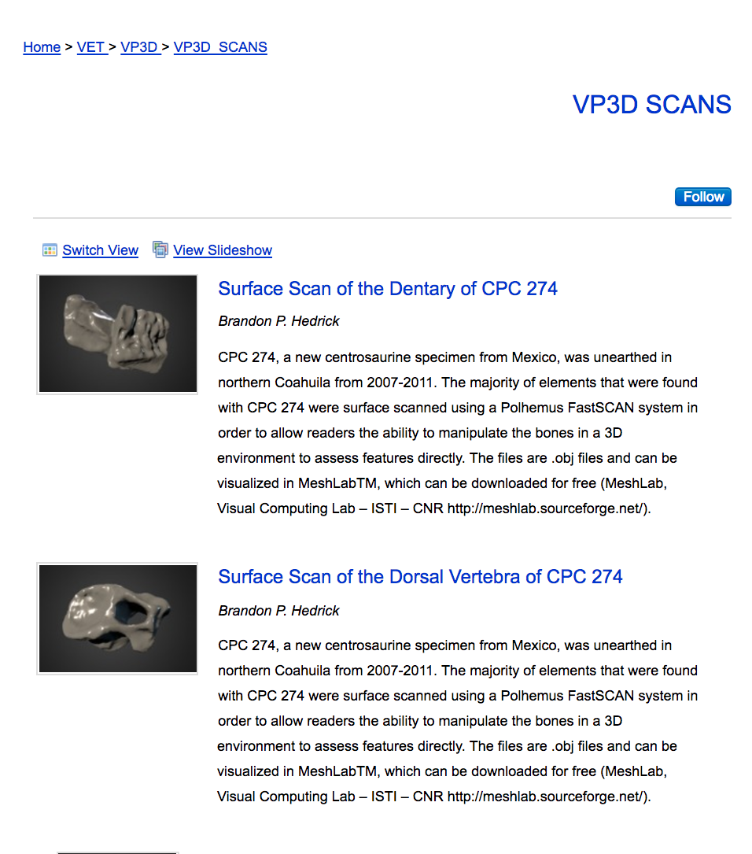

Slide 27
Awesome.
How do individuals contribute?

Slide 28
Assisted
(faculty) submission

Slide 29
Self-submission

Slide 30
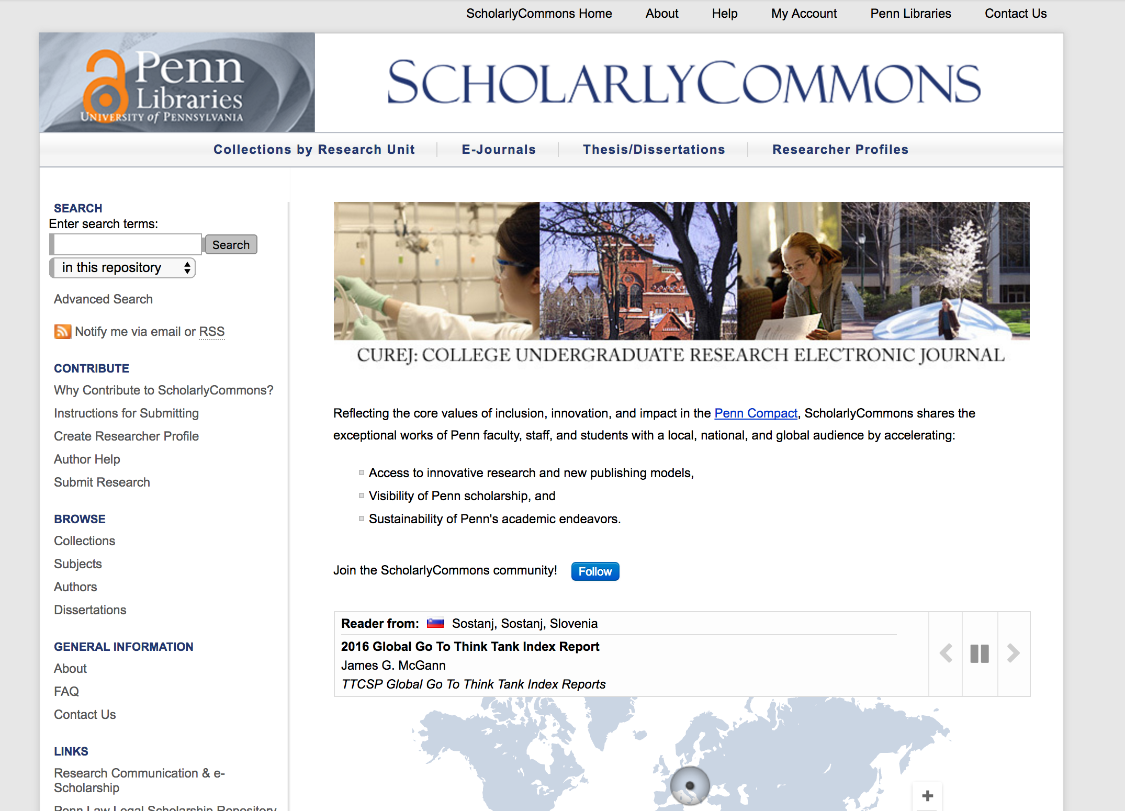

Slide 31
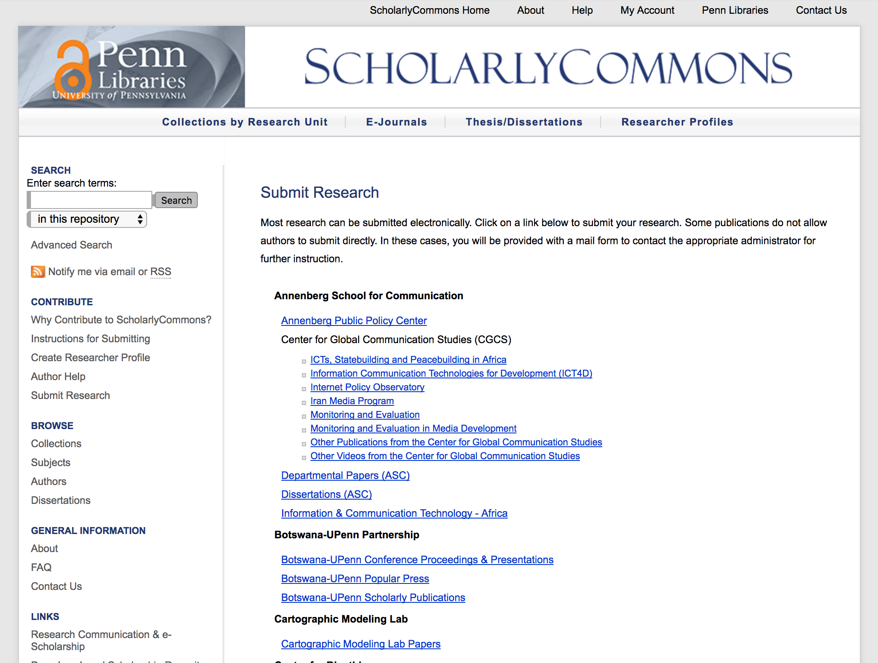

Slide 32
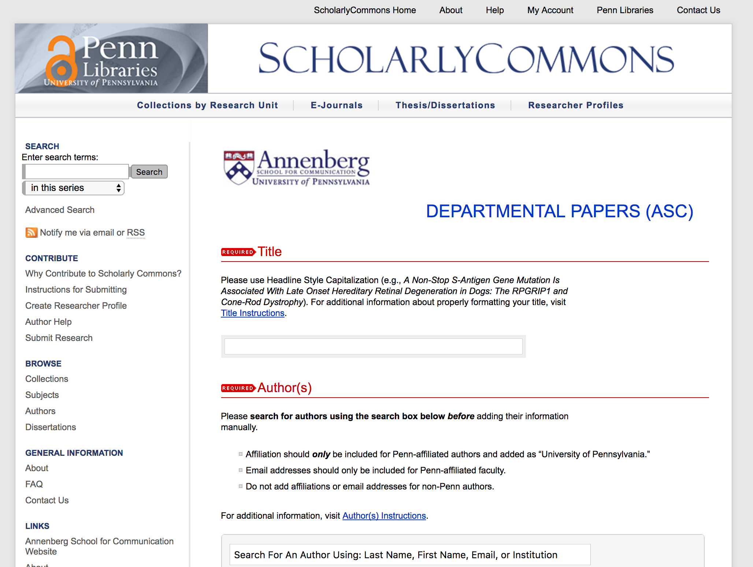

Slide 33
How do groups contribute?

Slide 34
Set up a consultation libraryrepository@pobox.upenn.edu

Slide 35
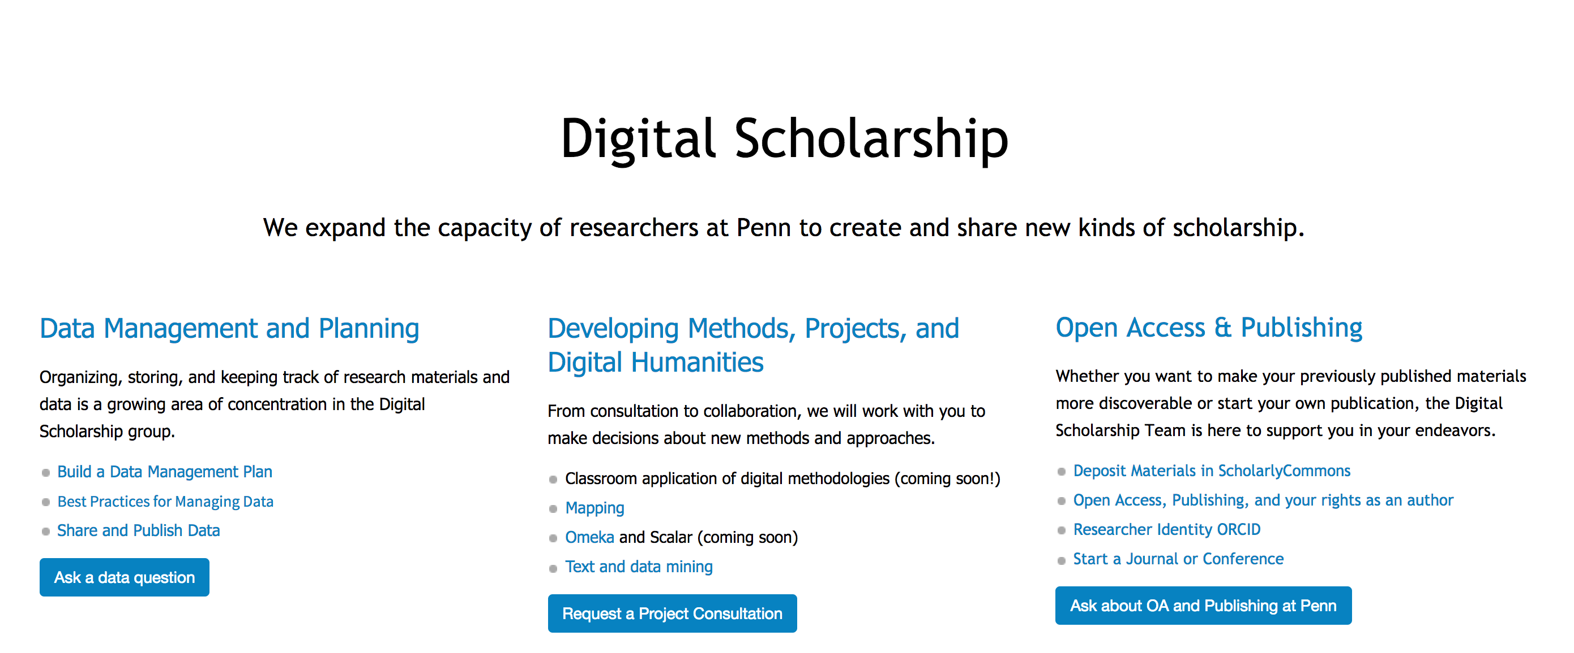
guides.library.upenn.edu/digital-scholarship

Slide 36
Thanks!
repository.upenn.edu / kenwhi@upenn.edu

