Slide 1

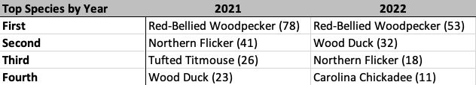
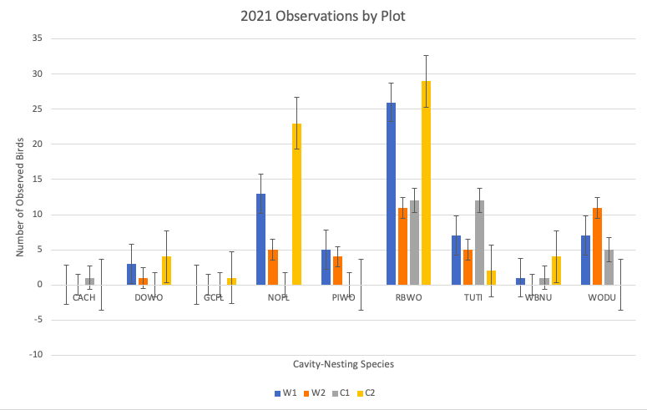
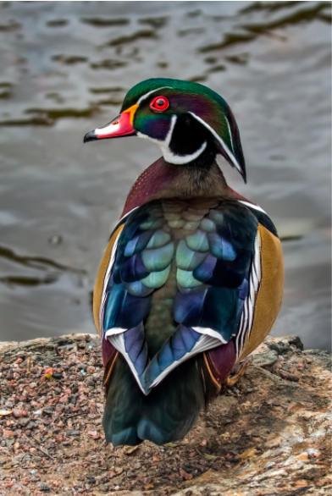
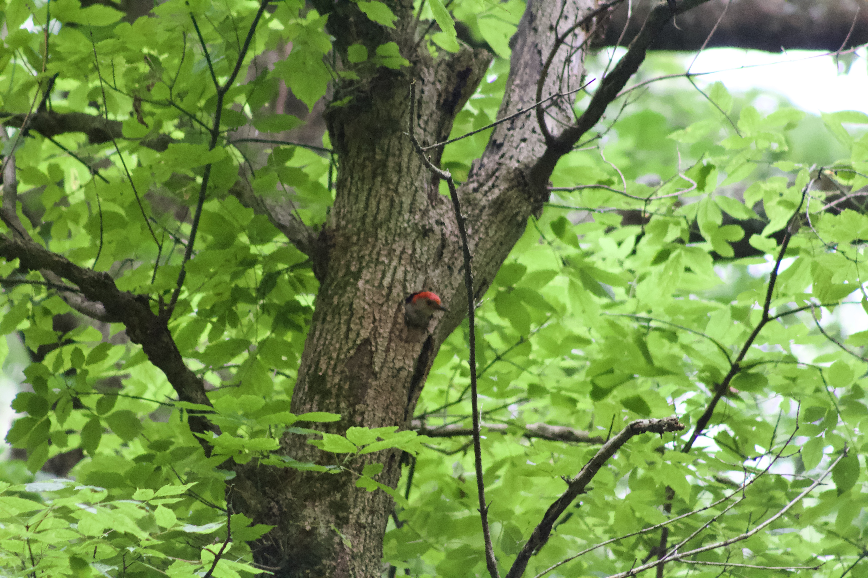
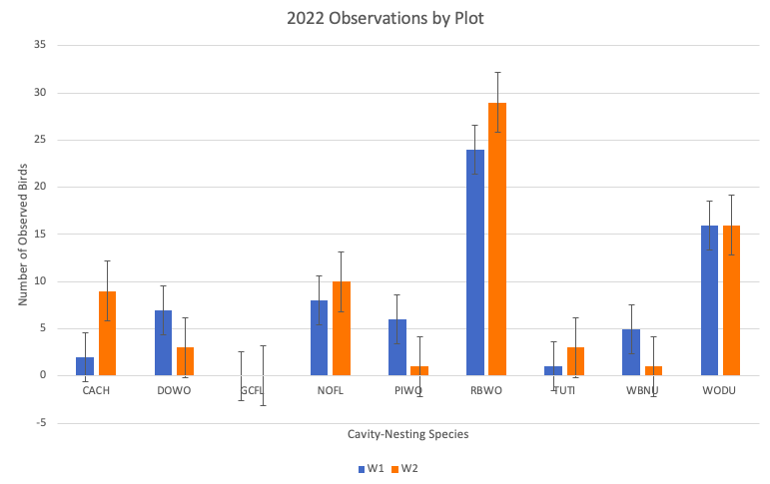
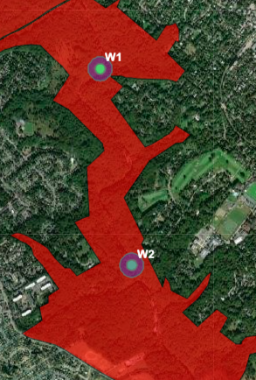
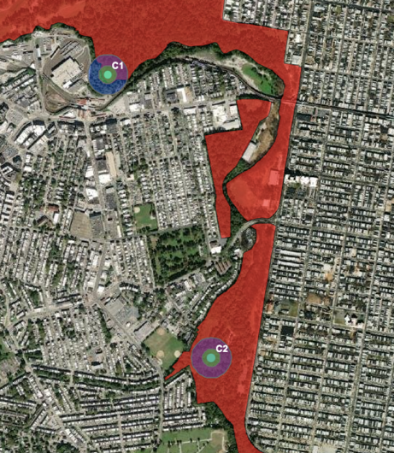
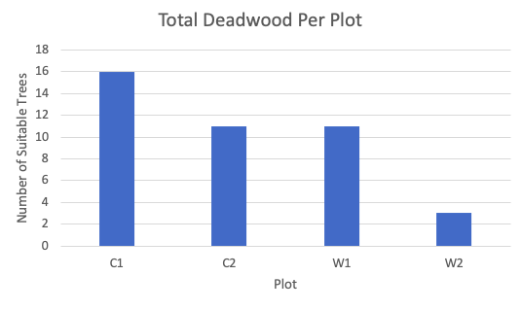
Snag Availability and Preference:
A Look at Cavity-Nesting Species in Philadelphia Urban Parks
Angelique Noëlle Raezer
Master of Environmental Studies, 2022
Primary Reader: Lisa Kiziuk, Willistown Conservation Trust
Secondary Reader: Sally Willig, PhD, University of Pennsylvania
Introduction
Results
Discussion
Dead standing trees, known as snags, provide habitat and food for 45% of native bird species across North America but are frequently removed for safety and aesthetic purposes (Hutto, 2006). Places where wildlife can find suitable food and shelter have continued to decrease in size and quantity due to urbanization leading to isolated forest islands. Climate change is also forcing a lot of species to shift their ranges poleward, with predictions of 30% range lost for the wood duck (National Audubon Society, n.d.; Figure 1)
Table 1. The top four most-observed species in the years 2021 and 2022.
The most commonly observed cavity-nesting species was the Red-bellied Woodpecker with 78 observations at the four plots (W1, W2, C1, and C2) combined in 2021 and 53 observations at the two plots (W1, W2) combined in 2022 (Table 1). In 2021, this is followed by the Northern Flicker, the Tufted Titmouse, and the Wood Duck. In 2022, the Wood Duck was second-most observed, followed by the Northern Flicker and the Carolina Chickadee though many other species were observed both years (Figures 3 and 4). The most deadwood was at Plot C1, with the highest recorded number and high diversity in sizing, most likely due to nearby beaver activity (Figure 5). Two nests were seen: a Northern Flicker pair at
To improve these urban spaces, better stewardship techniques could be implemented and better understood to benefit wildlife, especially cavity-nesting species. In this research paper, various characteristics of snags and cavity-nesting species are explored to identify land management methods for Cobbs Creek Park, Wissahickon Valley Park, and other urban forest islands.
C2 in 2021 and a Red-bellied Woodpecker pair at W2 in 2022 (Figure 6). When considering the size and the width of these parks, it is understandable to assume that Wissahickon Valley Park supports more forest-interior species, as it is more than double the area of Cobbs Creek Park and the data supports this.
Figure 1. A male wood duck, secondary cavity nester, prefers riparian habitat. (Key, n.d.).
Figure 3. The overall observations of the 2021 season by species and plot.
Figure 6. A male Red-Bellied Woodpeckers pokes his head out of the cavity nest seen at Plot W2 in 2022.
Methods
Conclusion
Data was collected from two of the major urban parks in Philadelphia, Pennsylvania: Wissahickon Valley Park and Cobbs Creek Park (Figure 2). Species abundance data was collected in the field through 7 1-hours point-and-count monitoring sessions in randomly-selected 0.5-acre circular plots in riparian habitat during nesting season in 2021 and 2022 (Lundquist & Mariani, 1991). Snag availability was determined through a habitat assessment, as well as edge-effect, invasive presence and other habitat characteristics.
Despite urban forest islands being overrun with invasive species, predation, parasitism, and a lack of resources, they can still offer crucial habitat to many bird species. This is important for breeding cavity-nesting species, which have a difficult time finding suitable nesting sites due to the frequent removal of snags. Although limited nests were found, many young were observed, suggesting there is suitable habitat nearby, but outside of the plots. While Wissahickon Valley Park provides a suitable forest island for more specialized forest-interior birds and Cobbs Creek Park is more suitable for generalist species, many forest islands are not as hospitable and could be improved. For example, nesting box programs combined with promoting and maintaining snags are useful tools for improving the resources that an urban area can offer. It’s important to work on conserving the remaining woodlands of the east coast, reconnecting isolated patches where possible, and encouraging the overall health and biodiversity of these forests so that they can support and encourage healthy bird populations.
Equipment:
Clinometer
Biltmore & reach stick
Binoculars
Compass & GPS
Various field guides
Figure 4. The overall observations of the 2022 season by species and plot.
Works Cited
Hutto, R. L. (2006). Toward Meaningful Snag-Management Guidelines for Postfire Salvage Logging in North American Conifer Forests. 20(4), 984-993. Retrieved from https://doi.org/10.1111/j.1523-1739.2006.00494.x
Key, D. (n.d.). Breeding adult male [Photograph]. National Audubon Society. https://www.audubon.org/field-guide/bird/wood-duck#photo7
Lundquist, R. W., & Mariani, J. M. (1991). Nesting Habitat and Abundance of Snag-Dependent Birds in the Southern Washington Cascade Range., 221-240.
National Audubon Society (n.d). How Climate Change Will Reshape the Range of the Wood Duck [Map]. National Audubon Society. https://www.audubon.org/field-guide/bird/wood-duck#
Raezer, N. (2022). MES Capstone Plots [map]. (ca. 1 : 288895.277144) Philadelphia, PA : ArcGIS.
Figure 2. Left: A close-up satellite view of Wissahickon Valley Park and its Plots. Right: A close-up satellite view of Cobbs Creek Park and its Plots (Raezer, 2022).
Figure 5. Total standing deadwood at each plot based on most recent habitat assessment.

