Slide 1

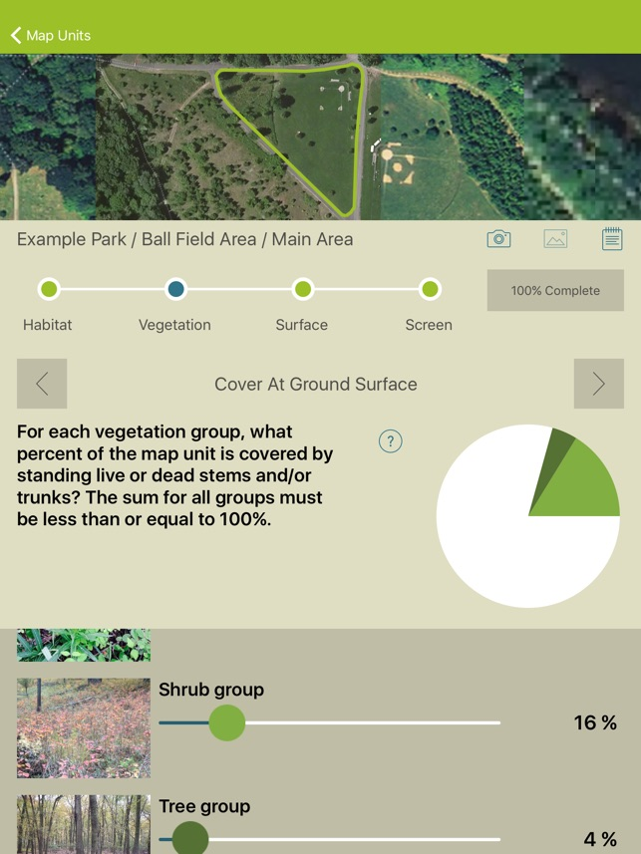


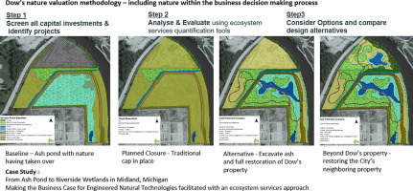
Rebecca Ross
Master of Environmental Studies
Fall 2020
NGO and Corporate Collaborations
Nancy English, Ph.D.
University of Pennsylvania
Primary Reader
James Hagan, Ph.D.
University of Pennsylvania
Secondary Reader
. Figure 1:Ash Pond project. Guertin, F., Halsey, K., Polzin, T., Rogers, M., Witt, B. (2018). From ash pond to Riverside Wetlands: Making the business case for engineered natural technologies. Science of The Total Environment, 651, 419-426. doi:10.1016/j.scitotenv.2018.09.035 2.
Figure 2: ESII tool. https://appadvice.com/app/esii-tool/1081471752
Collaboration Case Study:
The Nature Conservancy (TNC) & Dow.
Partnership since 2011 for “demonstrating that building nature’s value into business strategy could lead to better outcomes for companies and conservation”. 3
Nature-based solutions for environmental impacts.
Dow’s goal: all capital, real estate, new business development and new product development projects to be screened for nature value, using tools developed with TNC to measure the value of ecosystem services.
Collaboration contributed to the development of Ecosystem Services Identification and Inventory (ESII) Tool to quantify ecosystem services to help in gaining information regarding value of nature. See Figure 2 for illustration of tool.
The remediation of the ash pond in Midland, MI pilot project, used nature value methodology and ESII tool. Found that existing ecosystem services at baseline (prior to any remediation efforts) would actually be lowered rather than handling by a standard remediation. Dow created a wetland area to resolve the ash pond. 6 See Figure 1 for illustration.
Figure 2.
Introduction: How to evaluate whether to partner in a cross-sector collaboration. A key literature review and interview of partnering executives offer conclusions regarding the important points and lessons to a suggested audience of organizations that are exploring a potential NGO-corporate collaboration.
Literature Review of NGO and Corporate collaborations
Some Benefits of Collaborating to Organizations:
May yield financial, human resource and reputational benefits for NGOs.
Collaboration could create more credibility in general public’s view as well as a possible competitive advantage for corporation. 4
NGO might obtain more awareness and recognition for its mission.
Some Risks of Collaborating to Organizations:
NGO: Detract from focus on pursuit of traditional mission. Less likely to engage in strategies like protest for fear of upsetting corporation. 5
Inherent risk that partnerships enhance existing imbalance of power in favor of the corporations as corporations often engage with NGOs with deliberate strategy of risk control. 6
Risk the potential unauthorized use of their name to "certify" corporate practices or products.
Corporations risk by sharing their internal practices and exposing operational activities to an NGO partner, potential unauthorized use of this information in advocacy attack if alliance breaks down. 7 Also risk being seen as partnership lacking credibility with co-opted partner.
Discussion:
Key Points from Interview: Martha Rogers of TNC
The collaboration with Dow can be like to “trying to turn the titanic.”
“There is always going to be a tension” with the type of work associated with quantifying the value of the ecosystem services. The most beneficial alternative to the environment is “not always the cheapest option, when the company has the information on the effects it could have taking that route, it still may elect a less expensive option even with the ecosystem value knowledge at hand.”
About the ESII tool, “just getting Dow to use a tool that quantifies ecosystem services was huge for TNC.”
About the public view of TNC engaging in corporate collaboration, Rogers indicated that “there are both sides of the fence and it depends on who you ask.”
Rogers indicated, many corporations are big emitters, and if “we don’t engage with them, we can only do so much.”
(M. Rogers, personal communication, July 15, 2020).
Conclusions for groups considering a collaboration: How to evaluate and consider potential collaboration for NGO and corporate partners based on results of NGO and Corporate Executive Interview of case study collaboration members
Ensure each organization thoroughly understands other’s goals at the start to see whether they are the best fit as a partner
Corporation: Seek skills, abilities and content expertise able to help manage environmental impact of their operations sought by stakeholders, that the corporation does not possess in house
Seek an independent NGO who is unlikely to be co-opted
May expect not to make a profit from alliance. May need to meet upfront set-up costs.
NGO: Might look foremost for ability to have large impact on corporation’s operations while not straying from original mission.
Set ground rules for use of NGO logo for public-facing overt sanctioning of partnership efforts
Look for cooperation with willingness to target larger causes of their footprint.
NGO needs to evaluate whether they can prepare to accept corporation not necessarily always to take desired actions even when data is made available.
Both organizations: Seek complementary goals or “win/win”. Recognize necessity of willingness for both organizations to shift how they do business to adapt to collaboration.
Support from senior leaders in both NGO and Corporation. Likelihood of strong relationship-building, resources allocated to the partnership, time and support to develop an effective alliance. Manage expectations of what will come from the partnership and how quickly. Expect consistent transparent communication/ open dialogue.
Key Points from Interview: Eunice Heath of Dow
Heath asserted that Dow sees sustainability as “a business opportunity rather than merely risk management.”
When seeking an NGO partner, Dow knew they needed to “elevate their game.” Heath said they needed a partner of whom “that was their speak.”
About the ESII tool, Heath made the point that you can’t hold such a tool proprietary in house as this is how benefits can help nature; “clean air and clean water belongs to all of us.”
Heath says “transparency has to be there” to prevent greenwashing outcomes.
Heath says to find the mutual “win/win” space involves proactive listening and communication so the common mission does not go astray.
Heath say, it is “important to know that corporation’s core values are its word. When a non-profit decides to work with a corporation it needs to look hard at core values, and the purpose.”
(E. Heath, personal communication, July 8, 2020).
Methods: Qualitative Measures Key Literature Review
Interview questions and synthesis of data
Works Cited:
1. Figure 1: Guertin, F., Halsey, K., Polzin, T., Rogers, M., Witt, B. (2018). From ash pond to Riverside Wetlands: Making the business case for engineered natural technologies. Science of The Total Environment, 651, 419-426. doi:10.1016/j.scitotenv.2018.09.035 2. Figure 2: Appadvice. (2019, April 16). ESII Tool by EcoMetrix Solutions Group. Retrieved November 1, 2020, from https://appadvice.com/app/esii-tool/1081471752 3. (Who We Are, How We Work, n.d.) 4. (Baur and Schmitz, 2011, p.18) 5. (Baur and Schmitz, 2011) 6. (Baur and Schmitz, 2011) 7. (Rondinelli and London, 2003, p.67).

