Slide 1

Namibia Institute for Democracy
Profile - 2014

Slide 2

Profile
The Namibia Institute for Democracy (NID) was founded in 1991 and registered according to Section 21 of the Companies Act (Act 61 of 1973) as an “Association not for Gain”.
The NID is a non-partisan institution that supports the strengthening of democratic institutions and in this regard constructively cooperates with the government, civil society, interest groups, political parties, the media, institutional authorities and private citizens by designing and implementing democracy, governance and human rights programs in Namibia.

Slide 3
Vision & Mission Statement
The NID is loyal to the Constitution of the Republic of Namibia,
the State and its institutions. The NID zealously guards its political
neutrality and objectivity. The NID is committed to the well being of the
citizens of the Republic of Namibia and the promotion of the Republic
of Namibia as a democratic state.
Its mission is to promote and protect values and principles of multi-party
Democracy through education and research and to nurture political
tolerance and national reconciliation in Namibia.

Slide 4
Current programs
Zero Tolerance for Corruption Campaign: The ZTfCC, initiated in 2004, is being continued through training of trainers from the public, private and non-governmental sectors throughout Namibia in anti-corruption. Extensive training materials on anti-corruption and organisational ethics are developed for this purpose. An educational program on anti-corruption in secondary schools is conducted. The NID has been contracted by the Anti-Corruption Commission to lead the process of compiling a National Anti-Corruption Strategy in line with the requirements of the UN Convention on Anti-Corruption.
Organisational skills training for civil society organisations: The NID conducts organisational management skills training and technical assistance programs with mostly rurally based civil society organizations with the focus on legal structures, the role and function of government boards, general management, project management and reporting, financial management and M&E of projects.
Electoral Law Reform Project: Conducted in partnership with the Law Reform and Development Commission and the Electoral Commission of Namibia, the NID is leading a project on electoral law reform in Namibia. A series of public hearings and workshops with stakeholders (parties, civil society, churches, government, academics, traditional leaders and the judiciary) are conducted to result in a report containing recommendations on electoral law reform. This will be used to brief a legal drafter to draft an electoral bill to be handed over to government.
Election Support Programme: This programme consists of voter education , political party training, a panel discussion series on challenges faced by the Namibian nation as well as an elections observation mission.
Decentralisation Support Programme: This programme aims to strengthen the interaction between civil society and regional and local authorities through development committees.

Slide 5
Democracy and governance projects implemented by the NID are varied and generally cover the following:
Civic education on democracy and Namibia’s constitution
Zero Tolerance for Corruption Campaign
Elections observation program, 2009 general and presidential elections
Voter education in preparation of all elections since 1992
The land issue in Namibia
Training women to become political leaders
Strengthening the institutional capacities of civil society organisations in Namibia
Support to Parliamentary legislative outreach
Media training
Advocacy skills training for CSOs
Study Circle program
Rule of Law and justice sector
Research, publications and educational media materials on a variety of topics relating to democracy
The impact of HIV/AIDS on the electoral system
Transparency of political finance

Slide 6
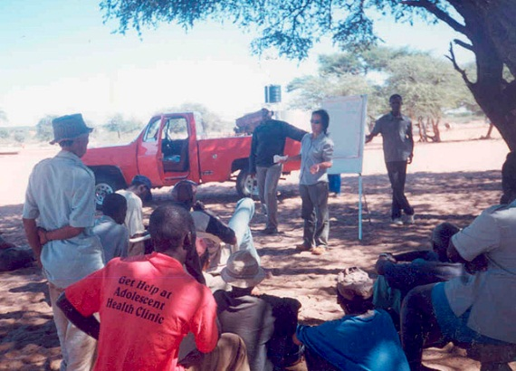
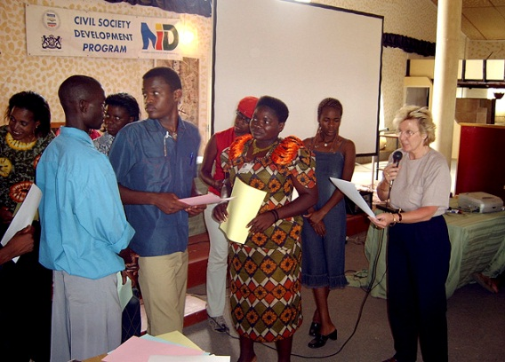
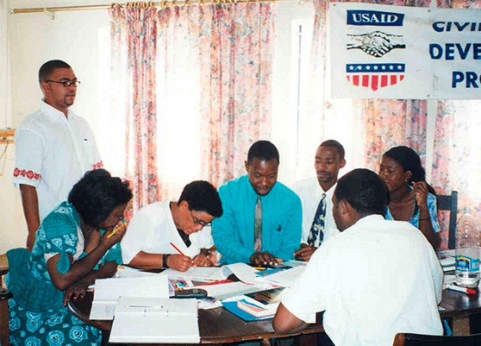


Contact
Mr. Theunis Keulder
Executive Director
Namibia Institute for Democracy
P.O.Box 2217
Swakopmund
Namibia
Tel: +264 81 124 1434
Fax +264 88615582
tkeulder@iway.na
www.nid.org.na

