Slide 1


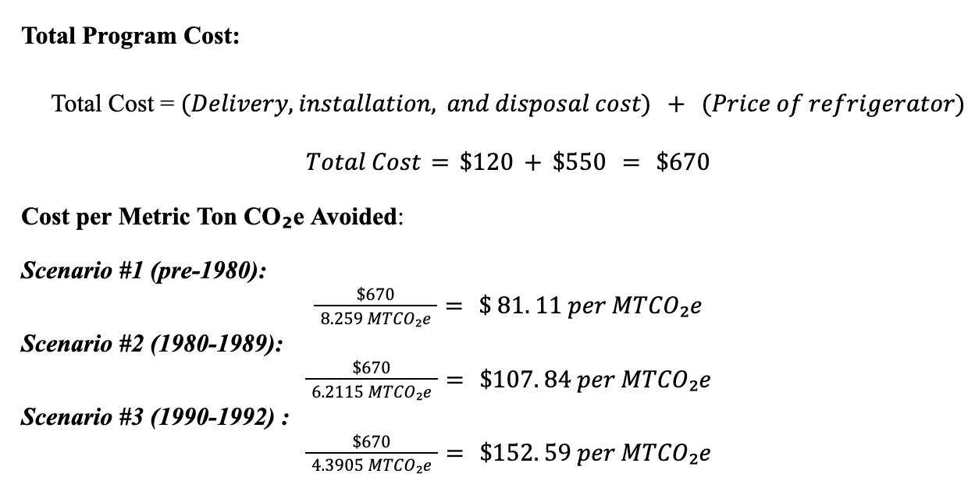
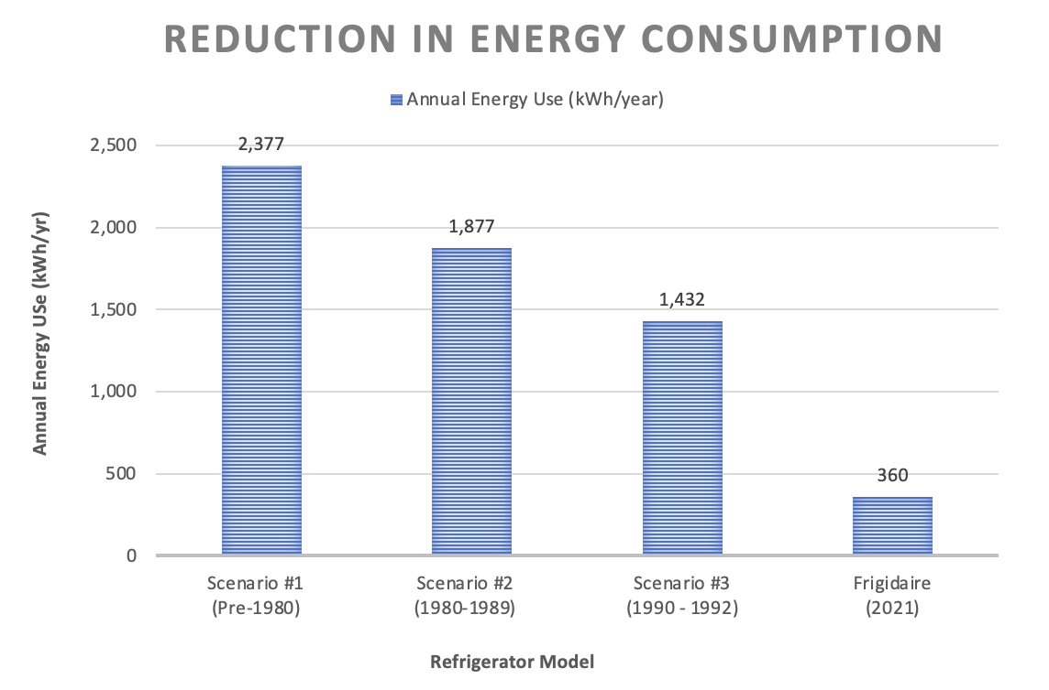
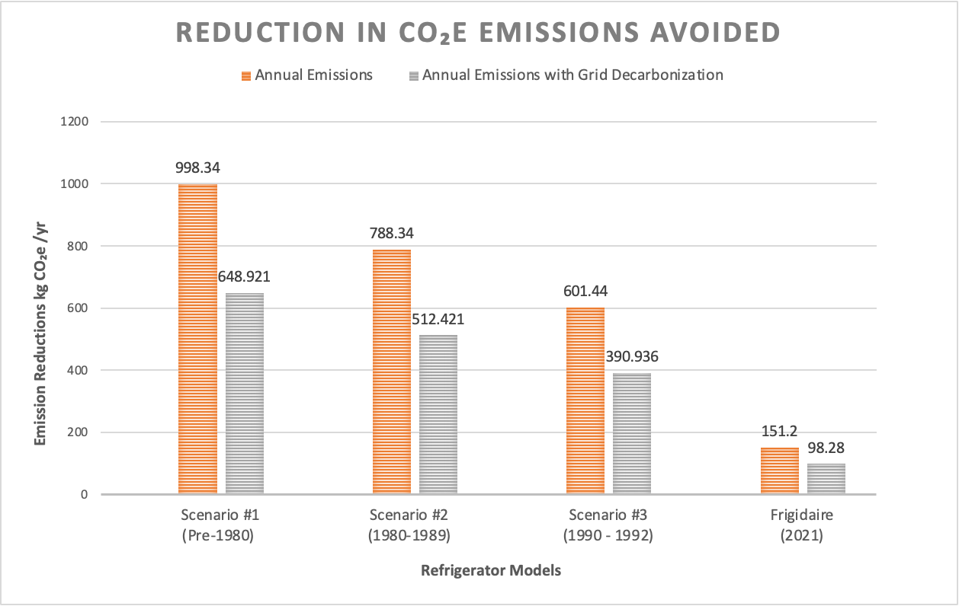
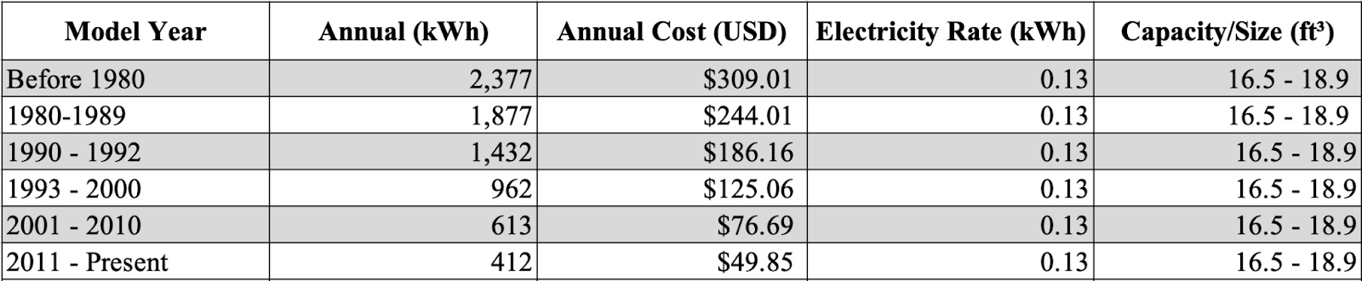
Evaluating a Refrigerator Replacement Program For Low-Income
Customers as a Cost-Effective Climate Strategy
Ask for
a logo!
Ask for
a logo!
Bianca Montañez Sanfiorenzo | biancams@sas.upenn.edu | 787-529-9949
Department of Earth and Environmental Science | Mentor: Professor Andrew E. Huemmler | Advisor: Dr. Jane E. Dmochowski
Abstract
Methods
Results
The energy transition is driving the implementation of cleaner energy sources and more efficient technology for millions of Americans. This shift is facilitated by federal incentives aimed at enhancing energy efficiency across the U.S. However, low-income communities face barriers to accessing these benefits. This study employs a mixed-methods approach to examine whether a program to replace outdated, inefficient refrigerators in low-income households could serve as a cost-effective strategy to reduce Greenhouse Gas (GHG) emissions, improve energy security for low-income customers, and address administrative barriers in accessing federal incentives. The qualitative analysis explores administrative challenges, including application complexities, technological barriers, and eligibility discrepancies that hinder low-income households from accessing the full benefits of energy efficiency incentives. The quantitative analysis utilizes emissions calculations and grid decarbonization assumptions to conduct a cost-benefit analysis evaluating the feasibility of replacing outdated refrigerators. The results demonstrate that upgrading to energy-efficient models reduces electricity use and carbon emissions. Given that program costs in three scenarios are below the social cost of carbon (SC-CO₂) estimated at $194/MTCO₂e, findings suggest refrigerator replacement should be considered a cost-effective climate strategy. Furthermore, this program reduces barriers for low-income homeowners to access energy efficiency incentives. Ultimately, these outcomes are crucial to understanding practical adaptive solutions for a more economically viable and equitable energy transition.
Mixed-methods approach tests cost-effectiveness and feasibility of a refrigerator replacement program.
Qualitative Analysis: Examines barriers low-income households face in accessing rebate energy programs under the IRA and BIL.
Quantitative Analysis: Compares energy use and emissions from older refrigerators to ENERGY STAR models, using carbon emissions calculations and a grid decarbonization assumption.
Figure 1 - The 2021 Frigidaire model consumes 85% less energy than a pre-1980 model, 81% less than a 1980-1989 model, and 75% less than a 1990-1992 model, while cooling a similar storage capacity.
Figure 2 – Replacement avoids 551, 414, and 293 kgCO₂e annually across Scenarios 1–3, even as grid carbon intensity averages 0.273 kgCO₂e/kWh.
Replacing outdated refrigerators saves 1,072–2,017 kWh/year and avoids 293–551 kg CO₂e annually, totaling 4.39–8.26 MTs over 15 years under the grid decarbonization assumption.
Annual electricity bill savings between $139 to $262 per replacement.
Cost per MT of CO₂e avoided of all refrigerator replacement scenarios is below the SC-CO₂ valued at $194/MT (Wingenroth et al. 2024).
Figure 3 – Calculation of the cost per MT CO₂e across three refrigerator age scenarios. Results offer better emissions reductions per dollar spent compared to the SC-CO₂ ($194/MT).
Discussion/Conclusion
Background
Refrigerator replacement is a cost-effective GHG reduction strategy, with emissions avoided well below the SC-CO₂.
Addresses energy insecurity in low-income households through reduced consumption and lower utility bills.
Streamlines appliance replacement to low-income eligible households reduces administrative burden, offering a simpler alternative to more complex energy efficiency rebate programs.
Energy-efficient appliances are critical to U.S. decarbonization efforts, but low-income households face financial and administrative barriers to accessing federal rebate programs.
Older refrigerators, commonly found in low-income households, are inefficient and pose both health and safety risks.
Evaluates a targeted refrigerator replacement program as a cost-effective and accessible climate mitigation strategy.
Table 1- Annual energy consumptions and costs for refrigerators of a capacity of 16.5 to 18.9 cu. ft., categorized by model year. Data reflects an 82.6% reduction in energy consumed between models before 1980 and models from 2011 to present. (Energy Star, n.d.)
References
Arroyo-Cabañas, F.G., J.E. Aguillón-Martínez, J.J. Ambríz-García, and G. Canizal. 2009. “Electric Energy Saving Potential by Substitution of Domestic Refrigerators in Mexico.” Energy Policy 37 (11): 4737–42. https://doi.org/10.1016/j.enpol.2009.06.032.
BlueGreen Alliance . 2023. “BlueGreen Alliance | a User Guide to the Bipartisan Infrastructure Law (BIL).” Www.bluegreenalliance.org. January 27, 2023. https://www.bluegreenalliance.org/site/a-user-guide-to-the-bipartisan-infrastructure-law-bil/.
Borenstein, Severin, and Lucas W. Davis. 2016. “The Distributional Effects of US Clean Energy Tax Credits.” Tax Policy and the Economy 30 (1): 191–234. https://doi.org/10.1086/685597.
Buettner, Thiess, and Boryana Madzharova. 2021. “Promoting Sales of Energy Efficient Household Appliances: Outcomes and Cost Effectiveness of Rebate Programs.” SSRN Electronic Journal No. 9048. https://doi.org/10.2139/ssrn.3837776.
California Air Resources Board (CARB) . 2018. “Low-Income Barriers Study, Part B: Overcoming Barriers to Clean Transportation Access for Low-Income Residents FINAL GUIDANCE DOCUMENT.” https://ww2.arb.ca.gov/sites/default/files/2018-08/sb350_final_guidance_document_022118.pdf.
Campbell, Eryn, Lauren Lutzke, Heather Kostick, and Michael Mann. 2024. “Communicating Policy: Raising IRA Awareness in Philadelphia.” Kleinman Center for Energy Policy. September 18, 2024. https://kleinmanenergy.upenn.edu/commentary/blog/communicating-policy-raising-ira-
awareness-in-philadelphia/.
City of Philadelphia. 2024. “Alleviating Energy Poverty in Philadelphia.” https://www.phila.gov/media/20240701150359/Energy-Poverty-Alleviation-Strategy-Final.pdf.
Datta, Souvik, and Sumeet Gulati. 2014. “Utility Rebates for ENERGY STAR Appliances: Are They Effective?” Journal of Environmental Economics and Management 68 (3): 480–506. https://doi.org/10.1016/j.jeem.2014.09.003.
Eisenberg, Joel. 2010. “Weatherization Assistance Program Technical Memorandum Background Data and Statistics.” Oak Ridge, TN: Oak Ridge National Laboratory.
Energy Star . 2021. “Product Finder - ENERGY STAR Certified Refrigerators.” Energystar.gov. 2021. https://www.energystar.gov/productfinder/product/certified-residential-refrigerators/details-plus/2386226.
———. 2024. “Expanding Access to Whole-Building Energy Data.” 2024. https://www.energystar.gov/buildings/benchmark/find_utilities_provide_data_benchmarking/unlock-data.
———. n.d. “Energy Star Flip Your Fridge Calculator | Products .” Www.energystar.gov. https://www.energystar.gov/products/refrigerators/flip-your-fridge.
Gupta, Vallary, Ahana Sarkar, Aditya Saxena, Arnab Jana, and Santanu Bandyopadhyay. 2024. “Appliance Utility in Low-Income Housing: On the Relation between Socio-Economic Characteristics, Thermal Comfort and Appliance Usage Pattern.” Energy and Buildings 323 (114849): 114849. https://doi.org/10.1016/j.enbuild.2024.114849.
Houde, Sébastien, and Joseph E. Aldy. 2017. “Consumers’ Response to State Energy Efficient Appliance Rebate Programs.” American Economic Journal: Economic Policy 9 (4): 227–55. https://doi.org/10.1257/pol.20140383.
Huffman, Jared . 2023. “Huffman Leads 66 Members of Congress in Demanding Solution to Clean Energy Rollout Delays | U.S. Congressman Jared Huffman.” House.gov. September 18, 2023. https://huffman.house.gov/media-center/press-releases/huffman-leads-66-members-of-congress-in-demanding-solution-to-clean-energy-rollout-delays?utm_source=chatgpt.com.
International Energy Agency . 2023. “Energy Efficiency - the Decade for Action Ministerial Briefing IEA 8th Annual Global Conference on Energy Efficiency Versailles.” https://iea.blob.core.windows.net/assets/f6df3a56-2257-4f47-a130-bf0862c31065/EnergyEfficiency-TheDecadeforAction.pdf.
Lowenberger, Amanda, Joanna Mauer, Andrew Delaski, Marianne Dimascio, Jennifer Amann, and Steven Nadel. 2004. “The Efficiency Boom: Cashing in on the Savings from Appliance Standards Updated from and Supersedes Report ASAP-7/ACEEE-A091” 202 (202): 429–2248. https://www.aceee.org/sites/default/files/publications/researchreports/a123.pdf.
McKinsey & Company. 2023. “Global Energy Perspective 2023 | McKinsey.” Www.mckinsey.com. October 18, 2023. https://www.mckinsey.com/industries/oil-and-gas/our-insights/global-energy-perspective-2023.
Patterson, Murray G. 1996. “What Is Energy Efficiency?” Energy Policy 24 (5): 377–90. https://doi.org/10.1016/0301-4215(96)00017-1.
Paul, Andreas, Elmar Baumhögger, Andreas Elsner, Michael Reineke, Christian Hueppe, Rainer Stamminger, Heike Hoelscher, et al. 2022. “Impact of Aging on the Energy Efficiency of Household Refrigerating Appliances.” Applied Thermal Engineering 205 (March): 117992. https://doi.org/10.1016/j.applthermaleng.2021.117992.
Pechmann, Cornelia, and Tim Silk. 2013. “Policy and Research Related to Consumer Rebates: A Comprehensive Review.” Journal of Public Policy & Marketing 32 (2): 255–70. https://doi.org/10.1509/jppm.08.155.
Ramseur, Jonathan L. 2022. “Inflation Reduction Act of 2022 (IRA): Provisions Related to Climate Change.” Congress.gov. 2022. https://www.congress.gov/crs-product/R47262.
Silicon Valley Power. 2023. “Appliance Energy Use Chart .” Www.siliconvalleypower.com. August 28, 2023. https://www.siliconvalleypower.com/residents/save-energy/appliance-energy-use-chart.
The Washington Post . 2023. “July 13-23, 2023, Washington Post-University of Maryland Climate Poll.” Washington Post, October 3, 2023. https://www.washingtonpost.com/tablet/2023/08/04/july-13-23-2023-washington-post-university-maryland-climate-poll/.
The White House . 2023. “Building a Clean Energy Economy: A Guidebook to the Inflation Reduction Act’s Investments in Clean Energy and Climate Action.” https://bidenwhitehouse.archives.gov/wp-content/uploads/2022/12/Inflation-Reduction-Act-Guidebook.pdf.
Transue, Morghan, and Frank A. Felder. 2010. “Comparison of Energy Efficiency Incentive Programs: Rebates and White Certificates.” Utilities Policy 18 (2): 103–11. https://doi.org/10.1016/j.jup.2009.12.003.
U.S. Department of Energy (DOE). 2021. “Low-Income Energy Affordability Data (LEAD) Tool.” Energy.gov. 2021. https://www.energy.gov/indianenergy/low-income-energy-affordability-data-lead-tool.
———. 2025. “State Energy-Efficient Appliance Rebate Program.” Energy.gov. 2025. https://www.energy.gov/eere/buildings/state-energy-efficient-appliance-rebate-program.
U.S. Energy Information Administration (EIA). 2019. “Electricity Use in Homes.” Www.eia.gov. May 9, 2019. https://www.eia.gov/energyexplained/use-of-energy/electricity-use-in-homes.php.
U.S. Environmental Protection Agency (EPA). 2006. “National Action Plan for Energy Efficiency.”
US Census Bureau. 2024. “U.S. Department of Energy Uses ACS Data to Power the Low-Income Energy Affordability Data (LEAD) Tool.” Census.gov. May 14, 2024. https://www.census.gov/programs-surveys/acs/about/acs-data-stories/lead-tool.html.
Wingenroth, Jordan, Brian Prest, Lisa Rennels, Kevin Rennert, Frank Errickson, and David Anthoff. 2024. “Accounting for Biodiversity Loss Raises the Social Cost of CO 2.”

