Slide 1

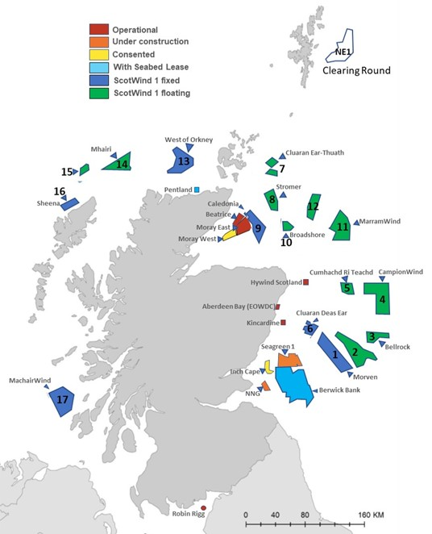
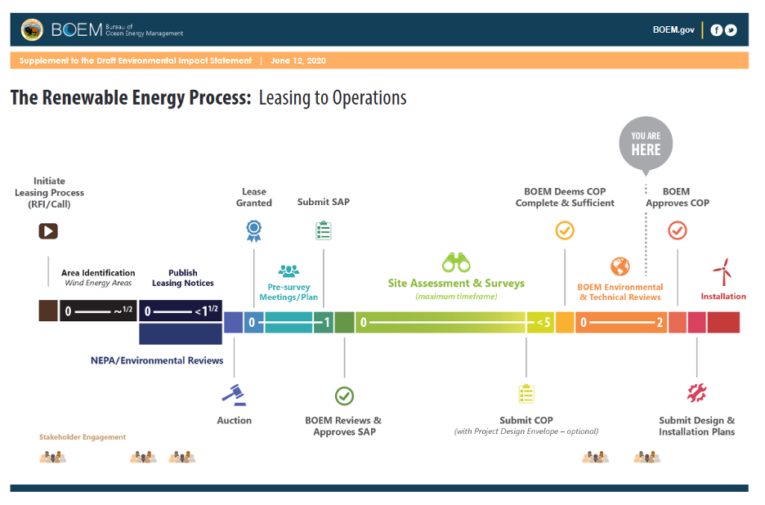
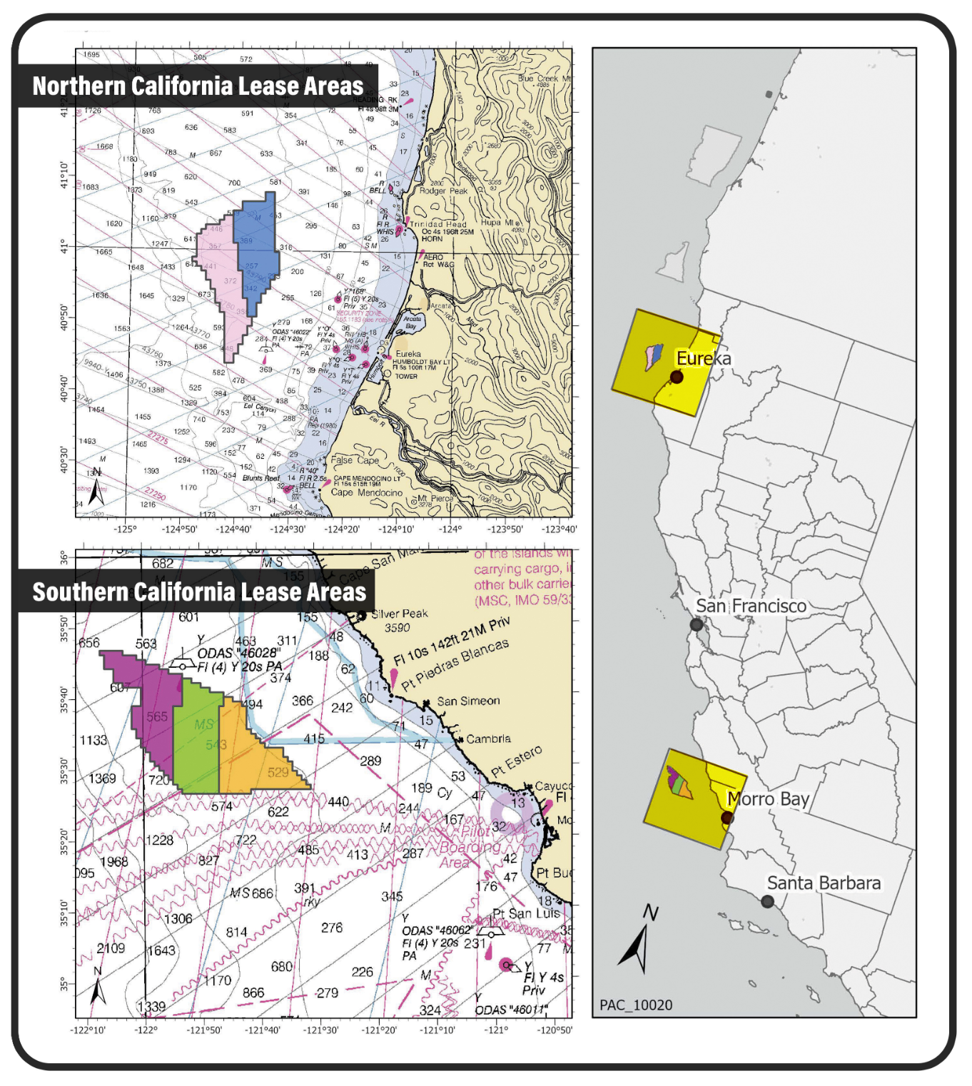
Reviewing Mechanisms for Stakeholder Engagement
With Local Governments During Offshore Wind Development
By R. Graham Barrett, Master of Environmental Studies, Spring 2023
Readers: Brandon Burke, Esq., Yvette Bordeaux, Ph.D.
In both domestic and international offshore wind (OSW) markets, project developers have invested significant resources on stakeholder engagement activities to accommodate the concerns and needs of nearby coastal communities. Yet as OSW becomes more essential to nations’ renewable energy agendas, it is even more critical that stakeholder engagement activities and negotiations with local communities and governments are successful. National governments have thus begun offering mechanisms to developers that help with stakeholder engagement practices.
This project examines the following research question: If Offshore Wind Energy project developers want to foster relationships with local governments, what types of government and regulatory mechanisms can developers use for productive stakeholder engagement activities with local governments?
To answer this question, two mechanisms were examined, a Scottish Government document that outlines voluntary community benefit schemes (CBS), and the American Bureau of Ocean Energy Management’s (BOEM) OSW permitting process.
United States
Introduction
Scotland
Before 2015, developers in Scotland lacked institutional guidance on how best to engage with local communities (Aitken, 2010). In response, the Scottish government published “Good Practice Principles for Community Benefits from Offshore Renewable Energy Developments”. These guidelines encourage OSW developers to voluntarily create CBS packages that offer benefits (i.e., monetary funds) to local communities (Energy and Climate Change Directorate, 2018). The guidelines recommend that OSW developers introduce CBS packages early in the development cycle and to let local authorities dictate what benefits their communities receive (Energy and Climate Change Directorate, 2018).
Scottish OSW developers have subsequently benefitted from the document. The Aberdeen Bay Wind Farm’s (Figure 1.) developer, Vattenfall, used the document to create a CBS and a Local Community Liaison Officer (LCLO) position to build a mutually-beneficial relationship with Aberdeen officials (Glasson et al., 2022). Aberdeen is now seen as an exemplary Scottish OSW project, due in part to following to the Government’s framework for CBS packages (Glasson et al., 2022).
As part of BOEM’s regulatory framework (Figure 2.), the agency has provided two features that provide opportunities for OSW developers and stakeholders to engage with each other on future projects. First there are the Intergovernmental Renewable Energy Task Forces, which coordinates engagement between relevant authorities on projects’ development (BOEM, 2016). Over the years BOEM has worked to improve the Task Forces to make them more transparent and to enhance the role of local governments in them (BOEM, 2018).
The second feature is BOEM’s sale notices for leases in Wind Energy Areas in markets like California (Figure 3.). Each sale notice includes a public comment period where stakeholders can provide input on the potential lease (BOEM, 2022). BOEM often incorporates stakeholder feedback from the public comment periods into the auction process, such as in a recent sale notice where BOEM offered credits in the California auction to developers that offer community benefit agreements (CBAs) as part of their project bid (BOEM, 2022).
Figure 2. A diagram of BOEM’s OSW permitting and leasing process, including stakeholder engagement periods. Source: BOEM.
Figure 3. A series of maps showing areas off the California coast designated for wind farms. Source: BOEM
Both case studies about these stakeholder engagement mechanisms demonstrate their potential to create positive working relationships between OSW developers and local authorities and communities. It is suggested that OSW developers follow these mechanisms’ example and emphasize the following actions in stakeholder engagement work with local governments:
Recommendation #1: Start engagement with local authorities as early as possible.
Recommendation #2: Voluntarily create CBS packages that supplement legally required community benefits.
Recommendation #3: Invite local authorities to provide feedback on preferred benefits offered in CBS packages.
Conclusion
Works Cited
Text
Aitken, M. (2010). Wind Power and Community Benefits: Challenges and Opportunities. Energy Policy, 38(10), 6066–6075. https://doi.org/10.1016/j.enpol.2010.05.062
Energy and Climate Change Directorate. (2018) Scottish Government Good Practice Principles for Community Benefits from Offshore Renewable Energy Developments. Scottish Government. 1–34. Edinburgh.
Glasson, J., Durning, B., Welch, K., & Olorundami, T. (2022). The local socio-economic impacts of offshore wind farms. Environmental Impact Assessment Review, 95, 1–11. https://doi.org/10.1016/j.eiar.2022.106783
Bureau of Ocean Energy Management (BOEM). (2016, December). A Citizen’s Guide to the Bureau of Ocean Energy Management’s Renewable Energy Authorization Process. Retrieved February 21, 2023, from https://www.boem.gov/sites/default/files/renewable-energy-program/KW-CG-Broch.pdf
Bureau of Ocean Energy Management (BOEM). (2018, February). Strengthening the Intergovernmental Renewable Energy Task Forces. Retrieved February 21, 2023, from https://www.boem.gov/sites/default/files/renewable-energy-program/Strengthening-the-Task-Forces-Final-4.2-%281%29.pdf
Bureau of Ocean Energy Management (BOEM) Pacific Wind Lease Sale 1 (PACW–1) for Commercial Leasing for Wind Power on the Outer Continental Shelf in California—Final Sale Notice, 87 Fed. Reg. 64093-64110 (October 21, 2022)
Figures
Figure 1: Scottish Enterprise (n.d.). Map of operational and in development offshore wind farms in Scotland [Map]. Heavy Lift News. https://www.heavyliftnews.com/wp-content/uploads/2022/05/0513-scotwind-map-april-2022.jpg
Figure 2: Bureau of Ocean Energy Management (BOEM) (n.d.) Diagram of BOEM’s Renewable Energy Leasing Process [Diagram]. The University of Rhode Island. https://web.uri.edu/offshore-renewable-energy/wp-content/uploads/sites/1487/x.png
Figure 3: Bureau of Ocean Energy Management (BOEM) (n.d.). A series of maps showing the location and composition of BOEM designated areas for offshore wind farm development. [Map] Offshore Wind California. https://images.squarespace-cdn.com/content/v1/5d87dc688ef6cb38a6767f97/a607d9b4-4fa9-4fc6-8af8-c477c4534260/CA+Wind+Energy+Areas+-+Dec+21%2C+2021.png
Figure 1. A map showing offshore wind farms off the coast of Scotland. Source: Scottish Enterprise

